Slide 1
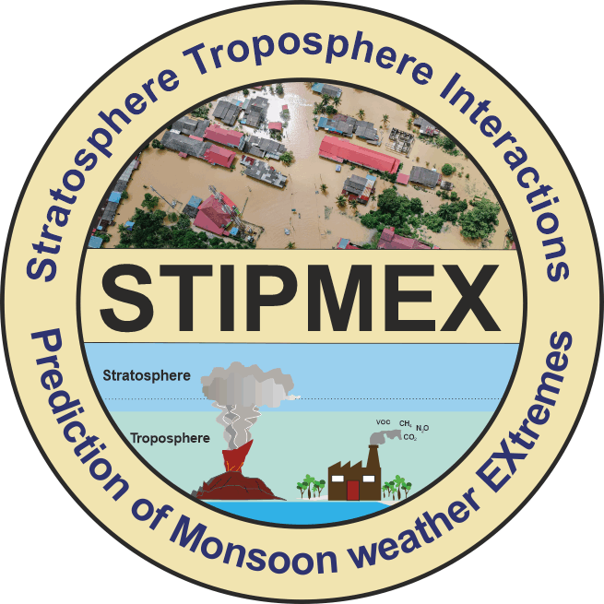
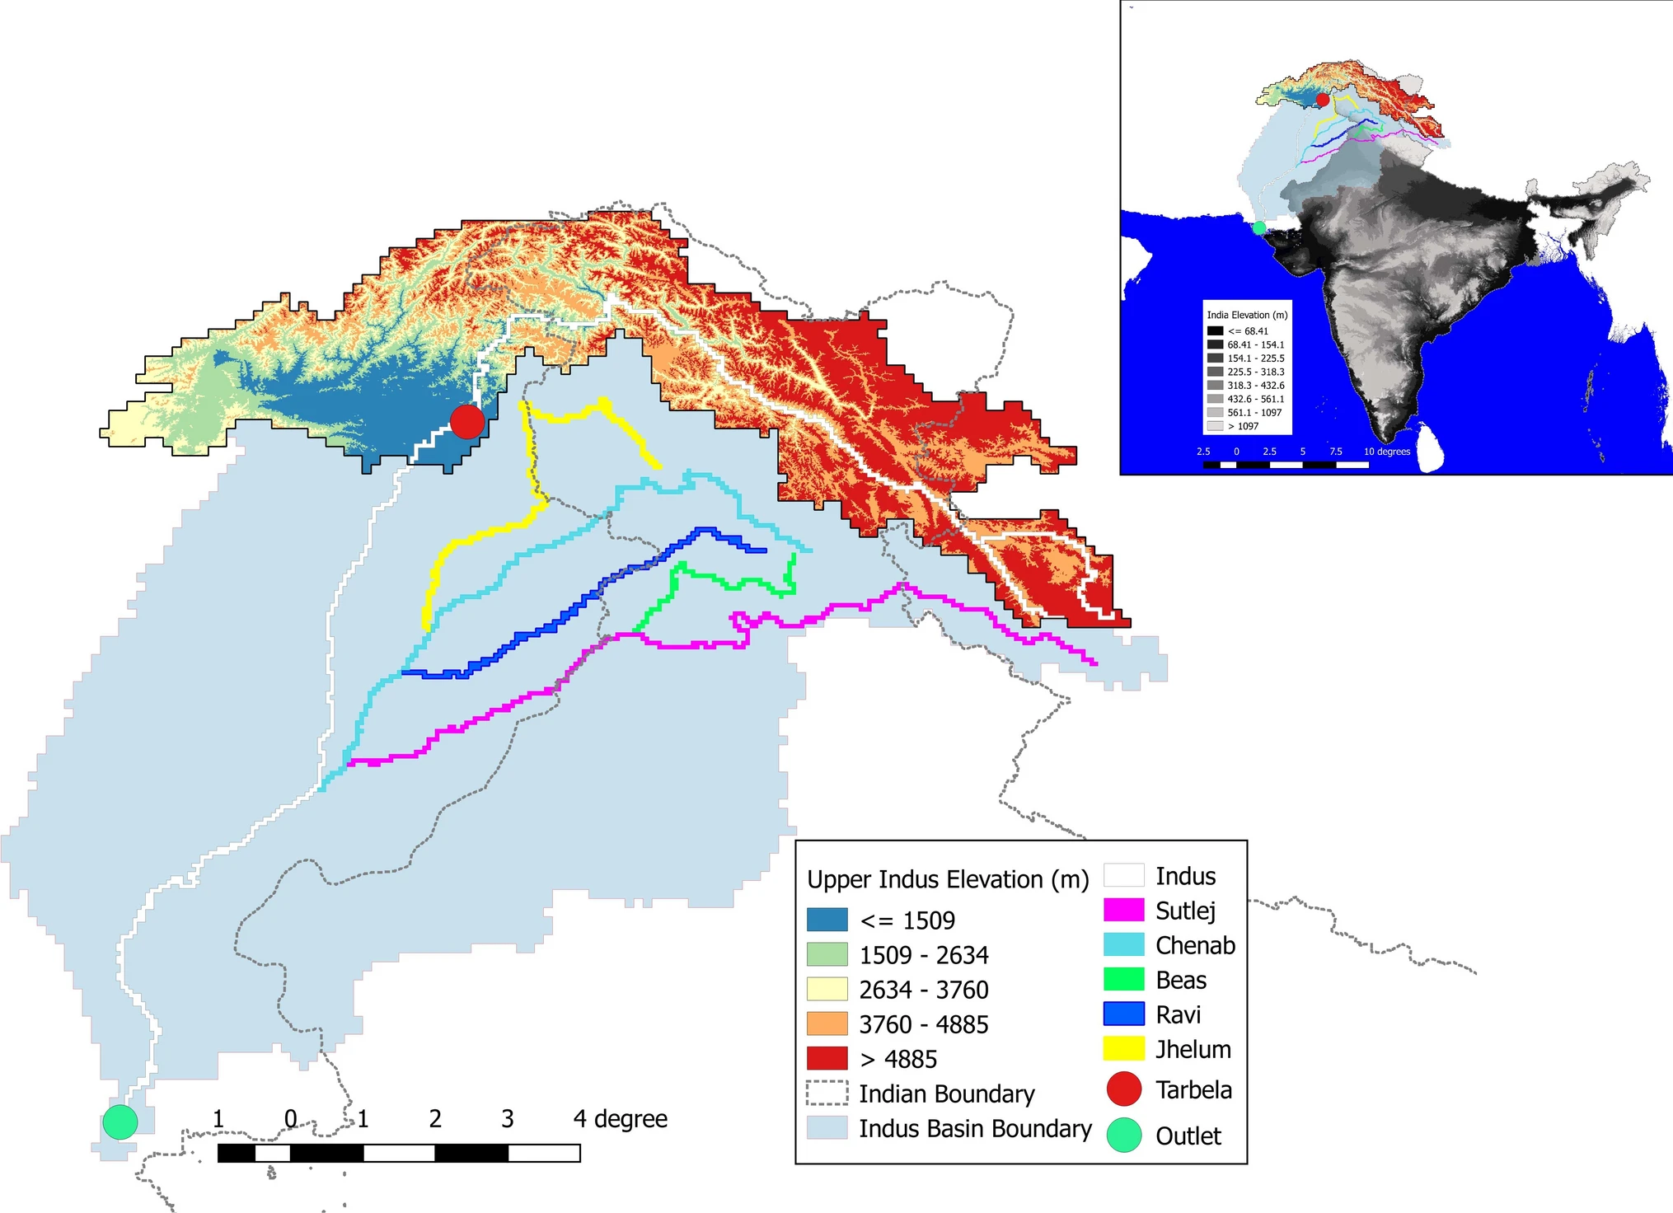
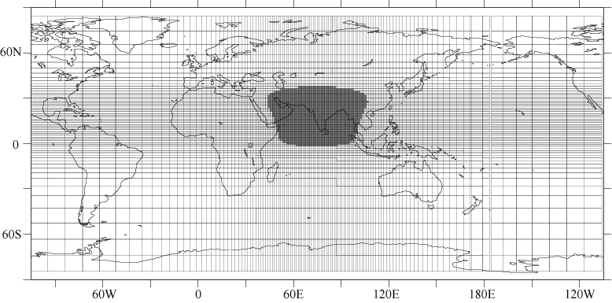
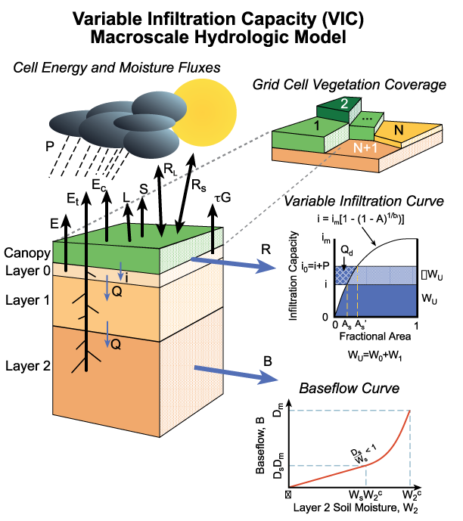
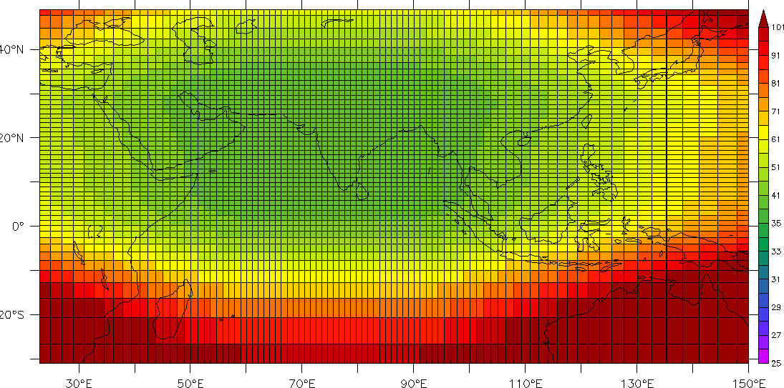
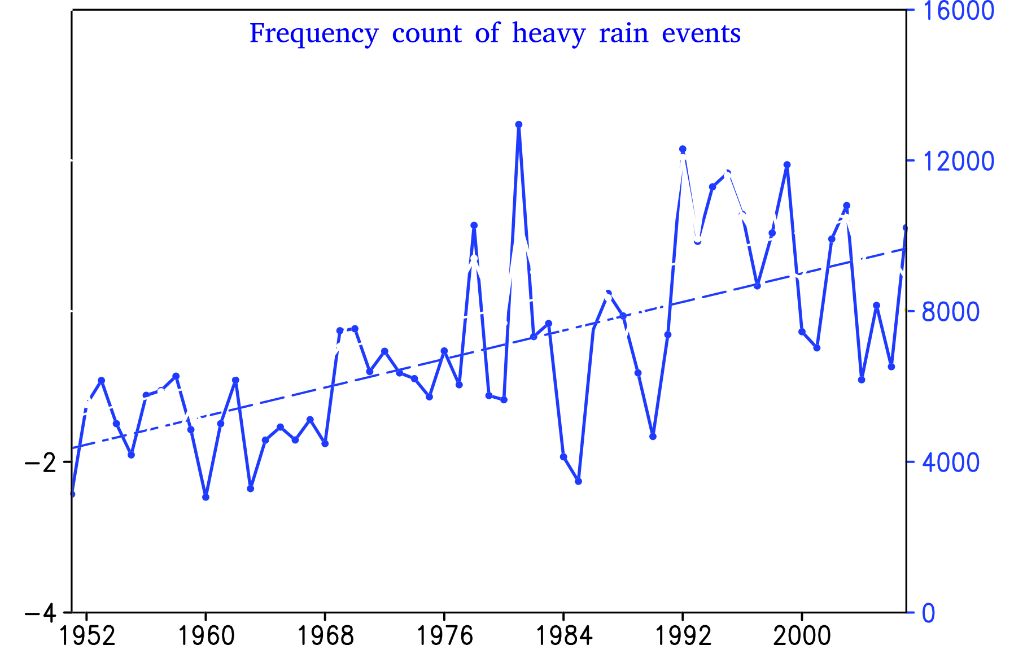
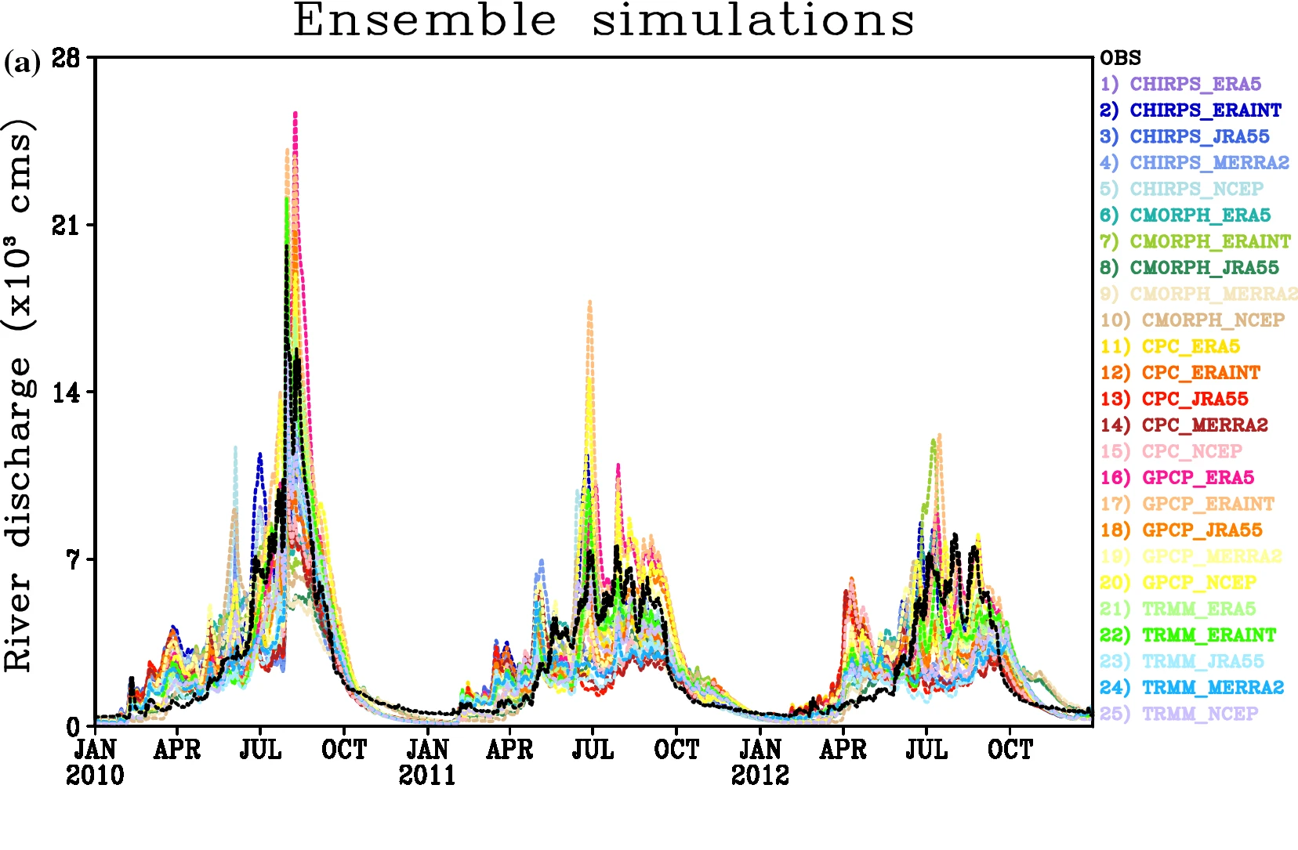
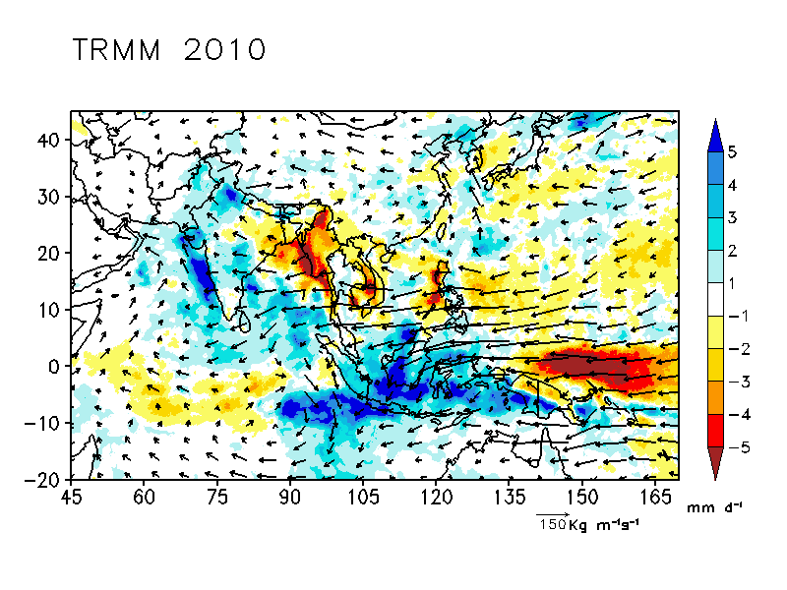
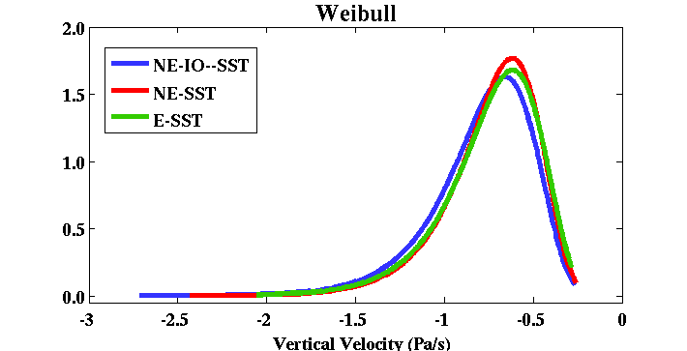
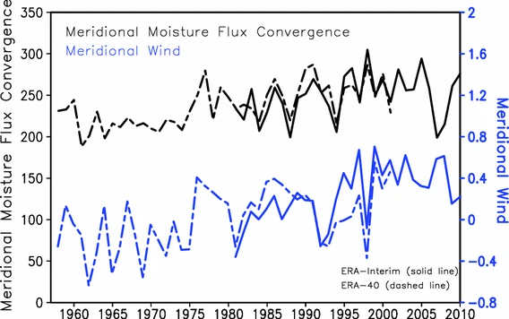
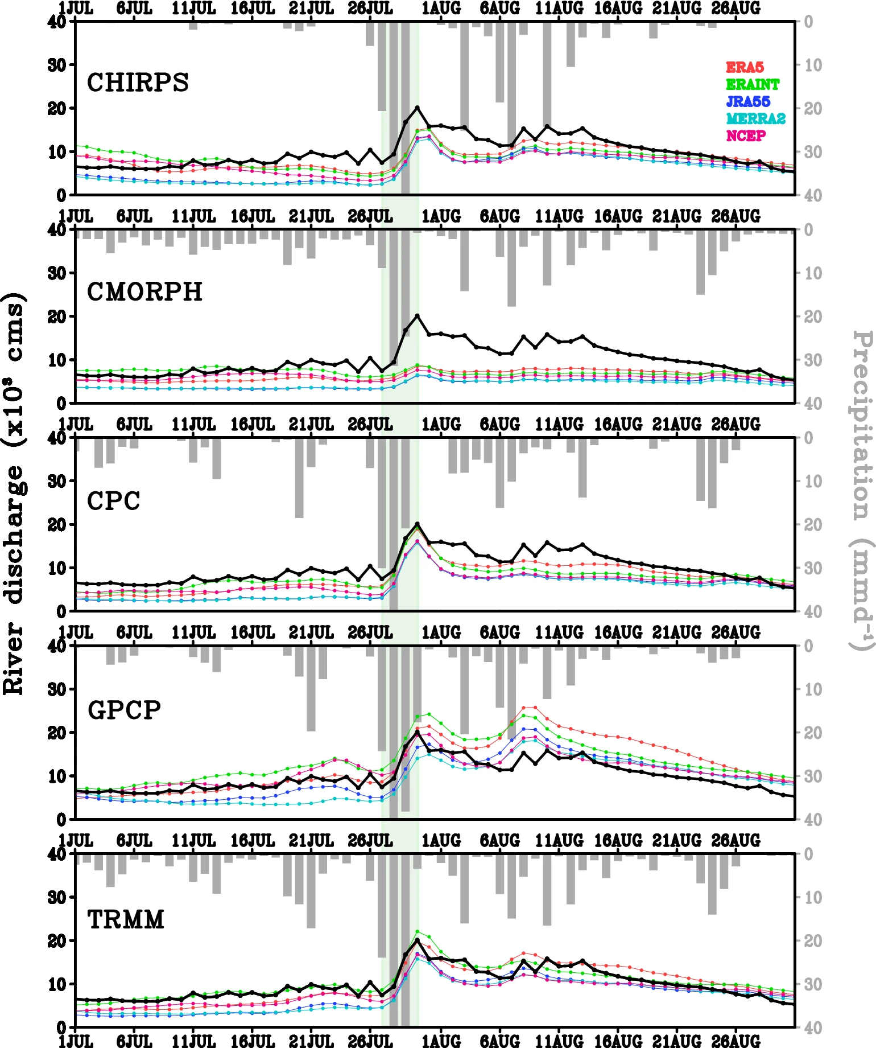
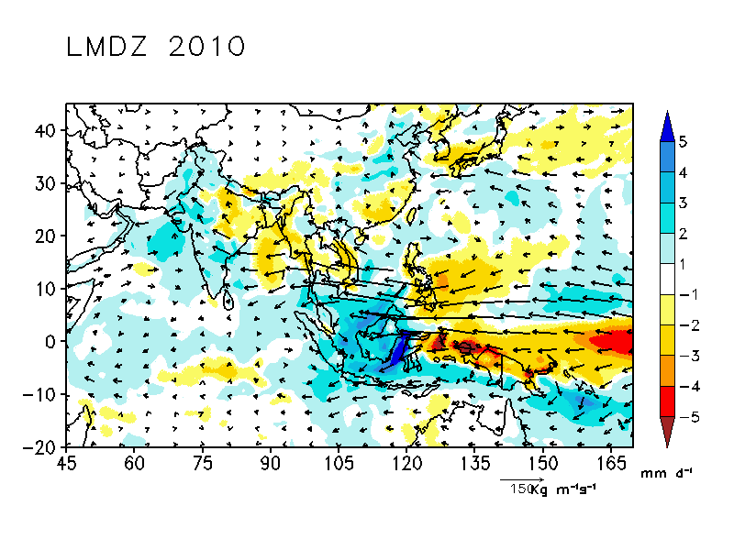
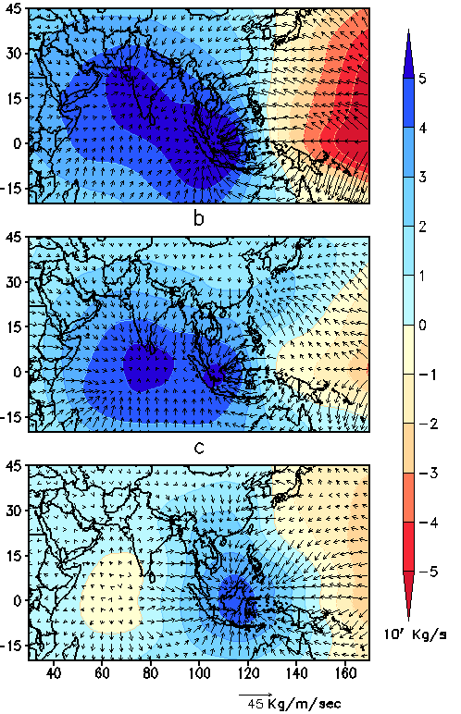
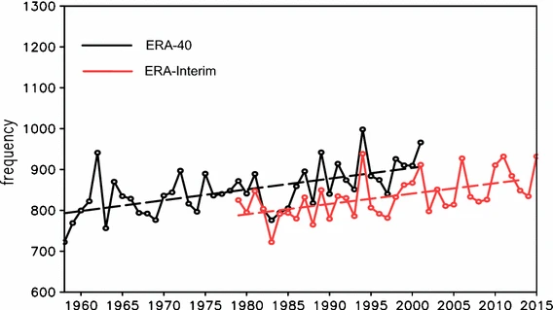
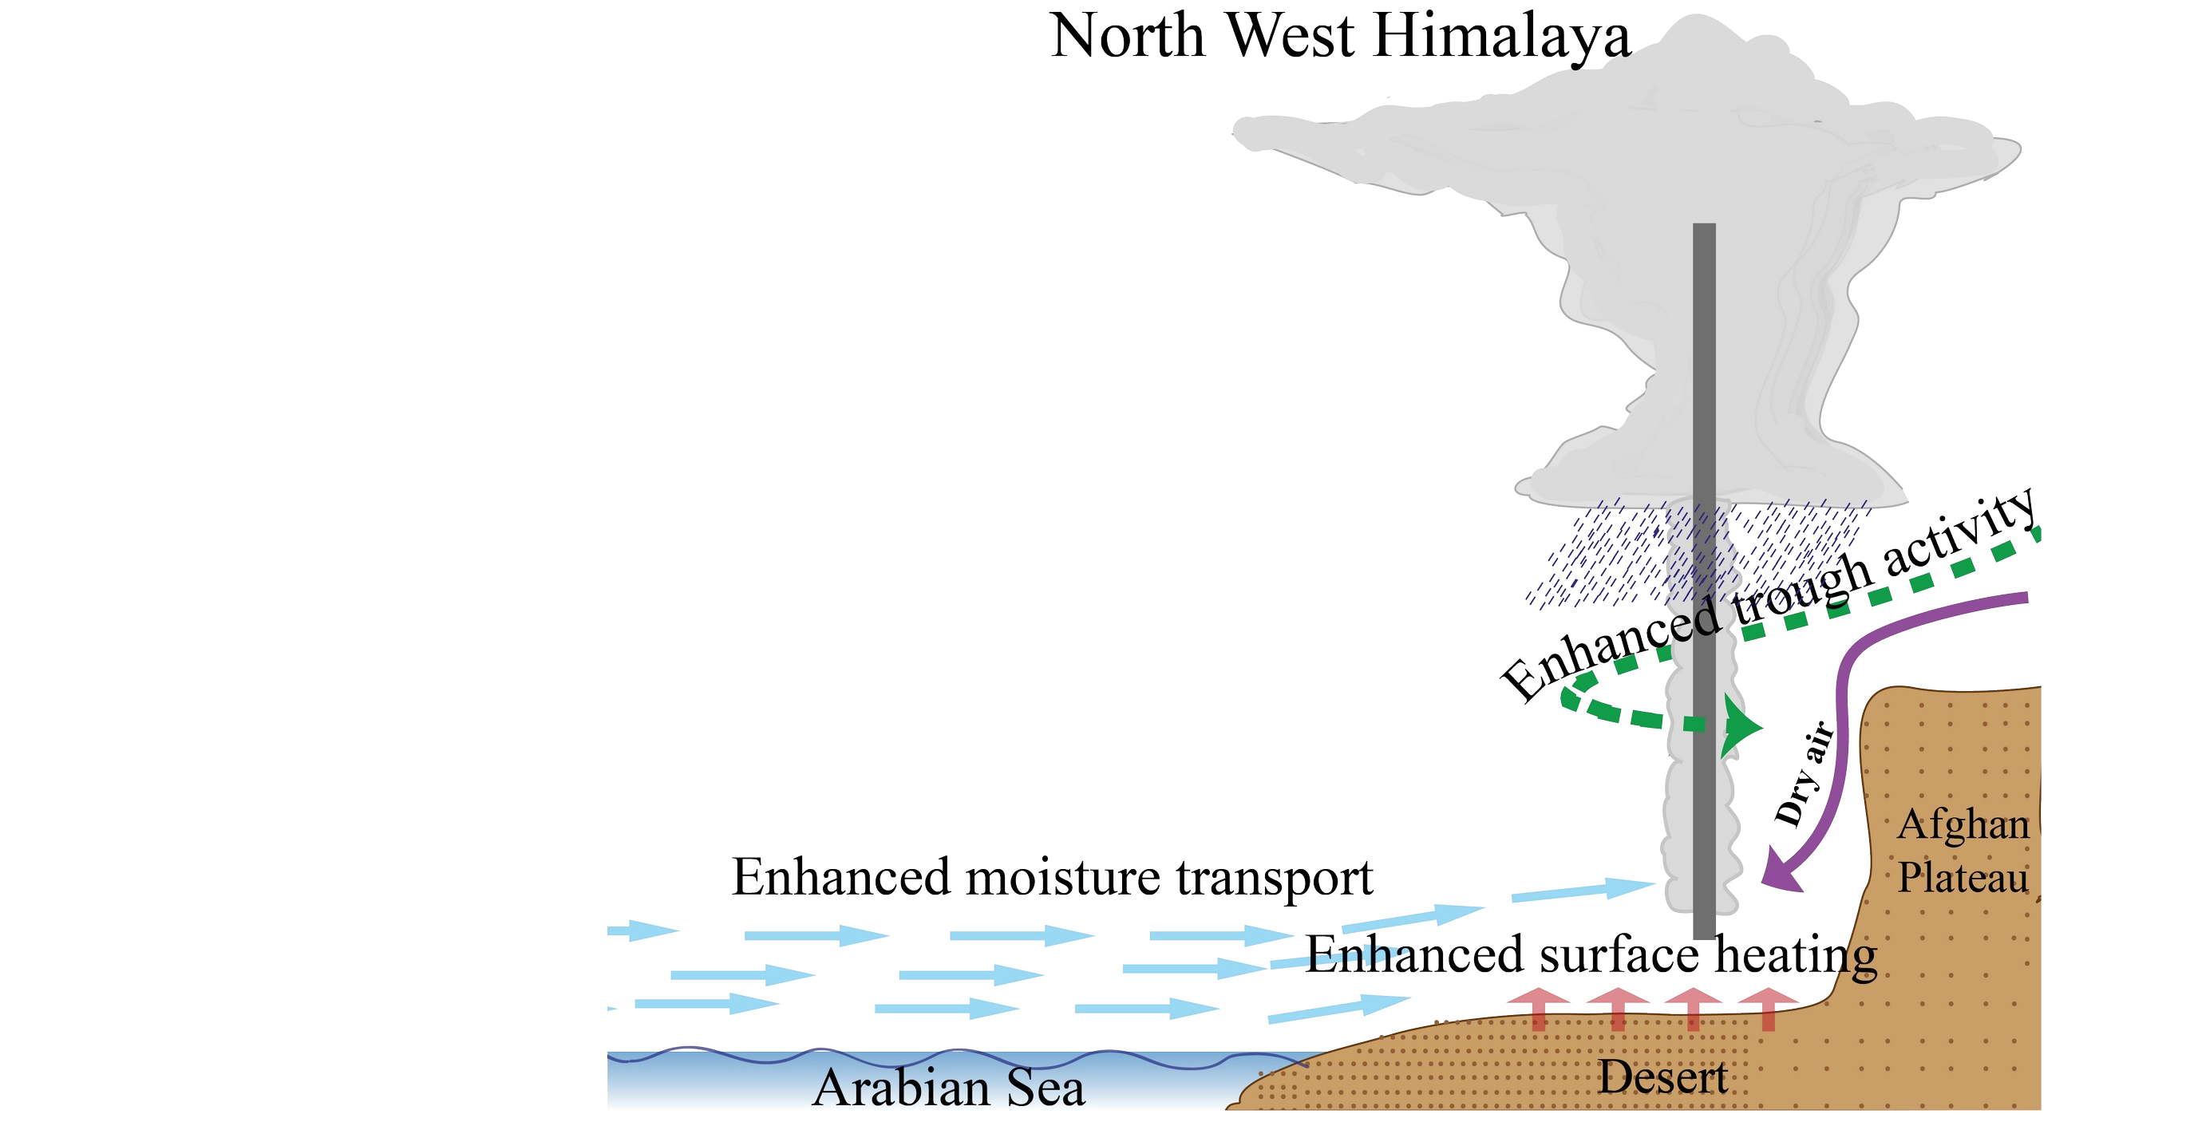
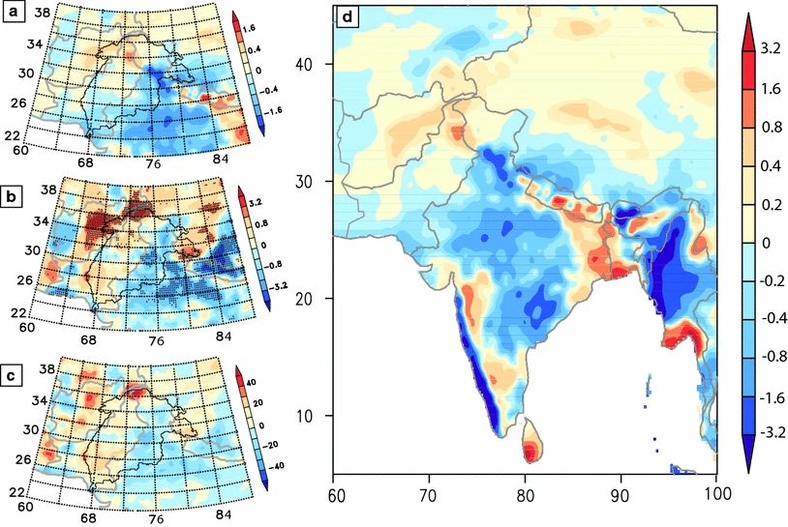
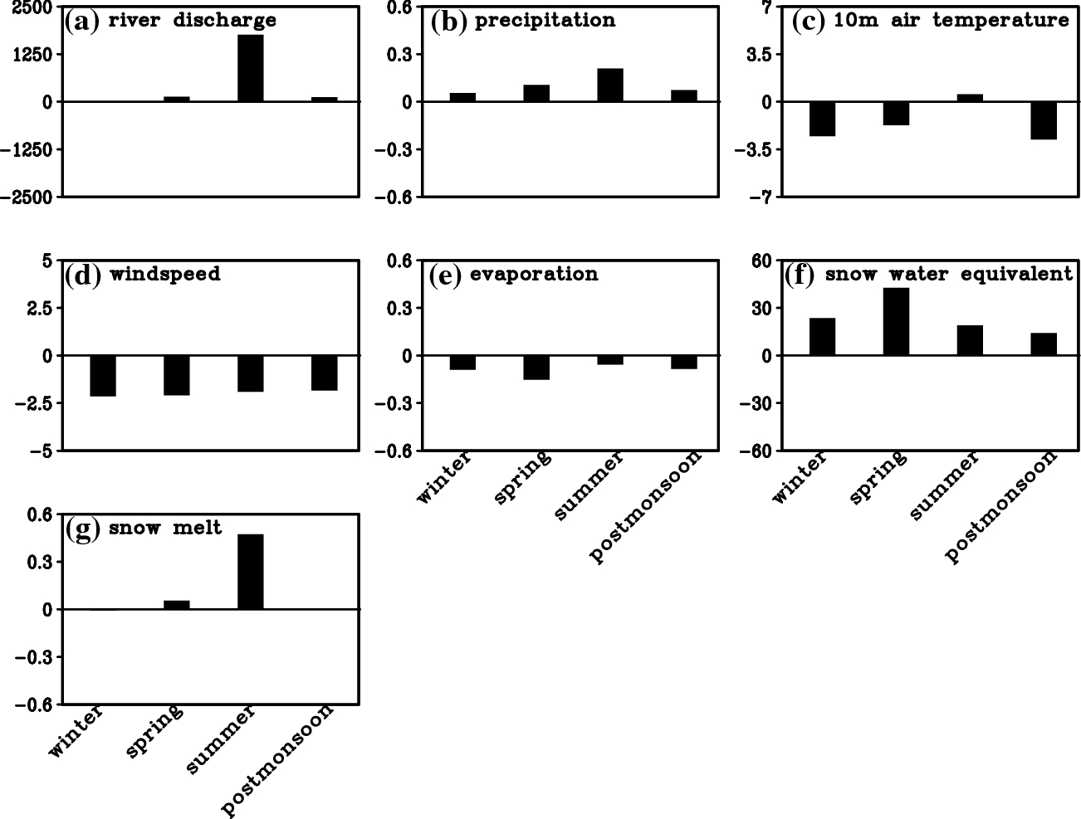
Simulation studies on hydro-meteorological response of extreme monsoon rain events over elevated region of western Himalaya
P Priya¹, R Krishnan¹, M Mujumdar¹, T P Sabin¹, T Pascal², R Houze Jr^{3,4}
¹Indian Institute of Tropical Meteorology, Pune, India
²Institut Pierre Simon Laplace (IPSL), Sorbonne Universites, France
³University of Washington, USA
⁴ Pacific Northwest National Laboratory, Richland, Washington
Email: priya@tropmet.res.in
Abstract
The present study investigates regional and global circulation patterns, long-term changes, and hydrological repercussions associated with heavy monsoon rain events over northwest India. Initially, a series of high-resolution Atmospheric General Circulation Model experiments were conducted to comprehend the influence of tropical sea surface temperature anomalies on the occurrence of heavy monsoon rain events over the India-Pakistan region during 2010. Our analysis reveals the prominent role of intrinsic Indian Ocean variability in amplifying and sustaining heavy rainfall events over the northwest India-Pakistan region, against the backdrop of modulated Walker circulation due to prevailing La Niña conditions over the East Pacific. Further analysis, using historical rainfall records, indicates an increase in the occurrence of heavy monsoon rain events over elevated regions of northwest India. Our investigation using multiple datasets, elucidates the combined effect of weakened monsoon circulation, increased transient trough activity over the region, and enhanced moisture supply from the Arabian Sea as the causative factors for the occurrence of these events. Additionally, ensemble hydrological model simulations were also conducted using the macro-scale Variable Infiltration Capacity hydrology model to understand the hydrological response of these events at the river basin scale. While heavy monsoon rain events were responsible for the 2010 Pakistan flood conditions, our results also emphasize the importance of regional surface air temperature in seasonal river discharge over the region.
Objectives
Study area
Models
Investigate the role of remote and regional sea surface temperature forcings on 2010 Pakistan flood
Understand the long term changes in heavy monsoon rain events over Western Himalaya
Understand the uncertainty due to observed datasets in the simulation of river discharge over Western Himalaya
Western Himalaya-
Indus basin
LMDZ -AGCM VIC Hydrology model
Results and Conclusions
2010 Pakistan Flood
SSST anomaly for JJAS 2010
Long-term changes
Total count of extreme rain events over Indus basin
Regression patterns
Time series of frequency of 500hPa
relative vorticity exceeding 1 sigma
Uncertainty in river discharge
Simulation for 2010 Pakistan flood
Seasonal ensemble mean difference
Priya et al. (2015)
Priya et al. (2017)
Priya et al. (2020)
LMDZ - AGCM Experiments | SST Boundary Conditions
C-SST | Climatological SST
R-SST | Real SST 2010
E-SST | ENSO-SST
NE-SST | Non ENSO SST
Season: JJAS
Years : 1951-2005
Data :
Precipitation - APHRODITE
Wind - ERA40 & ERA Interim
Heavy rain day is defined as the day when rainfall exceeds 99th percentile value
Model : VIC model setup at 0.125º x 0.125º resolution
Years : 2010-2012 ; NSE : 0.83/0.90 for 2010-2012/JJAS 2010
Data :
Precipitation-APHRODITE, CHIRPS, CMORPH, CPC, GPCP & TRMM
Wind and temperature - ERA5, ERAInterim, JRA55, MERRA2 & NCEP
River discharge data – Digitization of Fig 11 of Shreshta et al. (2014)
Observation TRMM (Rainfall) & NCEP (Moisture Transport)
Probability Density
Vertical Velocity (Pa s⁻¹)‏
Simulation LMDZ4 AGCM R-SST ensemble mean
Velocity Potential
R-SST
ENSO SST
E-SST
Trend in JJAS rainfall
Non ENSO SST
NE-SST
Ensemble mean difference is computed by subtracting the mean of ensemble VIC model simulations with negative bias in annual river discharge from those with positive bias in annual river discharge.
This study points to the key-role of intrinsic IO SST anomalies in inducing the northward moisture transport from AS into sub-tropical Indo-Pak region in the background of modulated large-scale Indo-Pacific summer monsoon circulation by Pacific SST anomalies during 2010
This study indicates the combined role of weakened monsoon circulation, enhanced upper air trough activity and enhanced southerly moisture transport from the Arabian Sea for the observed increase in extreme rain events over Western Himalaya in the recent decades.
This study shows that significant amount of uncertainty in the simulation of daily river discharge arises from the uncertainties in the precipitation datasets.
This study also shows that a marginal difference in temperature forcing can create large difference in snow melt, which in turn contribute to a large uncertainty in the summer monsoon river discharge.
References
Priya, P., Krishnan, R. & Mujumdar, M. (2020). Uncertainties in river discharge simulations of the upper Indus basin in the Western Himalayas. J Earth Syst Sci 129, 150.. https://doi.org/10.1007/s12040-020-01409-w
Priya, P., Krishnan, R., Mujumdar, M. & Houze, R. (2017). Changing monsoon and midlatitude circulation interactions over the Western Himalayas and possible links to occurrences of extreme precipitation. Clim Dyn 49, 2351–2364. https://doi.org/10.1007/s00382-016-3458-z
Priya, P., Mujumdar, M., Sabin, T. P., Terray, P., & Krishnan, R. (2015). Impacts of Indo-Pacific sea surface temperature anomalies on the summer monsoon circulation and heavy precipitation over northwest India–Pakistan region during 2010. Journal of Climate, 28(9), 3714-3730. https://doi.org/10.1175/JCLI-D-14-00595.1
Acknowledgement
Director, IITM
Organizers, STIPMEX
International Workshop on Stratosphere-Troposphere Interaction and Prediction of Monsoon Weather Extremes (STIPMEX) 02-07 June 2024, IITM Pune

