Slide 1
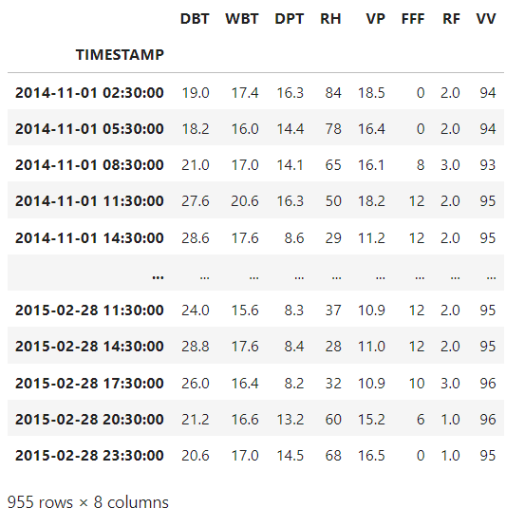
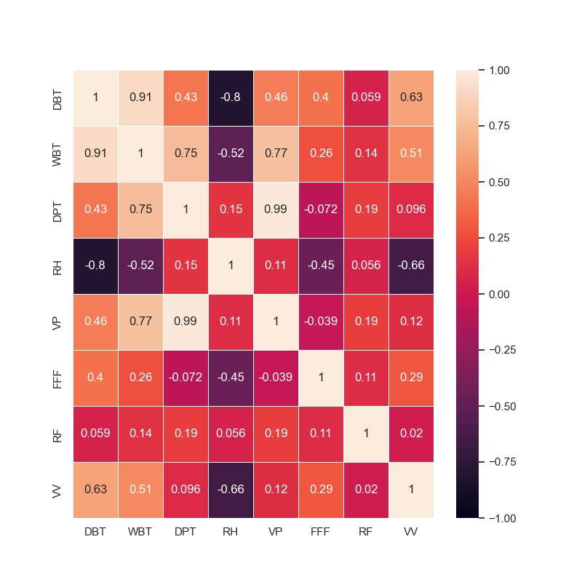
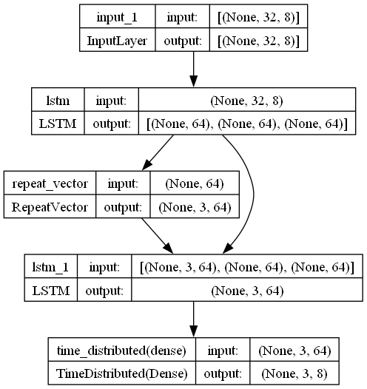
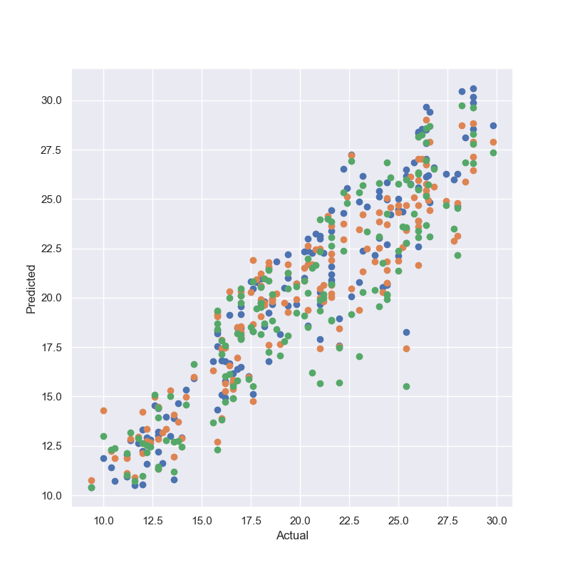
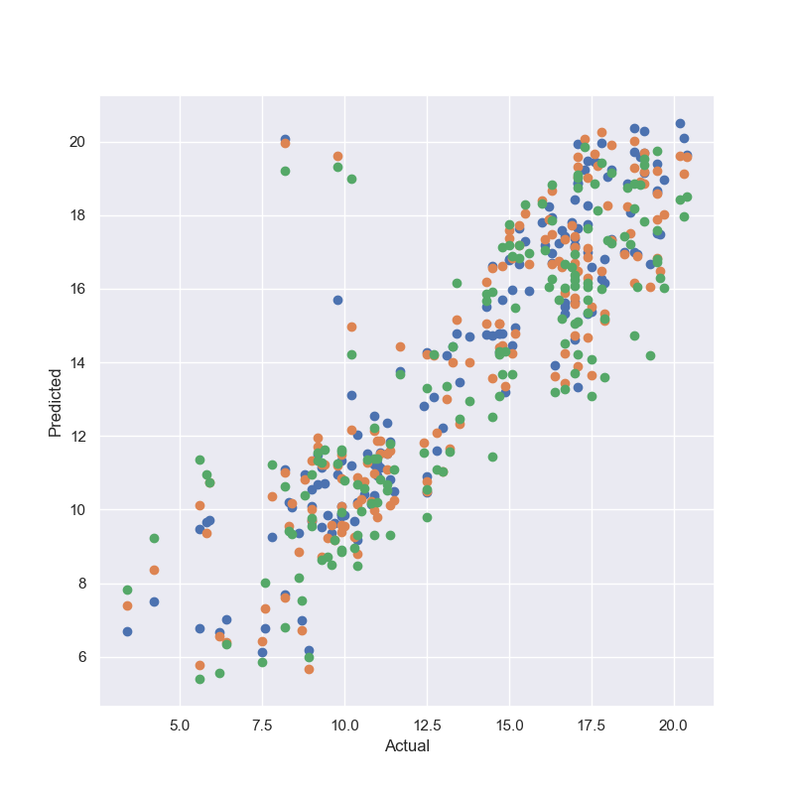
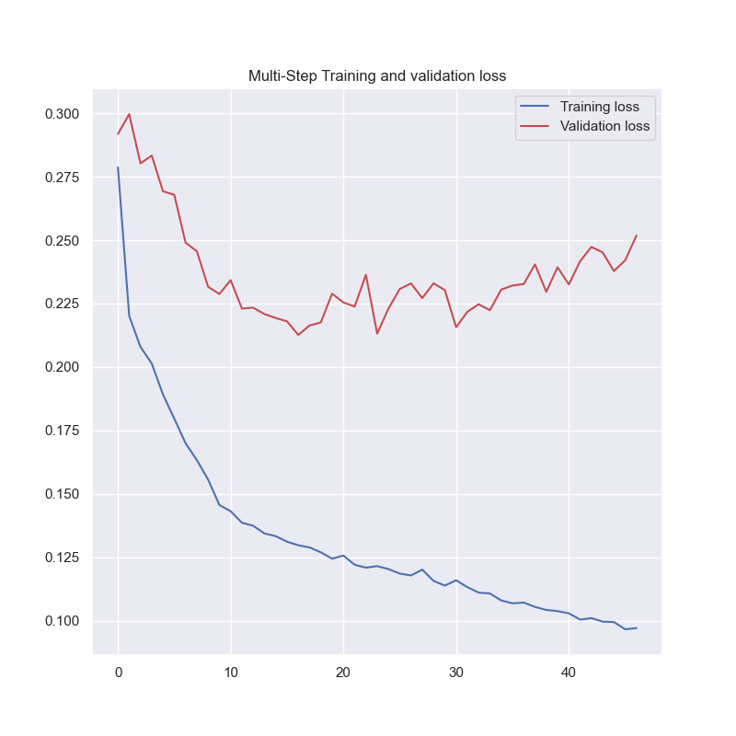
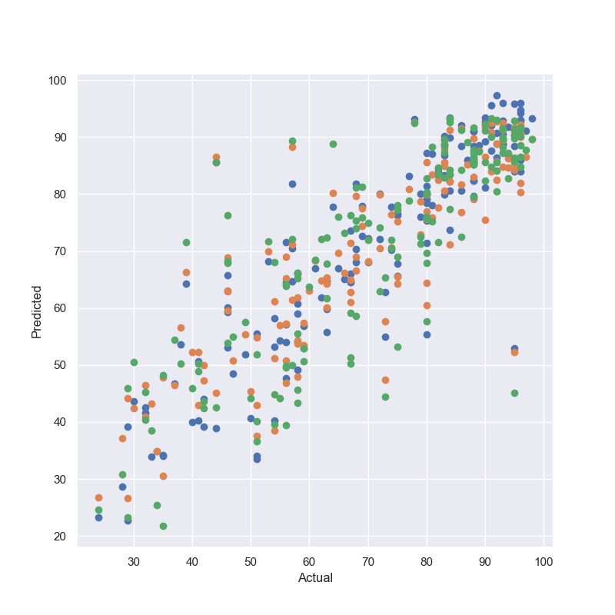
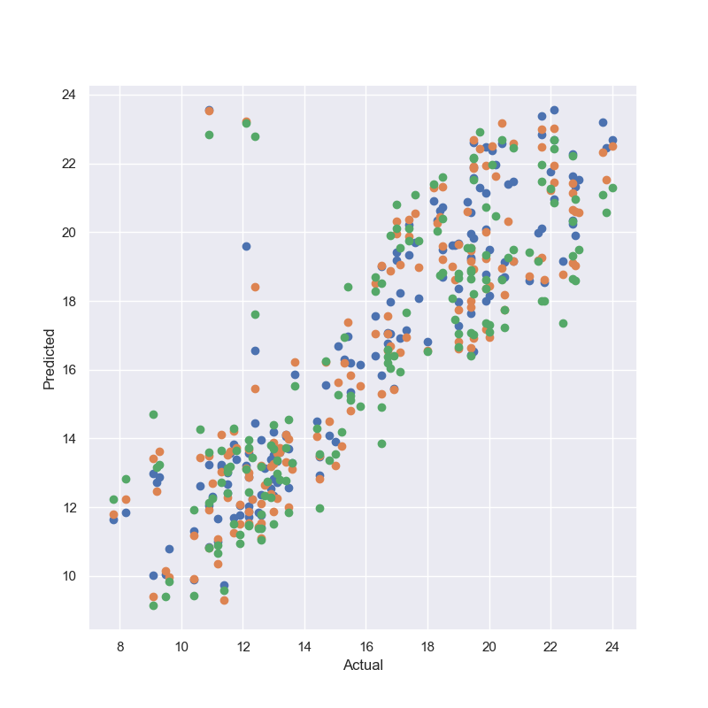
Multi-input multi-output LSTM model for meteorological parameters prediction
Tanushree Roy¹, Oishila Bandyopadhyay¹, Dalia Nandi¹, Uma Das^{1,*}
¹Indian Institute of Information Technology Kalyani, Kalyani- 751235, West Bengal, India
*Email: uma@iiitkalyani.ac.in
Objective: To predict meteorological parameters causing extreme fog using multi-input multi-output Long-Short Term Memory (LSTM) technique.
Background:
In recent times, heavy and dense fog is causing huge losses in the aviation sector as well as for other modes of transportation during winter time. Indira Gandhi International airport Delhi alone suffered economic losses of approximately 248 million Indian rupees due to a total of 653 hours of dense fog between 2011 and 2016. Road accidents only due to foggy and misty weather increased by 18% from 2021 to 2022, according to a report of the Ministry of Road Transport and Highways.
AI/ML techniques are proving useful in various domains and in the current work, we use the LSTM, a specially designed ANN for working with sequential time series dataset, to investigate the meteorological parameters leading to foggy conditions.
Dataset and Data Preprocessing:
Meteorological data for the month of November, December, January and February of 2014-15, at Delhi (Safdarjung) station, is obtained from India Meteorological Department (IMD).
From eight different features in the dataset, four most important features - dry bulb temperature (DBT), relative humidity (RH), vapour pressure (VP) and dew point temperature (DPT) – are chosen based on information gain, correlation matrix and predictions for short term.
The dataset contains 955 datapoints. For normalisation, the complete dataset has been scaled with min-max scaling method in the range of 0 to 1.
Data windowing for time series prediction: The datapoints were recorded in every 3 hours in the dataset. For this model, 32 data points i.e. 96 hours data points have been taken from past and 3 data points i.e. 9 hours data have been predicted in the future at a time.
Fig 1. Structure of the dataset
Fig 2. : Correlation Matrix of complete dataset
Input Width = 32
t=1
t=2
t=3
t=..
t=..
t=30
t=31
t=32
t=33
t=34
t=35
Time steps
Output Width = 3
Fig 3.: Data Windowing
Structure of proposed 2-step Long-Short Term Memory (LSTM) architecture:
The model works in two step LSTM layer, first step is used for encoding the information collected from the features and the second step is used for decoding.
Both LSTM layers contain 64 nodes each and the output predicts 8 features for 3 consecutive time steps.
Every node is interconnected with every other node.
Compilation of the Proposed Model:
70% of the total dataset has been used for training, 10% for validation and 20% for testing purposes. The model was run for 100 epochs with batch size of 16. Loss was calculated with mean absolute error (MAE) function.
DBT
DPT
Fig 4.: Structure of proposed LSTM model
Results
Average MAE of all predicted features are shown in Table 1 and comparison with other works are given in Table 2.
Table 1: Average mean absolute error (MAE) of different features and comparison with other models.
RH
VP
 | DBT (ºc) | DPT (ºc) | RH (%) | VP (hPa)
Standalone RNN | 2.7018 | 1.4867 | 11.1905 | 1.6926
Standalone LSTM | 2.9581 | 1.5519 | 11.9571 | 1.5882
Standalone GRU | 2.7976 | 1.6272 | 11.2132 | 1.7458
Current work - Two stepped dense LSTM | 1.722 | 1.517 | 5.192 | 1.619
Fig 6.:Multi-step training and validation loss
Fig 5.: Plots of actual and predicted values of different features
Advantages:
LSTM is specially made for long-term dependencies.
It prevents vanishing and exploding gradient problem and allows network to memorize state information over longer periods of time.
The model can predict multiple features for multiple time stamps.
Reference | Methods Used | DBT (ºc) | DPT (ºc) | RH (%) | VP (hPa)
Omodara E. Obisesan [3] | Multiple Linear regression Techniques | 1.17 | -- | 6.50 | --
Arikan et al. [4] | Recursive | -- | 2.939 | -- | --
Hou et al. [5] | CNN-LSTM | 1.02 | -- | --
Current model | Two stepped dense LSTM | 1.57 | 1.26 | 6.01 | 1.38
Fig 7.: Comparison among correlation coefficient of different features
Fig 8.: R² scores of different features
Important References:
Ghanbari, R., & Keivan Bo. "Multivariate time-series prediction using LSTM neural networks." 2021 26th International Computer Conference, Computer Society of Iran (CSICC). IEEE, 2021.
Kulkarni, R. & Jenamani, R. & Pithani, P. & Konwar, M. & Nigam, N. & Ghude, S. Loss to Aviation Economy Due to Winter Fog in New Delhi during the Winter of 2011–2016. Atmosphere (2019). 10(4),198. 10.3390/atmos10040198.
3. Obisesan, Omodara E. "Machine Learning Models for Prediction of Meteorological Variables for Weather Forecasting." International Journal of Environment and Climate Change 14.1 (2024): 234-252.
4. Hou, Jingwei, et al. "Prediction of hourly air temperature based on CNN–LSTM." Geomatics, Natural Hazards and Risk 13.1 (2022): 1962-1986.
5. Arikan, Bugrayhan Bickici, et al. "Dew point time series forecasting at the North Dakota." Knowledge-Based Engineering and Sciences 2.2 (2021): 24-34.
Table 2: Comparison of average MAE (of 1st three hours) with earlier works.
Challenges and Future scopes:
The dataset is very small and also unbalanced, which causes difficulties in building the model.
The model is just predicting some meteorological parameters, but can not classify fog according to the predicted values. In future model, that can be implemented.
Acknowledgements:
This work is supported by funding from Ministry of Earth Sciences vide MOES/16/07/2022-RDESS/AI-ML-07. IMD is acknowledged for providing access to meteorological data (https://dsp.imdpune.gov.in/index.php).
INTERNATIONAL WORKSHOP ON Stratosphere-Troposphere Interactions and Prediction of Monsoon weather EXtremes (STIPMEX) 03-07 June 2024
Indian Institute of Tropical Meteorology, PUNE

