Slide 1
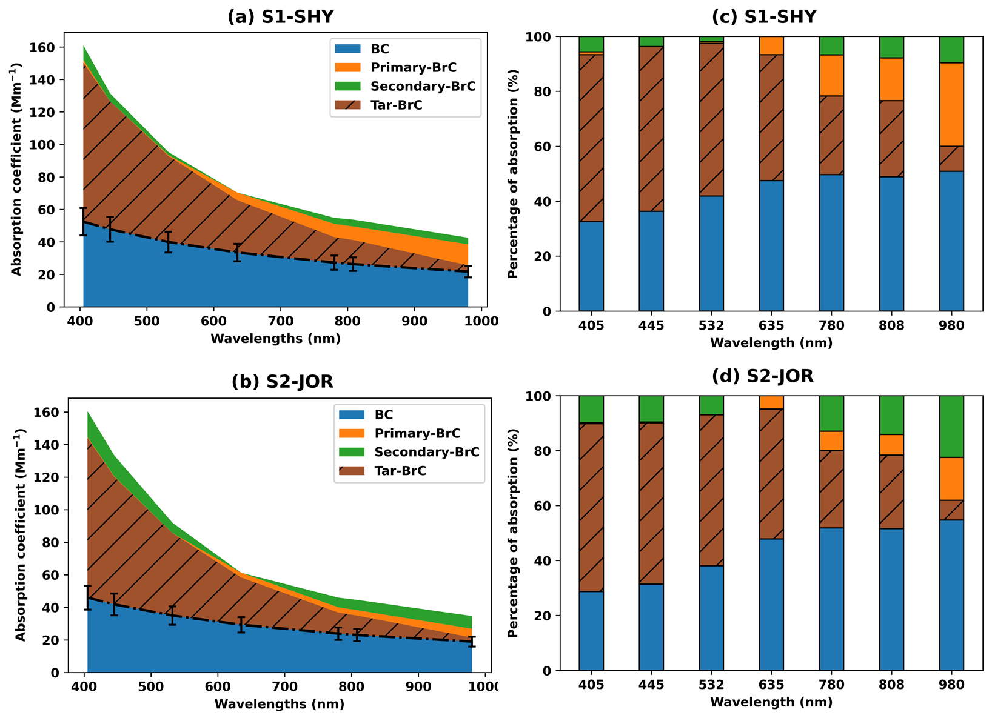
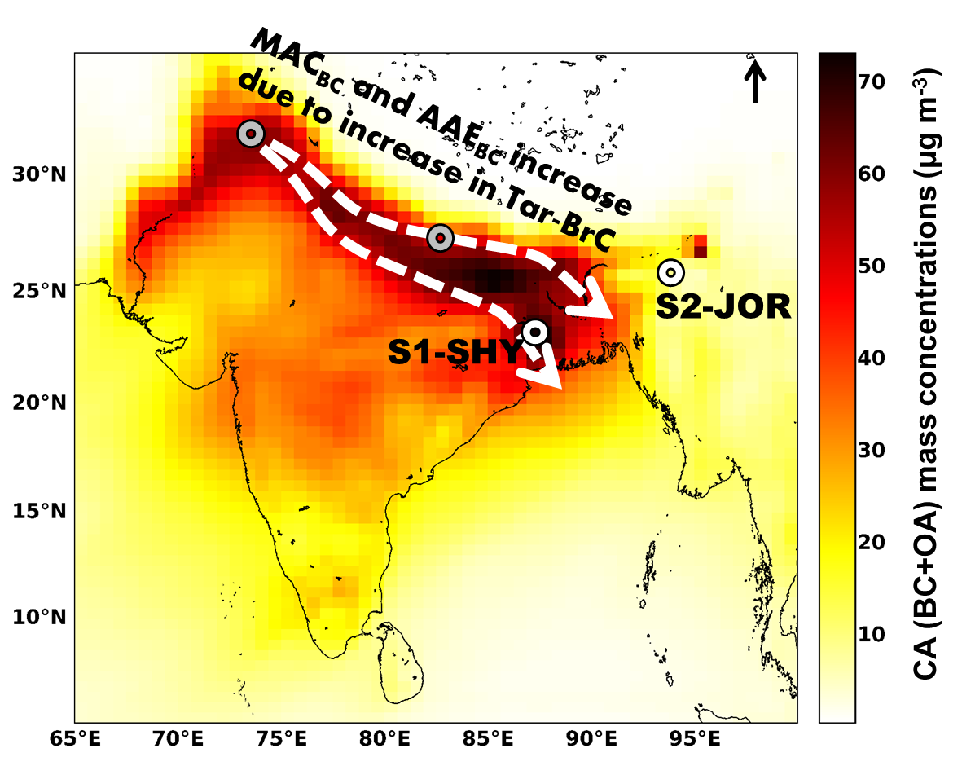
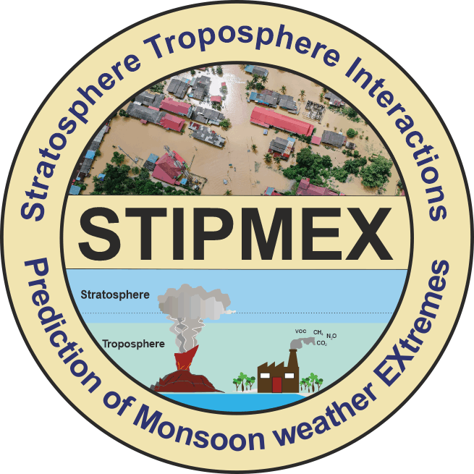
Mass and Light Absorption Properties of Atmospheric Carbonaceous Aerosols over the Outflow Regions of Indo-Gangetic Plain
Ashish Soni ^{1,2}, Abhijit Chatterjee ³, Binoy K Saikia ⁴, and Tarun Gupta ^{2,*}
¹Indian Institute of Tropical Meteorology, Ministry of Earth Sciences, Pune, 411008, Maharashtra, India
²Indian Institute of Technology, Kanpur, 208016, Uttar Pradesh, India
³Bose Institute, P 1/12 CIT Scheme VIIM, Kolkata, 700054, West Bengal, India
⁴CSIR-North East Institute of Science & Technology, Jorhat, 785006, Assam, India
Email: Prof. Tarun Gupta (tarun@iitk.ac.in)
Abstract
The uncertainty associated with carbonaceous aerosols in climate models becomes an obstacle to evaluating their harmful environmental effects. Brown Carbon (BrC) has recently become an eye-catching carbonaceous aerosol in ambient air because of its strong light absorption properties. The optical properties of soluble BrC are well studied in South Asia, one of the largest emitters. However, the absorption property of strong light-absorbing insoluble BrC is highly uncertain because of their complex mixing. Besides, the simultaneous apportionment of light-absorbing carbonaceous aerosol constituents as a function of wavelengths is seldom explored. The present study aims to study the apportionment of absorption properties of Black Carbon (BC) and different BrC chromophores using a multi-wavelength thermal-optical carbon analyzer over the least explored Eastern part of India to fill the knowledge gap. The BrC is the dominant light-absorbing carbonaceous aerosol in the ultraviolet wavelengths. Besides, significant light absorption by BrC chromophores in near-infrared wavelengths (up to ~50% of total aerosol absorption) suggested the absorption by BrC in longer near-infrared wavelengths cannot be neglected. The insoluble BrC (Tar-BrC), which has a property identical to BC, contributes significantly to light absorption and is more than 50% of total absorption by aerosols in shorter ≤635nm wavelengths. The present study also revealed that the contribution of Tar-BrC is more pronounced in the Indo-Gangetic Plain (IGP) outflow region than in the IGP emission source regions.
Motivation
Methodology
Results
Air pollution reduction is the primary target of the UN SDGs to mitigate its adverse impacts on human health and global climate (UNEP, 2018).
Carbonaceous aerosols, composed of Black Carbon (BC) and Organic Aerosols (OA) is the most important constituent of air pollutants, yet it carries significant uncertainties.
Climate models underestimate carbonaceous aerosols’ absorption properties by a factor of 2-3 over South Asia (Gustafsson and Ramanathan, 2016), home to one-fourth of the world’s population.
Research toward the reduction of these discrepancies in South Asia is urgently needed, as air pollution resulted in 1.67 million fatalities and 3.06 lakh crores INR ($36.8 billion) economic loss alone in India in the year 2019 (Pandey et al., 2021).
One of the most important reasons for this discrepancy is the limited in-situ observation based knowledge on optical properties of different carbonaceous aerosols species over South Asia.
PM_{2.5} filters were analyzed in multi wavelength thermal optical carbon analyzer (DRI 2015)
Absorption properties of BC and bulk BrC species were estimated using absorption spectra at different stages given by DRI 2015 (Soni and Gupta, 2022).
$$b_{abs}\left(λ\right)=\frac{ATN(λ)}{C \left(λ\right)×R (λ)}$$
At the starting of analysis absorption is considered due to BC+BrC, while after evaporation of charred BC absorption is considered due to only BC.
$$b_{abs, BrC}=b_{abs, BC+BrC}−b_{abs, apportioned BC}$$
b_{abs} of Primary and Secondary BrC were apportioned using modified EC-tracer method (Soni et al., 2024).
$$b_{abs, Primary−BrC}(λ)={\left(\frac{b_{abs}\left(λ\right)}{b_{abs}\left(635nm\right)}\right)}_{min}×b_{abs}\left(635nm\right)$$
$$b_{abs,Secondary−BrC}(λ)=b_{abs,OC}(λ)−b_{abs,Primary−BrC}(λ)$$
High wavelength dependence (AAE≥2) of apportioned BC suggested the significant influenced of the Tar-BrC, which has an identical properties with BC.
The b_{abs} of pure BC was estimated empirically by considering widely used MAC value 7.5±1.2 m² g⁻¹ (at 550nm) and AAE of 1 (Bond and Bergstrom, 2006).
The share of Tar-BrC was estimated by subtracting b_{abs} of pure BC from the b_{abs} of apportioned BC.
$$b_{abs,Tar−BrC}\left(λ\right)=b_{abs,apportioned−BC}\left(λ\right)−b_{abs,pure BC}\left(λ\right)$$
Figure 2. Absorption contribution of different fractions of atmospheric carbonaceous aerosols as a function of seven different wavelengths
Conclusion
Objectives
The key output of the present study depicted:
The absorption by BrC in near-infrared wavelengths cannot be neglected.
Insoluble fraction of BrC (strongly absorbing BrC or Tar-BrC), contributes significantly to light absorption.
The contribution of strongly absorbing Tar-BrC is more pronounced in the IGP outflow region than in the IGP emission source regions.
The objectives of the present study are:
Apportionment of absorption properties of Black Carbon (BC) and different fractions of Brown Carbon (Primary-vs. Secondary-vs. Tar-BrC) as a function of wavelengths.
Study Area
Results
Acknowledgements & References
Atmospheric fine particulate matter (PM_{2.5}) was collected on filter media during January, February, and March 2020 over:
S1-SHY (Shyamnagar, West Bengal)
S2-Jor (Jorhat, Assam)
Study site map is shown below in Figure 1.
Figure 1. Average carbonaceous aerosol (CA) mass concentrations simulated by MERRA-2 from December-2021 to February-2022 over South Asia. Study sites are shown with white circles.
The estimate average MAC value of atmospheric BC aerosols are shown in below table.
The absorption of BC contributed significantly to all seven wavelengths (Figure 2).
In the context of Primary- and Secondary-BrC:
the absorption in shorter wavelengths was dominated by the Secondary-BrC, which is expected to be more oxidized and soluble organics.
the absorption due to Primary-BrC is more pronounced in more extended red to near-infrared wavelengths.
Another insoluble group of BrC, Tar-BrC, also showed significant absorption in all the wavelength ranges.
The AAE of Tar-BrC (between 405–980nm wavelength) was observed to be 3.36 and 3.81 at S1-SHY and S2-JOR, respectively.
Acknowledgements
MoEFCC, GOI for the financial support to NCAP-COALESCE [Grant number: 14/10/2014-CC(Vol.II)].
INSA for providing funds to Prof. Tarun Gupta [SP/YSP/113/2015(1091)].
Dr. Gyanesh Singh for sharing samples collected at IGP emission source region.
References
UNEP, (2018). Air Pollution in Asia and the Pacific.
Gustafsson & Ramanathan, (2016). Proc. Natl. Acad. Sci. 113(16), 4243–4245.
Pandey et al. (2021). Lancet Planet. Heal. 5(1), e25–e38.
Soni and Gupta, (2022). ACS Earth & Space Chem. 6(2), 261–267
Soni et al. (2024). Atmo. Envi. 325, 120413
Bond and Bergstrom, (2006). 40(1), 27–67
Wavelengths (nm) | S1-SHY | S2-JOR
405 | 30.65±6.62 | 27.76±6.29
445 | 24.74±5.12 | 22.01±4.81
532 | 17.9±3.52 | 15.27±3.23
635 | 13.46±2.67 | 11±2.46
780 | 10.39±2.1 | 8.13±1.89
808 | 10.19±2.03 | 7.9±1.78
980 | 8.01±1.67 | 5.98±1.66
Stratosphere-Troposphere Interactions and Prediction of Monsoon weather EXtremes (STIPMEX)
02-07 June 2024
IITM-Pune

