Slide 1
An Investigation on the Prediction of Extreme Rainfall events over Indian Peninsular region during North-East Monsoon 2023
Shravan Kumar Muppa, D R Pattanaik, Pradeep Mishra, Satendra Kumar, Mohapatra Mrutyunjay
Hydromet division, India Meteorological Department,
New Delhi-110003, India

Slide 2
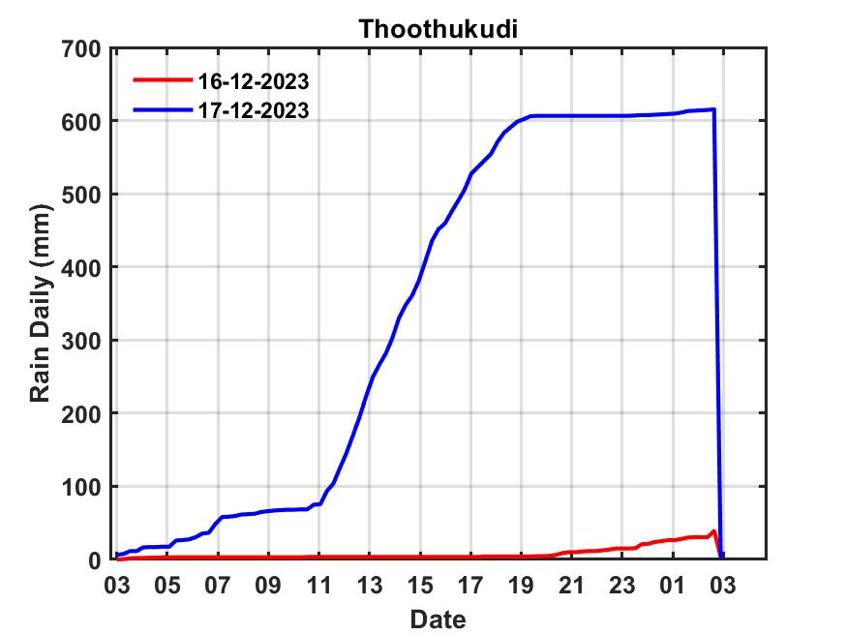
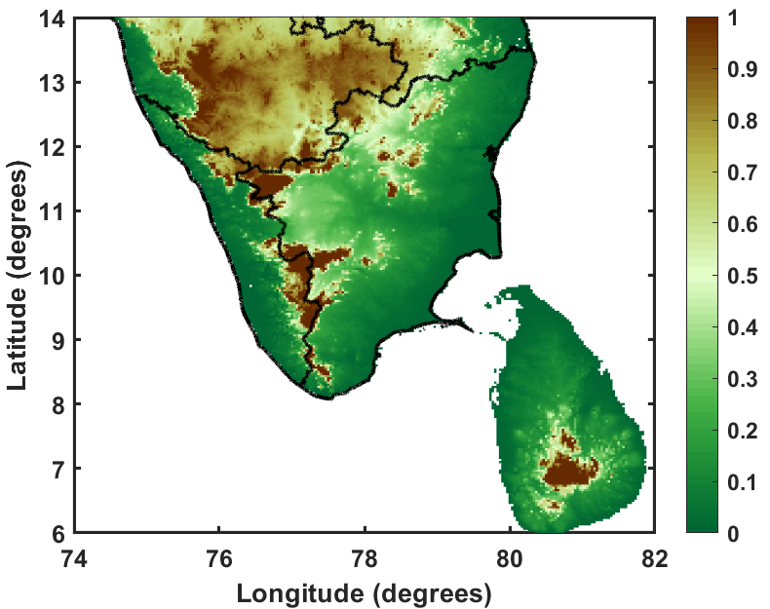
Extremely heavy rainfall cases over Tamil Nadu
Rainfall received (cm):
Case 1) 22-11-2023: Tamil Nadu, Puducherry & Karaikal: Mettupalayam (dist Coimbatore) 37, Kil Kotagiri Estate (dist The Nilgiris) 24, Kadaladi (dist Ramanathapuram) 17, Kavundapadi (dist Erode), Valinokam (dist Ramanathapuram) 15, Kerala & Mahe: Thiruvananthapuram 15, Kunnathanam (dist Pathanamthitta) 15
Case 2) 17-12-2023: Tamil Nadu: Districts Thoothukudi and Tirunelvelli
Kayalpattinam 95, Tiruchendur 69, Old Taluk Office Srivaikuntam 62, Thiruchendur AWS , Moolaikaraipatti 61 each, Kovilpatti (dist Thoothukudi), 53, Gundar Dam (dist Tenkasi) 51, Oothu (dist Tirunelveli) 50, Manjolai (dist Tirunelveli) 55, Nalumukku 47, Palayamkottai 44, Ambasamudram 43, Maniyachi 42, Cheranmahadevi 41, Kannadaian Anicut 41 each, Ottapadiram, Kadambur 37 each, Kakkachi, Nambiyar Dam 36 each, Papanasam (dist Tirunelveli) 35, Nanguneri, Kulasekarapattinam, Manimutharu 33 each, Kalakadu (dist Tirunelveli) 32, Tirunelveli 31

Slide 3
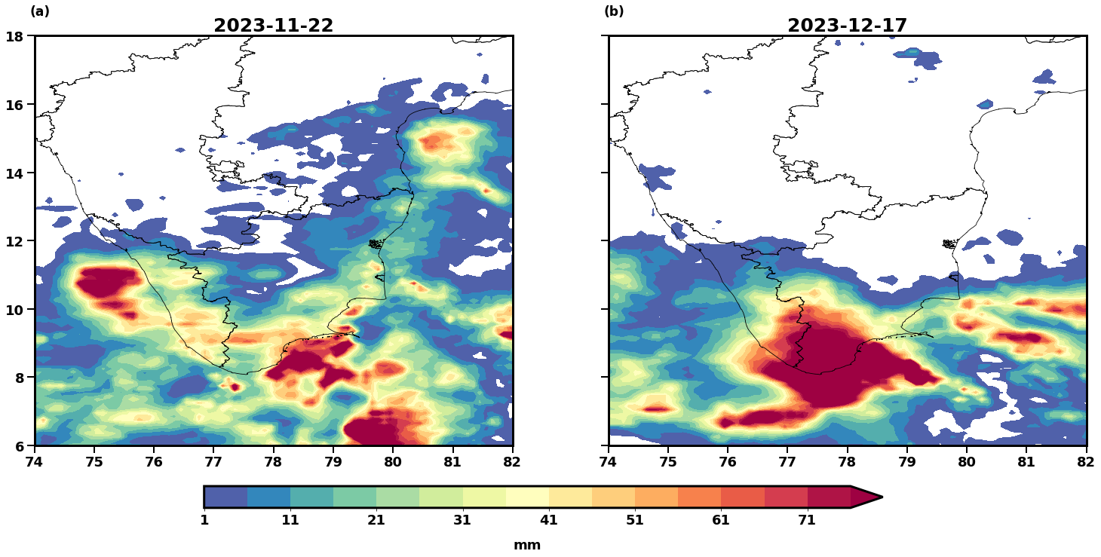
IMERG Rainfall data

Slide 4
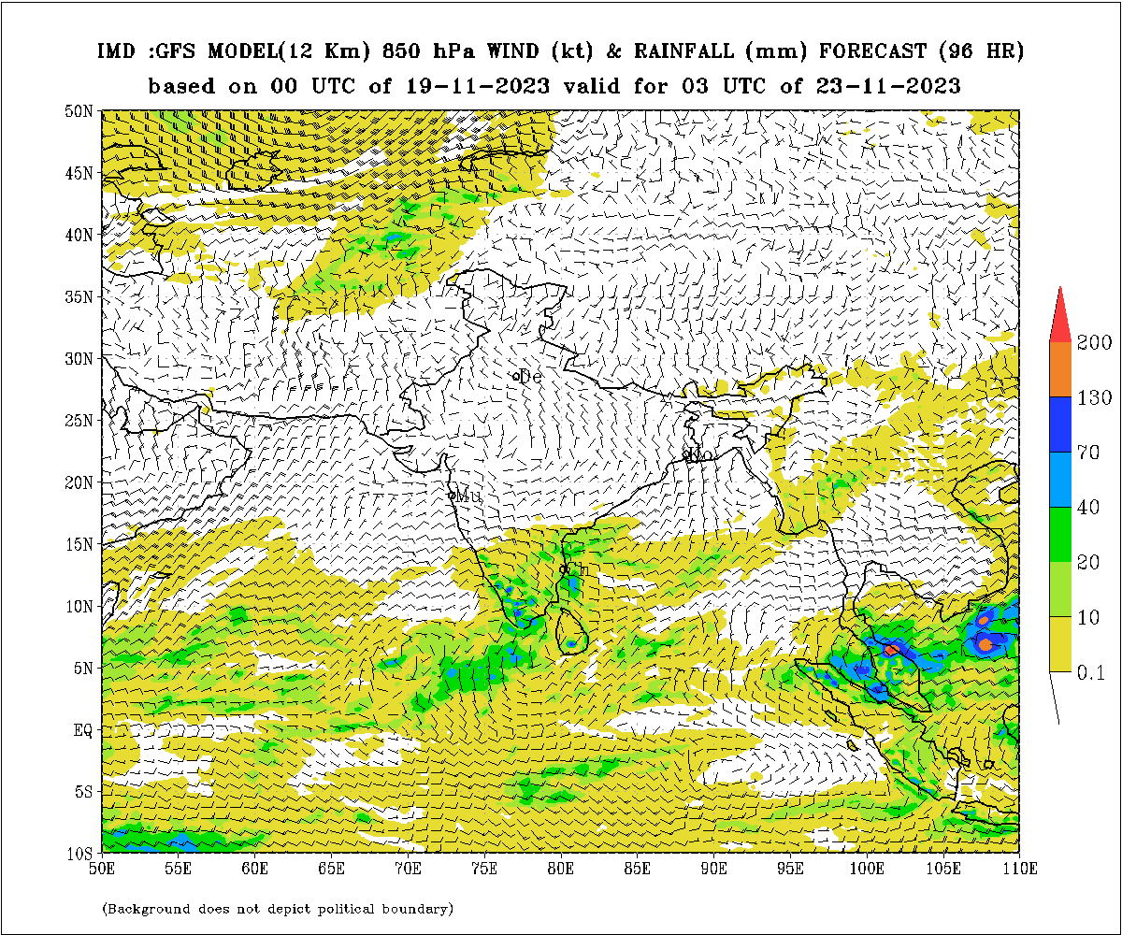
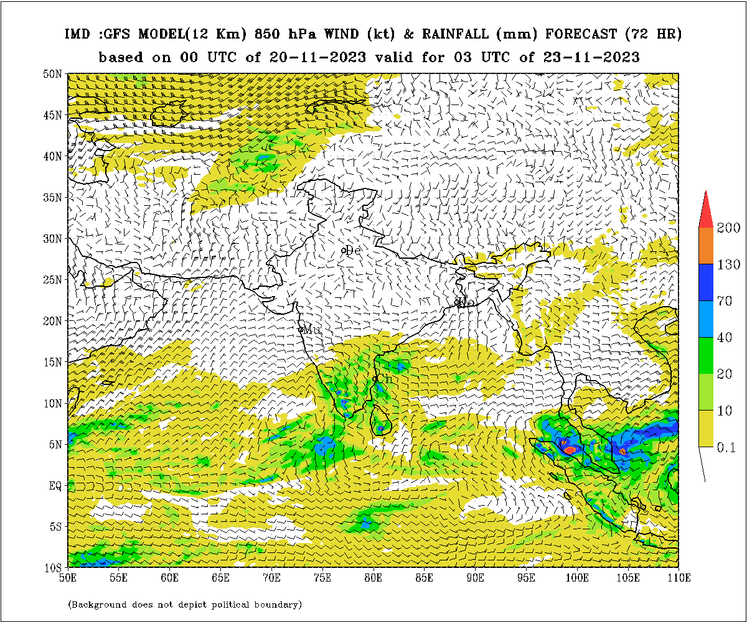
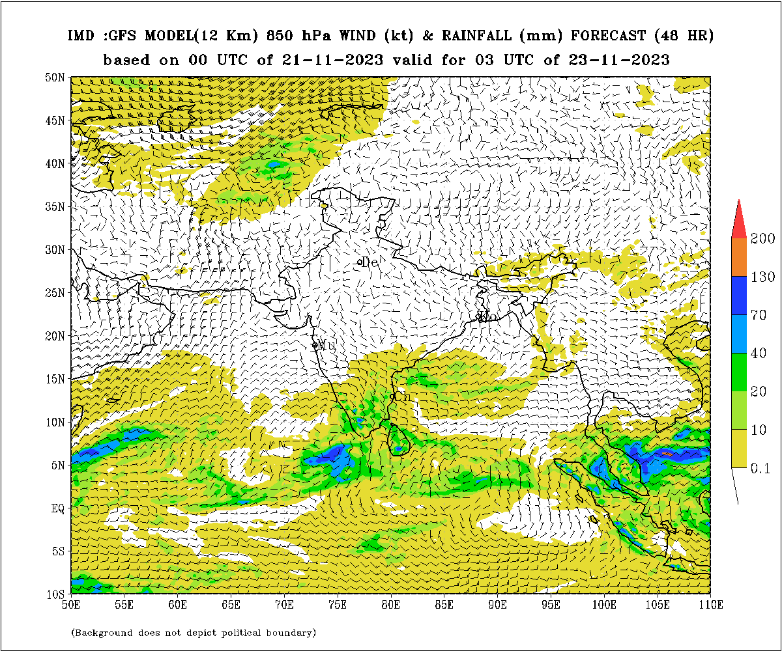
IMDGFS: Day 2, 3 and Day 4 rainfall forecasts for 23-11-2023, 08:30 IST
Day 4
Day 3
Day 2
TAMILNADU & PONDICHERY 22-11-2023 | IMD GFS MEAN(MAX) | NCUM MEAN(MAX) | NCEP_GFS MEAN(MAX) | GEFS MEAN(MAX) | NEPS MEAN(MAX) | ECMWF MEAN(MAX)
(Day 1) | 14 (93) | 19 (84) | 22 (98) | 14 (55) | 17 (44) | 17 (44)
(Day 2) | 16 (85) | 19 (95) | 8 (29) | 15 (45) | 18 (58) | 12 (38)
(Day 3) | 17 (171) | 16 (173) | 30 (182) | 17 (64) | 17 (53) | 9 (40)
(Day 4) | 16 (171) | 16 (206) | 22 (93) | 17 (76) | 16 (59) | 13 (43)

Slide 5
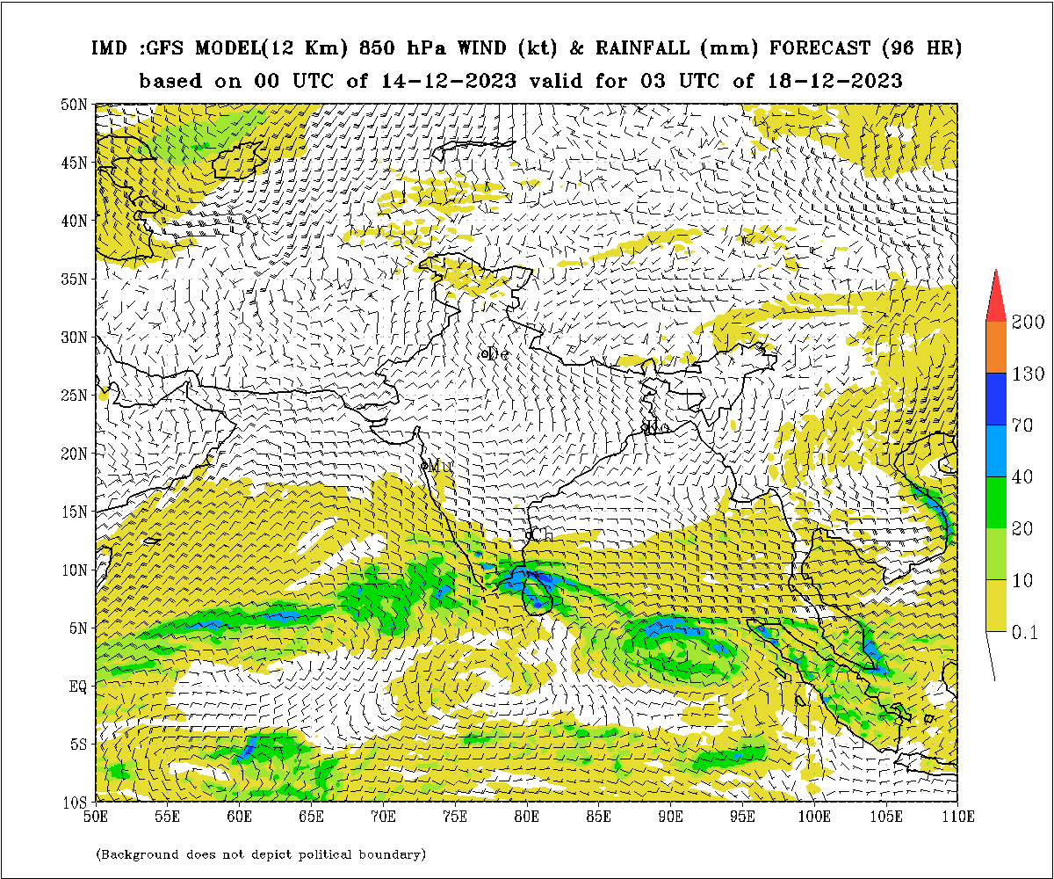
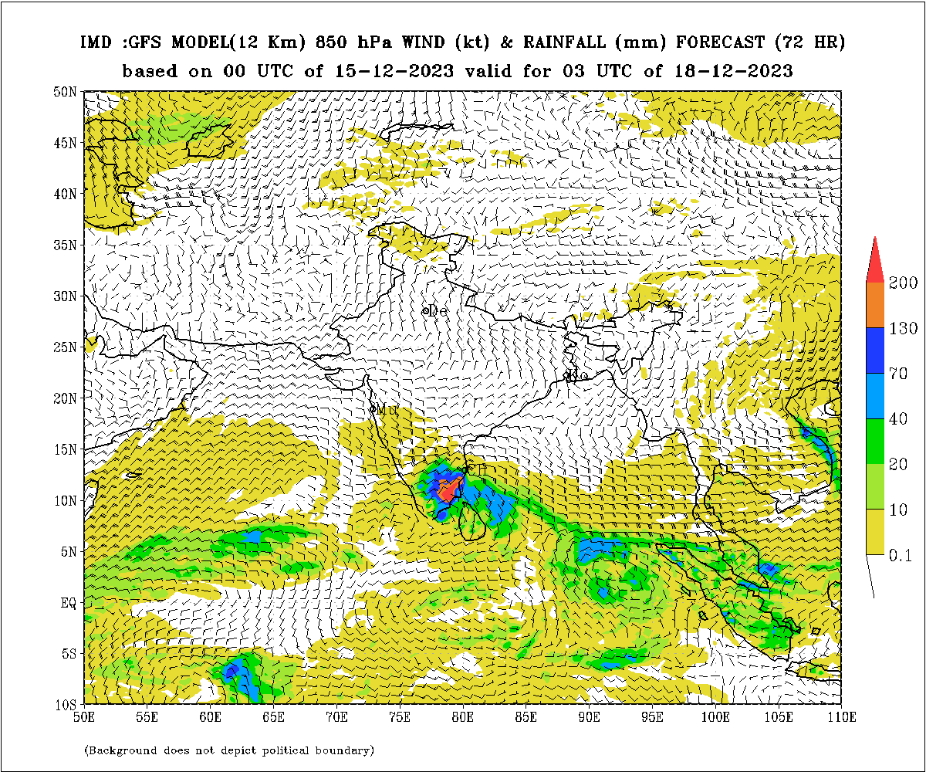
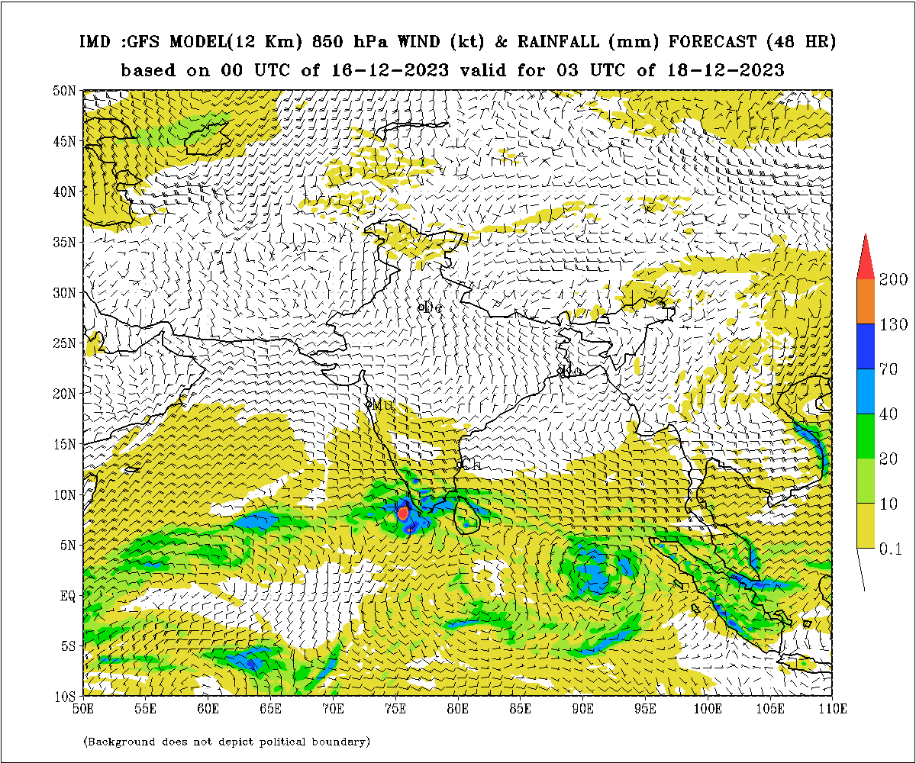
IMDGFS: Day 2, 3 and Day 4 rainfall forecasts for 18-12-2023, 08:30 IST
Day 4
Day 3
Day 2
TAMILNADU & PONDICHERY 17-12-2023 | IMD GFS MEAN(MAX) | NCUM MEAN(MAX) | NCEP_GFS MEAN(MAX) | GEFS MEAN(MAX) | NEPS MEAN(MAX) | ECMWF MEAN(MAX)
(Day 1) | 11 (127) | 11 (857) | 16 (200) | 10 (47) | 15 (320) | 28 (373)
(Day 2) | 17 (173) | 6 (409) | 5 (43) | 18 (90) | 16 (311) | 18 (187)
(Day 3) | 93 (352) | 5 (161) | 3 (13) | 70 (189) | 12 (163) | 13 (149)
(Day 4) | 13 (144) | 3 (58) | 5 (67) | 13 (47) | 10 (61) | 5 (107)

Slide 6
Conclusions & Outlook
Extreme rainfall events are occurring frequently over Tamil Nadu
in the last decade
Over 20 stations reported rainfall of above 300 mm on 17th December 2023
with peak rainfall of 950 mm at Kayalpattinam.
True evidence of changing extreme event scenarios: rainfall and temperature
Outlook
If these extreme rainfall events are believable, then the extreme high temperatures
reported over different parts of the country this year, should be well understood.
Thank you for your kind attention

