Slide 1
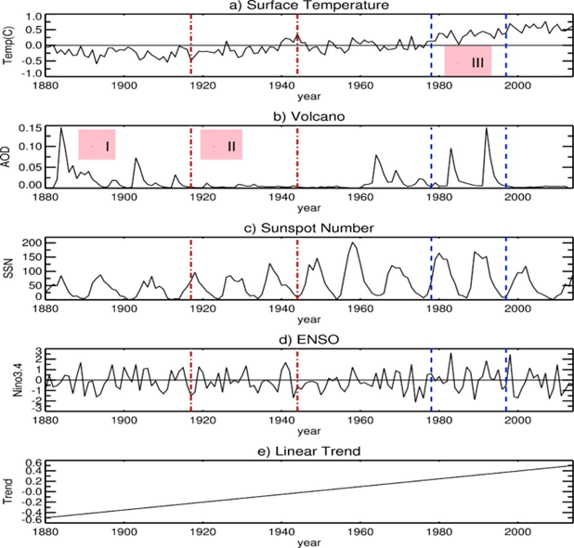
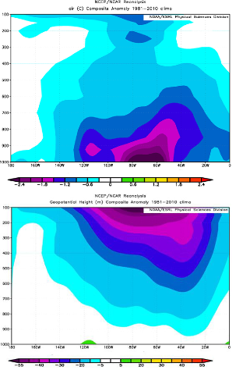
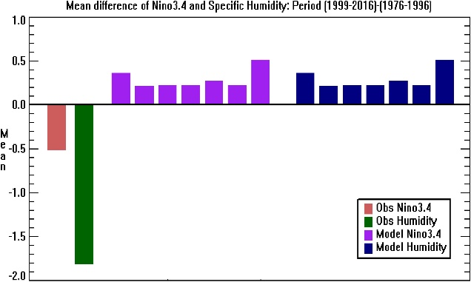
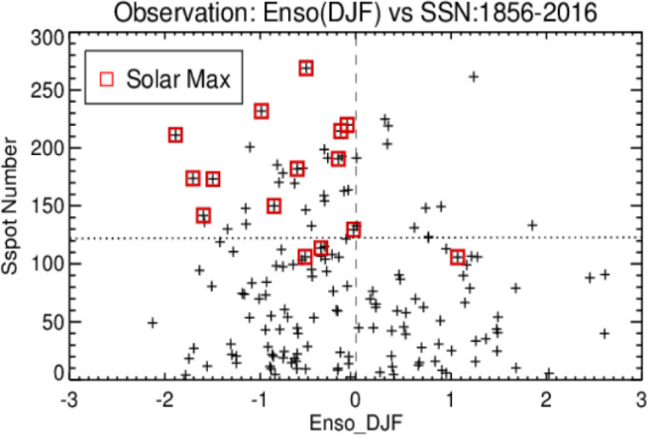
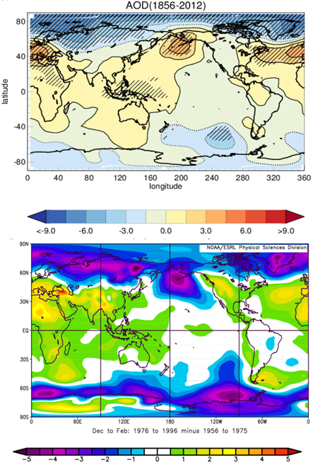
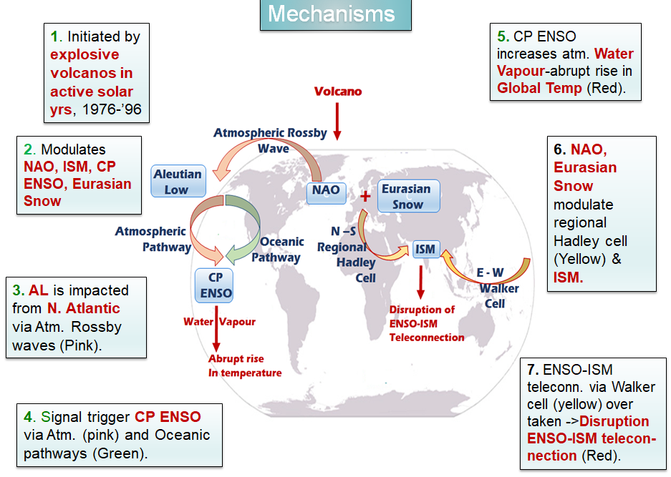
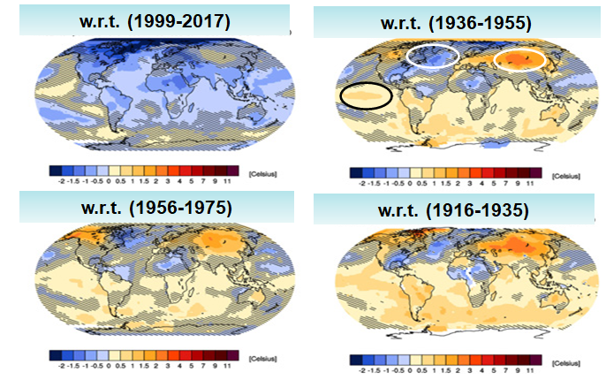
Abrupt global warming, warming trend slowdown thereafter and associated Indian Summer Monsoon behaviour
Indrani Roy (Indrani.roy@ucl.ac.uk) Department of Earth Sciences, University College London, UK
Abstract. This study addresses abrupt global warming in the later two decades of the last century and a slowdown thereafter for around two decades, prior to the strong ENSO of 2015. It separated the role of anthropogenic CO2 led linear trend to that from natural factors (volcanoes and the sun). It segregates a period 1976–1996 where two explosive volcanic eruptions occurred in active phases of strong solar cycles and also the period covers two whole solar cycles. That same period coincided with abrupt global warming. This study suggests that domination of a particular type of ENSO, the Central Pacific (CP) type ENSO and related feedback from water vapour played a crucial role. A plausible mechanism was proposed that could be triggered by explosive volcanos via a preferential North Atlantic Oscillation (NAO) phase. It modulates the CP ENSO via extratropical Rossby wave and affects the Aleutian Low. From that angle, it is possible to explain the disruption of ENSO and Indian Summer Monsoon teleconnection during the abrupt warming period and how it recovered subsequently afterward. Interestingly, individual models and also the CMIP5 model ensemble fails to agree with the observation. This study further explores important contributions due to natural drivers those are missed by models.
1. Background: Global Temperature
3.3. Results: Air Temperature and Geopotential Height
Two decades of last century were segregated (1976-96) where two explosive volcanic eruptions (El Chichon in 1982 and Pinatubo in 1991) occurred in active phases of strong solar cycles (Fig.1). Global temp had risen .13ºC/decade during that period; whereas, rise for overall period of 150 years upto 2015 is 0.07ºC/decade. There was a slowdown of rise in global temp afterwards around next 2 decades.
Fig. 4. Longitude vs. Height anomaly plot for Dec-Feb, (1979–1996 minus 1999–2017) averaging over 50N to 70N. Parameters used are air temperature (top) and geopotential height (bottom). The signal in the north Atlantic region is seen even present high in the stratosphere.
Fig. 1 Timeseries of various parameters. a) shows surface temperature from GISS data which is influenced by various parameters b) volcano, c) solar cyclic variability represented by Sunspot number (SSN), d) ENSO and e) Linear Trend. Main interest is period III and after. In period III two major volcanos erupted in active phases of strong solar cycles. ENSO in period III was strongest in terms of amplitude and variability. Global temperature had risen abruptly. [Roy (2020)]
Fig. 5. Mean difference between ‘1999-2017’ to ‘1976-1996’ for Nino3.4 and specific humidity. The first two bar plots are for Niño3.4 and specific humidity using observed or reanalyses products. Seven arbitrary models are also presented; purple for Niño3.4 and blue for sp. humidity. Interestingly signs are different in models from observation. Though only a few models are presented, all models suggest similarly [Roy (2018)].
2. Method & Data
3.4. Results: SSN vs. ENSO
We employ monthly datasets of Sun Spot Number (SSN), Sea Level Pressure (SLP), Air temperature, Geopotential Height, specific humidity. We use different techniques, e.g., Compositing technique and Multiple Linear Regression (MLR) Analysis, incorporating an AR(1) noise model. In MLR, dependent parameters are: a linear trend, stratospheric aerosol optical depth (AOD, to represent volcanic effects) and ENSO. Results of some CMIP5 models are also analysed [See at the end for data sources.]
Fig 6. Solar Max or peak years (marked by red) for high solar cycles (SSN>120) are biased towards the cold event side of ENSO. Interestingly, all points of the top right quarters are for the period 1958-1997.
3.1. Results: SLP
We also find the sun and ENSO (DJF) have different connections (which is cold event type) after 1998 and before 1957 in all active solar years (SSN >120) and not only to solar maximum or peak years. Such feature is however missed by all CMIP models (Roy, 2018, not shown here). Thus, the solar contribution to warming as observed via ENSO in the later decades of the 20th century is missing in all CMIP models.
Fig. 2. The influence of strong volcanic eruptions are shown using SLP data, for DJF. The top plot shows signals for HadSLP2 data of Volcano using Multiple Linear Regression (MLR), where ENSO, SSN and trend removed. Significant regions at 95% levels are marked by hatching. Bottom plot shows SLP anomaly for the period 1976-1996 w.r.t. two previous decades (1956-1975). For both cases, strong positive NAO pattern is identified for strong volcanos.
3.5 Proposed Mechanism
3.2. Results: Surface Temperature
Fig.3. The anomaly of surface temperature (ºC) in observation (DJF), using GISTEMP data [after, Roy (2018)]. Anomaly during (1976-1996) is presented w.r.t. three other periods (covering two decades each). The first plot is an anomaly w.r.t. recent two decades. Significant regions (95% level) are shown without hatching. Central Pacific warming and cooling in the north Atlantic, while warming in Eurasian sectors are very distinct. Results are similar using other temperature data sources too. None of the CMIP5 model captured those combined features. Also, no consensus among models.
Studies indicated ENSO, Indian Summer Monsoon (ISM) usual teleconnection weakened in later two decades of the last century, which reverted back again in recent decades. In period of disruption, teleconnection of ISM via north Atlantic and Eurasian sector was strengthened. That feature of ISM disruption was identified using correlation between ISM (JJAS) and different regional temperature fields (Roy, 2018, not shown here).
Fig. 7. Mechanisms proposed following discussions earlier. Those are initiated by explosive volcanos in active phases of strong solar cycles. That modulated various features e.g, NAO, AL, and ISM .
4. Conclusions
This study segregates a period 1976–1996 where two explosive volcanic eruptions occurred in active phases of strong solar cycles and also the period covers two whole solar cycles.
Very strong influence from volcanoes was observed around the North Atlantic during 1976-1996, DJF by Multiple Linear Regression (AR1 noise model). as well as anomaly technique.
The signal is also extended high up in stratosphere. Temperature anomaly during ‘1976-1996’ detected warming in central Pacific, cooling in north Atlantic, while warming in Eurasian sector
Such pattern is noticed using different anomaly periods of two decades, earlier or later and using various observed data sources.
Performance of individual CMIP models and AR5 CMIP5 subsets were analysed but those failed to match with observation. No Consistency is found among those models too.
Analyses on specific humidity and Nino 3.4 suggest that observations and models even show different signs of change in later two decades upto 2017 to that from previous two decades.
ISM and ENSO teleconnection was weakened in those two decades and there was also abrupt global warming in that period.
The sun and ENSO (DJF) have different connections (which is cold event type) after 1998 and before 1957 in all active solar years (SSN >120) and not only to solar maximum or peak years. Such feature is however missed by all CMIP models
A series of mechanisms are proposed which are initiated by explosive volcanos that erupted during 1976-’96 and coincided with active phases of strong solar cycles. It modulates NAO, Aleutian Low (AL), Eurasian Snow, Central Pacific (CP) ENSO and ISM. Those also caused abrupt warming and disruption of ISM-ENSO teleconnections (Fig.6).
The role of natural factors on climate is identified though models miss many important contributions from natural drivers. This study discussed mechanisms based on observed data and gave directions on where models can improve.
For further details see: Publications of Roy, I (2018- 2023), underneath for references
Data
SLP: HadSLP2. http://www.metoffice.gov.uk/hadobs/hadslp2. Updated up to 2012 using HadSLP2r_lowvar data52
(http://www.metoffice.gov.uk/hadobs/ hadslp2/data /down load.html);
SSN: http://www.sidc.be/silso/versionarchive ;
Air temperature ; Geopotential height: http://www.esrl.noaa. gov/psd/.
ENSO, AOD, Sp Humidity (ERA-Interim): KNMI Climate Explorer (http://climexp.knmi.nl)
References
Roy, I. (2023). https://doi.org/10.1142/9789811275449_0001. Proceedings of the 19th Ann. Meeting of the Asia Ocea. Geosc. Soc.
Roy, I (2018). Front. Earth Sci. 6:136. https://www.frontiersin.org/articles/10.3389/feart.2018.00136/full
Roy I. (2020), Pure and Applied Geophysics, Springer Nature, https://doi.org/10.1007/s00024-020-02522-z, 2020.
Roy, I (2021), Natural Hazards, publisher, Springer Nature, https://doi.org/10.1007/s11069-021-04653-5, 2021.

