Slide 1
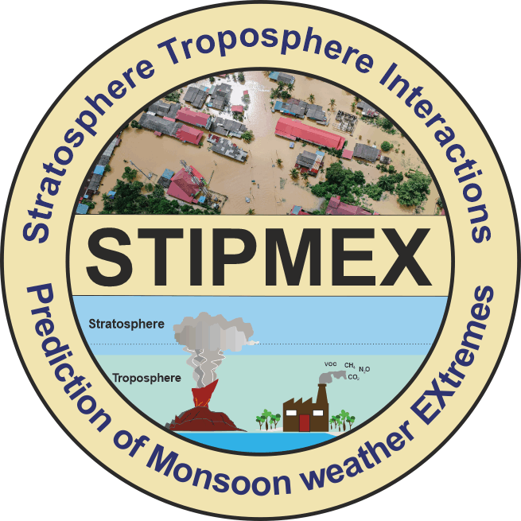
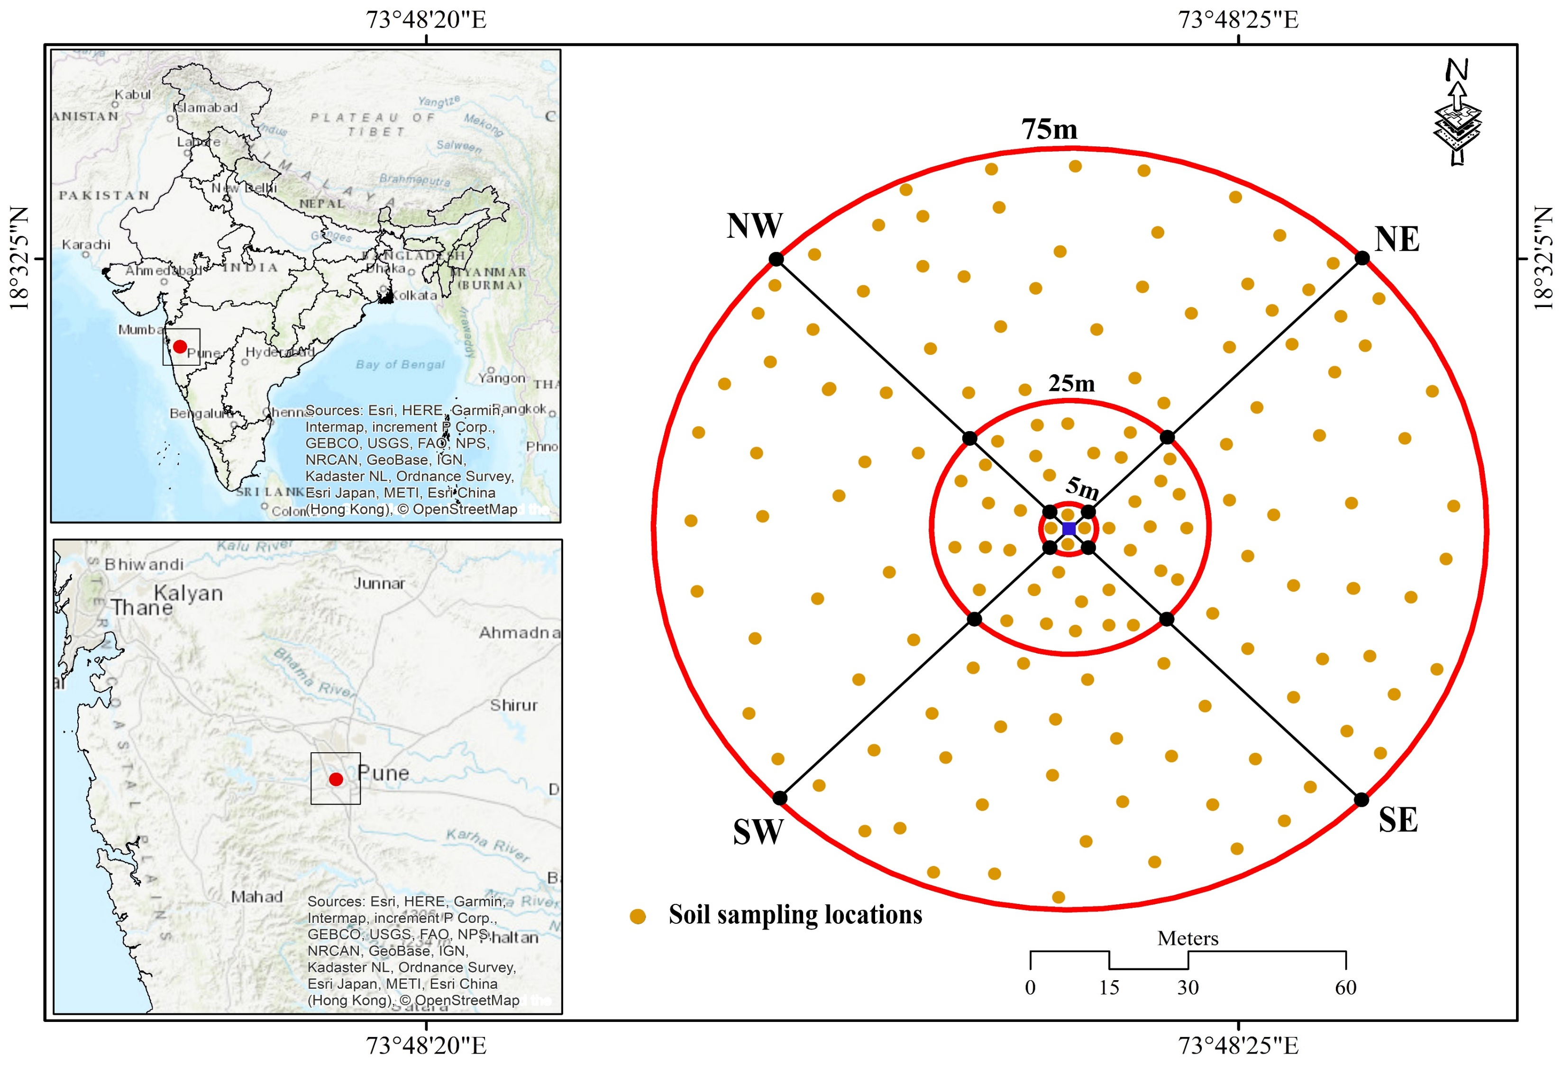
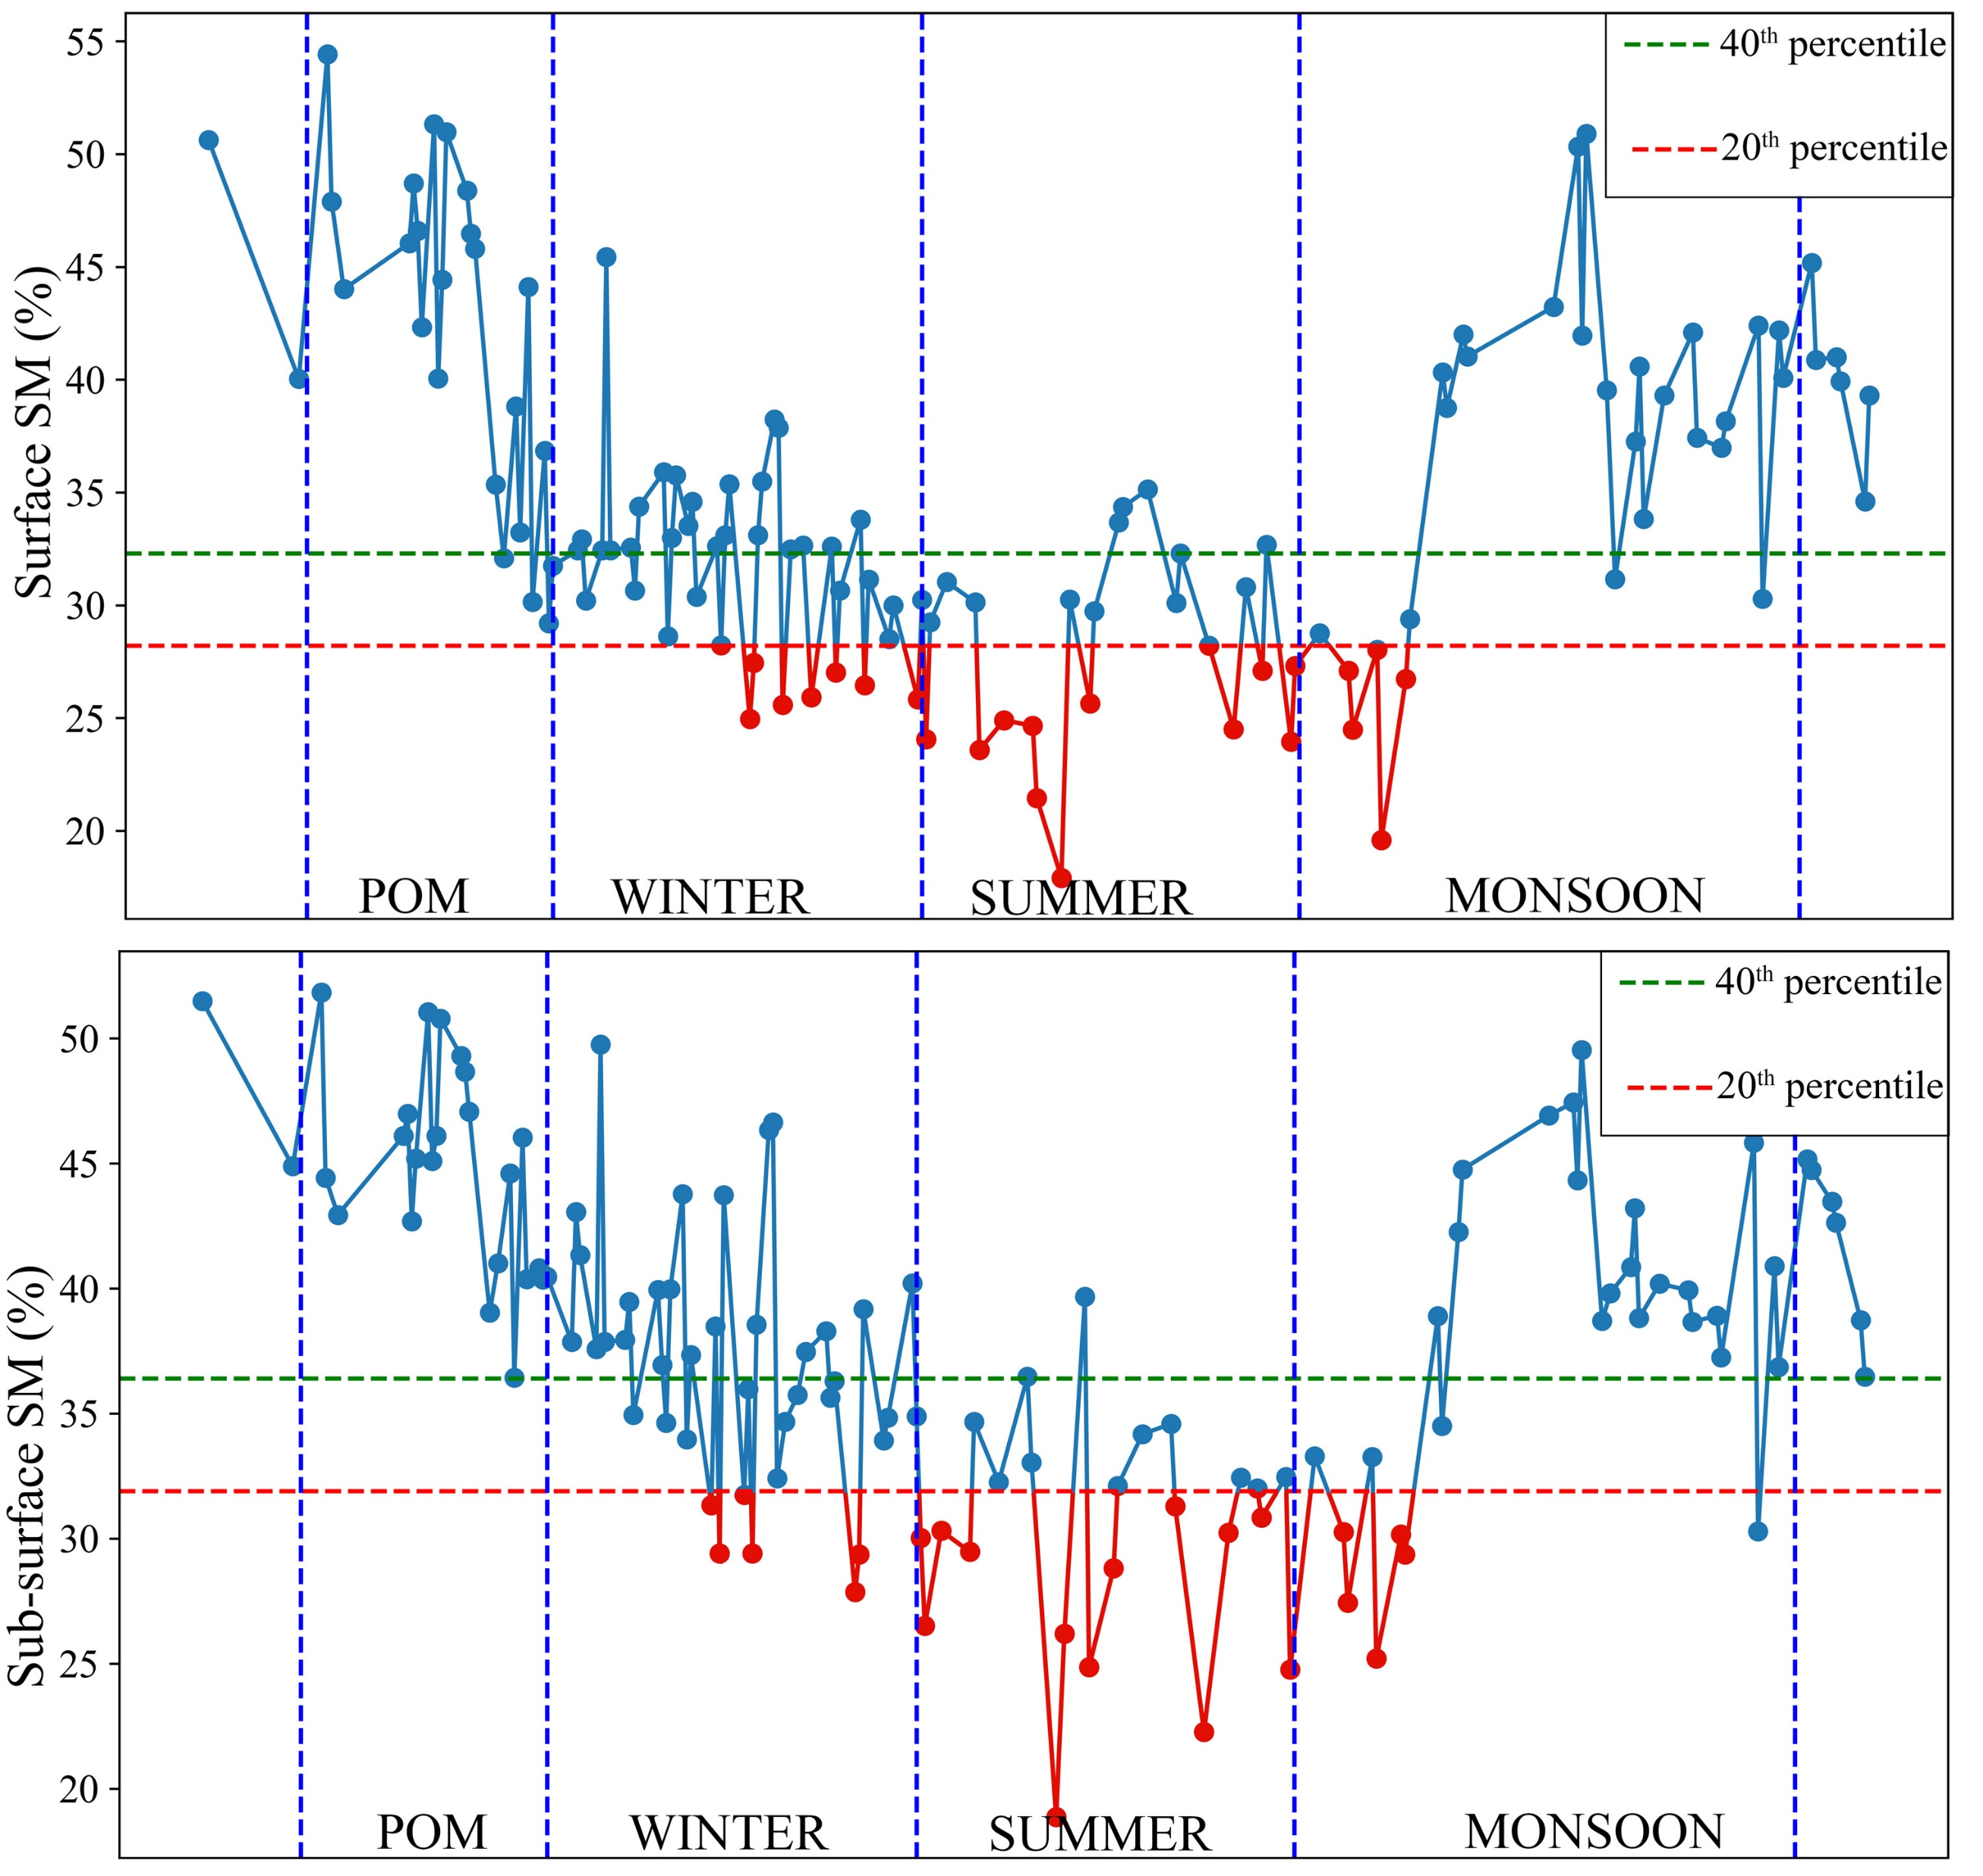
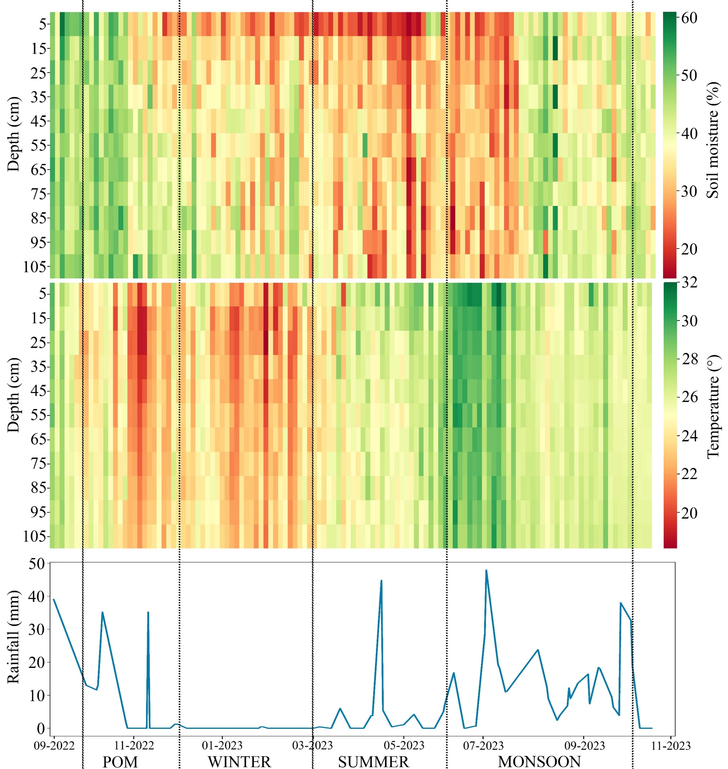
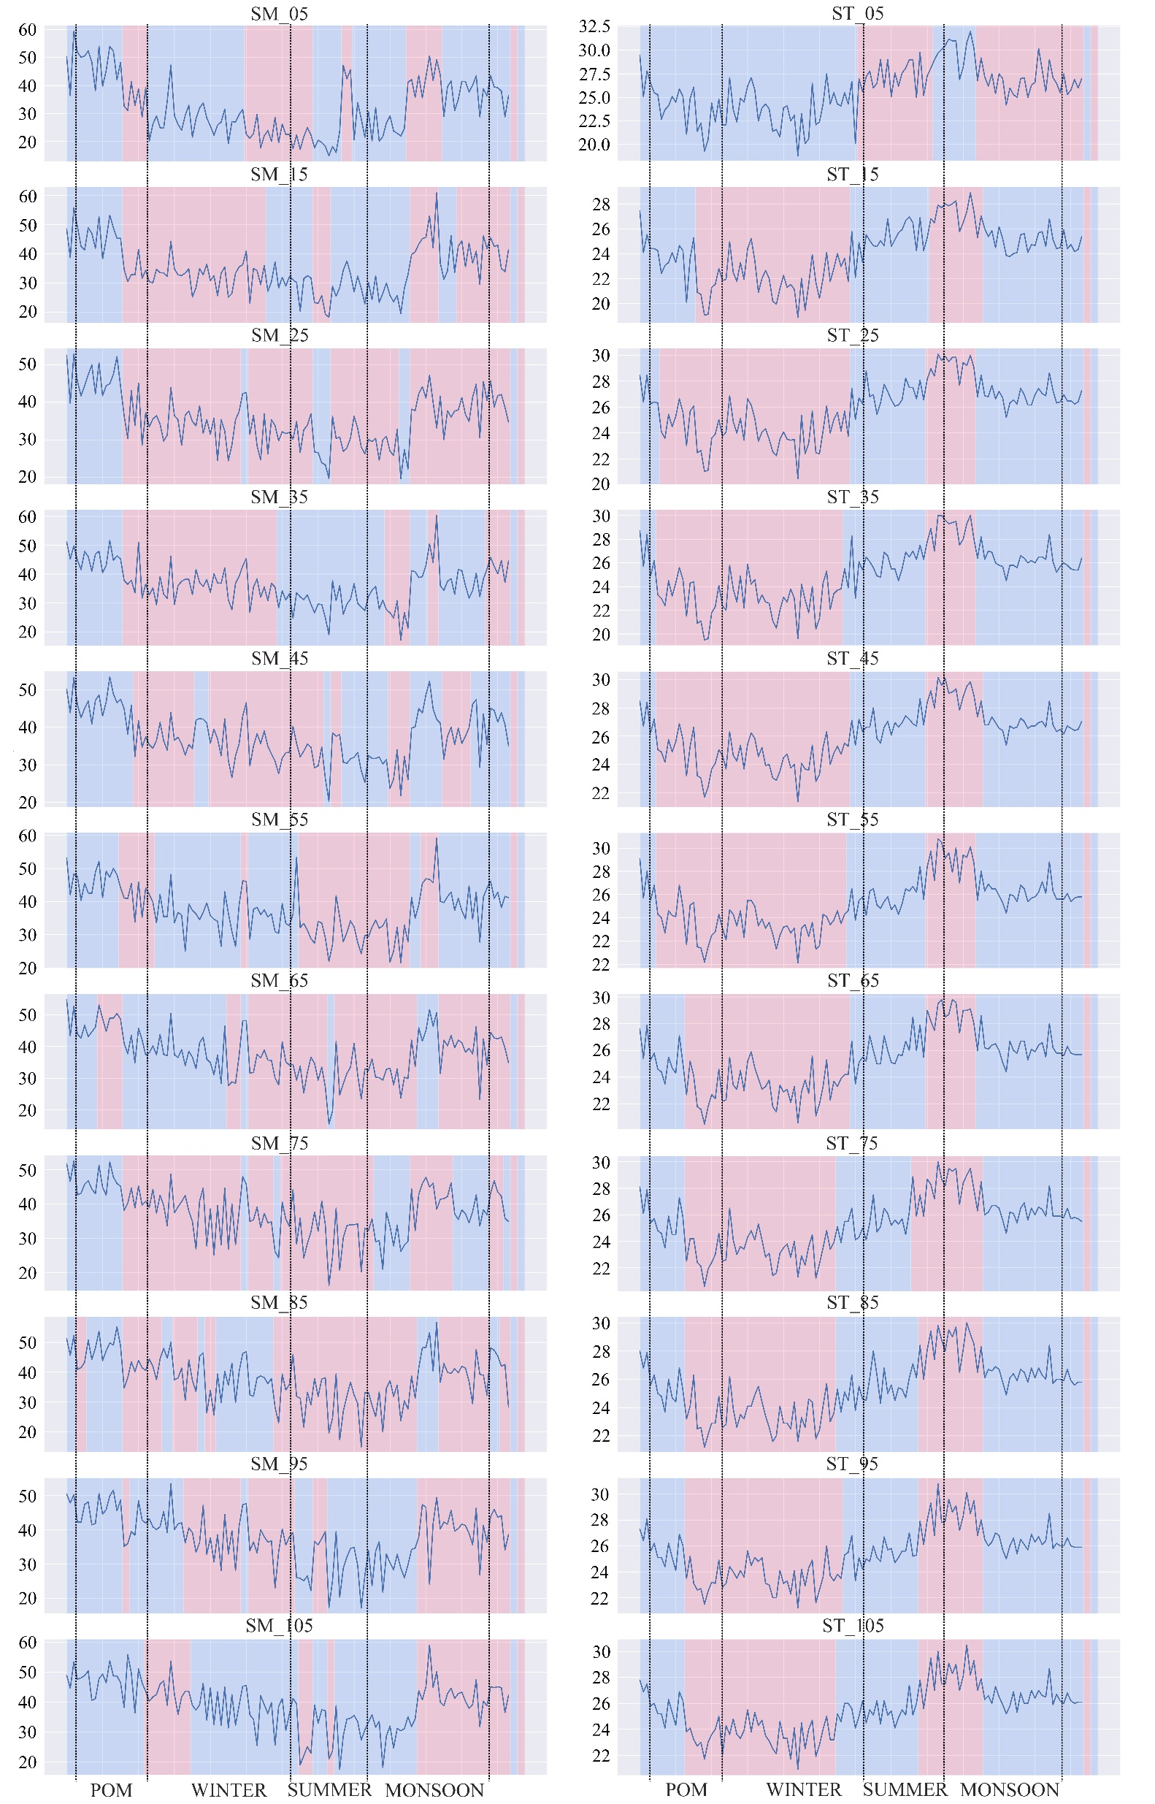
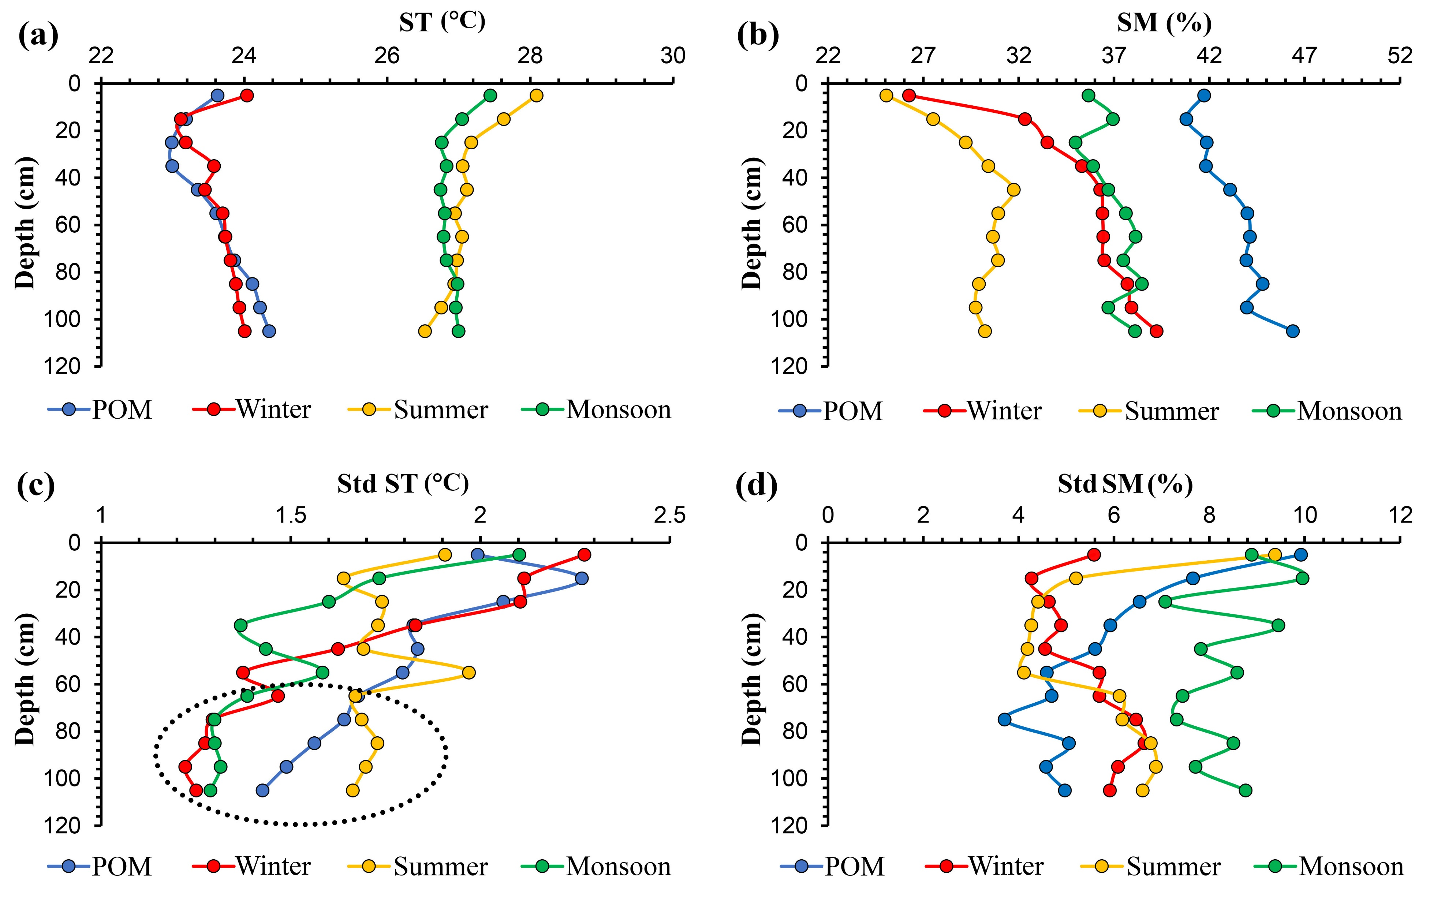
Field-Scale Investigation of Temporal Dynamics in Soil Moisture and Temperature Profiles in Response to Rainfall Events
Aju C.D¹, Milind Mujumdar¹*, Bhupendra Bahadur Sing¹, Mangesh Goswami¹, Madhusudan Ingale¹, Naresh Ganeshi²
¹ Center for Climate Change Research, Indian Institute of Tropical Meteorology, Pune
²Department of Atmosphere, Ocean and Earth System Modelling Research, Meteorological Research Institute, Tsukuba, Japan
*Corresponding author email address: mujum@tropmet.res.in
1
2
Introduction
Study area
Soil moisture (SM) and soil temperature (ST) are critical factors influencing agricultural productivity, ecosystem health, and hydrological processes. Understanding their dynamics is essential for effective water resource management and predicting crop yield.
Field-scale studies provide insights into real-world conditions, capturing the complexity of soil heterogeneity, topography, and local climate influences on soil moisture and temperature dynamics.
The primary focus of this study is to identify the temporal behaviour and interrelationship of soil moisture and soil temperature with respect to rainfall and seasonal changes.
The study area (Figure 01) is located on the western margin of the Deccan plateau, at an altitude of 560 m above sea level. The area receives moderate rainfall, primarily from the southwest monsoon.
The study area is mainly characterised by black cotton soil and features a land use pattern of mixed vegetation, including native trees (Mujumdar et al., 2021).
Figure 01. Location of the study area, a 75m radius circle was established from the point having 18.5374°N and 73.8054°E cordinates. Soil sampling locations are marked with yellow dots
3
Methodology
Soil sample
collection
Gravimetric analysis
Data analysis
A total of 151 Soil profiles (area-averaged) were collected at various depths, i.e., at 5cm, 15cm, 25cm, 35 cm, 45 cm, 55 cm, 65 cm, 75 cm, 85 cm, 95 cm, thereby making 1661 number of soil samples analysed.
Study period: 09/2022 to 11/2023
Flash-drought conditions were observed in the study area both in surface and sub-surface soils, especially during summer
Soil moisture was measured using the gravimetric method, soil temperature was measured using a temperature probe, and daily rainfall data was collected from the rain gauge station installed in the study area.
The flash drought frequency is higher on the surface than on the sub-surface (Figure 04).
The flash drought frequency is higher on the surface than the sub-surface, primarily because the surface soil layer, directly exposed to atmospheric elements and sunlight, is prone to quick moisture fluctuations.
In contrast, the sub-surface layers, shielded from immediate atmospheric impact, undergo slower moisture changes due to reduced evaporation rates and the buffering effect of soil moisture memory (Goswami et al., 2023), which helps to mitigate the impact of sudden atmospheric moisture changes.
For data analysis, the study utilised descriptive statistics and time series analysis, and for change detection, the Pruned Exact Linear Time (PELT) algorithm was used.
4
Results & Discussion
The field-scale SM & ST exhibit notable variations across different depths and seasons (Figure 02).
SM and rainfall exhibit a direct relationship, whereas ST and rainfall show an inverse relationship.
Figure 03. Change point detection plots of soil moisture and soil temperature profiles (SM in % and ST in degrees Celsius)
Rainfall and SM of surface layers (<35cm) have a higher positive correlation (r=0.29) than sub-surface (>35cm) layers (r=0.15).
This suggests that rainfall has an instantaneous impact on surface soil layers compared to sub-surface layers.
Rainfall and ST of measured depths exhibit less correlation (r<0.31).
Figure 04. Time series surface (5 to 35cm) and subsurface (35cm to 105 cm) SM. The green dashed line represents the 40th percentile, and the red dashed line represents the 20th percentile.
Figure 05. Seasonal variation of field-scale ST (a), SM(b), standard deviation of ST (c) and standard deviation of ST (d)
Figure 02. Soil moisture and soil temperature heat map compared with rainfall
ST across various depths demonstrate better correlations with one another (r>0.79)
The change point detection plots show (Figure 03) that SM at shallower depths (5 to 55 cm) exhibits continuous changes during winter, whereas from 55 to 95 cm, it exhibits continuous changes during summer.
The change point detection analysis indicates a consistent pattern in ST across different depths, with a generally consistent trend. However, the topmost layer displays a distinct pattern compared to the other layers.
The standard deviation of field-scale ST decreases with depth (Figure 05).
The standard deviation of field-scale SM is decreasing with depth in all seasons except winter and summer, where it increases at mid-depths.
5
Conclusion
The unique pattern observed in the topmost layer, especially during winter and monsoon, could be linked to the process of land-atmosphere interaction
The study identifies distinct seasonal variations in SM and ST profiles, with notable shifts aligning with transitions between seasons.
The study shows depth-dependent dynamics in both ST and SM, noting that surface layers respond more substantially to land-atmosphere interactions than sub-surface layers.
Reference
Goswami, M. M., Mujumdar, M., Singh, B. B., Ingale, M., Ganeshi, N., Ranalkar, M., ... & Patil, S. N. (2023). Understanding the soil water dynamics during excess and deficit rainfall conditions over the core monsoon zone of India. Environmental Research Letters, 18(11), 114011.
Mujumdar, M., Goswami, M. M., Morrison, R., Evans, J. G., Ganeshi, N., Sabade, S. S., ... & Patil, S. N. (2021). A study of field-scale soil moisture variability using the COsmic-ray Soil Moisture Observing System (COSMOS) at IITM Pune site. Journal of Hydrology, 597, 126102.

