Slide 1
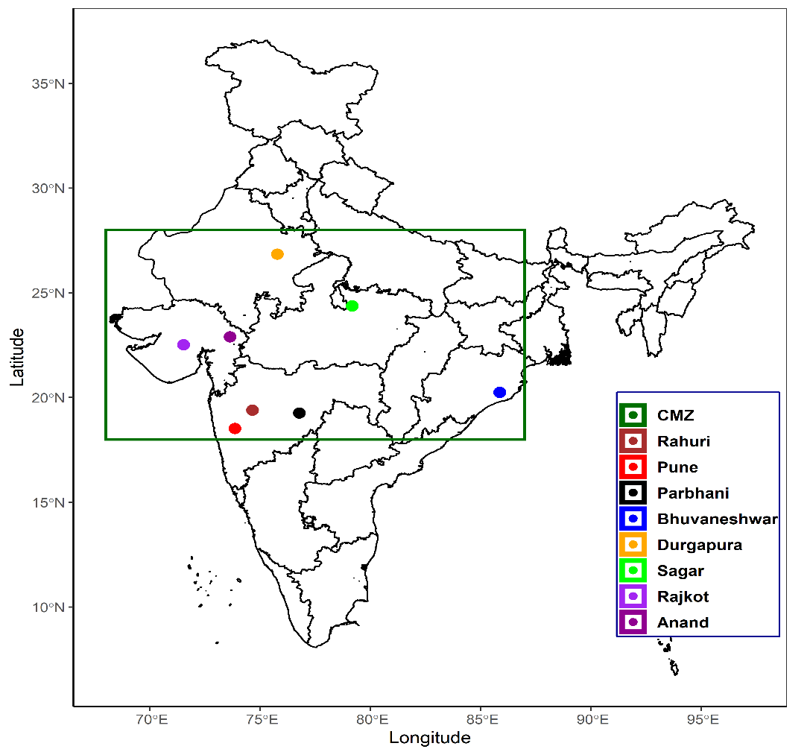
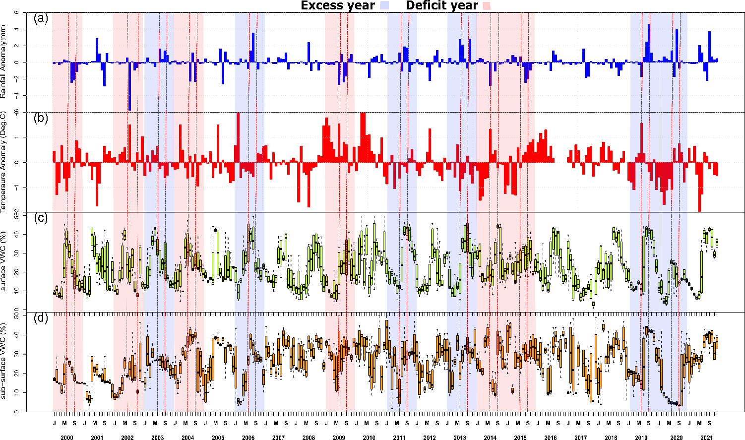
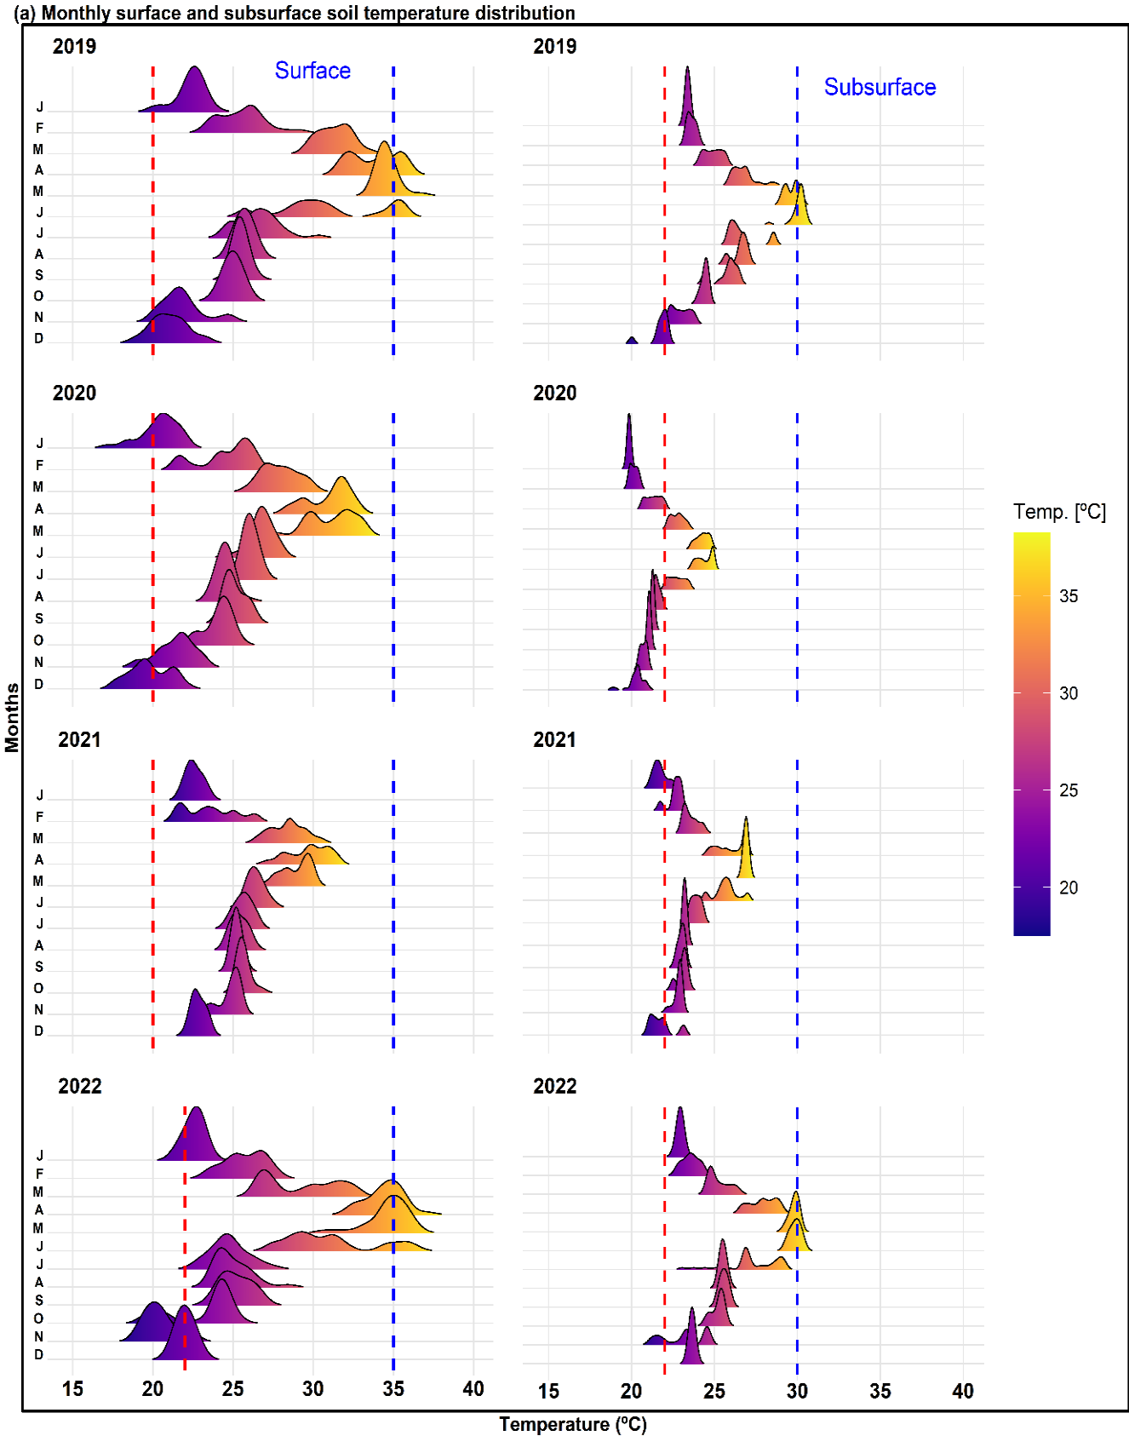
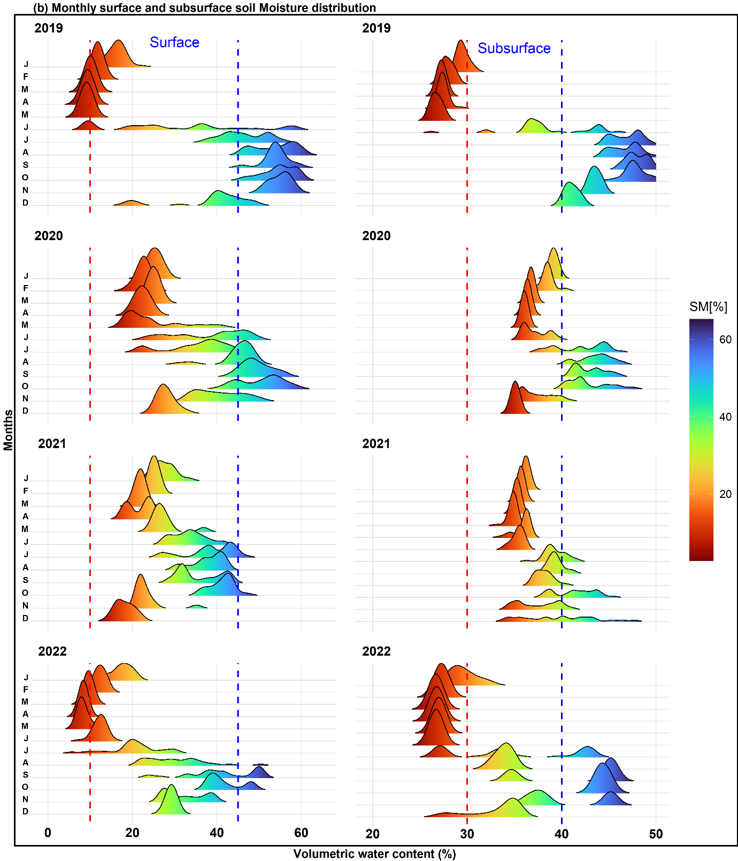
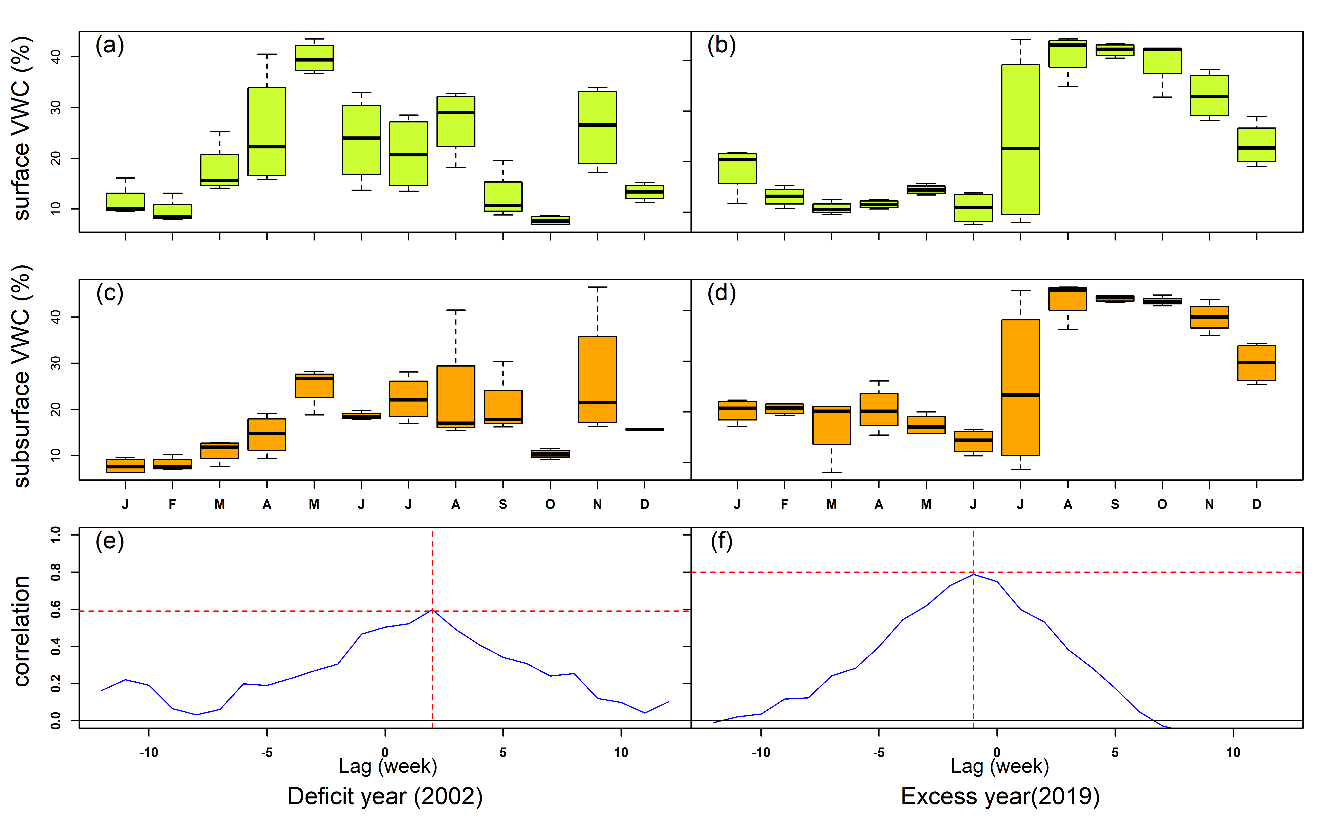
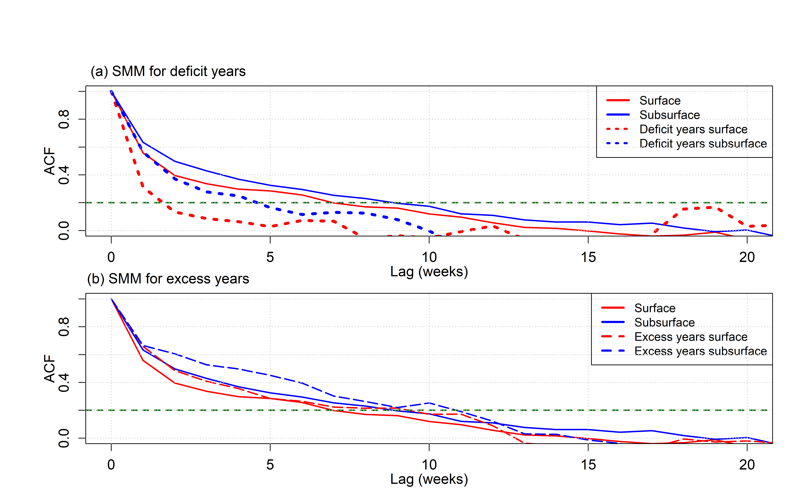
Understanding the soil water dynamics during the excess and deficit monsoon: the role of surface and subsurface soil moisture
Mangesh M. Goswami^{1,2}, Milind Mujumdar¹, Bhupendra Bahadur Singh¹, Madhusudan Ingale¹, Naresh Ganeshi¹, S. N. Patil², and R. Krishnan¹.
¹Indian Institute of Tropical Meteorology, Pune-411008. ²Kaviyatri Bahinabai Chaudhari North Maharashtra University, Jalgaon-425001
Motivation:
Understand the surface and subsurface processes and their linkage to land-atmosphere energy exchanges.
Understanding the profound influence of soil moisture is paramount in deciphering the intricate dynamics of regional hydro-meteorological extremes.
Methodology
In the present study, we implemented two different approaches to find out the linkage between surface and subsurface SM.
(1) Regression analysis (Dirmeyer, 2011):
Linear regression of weekly surface SM on subsurface SM anomalies is evaluated at each grid point to estimate the slope Rc for each year during 2000 - 2021.
To account for the influence of SM variability on the slope (indicative of the strength of correlation), we also computed the standard deviation of weekly surface SM ($σ_{SM}$) for each year across the study period. The coupling strength is therefore given by (Dirmeyer, 2011)
$Ω=σ_{SM}×R_{c}$ (1)
Higher positive (negative) $Ω:$regions where surface SM has a dominant (weak) impact on subsurface SM variability
(2) Cross-correlation analysis (Xu et al., 2022)
Cross-correlation analysis: characterizes lead/lag relationship between the surface and subsurface SM at different depths.
Objectives:
To understand surface and subsurface soil water dynamics during the wet and dry SM conditions for the period 2000 -2022.
Understanding Soil Water Dynamics (SWD) during regional extremes, particularly in successive winter and pre-monsoon conditions.
To study the impact of rainfall extremes the surface and subsurface SMM and coupling strength.
Core monsoon
zone (CMZ)
Figure.1: Various IMD Hydro-meteorological observation stations across the core monsoon zone (CMZ) of India (represented by distinct colour inside the CMZ box).
Result:
Figure 5: The monthly mean rainfall anomaly (mm/day) and Bowen ratio (ratio of sensible to latent heat flux) are shown for the period of 2000-2021 over the CMZ of India. The dark red and green colour bars indicate negative and positive rainfall anomalies respectively, while grey bars indicate Bowen ratio. The hatched region with red (green) shading represents the June-December months of deficit (excess) years. Whereas the plane shaded region with red(green) depicts the successive winter and pre-monsoon season.
Figure. 2: Time series of monthly (a) rainfall anomaly (mm) and (b) 2M temperature anomaly (°C). Monthly statistics represented as Box and Whisker plots for weekly (c) surface, and (d) subsurface volumetric SM (%) content based on IMD in-situ observations over the CMZ of India for the period 2000–2021. The dotted red line indicates the monsoon months (JJAS). The shaded area in red and blue indicates the deficit and excess years respectively.
Figure 6 The probability density function of surface and subsurface (a) soil temperature (ST, ° C) and (b) soil moisture (SM, VWC %) for each month of the period between 2019 and 2022, using in-situ measurements at the COSMOS-IITM, Pune. The dashed red lines indicate the threshold for extremely dry (warm) SM (ST) conditions, whereas the dotted blue line, indicates the threshold for extremely wet (cool) SM (ST) conditions.
Summary and conclusion:
Surface soil moisture (SM) shows higher variability year-round, while subsurface SM variability is more pronounced during extreme wet or dry conditions.
Coupling strength is significantly higher during excess monsoon years (e.g., 2019) compared to deficit years (e.g., 2002).
In general Soil moisture memory (SMM) is about 6-7 weeks at the surface and 9-10 weeks at the subsurface level during the study period 2000 to 2021. Interestingly, In deficit years, subsurface SMM decreases by ~50%, while in excess years, it increases by around 7-10%.
For deficit or excess years, SMM and coupling strength during post-monsoon seasons influence the balance between sensible and latent heat fluxes which in turn affect convective activities during successive winter and pre-monsoon seasons.
SMM during the Indian summer monsoon season has a notable impact on land-atmosphere energy exchange.
Figure 3: Upper and middle panels represent monthly surface and subsurface SM variability respectively as a Box and Whisker plot. Last panel shows lag-correlation between surface and subsurface SM. All the left panels (a), (c) and (f) are for the deficit year (2002). Whereas all the right panels (b), (d) and (f) are for the excess year (2019).
Figure 4: Estimates of surface (Red) and subsurface (Blue) SM persistence timescale (Soil moisture memory) during the period of 2000-2021 using 52-week lag auto-correlation function over the CMZ of India. (a) Deficit years are represented by the dotted lines and (b) excess years by the dashed lines. The dashed green line indicates 95% significance level.
REFERENCES: Xu, Z., Man, X., Duan, L., Cai, T., 2022. Improved subsurface soil moisture prediction from surface soil moisture through the integration of the (de)coupling effect. J. Hydrol. 608, 127634. https://doi.org/10.1016/j.jhydrol.2022.127634 . Dirmeyer, P. A. (Aug. 2011). The terrestrial segment of soil moisture–climate coupling. Geophysical Research Letters, 38(16), L16702.
Goswami, M.M., Mujumdar, M., Singh, B.B., Ingale, M., Ganeshi, N., Ranalkar, M., Franz, T.E., Srivastav, P., Niyogi, D., Krishnan, R., Patil, S.N., 2023. Understanding the soil water dynamics during excess and deficit rainfall conditions over the core monsoon zone of India. Environ. Res. Lett. 18, 114011. https://doi.org/10.1088/1748-9326/acffdf
ACKNOWLEDGMENT: we are graceful to the Director IITM and organiser of this workshop
For more details
Email: Mangesh@tropmet.res.in

