Slide 1
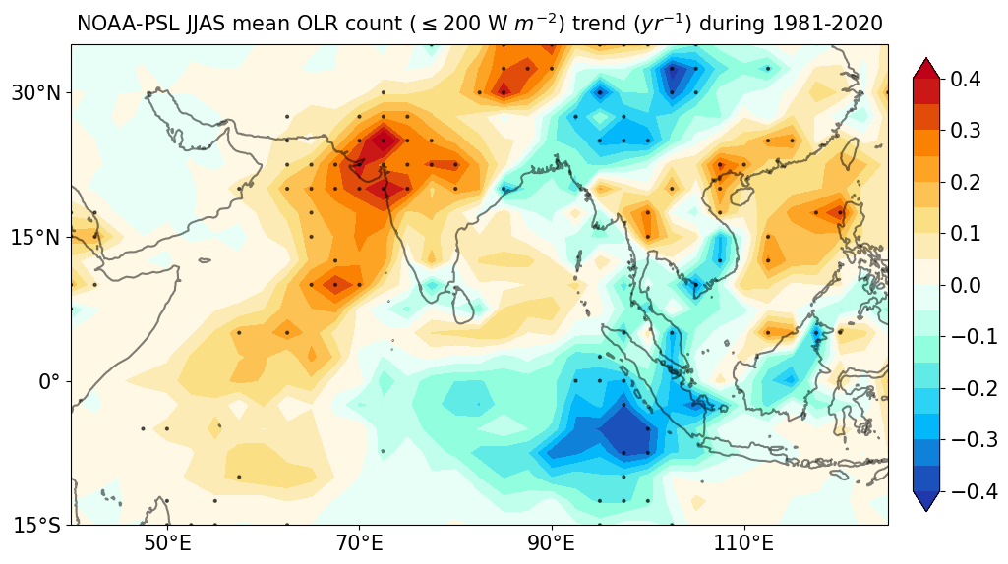
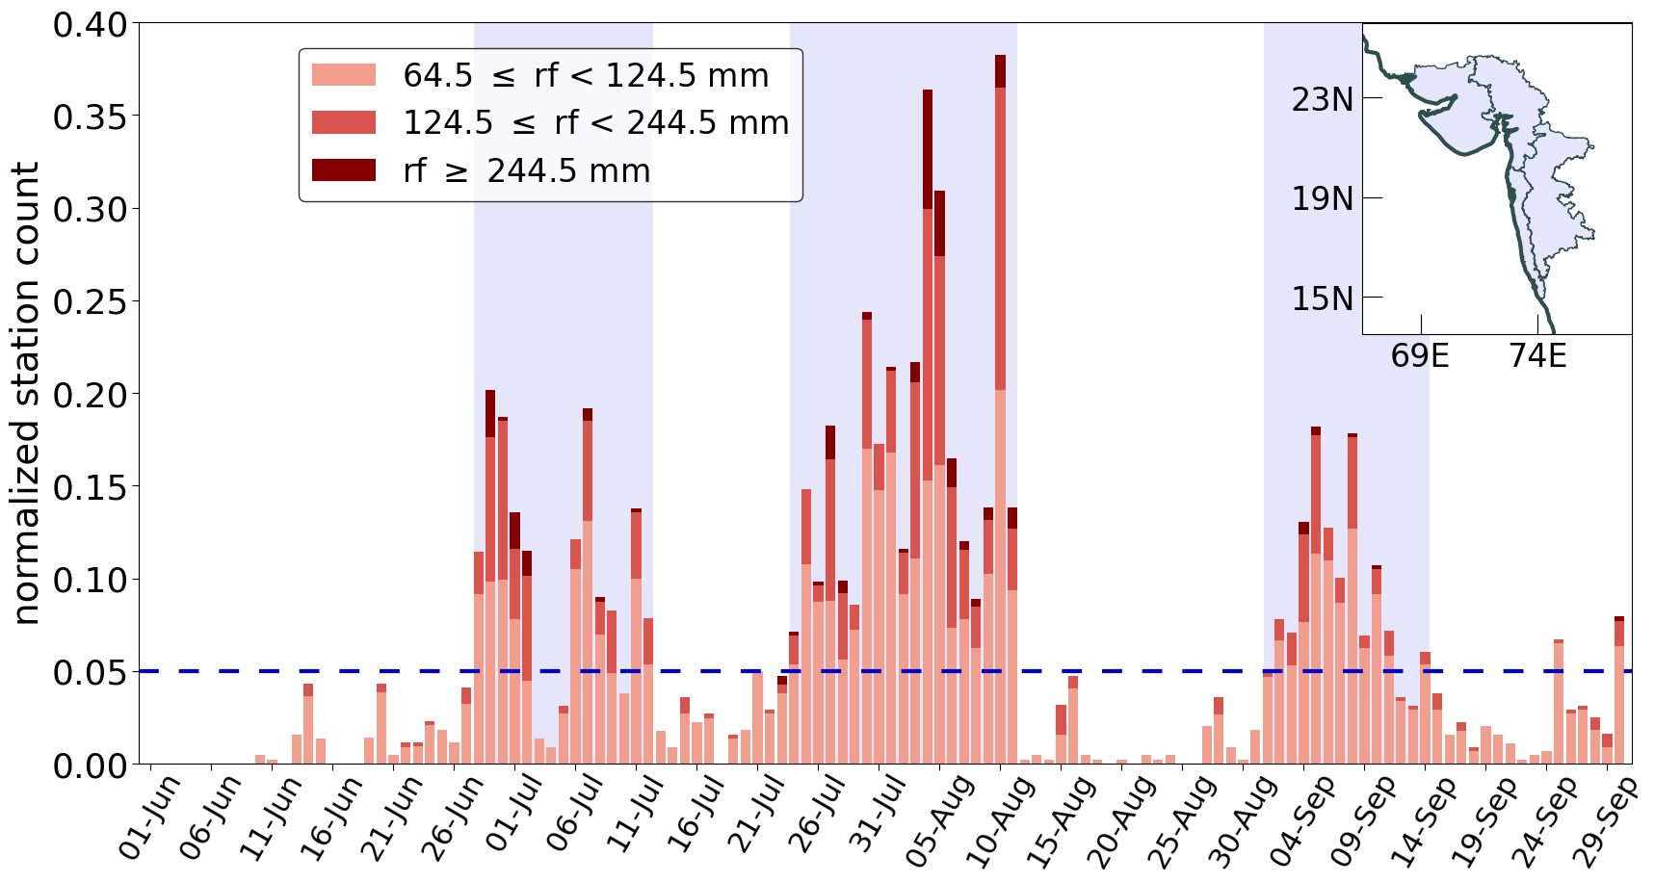
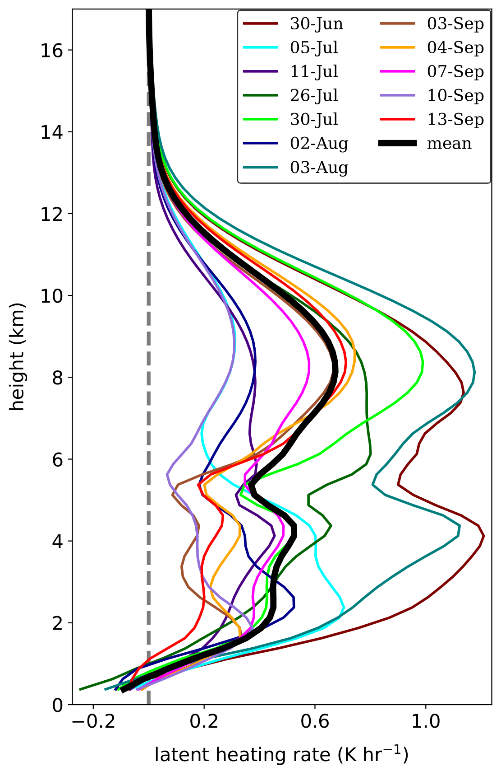
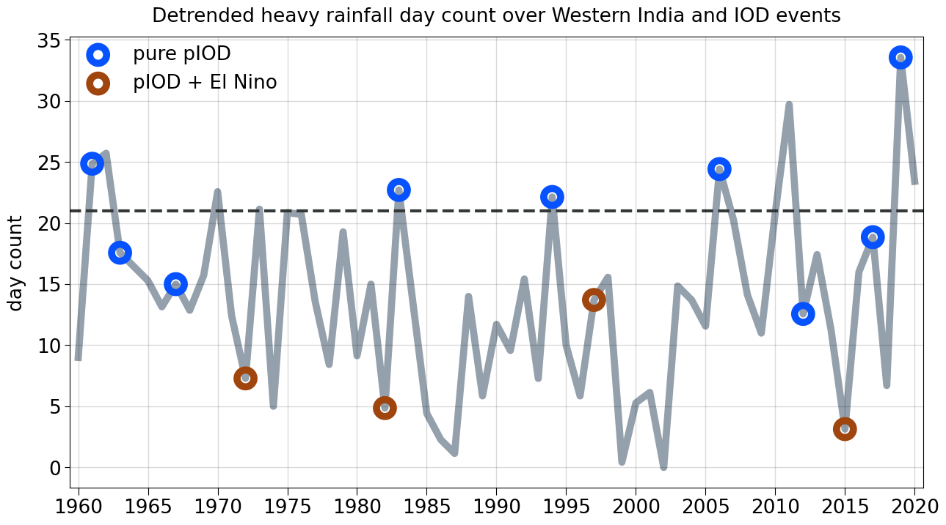
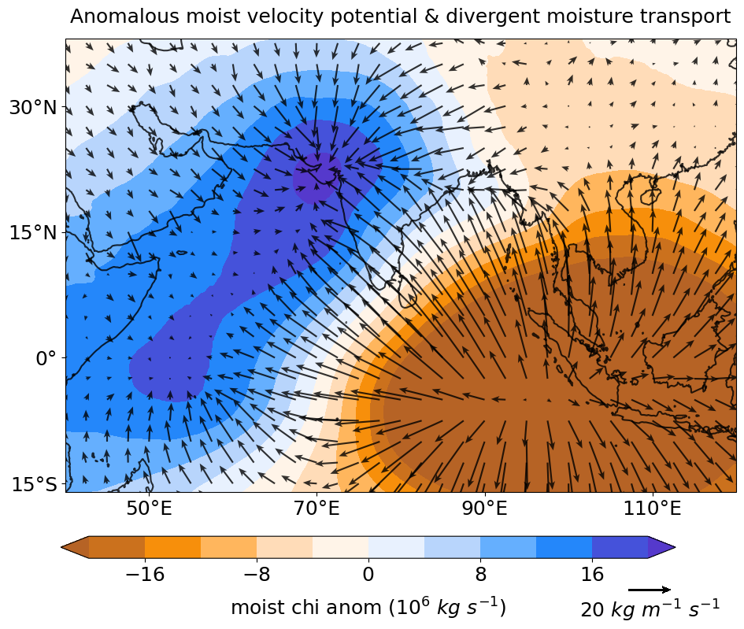
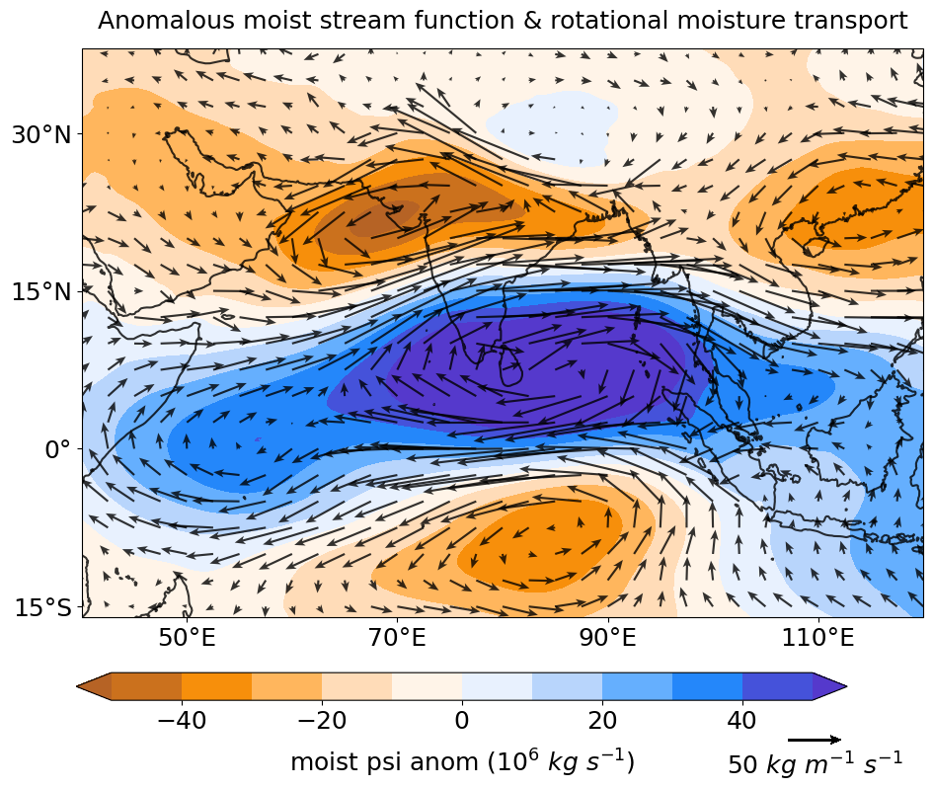
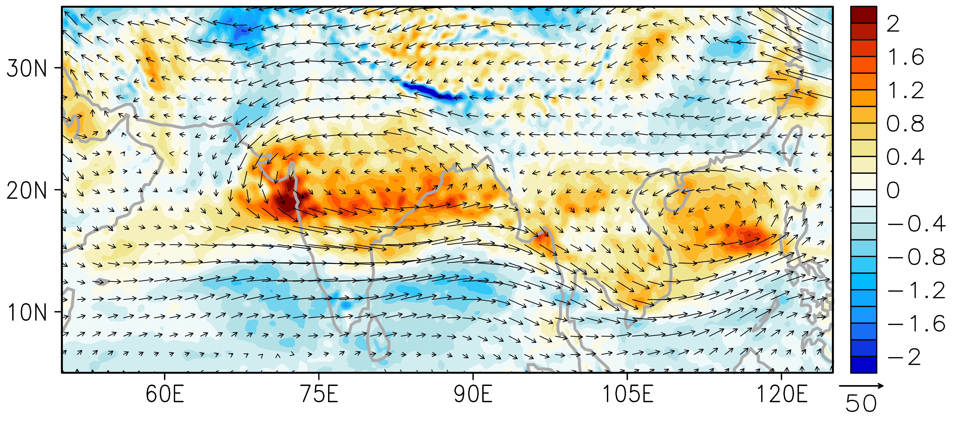
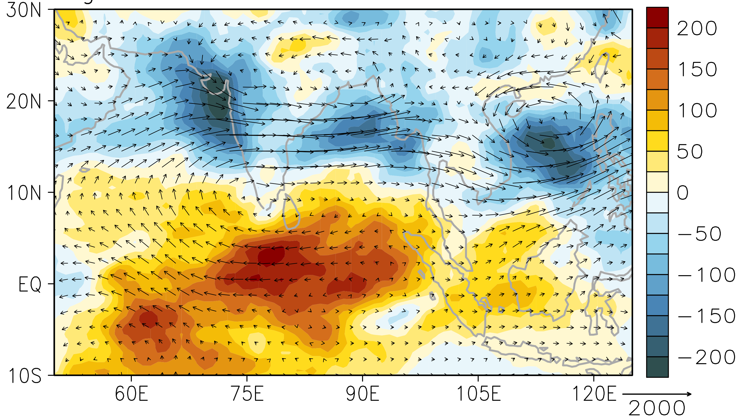
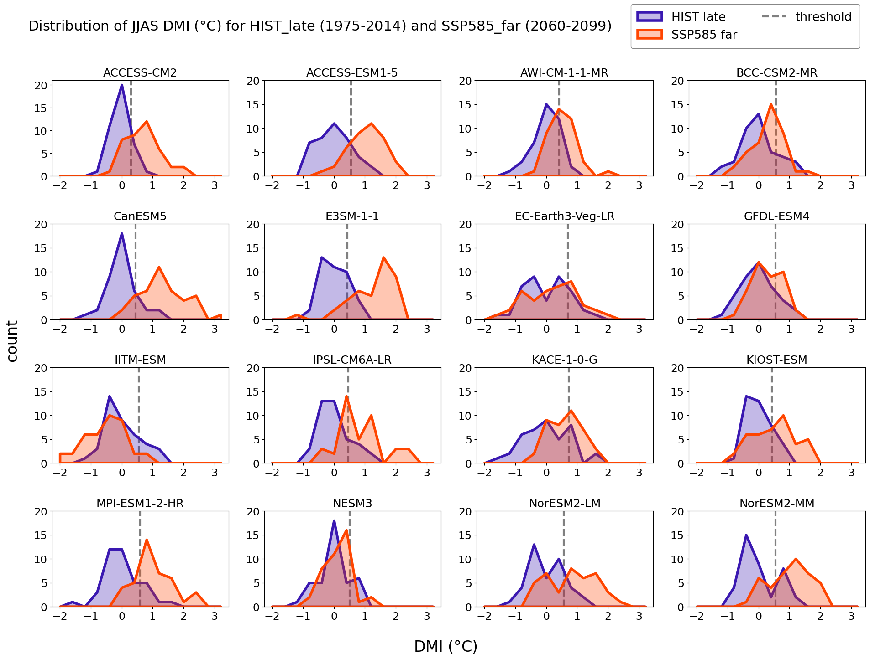
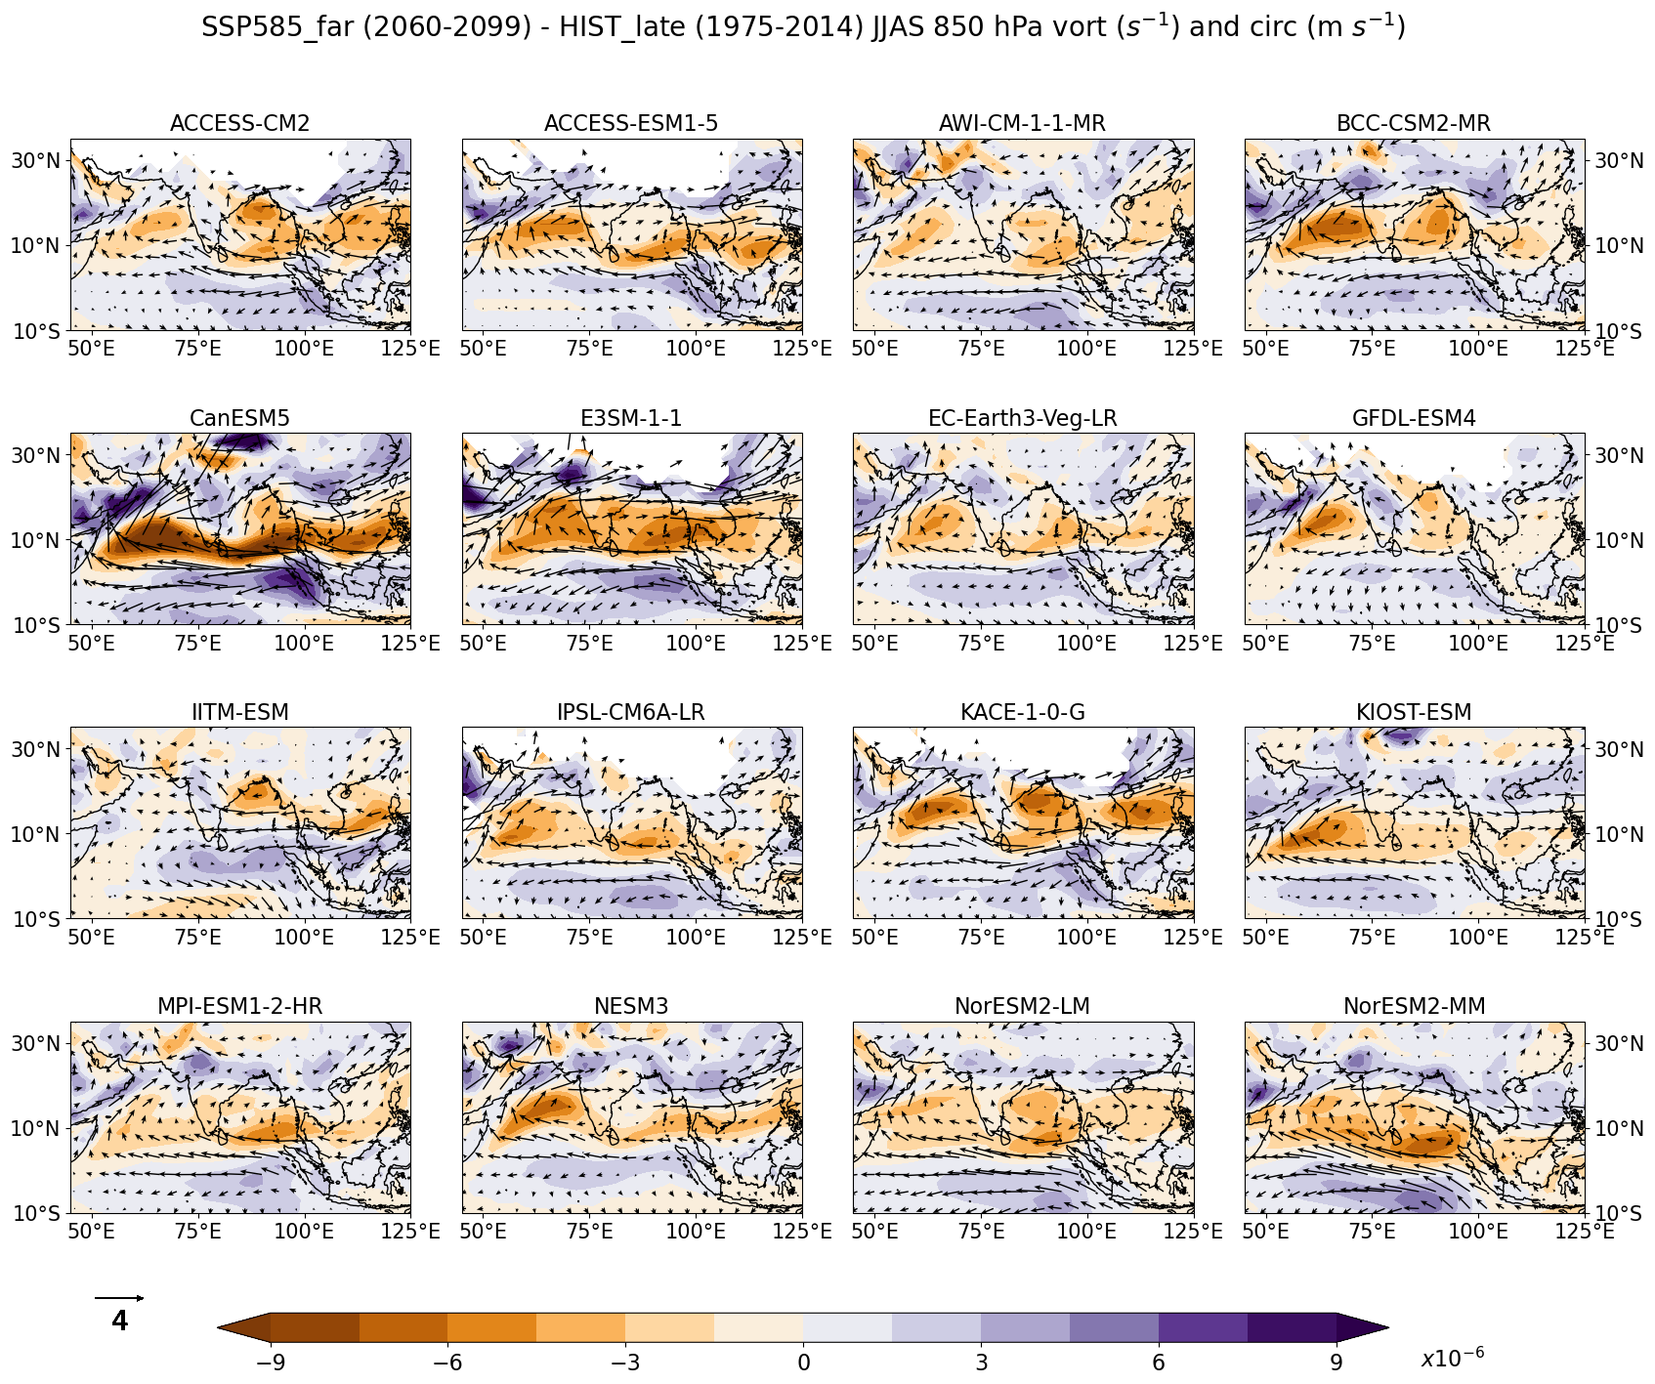
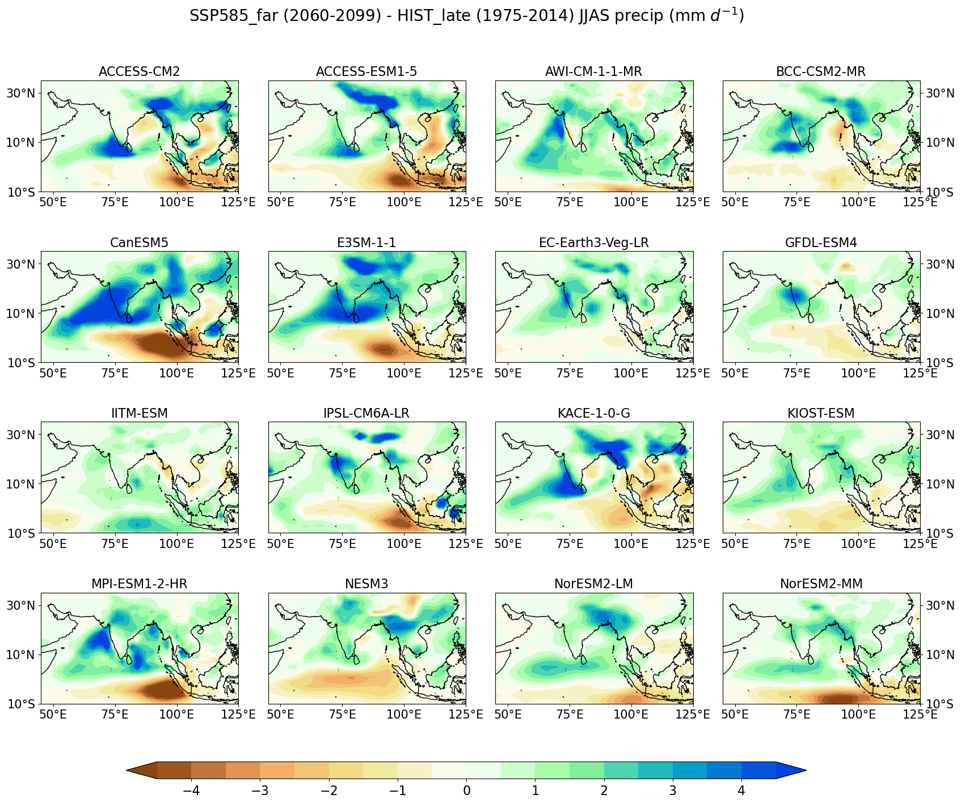
STIPMEX-2024
Rainfall amplification over Western India in a warming climate
: An Indian Ocean Dipole perspective
Sumit K. M.^{1,2}, Ayantika D. C.^{1,2},
R. Krishnan¹, R. Vellore¹
¹Indian Institute of Tropical Meteorology, Pune, India
²Savitribai Phule Pune University, Pune, India
Introduction
The heaviest rainfall and the strongest pIOD ‒ 2019
Increase in the frequency of extreme rain events in India (Goswami et al. 2006; Rajeevan et al. 2008; Roxy et al. 2017)
Western India (W-Ind) shows significantly high trend in heavy rainfall and deep convection since 1990s
(Ayantika et al. 2024)
Daily IMD station counts for heavy rainfall during JJAS 2019 over W-Ind
Trend of OLR ≤ 200 W m⁻² day count
W-Ind heavy rainfall and positive IOD (pIOD)
3 episodes of widespread heavy rainfall in W-Ind
Stratiform top-heavy latent heating from organized convective systems
Rossby wave pattern of enhanced cyclonic circulation is generated over India with PV-maximum over W-Ind in the mid-levels
Intense pIOD conditions over the tropical Indian Ocean fostered enhanced cross-equatorial moisture transport and deepened organized convection over W-Ind
Heavy rainfall day count over W-Ind (detrended)
Heavy rainfall day: rainfall ≥ 95th %ile at ≥ 10% of the grids; Heavy rainfall season: day count ≥1 SD above mean
W-Ind rainfall 25% higher in 5 heavy rainfall seasons with pIOD than the 5 without pIOD
(qU)_{divergent} and χ_{moist}
(qU)_{rotational} and Ψ_{moist}
Latent heating from GPM satellite swaths over W-Ind
Composite anomalies of 5 pIOD + Heavy rainfall seasons
Regression on heavy rainfall station count
Intense moisture divergence over Eastern Equatorial Indian Ocean
Enhanced moisture convergence over W-Ind
Strengthened cross-equatorial moisture transport
Seasonal scale cyclonic anomaly over W-Ind
330 K potential vorticity and winds
OLR and rotational moisture flux anomalies
CMIP6 projections
In the future projections,
Tropical Indian Ocean SST shifts towards a pIOD-like pattern
Enhanced low-level equatorial easterlies feeds greater moisture to the monsoon southwesterlies
Increase in vorticity favors convergence
Intensification of South Asian monsoon rainfall, specifically, over western India
Out of 40 models, best ones are chosen based on their reproducibility of observed monsoon rainfall pattern and magnitude (Taylor diagram) and observed dipole mode index (DMI)’s magnitude and seasonal cycle.
Hist: 1975-2014 (Historical)
SSP5-8.5: 2060-2099 (Future)
JJAS DMI distribution: Hist & SSP5-8.5
JJAS 850 hPa vorticity and winds: SSP5-8.5 - Hist
JJAS rainfall: SSP5-8.5 - Hist
Conclusion
Interested in our paper?
Scan here.
pIOD induced large-scale circulation reinforces organized convection over W-Ind and produces heavy monsoon rainfall
CMIP6 models suggest an increased occurrence of pIOD events in the future which will potentially lead to amplification of monsoon rainfall over W-Ind
sumit.kumar@tropmet.res.in

