Slide 1


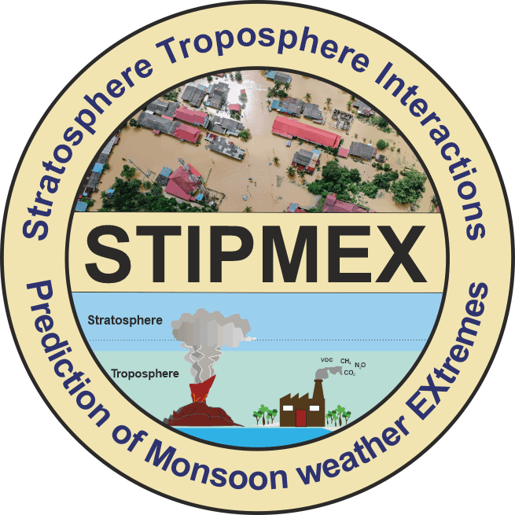


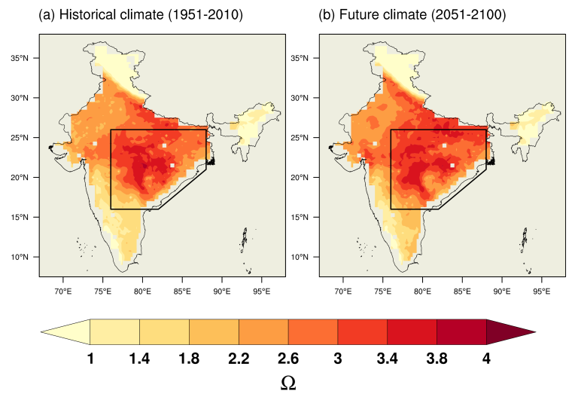
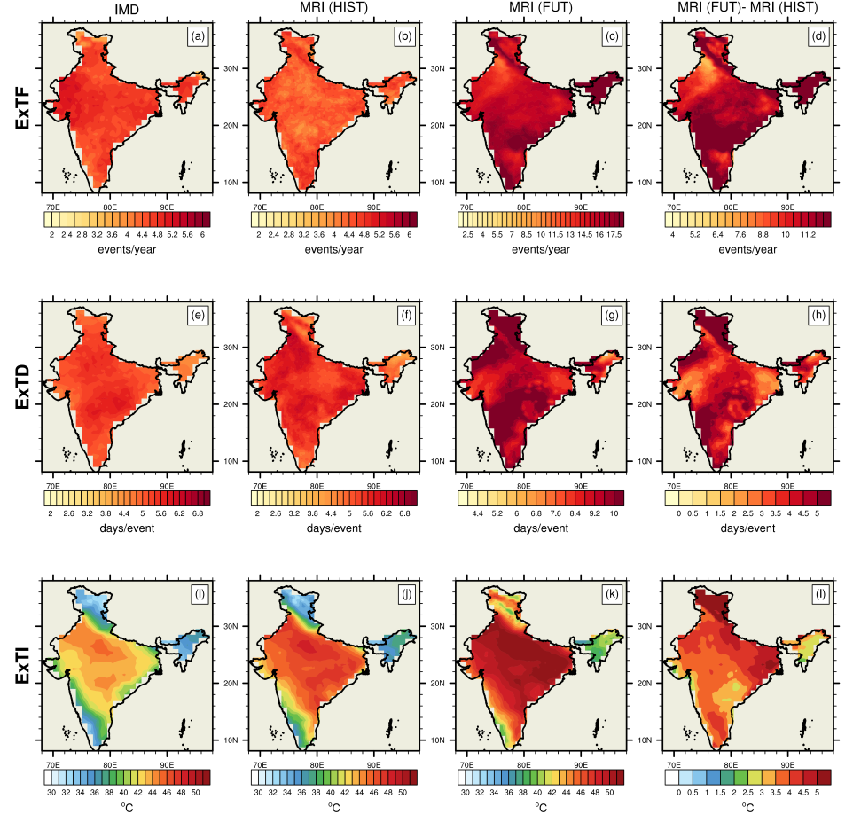



Soil moisture revamps the temperature extremes in a warming climate over India
Naresh Ganeshi¹, Milind Mujumdar², Yuhei Takaya¹, Mangesh Goswami², Bhupendra Bahadur Singh², R Krishnan² and Toru Terao³
¹Meteorological Research Institute, Climate Research Department, Ibaraki, Japan.
²Centre for Climate Change Research, Indian Institute of Tropical Meteorology, Pune, India.
³Faculty of Education, Kagawa University, Kagawa, Japan.
naresh.ganeshi057@gmail.com
DOI: https://doi.org/10.1038/s41612-023-00334-1
1. Introduction
4. Results
4.5 Factors contributing the land-atmosphere interaction
The Indian subcontinent is highlighted as one of the hotspots for exacerbated extreme temperature (ExT) conditions during the last few decades (Perkins-Kirkpatrick and Lewis, 2020; Satyanarayana and Rao, 2020). Recent studies have projected that a spate of severe extremes is likely to become more common over the Indian region at the end of the 21st century (Das and Umamahesh, 2021; Krishnan et al., 2020; Mizuta et al., 2017; Murari et al., 2015; Rohini et al., 2019). These extreme heat conditions may extend into the summer monsoon and post-monsoon seasons due to land-atmosphere interactions (Dimri, 2019; Ganeshi et al., 2020).
Most of the earlier studies have focused on the role of large-scale atmospheric dynamics on ExT occurrences over the Indian region (Ratnam et al., 2016; Rohini et al., 2016; U S De and Mukhopadhyay, 1998). Some studies demonstrated that the land-atmosphere coupling is one of the dominant aspect for explaining the processes underlying extreme heat magnitude, duration and severity (Fischer et al., 2007; Ganeshi et al., 2020; Gevaert et al., 2018). Also model simulation experiments have mostly explored the soil moisture-precipitation feedback mechanism over the Indian subcontinent (Asharaf et al., 2012; Raman et al., 1998; Shukla and Mintz, 1982). However, the impact of soil moisture (SM) variations on ExT is not clearly understood and warrants in-depth investigation.
4.1 Soil moisture-temperature coupling ($Ω$)
Spatial distribution of soil moisture-temperature coupling (Ω) over the Indian region is shown in the Figure 4.1a and 4.1b for HIST (1951-2010) and FUT (2051-2100) model experiments, respectively.
Mechanism: Schematic explains the impact of soil moisture-temperature coupling on temperature extremes using the DRY-SM and WET-SM sensitivity experiments
Figure 4.1a
Coupling strength$\left(Ω\right)$
$$=−𝓡_{c}∗σ_{SM}$$
Figure 4.5
Figure 4.1b
Whereas, $ℛ_{c}$ denotes the slope of linear regression of temperature anomaly on SM anomaly and $σ_{SM}$ indicates the standard deviation of soil moisture
Hotspot of strong soil moisture-temperature coupling is located across the monsoon dominated regions of north-central India (shown with polygon).
In case of dry sensitivity run, below normal SM conditions cause the sensible heating process to entrain more energy back into the environment by reducing the evapotranspiration (ET) and soil moisture memory (SMM), leading to increase of temperature extremes. On the other hand, in wet conditions the amount of energy available at the surface is used to cool the near-surface atmosphere by increasing the LHF through the ET process. As a result, the near-surface air temperature is remains below normal and high temperature occurrences are gradually slowed.
4.2 Simulation of temperature extremes
Spatial maps of frequency of extreme temperatures (Tmax > 90th percentile value) from HIST and FUT simulations are shown in Figure 4.2a and Figure 4.2b, respectively.
Figure 4.2a
Figure 4.2b
For the historical period, it is noted that at least four extreme temperature events occur per year over the Indian landmass.
2. Objectives
5. Summary and conclusion
Understanding the extreme temperature changes over the Indian region in historical and future climate
To study the impact of soil moisture-temperature coupling on temperature extremes over the Indian region using the soil moisture sensitivity experiments
Soil moisture-temperature coupling is found to be stronger over the north-central Indian region both in historical and future climate. On an average, drier SM conditions can increase the extreme temperature frequency by at least 3 events per year, the duration by 1.6 days per event and intensity by 0.8°C. WET-SM conditions shows average decrease of frequency, duration and intensity by 2 events/year, 2.5 days per event and ~ 1°C, respectively. The enhanced (reduced) extreme temperature conditions in DRY-SM (WET-SM) simulation are caused by the intensification (reduction) of sensible heat flux by limiting (intensifying) available total energy for evaporative cooling due to faster (slower) dissipation of positive soil moisture anomalies (also called as soil moisture memory).
It is noted that high intensity extreme temperature events are more likely to occur every 25-30 days over India in the 4K warming scenario.
3. Model simulation experiments
4.3 Impact of soil moisture changes on temperature extremes
We investigated the impact of soil moisture and temperature (SM-T) coupling on extreme temperature (ExT) using the MRI-AGCM (3.2) high-resolution (~60 km) climate model. We have analyzed a suite of model experiments (HIST, FUT, DRY-SM (HIST), WET-SM (HIST), DRY-SM (FUT) and WET-SM (FUT)) for the historical period (HIST: 1951-2010) and future (FUT: 2051-2100). The DRY-SM and WET-SM simulations are sensitivity experiments in which the SM initial conditions are perturbed on 1st day of each month. In DRY-SM, the SM is decreased by 20% of the HIST and FUT simulations, respectively. Conversely, in the WET-SM experiments the SM is increased by 20% of the HIST and FUT simulations, respectively.
Changes in the extreme temperatures for the DRY-SM and WET-SM simulations relative to the HIST experiment are shown in Figures. 4.3a and 4.3b. Likewise, the changes in extreme temperatures for the DRY-SM and WET-SM experiments relative to the FUT experiment are shown in Figures. 4.3c and 4.3d, respectively.
Figure 4.3a
Figure 4.3b
Figure 4.3c
Figure 4.3d
Acknowledgements:
The authors are grateful to the Director, Indian Institute of Tropical Meteorology (IITM, India), for the support to carry out this research work. The IITM HPC support is duly acknowledged. The IITM is fully funded by the Ministry of Earth Sciences, Government of India. The authors would like to thank Dr. Ryo Mizuta and Dr. Yukiko Imada at the Meteorological Research Institute for their support on model experiments.
HIST FUT
Experiment | Forcing used | Period
HIST | Natural (e.g. volcanoes and solar variability) and anthropogenic forcing (e.g. greenhouse gases (GHG), aerosols etc.). | 1951-2010 (60 years)
FUT | Future climate in which global mean temperature becomes 4K warmer than pre-industrial climate. | 2051-2100 (50 years)
DRY-SM (HIST-20) | The sensitivity experiment initialized by decreasing the soil moisture on 1st day of each month by 20% in HIST. | 1951-2010 (60 years)
DRY-SM (FUT-20) | The sensitivity experiment initialized by decreasing the soil moisture on 1st day of each month by 20% in FUT. | 2051-2100 (50 years)
WET-SM (HIST+20) | The sensitivity experiment initialized by increasing the soil moisture on 1st of each month by 20% in HIST and FUT. | 1951-2010 (60 years)
WET-SM (FUT+20) | The sensitivity experiment initialized by increasing the soil moisture on 1st of each month by 20% in FUT. | 2051-2100 (50 years)
It can be seen that drier SM conditions significantly enhance the extreme temperature characteristics over the Indian region. Whereas, wet SM conditions significantly reduce the extreme temperature characteristics.
References
Asharaf, S., Dobler, A., Ahrens, B., 2012. Soil Moisture–Precipitation Feedback Processes in the Indian Summer Monsoon Season. J. Hydrometeorol. 13, 1461–1474. https://doi.org/10.1175/JHM-D-12-06.1
Das, J., Umamahesh, N.V., 2021. Heat wave magnitude over India under changing climate: Projections from CMIP5 and CMIP6 experiments. Int. J. Climatol. 1–21. https://doi.org/10.1002/joc.7246
Dimri, A.P., 2019. Comparison of regional and seasonal changes and trends in daily surface temperature extremes over India and its subregions. Theor. Appl. Climatol. 136, 265–286. https://doi.org/10.1007/s00704-018-2486-5
Ganeshi, N.G., Mujumdar, M., Krishnan, R., Goswami, M., 2020. Understanding the linkage between soil moisture variability and temperature extremes over the Indian region. J. Hydrol. 589.
Krishnan, R., Sanjay, J., Gnanaseelan, C., Mujumdar, M., Supriyo, C., Kulkarni, A., 2020. Assessment of Climate Change over the Indian Region, Assessment of Climate Change over the Indian Region: A Report of the Ministry of Earth Sciences (MoES), Government of India. https://doi.org/10.1007/978-981-15-4327-2_5
Mizuta, R., Murata, A., Ishii, M., Shiogama, H., Hibino, K., Mori, N., Arakawa, O., Imada, Y., Yoshida, K., Aoyagi, T., Kawase, H., Mori, M., Okada, Y., Shimura, T., Nagatomo, T., Ikeda, M., Endo, H., Nosaka, M., Arai, M., Takahashi, C., Tanaka, K., Takemi, T., Tachikawa, Y., Temur, K., Kamae, Y., Watanabe, M., Sasaki, H., Kitoh, A., Takayabu, I., Nakakita, E., Kimoto, M., 2017. Over 5,000 years of ensemble future climate simulations by 60-km global and 20-km regional atmospheric models. Bull. Am. Meteorol. Soc. 98, 1383–1398. https://doi.org/10.1175/BAMS-D-16-0099.1
Murari, K.K., Ghosh, S., Patwardhan, A., Daly, E., Salvi, K., 2015. Intensification of future severe heat waves in India and their effect on heat stress and mortality. Reg. Environ. Chang. 15, 569–579. https://doi.org/10.1007/s10113-014-0660-6
Perkins-Kirkpatrick, S.E., Lewis, S.C., 2020. Increasing trends in regional heatwaves. Nat. Commun. 11, 1–8. https://doi.org/10.1038/s41467-020-16970-7
Raman, S., Mohanty, U.C., Reddy, N.C., Alapaty, K., Madala, R. V., 1998. Numerical simulation of the sensitivity of summer monsoon circulation and rainfall over India to land surface processes. Pure Appl. Geophys. 152, 781–809. https://doi.org/10.1007/s000240050178
Ratnam, J. V., Behera, S.K., Ratna, S.B., Rajeevan, M., Yamagata, T., 2016. Anatomy of Indian heatwaves. Sci. Rep. 6, 1–11. https://doi.org/10.1038/srep24395
Rohini, P., Rajeevan, M., Mukhopadhay, P., 2019. Future projections of heat waves over India from CMIP5 models. Clim. Dyn. 53, 975–988. https://doi.org/10.1007/s00382-019-04700-9
Rohini, Rajeevan, Srivastava, 2016. On the Variability and Increasing Trends of Heat Waves over India. Sci. Rep. 6, 1–9. https://doi.org/10.1038/srep26153
Satyanarayana, G.C., Rao, D.V.B., 2020. Phenology of heat waves over India. Atmos. Res. 245, 105078. https://doi.org/10.1016/j.atmosres.2020.105078
Shukla, J., Mintz, Y., 1982. Influence of Land-Surface Evapotranspiration on the Earth’s Climate. Science (80-. ). 215, 1498–1501.
U S, D., Mukhopadhyay, R.K., 1998. Severe heat wave over the Indian Subcontinent in 1998,in perspective of global climate. Curr. Sci. 75, 1308–1311.
4.4 Impact of soil moisture changes on temperature extremes over north-central India (NCI)
Probability distribution of extreme temperature intensity (ExTI) over NCI for HIST and DRY-SM simulations (Figure 4.4a). The lower panel is for corresponding FUT simulations (Figure 4.4b).
Figure 4.4a
Figure 4.4b
A 20% decrease of SM in HIST-20 over NCI shifts the 90th percentile probability limit of ExTI by 0.5°C. It is further noted that a 20% decrease of SM in FUT-20 shifts the 90th percentile probability limit of ExTI by 0.74°C.

