Slide 1
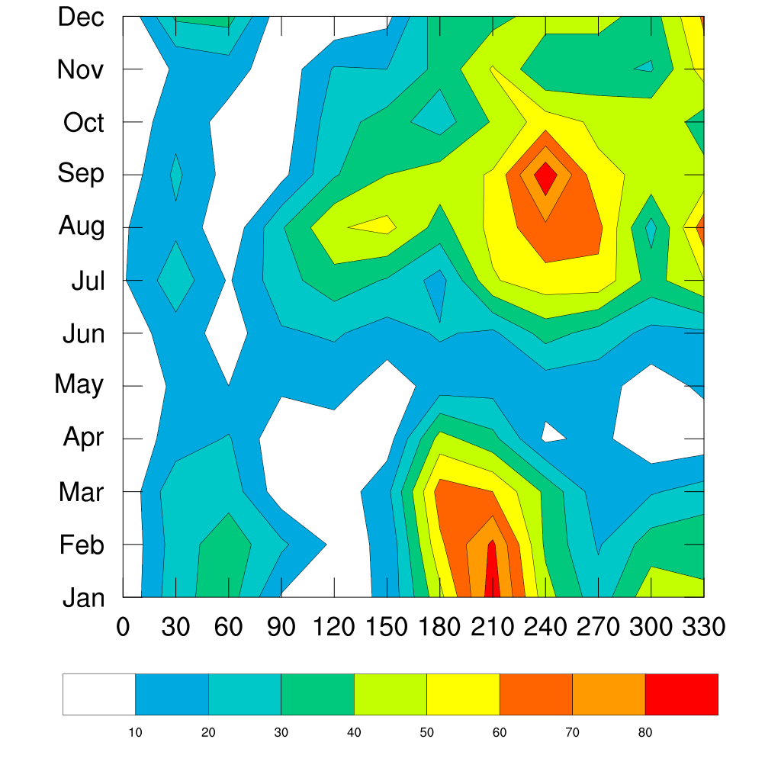
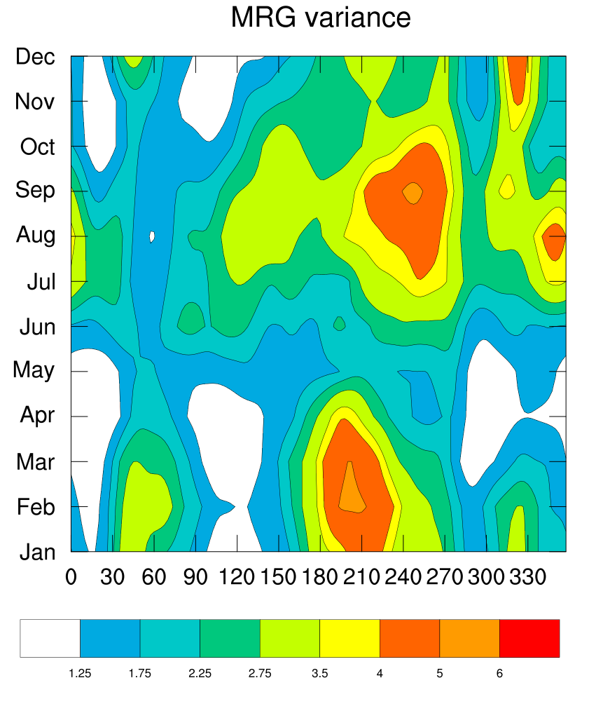
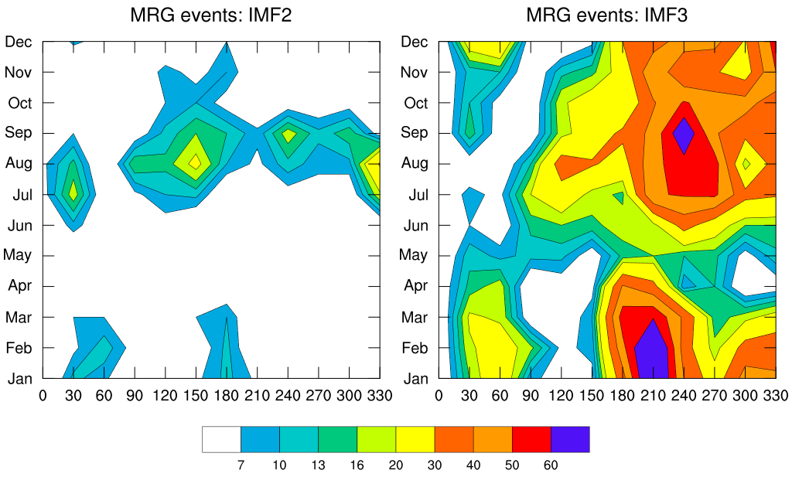
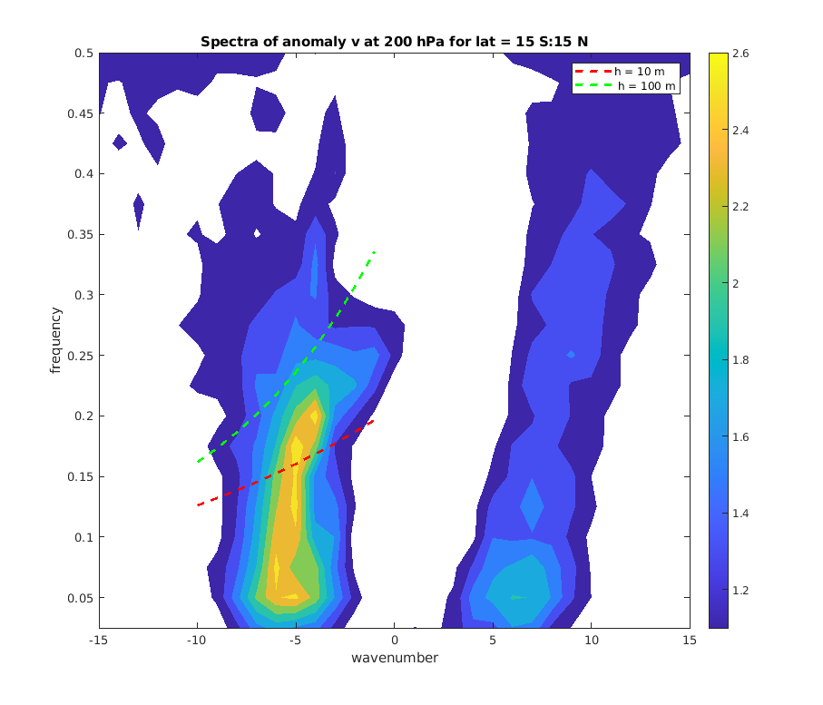
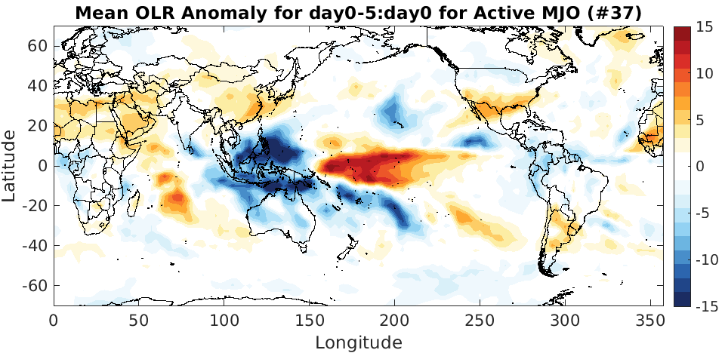
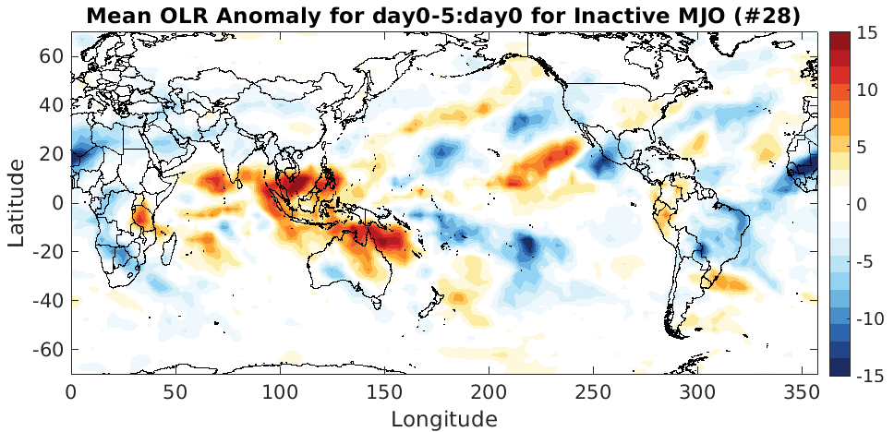
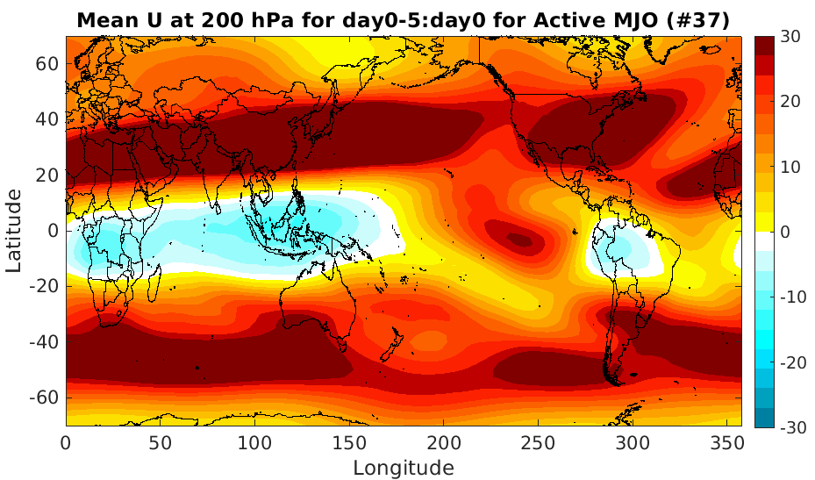
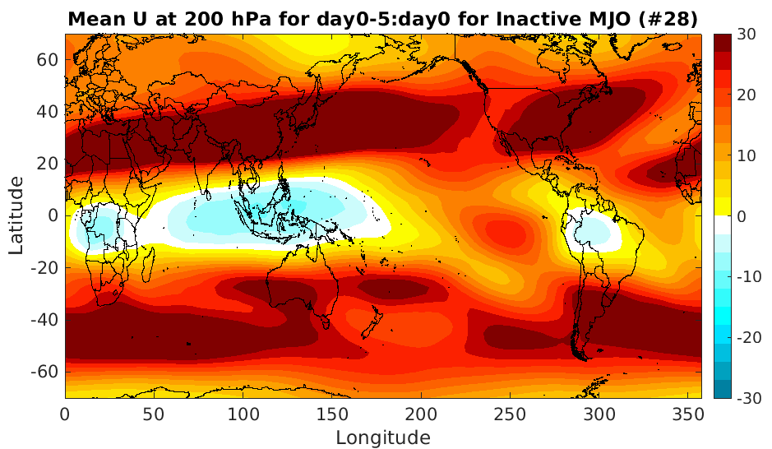
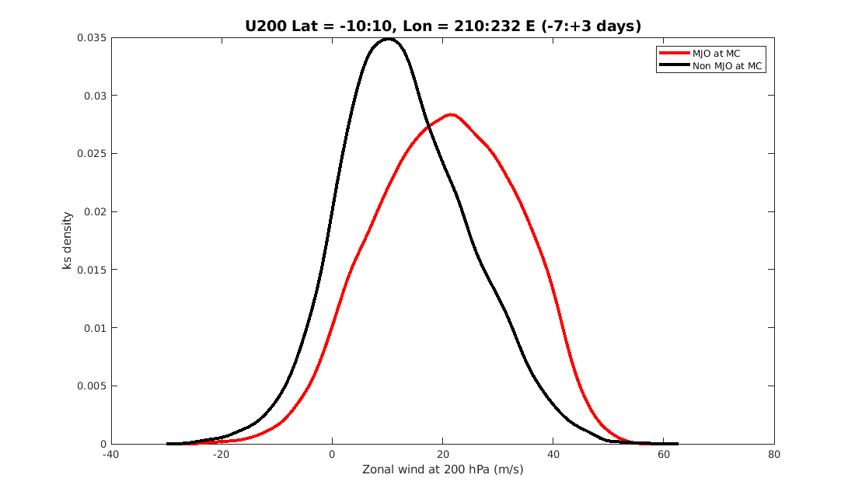
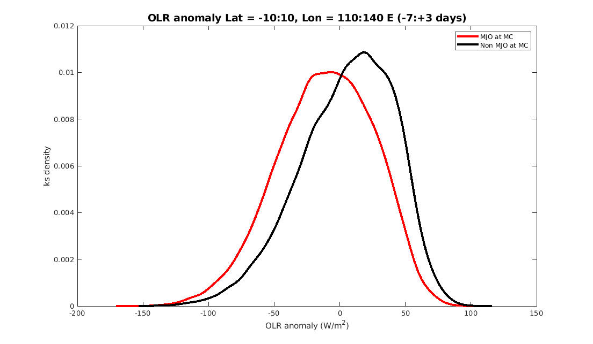
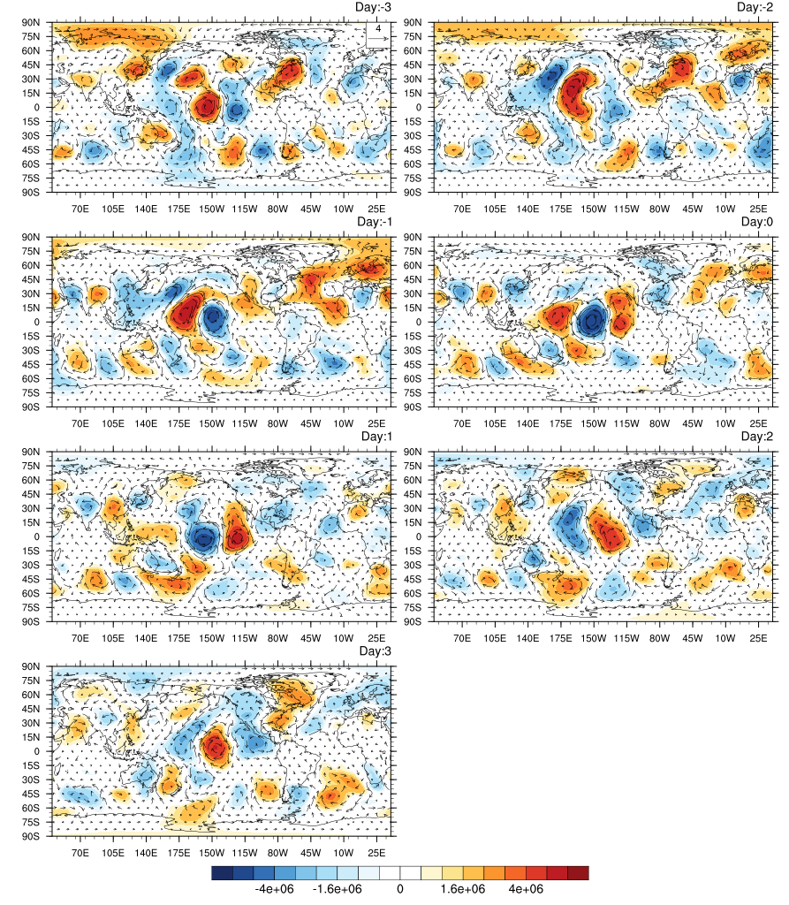
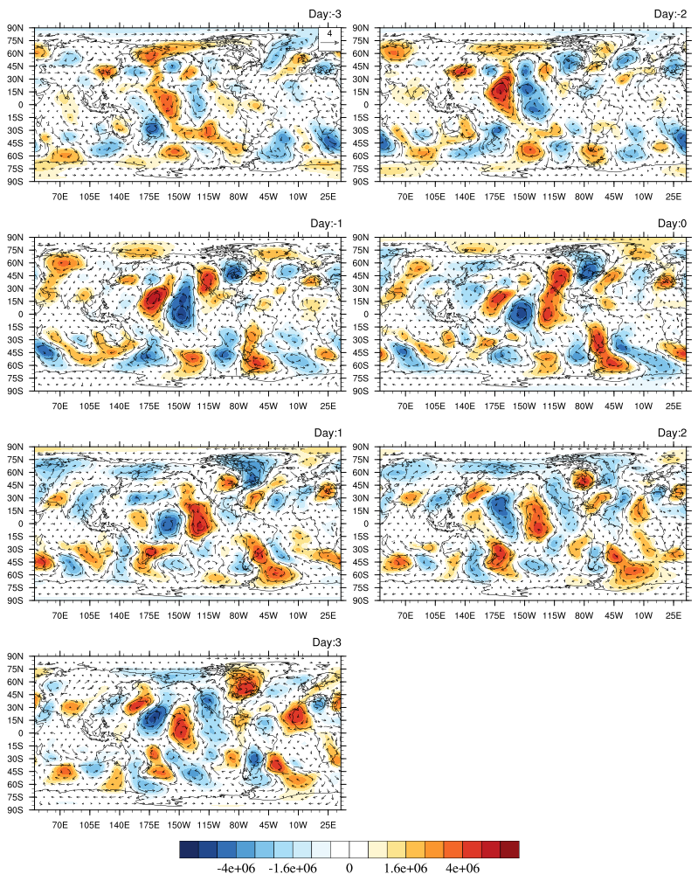
Remote Influence of Madden Julian Oscillations on the Genesis of Mixed Rossby-Gravity Wave Events
Mehak, R. Vishal, E. Suhas
Earth and Climate Science
Indian Institute of Science Education and Research, Pune
E-Mail: mehak.s@students.iiserpune.ac.in
Earth and Climate Science
Introduction
Results and Discussions
Conclusions & future scope
Mixed Rossby-Gravity (MRG) waves are westward propagating equatorially trapped disturbances (Yanai and Maruyama 1966, Wheeler Kiladis 1999).
They exhibit spatio-temporal scales in the range 2000-10000 Km and 3-10 days.
MRG waves modulate day-to-day weather and various modes of tropical variability.
Madden Julian Oscillations (MJO) is a slow eastward propagating convection-circulation coupled structure exhibiting periodicity ranging from 30-90 days.
MRG events (Frequency of occurrence)
The seasonality of MRG events identified using EMD closely matches with that of the MRG filtered v200.
Total 65 IMF3 MRG wave events have been identified which initiated over the westerly duct region, 230º-262.5º E during boreal winter (NDJF) for 1979-2022 at 200 hPa that were associated with northern hemispheric PV intrusions.
37 events out of 65 (57%) exhibit association with strong convection over the MC.
Strong convection over the MC associated with the MJO tends to strengthen the magnitude and the extent of the upper tropospheric zonal wind background over the central eastern Pacific ocean.
Strengthening of the westerly duct can give rise to more number of extratropical disturbances intruding into the tropics and thereby exciting higher number of MRG wave events.
We are interested in exploring the physical mechanism associated with the excitation of MRG waves with and without the active convection over the MC.
Figure 2. Monthly-longitudinal distribution of number of occurrence of MRG wave events (IMF2+IMF3) at 200 hPa and the variance associated with MRG filtered meridional wind (v) at 200 hPa for 1979-2022
IMF3 MRG wave events contribute majorly to the total MRG filtered variance.
Figure 3. Monthly-longitudinal distribution of number of occurrence of MRG wave events, IMF2 and IMF3 separately at 200 hPa for 1979-2022.
Figure 1. The symmetric wavenumber-frequency power spectra of meridional wind anomaly at 200 hPa for 1979-2022 period, normalized by the smooth red background. The red and green dashed lines represent the dispersion curves of shallow-water MRG waves of equivalent depth 10 and 100 m.
Objectives
References
Figure 4. Monthly-longitudinal distribution of number of occurrence of MRG wave events (IMF3) at 200 hPa associated with northern and southern hemispheric (NH and SH) PV intrusions (together), SH or NH intrusions and the events that exhibit no association with PV intrusions for 1979-2022.
Cheng, Y.M., Tulich, S., Kiladis, G.N. and Dias, J., 2022. Two extratropical pathways to forcing tropical convective disturbances. Journal of Climate, 35(20), pp.6587-6609.
Matsuno, T., 1966. Quasi-geostrophic motions in the equatorial area. Journal of the Meteorological Society of Japan. Ser. II, 44(1), pp.25-43.
Sun, J. and Wu, Z., 2020. Isolating spatiotemporally local mixed Rossby-gravity waves using multi-dimensional ensemble empirical mode decomposition. Climate Dynamics, 54(3-4), pp.1383-1405.
Tulich, S.N. and Kiladis, G.N., 2021. On the regionality of moist Kelvin waves and the MJO: The critical role of the background zonal flow. Journal of Advances in Modeling Earth Systems, 13(9), p.e2021MS002528.
Wheeler, M, & Kiladis, GN 1999, ‘Convectively coupled equatorial waves: Analysis of clouds and temperature in the wavenumber–frequency domain’, Journal of Atmospheric Science, vol. 56, no. 3, pp. 374–399
Waugh, DW, & Polvani, LM 2000, ‘Climatology of intrusions into the tropical upper troposphere’, Geophysical Research Letters, vol. 27, no. 23, pp. 3857–3860
Yanai, M. and Maruyama, T., 1966. Stratospheric wave disturbances propagating over the equatorial Pacific. Journal of the Meteorological Society of Japan. Ser. II, 44(5), pp.291-294.
This study explores the dynamical influence of the active phase of MJO over the Maritime Continent (MC) on the characteristics of the MRG wave events over the central Eastern Pacific ocean.
How does the MJO at MC modulate the background over the central eastern Pacific ocean?
Data and Methodology
Figure 5. Mean OLR anomaly for the IMF3 MRG wave events associated with only NH PV intrusions occurring over the westerly duct (WD) 230º-262.5º E during NDJF with and without active MJO convection at MC.
Data:
European Centre for Medium Range Weather Forecasts (ECMWF) ERA5 wind at 200 hPa and Potential Vorticity at 350 K isentrope for 1979-2022.
Spatial and temporal resolution of wind data used is 2.5ºx2.5º and 6 hourly.
Figure 6. Mean zonal wind at 200 hPa for the IMF3 MRG wave events associated with only NH PV intrusions occurring over the westerly duct (WD) 230º-262.5º E during NDJF with and without active MJO convection at MC. Coloured contours correspond to the difference between the mean active and suppressed MJO at MC.
Identification of MRG wave events:
An ‘event-based’ identification technique proposed by Sun and Wu (2019) is implemented to identify the MRG wave events.
Empirical Mode Decomposition (EMD) has been employed to identify MRG wave events over the equatorial belt.
A non-linear and non-stationary time series consists of different intrinsic modes of oscillation called IMFs.
Assumptions:
Any component of the signal has a wavy form determined adaptively from the.
Amplitude and frequency of a component can vary with time.
Events have been segregated as IMF2 and IMF3 events. For the purpose of this study, the events have been further classified as intrusion and non-intrusion events.
Figure 7. KDE distribution for the zonal wind at 200 hPa and OLR for the IMF3 MRG wave events associated with only NH PV intrusions occurring over the westerly duct (WD) 230º-262.5º E during NDJF with and without active MJO convection at MC. Coloured contours correspond to the difference between the mean active and suppressed MJO at MC.
Active MJO convection at MC
Suppressed MJO convection at MC
Acknowledgement
230-262.5E, #37
Active MJO at MC
230-262.5E, #26
Suppressed MJO at MC
This work is supported by IISER Pune, Ministry of Education.
Figure 8. Composite of IMF3 MRG wave events associated with only NH PV intrusions occurring over the westerly duct (WD) 230º-262.5º E during NDJF with and without active MJO convection at MC. Coloured contours correspond to the 3-15 day filtered stream function at 200 hPa.
Notes:
1

