Slide 1
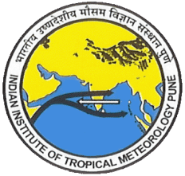
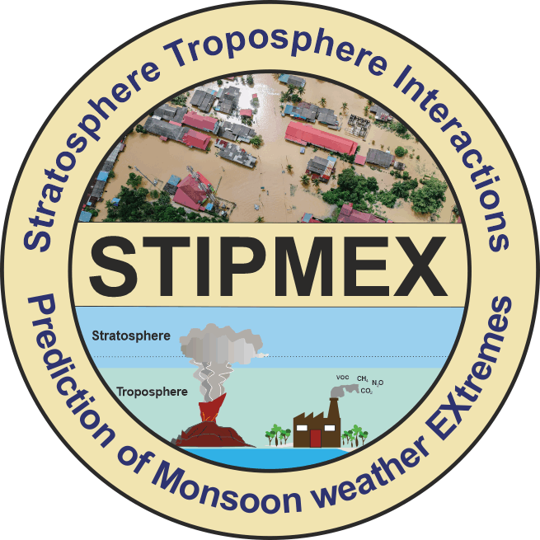
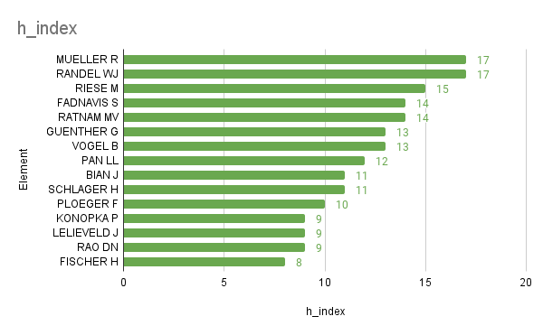
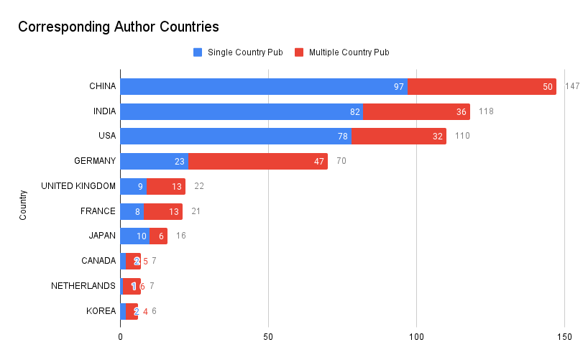
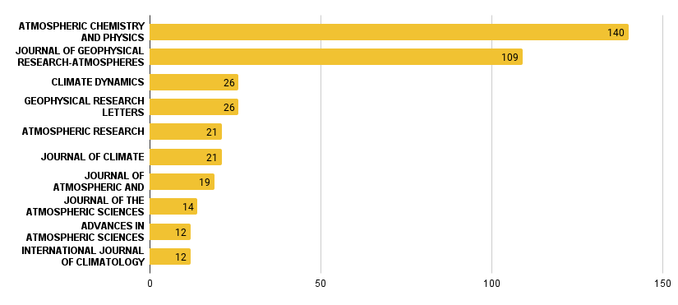
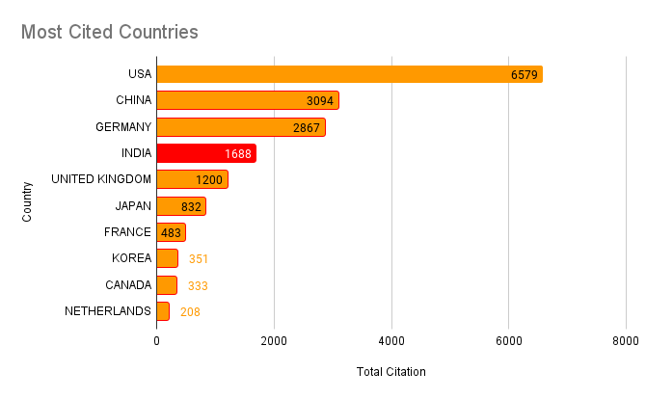
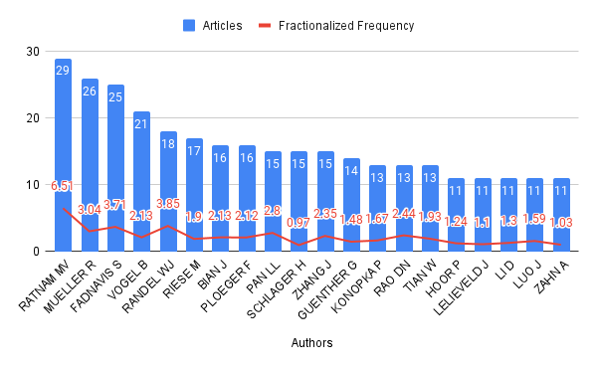
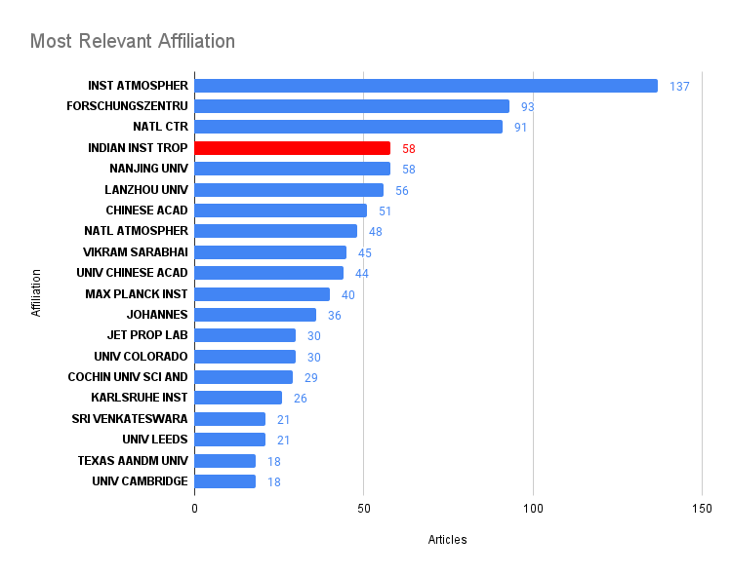
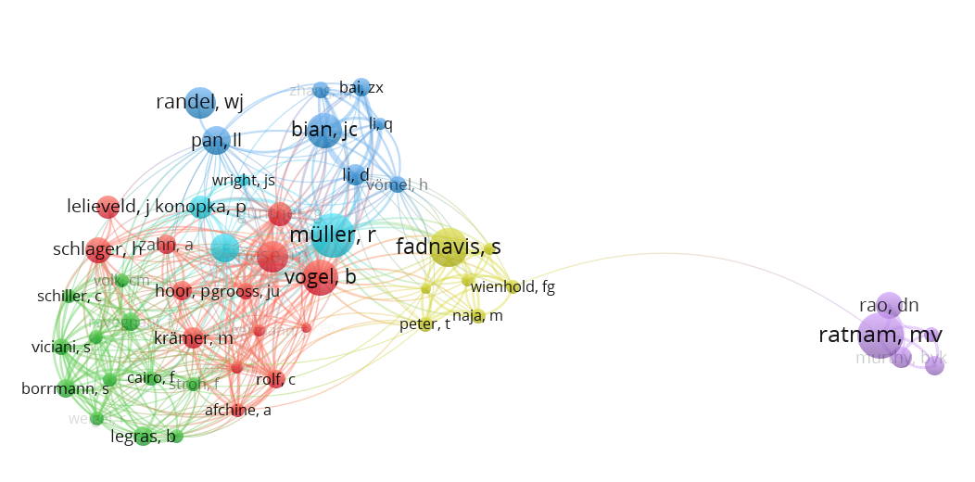
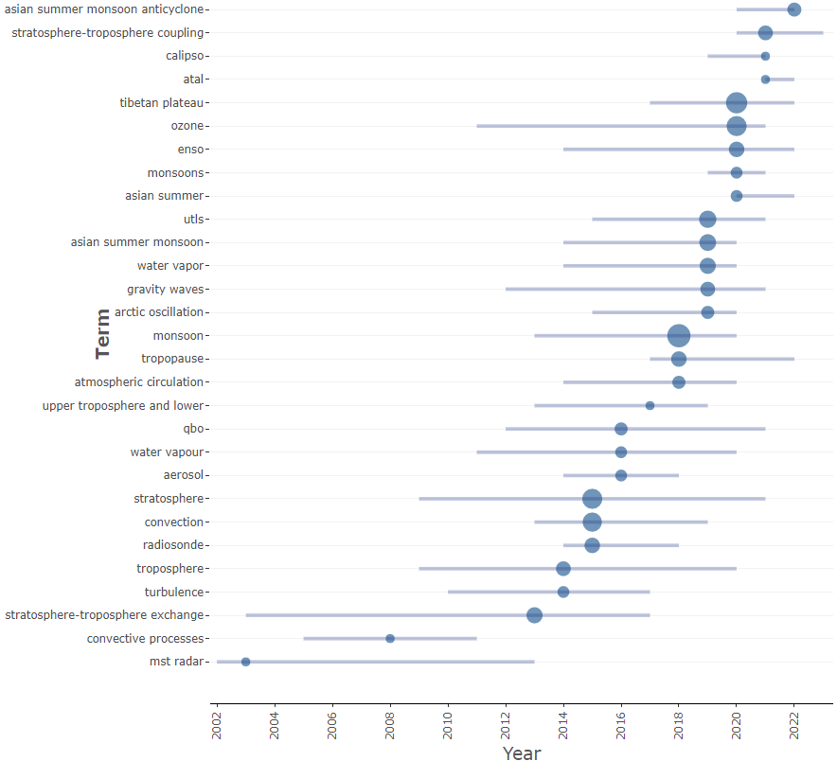
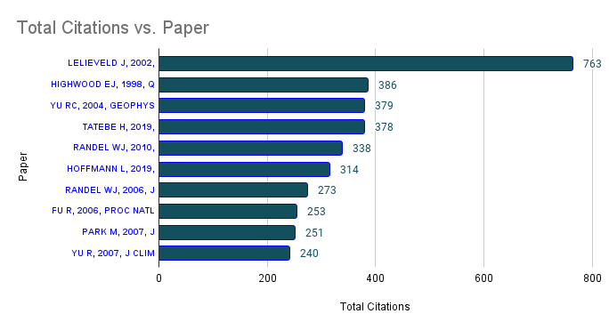
. Research Mapping and Trend Analysis on Troposphere Stratosphere Exchange during Monsoon Weather Extremes Arnab Chakraborty¹& Shompa Das¹ ¹Indian Institute of Tropical Meteorology, India
Contact
arnab.chakraborty@tropmet.res.in
Studying Stratosphere-Troposphere Interactions (STI) helps in having a perception of regional weather patterns. This Scientometric analysis delved into the scholarly landscape surrounding a research area of STI and Monsoon.
We have found 560 articles with growth rate of 11.71% annually and an international co-authorship rate of 43.04% showed a dynamic and collaborative research field with increasing global interest and scholarly influence. Though India has produced many publications, the citation count, i.e., 1688, is comparatively lower than in the USA and China, which signifies the need for more collaboration and publishing in high-impact journals.
Bibliometric analysis is a popular and rigorous method for exploring and analyzing large volumes of scientific data. Scholars use bibliometric analysis for various reasons, such as to uncover emerging trends in article and journal performance, collaboration patterns, and research constituents and to explore the intellectual structure of a specific domain in the extant literature.
Abstract:
Introduction:
Objective:
To analyze and visualize the state of scientific inquiry into Stratosphere-Troposphere Interaction (STI) during monsoon seasons, identifying key trends, contributors, patterns, and emerging topics.
Methodology:
Methodology:
Utilized Web of Science, focusing on articles published between 1992-2023 in English.
Incorporated a manual check and filters to eliminate data not meeting research objectives.
Used Biblioshiny, Vos-viewer, and MS-Excel for statistical analysis and data visualization.
Overview:
Fig 5: Top Authors Based on h-index (WoS)
Mueller R (FJ)and Randel WJ (NCAR)lead with an h-index of 17, Fadnavis S (IITM) and Ratnam MV (NARL) have an h-index of 14.
The group ranges in h-indices from 17 to 8, showcasing a spectrum of impactful contributors.
Fig 8: Global Distribution of Research Activity
(Source: Web of Science)
International collaborations enhance research quality and impact through diverse expertise and resources.
Data signifies global collaboration in research
Fig1: Overview (Web of Science)
The study shows an annual growth rate of 11.71%, international collaboration at 43.04%, co-authorship with an average of 6.63 authors per document, and a average citation of 32.81 citations per document, indicating a dynamic and collaborative research field with global interest and scholarly influence.
Relevant Authors:
Geographical distribution of Research:
Documents
560
Annual growth rate 11.71%
International collaboration 43.04%
Average citation 32.81
Co-authorship 6.63
Key Journals Contributing to the Field:
Fig 2: Relevant Journals (Source : WoS)
High-impact publications like "Atmospheric Chemistry and Physics" and "Journal of Geophysical Research-Atmospheres" reflect quality and recognition in the field emphasizing on atmospheric and climate sciences.
Fig 9: Top Cited Countries (Web of Science)
USA leads with 6,579 citations, showing highly influential research.
India has 1,688 citations, that is comparatively lower than China and USA indicating an area of improvement on the impact or quality of that research.
The data highlights the collaborative and international nature of impactful research.
Fractionalized frequency :
Highly Cited countries :
Fig 6: Leading Authors (Fractionalized) (WoS)
Fractionalized frequency indicates an individual contribution of each author by assuming equal share among all co-authors of the affiliated papers.
Fig 3:Leading Institutions (Web of Science)
Leading institutions: Institute of Atmospheric Physics with 137 articles, Forschungszentrum Juelich (93 articles), National Center for Atmospheric Research (91 articles), Indian Institute of Tropical Meteorology (58 articles) .
Presence of Multiple Indian institutes highlights the strong research performance of the country.
Most Relevant Institutions :
Fig 7: Co-authorship Analysis (Vos Viewer)
Ratnam MV, Mueller R, and Fadnavis S are key authors leading with numerous publications and significant contributions.
Authors Randel WJ and Riese M, show strong individual contributions, indicating active participation in collaborations with less publication.
Co-authorship Analysis :
Trending Topics:
Fig 10: Trending Topics (Web of Science)
Key terms indicate a focus on atmospheric layer interactions, highlights interest in chemical composition and trace gases , shows studies on microphysical and thermodynamic processes, emphasize the global and interconnected nature of the study area.
Top cited Papers :
Fig 4: Highest Cited Papers (WoS)
The most cited paper by Lelieveld J. (2002, SCIENCE), signifyies its influence on the scientific community in this domain.
Strong global research partnerships: 43.04% international co-authorship rate.
India's citation count is significantly lower than the USA and China, indicating a need for improvement and also highlights the impact of “Publish or Perish” phenomenon of academic research.
High climatic relevance: Multidisciplinary approach, high growth(11.71%) and citations, diverse topics.
Further study needed on the research gravity of STI and climate change.
Conclusion:
References:
Donthu, N., Kumar, S., Mukherjee, D., Pandey, N., & Lim, W. M. (2021). How to conduct a bibliometric analysis: An overview and guidelines. Journal of business research, 133, 285-296. https://doi.org/10.1016/j.jbusres.2021.04.070
A Study by Library, Information & Publication Division, Indian Institute of Tropical Meteorology, Pune, India

