Slide 1
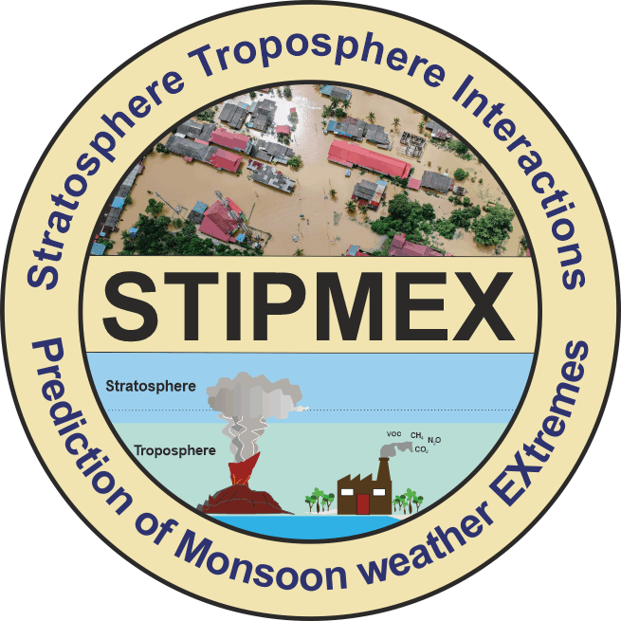

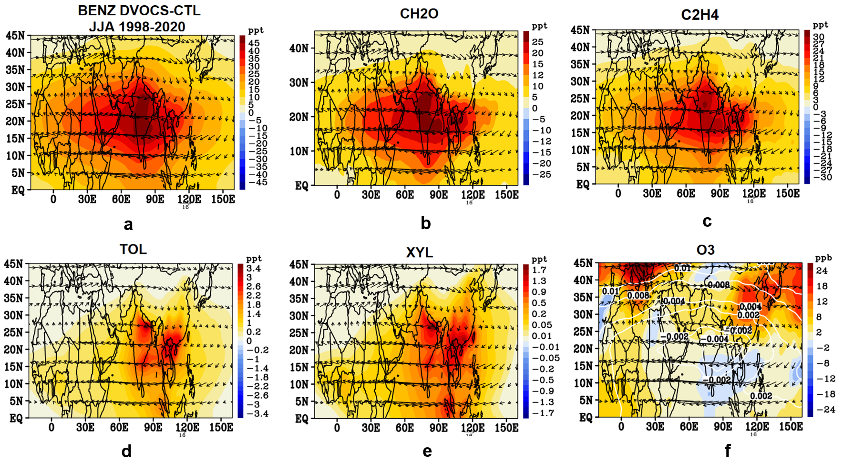
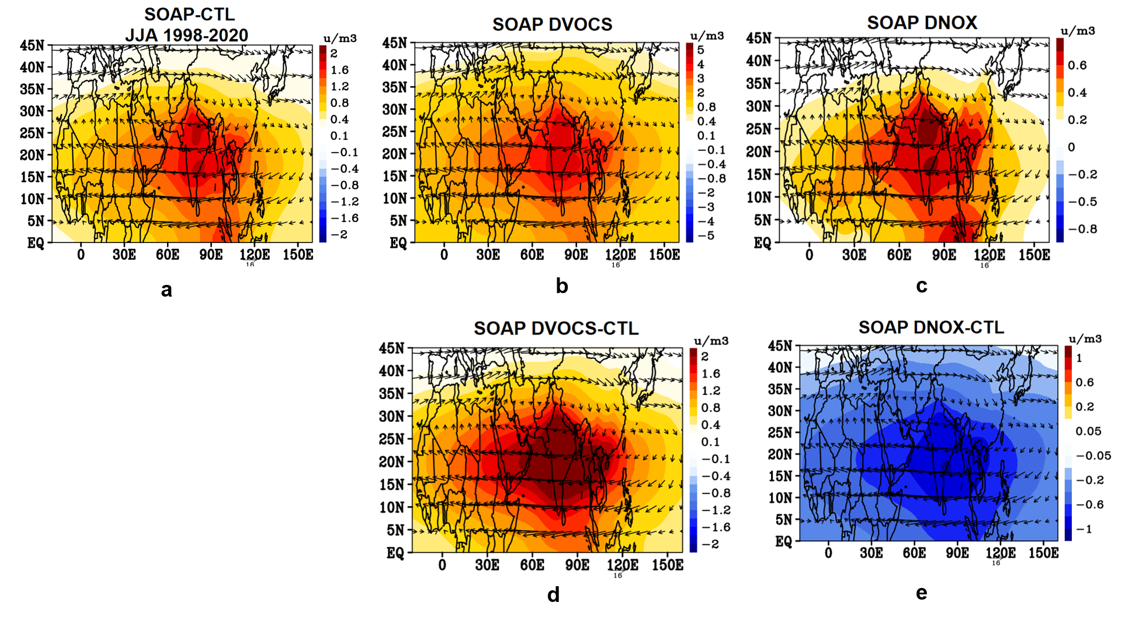
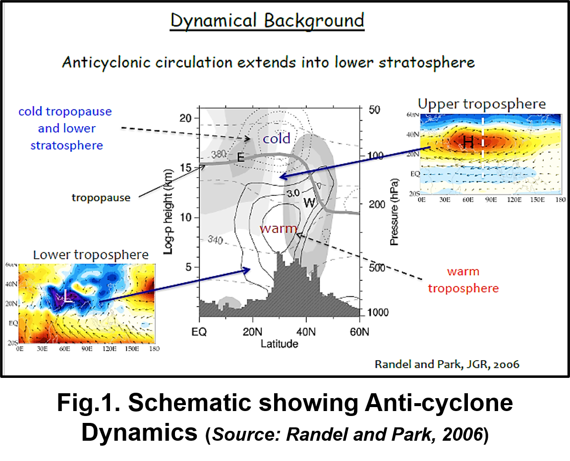
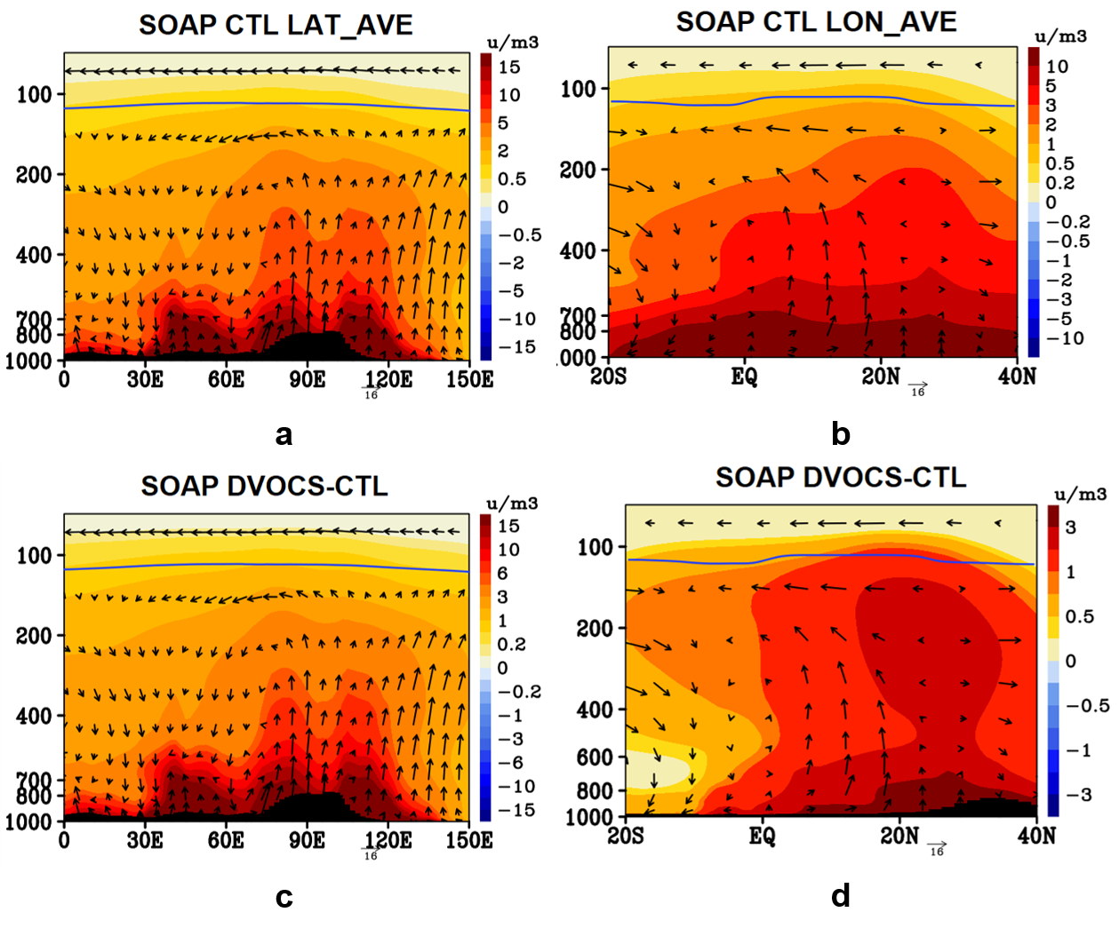
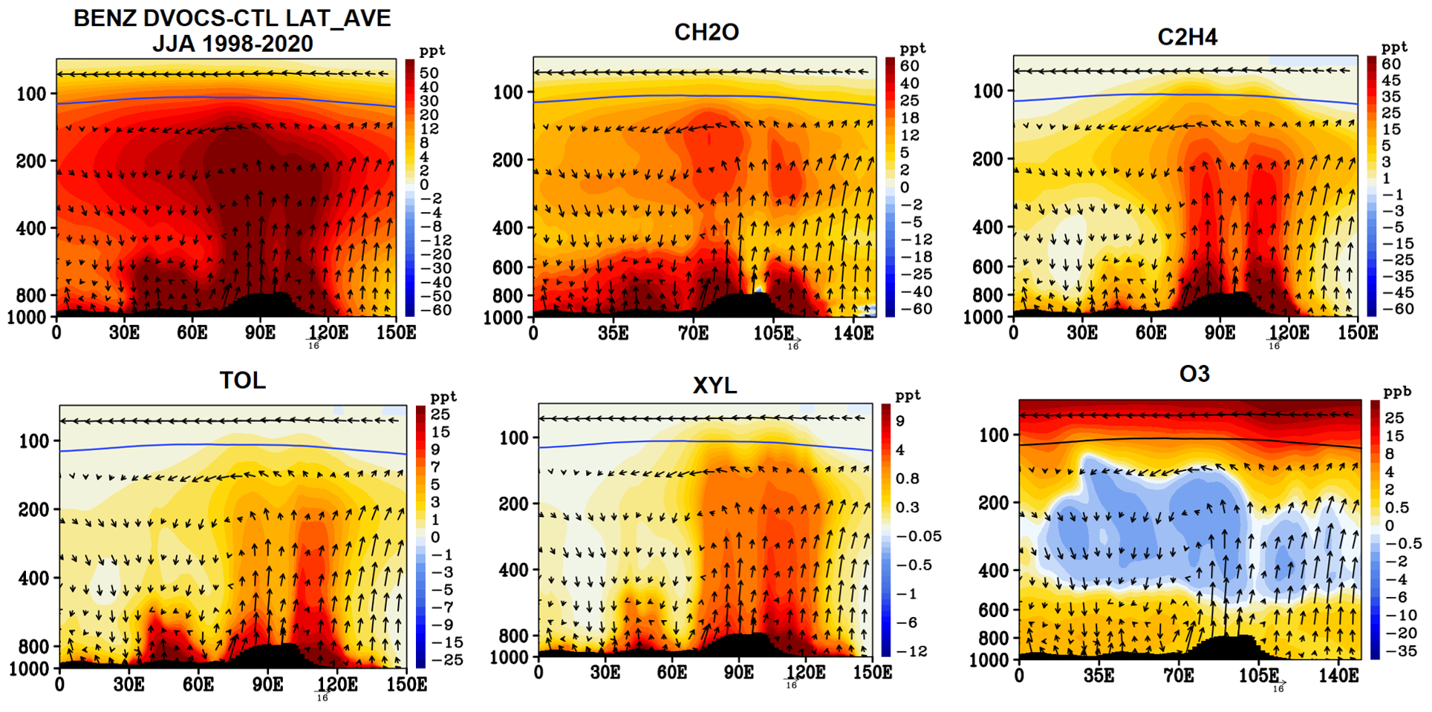
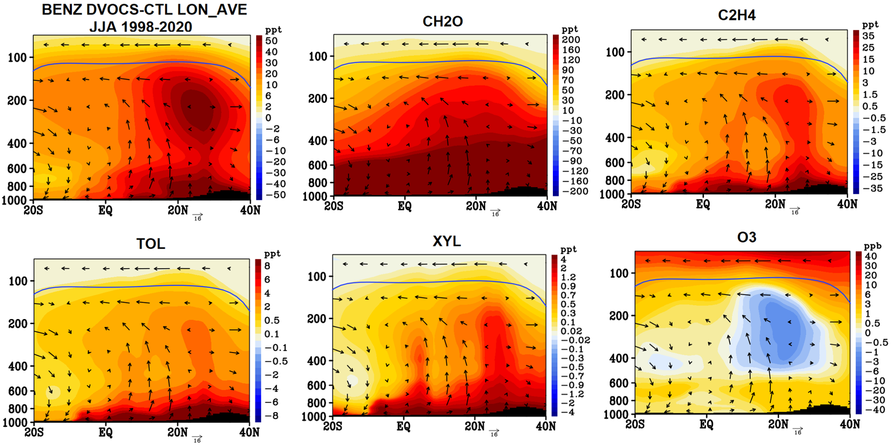
Overall, VOC emission and transport to the anti-cyclone and UTLS are key pollution factors in this region. We need to combine model results, satellite measurements, and observations to understand the chemistry behind anticyclone SOA production.
Impact of Volatile Organic Compounds on Ozone and Secondary Organic Aerosol Distribution in Asian Summer Monsoon Anticyclone
Annada Padhi, Satheesh Chandran PR, Prashant Chavan and Suvarna Fadnavis
Centre for Climate Change Research,
Indian Institute of Tropical Meteorology, (MoES)
India-411008
Introduction
Spatial Distribution of VOC Anomalies
Spatial and Vertical Distribution of SOAP Anomalies
The Asian monsoon anticyclone (ASMA) is one of the most prominent circulation features in the upper troposphere and lower stratosphere (UTLS) during the northern hemispheric summer
The convective uplift of surface pollutants and their subsequent confinement by ASMA acts as an efficient transport pathway from the surface to the UTLS.
Spatial distribution of SOAP for the 3 scenarios of model simulation CTL, DVOCS and DNOX is shown above
The maximum values principally occurring between 15° to 30° N
Central India and IGP exhibit higher SOAP values for DVOCS and DNOX. This may be owing to significant VOC emissions sources
However, DNOX-CTL has a uniformly negative SOAP concentration in the anti-cyclone region. As SOA yield increases under low NOx condition and decreases under high NOx condition (Ng et al.2007)
Fig.2 (a-f)
#Fig.2(f) Shows NOx distribution in anticyclone as contours
Spatial distribution of VOC anomalies shows maximum at core of anticyclone (60°-120°E)
VOC anomalies are higher at the eastern side of the monsoon anticyclone, since convective injection into the anticyclone occurs mainly in that region (Fadnavis et al., 2013)
Anomalies are more pronounced in case of CH2O, C2H4 and BENZ with concentrations ranging from 25 to 45 ppt.
However, Ozone shows lower concentration values in the core region of monsoon anticyclone, in agreement with literature (Basha et al.2020)
Convectively elevated tropospheric species in the UTLS can alter the region's chemistry and radiation balance
Volatile organic compounds (VOCs) are the principal precursors of ozone and secondary organic aerosol (SOA).However, inadequate research has been conducted to investigate the impact and spatial distribution of VOC in UTLS
Vertical Distribution of VOC Anomalies
In this study, we investigated the potential impact of VOCs on the distribution of UTLS SOA & ozone using the state-of-the-art chemistry-climate model ECHAM6-HAMMOZ
The SOAP estimated cumulatively from VOCs in the model, show upliftment of plume and confinement at 100 hpa as well as transport to the UTLS
They are formed through photooxidation of precursor (VOCs) into fine SOA particles. These particles are then carried to the UTLS
Methodology
The influence of VOC in the UTLS is investigated using the cutting-edge aerosol-chemistry-climate model ECHAMM6-HAMMOZ, which includes the general circulation model ECHAMM6, the tropospheric chemistry module MOZART2, and the aerosol module Hamburg aerosol model (HAM)
Model sensitivity experiments were carried out by doubling the VOC emissions (DVOCS) and NOx (DNOX) globally during the period 1998–2020 from the current level (CTL) to understand the influence of VOC emissions on SOA and O3 distribution within ASMA
We calculated the SOA formation potential of VOCs using the concept of secondary organic aerosol potential (SOAP) which indicates the propensity of these organic compounds to form SOA relative to toluene in the anticyclone zones
Summary and Conclusion
The findings derived from this study are significant for enhancing comprehension of VOC transportation and dynamics in Asian summer monsoon, as SOA directly impacts the atmospheric radiation budget by scattering and indirectly as cloud condensation nuclei (CCN)
Overall, VOC emission and transport to the anticyclone and UTLS are key factors affecting the formation chemistry of O3 and SOA
We need to combine model results, satellite measurements, and observations to understand the chemistry behind anticyclone SOA production
Increased mixing ratios for all VOCs inside the anticyclone is found from (15°-35°N and 30° E- 120°E) NH
The anomalies (DVOCS-CTL) averaged inside the anticyclone over (15°-35°N and 0°-150°) show VOC concentrations increasing in the order CH2O>BENZ>C2H4>TOL>XYL
This may be attributed to emission source concentration variation, as formaldehyde and benzene are more pervasive in the environment
Average concentration of BENZ 19±9.1ppt and CH2O 8.8±7.5 ppt. Increased VOC anomalies range from 4.2% to 7.6%
Ozone anomaly is low in the anticyclone.
SOAP estimation equation-
References
Basha, Ghouse, M. Venkat Ratnam, and Pangaluru Kishore. "Asian summer monsoon anticyclone: trends and variability." Atmospheric Chemistry and Physics 20.11 (2020): 6789-6801.
Derwent, Richard G., et al. "Secondary organic aerosol formation from a large number of reactive man-made organic compounds." Science of the Total Environment 408.16 (2010): 3374-3381.
Fadnavis, S., et al. "Transport of aerosols into the UTLS and their impact on the Asian monsoon region as seen in a global model simulation." Atmospheric Chemistry and Physics 13.17 (2013): 8771-8786
Ng, N. L., et al. "Effect of NO x level on secondary organic aerosol (SOA) formation from the photooxidation of terpenes." Atmospheric Chemistry and Physics 7.19 (2007): 5159-5174
Where, C_{i} is mass concentration of species i and
SOAPi is the SOA formation potential value of species i,
as per (Derwent et al., 2010)

