Slide 1
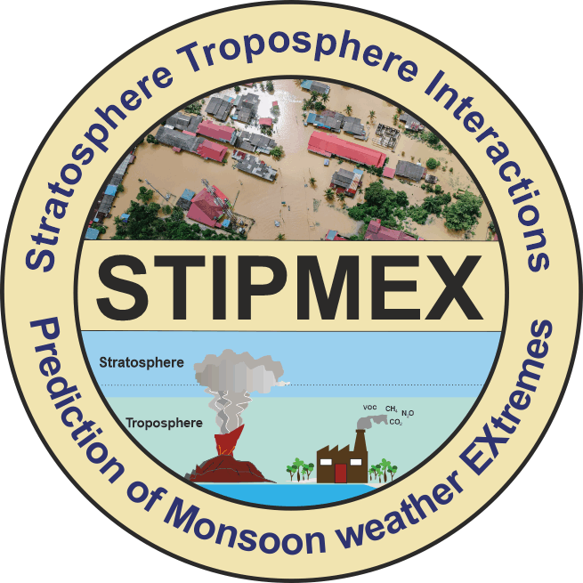
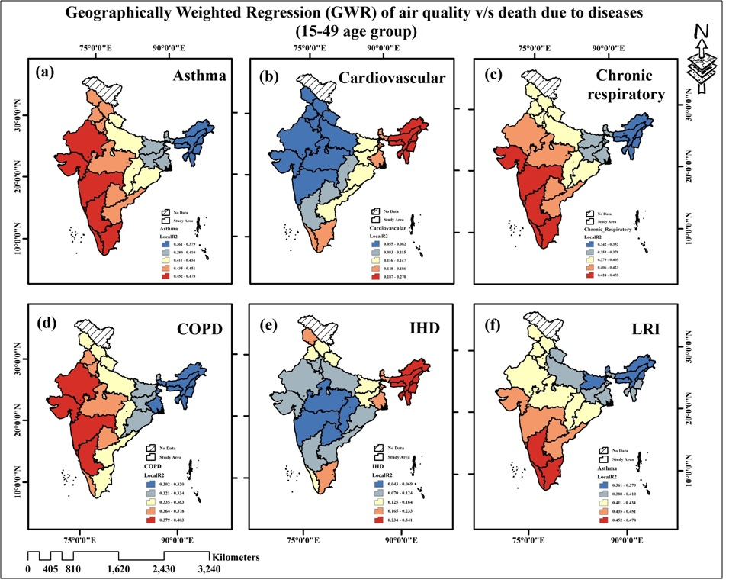
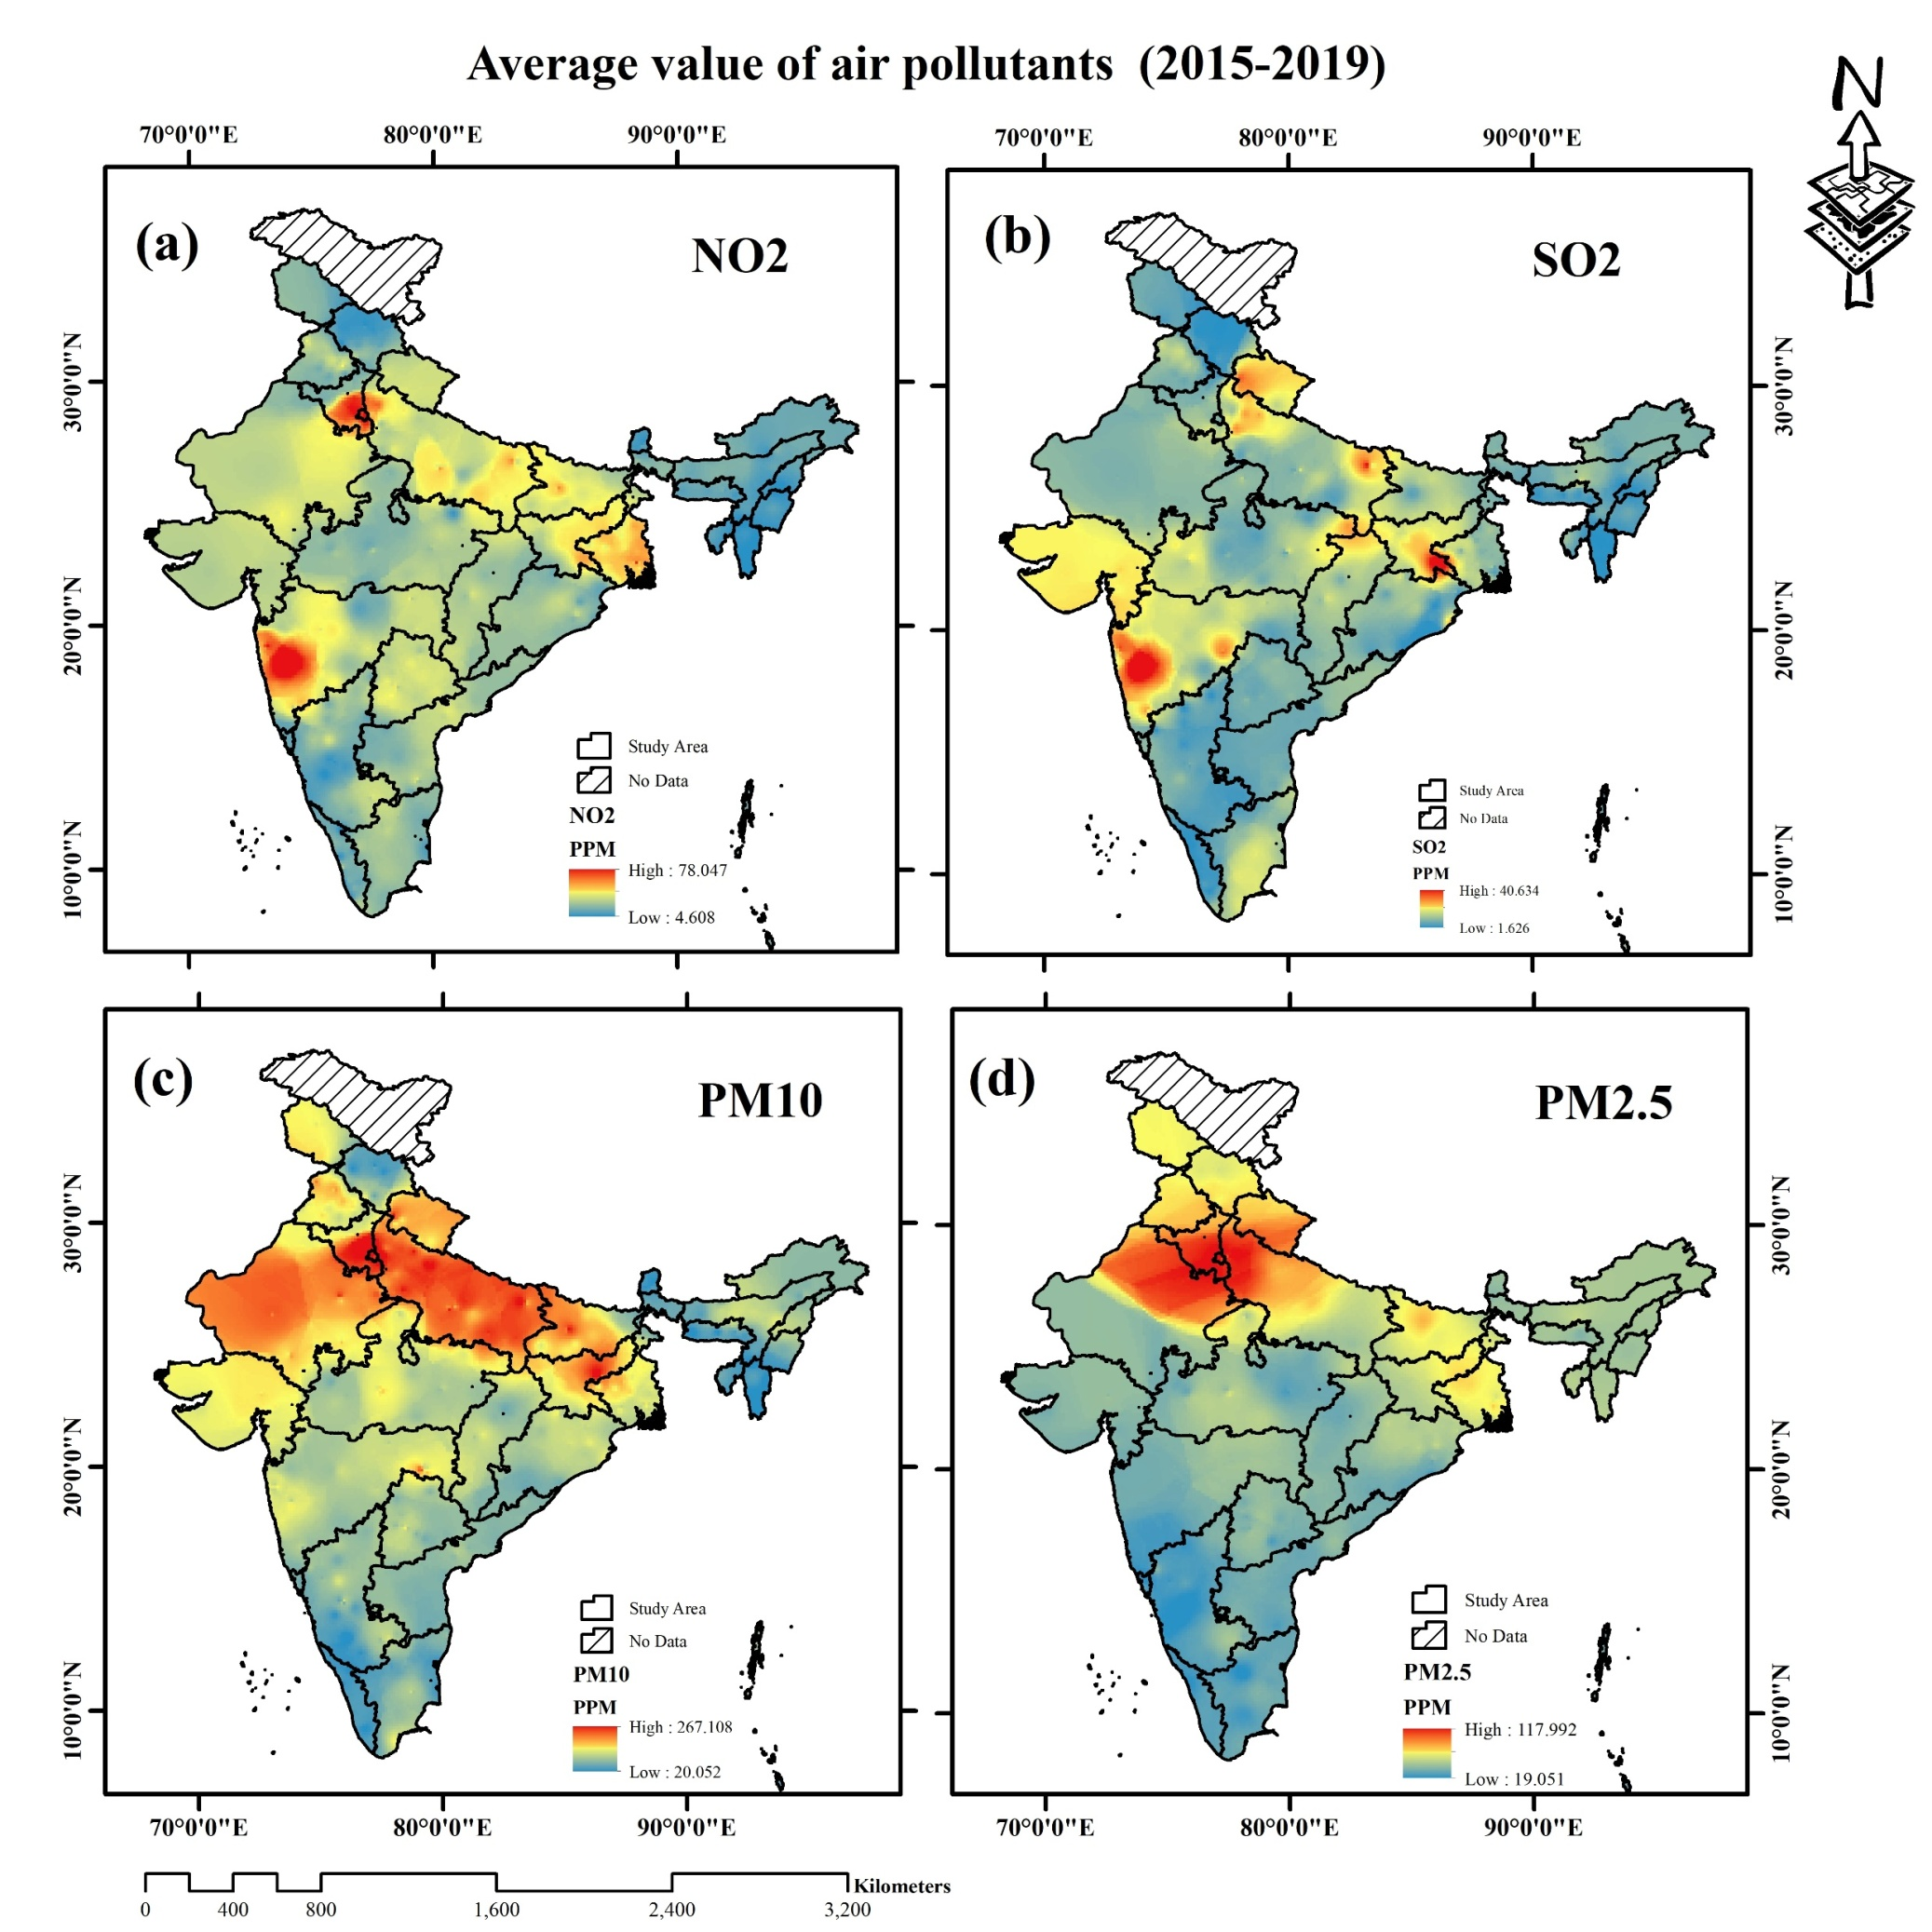
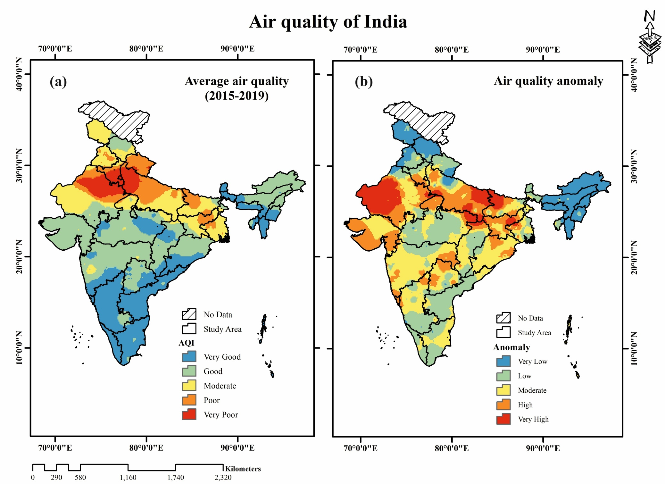
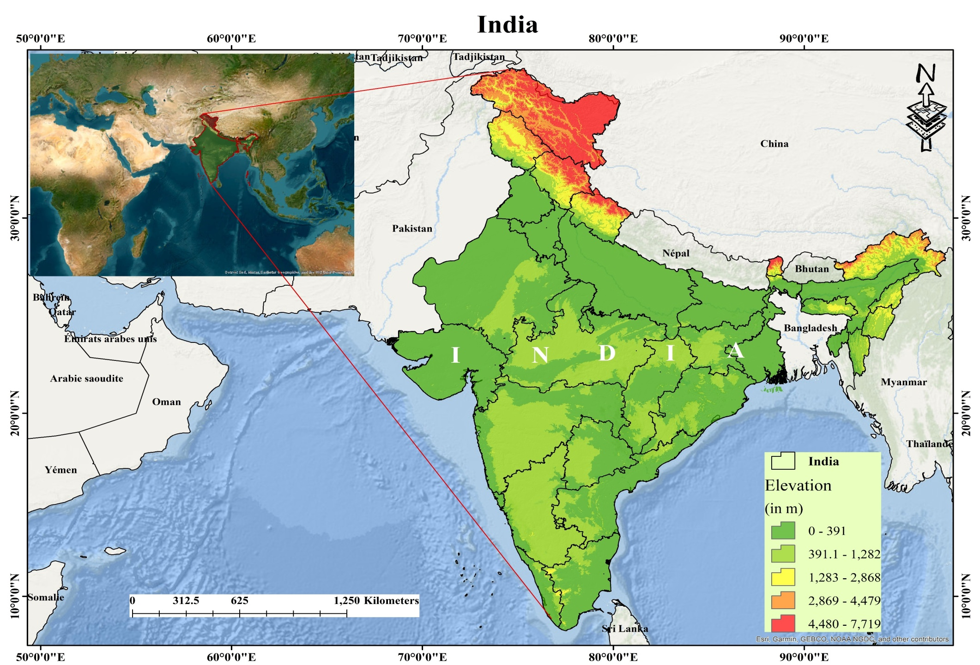
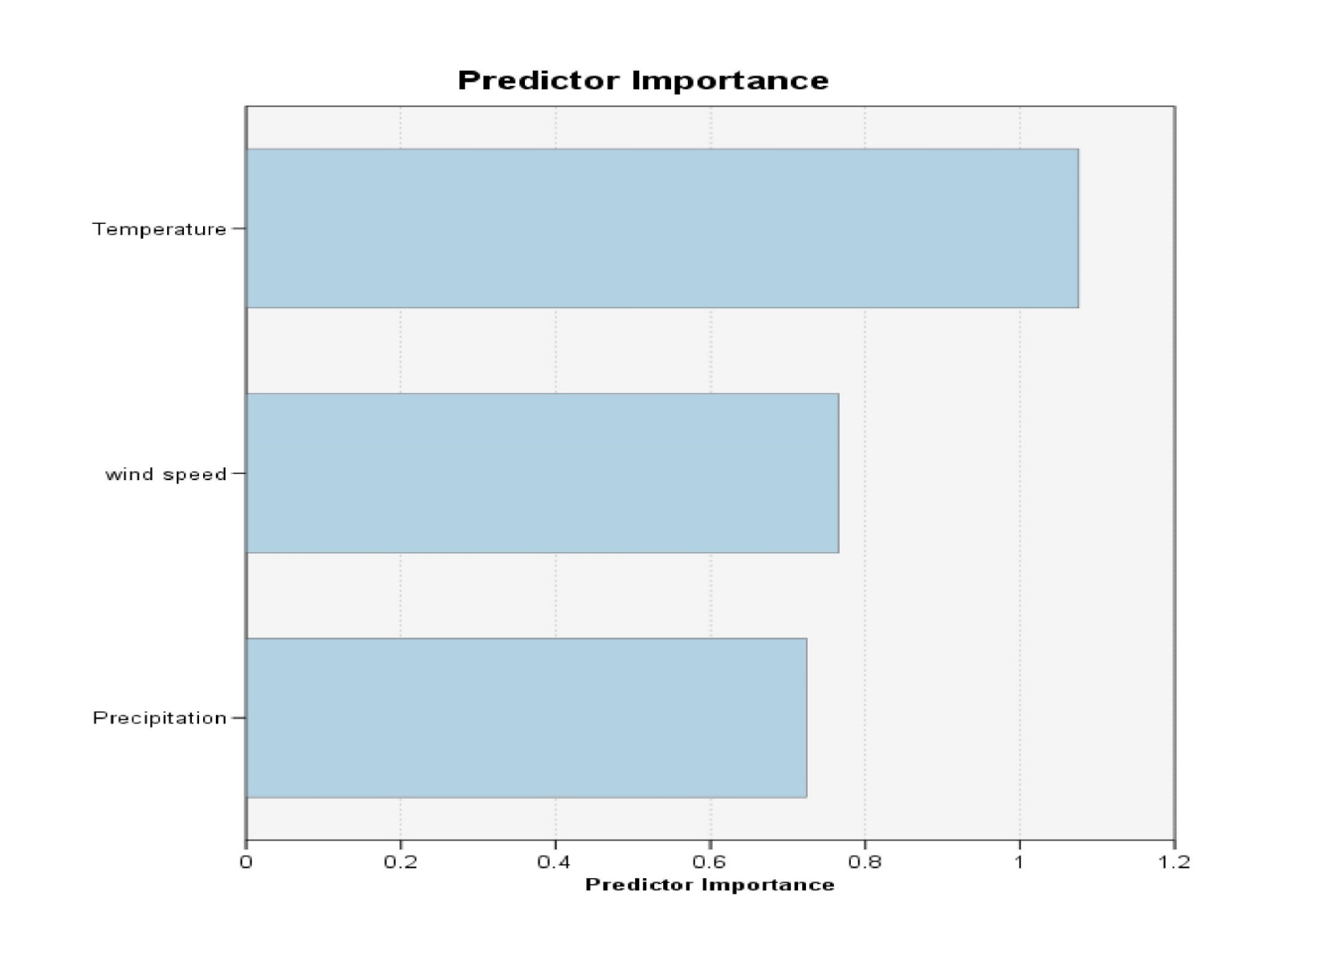
Exploring the influence of Troposphere-Stratosphere Interaction on Air Pollution and its impact on 15-49 Years Age Group Population in India: A Multi-Dimensional Analysis
Jahnavi Singh¹ , Dr. Manish Kumar¹ , Dr. Swati Thakur$²$, Akash Tiwari¹
¹Central University of Haryana $²$Dyal Singh College, University of Delhi
Introduction
Results
India is a second most populous country (Census,2011) and third most polluted country in the word (IQ Air,23). The exponential increase in population of India has had a significant and profound effect on the levels of environmental degradation.
Pollutants in the air immediately affect air quality. Pollutants including NO2, SO2, PM10, PM2.5, and CO may negatively impact air quality and pose health hazards (WHO, 2018).
Air quality is also affected by some meteorological factors such as temperature, wind speed, precipitation etc.
These factors affect air quality, causing pollution and deteriorating human health and raising the chance of premature mortality from fatal diseases.
Air quality map considered four pollutant (NO2,SO2,PM10 AND PM2.5) were prepared using interpolation techniques is shown below.
Expert opinion-based confusion matrix used for the AHP weight estimation, successfully provided the effective weight to each parameter by maintaining the consistency ratio (CR) of 0.08%. Highest weightage was given to PM2.5 i.e., 0.55, while lowest weight was given to SO2 i.e., 0.05.
Best Fuzzy overlay method for the preparation of Fuzzy-AHP based air quality map was selected using the coefficient of correlation method (ECMWF; Buckley, J. J., 1985).
Natural breaks was used to classify the map into five classes viz., very good, good, moderate, poor and very poor.
Results revealed that the air quality in the western Indian states is significantly worse than that the southern and north-eastern states of India.
Result from machine learning assessment of Random Forest is depicted as among considered influencing factors, temperature has major ability to affect air quality.
Contaminated air quality could lead to several health concerns among humans, particularly for the pre-mature age group (15–49 years).
Conclusion
Objectives
Fuzzy-AHP based air quality map were developed to assess spatial variation of air quality across India.
The air quality assessment results indicate that Delhi's entire area falls under 'very poor' air quality category, with Haryana occupying the second position. Due to their proximity to the ocean and high wind speed as well rainfall, the southern Indian states have the highest quality of air.
Among influencing factors, temperature affected more air quality.
GWR shows that issue of pre-mature mortality is majorly on north yo south-west region of India.
To assess the spatial variation of air quality across India.
To assess the effect of major meteorological parameters on air quality of India.
To analyze the relation between air pollution and the pre-mature deaths in India.
Methodology & Study Area
Acknowledgements & References
India is located between 8º 4’ N to 37º 6’ N Latitude and 68º 7’ E to 97º 25’ E Longitude, encompassing an area of 32, 87, 267 km².
Research involves three stages: (a) collecting air pollutant data from CPCB to assess the spatial variation of air quality across India, (b) behavioral assessment of meteorological factors on air quality, (c) collecting pre-mature deaths data from GBD to assess the relation between air quality and pre-mature deaths
Air pollutants: (a) NO₂, (b) SO₂, (c) PM10, (d) PM 2.5
Meteorological Factors: (a) Temperature, (b) Wind speed, (c) precipitation
TSI Data (ERA-5): (a) Temperature, (c) Precipitation
Global Wind Atlas – Wind speed
Pre-mature deaths data collected from GBD of India
Expert opinions based AHP confusion matrix was used for weight determination of air pollutants. For Fuzzy-AHP, fuzzy standardization with appropriate membership functions and fuzzy overlay was employed.
Random Forest was applied to identify the major factors responsible for the air quality contamination.
Applied GWR to assess the mortality in India due to air pollutants.
Acknowledgements
This research did not receive specific grant from funding agencies in the public, commercial, or not-for-profit sectors. Authors are thankful to Central University of Haryana for providing the necessary resources to conduct this research and STIPMEX, 2024 for providing a platform to showcasing these important results on the national level. Authors is also thankful to the Central pollution control board, New Delhi for providing secondary reports of air pollutant.
References
Office of the Registrar General & Census Commissioner, India. (2011). Census of India 2011. Ministry of Home Affairs, Government of India. Retrieved from https://censusindia.gov.in.
IQAir, 2023 https://www.iqair.com/world-air-quality
World Health Organization. (2018). Ambient (outdoor) air pollution. Key facts. Retrieved from https://www.who.int/news-room/fact-sheets/detail/ambient-(outdoor)-air-quality
GBD 2019 Risk Factors Collaborators. (2020). Global burden of 87 risk factors in 204 Countries and territories, 1990–2019: a systematic analysis for the Global Burden of Disease Study 2019. The Lancet, 396(10258), 1223-1249
ECMWF ERA5 data extracted from https://cds.climate.copernicus.eu/cdsapp#!/search?type=dataset .
Global Wind Atlas, extracted from https://globalwindatlas.info
Buckley, J. J. (1985). Fuzzy hierarchical analysis. Fuzzy sets and systems, 17(3), 233-247.
INTERNATIONAL WORKSHOP
ON STRATOSPHERE-TROPOSPHERE INTERACTIONS AND PREDICTION OF MONSOON WEATHER EXTREMES (STIPMEX)
June 02-07, 2024, IITM, Pune, Maharashtra

