Slide 1
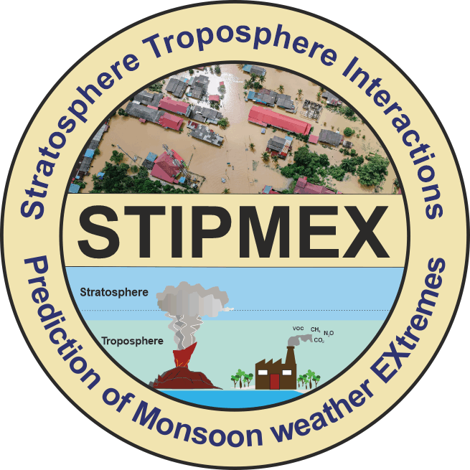
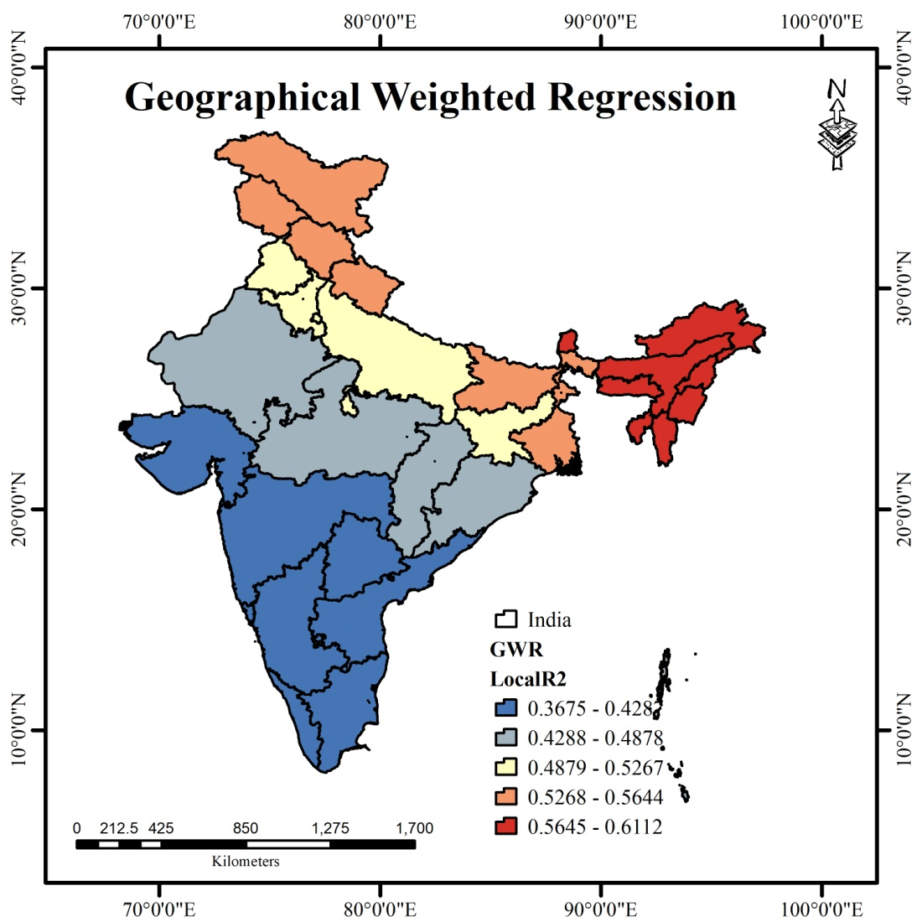
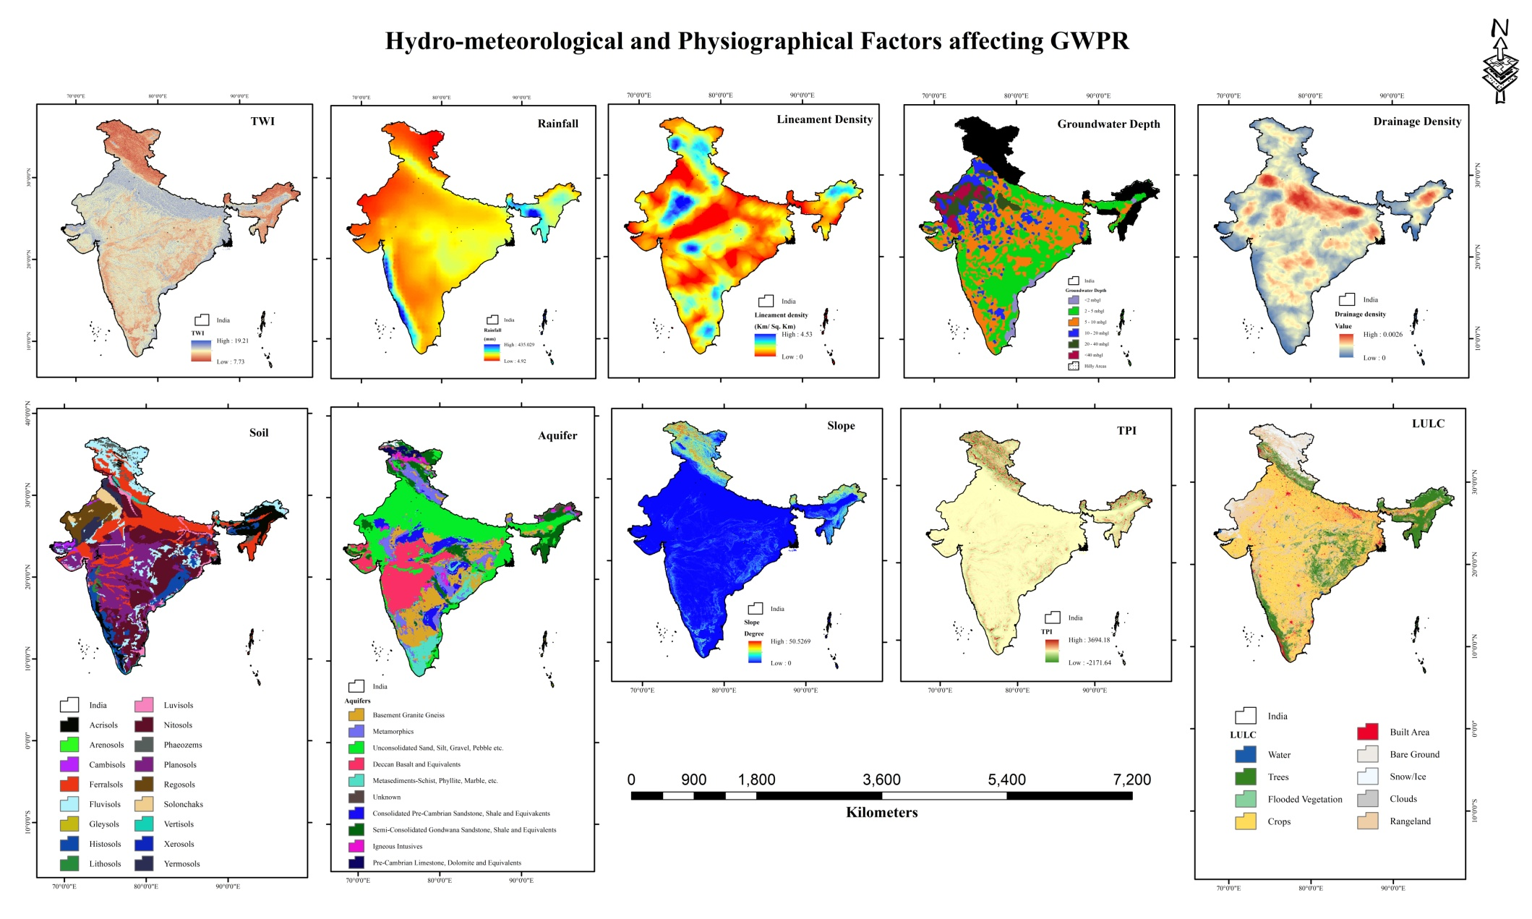
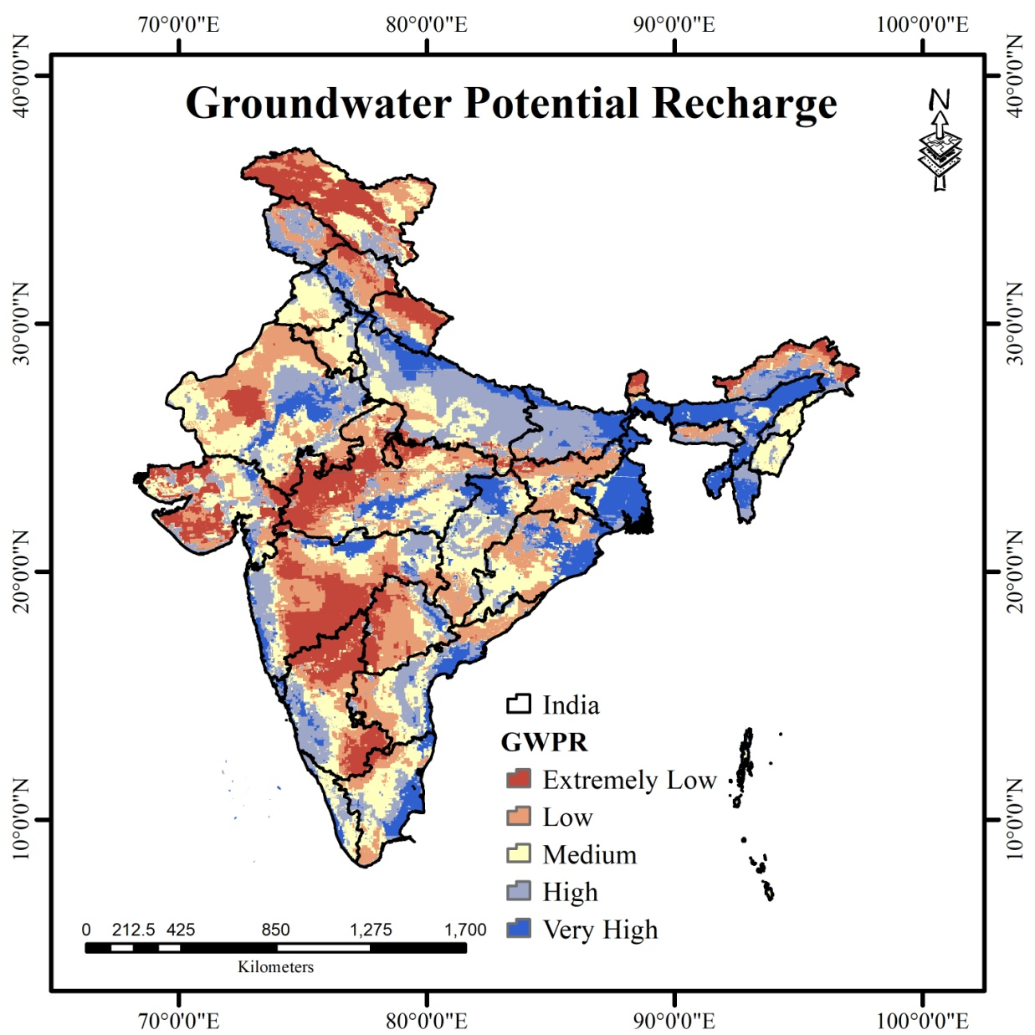
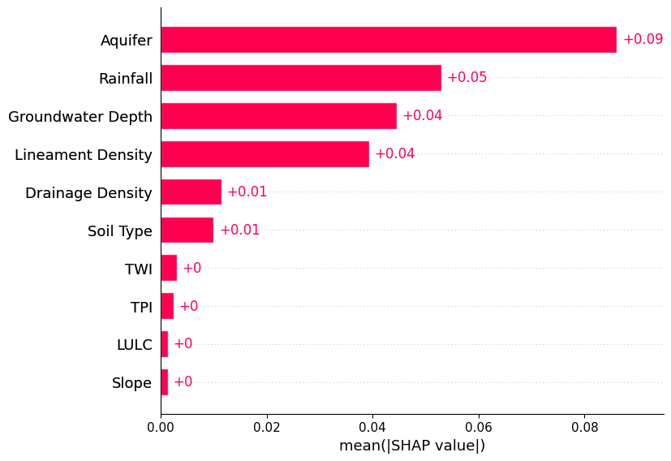
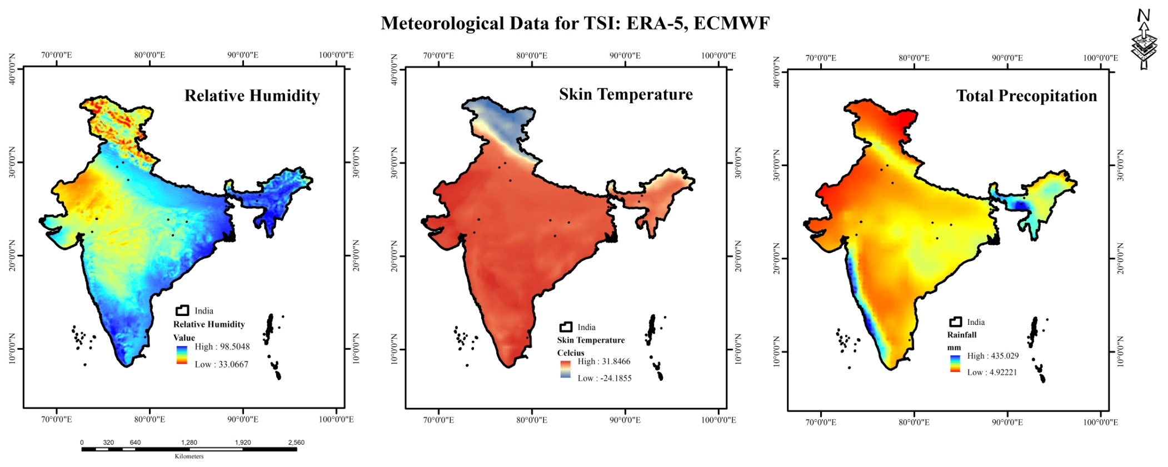
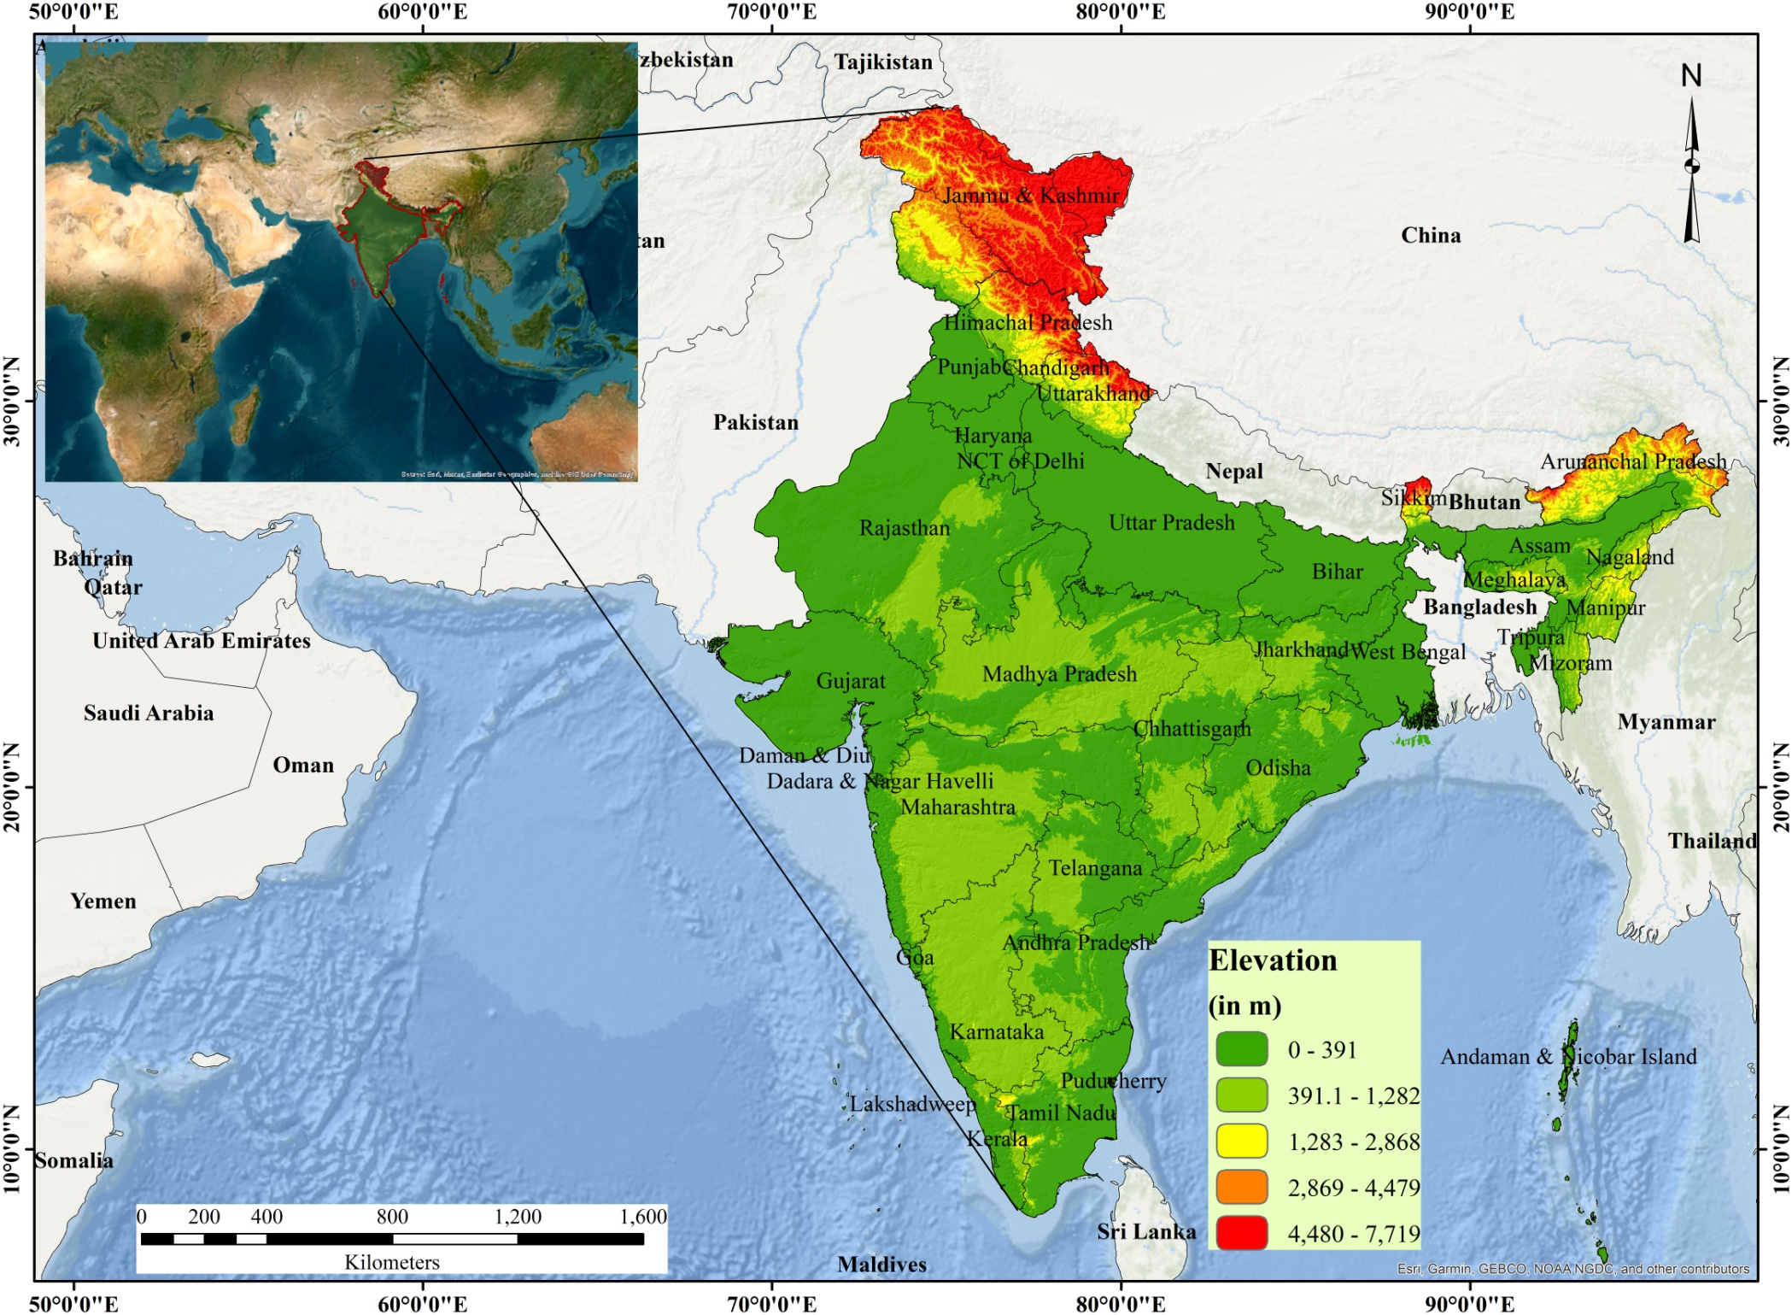
Unveiling the Influence of Troposphere-Stratosphere Interaction on Groundwater Hydrology: A Novel Multi-Scaler Assessment
Akash Tiwari¹, Manish Kumar¹, Swati Thakur², Jahnavi Singh¹
¹Central University of Haryana, ²Dyal Singh College, University of Delhi
researchakashgeo@gmail.com
Introduction
Results
Spatial variation of the result of GWR is depicted in below figure.
In India, 60% of the agricultural irrigation and approximately 85% of drinking water demand is met by the groundwater (GW), which makes it the world’s largest consumer by consuming approximately 230 km³ GW annually (World Bank, 2012).
GW contamination as a global environmental concern, is difficult to trace than surface water contamination because of the slow movement of water in the subsurface (Jha M.K. et al., 2020).
This study delves into the influence of Troposphere-Stratosphere Interaction (TSI) on groundwater hydrology, utilizing ERA-5 reanalysis data to assess atmospheric conditions and employing Fuzzy-AHP (Analytic Hierarchy Process) to evaluate groundwater potential recharge (ECMWF; Buckley, J. J., 1985).
Figure below is showing the spatial variation of the GWPR influencing factors.
Expert opinion-based confusion matrix used for the Fuzzy-AHP weight estimation, successfully provided the effective weight to each parameter by maintaining the consistency ratio (CR) of 0.08%. Highest weightage was given to aquifer i.e., 0.24, while lowest weight was given to LULC i.e., 0.01.
Natural breaks was used to classify the GWPR maps into five classes, namely, ‘extremely low’, ‘low’, ‘medium’ , ‘high’ and ‘very high’, as shown in figure below. Highest 24.94% area of India is under ‘medium’ GWPR zone, while only 13.51% area is under ‘very high’ GWPR zone.
SHAP Game theory revealed that aquifers are very much responsible for the groundwater recharge, whereas, LULC, slope, TPI are least important, as shown in the above SHAP based importance bar graph.
ERA-5 dataset were prepared on the basis of the netCDF file obtained from ECMWF, which are shown in the below figure.
Results from the GWR revealed that north Indian states are highly correlated with the TSI on GWPR as compared to the south Indian states.
Local R² is high (0.52-0.61) for the north India, whereas it is around 0.36-0.48 for the southwestern India.
Conclusion
Objectives
India have maximum GWPR in its major river basins.
GWPR plays a crucial role in water resource planning, sustainable development, and ensuring the equitable and efficient utilization of groundwater in India.
16.35% area of India is under ‘extremely low’, while 13.51% area is under ‘very high’ GWPR category.
Aquifer is the highest influencing factor in ‘GWPR’, whereas ‘slope’ and ‘LULC’ are the lowest influencing factor.
GWR revealed that north Indian states have higher level of TSI with GWPR, whereas south and central India have lower level of correlation.
Assessment of the GW recharge potential and its spatial variability.
Assessment of the major factor responsible for the GW recharge.
Impact of TSI on the GW recharge over India.
Methodology & Study Area
Acknowledgements & References
India is located between 8º 4’ N to 37º 6’ N Latitude and 68º 7’ E to 97º 25’ E Longitude, encompassing an area of 32, 87, 267 km².
Research involves three stages: (a) preparation of the groundwater recharge criterion layers and estimation of the GWRP, (b) behavioural assessment of these criterions in GWRP, (c) gathering climate data on TSI and evaluation of its impact of GWRP
Hydro-meteorological Factors: (a) Groundwater depth, (b) Aquifer, (c) Rainfall, (d) Drainage density
Physiographical Factors: (a) LULC, (b) Slope, (c) TPI, (d)TRI, (e) Soil types, (f) Lineament density
TSI Data (ERA-5): (a) Total precipitation, (b) Skin temperature, (c) Relative Humidity
Expert opinions based AHP confusion matrix was used as base for Fuzzy-AHP, subsequently Fuzzy standardization with appropriate membership functions and fuzzy overlay was employed.
Major factors responsible for the groundwater contamination was observed on the basis of SHAP based Game theory.
Impact of TSI on GWPR was assessed on the basis of Geographical Weighted Regression.
Local R² within GWR, was used to assess the impact of TSI on the GWPR.
Acknowledgements
This research did not receive any specific grant from funding agencies in the public, commercial, or not-for-profit sectors. Authors are thankful to Central University of Haryana for providing the necessary resources to conduct this research and STIPMEX, 2024 for providing a platform for showcasing these important results on the national level.
References
World Bank, 2012. “India Groundwater: a Valuable but Diminishing Resource”.
Jha, M. K., Shekhar, A., & Jenifer, M. A. (2020). Assessing groundwater quality for drinking water supply using hybrid fuzzy-GIS-based water quality index. Water Research, 179, 115867.
ECMWF ERA5 data extracted from https://cds.climate.copernicus.eu/cdsapp#!/search?type=dataset
Buckley, J. J. (1985). Fuzzy hierarchical analysis. Fuzzy sets and systems, 17(3), 233-247.
INTERNATIONAL WORKSHOP
ON STRATOSPHERE-TROPOSPHERE INTERACTIONS AND PREDICTION OF MONSOON WEATHER EXTREMES (STIPMEX)
June 02-07, 2024, IITM, Pune, Maharashtra

