Slide 1
Response of Rainfall of the Western Half of the Indian Sub-continent to the Large-Scale Stratospheric Circulations Busnur Rachotappa Manjunatha* Department of Marine Geology, Mangalore University, Mangalagangothri-574 199, India *E-mail manjzircon@gmail.com

Slide 2
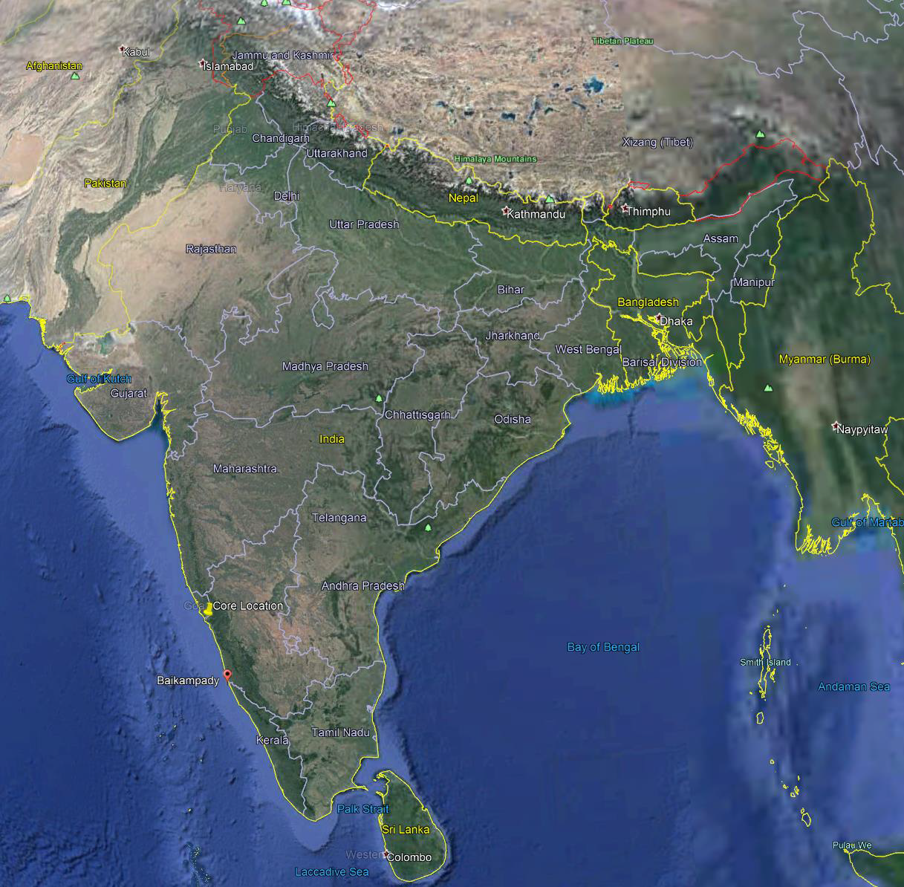
In order to update the latest findings on Troposphere- Stratosphere-Polar circulations and participate in the STIPMEX conference, this study has been undertaken to know the teleconnection of the Northern Hemispheric Polar (Arctic Region) on precipitation along the western part of the Peninsular India over the past four decades. Some of the probable interfering factors of the rainfall of the western part of the Peninsular India such as dust surface mass concentration (pm 2.5), dry and wet deposition of dust, specific humidity, AOD 550 nm (dark target), black carbon column mass density, precipitation rate, surface wind speed and surface air temperature of the study area have been retrieved from the Giovanni website (https://giovanni.gsfc.nasa.gov/giovanni/) during the satellite monitoring period (1980 to 2023). In addition, the data about the plausible atmospheric teleconnecting forces, such as Arctic Oscillation (AO), North Atlantic Oscillation (NAO), El Niño-Southern Oscillation (ENSO), Niño 3.4, global temp anomaly, tropical temperature, Atlantic Multi-decadal Oscillation (AMO) and the Quasi‐Biennial Oscillation have been taken from NOAA Physical Sciences Laboratory (PSL) (https://psl.noaa.gov/; QBO; Han et al., 2022; Wyburn-Powell et al., 2022). All data processed for the PCA by using the SPSS statistical program.
Fig. 1. Google map of the western part of India with an inset box region of data extracted from the Giovanni website (https://giovanni.gsfc.nasa.gov/giovanni/).

Slide 3
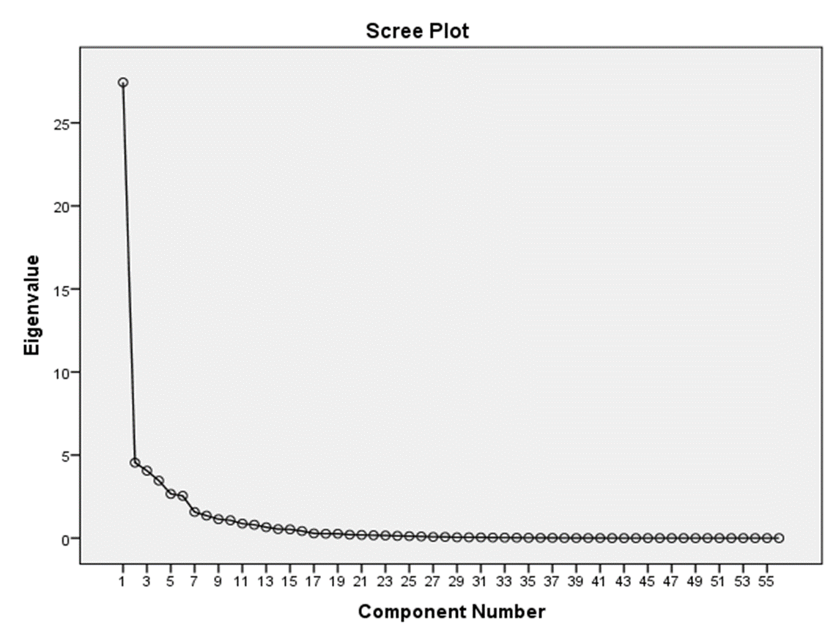
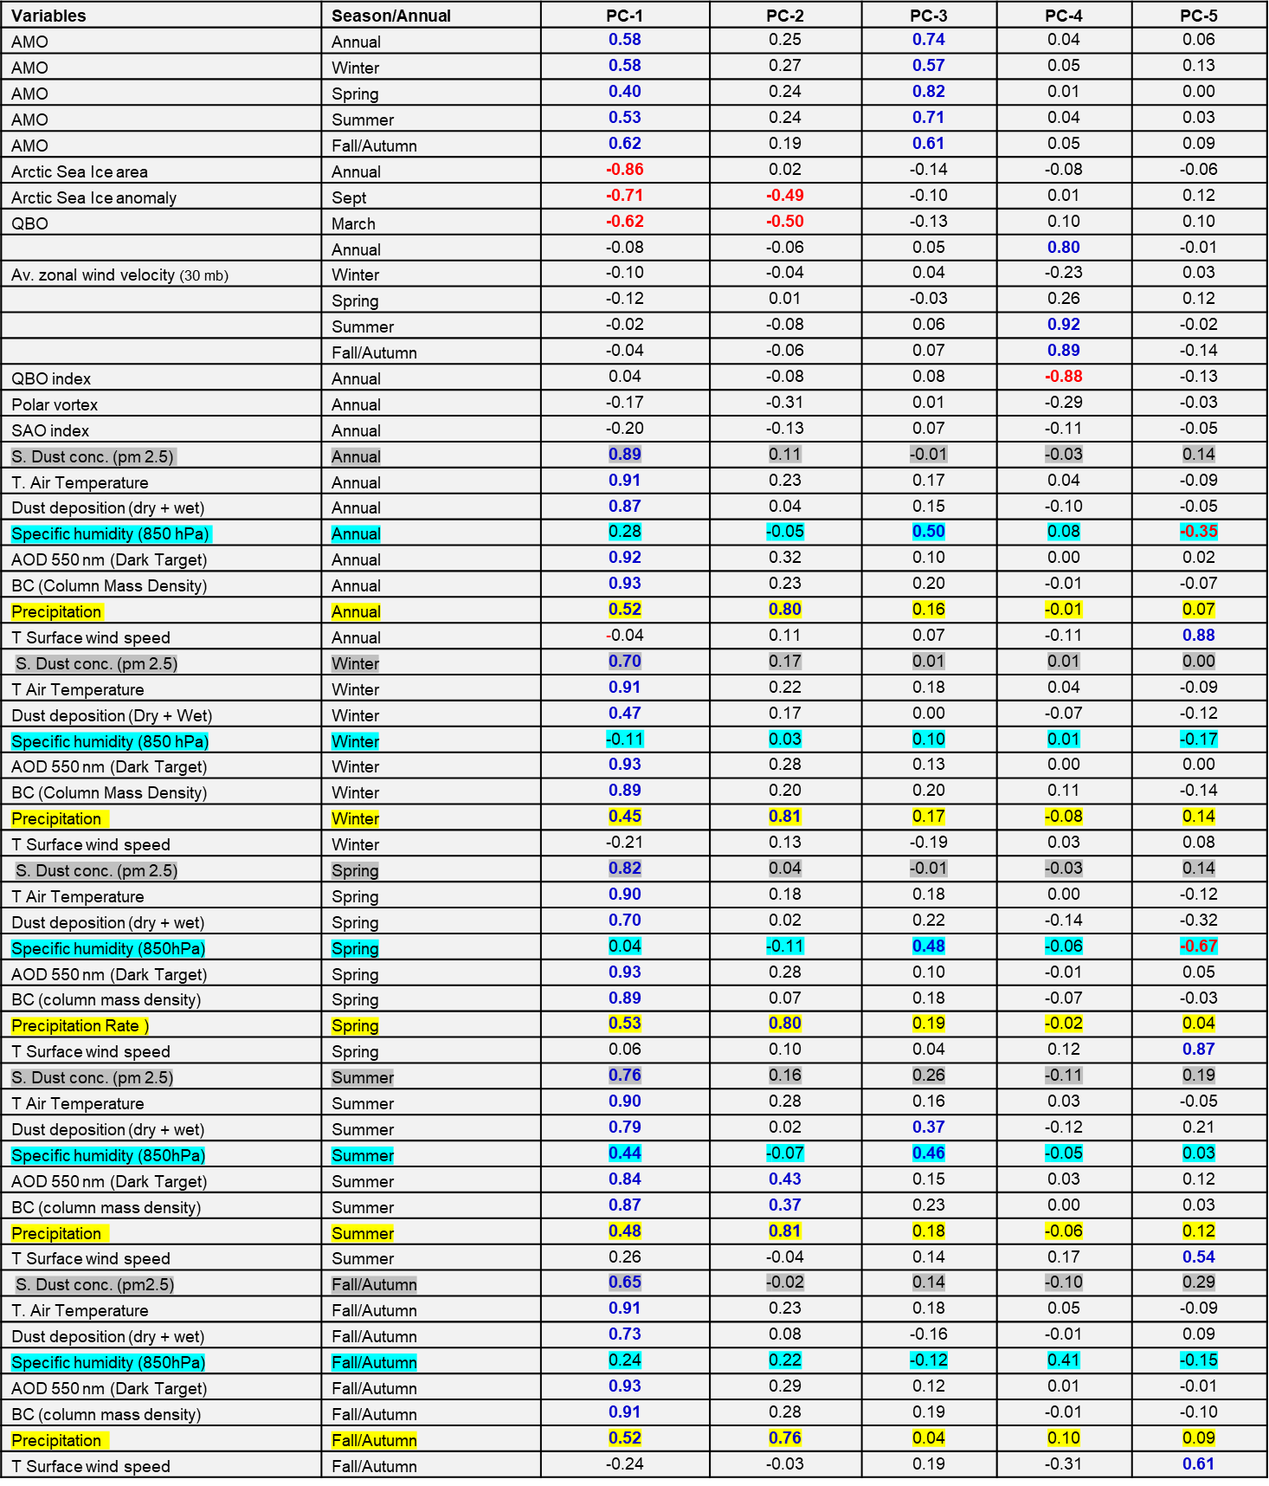
The results of the statistical analysis (Fig. 3) show that there about 15 components which are greater than Eigen Values 1.0. To reduce further description of data, the Eigen Values versus number of components are plotted as Scree plot which indicates that only one profound component above the first inflexion point, followed by four components above the second inflexion point, suggesting the complex in relationship among the data of the study area along with tele-connections. The principal components matrix of the results of the data are given in Table 1.

Slide 4
The results of the Principal Component Analysis (PCA) are given in Table 1. The most significant Principal Component (PC) -1 is identified as the Arctic Component based on very strong negative loadings on the annual Arctic Sea Ice area and Arctic Sea Ice anomaly during September as well as March. This component is inversely with Atlantic Multidecadal Oscillation as well as atmospheric dust concentration indicators, such as aerosol optical depth at 550 nm, total dry and wet deposition as well as humidity and precipitation during almost all seasons. It is quite well know that there is a positive relationship between Atlantic Multidecadal Oscillation with monsoon rainfall of India.
The PC-2 is identified as a precipitation component which is highly positively loaded during almost all seasons. In this component also, the variables representing the Arctic component are inversely loaded, suggesting negative impact of the Arctic Sea Ice on monsoon rainfall of India. In addition some of anthropogenic indicator, such as black carbon and tropical increase in temperature seem to aggravate the rainfall.
The PC-3 represents the AMO, which is positively loaded during most of seasons and the humidity of the study area during the summer, suggesting the influence of the Atlantic Ocean on the summer monsoon rainfall.
The PC-4 indicates that it is Quasi‐Biennial Oscillation (QBO) component which seems to be important in the enhancement of the humidity during the Fall Inter Monsoon (Autumn season).
The last component PC-5 is identified as the wind speed, which is inverse with the specific humidity particularly during the winter season, where the air mass originating mainly over the subtropical-temperate region of the Central Asia.
Acknowledgments: I am grateful to the organizers for providing me a wonderful opportunity to participate in the conference. I also thank many global agencies for open access of voluminous data (https://disc.gsfc.nasa.gov/). I also thank Rolf Muller, Forschungszentrum Jülich GmbH 52425 Jülich Sitz der Gesellschaft: Jülich for providing the partial financial assistance to participate in this conference.

