Slide 1
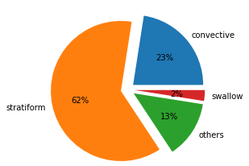
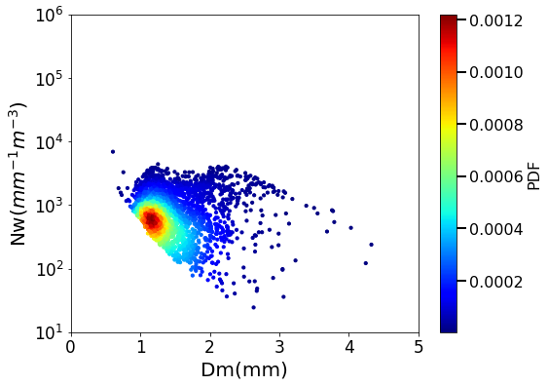
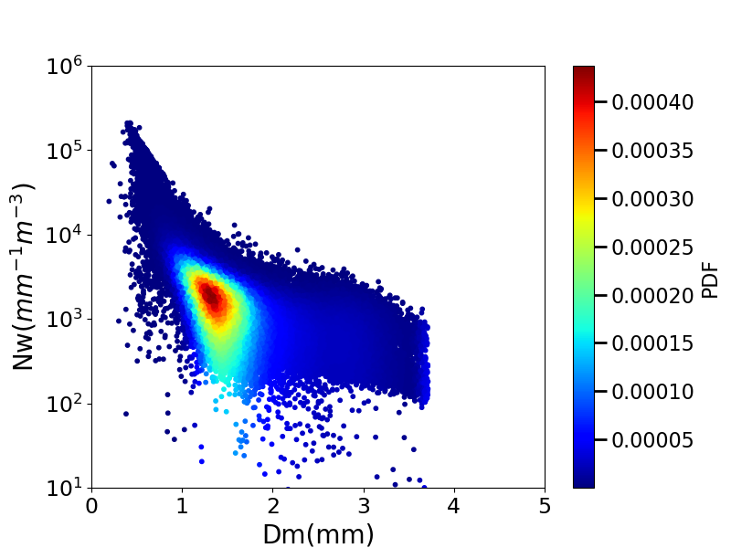
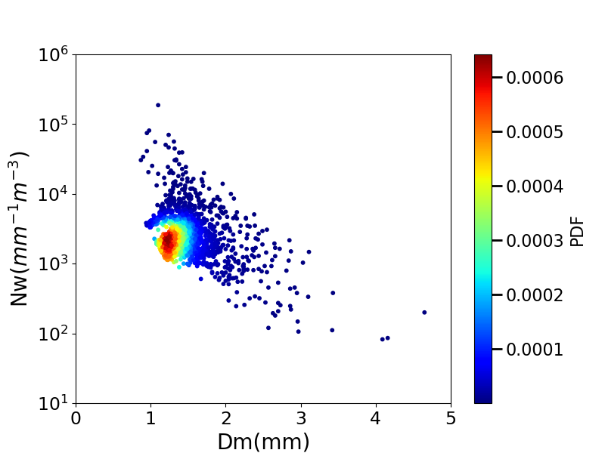
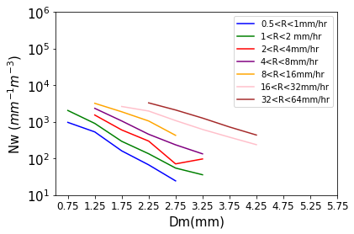
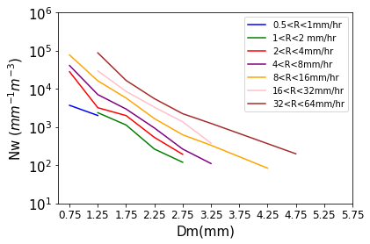
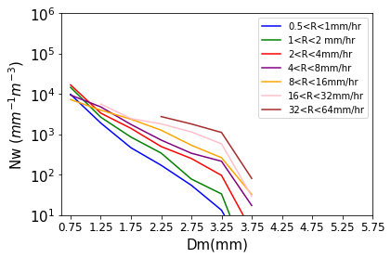
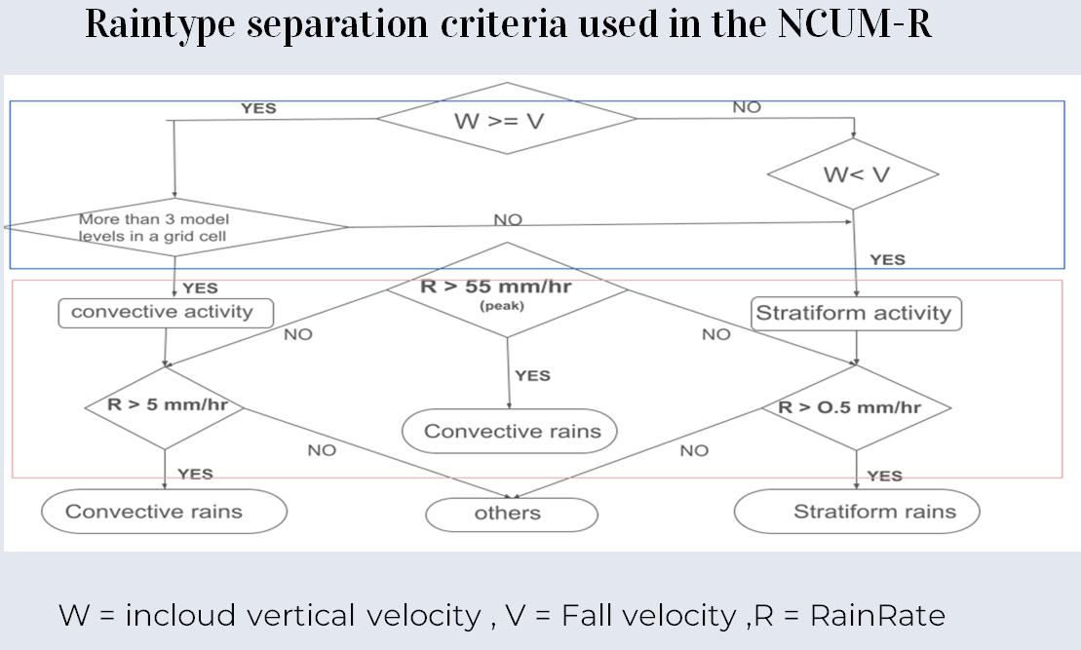
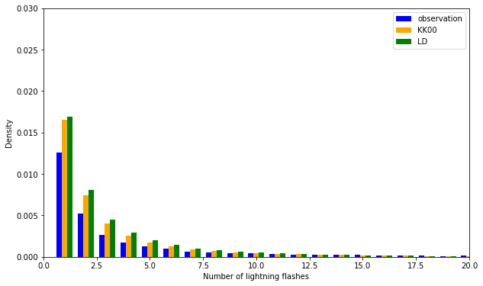
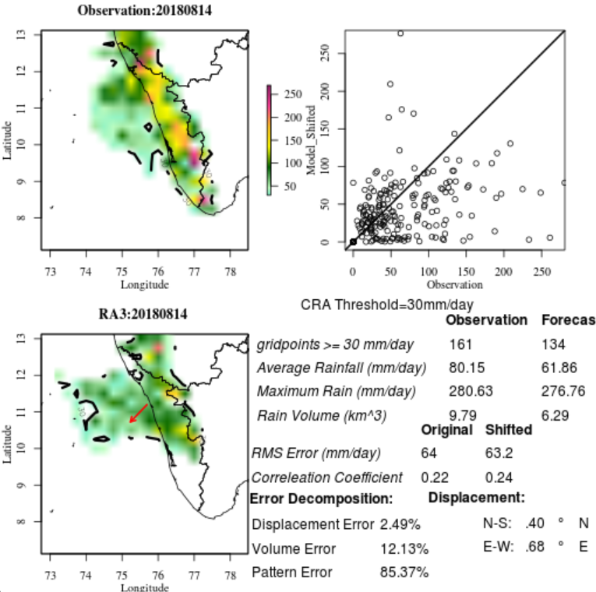
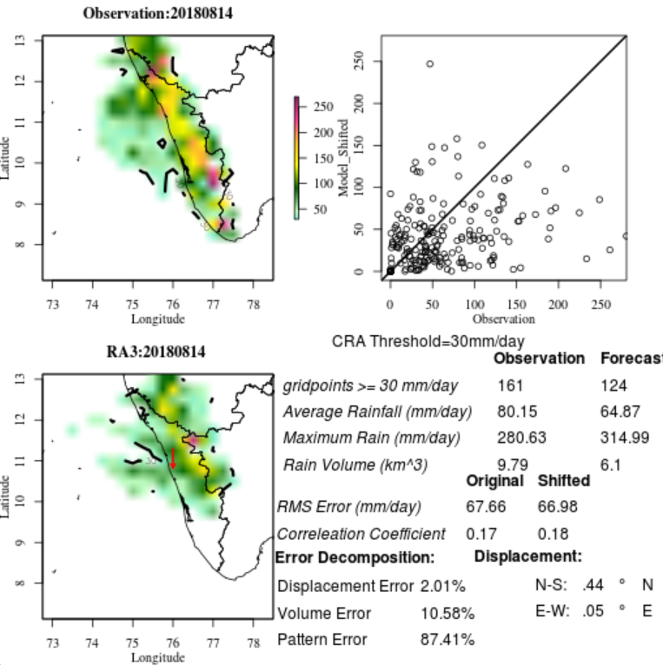
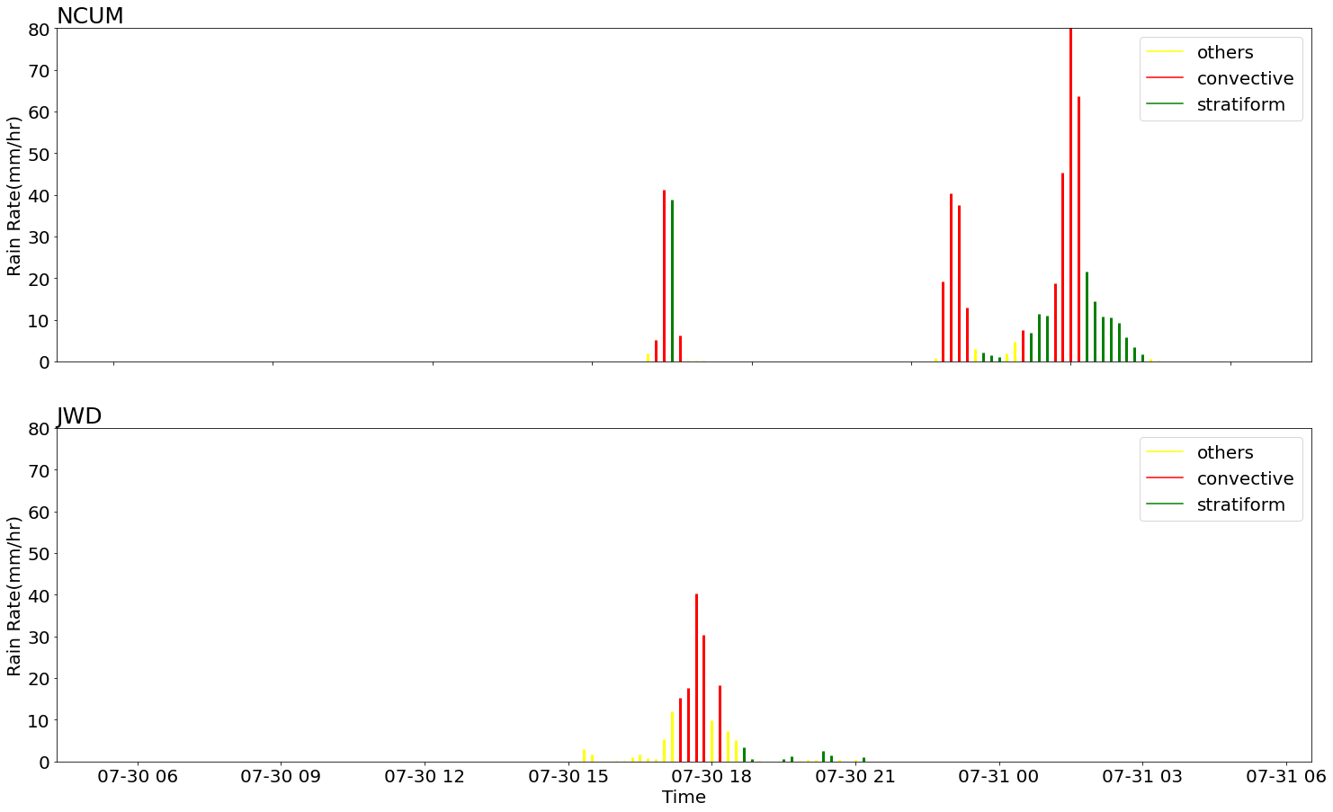
Modification of Cloud-Aerosol Interacting Microphysics for the tropical monsoon region
Apsara K S ^{1, 2}, Jayakumar A ¹ ,Anurose T J ¹ , Saji Mohandas ¹,Prabhakaran. T ³,Paul Field ⁴ ,V S Prasad ¹
¹ National Centre for Medium Range Weather Forecasting(NCMRWF),Noida,India,² Indian Institute of Science Education and Research,Tirupati, ³ Indian Institute of Tropical Meteorology,Pune,
⁴ Met office Exeter,UK
Email id :jayakumar.a@nic.in
INTRODUCTION AND MOTIVATION
RESULTS
Climatological analysis consistently demonstrate the prevalence of stratiform events over convective events in tropical monsoons. The Drop Size Distribution (DSD) analysis of these events are widely used to investigate the underling microphysical processes of these events. The nature of DSD parameters are estimated from
JWD
NCUM-R
GPM
Figure 1 showing the different raintype occurrence at Tuljapur, Maharastra
Figure 4 - DSD characteristics from model and observations
double moment cloud microphysical scheme (CASIM : Cloud Aerosol Interacting Microphysics) employed in the operational convection permitted model of NCMRWF. This is the first study which comprehensively compare the model estimated DSD bulk parameters from CASIM against ground based disdrometer (JWD) and GPM-DPR. Further the interpretations from the study is utilized for the detailed study of different microphysical processes. The sensitivity analysis of these microphysical processes (autoconversion) using more advanced schemes, gives the reliability check on the current schemes and its scope of improvement in the tropical region.
Analysation of DSD of the case events shows the overestimation of Nw in the NCUM-R for smaller drops (Dm < 3mm) and significant underestimation of larger drops (~ Dm> 4 mm)
The model is not able to characterize the bigger drops (~Dm> 4mm) ,which is formed mostly due to convective rain.
There is an overall domination of stratiform events by the model and an incompatibility in the prediction of convective events.
sensitivity analysis of autoconversion on extreme events
The discrepancies in these DSD characteristics obtained are influenced by microphysical process resulting the events, wherein the primary process during the formation of the rain droplets, autoconversion, is studied. Sensitivity experiments using more comprehensive Liu and Daum 2004 (LD) parameterization against current Khairoutdinov and Kogan 2000 (KK00) autoconversion scheme have shown improvement in the DSD characteristics.
LD scheme supported the growth of larger drops and in realistic microphysical processes compared to KK00.
The impact in the extreme events - lightning and heavy precipitation are shown below:
METHODOLOGY
Introduction of raintype separation algorithm in the model for effective classification of precipitation into convective or stratiform.
Figure 2-Raintype separation algorithm introduced in NCUM-R
Lightning Event (18/07/23)
Kerala Flood 2018
KK00
LD
DSD diagnostics in the model to obtain the bulk parameters mass weighted mean diameter (Dm) and normalized number concentration parameters (Nw) for each timestep. This involved deriving the equation of Dm and Nw in terms of the double moment gamma distribution function followed by the model.
Figure 5 - The impact of LD and KK00 scheme on these selected extreme events
CONCLUSIONS AND FUTURE SCOPES
LD scheme is found to improve the DSD characteristics compared to the current KK00 scheme, but more optimisation in LD is required before implementing the scheme operationally in terms of observationally validated dispersion term and mechanisms of the growth.
The extension of this DSD analysis to all homogeneous regions of the Indian tropical subcontinent using GPM to evaluate the consistency in present results which can lead to generalized parametrization specific to tropical settings
Certain case events with convective stratiform precipitation distribution is selected using the IMERG and JWD data for simulation.
Algorithm verification using JWD observations of case events shows the proper segregation of precipitation to convective and stratiform.
REFERENCES
Paul R Field, Adrian Hill, Ben Shipway, Kalli Furtado, Jonathan Wilkinson, Annette Miltenberger, Hamish Gordon, Daniel P Grosvenor, Robin Stevens, and Kwinten Van Weverberg. Implementation of a double moment cloud microphysics scheme in the uk met office regional numerical weather prediction model. Quarterly Journal of the Royal Meteorological Society, 2023
Jingxuan Zhu, Shuliang Zhang, Qiqi Yang, Qi Shen, Lu Zhuo, and Qiang Dai. Comparison of rainfall microphysics characteristics derived by numerical weather prediction modelling and dualfrequency precipitation radar. Meteorological Applications, 28(3):e2000, 2021.
Yangang Liu and Peter H Daum. Parameterization of the autoconversion process. part i: Analytical formulation of the kessler-type parameterizations. Journal of the atmospheric sciences, 61(13): 1539–1548, 2004.
Figure 3 - Time series of rain events on 30 th July 2022

