Slide 1
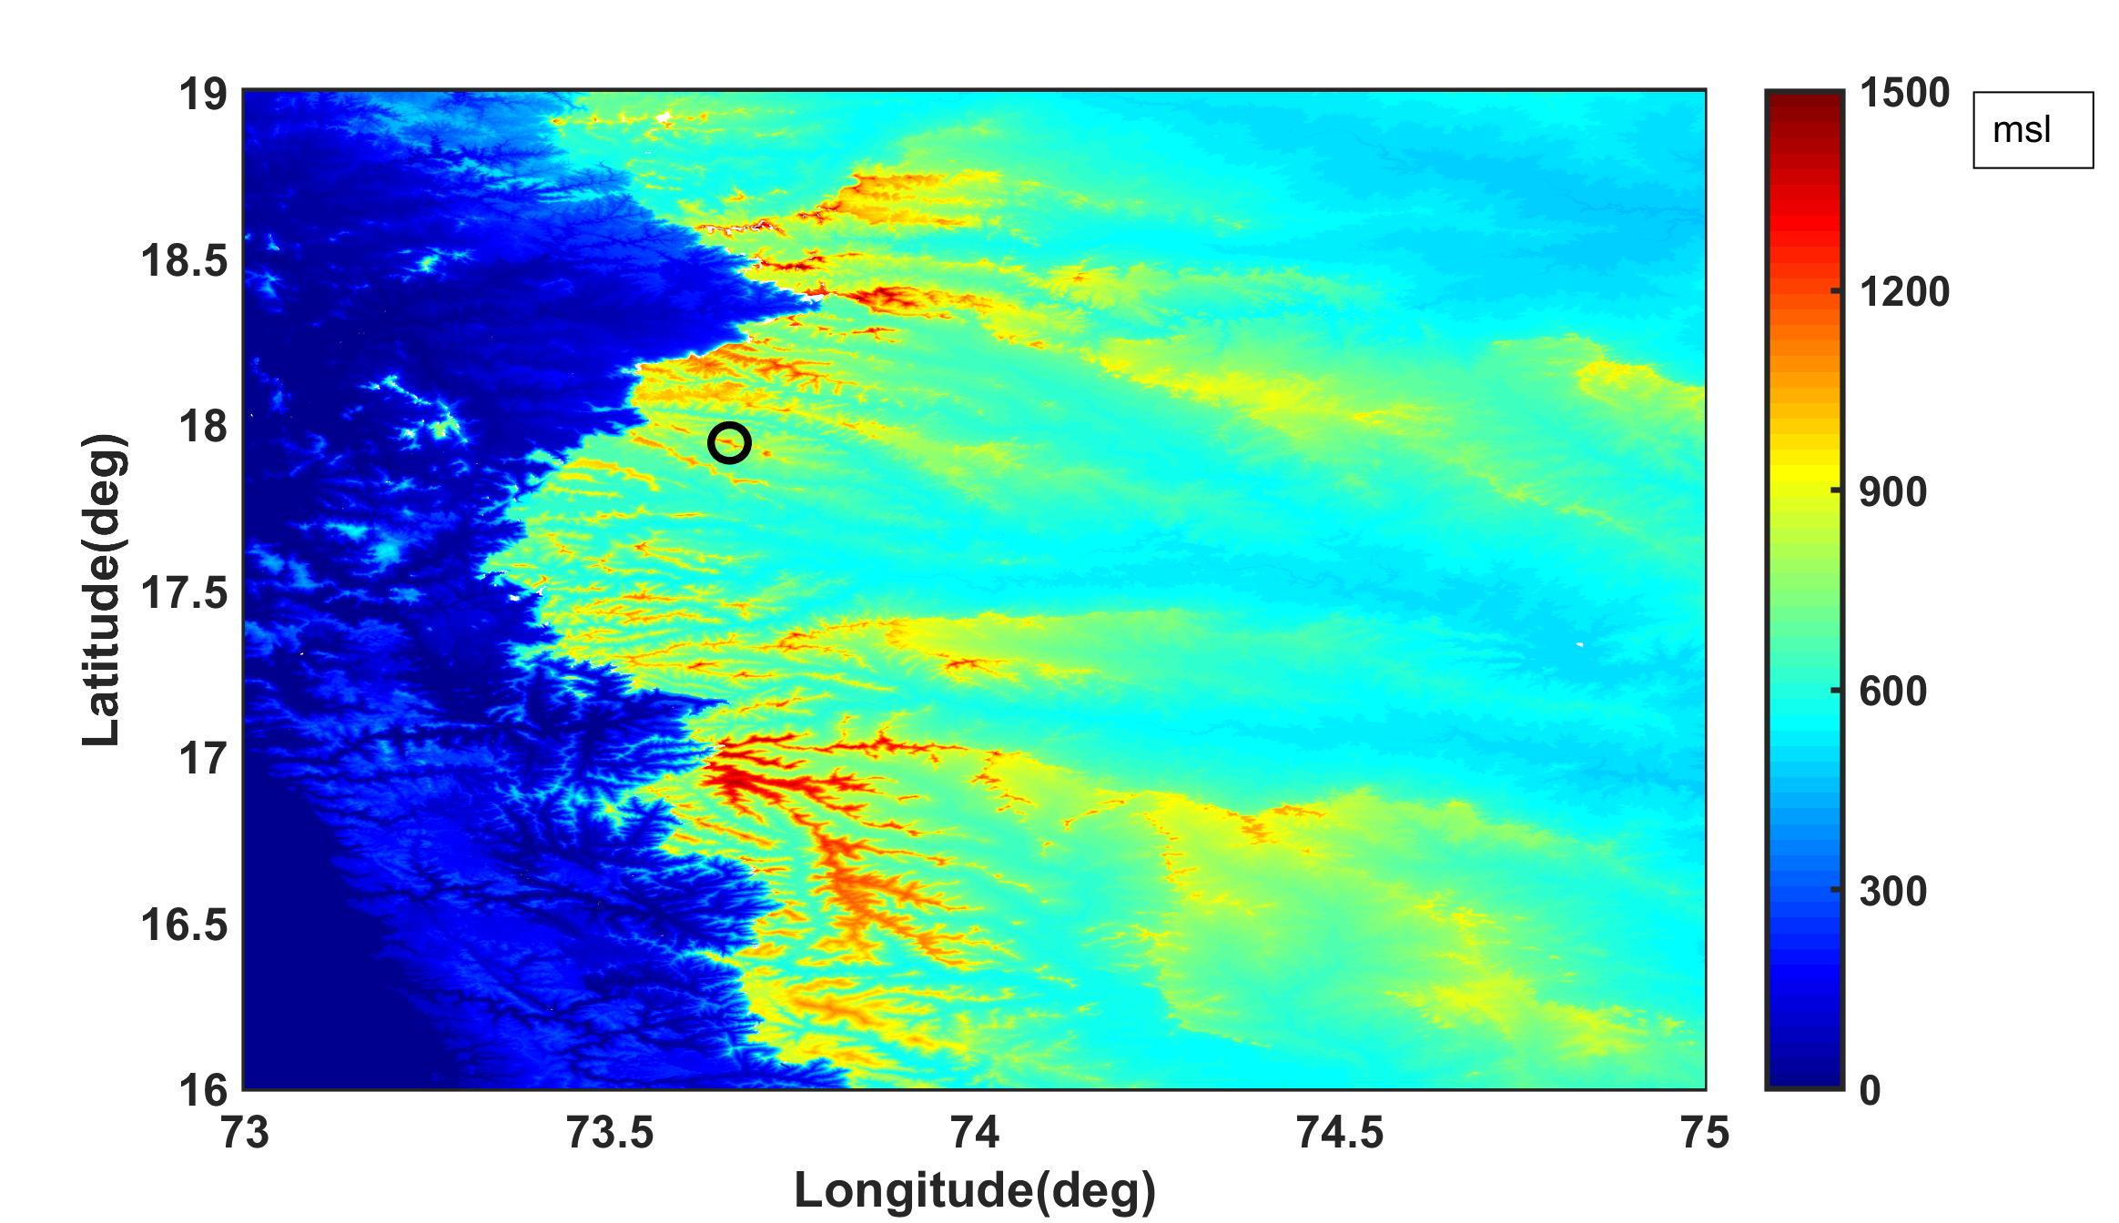
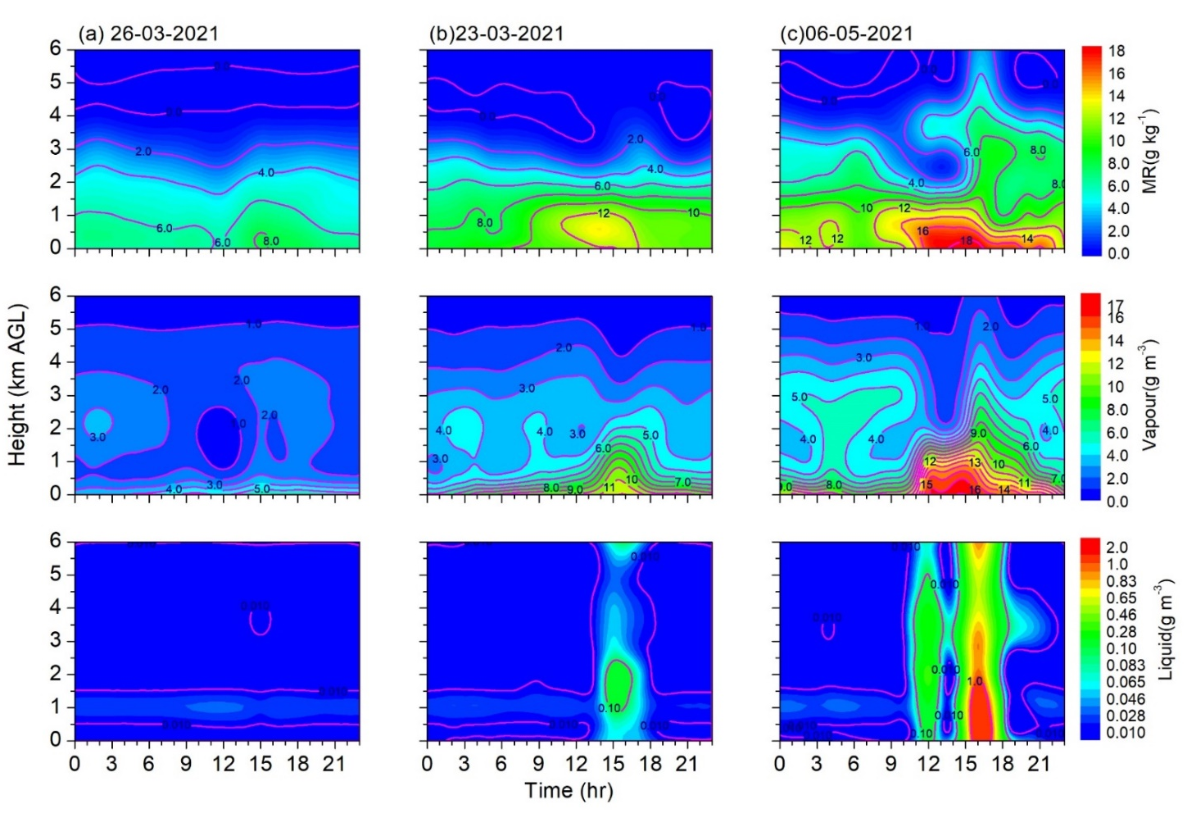
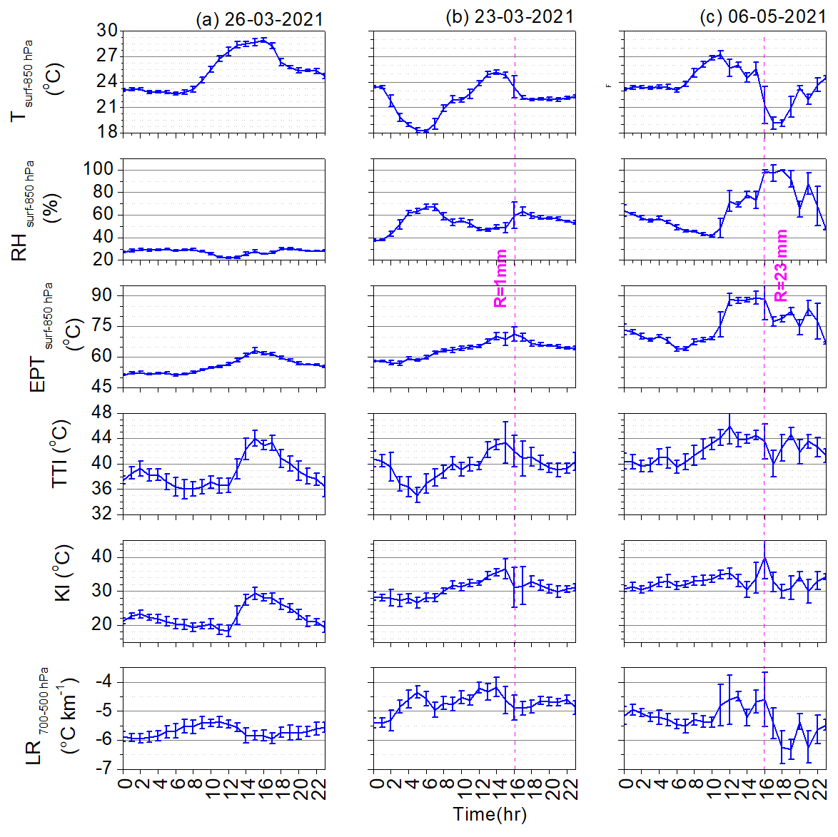
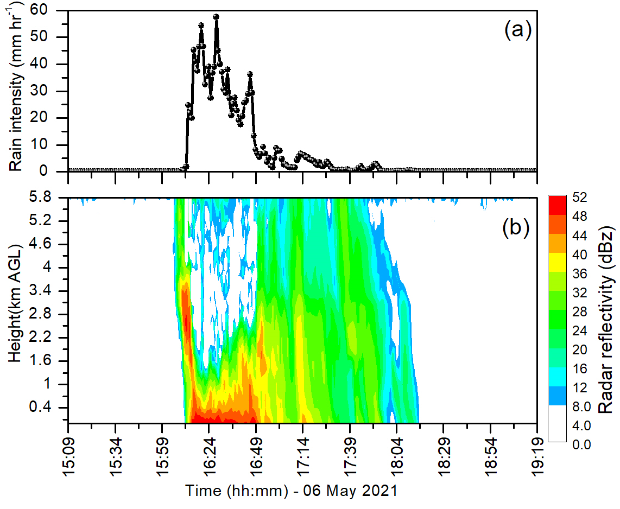
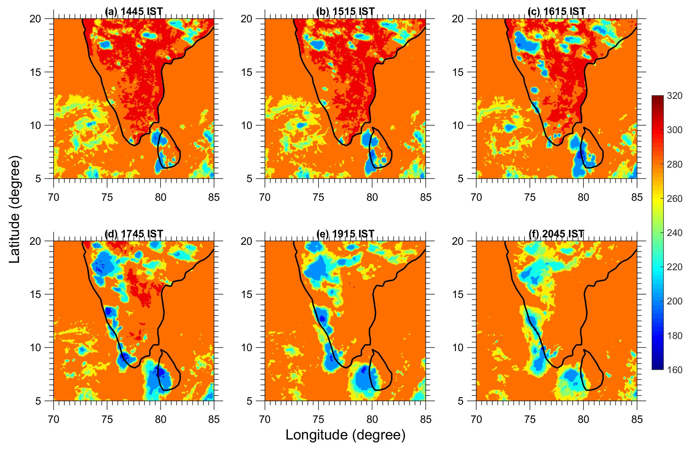
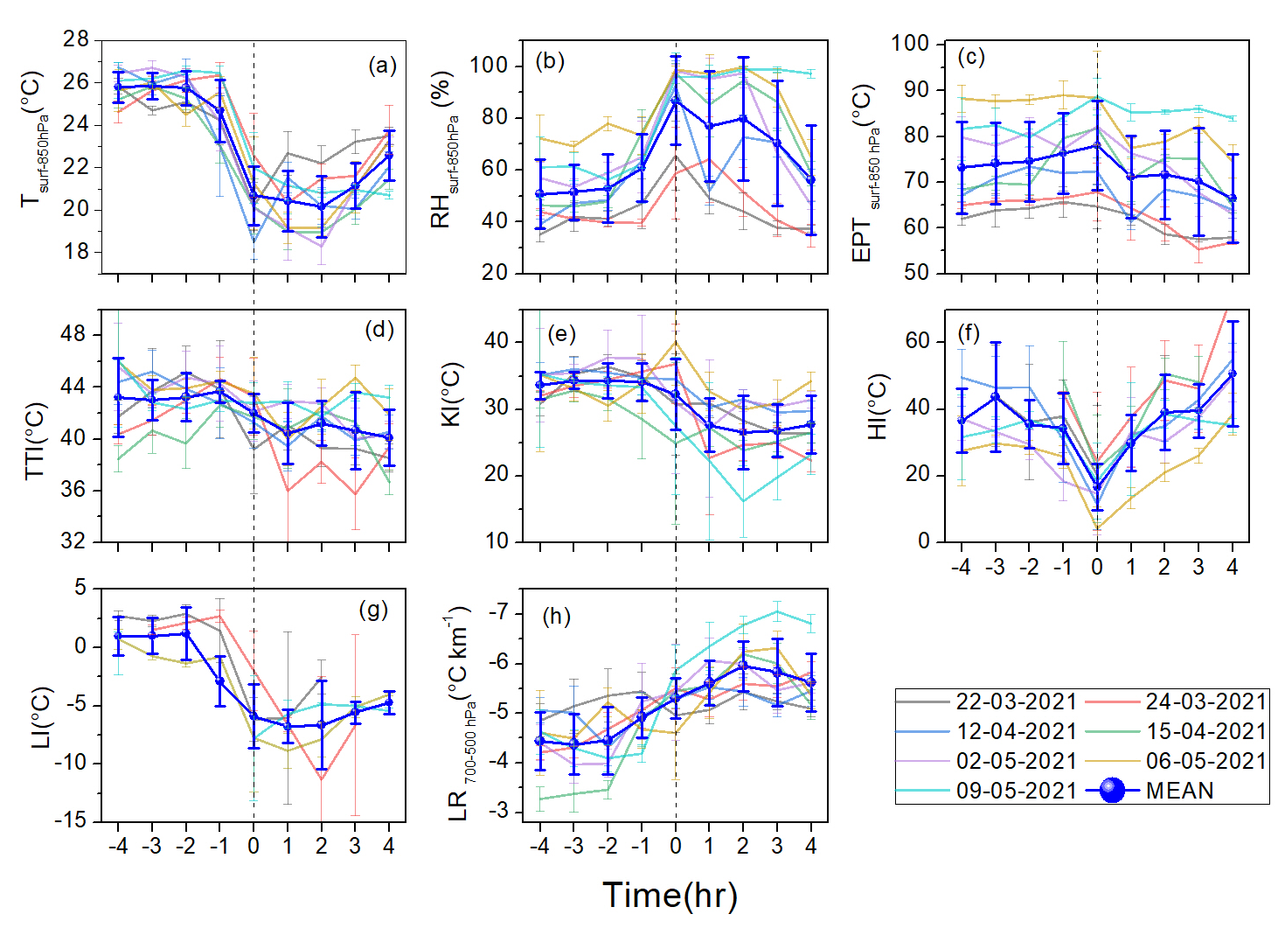
Atmospheric stability and cloud-rain characteristics during pre-monsoon precipitating events analysed using ground-based observations of a high-altitude site in Western Ghats, India
Leena.P.P¹ , Resmi.E.A² , Dhwanit.J.Mise³ , V. Anilkumar¹ , Arun.V.S¹ , Rohit.P.Patil¹ , G. Pandithurai¹
1 Indian Institute of Tropical Meteorology, Ministry of Earth Sciences, Pashan, Pune 411008, Maharashtra, India
2 National Centre for Earth Science Studies, Ministry of Earth Sciences, Thiruvananthapuram 695011, Kerala, India
3 Department of Atmospheric & Space Sciences, Savitribai Phule Pune University, Pune 411007, India
Objective
The Indian subcontinent frequently experiences severe thunderstorms during the pre-monsoon season i.e., March, April, and May.
Thus, understanding its thermodynamic characteristics, cloud types and formation mechanism, precipitation etc. is essential as convection is often associated with these aforesaid processes.
Most of these abovesaid processes can be addressed in a single study is possible through co-located ground-based observation as individual convective storms has short lifetime (Madhulatha et al., 2013).
Thus, considering the advantage of co-located observation, the present study focused to understand the thermodynamics-cloud-rain properties particularly during pre-monsoon precipitating events over a high-altitude location in WG, India.
Data Used
Results and Discussion
Height (km AMSL)
Topography map highlighting the study region
(black circle- Mahabaleshwar (17.56 ⁰ N, 73.4° E)).
Instruments/ datasets | Parameters used (unit) | Resolution/range
Ground based microwave radiometer | Vertical profile of T (ºC), RH (%), liquid (gm⁻³) | 02 min; varying vertical resolution from 0-10 km AGL
Ceilometer | CBH (km AGL) | 15m from 0-15km AGL and 15 sec
Impact disdrometer | Rainfall(mm), rain intensity (mm hr⁻¹), and rain DSD (mm⁻¹ m⁻³) | 30 sec; 0.3–5.3 mm
MRR | Reflectivity (dBz) | 200 m from 0-6 km AGL and 01 min
AWS | Wind speed (ms⁻¹) | 01 min
INSAT 3D | TIR1 Brightness temperature (K) | 4km×4km
Time-height cross-section of MR (first row), vapour (mid row) and liquid (third raw) during (a) 26-03-2021 (non-precipitating), (b) 23-03-2021(weak precipitating), and (c) 06-05-2021 (strong precipitation).
A remarkable difference in the T and RH, equivalent potential temperature, stability indices (KI, TTI, HI), moisture (MR and vapour), and liquid are noticed from non- precipitating to a precipitating day.
Strong precipitating case showed sharp changes in the meteorological parameters (T < 24ºC, RH > 95%) and stability indices (TTI >44ºC, KI>38ºC etc). In addition, higher low-level moisture availability (MR~16-18 g kg⁻¹, vapour ~16 gm⁻³) and high value in cloud liquid (>0.50 gm⁻³) was noticed just before and during the event.
Diurnal variation of T _{surf-850 hPa} , RH _{surf-850 hPa} EPT _{surf-850 hPa}, TTI, KI and LR _{700-500 hPa} during (a) 26-03-2021 (non-precipitating), (b) 23-03-2021( weak precipitating) and (c) 06-05-2021 (strong precipitating). The Magenta line in the second and third columns- highlights the rainfall amount and the time of occurrence. Vertical bar- standard deviation.
Results and Discussion
Temporal variation of rain intensity from impact disdrometer, and (b) time-height cross section of reflectivity from during 06 May 2021.
Spatial distribution of brightness temperature from INSAT 3D at (a) 1415, (b) 1515, (c) 1615, (d) 1745, (e) 1915 and (f) 2045 IST respectively of 06th May 2021.
The rain intensity measured from impact disdrometer showed rainfall event starting from ~ 16:10 IST with intensity > 20 mm hr⁻¹ from 16:13 to 16:48 IST and there after it reduced to 10 mm hr⁻¹.
The radar reflectivity was mostly higher at the surface. The reflectivity showed maximum > 40 dBz and the vertical extension of higher reflectivity values (> 36 dBz) were till ~ 4 km AGL for the same above-mentioned timing. The higher values of radar reflectivity indicate this event as a convective storm as the reflectivity is a proxy for identifying the intensity of storm.
The signatures of deep cloud with low base have noted from the vertical profile of liquid. Further the evolution of clouds has been analysed from INSAT 3D brightness temperature. The BT values have confirmed the presence of deep clouds over and the nearby area of study region during the time event. Clear evolution to dissipation of clouds is also noted from the spatial distribution of BT.
Temporal variation (±04 hrs) (a) T _{surf-850 hPa}, (b) RH _{surf-850 hPa}, (c) EPT _{surf-850 hPa}, (d) TTI, (e ) KI, (f) HI, (g) LI, and (h) LR _{700-500 hPa} respectively during the individual strong convective cases and their composite mean estimated from MWR. Vertical bar- standard deviation.
Higher T, EPT, TTI, KI, HI, and LI was noted ~2 hrs before the event suggesting the atmosphere is unstable and conducive for the development of thunderstorm (Umakanth et al., 2021). Higher moisture convergence during and ~ 01 hrs before the event were noted from the RH and HI. LR showed heating (cooling) before (after) the event, which confirms, more unstable (stable) atmosphere.
In the present work, co-located ground-based observations are utilized to study the atmospheric stability and cloud-rain properties over a high-altitude during pre-monsoon precipitating events.
The meteorological-moisture parameters ,stability indices (TTI, KI, LI and LR), and cloud properties (liquid profiles) showed an apparent changes from non-precipitating to precipitating events.
The higher radar reflectivity values (> 40 dBz) indicated the event was a convective storm. Higher values in liquid and radar reflectivity and lower values of BT suggested that the strong precipitating event are evolved from the deep cumulonimbus clouds.
Analysis suggested that the localized convection formed over the region favoured the formation of strong precipitating event in the pre-monsoon season over Western Ghats. The locally originated convection in the afternoon hours from 16.00 LST, sustained for ~3 hours over the region.
Quantitative analysis of the stability indices (T, EPT, TTI, KI, HI and LI) depicts higher values ~2 hrs before the strong precipitating event over Mahabaleshwar, suggesting the atmosphere are unstable and conducive thunderstorm development.
Cloud layer statistics showed single-layer clouds of ~8% (20%) and double layer of ~ 42% (26%) before (after) the event.
References
Madhulatha, A., Rajeevan, M., Venkat Ratnam, M., Bhate, J., Naidu, C.V., 2013. Nowcasting severe convective activity over southeast India using ground-based microwave radiometer observations. J. Geophys. Res. Atmos. 118, 1–13. https://doi. org/10.1029/2012jd018174.
Umakanth, N., Satyanarayana, G.C., Naveena, N., Srinivas, D. & Rao, D.V. 2021. Statistical and dynamical based thunderstorm prediction over southeast India. Journal of Earth System Science, 130(2), 1–18.
Acknowledgements
The authors thank the Director of the Indian Institute of Tropical Meteorology (IITM) for his full support. The authors are thankful to the team members of HACPL of IITM. IITM and HACPL are fully funded by the Ministry of Earth Sciences (MoES), Government of India.
Main Findings
INTERNATIONAL WORKSHOP ON
Stratosphere-Troposphere Interactions and Prediction of Monsoon weather EXtremes (STIPMEX)
02-07 June 2024

