Slide 1
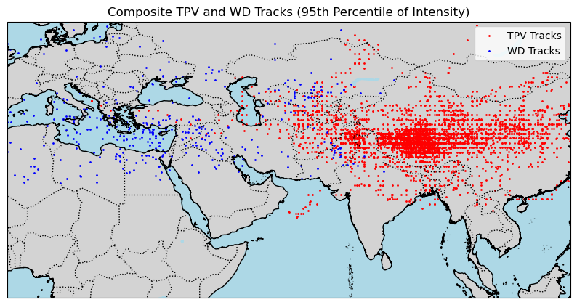
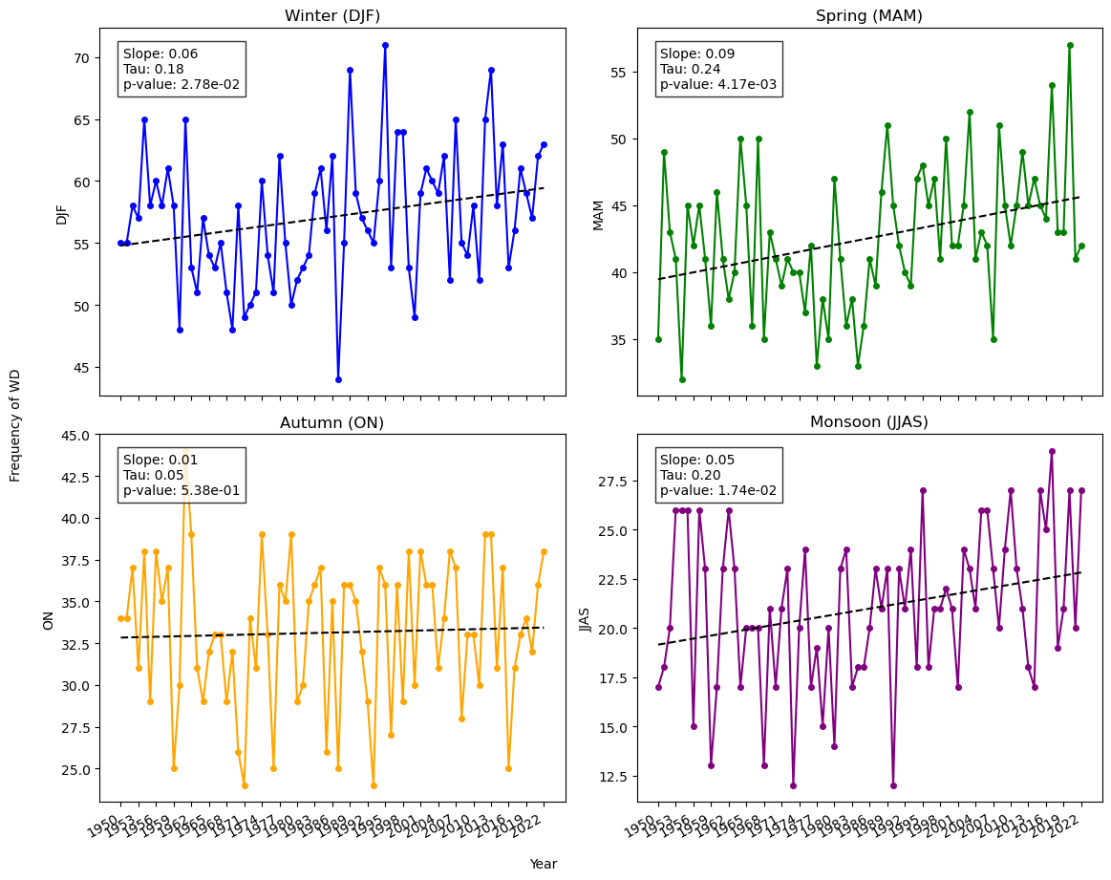
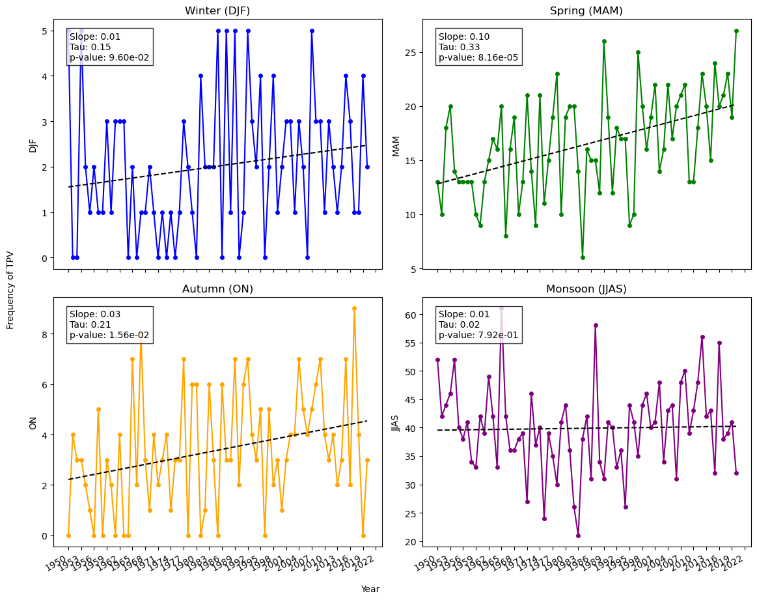
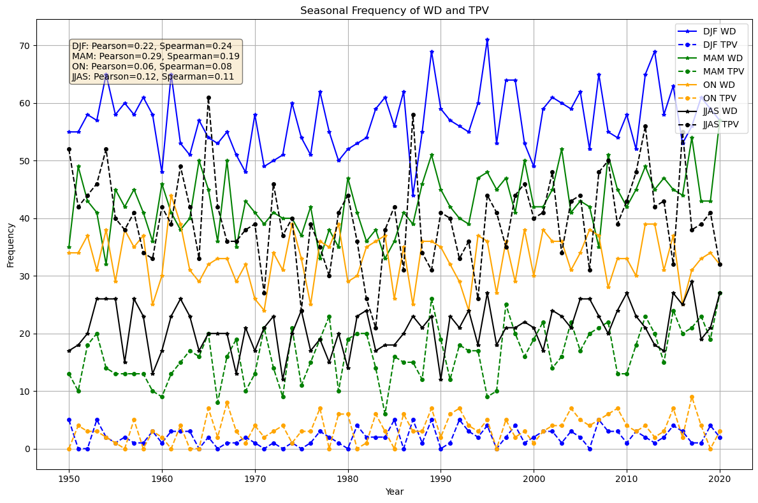
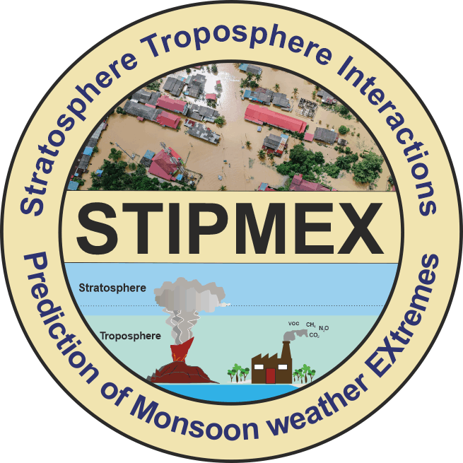
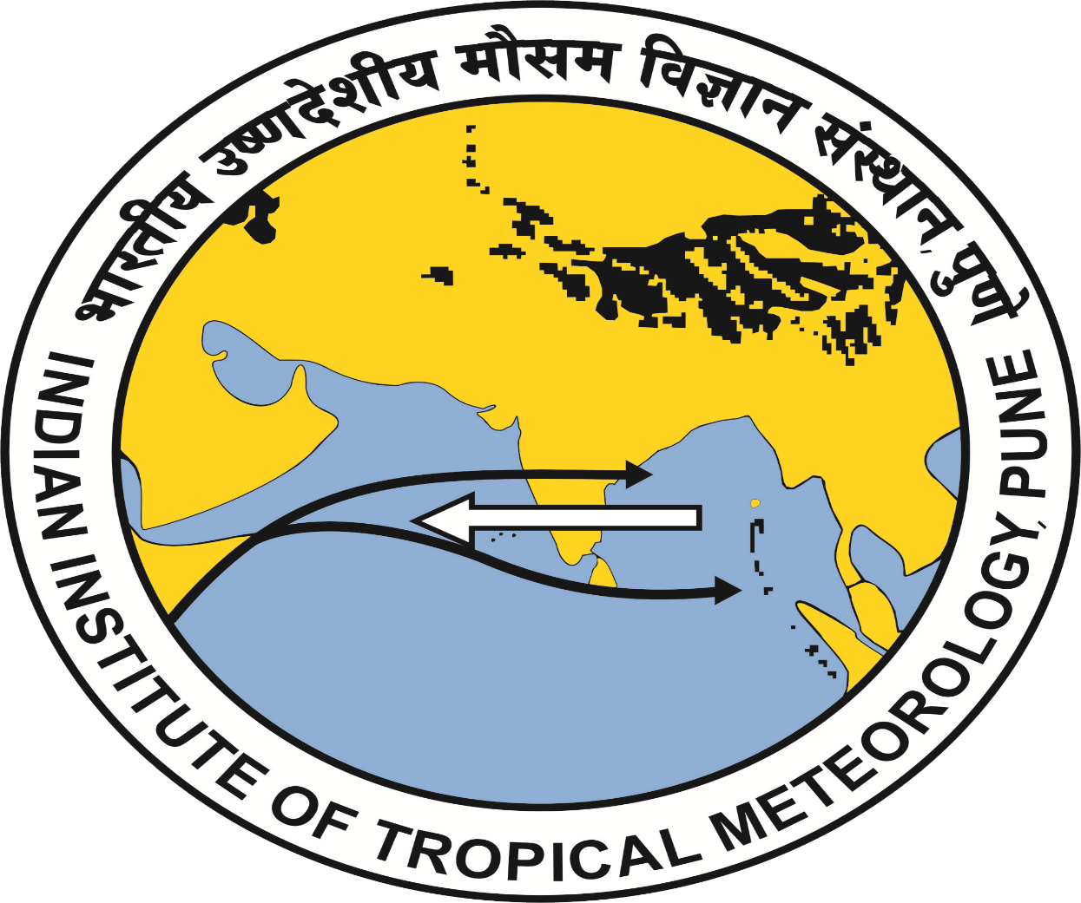
Trends of Western Disturbances and their Relationship with the Indian Summer Monsoon through Tibetan Plateau Vortex Spandita Mitra*, Ankit Agarwal Indian Institute of Technology Roorkee, India spandita_m@hy.iitr.ac.in | ankit.agarwal@hy.iitr.ac.in
Motivation and Objectives
Methodology
Western Disturbance (WD) is an extratropical low-pressure system dominant in winter month.
WD events are significantly increasing in seasons other than winter.
We comprehensively analyzes trend of WD events during all the seasons and investigates the impact of WD on the Indian Summer Monsoon (ISM) by focusing on semi-permanent system especially the Tibetan Plateau Vortex using statistical techniques.
Tibetan Plateau Vortex (TPV) plays an important role in modulating air circulation, moisture transport, and precipitation patterns of the Indian Summer Monsoon. Therefore, the correlation between TPV and WD can be an important indicator for predicting ISM and WD.
Correlation Analysis
Spearman Rank Correlation
Pearson Correlation
Composite Tracks
Calculation of 95th Percentile Intensity
Identification of the Track IDs that reach and exceed 95th percentile at least once
Filtering both datasets to identify those track IDs
Datasets
Dataset Used | Selected Variables | Description
Track Data of WDs | Latitude Longitude Vorticity Date-Time | Provided by Hunt et al.(2018) has based on his tracking algorithm of western disturbance using ERA5 data. Contains track data of all the WD events from 1950-2022, events which lasted more than 24hrs.
Track Data of TPV | Latitude Longitude Intensity Date-Time | Provided by Lin Z.(2022) has based on the scheme of Lin (2015) geopotential height at 500 hPa using ERA5 dataset. Contains track data of all the TPV events from 1950-2021.
Results
Discussion
Season-Wise Variation of frequency of occurrence of WD from the year 1950-2022 (Trend Fitted) for DJF, MAM, JJAS and ON
WD Activity
TPV Activity
Delays
Northward Shift of Westerly Jet
Advances
Shift of Northward Westerly Jet
Supports Delay in ISM Arrival
Supports Ealier Onset of ISM
Increasing in Summer (MAM)
Increasing in Summer (MAM)
The composite of WD and TPV tracks from 1950-2022 which events have attended the 95th percentile w.r.t. intensity at least once in the entire tracks. Red dot shows the presence of intense TPV whereas Blue dot shows the presence of intense WD events
Increasing Joint Influence in Summer, increasing variability on ISM Arrival
Summary
WD and TPV events are increasing in the pre-monsoon season (MAM).
Higher positive correlation between WD&TPV during the summer indicates an increase in WD can lead to an increase in TPV events.
Increase in TPV supports the earlier onset of monsoon, whereas increase in WD events during summer can disrupt the arrival leading to a more complex and variable monsoonal season in India.
Season-Wise Variation of frequency of occurrence of TPV from the year 1950-2022 (Trend Fitted) for DJF, MAM, JJAS and ON
References
Mooley, D. A. (1957). The role of Western Disturbances in the production of weather over India during different seasons. MAUSAM, 8(3), 253–260. https://doi.org/10.54302/mausam.v8i3.5037
Hunt, K. M. R., Turner, A. G., & Shaffrey, L. C. (2018). The evolution, seasonality and impacts of western disturbances. Quarterly Journal of the Royal Meteorological Society, 144(710), 278–290. https://doi.org/10.1002/qj.3200
Hunt, K. M. R., Curio, J., Turner, A. G., & Schiemann, R. (2018). Subtropical westerly jet influence on occurrence of western disturbances and Tibetan Plateau vortices. Geophysical Research Letters, 45(16), 8629-8636. https:// doi.org/10.1029/2018GL077734
Lin, Z., Guo, W. (2022). Database of the Tibetan Plateau vortex derived from multiple reanalysis (1979-2021). A Big Earth Data Platform for Three Poles, DOI: 10.11888/Atmos.tpdc.272374. CSTR: 18406.11.Atmos.tpdc.272374.
Dimri, A. P., Chevuturi, A., Dimri, A. P., & Chevuturi, A. (2016). Western Disturbances–Indian Seasons. Western Disturbances-An Indian Meteorological Perspective, 61-82.
Correlation Between frequency of WD and TPV Occurrence from 1950-2022 for DJF (blue), MAM (green), ON (yellow) and JJAS (black). Pearson and Spearman Correlation has been done to better understand the relationship between these two phenomena. WD and TPV has been represented as solid and dashed lines respectively.
Acknowledgements
Indian Institute of Technology Roorkee
Indian Institute of Tropical Meteorology Pune
STIPMEX 2024
Stratosphere-Troposphere Interactions and Prediction of Monsoon weather Extremes (STIPMEX) Indian Institute of Tropical Meteorology, Pune
02-07 June 2024

