Slide 1
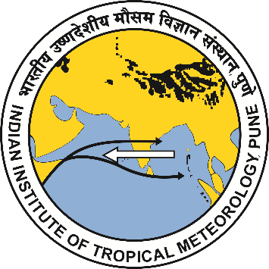
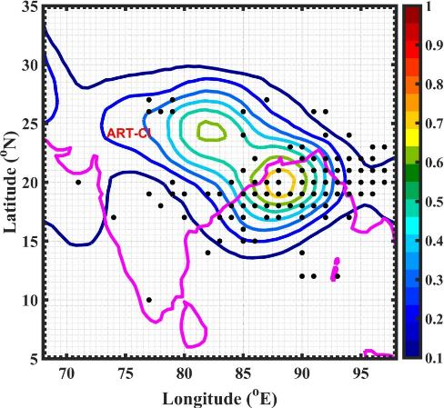
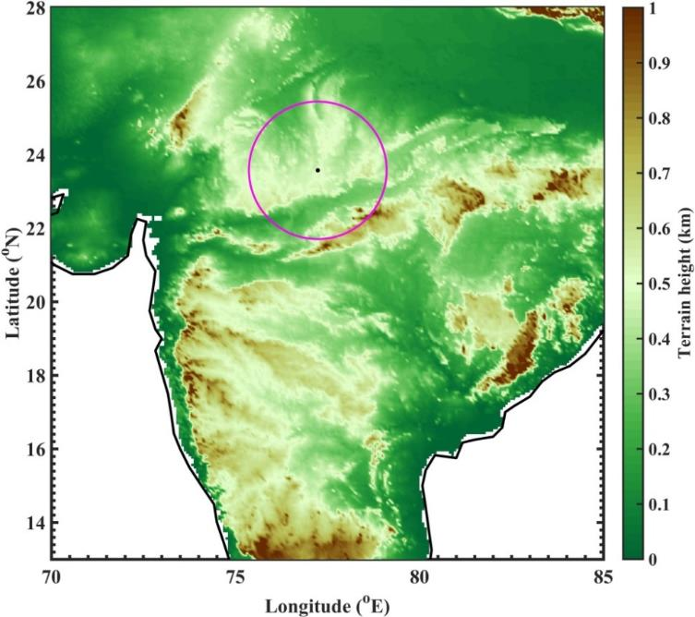
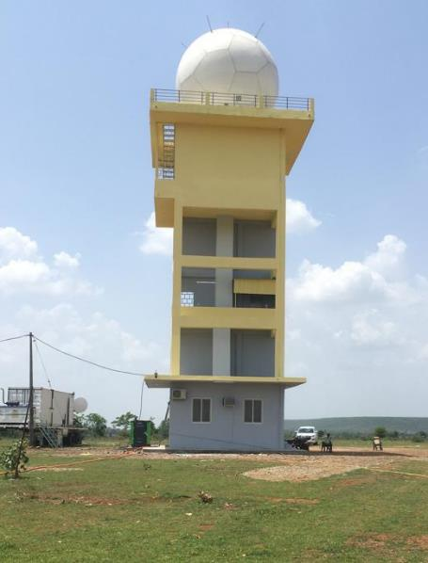
International Workshop on Stratosphere-Troposphere Interactions and Prediction of Monsoon Weather Extremes (STIPMEX)
Extreme rainfall over Indian core monsoon zone and their ingredients revealed by Radar and Reanalysis measurements
U. V. Murali Krishna*, Subrata Kumar Das, Yogesh K. Kolte and Govindan Pandithurai
Atmospheric Research Testbeds, Indian Institute of Tropical Meteorology, Silkheda, Bhopal, India
E-mail: murali.krishna@tropmet.res.in
ABSTRACT
The Indian core monsoon zone is a moisture-rich environment that aids the development of heavy rainfall during summer monsoon. The present study aims to understand the characteristics of extreme rainfall, like frequency, intensity, structure, etc. using dual-polarization Doppler weather radar measurements. Further, the dynamical and thermodynamical mechanisms responsible for these extreme rainfall events are investigated using European reanalysis data, ERA5.
Spatial climatology (JJAS) of LPSs (Jha et al., 2022)
DATA AND METHODS
Extreme rainfall events (EREs) are identified using the India Meteorological Department (IMD) gridded rainfall dataset. The EREs are identified for the monsoon season of 2022 based on the 99th percentile value of daily rainfall during the summer monsoon season over the base period from 1991 to 2021.
The EREs are tracked spatially and temporally using C-band dual-polarized Doppler weather radar installed at Atmospheric Research Testbed-Central India (ART-CI; 23.57 N, 77.24 E).
The Lagrangian storm tracking algorithm, TINT (TINT is not TITAN) is used to track the convective storms and to identify their characteristics. Here the convective storm is identified as the contiguous region of 32-dBZ reflectivity threshold that should be satisfied in a minimum volume of 30 km3
To understand the background mechanisms, the daily mean atmospheric parameters, such as specific humidity, temperature, winds, etc. from the ERA5 dataset has been utilized.
The moisture budget is estimated during a typical case of ERE and the contribution by the atmospheric dynamics and thermodynamics are investigated following Seager et al. (2010).
Topography of India showing the C-band radar site at Silkeda, Madhya Pradesh. Magenta circle shows 250 km from the radar.
To understand the relative roles of dynamic and thermodynamic processes on the moisture transport, the moisture and winds are decomposed into mean state and anomalies.
‘overbar’ denotes the climatological mean and ‘prime’ represents the deviations from the climatological mean
$−V. ∇_{H}q=−\left[u^{′}\frac{∂\overline{q}}{∂x}+v^{′}\frac{∂\overline{q}}{∂y}\right] −\left[\overline{u}\frac{∂q′}{∂x}+\overline{v}\frac{∂q′}{∂y}\right]$
RESULTS
Radar Observed Storm Properties
Frequency of Extreme Rainfall Events
Intensity of storms
Horizontal and vertical extent of convective storms
Histogram of storm-area
Storm area Vs max. Z
Distribution of ETH
Higher frequency of extreme events aligned parallel to monsoon trough region (from southeast to northwest).
The maximum reflectivity of storms reaches up to 50 dBZ, indicating moderate-to-high intensity.
The convective top height shows its maximum occurrence at 5 km, indicating that the congestus storms dominated during ERE.
Storms are MCS-scale in the radar domain. The storm area increases with its intensity.
The vertical extent of the EREs is limited to 12 km over central India.
Bimodal distribution of EREs: Primary peak at ~7 km (cumulus) and a secondary peak at ~ 10 km (deeper storms)
Dynamic and Thermodynamic mechanism of EREs
Composite anomalies of geo-potential height at 500 hPa, and low-level wind shear
Vertical variation in relative humidity and vertical wind over radar domain
Pressure-latitude cross-section of equivalent potential temperature
The negative geopotential height anomalies at 500 hPa favours the development of EREs over CI.
The stronger low-level shear (between 900 and 700 hPa) supports the development of MCSs (LeMone et al., 1998).
Higher RH at the mid-levels and strong updrafts support the development of extreme events (shown with rectangle boxes).
Above 200 hPa (~12 km), the vertical wind is minimal, explaining the limited vertical extent of EREs.
The equivalent potential temperature shows a strong stable layer at about 550 hPa, coinciding with the primary peak in the ETH.
Mean vertical profiles of moisture budget terms
Divergence of moisture flux
Dynamics contribution to horizontal q advection
Thermodynamics contribution to horizontal q advection
Horizontal advection and convergence are crucial for the initiation of EREs.
Vertical advection plays a major role in the vertical development of EREs.
Atmospheric dynamics significantly contribute to the horizontal moisture advection.
Summary
The EREs form frequently along/parallel to the Monsoon trough region in the radar domain.
The storms are moderate to heavy intensity and are associated with MCS over central Indian landmass.
The vertical extent of the storms is limited to 12 km with a bimodal distribution: the primary maximum is associated with congestus storms and the secondary with deep convective storms.
The dynamics of the atmosphere play a crucial role in the development of EREs.
Indian Institute of Tropical Meteorology (IITM), Ministry of Earth Sciences (MoES), India. 02-07 June 2024.

