Slide 1
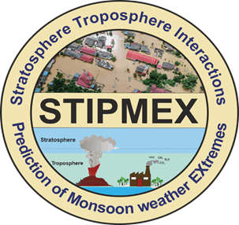

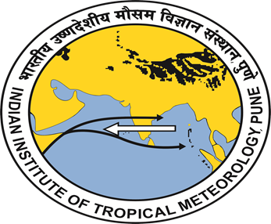
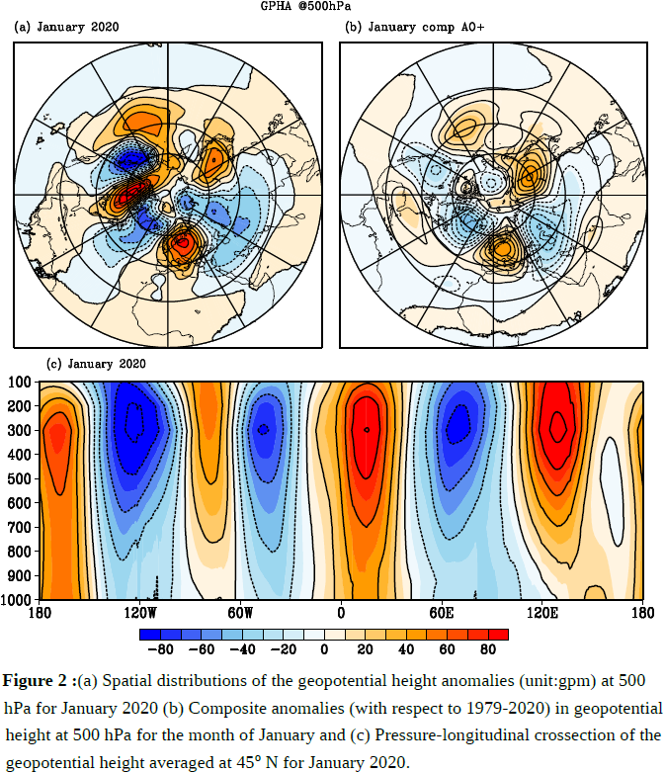
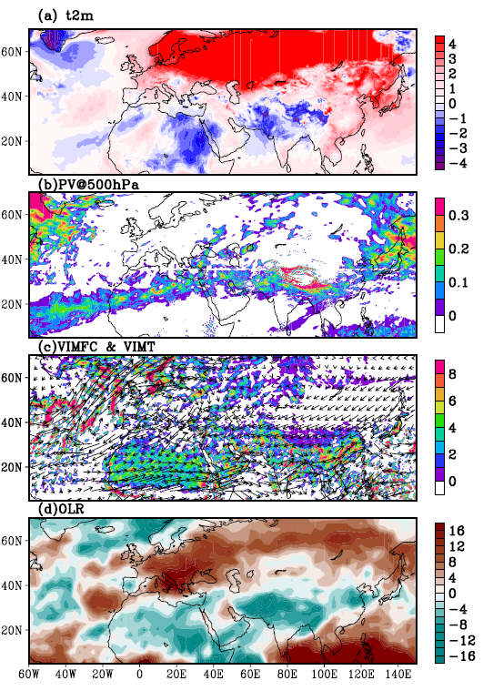
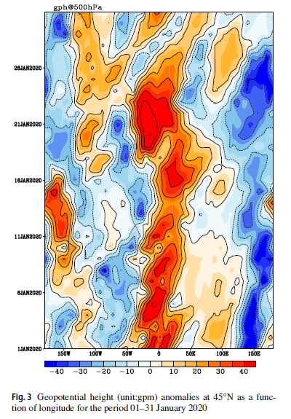
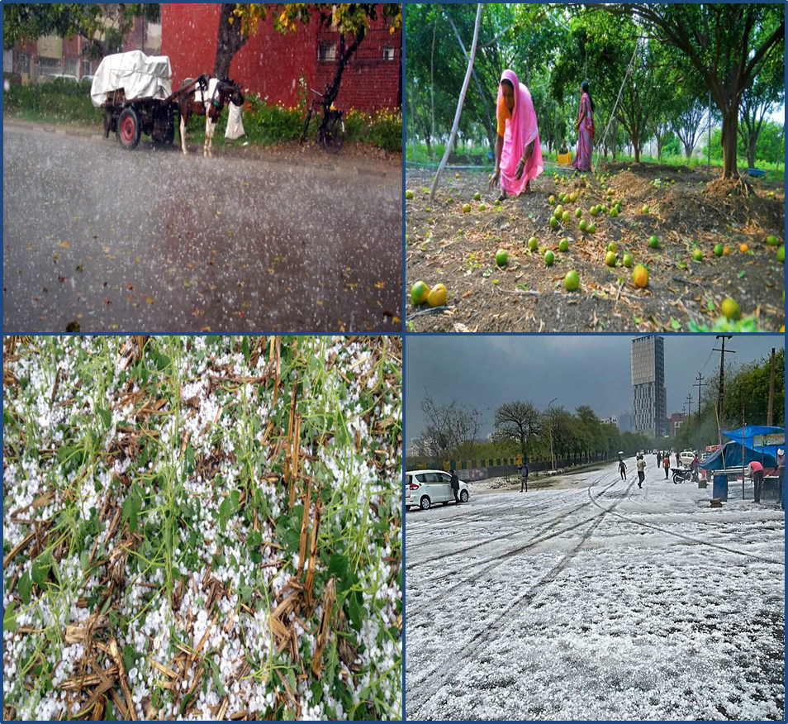
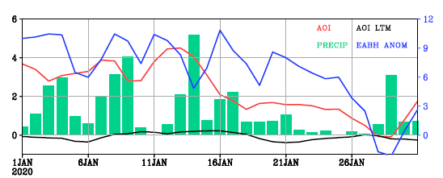
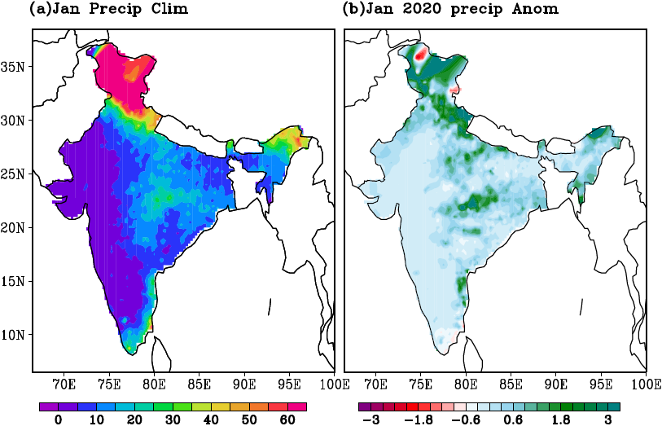
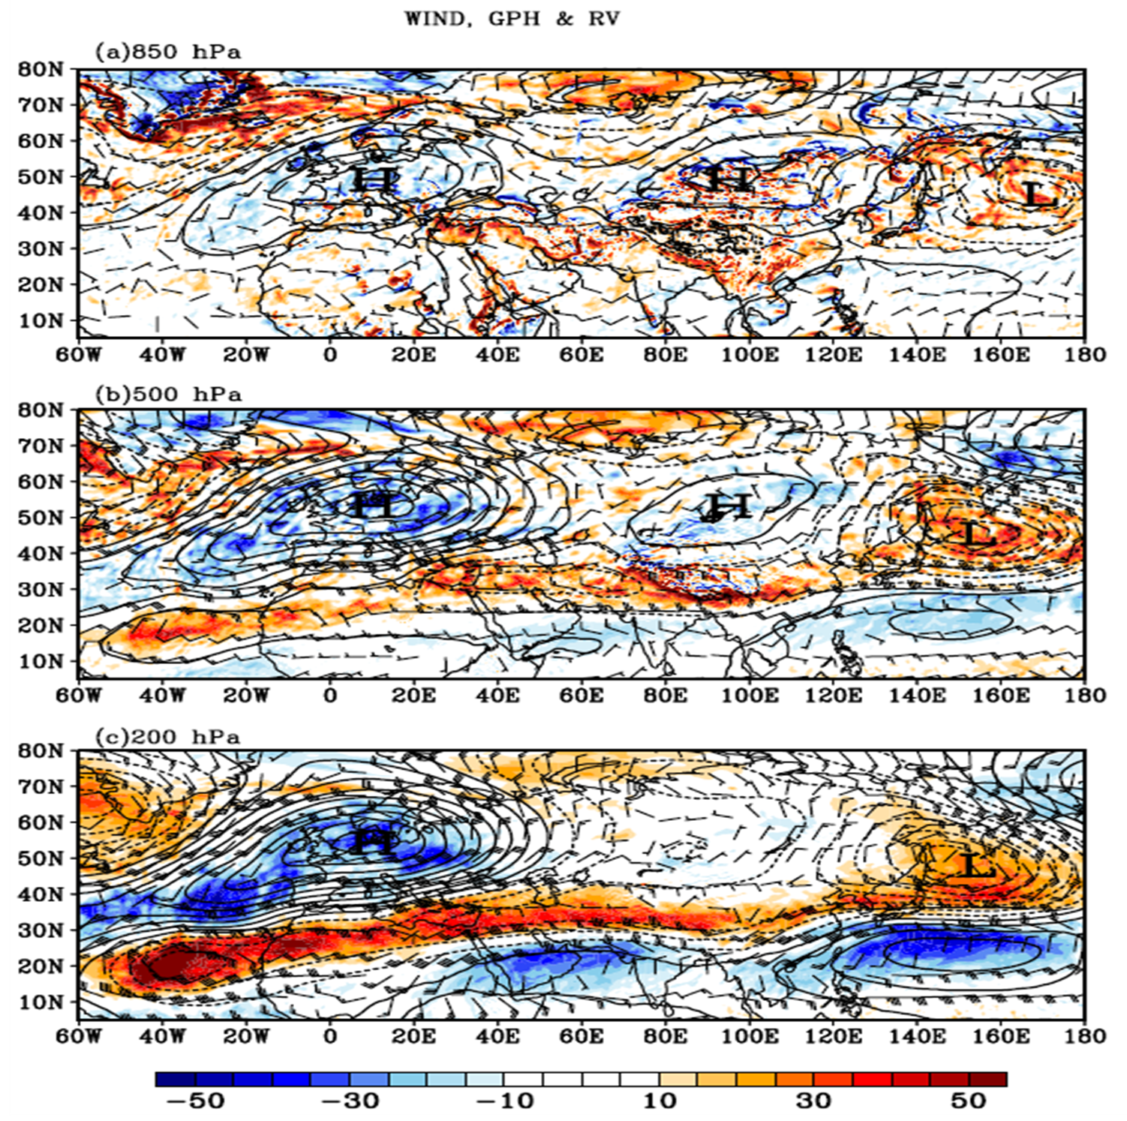
On the Association of the Arctic Oscillations and Winter Precipitation Extremes over the Indian Region
S. D. Sanap¹, M. Mohapatra², D. R. Pattanaik²
1. O/o The Climate Research and Services, Pune
2. O/o the Director General of Meteorology, New Delhi
India Meteorological Department
sd.sanap@imd.gov.in
Introduction
Results and conclusion
Winter precipitation in the central and northern parts of the Indian region plays a crucial role in supporting the growth of winter crops by complementing irrigation efforts and maintaining favorable temperatures and atmospheric conditions. During winter and pre-monsoon, the active western disturbances (WD, weather systems associated with subtropical westerlies in the Northern Indian region) are favorable for the hailstorm/thunderstorm occurrence over the region. So, a better understanding of the dynamics and thermodynamics of these events is necessary for improved weather forecasting and early warning dissemination. The teleconnections between AO (and blocking highs) and mid-latitudinal climate have been studied extensively however, its linkages to Indian winter precipitation are limited. Therefore, it is indispensable to understand the dynamical linkages between the AO and winter precipitation over the Indian region.
The moisture convergence along the region of the trough and the significant moisture transport from the Atlantic Ocean, Arabian Sea and Bay of Bengal resulted in the convection along the trough [corroborated with the negative OLR anomalies (Fig. 5d) and positive PV anomalies (Fig. 5b)].
Objectives
Fig. 2 (a) Spatial distributions of the geopotential height anomalies (unit:gpm) at 500 hPa for January 2020 (b) Composite anomalies (with respect to 1979–2020) in geopotential height at 500 hPa for the
To elucidate the influence of the AO and associated atmospheric circulation on the precipitation anomalies and hailstorm/thunderstorm occurrences over the Indian regions during January 2020.
The anomalies in 500 hPa geopotential height for January 2020 (Fig. 2a) suggest the planetary wavenumber 3 pattern with prominent blocking high over the Euro-Atlantic region.
Fig. 3. Geopotential height (unit:gpm) anomalies at 45°N as a function of longitude for the period 01–31 January 2020.
The suppression of the transient waves (formation of a block) between the longitudes 20ºE– 20ºW, which persisted for during 01–22 January 2020.
The wind reversal (northerly/easterly to westerly) from the outflow of the EABH at 30 ºN (Iraq and adjoining region) and 20 ºN (West coast of Africa and Atlantic Ocean) and easterlies as an outflow of the Siberian high reaching up to the middle east.
East–west trough extending from the East Atlantic Ocean to the northwest Pacific across North Africa, the Middle East, India and China.
Fig. 5 (a) Mean anomalies with respect to 1979–2020 for the month of January-2020 for a 2 m temperature (K) (b) potential vorticity (× 10^{–6}, unit: m⁻² s⁻¹ K kg⁻¹) at 500 hPa (c) vetically integrated moistureflux convergence (shaded, unit:Kg m⁻¹ s⁻¹) and transport (wind) (d) outgoing longwave radiation (W m⁻²)
Data and Methodology
For atmospheric variables: ERA-5 on a daily timescale at a horizontal resolution of 0.25° x 0.25°
India Meteorological Department (IMD) gridded rainfall data at 0.25x0.25 resolution is obtained from the IMD Pune.
The AO index (AOI) data on a monthly timescale has been obtained from the climate prediction centre (CPC).
NOAA OLR at 2.5 X 2.5
Fig. 6 Time evolution of the Arctic Oscillation Index (AOI, red curve), averaged precipitation over the central and north Indian region (72–97ºE, 20–37ºN, green bar), long term daily mean of the AOI and Euro Atlantic blocking high (EABH, blue curve) anomalies averaged over 15ºW–40ºE, 33–55ºN for the month of January 2020
In phase relationship between the AOI, EABH and
precipitation over the Indian region is observed.
The AO-induced EABH and detouring of the sub-tropical westerlies with moisture convergence over central and North India (with VIMT mainly from the Arabian Sea) facilitated the higher than normal precipitation over the region in January 2020.
For Further details please read:
Sanap, S. D., Mohapatra, M., Pattanaik, D. R., Devi, S. S., Kumar, S., & Kashyapi, A. (2024). Arctic–midlatitude–tropics interactions in January 2020: linkages to precipitation extremes over Indian region. Meteorology and Atmospheric Physics, 136(1), 2.
Sanap, S. D. (2023). Dynamical linkages between Arctic Oscillations and winter precipitation patterns over the Indian Region. Global and Planetary Change, 231, 104293.
Fig. 1 (a) Precipitation climatology (unit: mm) for the month of January (b) Precipitation anomalies (mm day⁻¹) for the month of January 2020. The data for the period 1979–2020 is utilised for computing climatology and anomalies respectively
Acknowledgements
The author expresses gratitude to Dr. M. Mohapatra, Director General of Meteorology at the India Meteorological Department, Ministry of Earth Sciences, for infrastructure support and guidance. The European Centre for Medium-Range Weather Forecasting is acknowledged for ERA-5 reanalysis products, the Climate Prediction Centre for the AOI, and thanks are extended to the India Meteorological Department for providing precipitation data.
Higher than normal precipitation with hailstorm/thunderstorm events was reported at various places in the central and northern Indian region in January 2020 (Fig. 1b).
The polar vortex was abnormally strong in January 2020 with an AOI of 2.413 (source: https:// www. ncdc. noaa. gov/telec onnect ions/ ao/).
Fig. 4. Mean anomalies with respect to 1979–2020 for the month of January-2020 for variables relative vorticity (shaded, unit: S^{–1}), geopotential height (contours, unit: gpm) and wind (barbs, unit: knots) for a 850 hPa (b) 500 hPa and (c) 200 hPa
INTERNATIONAL WORKSHOP ON
Stratosphere-Troposphere Interactions and Prediction of Monsoon weather EXtremes (STIPMEX)
02-07 June 2024

