Slide 1
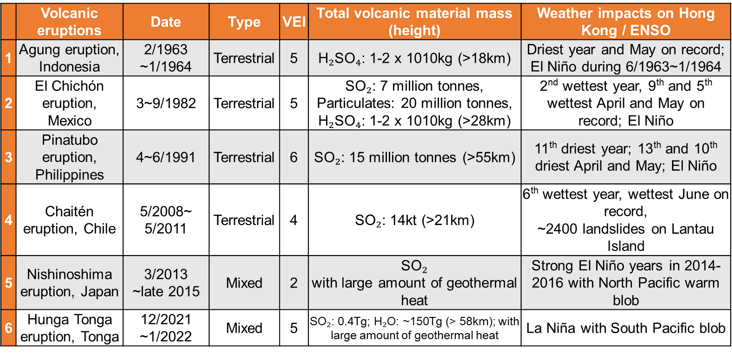
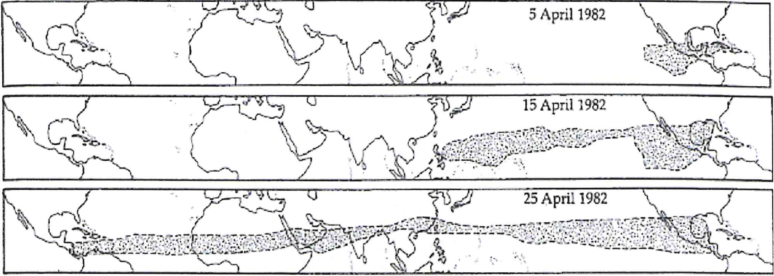
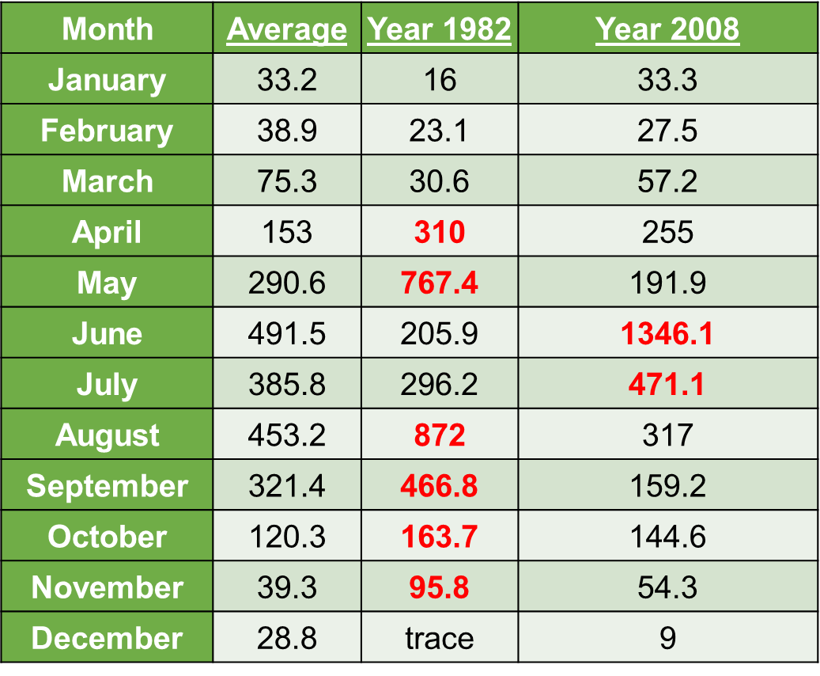
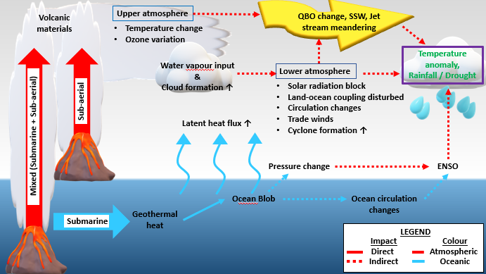
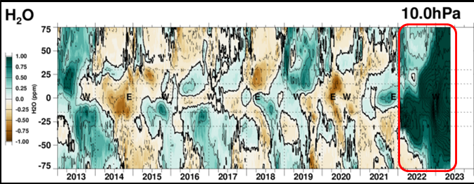
Volcanoes causing regional weather extremes
A. Roy ª , A. Wong ^{b}, W. Yim ^{c} and I. Roy ^{d} ,
ª SmartFlow Pneumatics, United Kingdom; ^{b} Volcanoes Study Group, Hong Kong SAR; ^{c} University of Hong Kong, Hong Kong SAR;
^{d} University College London, United Kingdom ,
(Email: Amitava.roy.2004@gmail.com)
Abstract. Strong volcanic eruptions (submarine, subaerial or mixed) not only can trigger many regional weather extremes, but numerous weather-related global anomalies are associated with it. Following the strength of eruption, sites of origin and eruption timings within the seasonal time of the year, volcanoes can have different regional and global impacts. Various climate modes that control regional weather patterns are perturbed and hence regional teleconnection patterns are modified. Both oceanic and atmospheric circulation patterns are often disturbed. Main mechanisms involved are the reduction of solar radiation, altering cloud distribution via aerosol loading, and altering ozone distribution in the stratosphere among others. Various effects are felt at the time scale of short, medium or longer-term range. In this work, studies using observation, reanalysis product and satellite data, effects of strong volcanic eruptions are examined and time progressions are analyzed for Hong Kong. Major interests are strong eruptions like Pinatubo (June 1991), El Chichon (March 1982) and Hunga Tonga (December 2021). Situations of regional weather extremes, including floods and droughts are of major interest. Similar analyses regionally as well as globally to underpin the impact of volcanic eruptions on climate can provide useful guidelines for volcanic risk assessment. It will lead to improved prediction skills of regional climate, alongside mitigating weather-related natural hazard risks.
1. Introduction
Background. Volcanic eruptions are one of the major causes of extreme weather but their direct and indirect roles on our climate are heavily underexplored. Volcanic eruptions which could be subaerial, submarine or mixed (combining atmosphere as well as oceanic) can play a key role in perturbing many atmospheric and oceanic features and ultimately leading to extreme weather. Possible mechanisms involved are modulation of radiation budget; affecting and altering atmospheric and oceanic circulation; perturbing teleconnection patterns and affecting cloud
distribution among others [1. 2]. Strong volcanos also influence major modes of variability e.g. ENSO and IOD [3], Asian Monsoon [4] and Arctic Oscillation [5] etc, though all those impacts are underestimated by climate models [ 6].
Methodology and Data. It used satellite, observational data and reanalyses products and applied some time series analyses. Data sources are at the bottom.
2 Results: One Specific Country, Hong Kong
Hong Kong experienced dry and wet seasons during 1963-2022 (Fig. 1) where timings matched with several volcanic eruptions as listed in Table 1 [7,8,^{a, b}]. The timing of rainfall events in Hong.
Fig 1. Locations of volcanic eruptions (left) and rainfall record of Hong Kong (right). (Source: Hong Kong Observatory [8, ª])
Table 1. A list of volcanic eruptions: Details and linkage to extreme rainfall record of Hong Kong
2. Method & Results
Fig 2. Sulphur dioxide from 1982 El Chichon eruption circled the globe in 21 days [^{c, d, e}]. [Source: Rampino, M.R. & Self, S. (1984). Sci. American 250/1:34-43
Table 2. Hong Kong rainfall amount in 1982 and 2008. [Source: Hong Kong Observatory]
Kong matched volcanic ash movements and E-folding time of 35 days for the conversion of SO₂ to sulphate. Sulphate can react with gases to form aerosols that block sunlight, as well as act as condensation nuclei. That favours cloud formation and alters rainfall amounts. Between 28th March and 4th April 1982, the El Chichón eruption ejected over 27 million tones of volcanic materials (sulphur dioxide, aerosols) into the stratosphere. It circled the globe completely in 21 days at an average rate of 20m/s; and reached Hong Kong on 16th April 1982 through the prevailing east/southeast winds. (Fig. 2, Table 2)
Table 2 showed much excess rain in Hong Kong during 1982 and 2008. 1982 was 2nd wettest year, 9th and 5th wettest April, May on record. Whereas, year 2008, 6th wettest year, wettest June on record, ~2400 landslides on Lantau Island.
3. Mechanism
Figure 3 discusses mechanisms, whereas Fig. 4 addresses strong influences of recent Hunga Tonga (HT) mixed eruption that extended even higher up the stratosphere. Fig 3 shows how direct and indirect influences of submarine, subaerial and mixed volcanoes impact atmosphere and ocean separately. It also presents some mechanisms of possible pathways for atmosphere and ocean
Fig 4. Water vapour (H₂O) at 10hPa between 75ºS-75ºN from MLS. [Source: MLS NASA ^{f}]
coupling. The HT eruption ejected ~ 0.4Tg of SO₂ and 150Tg of water vapour into stratosphere and mesosphere. Volcanic materials even reached an altitude of ~ 58km. There was a fivefold increase in stratospheric aerosols, which was the highest in last 30 years. Rapid ozone variation can modulate stratosphere-troposphere coupling.
Fig 3. A schematic showing various direct and indirect influences of strong volcanos (submarine, sub-aerial and mixed) on climate.
4. Discussions
Volcanic eruptions- subaerial, submarine or mixed can cause extreme rainfall.
Volcanic materials (sulphur dioxide, water vapour and aerosols) released can be carried by wind, affecting far locations.
Based on location, strength of eruptions and seasonal timing, volcanoes can influence the atmosphere and ocean differently.
Mechanisms for modulating rainfall: solar radiation reduction, changes in condensation nuclei and cloud interactions among others.
Strong eruptions can even change ozone distribution in the stratosphere altering stratosphere-troposphere coupling.
Time of 35 days for SO₂ conversion into sulphate matched extreme rainfall events in Hong Kong in 1982 and 2008 (Fig. 4).
This study using observation from satellite data and rainfall records from Hong Kong Observatory discussed (Fig. 1,2 and Table 1,2): The 1963 Agung eruption and the 1991 Pinatubo can be linked to the driest year and eleventh driest year in Hong Kong respectively.
Whereas, 1982 El Chichón and 2008 Chaitén eruptions could be linked to excess rain in Hong Kong, second and sixth wettest years on record respectively.
Mechanisms to influence atmosphere-ocean coupling by direct and indirect pathways are presented (Fig. 3).
After the recent Hunga Tonga mixed eruption from December 2021 to January 2022, many climate extremes happened regionally as well as globally. Short- term, medium-term and longer-term impacts (beyond 2022) need proper attribution with mechanisms (Fig. 4).
Important: Volcanic risk assessment and improvement in regional climate prediction.
Data
Atmospheric and Oceanic data:
a. HKO https://www.hko.gov.hk/en/cis/climat.htm
b. NOAA Physical Science Laboratory: https://psl.noaa.gov/data
Water (H2O):
f. MLS: https://acd-ext.gsfc.nasa.gov/Data_services/met/qbo/qbo.html
SO₂ and aerosol:
c. MODIS: https://worldview.earthdata.nasa.gov/
d. Metop: https://sacs.aeronomie.be/nrt/
e. CALIPSO: https://www-calipso.larc.nasa.gov/
References
Robock, (2000). Rev Geophys 38(2):191–219.
Roy, I (2018). Springer, Cham. https://doi.org/10.1007/978-3-319-77107-6_16.
Tiger and Ummenhofer, (2023). doi: 10.1029/2023GL103991
4. Wu et al., (2017). Atm. Chem. and Phy. doi: 10.5194/acp-17
5. Stenchikov, G. et al. (2004). J. of Geophy. Res: Atm, 109(3).
6. Chim, M. M., et al (2023). Geophy. Res. Letters, 50.
7. Global Volcanism Program. (2013). https://volcano.si.edu/.
8. Hong Kong Observatory. (2022). Climatological Information Services. https://www.hko.gov.hk/en/cis/climat.htm.

