Slide 1
Influence of the adjoining mountain ranges on the Indian Summer Monsoon
.
Dr. Abhishek Anand
Project Scientist II,
RMC, IMD, Kolkata
Notes:
Influence of the Advani mountain ranges on the Indian monsoon I am Dr Abhishek Anand project scientist at RMC IMD Kolkata and I want to say few words like how influence of

Slide 2
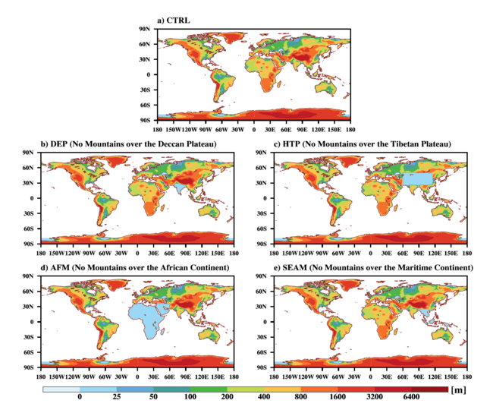
Isolating the Effects of Mountains
DEP
Deccan plateau (DP) and the western Ghats (WG) subdued
HTP
Himalayas and Tibet plateau subdued
AFM
African and Arabian Mountains subdued
SEAM
Indo-Chinese and Maritime Mountains subdued

Slide 3
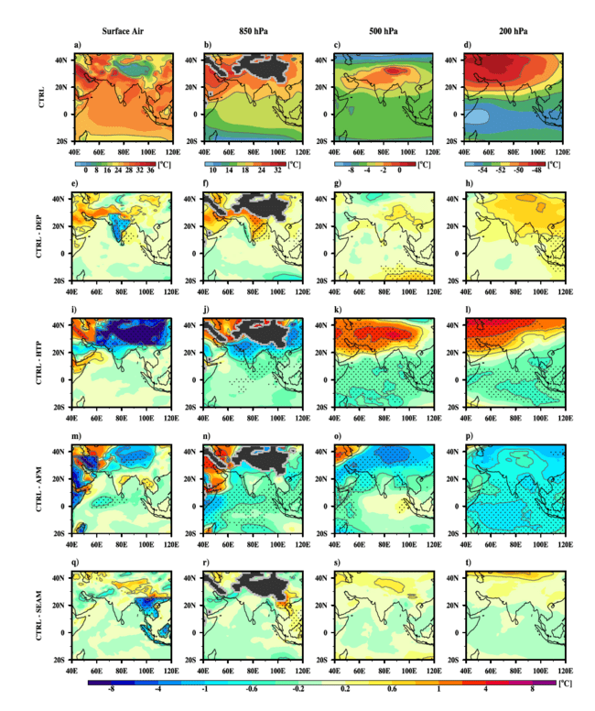
Effects of Mountains on Vertical Temperature distribution
Surface Air Temperature
Diff. significant at 95% confidence level
DEP: warming over Western Ghats - due to lapse rate effect; over rest of the Indian landmass cooling; in lower, middle & upper troposphere cooling.
HTP: Sig. warming over the Indian land mass; cooling over HTP & sig. warming in ocean above 500 hPa.
AFM: sig. warming over HTP and IO; cooling DEP; sig. warming over Indian land and oceans from 850-200 hPa.
SEAM:
Minimal warming over the Indian landmass in comparison to other expts.
Notes:
Then we are trying to find the effect of change on the highland on the Arabians on the mountain on the Indian monsoon like the effects of warming over Western Ghat the change the lapse rate after the Indian land mass goes in the lower and Middle Apartment over the Indian land mass cooling over the FTP and fingerprint form

Slide 4
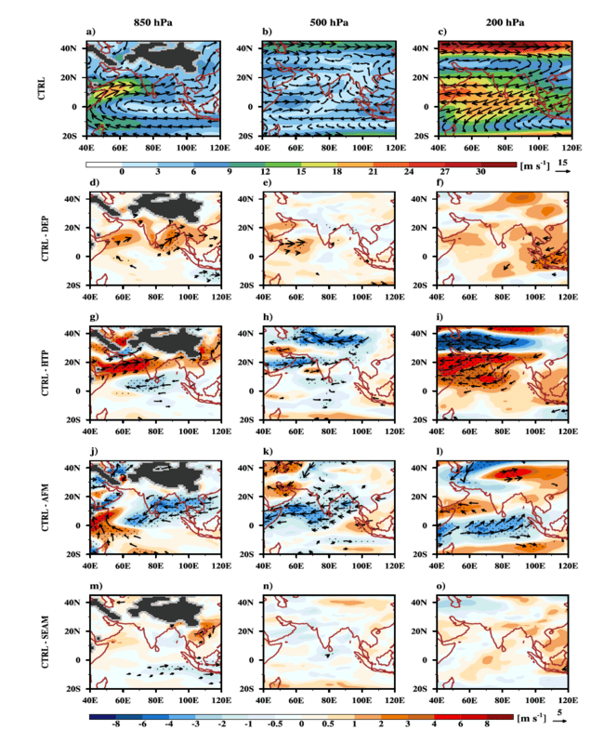
Effects of the Mountains on Wind Circulation
DEP:
Reduced wind speed over Arabian sea and Bay of Bengal; at 500 hPa, reduced wind speed at AS ; at 200 hPa, slightly weak STWJ and TEJ, Sig. wind over maritime regions.
HTP:
Significant wind speed reductions over Arabian sea penetrating into Indian land mass; at 500 hPa stronger wind circulation; at 200hPa, weaker TEJ & Tibetan anti-cyclone; stronger STWJ.
AFM:
Significant enhancement in wind speed over BoB, Indian land; at 500 hPa, increase in wind AS, BoB & Indian land; at 200 hPa, stronger STWJ, TEJ and Tibetan anti-cyclone.
SEAM:
Minimal changes in the wind speeds

Slide 5
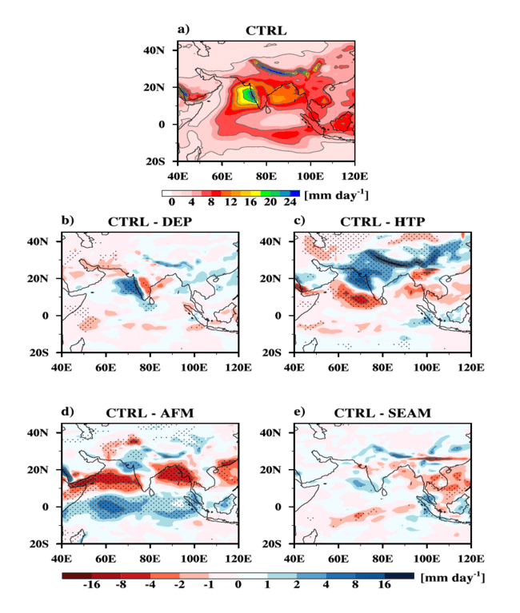
Effects of the Mountains on Precipitation
Diff. significant at 95% confidence level
DEP:
Reduced precipitation over Western Ghats and enhancement in the leeward side of Western Ghats
HTP:
Significant reduction in precipitation over the Indian land with increase in precipitation over southern Arabian Sea
AFM:
Significant reduction in precipitation over the northern India and Indian ocean, significant enhancement in precipitation over Arabian Sea and Bay of Bengal
SEAM:
Minimal significant effect on precipitation over the Indian land mass
Notes:
Effects of mountain on the precipitation where there is a decline in precipitation due to absence of Himalaya and Tibet Plateau is not there and enhancement in rainfall
mountain

Slide 6
Summary
Absence of Deccan plateau (DP) and the western Ghats (WG) would lead to weakening of Somali jet and reduction of precipitation over WG accompanied with enhancement of precipitation over DP. This signifies the role of mountain as a barrier to moisture-laden winds and orographic upliftment of moist wind leading to precipitation.
Absence of the Himalayas and Tibet plateau would drastically weaken the Somali jet and substantially reduce precipitation over the Indian sub-continent, both due to reduction in moisture transport into this region and incursion dry air from mid-latitudes.
continued…

Slide 7
Summary
Absence of African mountains would result in a stronger Somali Jet with a northward shift by a few hundred kilometres which penetrates further into the east; this would change the moisture divergence and lead to decrease of precipitation over the northwest India but increase over the western and Eastern Ghats.
Mountains over the Maritime continent has minimal impact on the Somali Jet and Indian summer monsoon.

Slide 8
Thank you.

