Slide 1
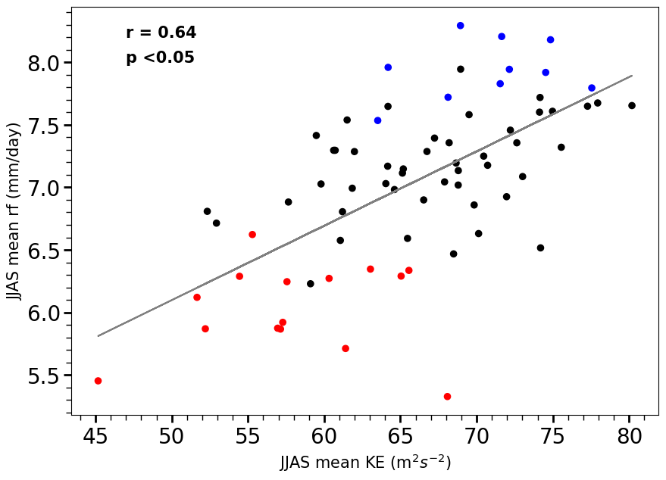
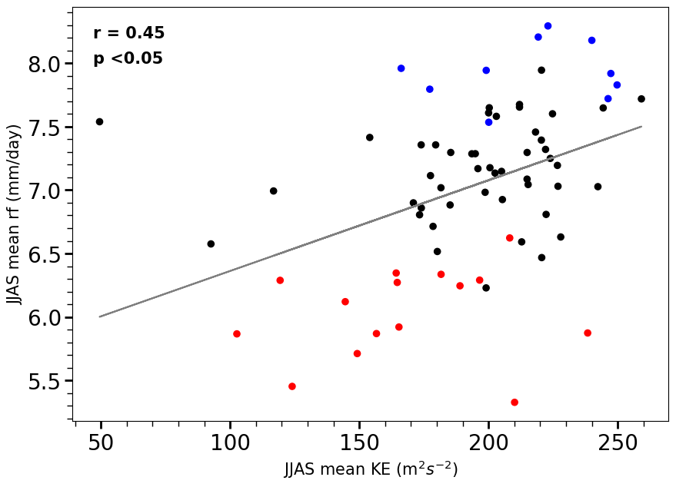
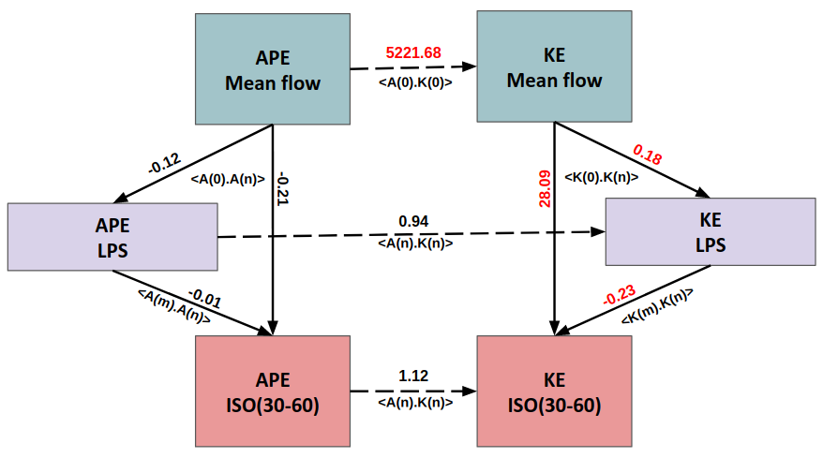
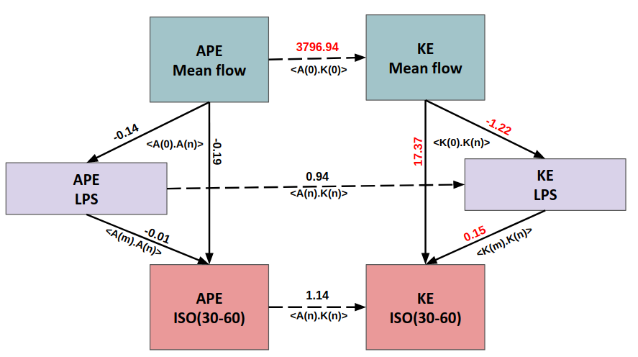
How do multi-scale interactions influence Indian Summer Monsoon ?
Dhishana P. R.¹ •Sarvesh Dubey¹ •Randhir Singh² • Sukanta Das²
¹ Centre for Atmospheric Sciences, Indian Institute of Technology Delhi, New Delhi, India.
² Space Applications Centre (ISRO), Ahmedabad, India.
Mail ID: dhishanapravi@gmail.com
KE interactions of ISO (30-60 days) and meanflow
Introduction
Results & Discussions
The intraseasonal oscillations (ISO) are quasi-periodic fluctuations modulating the active/break spells of the Indian Summer Monsoon (ISM) through the northward propagating 30-60 day mode and the westward propagating 10-20 days mode (Goswami 2005).
Low pressure systems (LPSs) are cyclonic , convectively coupled synoptic scale systems forming mostly over BoB in monsoon environment, propagating northwest along the monsoon trough.
Meanflow
(122 days)
LPS
(3-7 days)
ISO
(30-60 days)
Fig: The KE exchange from meanflow to ISO (upper) and all other scales excluding meanflow to ISO (lower). Units are in the order of *10⁻³ Wm/Kg.
Fig1: scatter plot for JJAS mean KE and rainfall averaged over MCZ. Blue dots represents floods years and red dots indicate drought years.
KE interactions of LPS and meanflow
All other scales
Generation of APE
In this study, we explain how scale interactions between meanflow, ISO and LPS can influence the variability of monsoon meanflow.
Fig: Longitudinally integrated Generation of APE (upper panel) and the diabatic heating (lower panel) in the MCZ is shown.
Fig: The KE exchange from meanflow to LPS (upper) and all other scales excluding meanflow to LPS (lower). Units are in Wm/Kg.
Data & Methodology
Data used
ECMWF ERA5 0.25°⨯0.25° daily data on pressure levels for JJAS season,
0.25°⨯0.25° daily gridded rainfall from Indian Meteorological Department (IMD).
DATA
Baroclinic conversion of APE to KE
Variables
Zonal, meridional and vertical components of wind, temperature, geopotential and specific humidity.
Time period
1950 to 2021 (72 years)
Study area
15°N–28°N, 67°E–88°E Indian Monsoon Core Zone (MCZ).
flood years (>10% rainfall departure from long term mean).
Drought years (<-10% rainfall departure from long term mean).
Fig: Zonally integrated baroclinic conversion of APE to KE for meanflow (upper panel), ISO (middle panel) and the LPS (last panel). The values are in Wm/Kg.
Kinetic Energy (KE) spectra
Horizontal gradient of seasonal mean u and v wind
Conclusions
Around 60% of interdecadal variability of upper level seasonal mean KE can be explained from the KE between ISO and seasonal mean.
LPSs are provided with additional KE from both the meanflow and ISO during flood years while the baroclinic conversion from LPS scale is remaining the same. This excess KE together may lead to more LPS days activity and further northward propagation of LPSs during flood years.
The baroclinic conversion of APE to KE is the primary source of KE for the monsoon meanflow and LPS. But in the case of ISO, the major KE it is receiving is from the KE conversion from the meanflow.
Baroclinic processes through which the scale n interact with other scales
Product of curvature terms and seasonal mean u and v wind
Spectral Equation of KE: 0 = 〈K.Kn〉 + 〈A.Kn〉 + Dn + Fn
Net radiation balance
+
meridional T gradient
Maintenance of Hadley Circulation
+ moisture
Large scale
deep convection
References
Dubey, S., Krishnamurti, T. N., & Kumar, V. (2018). On scale interactions between the MJO and synoptic scale. Quarterly Journal of the Royal Meteorological Society, 144, 2727– 2747. https://doi.org/10.1002/qj.3400
Suhas E, Neena J, Goswami B (2012) Interannual variability of Indian summer monsoon arising from interactions between seasonal mean and intraseasonal oscillations. J Atmos Sci 69(6):1761–1774
Dutta, S., Narkhedkar, S.G., Mukhopadhyay, P. et al. Use of large-scale atmospheric energetics for understanding the dynamics of contrasting Indian summer monsoon rainfall in different years. Meteorol Atmos Phys 131, 945–956 (2019). https://doi.org/10.1007/s00703-018-0610-9
Krishnamurthy, V., & Ajayamohan, R. (2010). Composite structure of monsoon low pressure systems and its relation to Indian rainfall. Journal of Climate, 23(16), 4285–4305. https://doi.org/10.1175/2010jcli2953.1
Growth / Decay of Kinetic Energy in the atmosphere
Dissipation of KE
Conversion of APE to KE in various scales
Generation of APE
Acknowledgement
All the freely available datasets used for the study.

