Slide 1
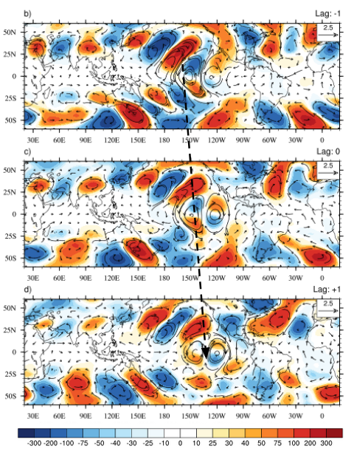
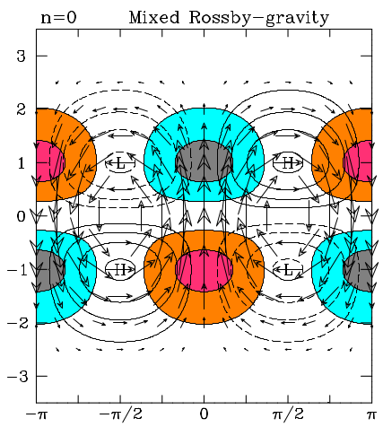
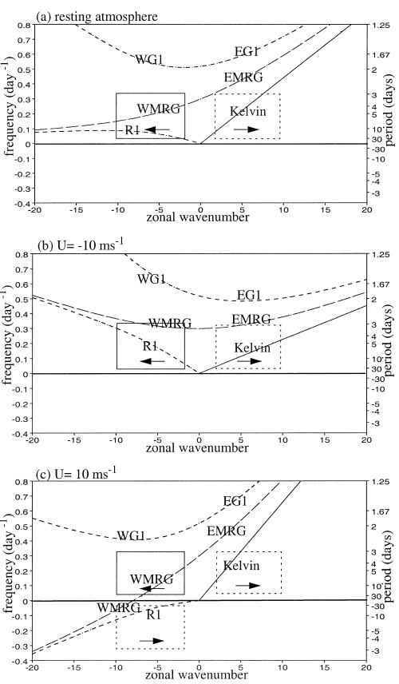
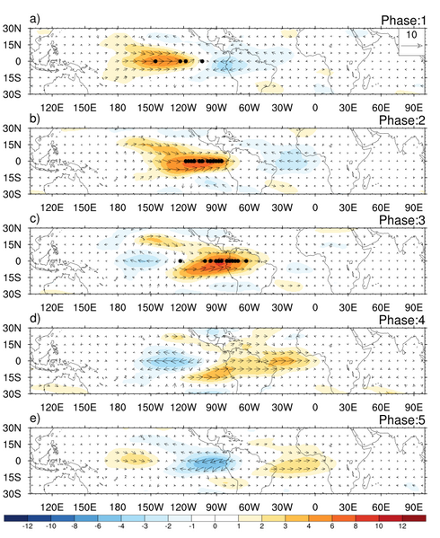
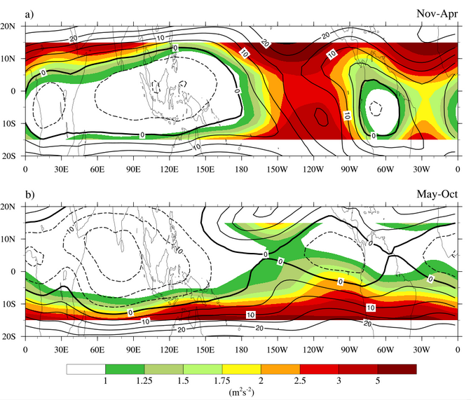
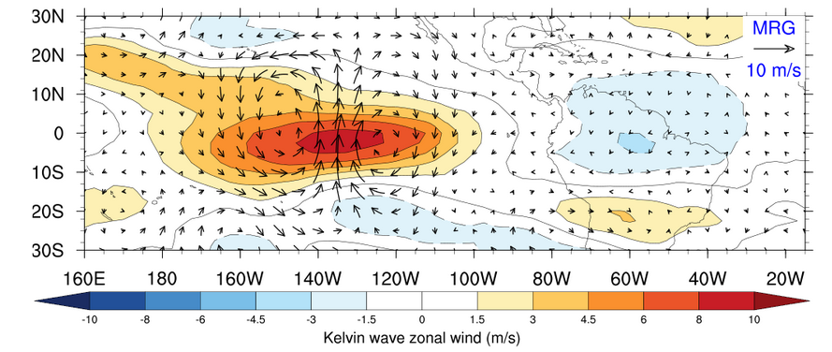
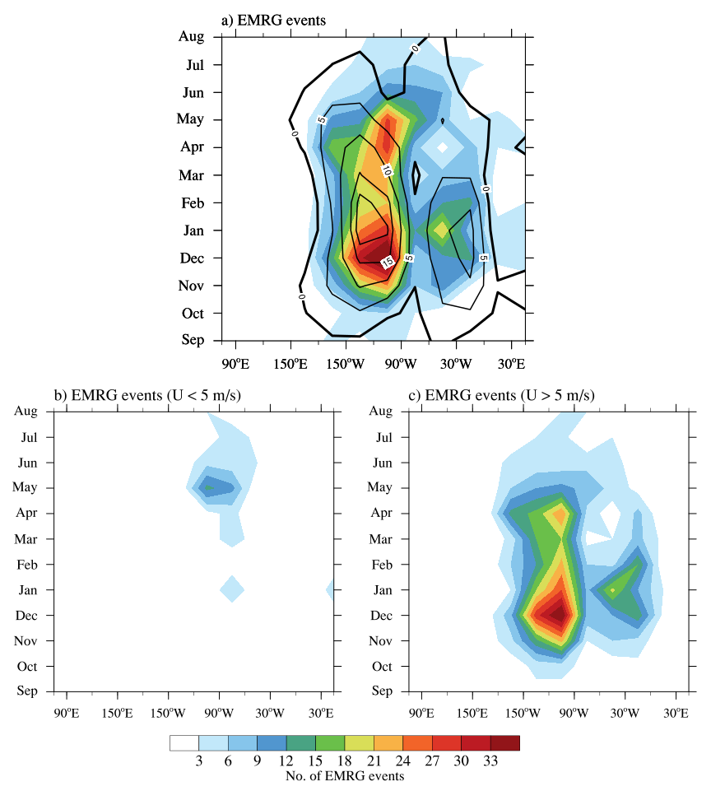
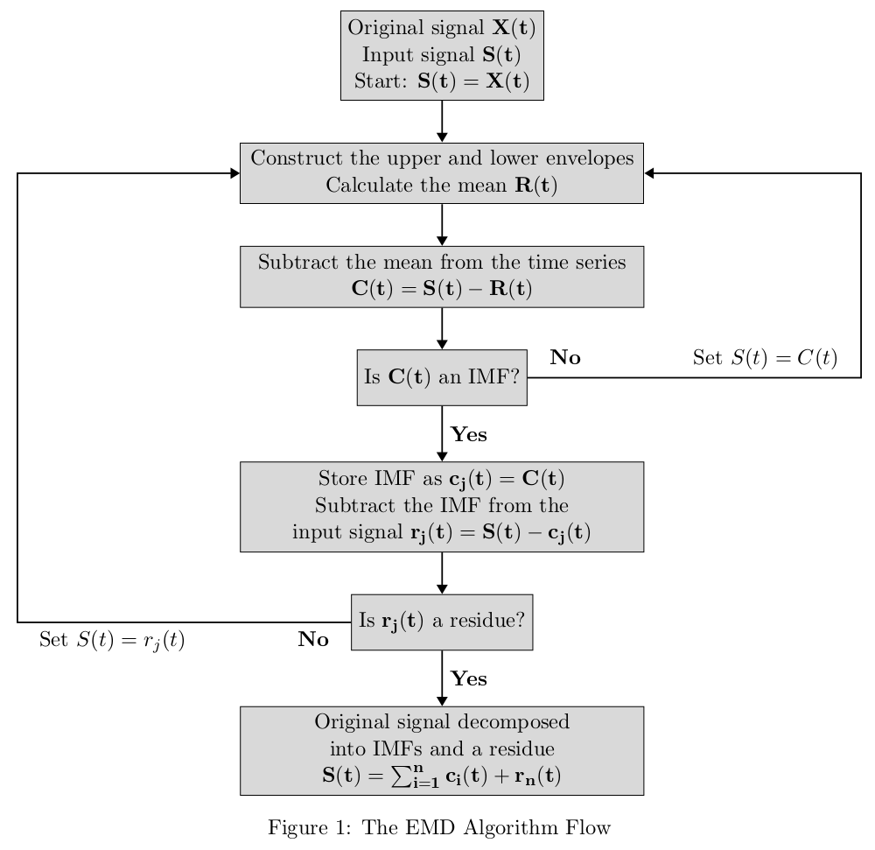
Does the Tropical Atmosphere Support Doppler shifted MRG waves?
ECS, Indian Institute of Science Education and Research, Pune
keshri.shreya@students.iiserpune.ac.in
suhas@iiserpune.ac.in
Shreya Keshri, Vishal Ranjith, Suhas Ettammal
Introduction
Results
Results
Tropical synoptic scale disturbances contribute to approx. 50% of the precipitation in the tropics.
Mixed Rossby-Gravity (MRG) waves are westward propagating synoptic scale equatorially trapped tropical disturbances.
Crucial in modulating variability in tropics, e.g. tropical cyclone, MJO, tropical depression, QBO.
Under influence of strong westerly background MRG waves can start propagating eastward.
Composite plots cohere with theoretical structure of MRG waves and show an eastward phase propagation, validating the method of identification used.
Extratropical wave intrusions from the NH and SH can be observed.
Eastward MRG waves assocaited with U < 5m/s
Stronger signal during NH winter
Western hemisphere (WH, 180E to 50E) accounts for majority of the power.
75 % E-MRG events associated with a background U < 5 m/s occur during March to July and the westerly phase of Kelvin wave eddies with a global wavenumber of 2 to 4.
Easterly phase of the Kelvin wave during EMRG wave activity is suppressed.
Theoretical horizontal structure of MRG waves
Theoretical w-k dispersion realtion
EMRG embedded in westerly phase of Kelvin wave
Normalized w-k power spectra for meridonal wind at 200 hPa and 850 hPa
U200 zonal mean and v200 synoptic eastward variance
Power in the eastward wavenumbers observed at 200 hPa, absent at the 850hPa.
Westerly duct well developed over western hemispheric during NH winter at 200hPa.
Maximum eastward amplitude in v200 and westerly ducts over east Pacific and Atlantic are collocated.
Objectives
Quantify the synotpic scale disturbances contributing to the power in the eastward wavenumbers at the 200 hPa.
Explore the role of background circulation in modulating the MRG waves.
Seasonality and geographical domain of activity
One full wavelength of EMRG wave completely embeds into the westerly phase of the large scale Kelvin wave.
Conclusions
Data and Methods
730 Doppler shifted eastward propagating MRG (EMRG) wave events were identified for a period of 44 years (1979 to 2022).
75% EMRG events occur over a local westerly background (U > 5 m/s).
70% EMRG wave events associated with U < 5 m/s occur during March to June over the westerly phase of large scale and large amplitude Kelvin wave eddies.
ERA5 reanalysis wind and geopotential data
Pressure level : 200 hPa, 850 hPa
Period : 1979 to 2022, 44 years
Resolution : Daily
Spatial resolution : 0.5 X 0.5 degrees lat x lon
Empirical Mode Decomposition Method
References
Yang, GY, & Hoskins, BJ 2016 ‘ENSO related variation of equatorial MRG and Rossby waves and forcing from higher latitudes’, Quarterly Journal of Royal Meteorological Society, vol. 142, no. 699, pp. 2488– 2504.
Yang, Gy, Hoskins, BJ & Slingo, J 2003, ‘Convectively coupled equatorial waves: A new methodology for identifying wave structures in observational data’, Journal of Atmospheric Science, vol. 60, no. 14, pp. 1637– 1654.
Maximum activity observed over east Pacific and Atlantic.
East Pacific bimodal seasonal peak - Nov to Feb and March to June.
Atlantic preferred season - Nov to Feb.
Events over EP and AO during NH winter coincide with regions of strong westerly background winds.
75% of E-MRG events occured with U > 5m/s.
Secondary peak over east Pacific during March to June associated with weak westerly winds (less than 5 m/s).
We would like to thank MINISTRY OF HUMAN RESOURCE DEVELOPMENT for funding this research.
Notes:
<number>

