Slide 1
Teleconnections between the Stratospheric – Tropospheric Interactions on the Seasonal and Annual Rainfall of the Peninsular India and, its Western Ghats and Coastal Region Poornachandra R^{1*}, Sudha¹ and SA Ahmed² ¹Department of Physics, Kuvempu University, Shivamogga, Karnataka 577451, India ²Department of Applied Geology, Kuvempu University, Shivamogga, Karnataka 577451, India * corresponding and presentation author

Slide 2
In response to the main theme of STIPMEX conference, the Quasi‐Biennial Oscillation (QBO) seems to be an inter-annual mode of shifting of the easterly and westerly zonal winds in the tropical stratosphere, affecting the planetary circulations and associated climate change.
Here, an attempt is made to understand the teleconnection among the Troposphere- Stratosphere-Polar circulation on the seasonal and annual rainfall of the all Indian, Peninsular and south-western (Coastal Karnataka) India.
Recent intense research indicates that the temperature increase over the Arctic Circle is three-to-four-fold higher than the global average. This may affect the climate of temperate and tropical regions.

Slide 3
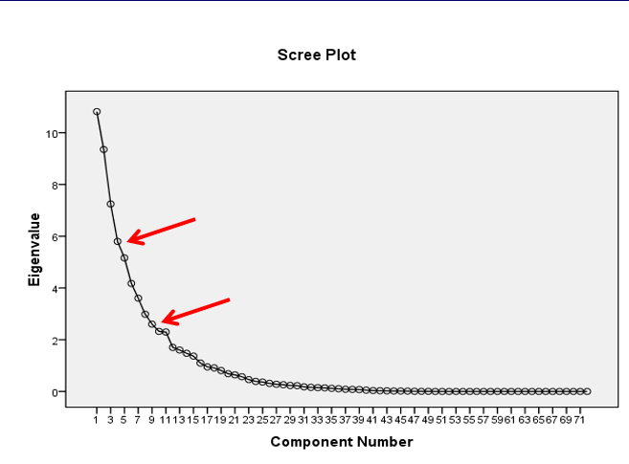
The Principal Component Analysis (PCA) of seasonal and annual rainfall data of the study area along with the possible tele-connecting forces, such as Arctic Oscillation (AO), North Atlantic Oscillation (NAO), El Niño-Southern Oscillation (ENSO), Niño 3.4 , global temp anomaly, Sun's Spots, Dipole Mode Index, Island Low, Azores High, North East Atlantic temperature (NEAT), Atlantic Multi-decadal Oscillation (AMO) and the Quasi‐Biennial Oscillation (QBO) have been studied in this investigation.
Fig 1.The Scree plot between Eigen Values and component numbers represents that there are four major components above the inflexion point, followed by another six components suggesting the complex relationship among the seasonal and annual rainfall of the study area with tele-connecting forces.

Slide 4
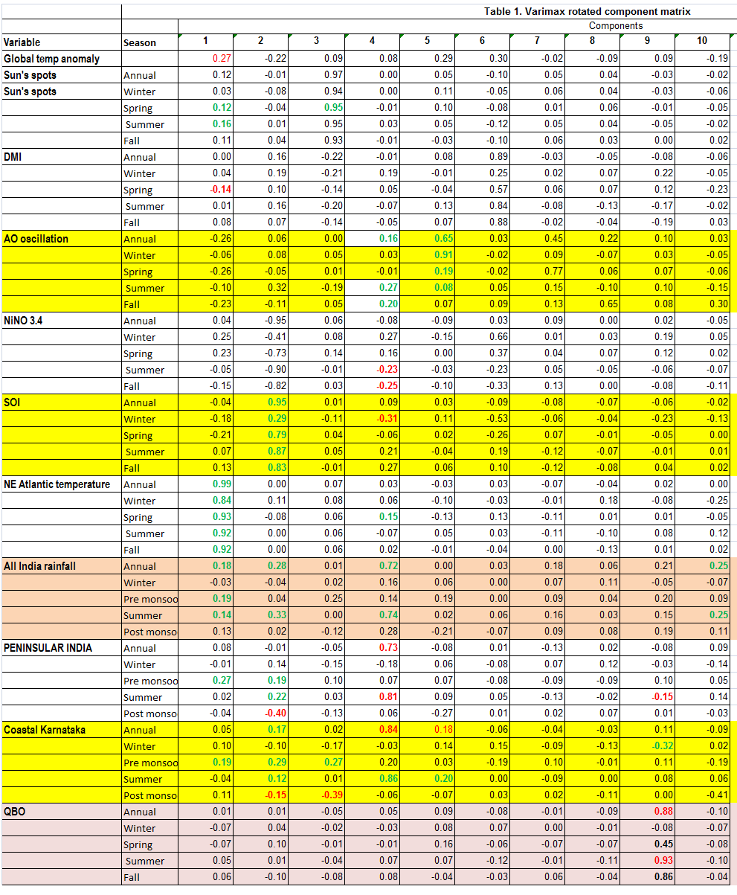
The results in Table 1. indicate that although the NEAT of all seasons is highly loaded in the PC-1, while, the PC-2 indicates ENSO is positively loaded with the annual and summer seasons of All India, Peninsular India and Southern west coast of India suggesting the robustness of the latter. The PC-3 shows poor loadings, implying a weak relationship of Sun’s spots with the study area.
The summer monsoon rainfall of southwest coast of India, Peninsular India and to some extent All Indian Average rainfall are positively loaded with NAO (annual), but negative with Nino 3.4. temperature.
The PC-5 indicates that the summer monsoon rainfall having links with the Arctic Oscillation during winter as well as with the annual rainfall. The dipole mode index has positive relationship with the Arctic Oscillation during summer and fall season, and with the NAO, suggesting the importance of NAO
The Arctic Amplification seems to strengthen the Polar Vortex thereby influencing the mid- and low-latitudes climate systems. However, there seems to be a negative relationship of the QBO with the summer monsoon rainfall barring to a lesser extent with the Spring season of the Study area.

Slide 5
Acknowledgements
I am grateful to the organizers for providing this valuable opportunity.
I thank IITM and global agencies for the rainfall and climate data.
I also thank Rolf Muller for providing financial assistance to attend this conference.
Thank you for your attention.

