Slide 1
International Workshop on Stratosphere-Troposphere Interactions and Prediction of Monsoon weather Extreme's (STIPMEX) 02-07 June 2024
LONG TERM CHANGES IN TROPICAL EASTERLY JET- OBSERVATIONAL AND MODEL ANALYSIS
Karthika P P
Research scholar
Sathyabama Institute of Science and Technology
Chennai.
Adviser
Dr. M. Venkat Ratnam
Sci./Eng –G
National Atmospheric Research Laboratory,
Gadanki,
Dept. of Space, India
Supervisor
Dr. M. Roja Raman
Assistant Professor(Research)
Sathyabama Institute of Science and Technology,
Chennai

Slide 2
Contents
Introduction
Objectives
Methodology
Results
Conclusion
References

Slide 3
Tropical Easterly Jet
Introduction
Monsoon
Land-Sea thermal contrast drives the monsoon.
Seasonal Reversal of wind
SW monsoon – JJAS
NE monsoon – ON
Figure : Tropical Easterly Jet at 200 hPa on 25 July 1955 marked by broken lines Source: Koteswaram (1958)
Himalayan mountains & elevated Tibetan plateau : Diabatic heating over large area of middle troposphere.
Southern Indian ocean : abundant moisture supply & strong meridional temperature gradients.
It leads to strong easterly flow at 100-300 hPa level Tropical Easterly Jet

Slide 4
Objectives
To study the characteristics of Tropical Easterly Jet (TEJ) Stream like TEJ Peak Height, TEJ Peak speed, TEJ Width, Wind Reversal Height and spatial coverage during the Summer Monsoon Season for a period 2006-2021.
To validate different model datasets with high resolution radiosonde observations for a period 2006-2021.
Lomb-Scargle Periodiogram is used to extract ENSO, QBO, IOD and Solar cycle variations.
To find TEJ Trend and make future projections of TEJ Characteristics.

Slide 5
Methodology
TEJ Characteristics estimation
TEJ Peak Height
Mean: 16.09 km
TEJ Width
TEJ Shear (Vertical Shear of Horizontal wind)
where, du is the change in wind speed and dz is the change in height.
Mean: 2.57 km
Wind Reversal Height
Mean: 8.04 km
Mean: -40.8 m/s

Slide 6
Methodology
TEJ Condition – Radiosonde data over Gadanki
Satisfying 2/3rd & less than 20 km condition
2006 : 6, 7
2008 : 7, 8, 9
2009 : 7, 8
2010 : 6, 7, 8, 9
2011 : 7, 8, 9
2012 : 6, 7, 8, 9
2013 : 6, 7, 8
2014 : 7, 8
2015 : 7
2016 : 7
2017 : 6, 7
2018 : 7
2019 : 7, 8
2020 : 7, 8, 9
2021 : 6, 7, 8

Slide 7
Methodology
IMF and Lomb-Scargle Peri0dogram
IMF Analysis
Empirical Mode Decomposition (EMD) : decomposing of a complex signal into a set of simple oscillatory components called Intrinsic Mode Functions (IMF’s).
EMD decomposes a time series signal into a series of IMF’s by identifying and removing oscillatory models until a residue is obtained.
Lomb-Scargle Periodogram
It is an algorithm for detecting and characterizing periodic signals in unevenly sampled data.
It is a well defined procedure to generate a power spectrum.
It is similar to least-squares fitting of sine waves.

Slide 8
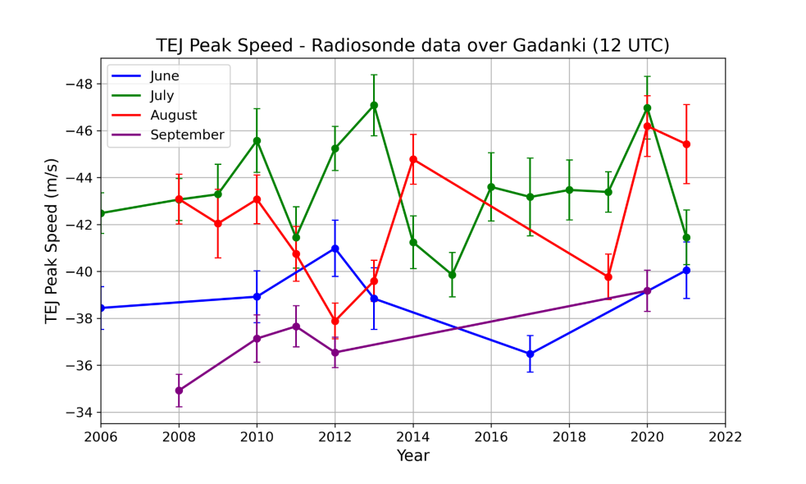
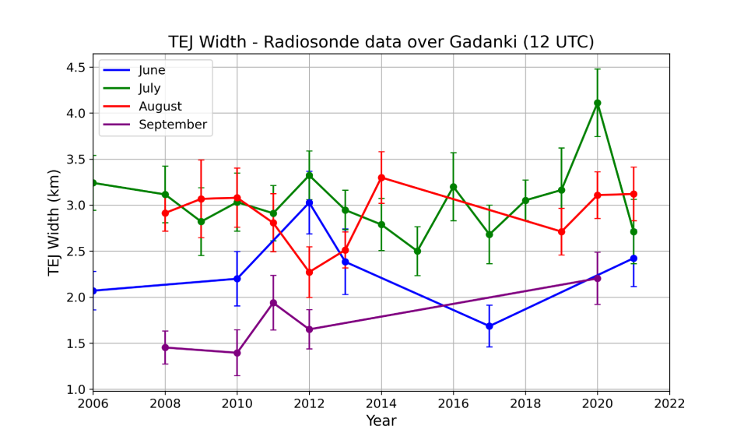
Results
Maximum WRH in 2013 July.
July and August shows similar trend in TEJ Peak Speed over Gadanki.
Maximum TEJ Peak Height is observed in 2010 August 16.6 km.
Most of the TEJ width is above 1.5 km.

Slide 9
Results : Mean (July-August) Zonal wind Profiles over Gadanki
Radiosonde data is compared with other model data.
Among the profiles from different models, IMDAA suits best to radiosonde profile over Gadanki.
CMIP6 profile has more variation from radiosonde profile.

Slide 10
TEJ Spatial Variation - IMDAA
Tej Spatial extent is highest in 2020.
2012, 2013, 2016, 2018 and 2020 → TEJ has more spatial extent and more strength.

Slide 11
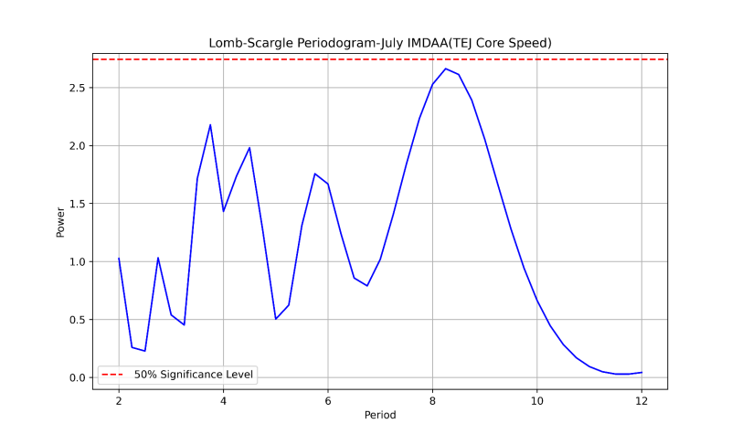
Results : TEJ Core Area-ENSO-Rainfall Relation in July
TEJ Core Area Estimation
IMDAA Zonal wind at 100 hPa is used.
Counts the number of grid points where zonal wind speed <-30 m/s.
2015- El Nino Year → Less TEJ Core area → Low amount of rainfall in Central India.
2020- TEJ has more strength, more spatial extent.

Slide 12
Results :IMDAA and CMIP6 (Monsoon Grid)
CMIP6 EC-Earth3-Veg-LR( Europe )model is used.
TEJ Core speed has decreasing trend.
TEJ Core Speed is going to decrease from 2023 – 2049.

Slide 13
Conclusions
From the comparison of Radiosonde uwind profile over Gadanki with the profiles from different models, IMDAA uwind profiles is found to be in match with radiosonde profile.
From TEJ statistics studied, a periodic oscillation observed in peak jet speed over Gadanki. In July, most of the TEJ peak height lies between 16 and 16.5 km. TEJ is observed above 90% during July. Jet width is found to be lower when wind reversal height is higher.
From TEJ Spatial variation, it is found that TEJ has more spatial extent in July at 100hpa.
Double core was found in 2020. In 2000 and 2023, weak TEJ is observed.
Using IMDAA data, it is clearly seen that TEJ has more spatial extent in 2020 and less in 2015. Core TEJ speed reaches about -42 m/s in 2020.

Slide 14
Conclusions
TEJ spatial extent has negative correlation with NiNo 3.4 index.
Lower El Nino, higher rainfall is observed over Central India. In 2020, Central India Rainfall is about 150 mm. 2015 is an El Nino year and TEJ strength is observed to be very weak. Amount of rainfall received in Central India during July 2015 is also very low.
This concludes El-Nino years are not favorable for strong and wide TEJ formation and also monsoon rainfall over India.

Slide 15
References
Roja Raman, M., V. V. M. Jagannadha Rao, M. Venkat Ratnam, M. Rajeevan, S. V. B. Rao, D. Narayana Rao, and N. Prabhakara Rao (2009), Characteristics of the Tropical Easterly Jet: Long-term trends and their features during active and break monsoon phases, J. Geophys. Res., 114, D19105, doi:10.1029/2009JD012065.
Roja Raman, M., V. V. M. Jagannadha Rao, M. Venkat Ratnam, G. Kishore Kumar, A. Narendra Babu, S. Vijaya Bhaskara Rao, N. Prabhakara Rao, and D. Narayana Rao (2008), Atmospheric circulation during active and break phases of Indian summer monsoon: A study using MST radar at Gadanki (13.5N, 79.2E), J. Geophys. Res., 113, D20124, doi:10.1029/2008JD010341.
Sathiyamoorthy, V., P. K. Pal, and P. C. Joshi (2007), Intraseasonal variability of the Tropical Easterly Jet, Meteorol. Atmos. Phys., 96, 305–316, doi:10.1007/s00703-006-0214-7.
Sathiyamoorthy, V. (2005), Large scale reduction in the size of the Tropical Easterly Jet, Geophys. Res. Lett., 32, L14802, doi:10.1029/ 2005GL022956.

Slide 16
References
Narayana Rao, D., S. Thulasiraman, S. Vijaya Bhaskara Rao, T. Narayana Rao, P. Kishore, M. Venkat Ratnam, and K. Krishna Reddy (2000), VHF Radar observations of tropical easterly jet stream over gadanki, Adv. Space Res., 26, 943–946, doi:10.1016/S0273-1177(00)00034-X.
Koteswaram, P. (1960), The Asian summer monsoon and the general circulation over the tropics, paper presented at Symposium on Monsoons of the World, India Meteorol. Dep., New Delhi.

