Slide 1

Analysing intensifying heat waves in India in recent years
Neethu C S and Abish B
Department of Climate Variability and Aquatic Ecosystems,
Faculty of Ocean Science and Technology
Kerala University of Fisheries and Ocean Studies (KUFOS), Kochi, Kerala,682506.
Presenting Author : csneethu0@gmail.com

Slide 2
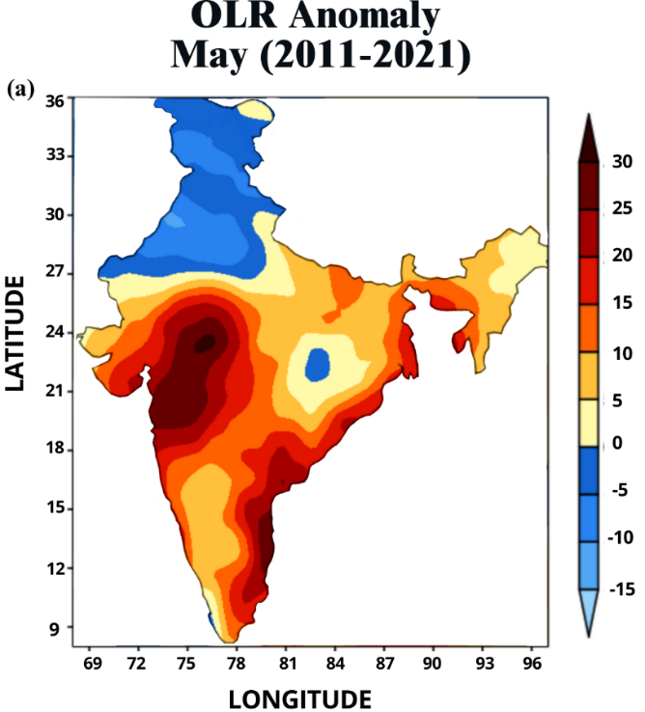
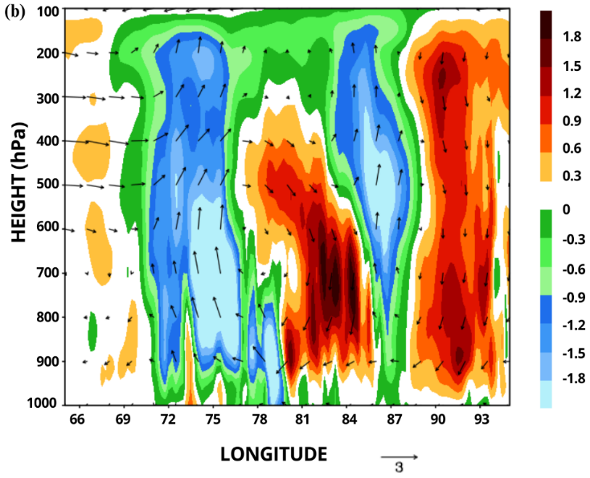
Figure 1. (a) Significant OLR (W/m²) anomalies for the period 2011-2021 for May month and (b) Height (pressure (hPa))-longitude cross section of vertical velocity (Pa s⁻¹; shaded contours, downward motion denoted with positive values) and the vector of zonal wind (m s⁻¹, Vectors) and vertical velocity (converted to meters per second and scaled with a factor of 100) in May.

