Slide 1
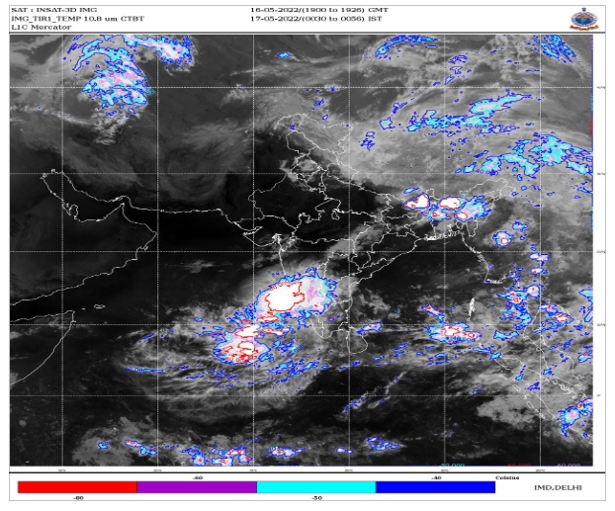
Heavy rainfall and thunderstorms in south interior Karnataka: A case study on August 31, 2023
Chanabasanagouda S Patil^{1,2*}, Shaik Darga Saheb¹ and Kamsali Nagaraj²
¹India Meteorological department, KIAL, Bengaluru, ²Physics Department Bengaluru University, Bengaluru
Highlights
Warning of thunderstorm before few hours is very important to mitigate hazards.
South interior Karnataka experienced wide-spread rainfall with isolated heavy to very heavy rainfall on 31 August 2023.
Cyclonic circulation over south interior Karnataka was extended upto 4.5 km AMSL with CAPE value of 2153 J/kg.
The synoptic and thermodynamic indices show a likelihood of significant precipitation occurring over Bengaluru and its surrounding regions during this event.

