Slide 1
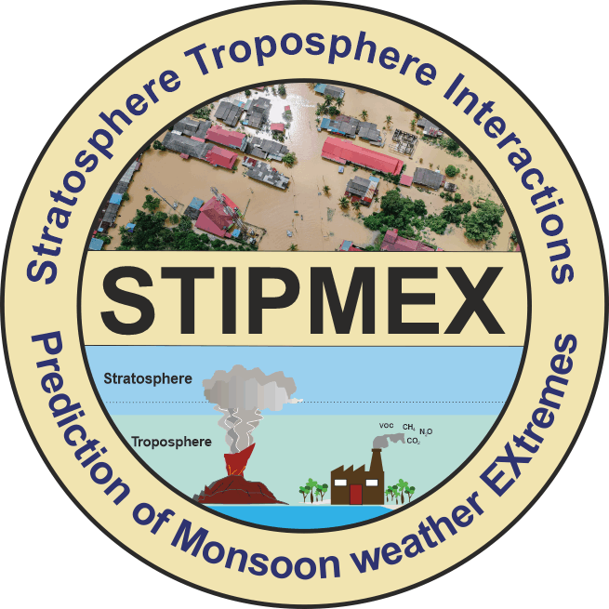
Sub daily to daily precipitation characteristics using Intensity, Duration, Frequency curves over the Mumbai region.
Stratosphere-Troposphere Interactions
and Prediction of Monsoon
weather EXtremes (STIPMEX)
Sunil Kumar Khadgarai,
Subrata Kumar Das,
G. Pandithurai
IITM,Pune

Slide 2
Datasets , Methodology And Results
High resolution rainfall information by rain gauges in MESONET and GPM-IMERG is used to derive IDF curves and extreme hotspots in Mumbai.
Dataused:2019, 2021-2023
Spatial distribution of maximum rainfall intensity, frequency observed in different temporal distribution is used as proxy to identify extreme hotspots.
Generalized Extreme Value Distribution treatment to derive IDF curves.

Slide 3
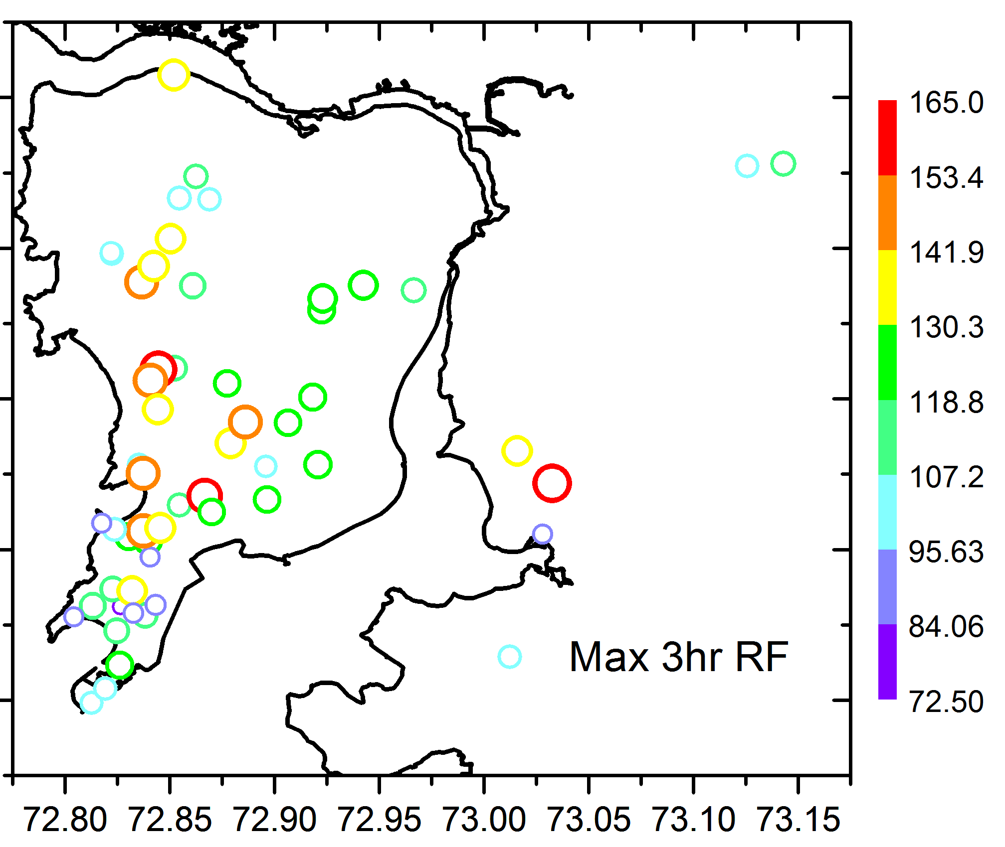
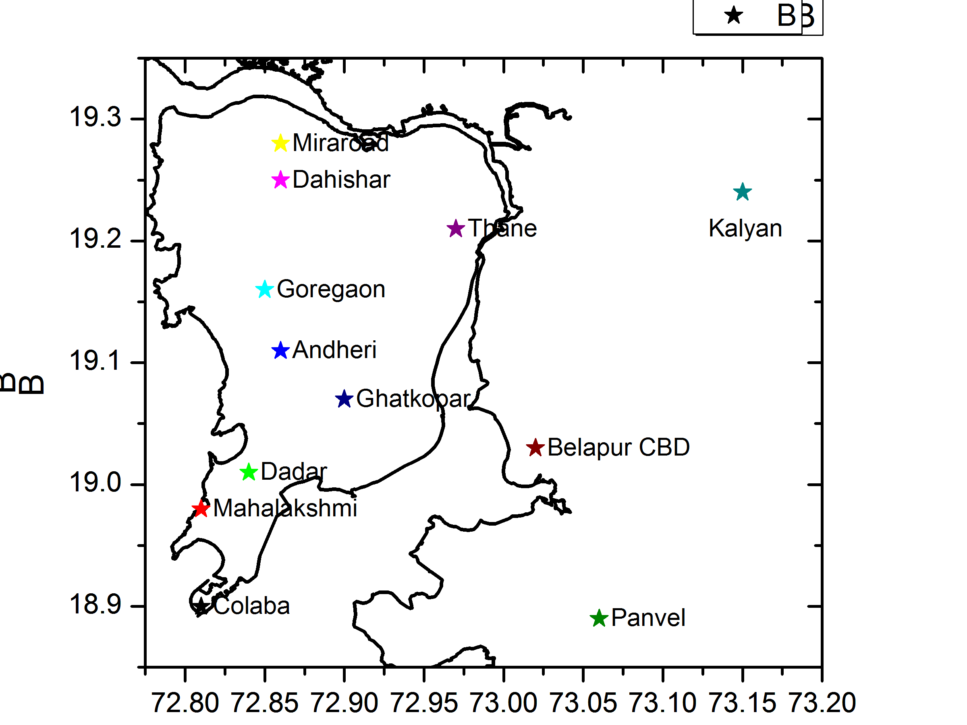
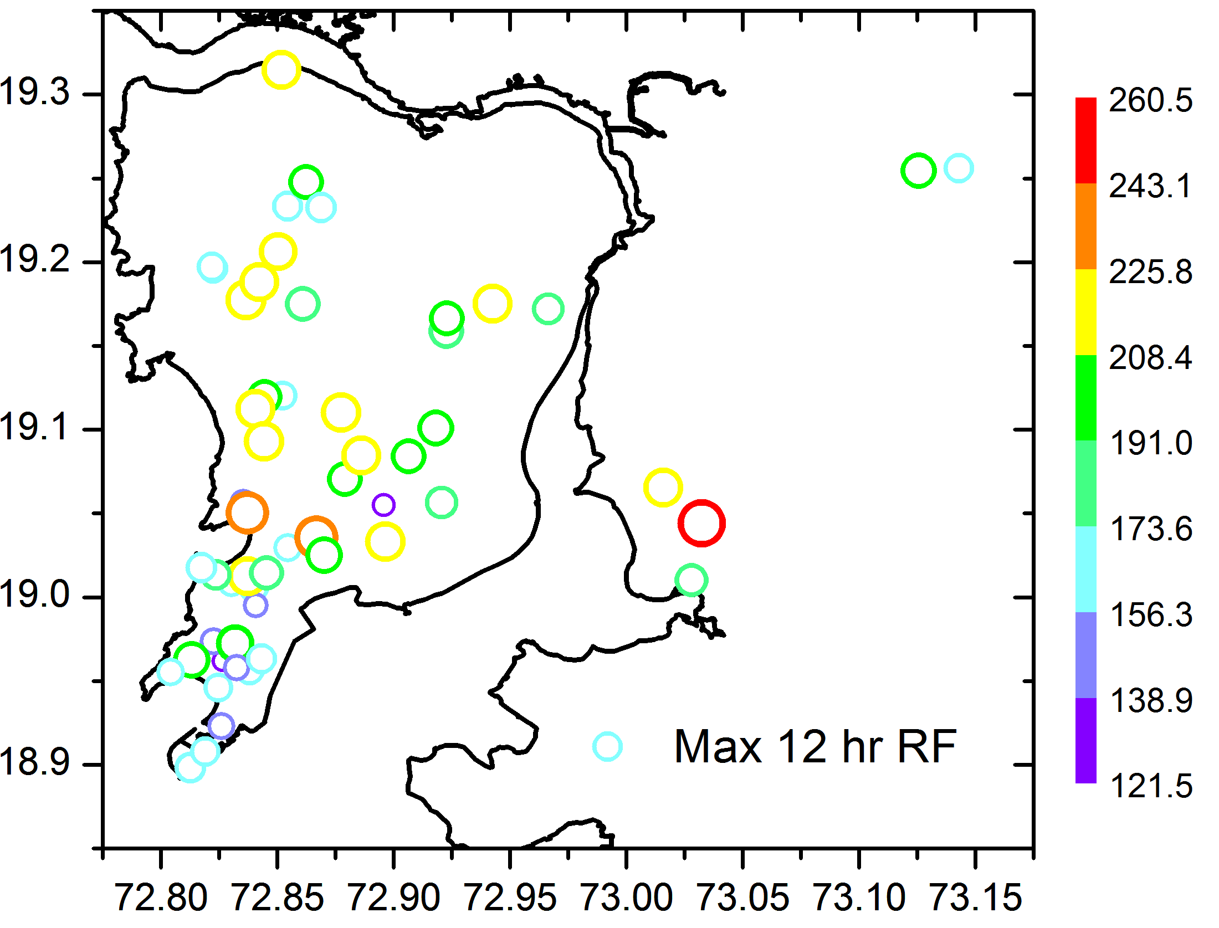
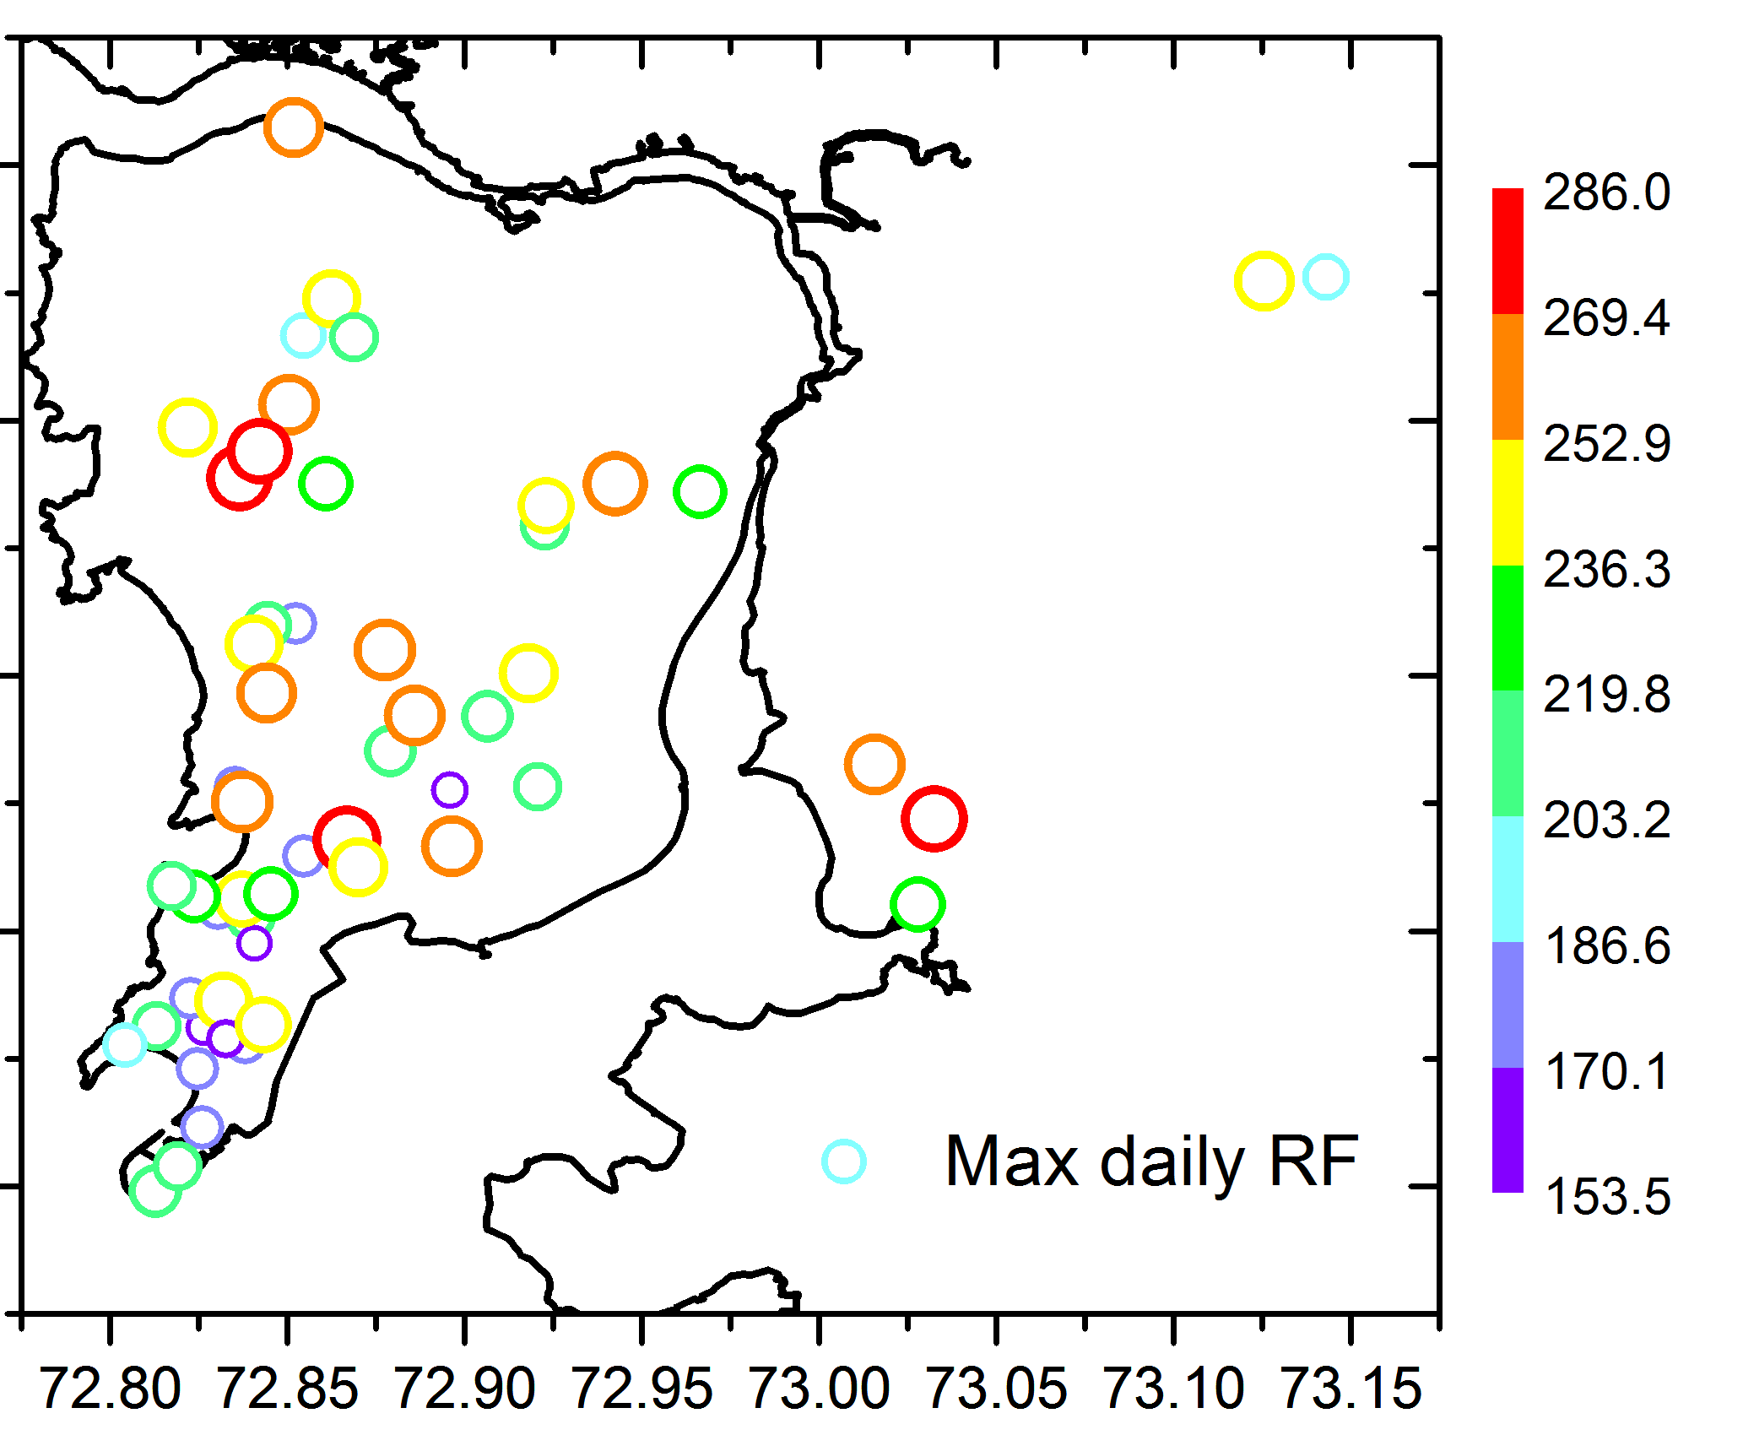
Extreme Hotspots based on maximum rainfall intensity

Slide 4
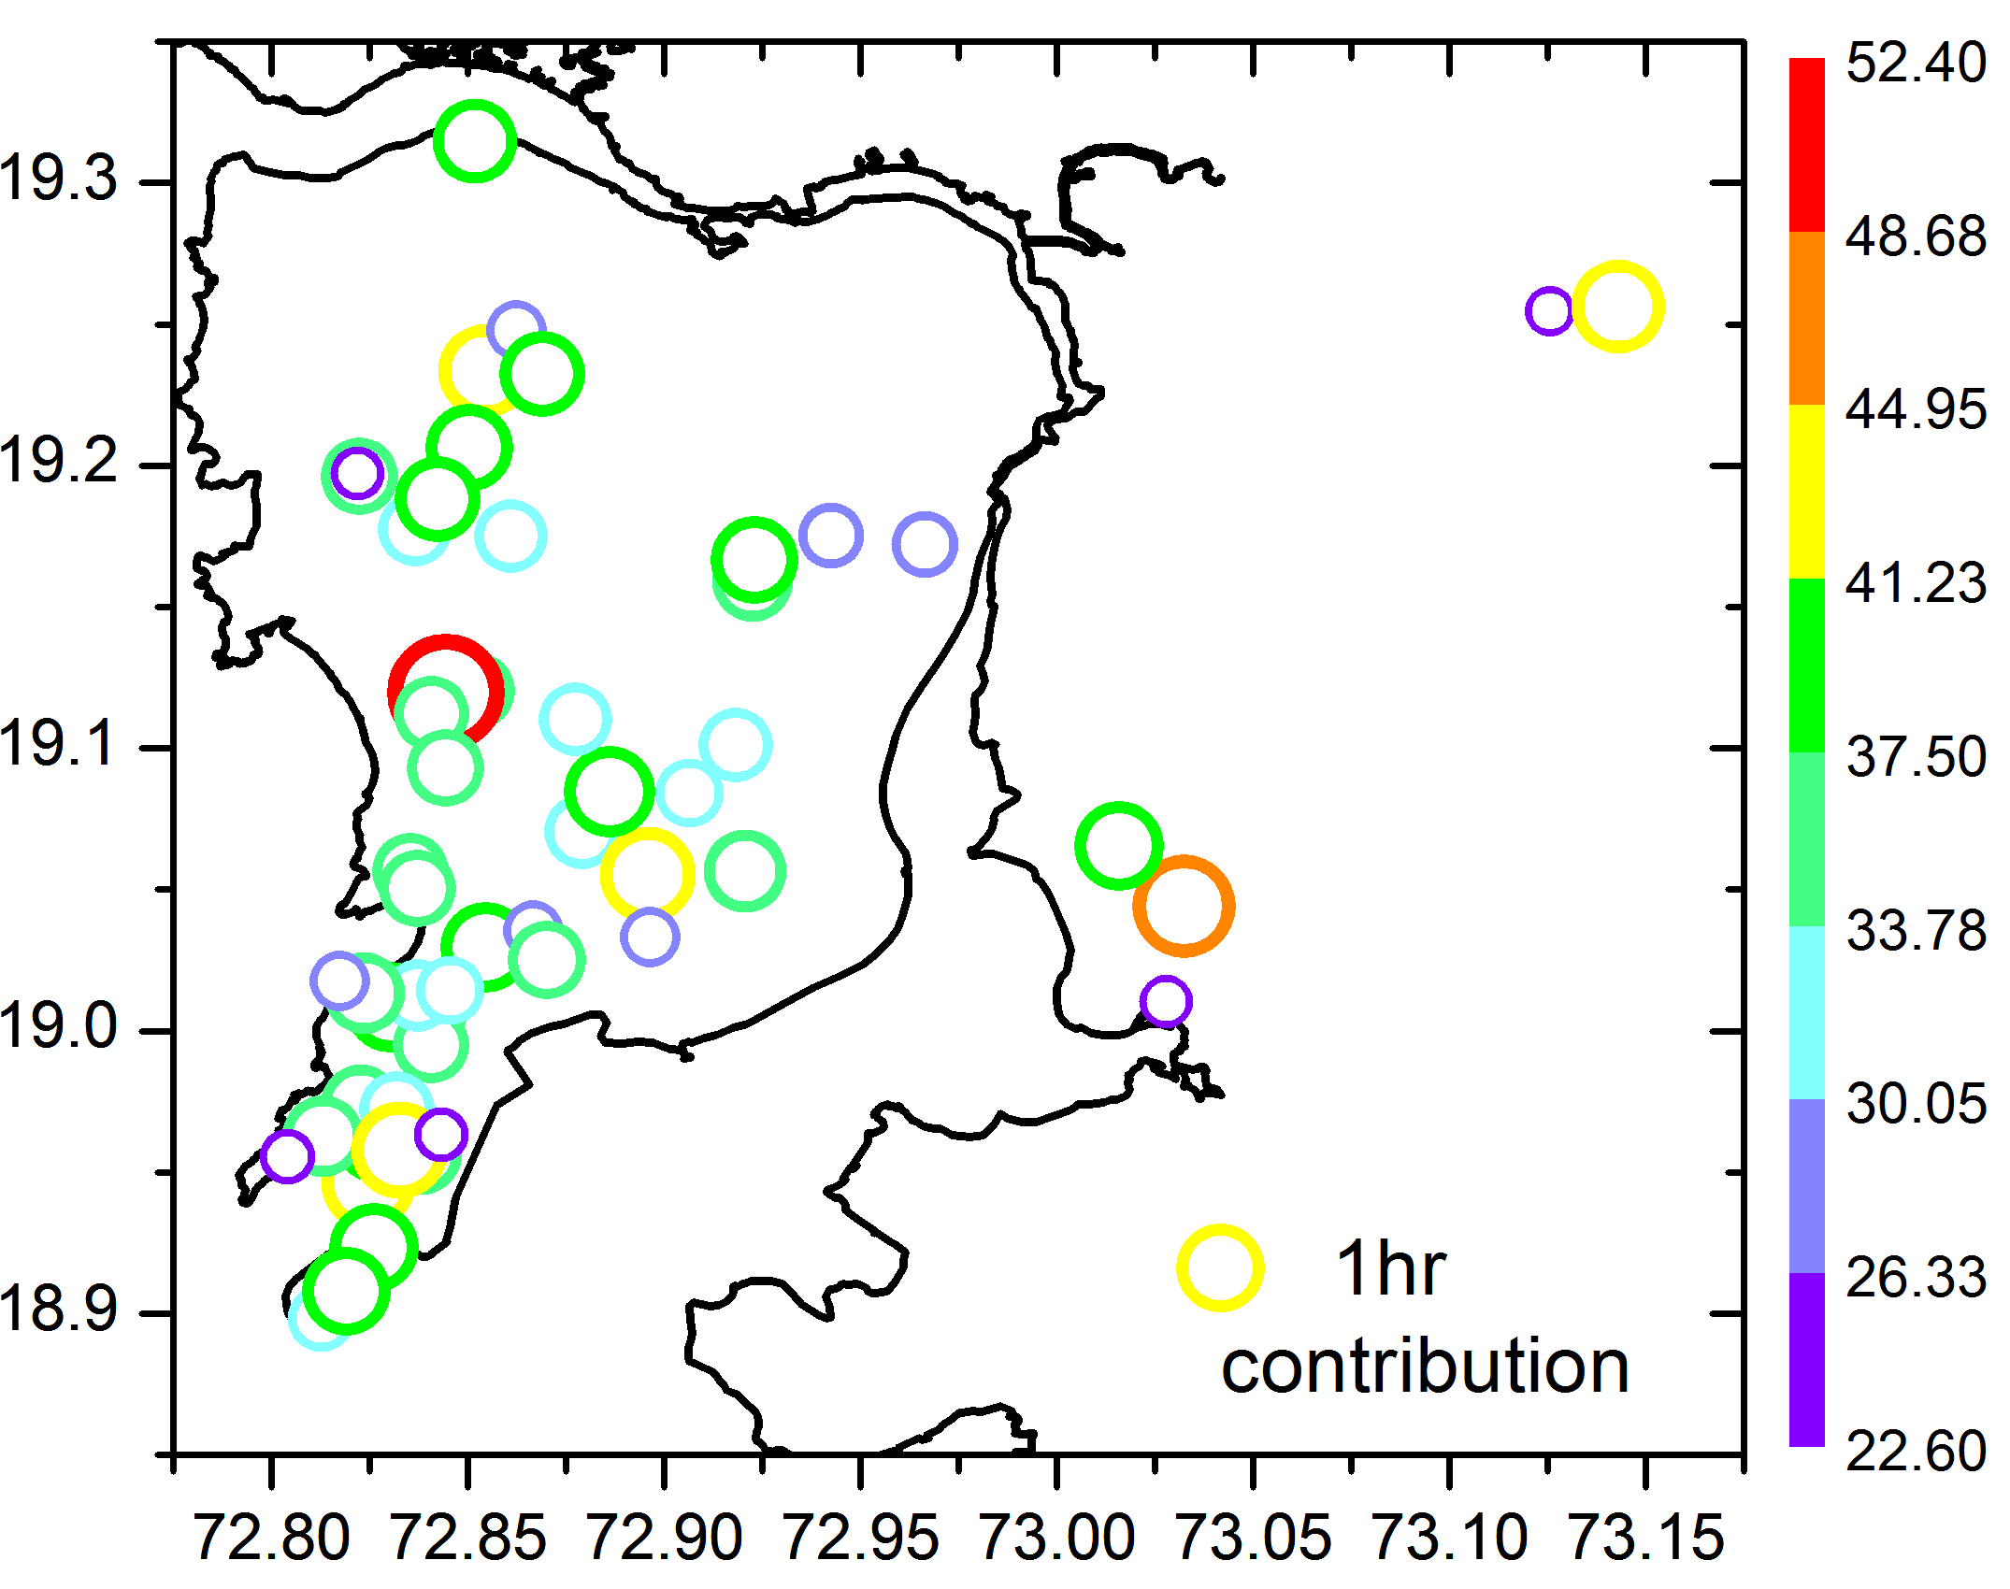
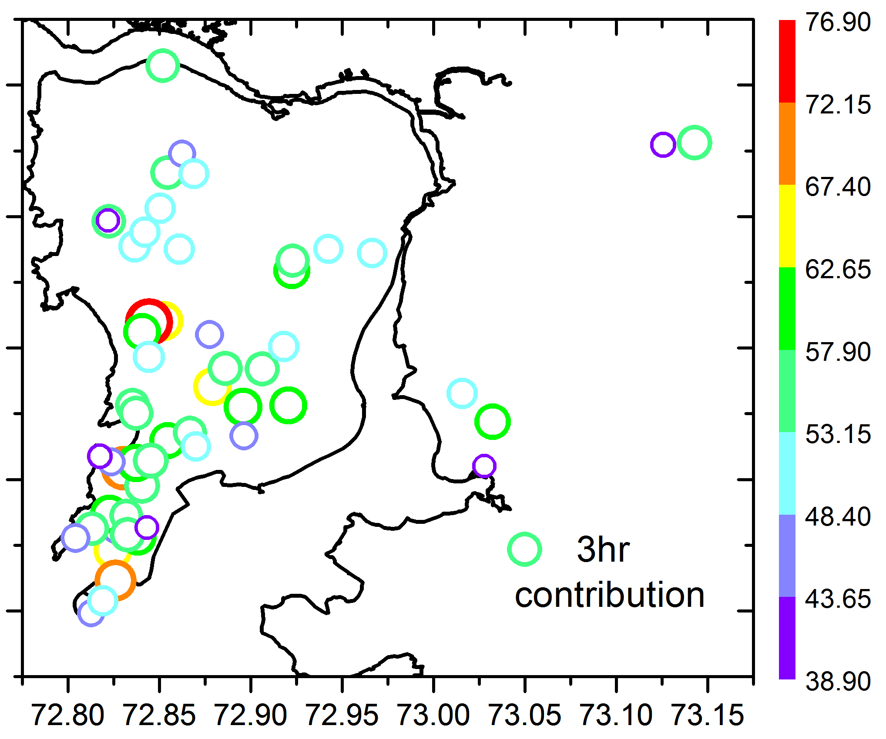
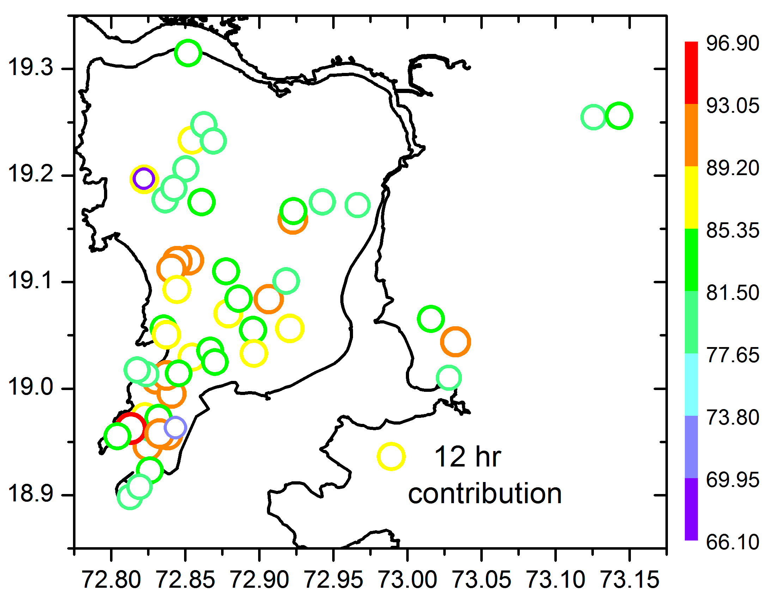
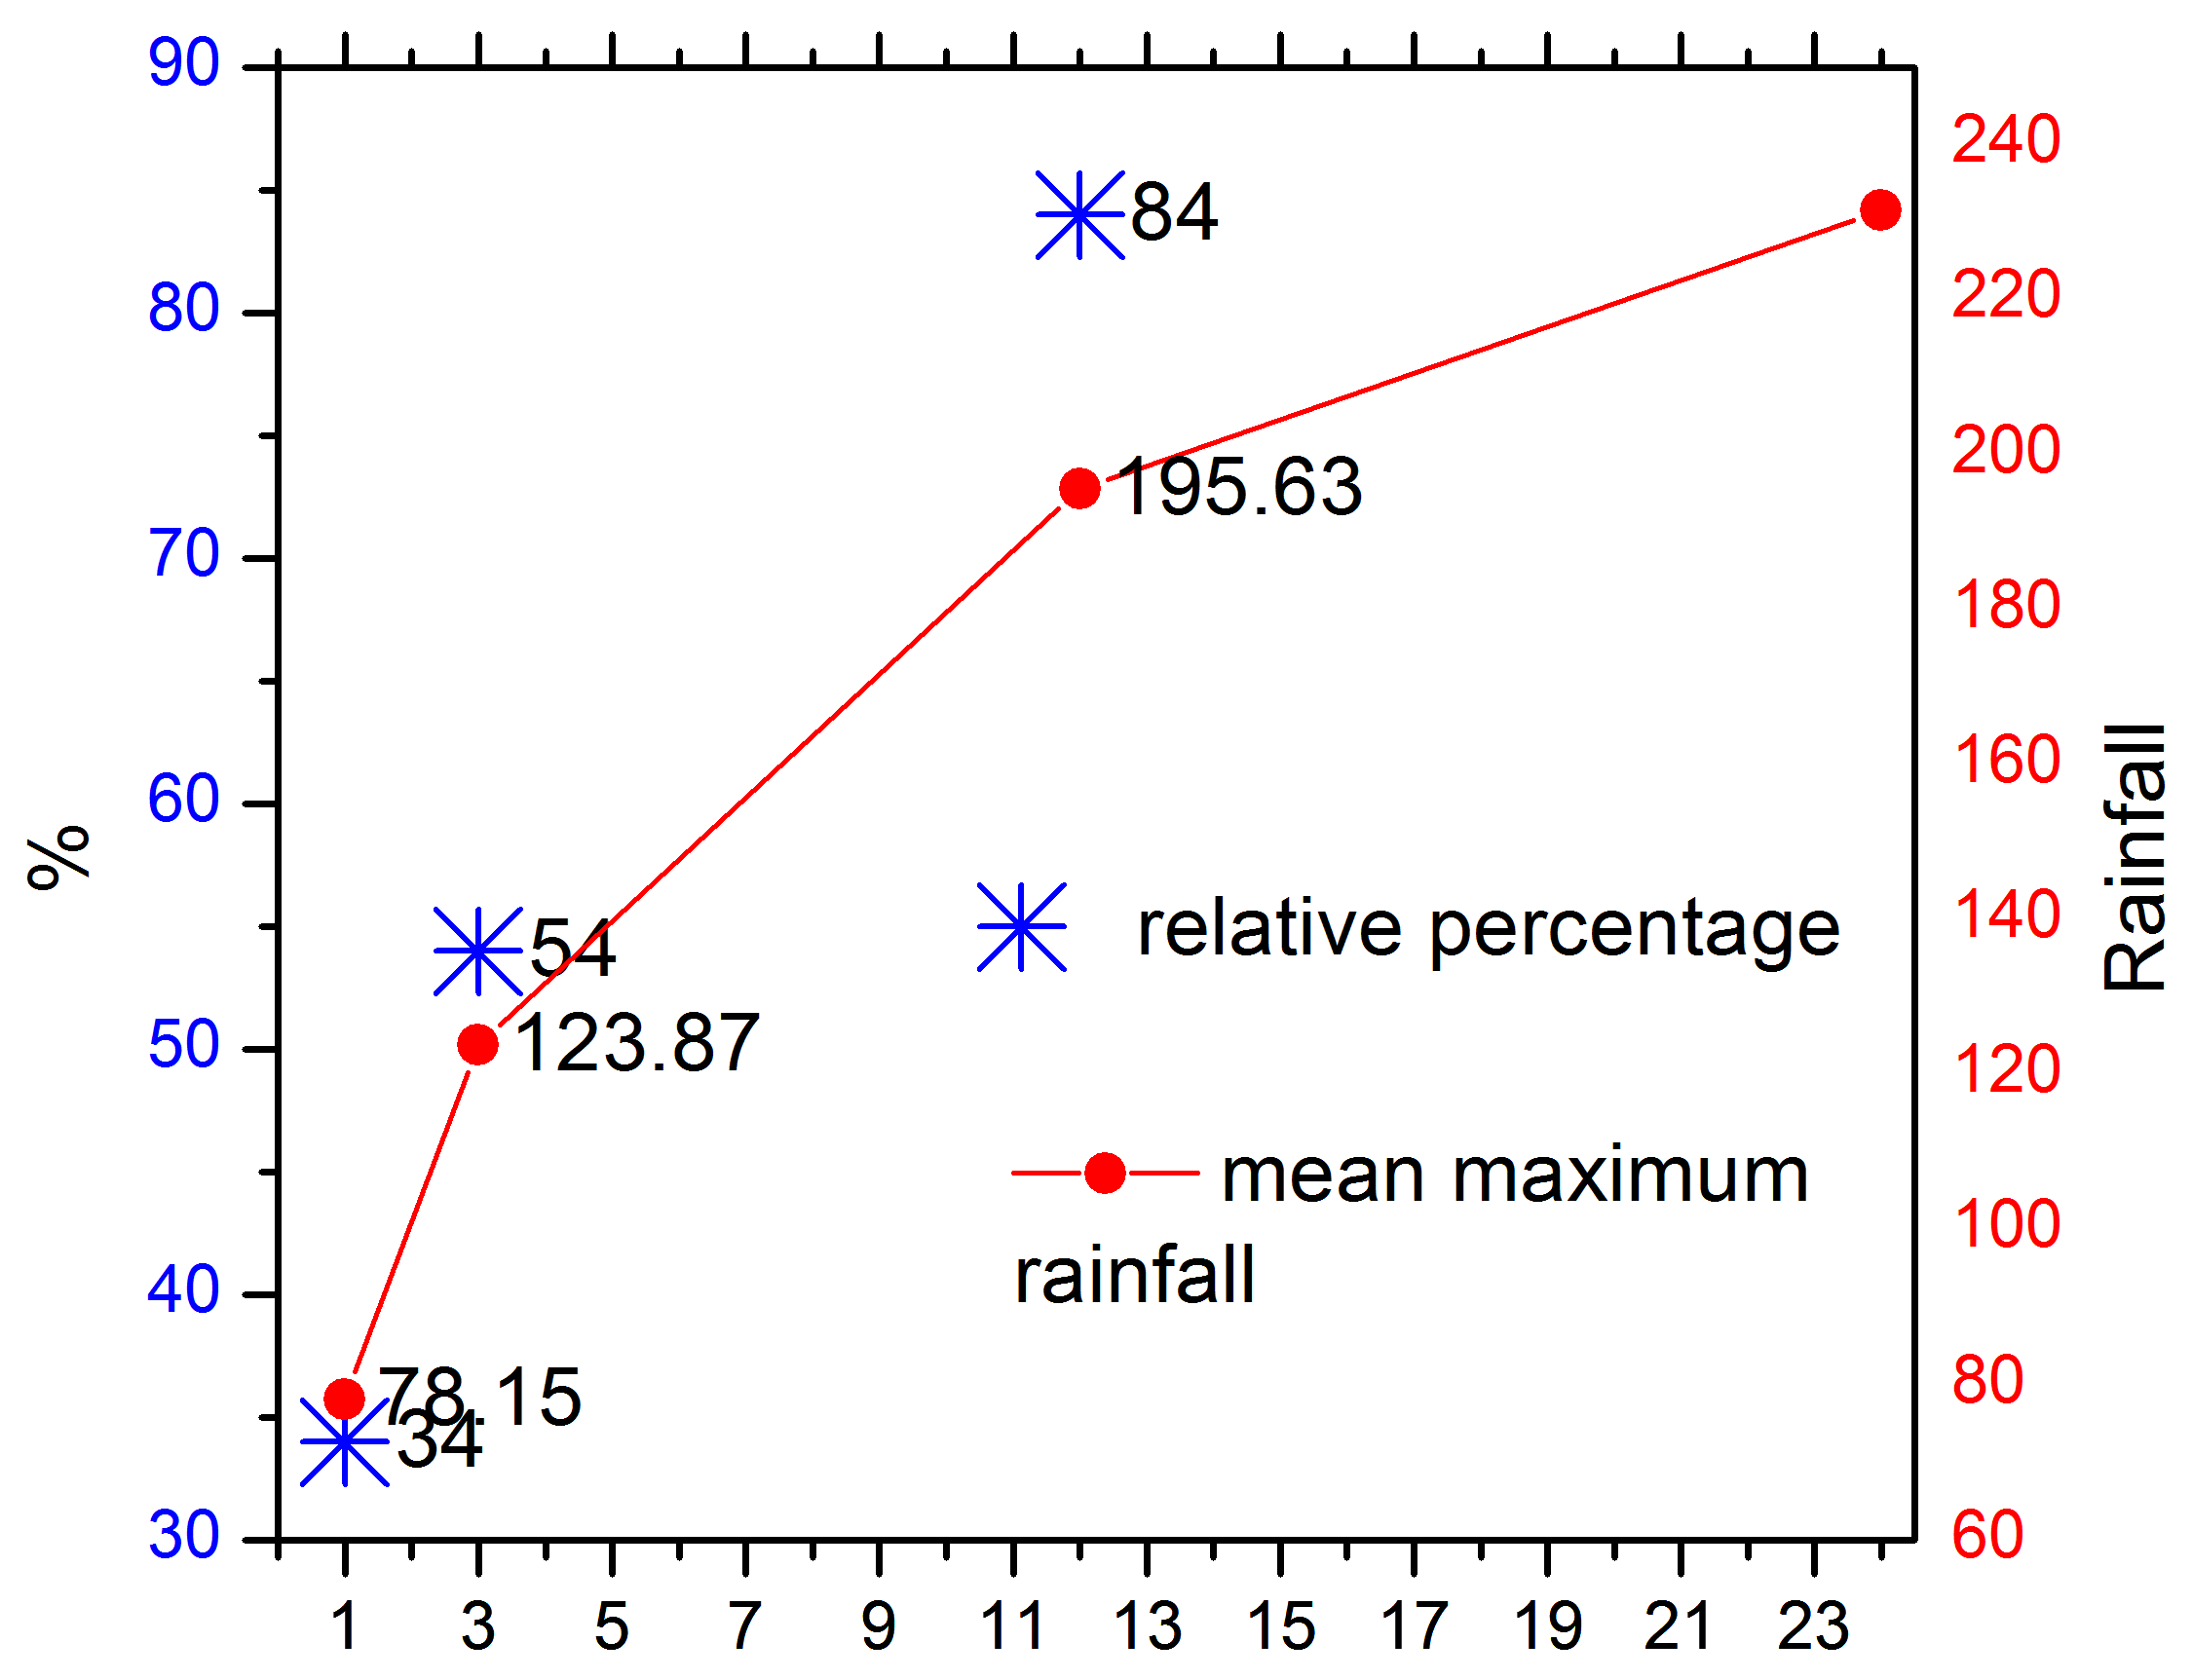
Extreme Hotspots based on maximum rainfall frequency

Slide 5
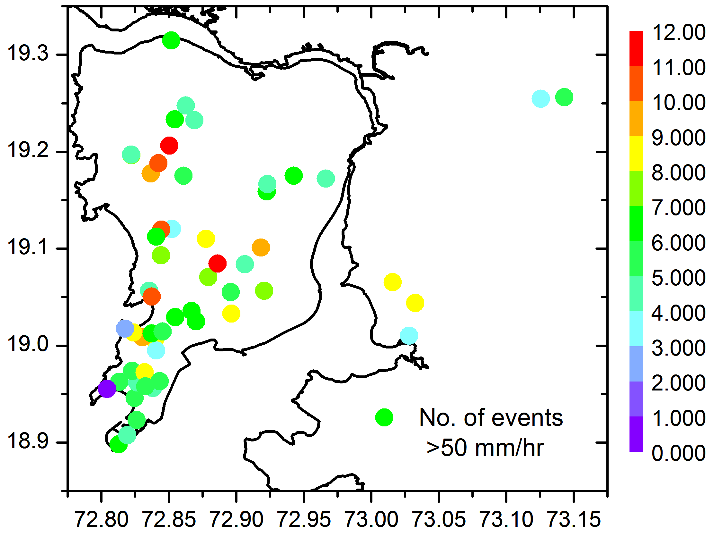
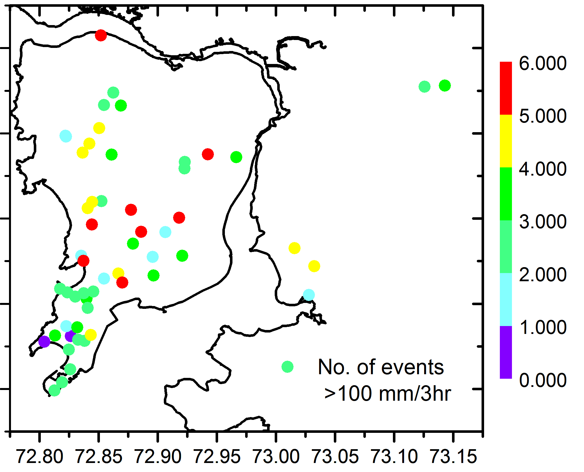
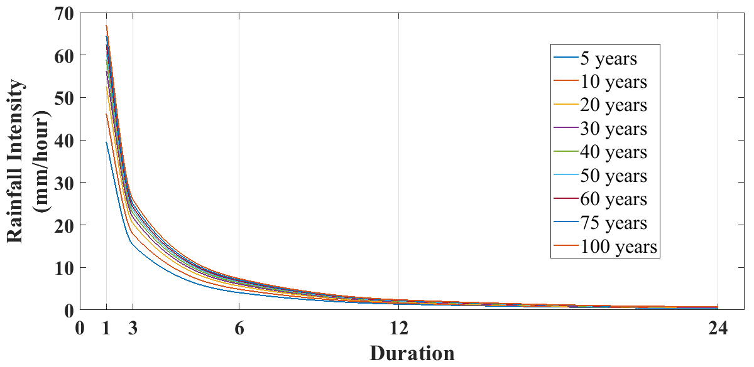
Extreme Hotspots based on maximum rainfall frequency

