Slide 1
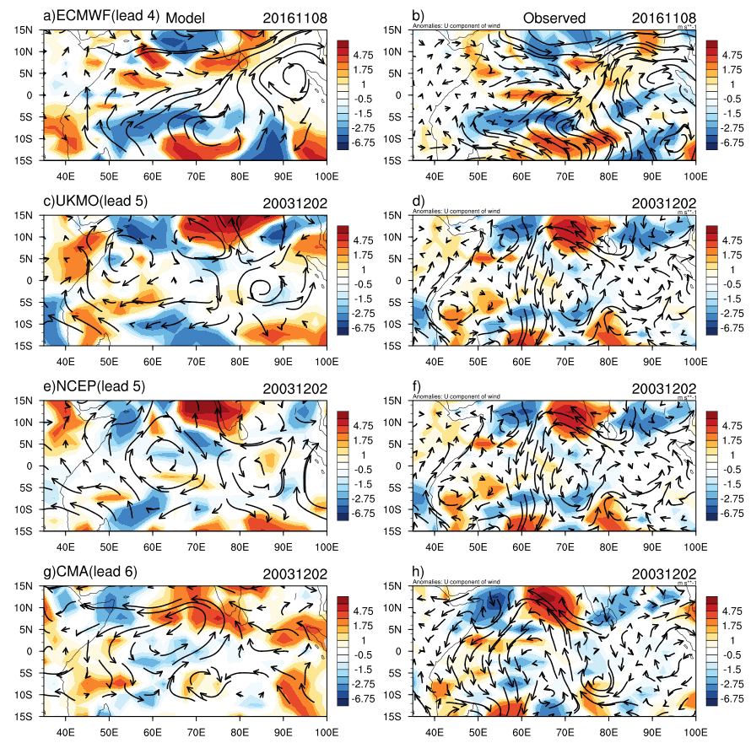
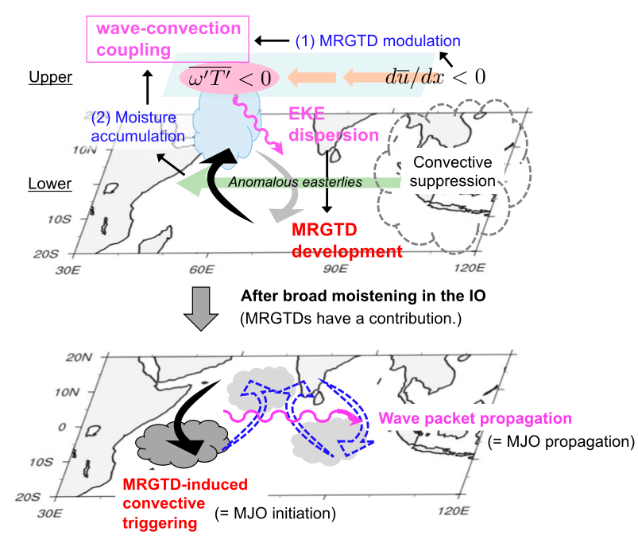
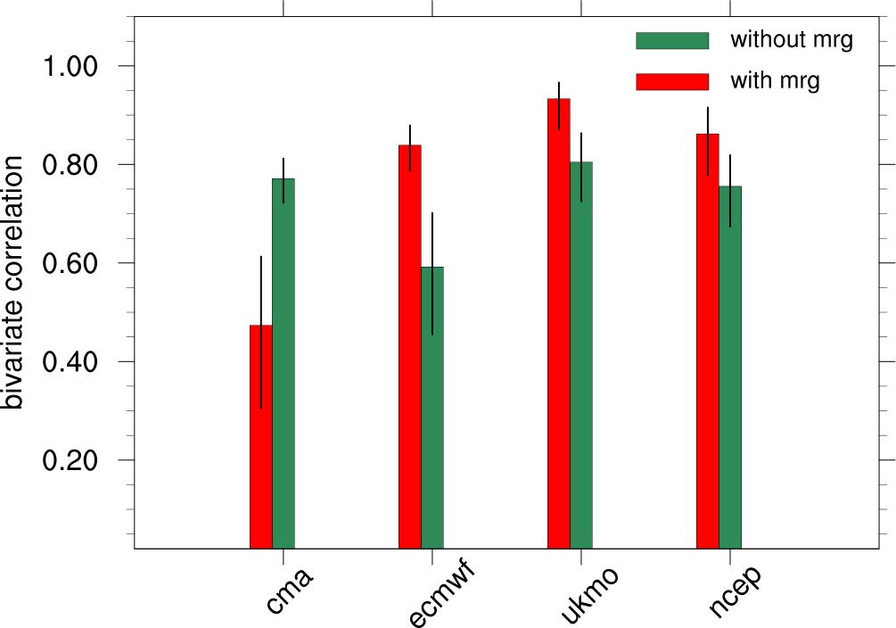
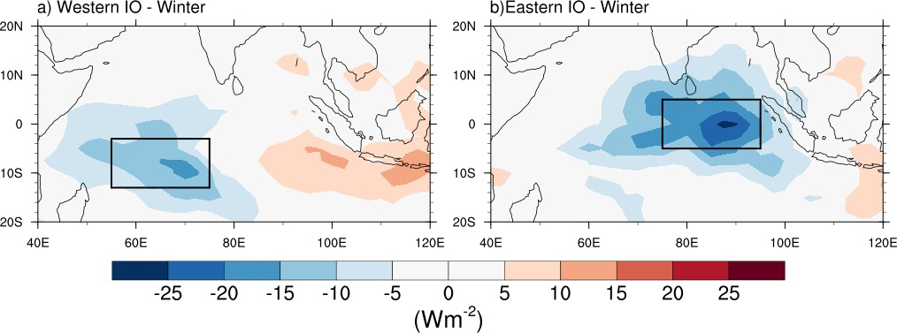
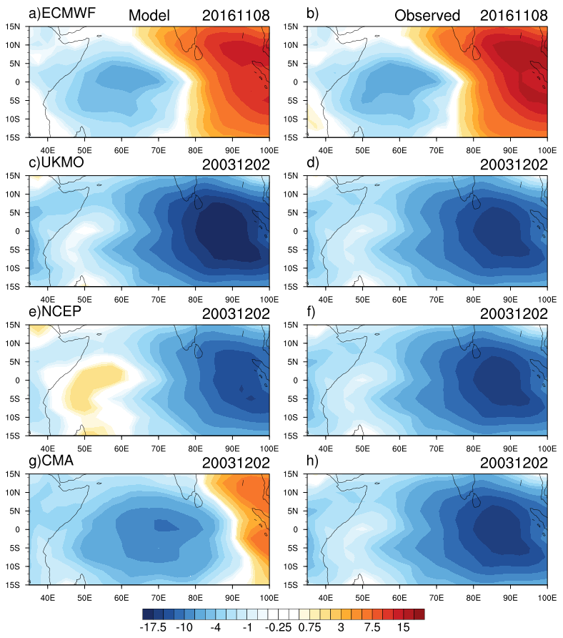
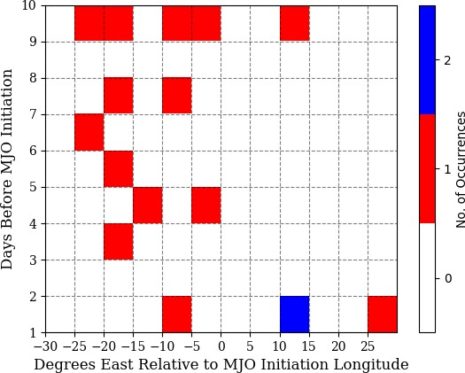
The role of Mixed Rossby-Gravity Wave dynamics in enhancing
the Prediction Skill of Indian Ocean MJO Convection Initiations
in S2S Model Reforecasts
Daniel Simon*ª, Dr. Neena Joseph Mani*, Dr. Suhas Ettammal*
*Indian Institute of Science Education and Research, Pune, India
ªsimon.daniel@students.iiserpune.ac.in
Introduction
Data and methods
Results
The Madden Julian oscillation(MJO) with the 30-90 day periodicity is associated with eastward propagating band of precipitation and cloudiness over the tropical regions which influences the tropical and extratropical weather.
Recent studies suggest that the MJO can be considered a moisture mode. However, they also emphasize that dry equatorial wave dynamics can be crucial for MJO initiation and propagation
Emerging research indicates that MRG wave packets can initiate the MJO convection over the Indian Ocean(Takasuka et al. 2019, Takasuka et al. 2020, Takasuka et al. 2021)
a. S2S model details
c. Synoptic scale moistening and circulation in models
The models part of the Subseasonal to Seasonal (S2S) prediction project are utilized to examine the hypothesis
Model | Reforecast period | Reforecast frequency | Ens size | No. of initiations(-2 to 2 day range)
 |  |  |  | With MRG | Without MRG
CMA (BCC_CSM1.2) | 1994-2014 | daily | 4 | 25 | 80
ECMWF (CY43R1) | 1998-2016 | 2/week | 11 | 15 | 10
UKMO (GloSea5) | 1993-2015 | 4/month | 7 | 5 | 15
NCEP (CFSv2) | 1999-2010 | daily | 4 | 15 | 35
Results
a. Dependence of MJO Initiation Skill on MRG Activity in S2S Models
Figure 6: The left panel displays synoptic-scale specific humidity (shade) summed over the 850-700 hPa levels and winds (vectors) averaged over the given levels in S2S models. The right panel showcases observed 3-10 day filtered specific humidity and winds. Lead days for model reforecasts are specified above each plot, with initiation cases labeled for individual models.
7th lead day skill
ECMWF effectively captures the moistening over the Western Equatorial Indian Ocean (WEIO).
UKMO and NCEO successfully capture the moistening over the northeastern Indian Ocean.
CMA, however, underestimates the moistening over the northeastern Indian Ocean
Taken from Takasuka et al. 2020
Figure 1: Schematic diagram showing how the MRG leads to Indian Ocean MJO initiation and propagation
Hypothesis
MJO initiations which are initiated by MRG mechanism may have larger predictability.
Data and methods
Figure 4: Bivariate Correlation of MJO Initiation Predicted One Week in Advance. The correlation is shown for cases with Precursor MRG (in Red) and cases without MRG (in Green). The vertical black line represents the 95% confidence interval of the bivariate correlation
Conclusions
a. MJO initiation identification
The study validates the hypothesis put forward by Takasuka et al. that MJO initiations with precursor MRG exhibit higher skill.
The convective initiation skill of the Indian Ocean MJO and its relationship with MRG activity are investigated in this study using four Subseasonal to Seasonal (S2S) prediction models (CMA, ECMWF, UKMO, and NCEP).
Models (ECMWF, UKMO, NCEP) capturing the MRG associated moistening demonstrate superior skill in predicting MJO initiation with preceding MRG, outperforming the model (CMA) lacking MRG associated moistening.
The models capturing MRG associated moistening also show high skill in predicting MJO initiations with preceding MRG compared to when it is absent.
OLR MJO index(OMI; Kiladis et al. 2014) is used for the identification of Indian Ocean MJO convective initiations.
ECMWF, UKMO and NCEP captures the MJO and MRG wave features relatively well compared to CMA(Zhao et al.2015, Janiga et al.2023, Yang et al.2023)
ECMWF, UKMO and NCEP show high skill of MJO initiation when preceded by MRG, compared to scenarios without preceding MRG.
CMA Model: Contrasting Results.
The skill in predicting MJO initiation with preceding MRG is higher for ECMWF, UKMO and NCEP.
Figure 1: 20-90 day filtered OLR composites for a) Winter Western Indian Ocean initiations(13S-3S & 55-75E), b) Winter Eastern Indian Ocean initiations(5S-5N & 75-95E)
b. MJO initiation representation in S2S models
The method successfully identified 27 Western and 14 Eastern Indian Ocean MJO convective initiations during the 1979-2021 winter (NDJFM) period.
b. MRG event identification method
Acknowledgements & References
Lower tropospheric MRG wave events in dynamical fields are identified using Empirical Mode Decomposition (EMD). This method provides event dates, duration, and location, using ERA 5 reanalysis data from 1979-2021, with 6-hourly data. Identification is primarily done using equatorial meridional winds.
Acknowledgements:
Author acknowledges the DST-INSPIRE research fellowship(grant no. IF180142).
References:
Takasuka, D., Satoh, M., & Yokoi, S. (2019). Observational evidence of mixed Rossby-gravity waves as a driving force for the MJO convective initiation and propagation. Geophysical Research Letters, 46, 5546–5555. https://doi.org/10.1029/2019GL08310.
Takasuka, D., & Satoh, M. (2020). Dynamical roles of mixed Rossby-gravity waves in driving convective initiation and propagation of the Madden–Julian oscillation: General views. Journal of the Atmospheric Sciences, 77(12), 4211–4231. https://doi.org/10.1175/JAS-D-20-0050.1
Takasuka, D., Kohyama, T., Miura, H., & Suematsu, T. (2021). MJO initiation triggered by amplification of upper-tropospheric dry mixed Rossby-gravity waves. Geophysical Research Letters, 48, e2021GL094239. https://doi.org/10.1029/2021GL094239
Kiladis G.N., J. Dias, K.H. Straub, M.C Wheeler, S.N. Tulich, K. Kikuchi, K.M. Weickmann, M.J. Ventrice . A comparison of OLR and circulation based indices for tracking the MJO. Monthly Weather Review, May 2014, 142 1697-1715.
Yang, G., Feng, X., & Hodges, K. (2023). Seasonal and interannual variation of equatorial waves in ERA5 and GloSea5. Quarterly Journal of the Royal Meteorological Society, 149(752), 1109–1134. Portico. https://doi.org/10.1002/qj.4460
Janiga, M. A., C. J. Schreck, J. A. Ridout, M. Flatau, N. P. Barton, E. J. Metzger, and C. A. Reynolds, 2018: Subseasonal Forecasts of Convectively Coupled Equatorial Waves and the MJO: Activity and Predictive Skill. Mon. Wea. Rev., 146, 2337–2360, https://doi.org/10.1175/MWR-D-17-0261.1.
c. Identifying MJO initiations with preceding MRG activity
MRG activity in the 10 days preceding the MJO initiation over the 30-95 E domain is identified.
16(39%) MJO initiations were identified with preceding MRG activity.
Occurrence of MRG Events Relative to MJO Initiation.
Figure 5: MJO Convective Initiation cases in S2S Models: ROMI Recreated OLR (Left) vs. Observed OMI Recreated OLR (Right). Model reforecasts with initiation on the 7th lead day are considered. The initiation cases considered for individual models are labeled above the respective diagrams.
ECMWF and UKMO: Accurately capture MJO initiation with realistic location and strength.
NCEP: Captures initiation with its location but underestimates strength.
CMA: Captures initiation but underestimates convective strength and exhibits westward shift in convection region.
Figure 3: Diagram showing the occurrence of MRG events relative to MJO initiation. Different colors represent MRG events relative to the MJO initiation day and location
Most MRG events occur 3 or more days before MJO initiation, west of the MJO initiation location.

