Slide 1
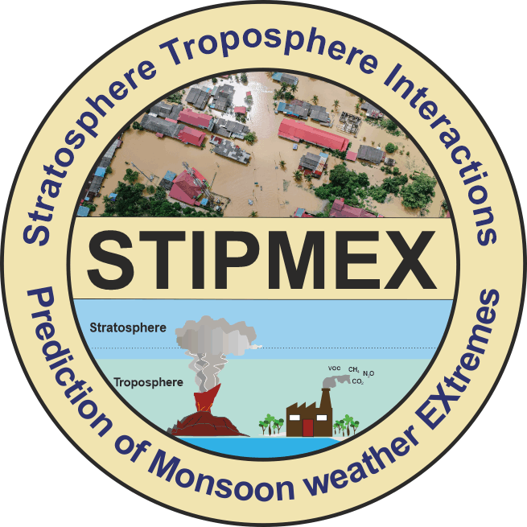
Stratospheric Impacts of an Extreme Australian Bushfire Event: A Multi-Satellite Analysis Presenter: Prasanth. S, CAOS, IISc, India Email: prasanthphy57@gmail.com
S. Prasanth^{1,2,} N. Anand³, k. Sunilkumar², K. Arun¹, S. Jose⁵, S. K. Satheesh^{2,4,6}, and K. K. Moorthy⁴
¹Department of Physics and Electronics, Christ University, Bengaluru, Karnataka, India
²Centre for Atmospheric and Oceanic Sciences, Indian Institute of Science, Bengaluru, Karnataka, India
³School of Earth, Environmental and Sustainability Sciences, Indian Institute of Science Education and Research Thiruvananthapuram, Kerala, India
⁴Divecha Centre for Climate Change, Indian Institute of Science, Bengaluru, Karnataka, India
⁵Department of Physics, Newman College, Thodupuzha, Kerala, India
⁶DST-Centre of Excellence in Climate Change, Indian Institute of Science, Bengaluru, Karnataka, India

Slide 2
Introduction
Australia faced a catastrophic extreme bushfire event during 2019/2020, an event widely recognized as the Black Summer event. Pyrocumulonimubus clouds released by the event injected a surplus amount of aerosols into the lower stratosphere. These aerosols provided surface area for heterogeneous chlorine activation reaction which led to additional ozone loss during 2020.
Along with the aerosols, polar stratospheric clouds (PSC) are also known for participating in the ozone depletion process. Despite that, the influence of bushfire aerosols on PSCs is not studied extensively so far. In the context of climate change, the rise in greenhouse gases is expected to increase the frequency of this kind of extreme wildfire events through troposphere warming (IPCC AR6, 2023; Mansoor et al., 2022). Simultaneously, stratospheric cooling is anticipated to expand PSC coverage (Robrecht et al., 2019). Together, these factors could significantly impact the ozone recovery process. Hence understanding the influence of the extreme bushfire event on PSC dynamics is vital for predicting the ozone recovery.
Therefore, this study aims to investigate the anomalies in stratospheric chemistry and PSC dynamics caused by the Black Summer event using satellite observations. Specifically, we will examine the impact of the event on aerosol loading in the lower stratosphere, focusing on HNO₃ and H₂O at high latitudes due to their importance as constituents of PSCs.
This research will provide valuable insights into the intricate interactions between extreme wildfire events, stratospheric chemistry, and PSC dynamics.

Slide 3
Data and Methods
Data used in the present study:
The aerosol extinction coefficient at 745 nm (C_{ext} ) is obtained from the Ozone Monitoring Profiler Suite (OMPS) on board Suomi NPP.
The gas phase mixing ratios of H₂O, HNO₃, and N₂O are obtained from the Atmospheric Chemistry Experiment-FTS (ACE-FTS) onboard SciSat.
Polar Stratospheric Clouds (PSC) areal coverage is obtained from the Cloud-Aerosol Lidar with Orthogonal Polarization (CALIOP Lidar) onboard the Cloud-Aerosol Lidar and Infrared Pathfinder Satellite (CALIPSO).

Slide 4
Data and Methods
Estimation of anomaly and standardized anomaly:
Anomaly (Δ) in aerosol extinction coefficient (C_{ext} at 745 nm), H₂O and HNO₃ mixing ratio and PSC areal coverage are estimated as follows,
$∆X=X_{2020}− \overline{X}$
Where ‘$∆X$’ is the daily anomaly of quantity ‘$X$’, ‘$X_{2020}$ ’ is the daily mean, and ‘$\overline{X}$ ’ is the daily background mean which is constructed by averaging daily values of ‘ $X$’ during the period 2009 to 2019 for H₂O and HNO₃ mixing ratio, and PSC areal coverage, and during the period 2012 to 2019 for C_{ext}. The year 2015 is excluded while constructing the background mean to avoid the effects of the Calbuco eruption 2015.
The standardized anomaly (SA) is estimated as follows,
$SA X= \frac{∆X}{σX}$
Where ‘$σX$ ’ is the standard deviation of quantity ‘$X$’.

Slide 5
Results and Discussion
The background mean of aerosol extinction coefficient (C_{ext}) remains ~1.25×10⁻⁴ km between February to May. But since early 2020, the C_{ext} gradually increasing and eventually peaked at 2.4×10⁻⁴ km by April 2020. It could be attributed to the coupled effect of the transportation of more aerosols from the mid-to-high latitude and aerosol aging process where bushfire aerosols coated with stratospheric sulfate aerosols result in increased size and extinction coefficient.
The simultaneous production and depletion of the HNO₃ and N₂O mixing ratio exceeded the respective one standard
deviation and confirms that the HNO₃ is produced through the N₂O₅ hydrolysis process. The reaction can be written as
follows,
N2O5 + H2O → 2HNO3
Further, though the hydrolysis process also results in the depletion of gas phase H₂O, the H₂O mixing ratio remained
within one standard deviation which could be due to the relatively high abundance of the H₂O in the lower stratosphere.
Increased aerosol loading and nitric acid production

Slide 6
Results and Discussion
Enhanced areal coverage of ice polar stratospheric clouds (PSC)
LNAT: Liquid Nitric Acid Trihydrate; ENAT: Enhanced Nitric Acid Trihydrate; STS: Supercooled Ternary Solution

Slide 7
Enhanced areal coverage of ice PSC
The Ice, ENAT, and STS PSCs exhibited more than three standard deviations. The increase in HNO -containing PSCs
(ENAT and STS) can be attributed to the increased surface area provided by the bushfire aerosols and the production of HNO₃ through the N₂O₅ hydrolysis process.
However, the LNAT areal coverage remains within one standard deviation and ice areal coverage exceeded three standard deviations.
We hypothesize that it is possibly due to the rapid conversion of these LNAT into ice PSC through the nucleation process.

Slide 8
Conclusion
The Black Summer event increased the lower stratospheric aerosol loading in early 2020. These aerosols promoted the N₂O₅ hydrolysis process which significantly increased the production of gas-phase HNO₃.
This was expected to increase the HNO₃ containing Polar Stratospheric Cloud (PSC) known as Liquid Nitric Acid Trihydrate (LNAT). However, in contrast, LNAT areal coverage remained within one standard deviation, but the water ice PSC areal coverage exceeded three standard deviations.
We find that HNO₃ condensed on the bushfire aerosols, leading to the formation of LNAT. However, it subsequently acted as nuclei for the formation of ice PSCs. The rapid conversion from LNAT to ice PSCs resulted in an anomalously high areal coverage of ice PSCs.
We conclude that the intrusion of aerosols into the stratosphere due to an extreme bushfire event can significantly influence the stratospheric chemistry and PSC dynamics.

