Slide 1
A polarimetric radar analysis of pre-monsoon deep convective systems and a hail-producing event observed in the monsoon core zone
Kumar Abhijeet^{*,1,2}; Sachin M. Deshpande¹; and G. Pandithurai¹
1 Indian Institute of Tropical Meteorology (IITM), Pune
2 Atmospheric Research Testbed (ART), Silkheda
*Contact email: abhijeetkrbhu11@gmail.com
02-07 June 2024 STIPMEX-2024 IITM-Pune.

Slide 2
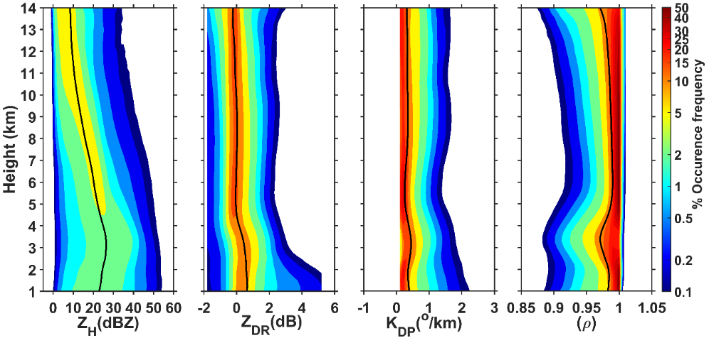
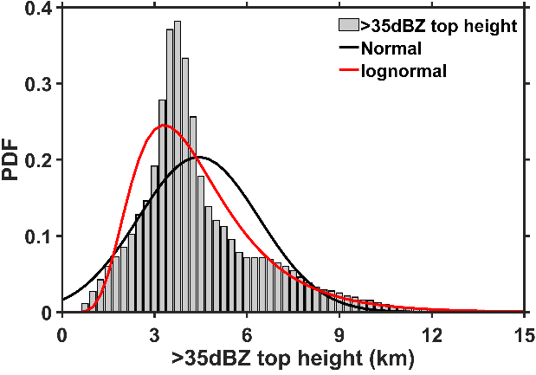
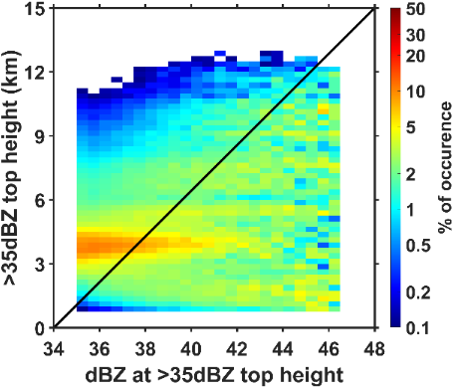
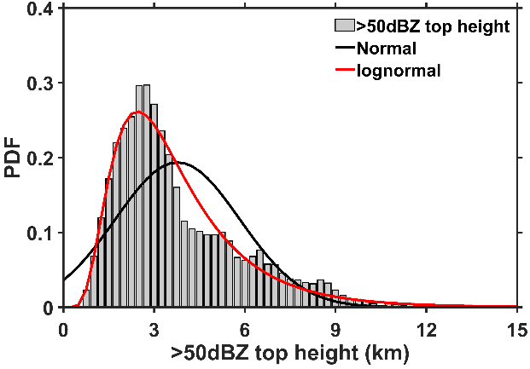
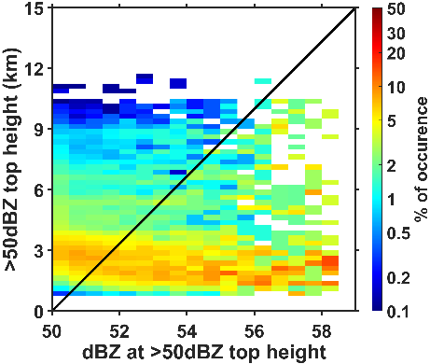
Main objectives:
Study the characteristics features of hail-producing pre-monsoon clouds in the monsoon core zone.
Understanding microphysical characteristics of hail-storm observed over Bhopal using C-band dual-polarization radar in the pre-monsoon months.
Introduction: Thunderstorms and lightning activity have shown an increasing and positive trend over central India in the pre-monsoon months driven by intense and deep convection.
CFADs
Characteristics of pre-monsoon clouds
Probability distribution of ETH
Occurrence of dBZ
Maximum height of >35-dBZ and >50-dBZ ETHs are around 13km and 11km respectively.
Multiple peaks of ETHs at >35dBZ and >50dBZ.
Low occurrence frequency of Z_{H}>55dBZ at higher heights than lower heights.
Large Z_{H}>50BZ at higher heights (>8km), may produce hail stones at the surface (Lemon 1980).
CFADs of combined 12 rain events.
High occurrence frequency of Z_{DR} and K_{DP} above the 5 km altitude, suggesting the deep and intense convective updraft within the rain cell with intense riming/accretion.
Wide distribution of Z_{H}, Z_{DR}, K_{DP ,}and ρ below the 5 km altitude suggests the melting of the rimmed particles.
02-07 June 2024 STIPMEX-2024 IITM-Pune.

Slide 3
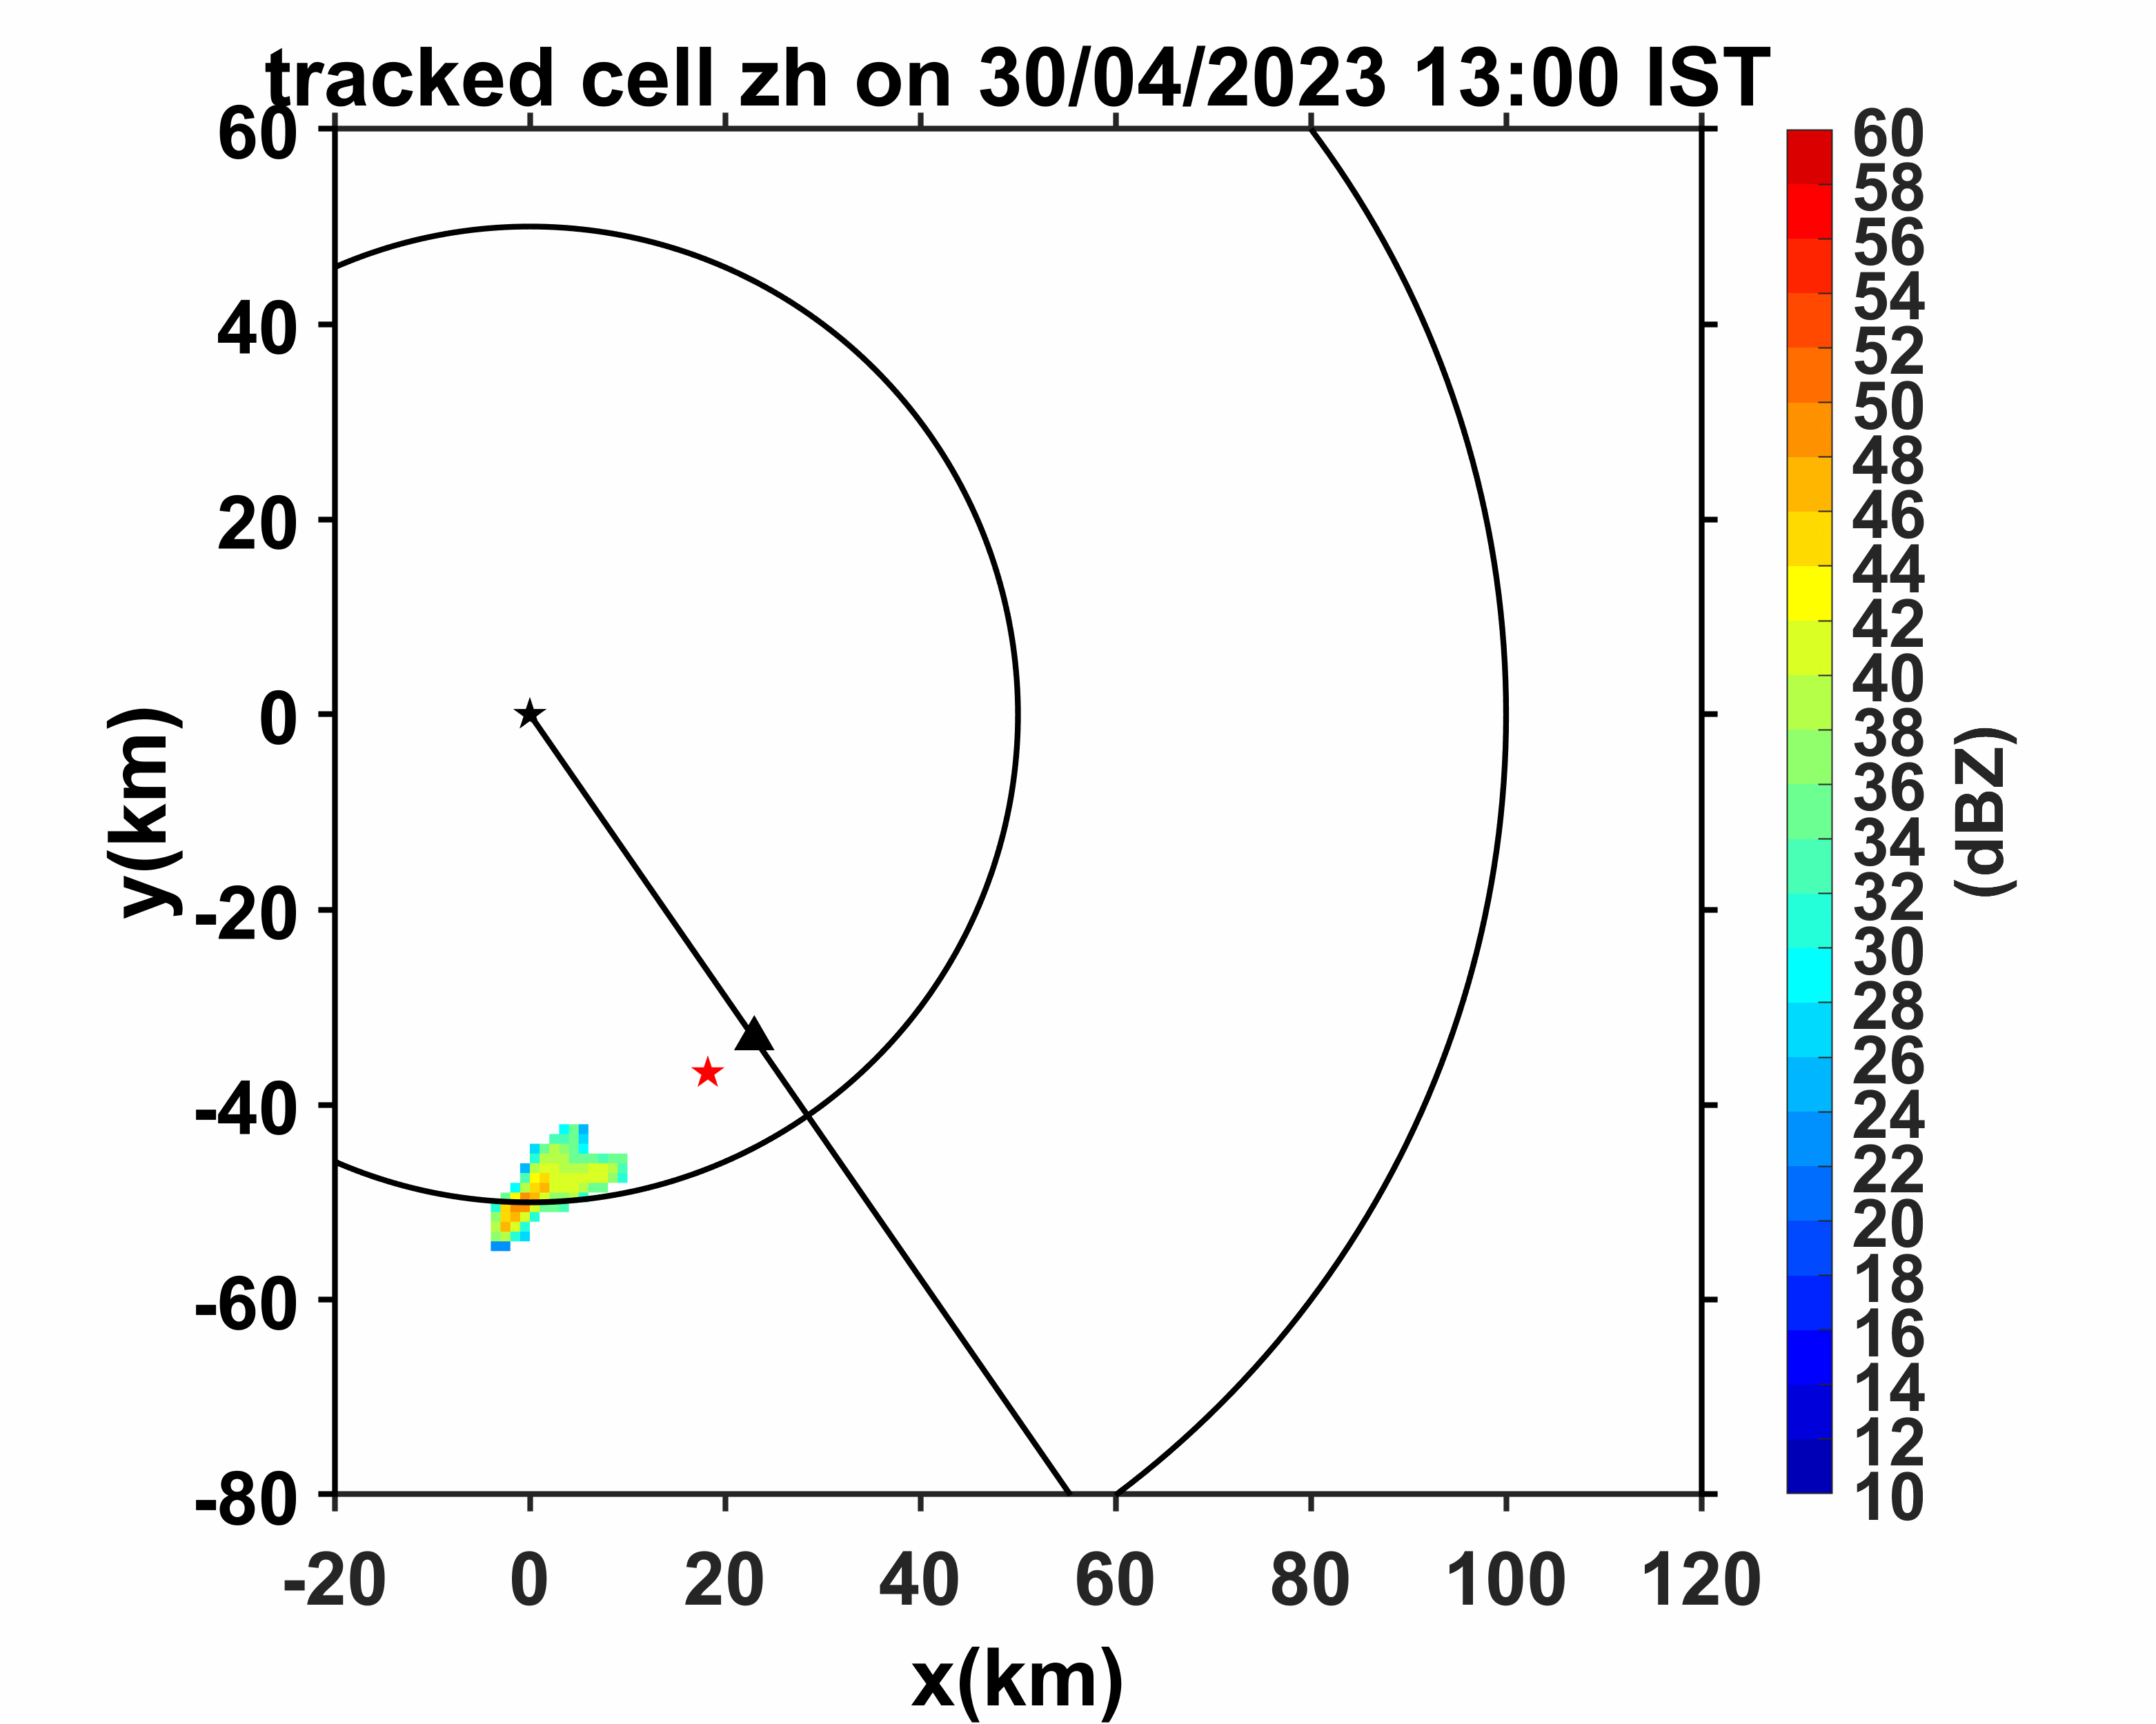
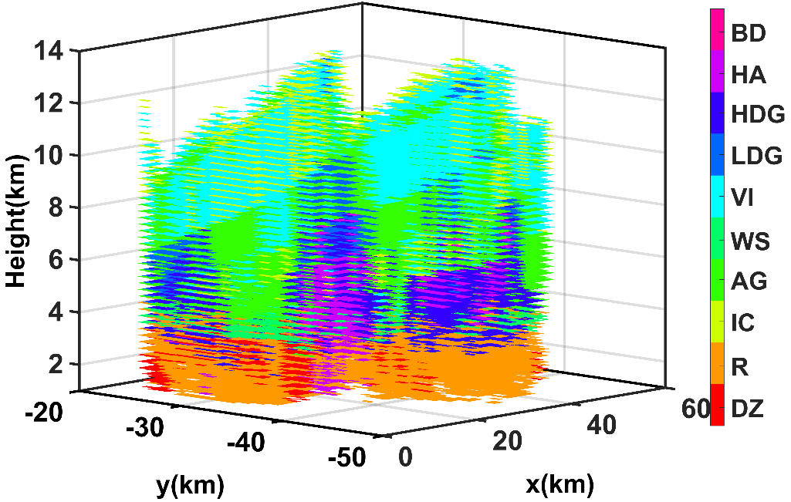
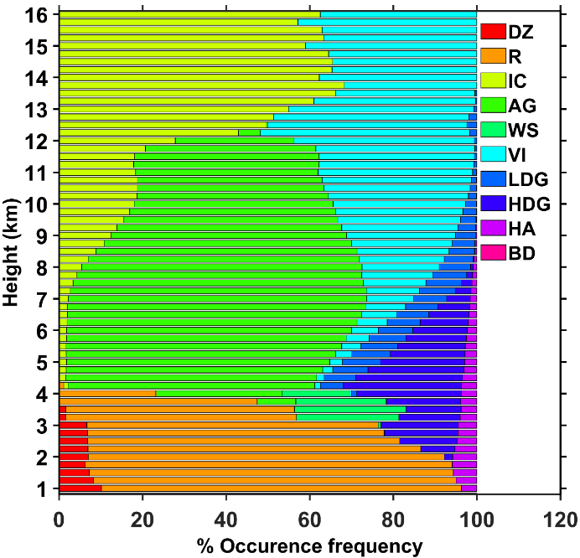
Diagnosis of hailstorm event over Bhopal on 30 April 2023 linked to deep convective system using C-band dual-polarization radar
Evolution of tracked cell
Time-height variation of the polarimetric parameters of the tracked cell
3D hydrometeors present during the hail spell over Bhopal on 30/04/2023 14:00
Occurrence of Hydrometeor classes
Main conclusions
The signature of melting of small hail is observed below 4 km at ~14:00 IST as Z_{H}>45dBZ, Z_{DR}>1.2dB, K_{DP}>0.5º/km, and ρ_{HV}<0.95 is observed and suggests that the partially melted water-coated hail/graupel may be observed at the surface.
02-07 June 2024 STIPMEX-2024 IITM-Pune.

Slide 4
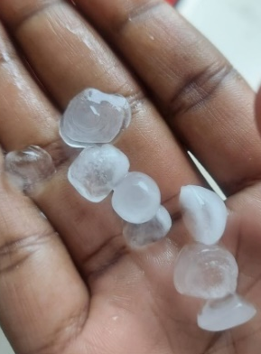
Hail sample collected over Bhopal on 30 April 2023 at ~14:00 IST
For more details please visit to the poster.
02-07 June 2024 STIPMEX-2024 IITM-Pune.

