Slide 1


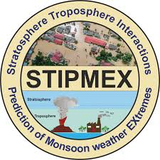
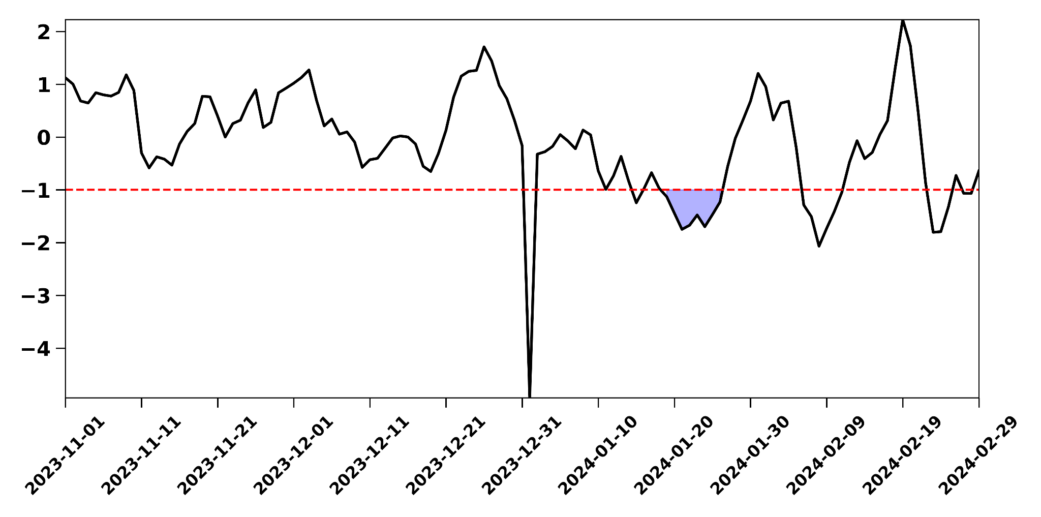
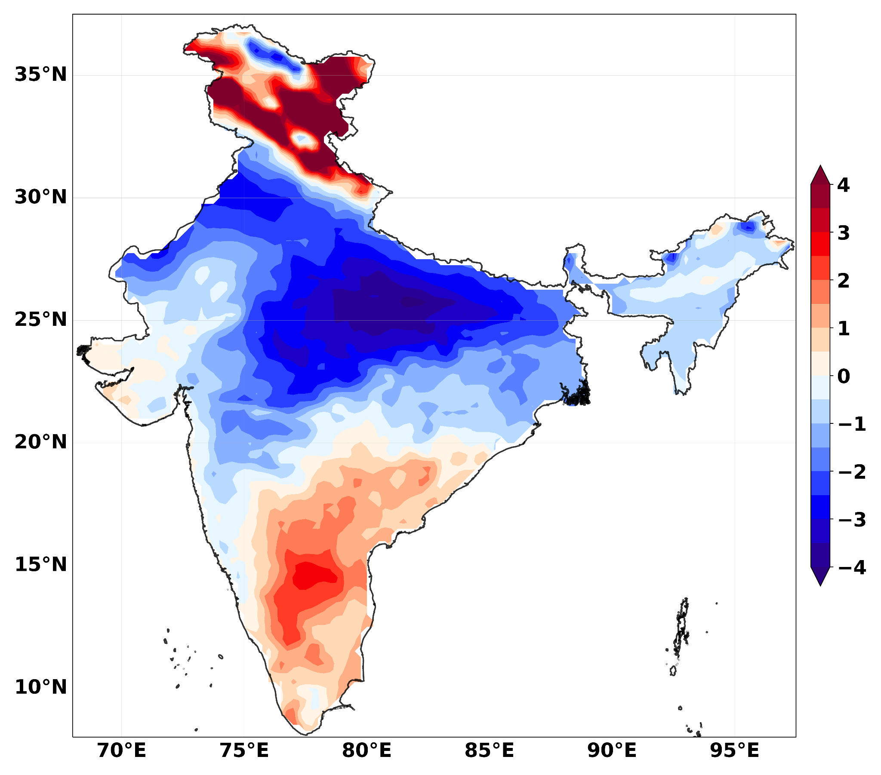
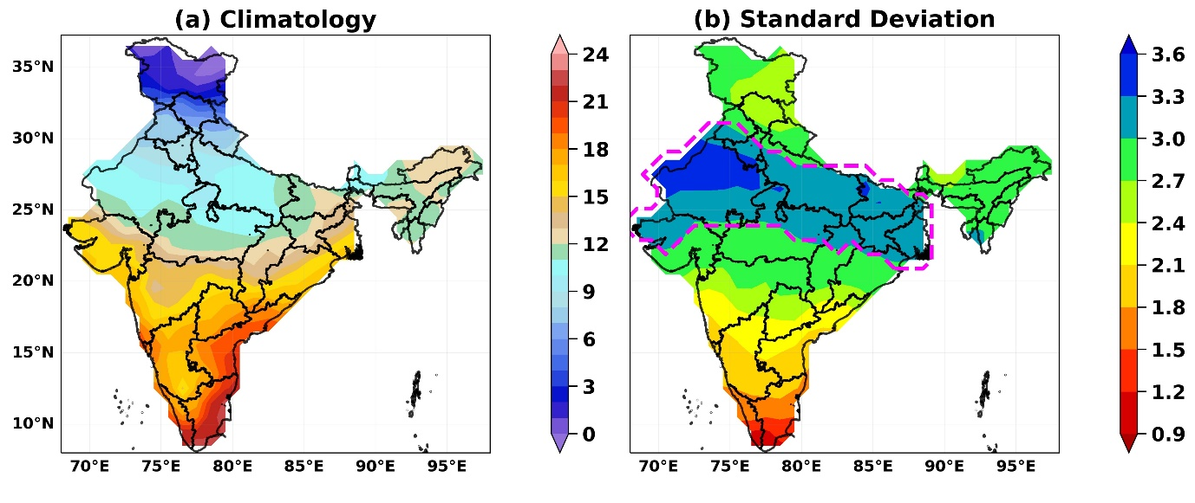
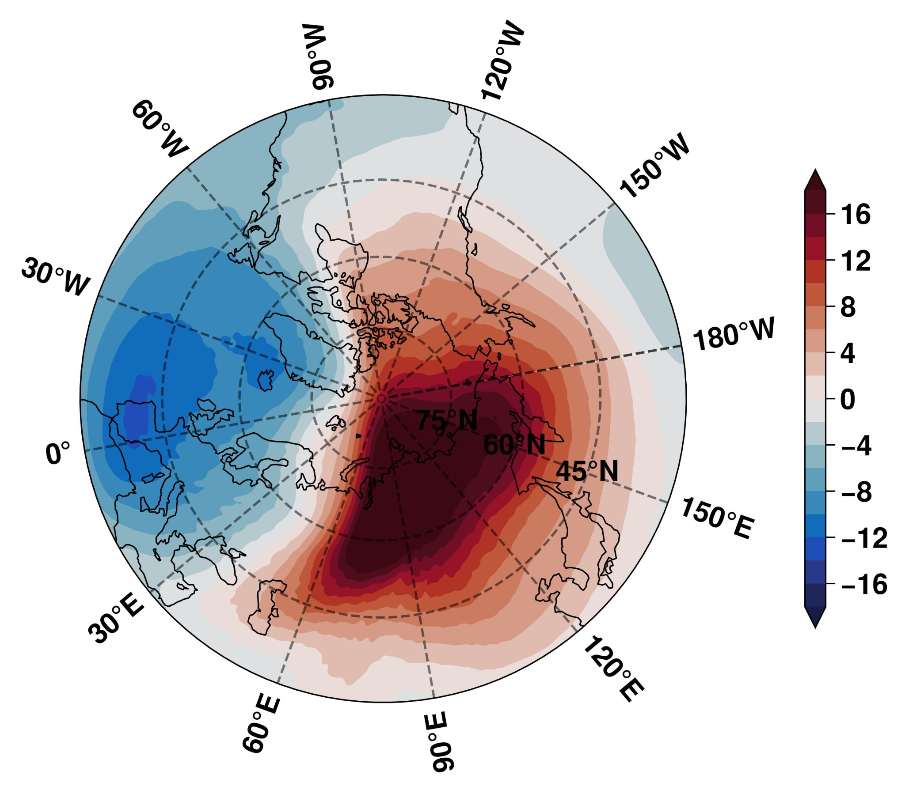
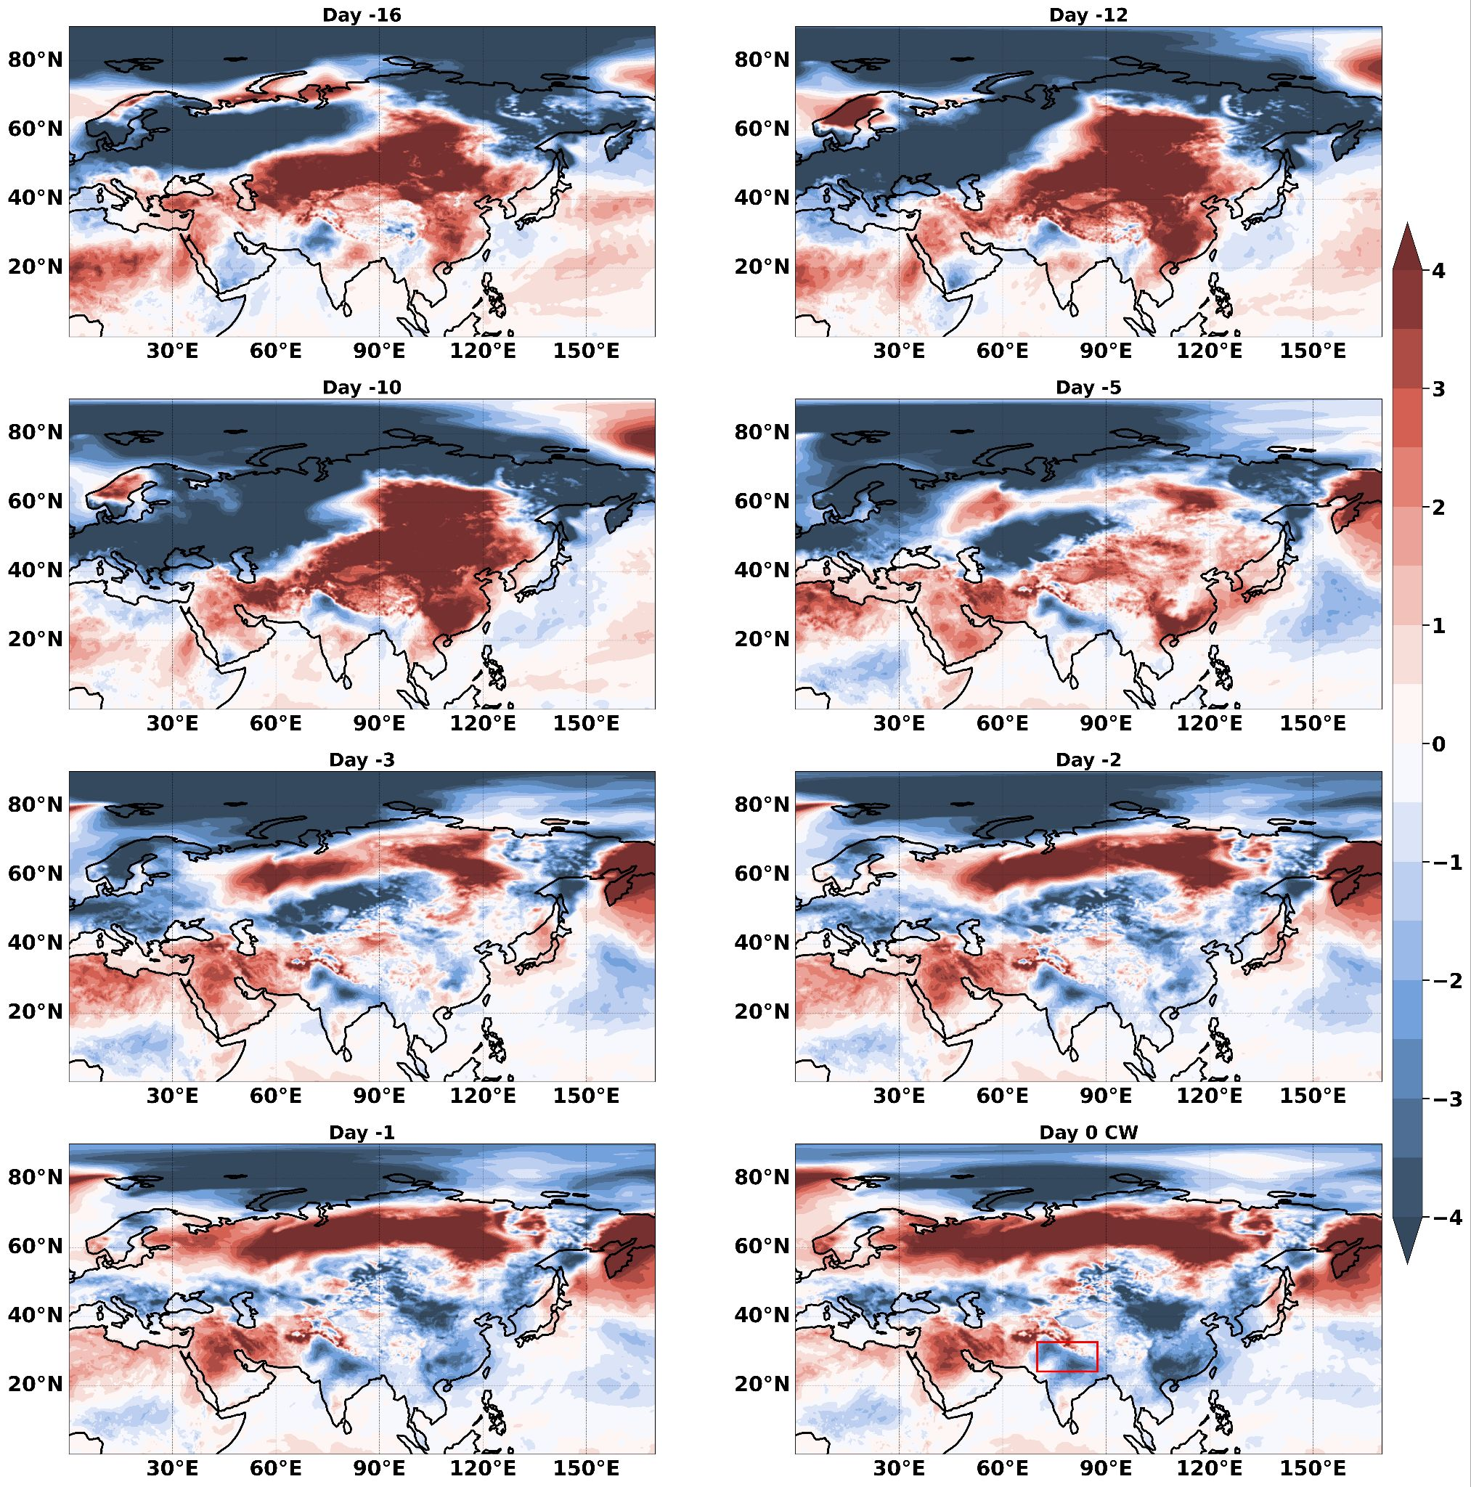
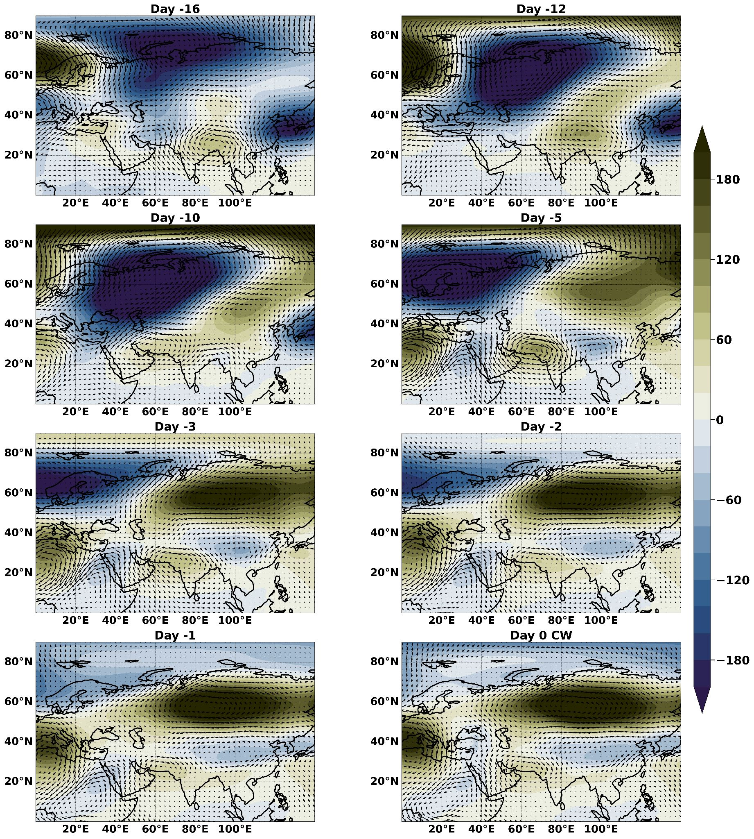
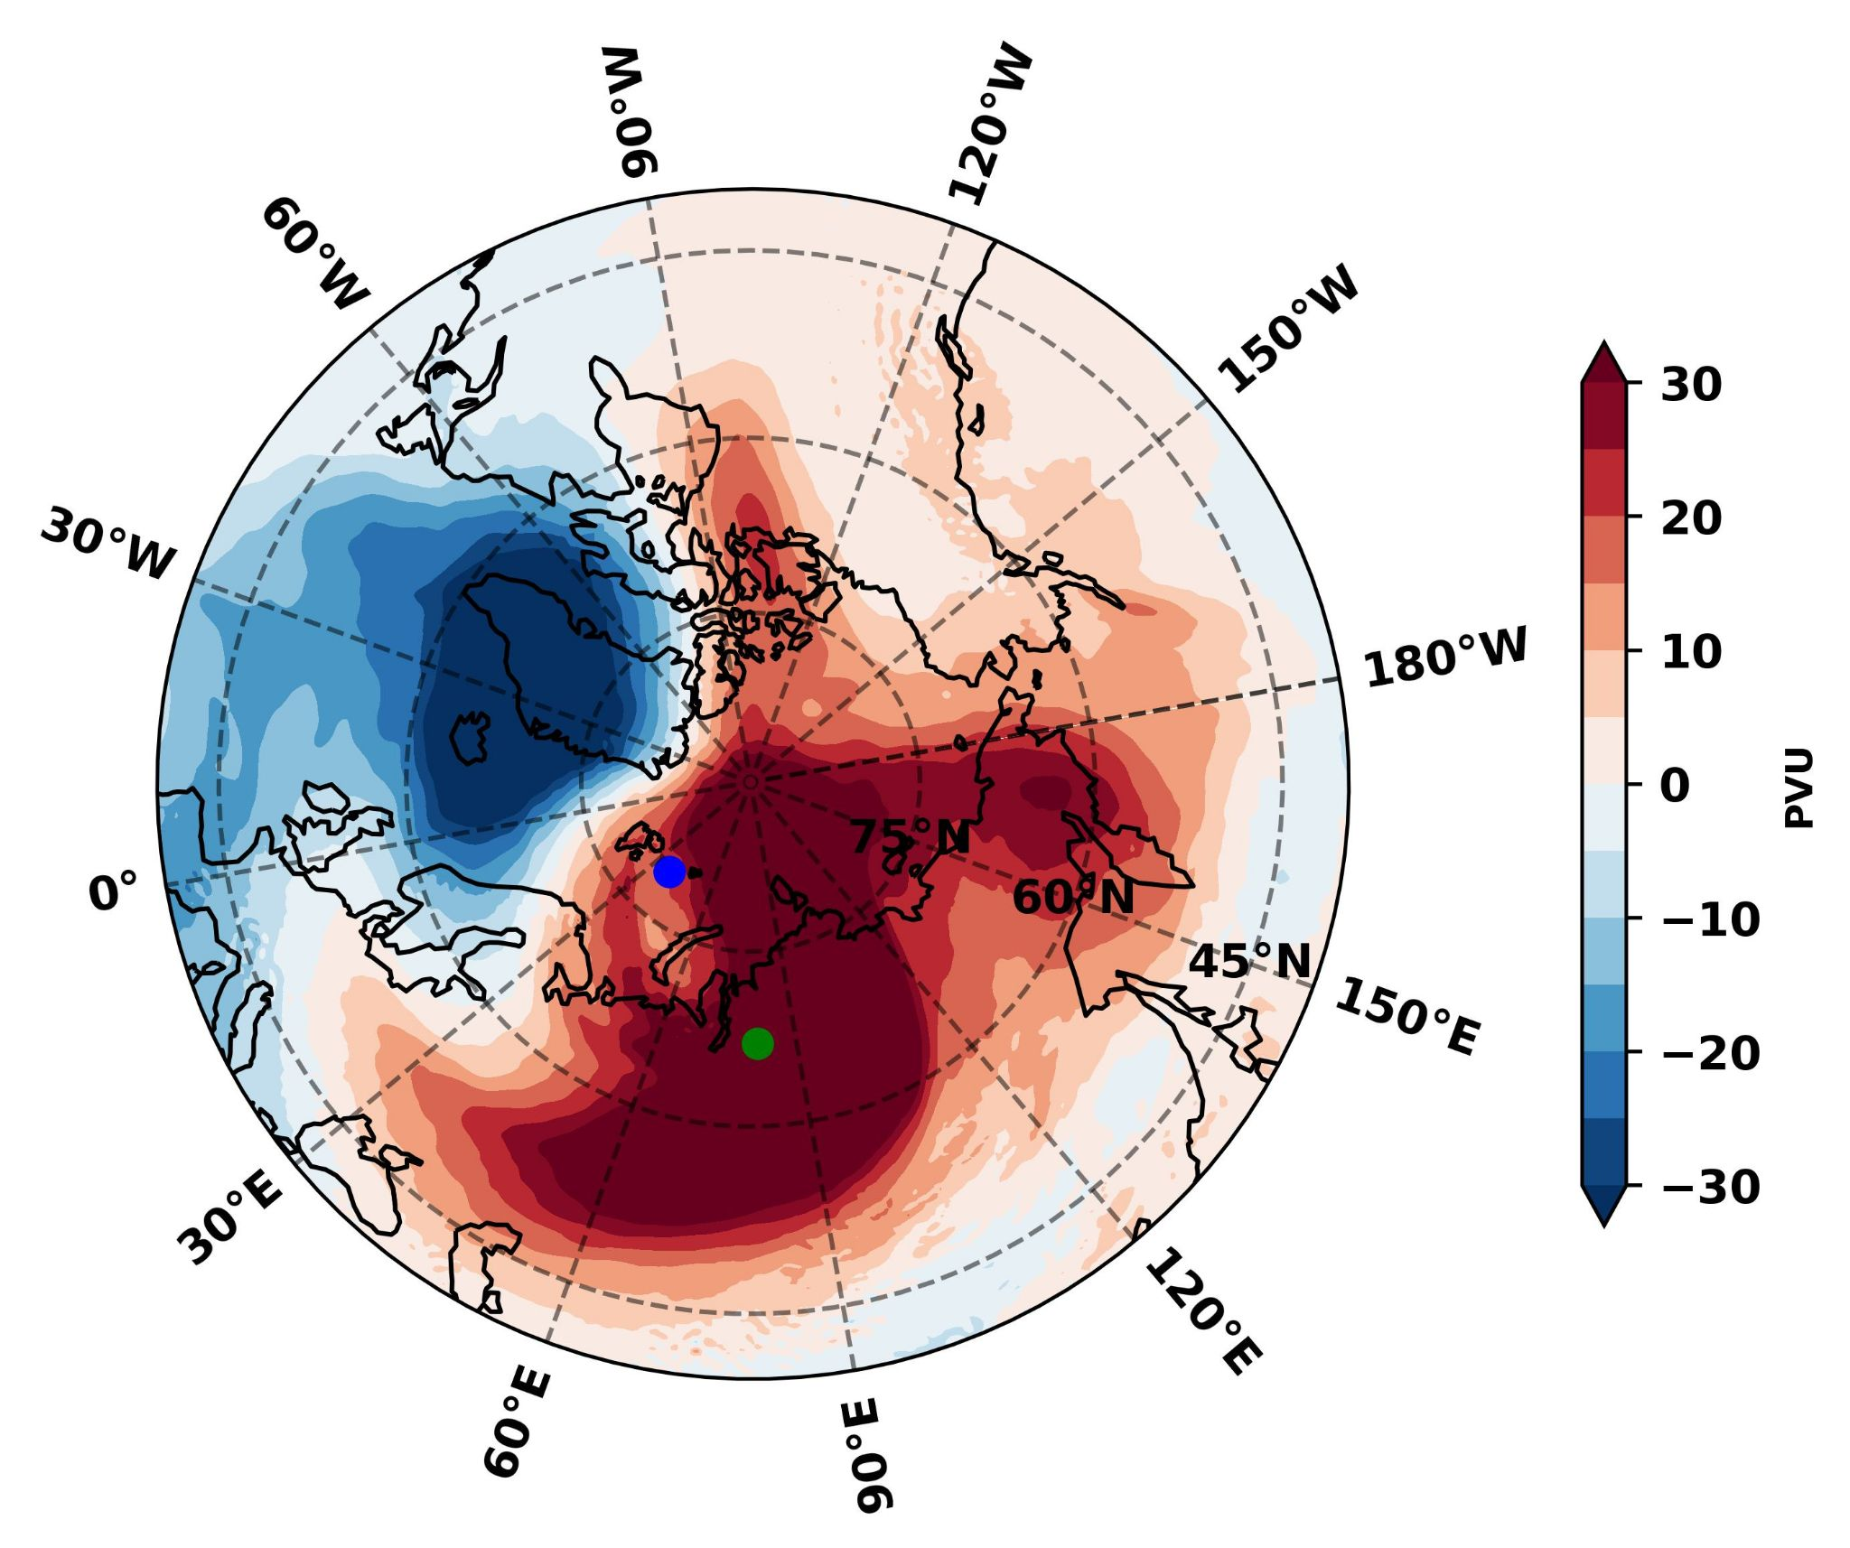

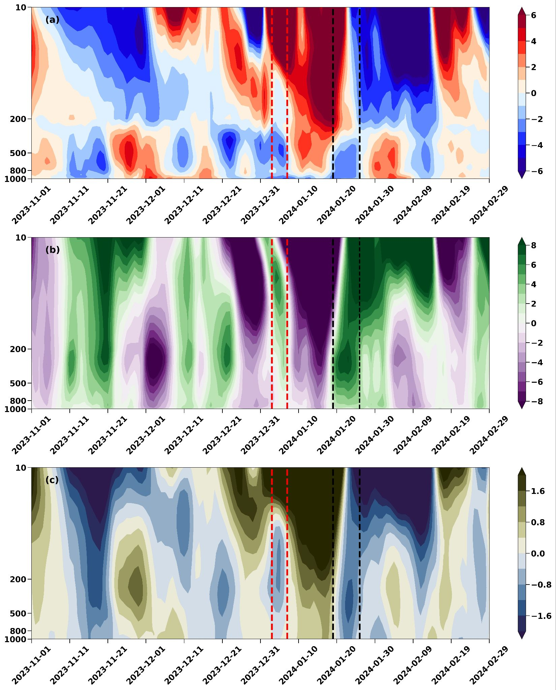
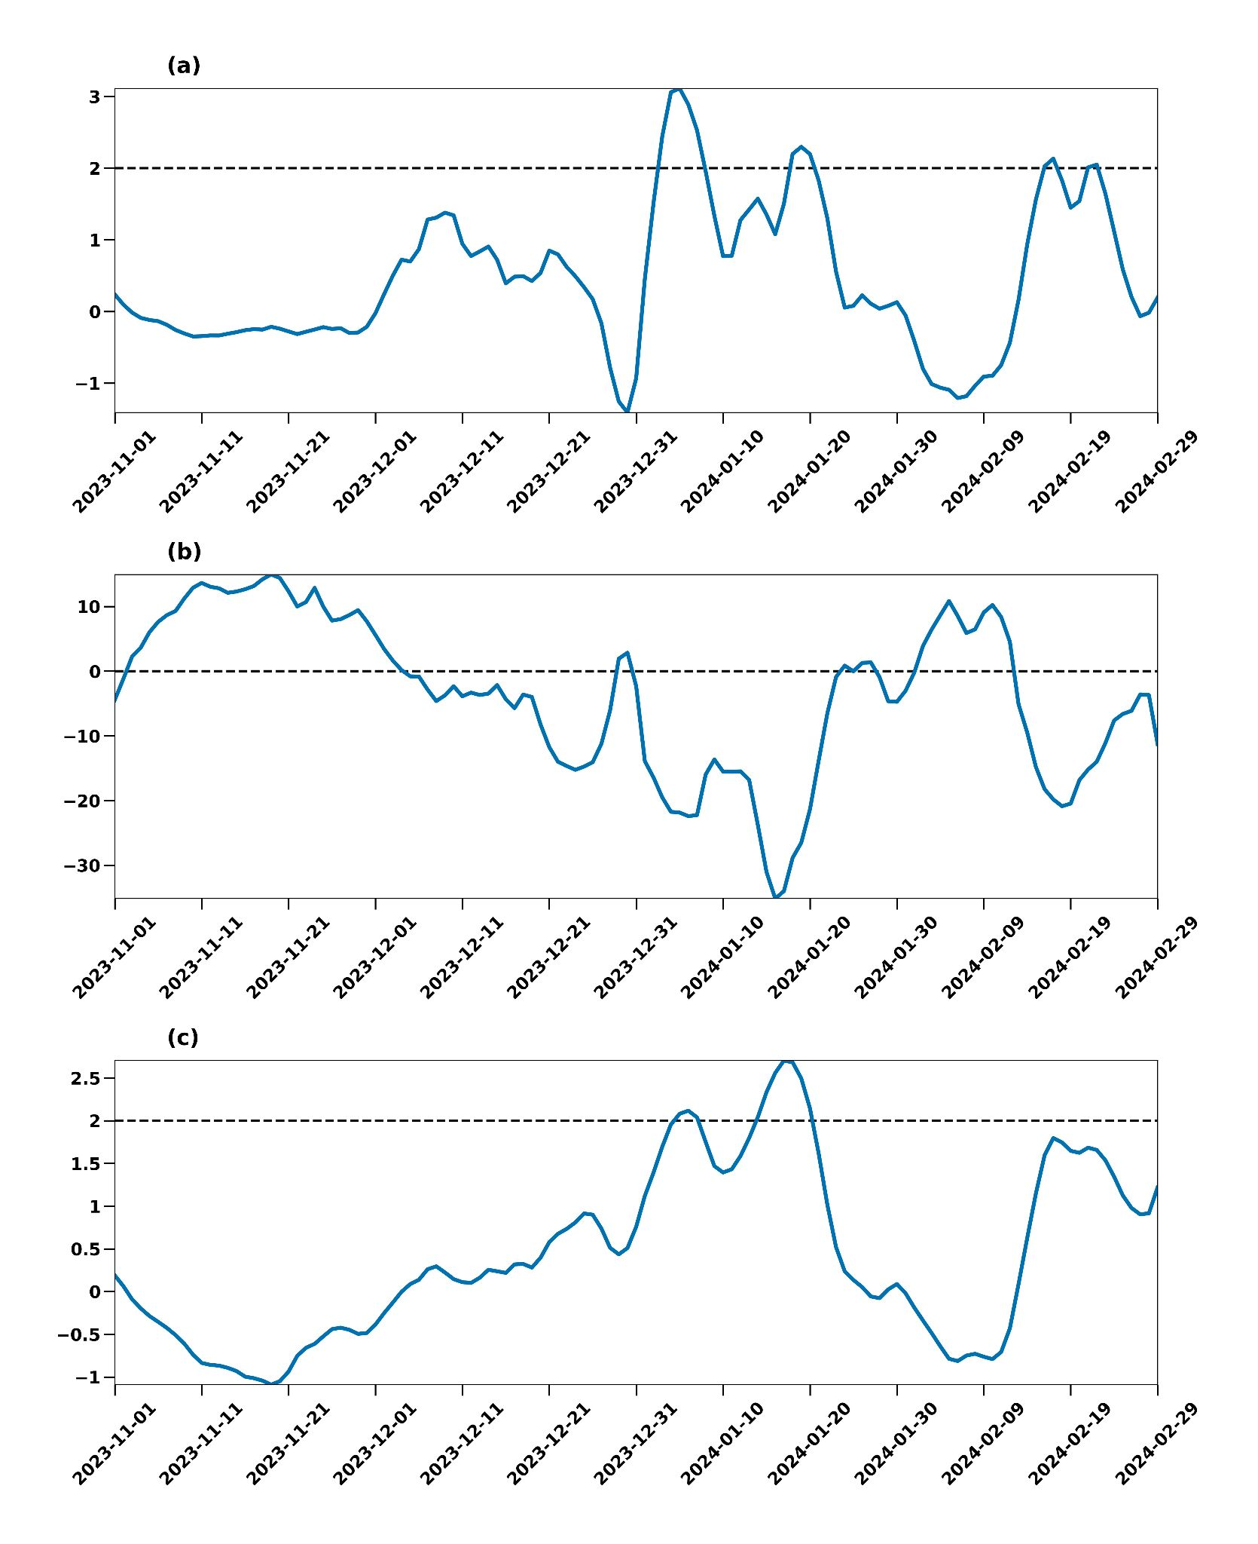
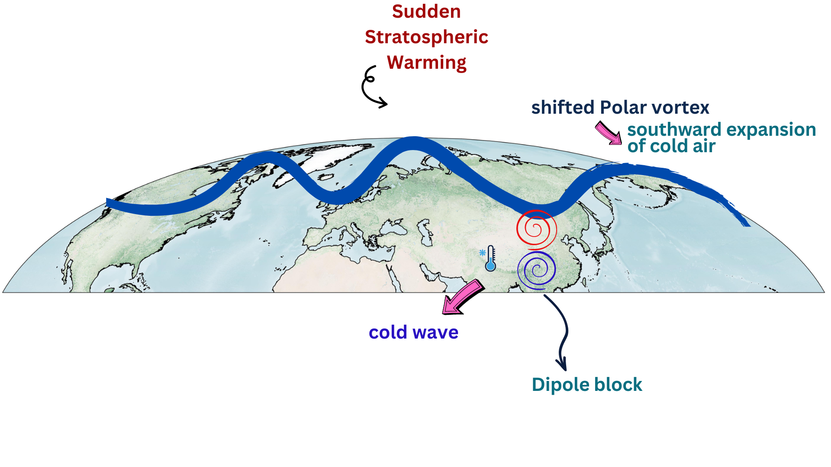
Impact of Sudden Stratospheric Warming on Extreme Winter Weather in North India
Athira K S and Raju Attada*
Department of Earth and Environmental Sciences
Indian Institute of Science Education and Research Mohali
Email: ph20044@iisermohali.ac.in
1. Introduction
2. Study Area and Methodology
Cold waves are extreme winter weather events prominent during the boreal winter season (November to February). The present study explores the linkage between the sudden stratospheric warming and the recent 2024 cold wave in north India.
Cold wave events are identified over north India (70°E – 87.5°E, 24°N – 32.5°N) during the winter season (November – February) when the normalized minimum temperature anomaly is less than -1 standard deviation for 4 or more consecutive days (Ratnam et al., 2016).
Sudden Stratospheric warming event of 2024 winter
3. Results
2m temperature anomaly during cold wave 2024
Geopotential height and wind anomaly at 200 hPa
Potential vorticity anomaly at 600 K &
polar vortex center
Blocking anticyclone
Siberia
Downstream end of ridge
cold air from East Asia
north India
Vertical profile of Atmospheric Parameters in the Arctic region for 2024 winter season
Indices for the identification of weak polar vortex
4. Summary and Conclusion
Sudden stratospheric warming
Shift of the polar vortex
Expansion of cold air to lower latitudes
Migration of cold air to East Asian region
Dipole block -cold air from East Asia to north India
Weakening of the polar night jet
5. References
Athira, K.S., Attada, R. and Rao, V.B., 2024. Synoptic dynamics of cold waves over north India: Underlying mechanisms of distinct cold wave conditions. Weather and Climate Extremes, 43, p.100641.
Huang, J. and Hitchcock, P., 2023. Defining Arctic stratospheric polar vortex intensification events. Journal of Geophysical Research: Atmospheres, 128(22), p.e2023JD039373.
Ratnam, J.V., Behera, S.K., Annamalai, H., Ratna, S.B., Rajeevan, M. and Yamagata, T., 2016. ENSO’s far reaching connection to Indian cold waves. Scientific Reports, 6(1), pp.1-12.
Acknowledgement
APARC and FRJ Jülich - financial support; STIPMEX 2024, IISER Mohali

