Slide 1
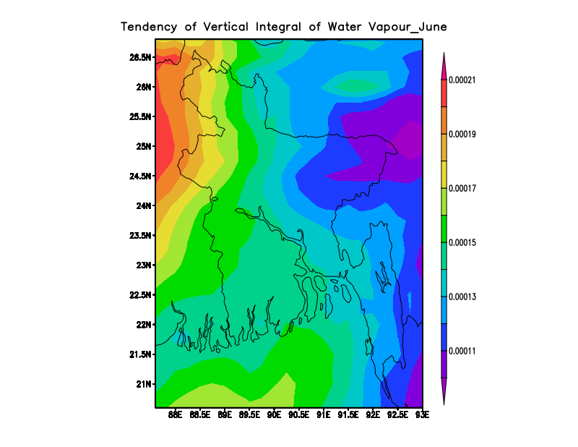
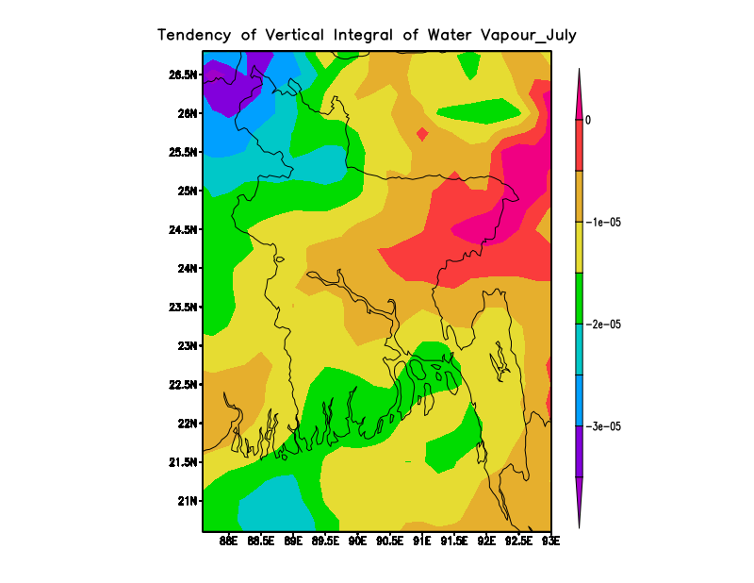
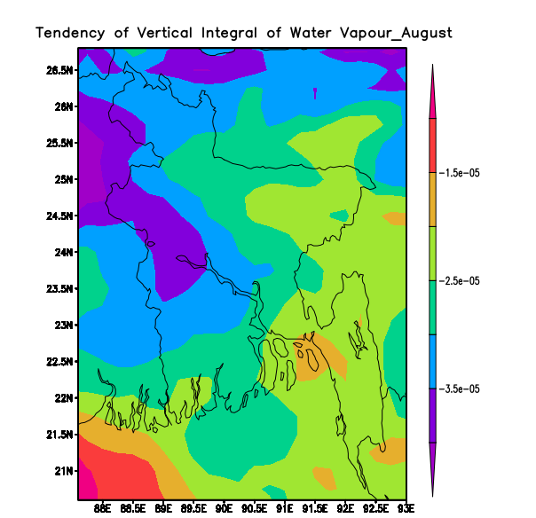
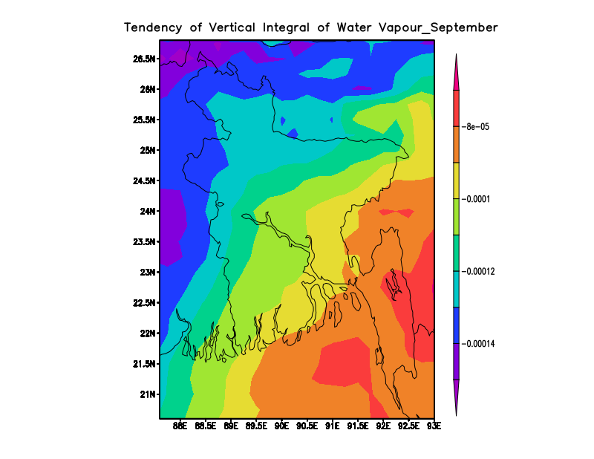
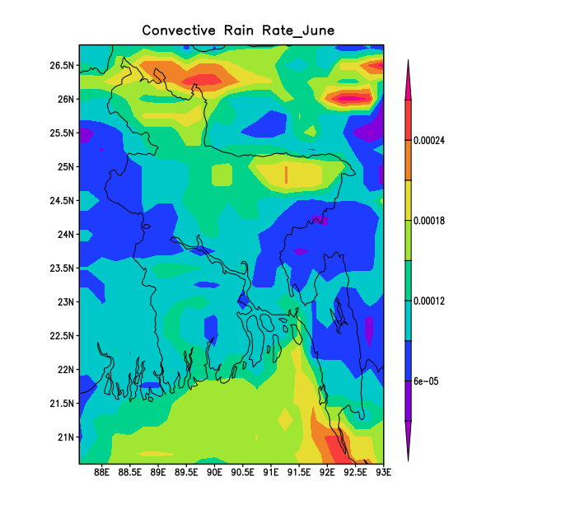
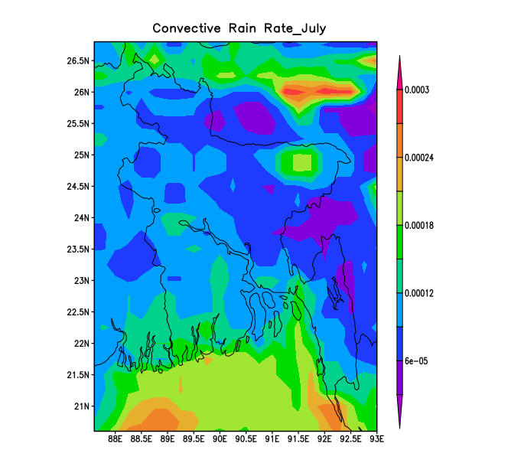
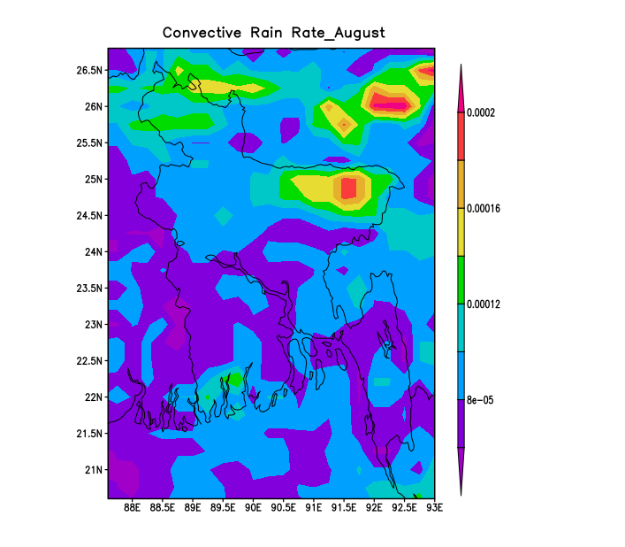
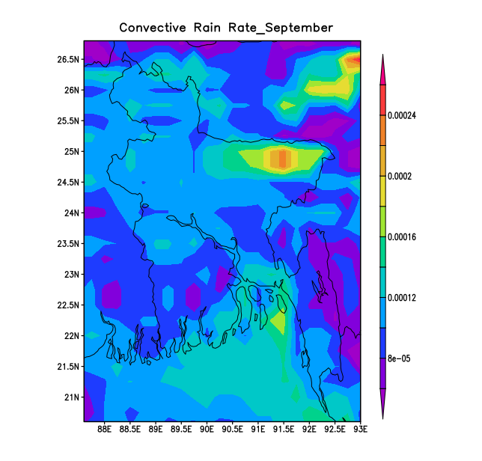
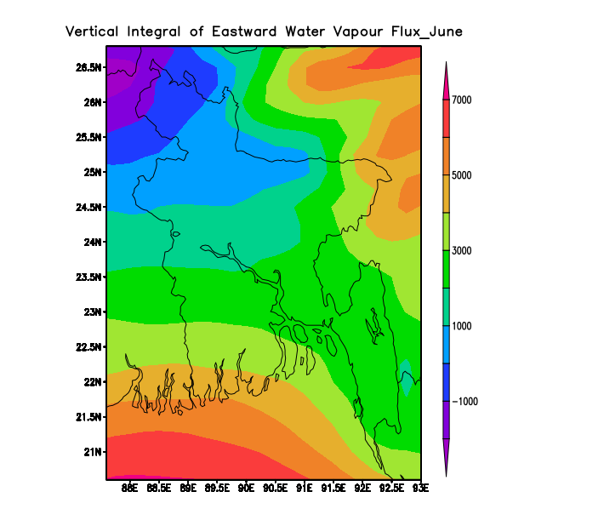
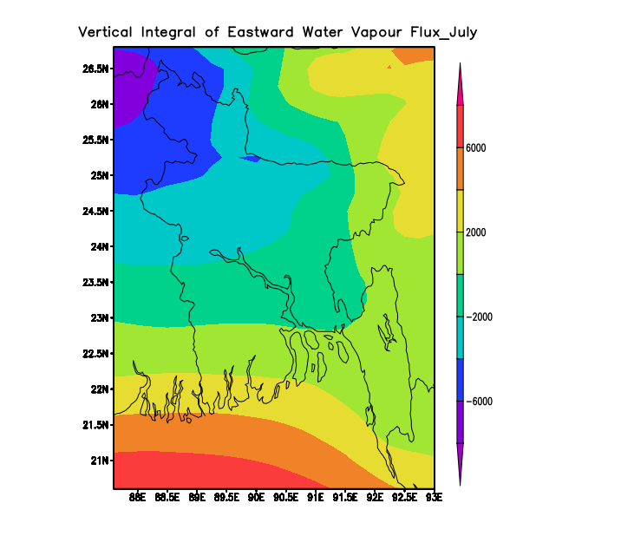
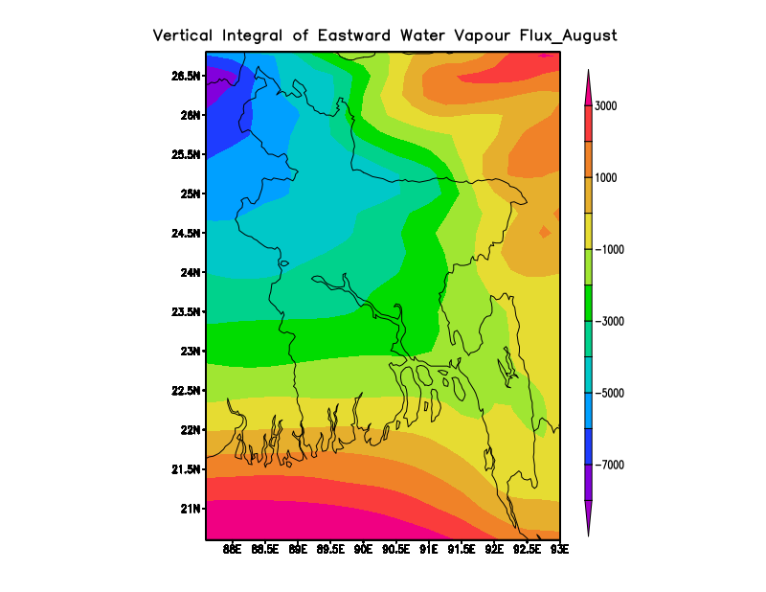
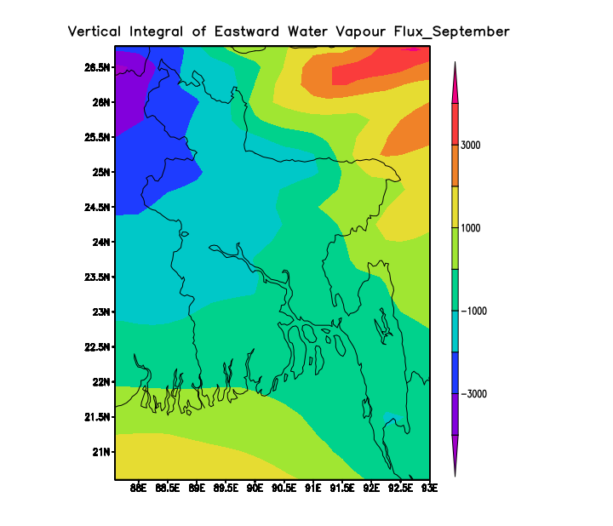
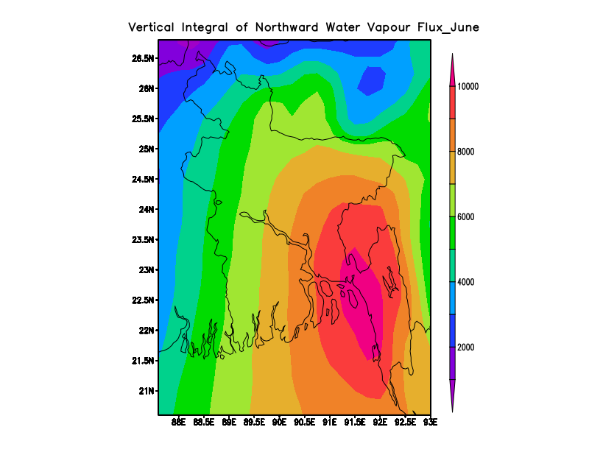
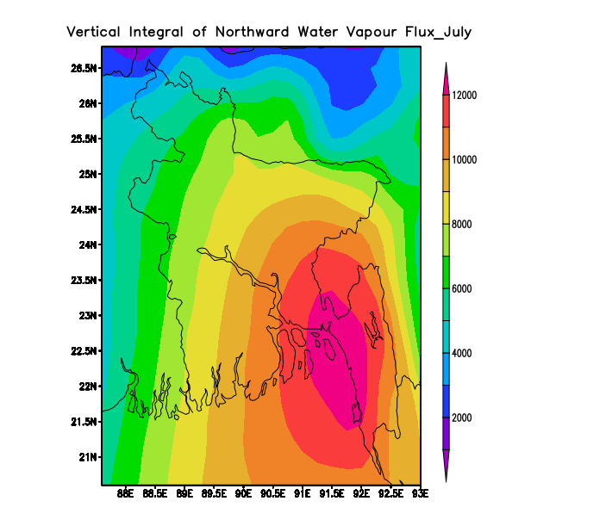
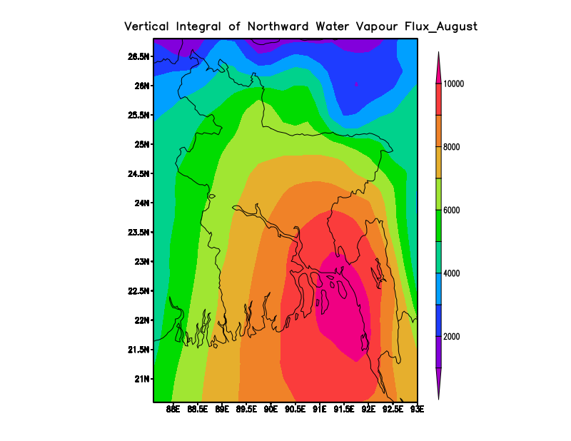
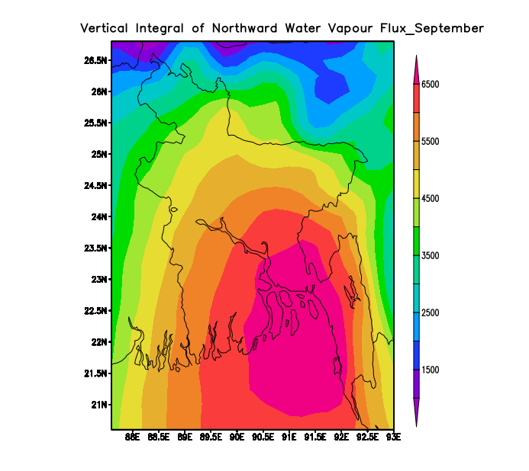
International workshop on Stratosphere-Troposphere Interactions and Prediction of Monsoon weather Extremes (STIPMEX) Organized by Indian Institute Tropical Meteorology
2- 7 June, 2024
Transport of water vapor associated with monsoon rainfall over Bangladesh
Sakia Shabnam Kader
Department of Computer Science & Engineering, Daffodil International University, Dhaka, Bangladesh.
sakiakader28@gmail.com
1.INTRODUCTION
Atmospheric water vapor transport is the most important part of the atmospheric branch of the hydrological cycle that contributes to the function of water bodies, evaporation, and precipitation. Advection of water vapor plays the most significant role to form precipitation in the monsoon season. The climate of Bangladesh can be influenced by the Asian Monsoon which follows the seasonal reversal of surface winds and a distinct seasonality of precipitation. The long term variability of the atmospheric water budget is affected by the fluctuations in the moisture flux which causes the changes in the monsoon activity. Water vapor is one of the dominant factors that is connected with the net radiative cooling of the troposphere which initiates the convective process. The cloud cycle carries a large portion of this content of water mass which is carried as ice and liquid droplets. Proper assessment of water vapor transport can be more effective in studying their influence on weather and climate.
(iii) Spatial variation of tendency of vertical integral of water vapor flux for 30 years
In June, most parts of Bangladesh show the increasing trend of water vapor flux with positive values. In July, the decreasing trend was observed and prominent all over the region. The similar decreasing trend was also significant for August. The decreasing trend has extended from the north western part of Bangladesh to other parts in September.
2. OBJECTIVES
To study the spatial variation of vertical eastward integral of water vapor flux for 30 years in the zonal direction.
To observe the spatial variation of vertical northward integral of water vapor flux for 30 years in the meridional direction.
To present the spatial variation of tendency of vertical integral of water vapor flux for 30 years.
To present the spatial variation of convective rain rate for 30 years.
3. DATA AND METHODS
Data: The moisture budget monthly data has been derived from ERA5 reanalysis which are taken from European Centre for Medium-Range Weather Forecasts (ECMWF) in the resolution 0.25°x 0.25°.
Study Period: 1990- 2019 (June-September)
Study Area: Bangladesh (20°N-27°N and 87°E-93°E)
Methods: Grid Analysis and Display System (GrADS) is used for visualizing and analyzing the data in a Linux based platform.
Fig 3: Spatial variation of tendency of vertical integral of water vapor flux for 30 years
(iv) Spatial variation of convective rain rate for 30 years
In June, the convective rainfall intensity is lower in most parts of the country except the northern part. The convective rain rate is less than average all over the region except the southern boundary of Bangladesh in July. The lower trend of convective rainfall intensity is prominent in most parts but the northeastern part of Bangladesh shows the higher intensity of rain rate in August. The similar higher intensity has been found in the northeastern zone except the other zone has presented the less convective rain rate in September.(Adams et al, 2013) demonstrated the importance of moisture contents to the formation of atmospheric convection. These changes in transport distance and direction of water vapor are important because they may shift in timing and direction of moisture delivery for the formation of rainfall.(Teale & Robinson,2020).
4. LITERATURE REVIEW
(Xu et al,2020) investigated the climatological characteristics of water vapor transport over the Tibetan Plateau.
(Dar & Dar, 2023) presented the relationship between precipitation and integrated water vapor transport (IVT) over the flooded areas.
(Patel & Kuttippurath,2023) examined the influence of tropospheric water vapor on the radiation budget of earth and in regional weather processes.
Very few researches have been carried out on the transport of water vapor over Bangladesh in monsoon for the longer time scale.
5. RESULT AND DISCUSSION
Fig 4: Spatial variation of tendency of convective rain rate for 30 years
(i) Spatial variation of vertical eastward integral of water vapor flux for 30 years
The water vapor transport is significant in the eastward direction over most of the parts of the country in June. The vertical integration of eastward water vapor flux on the boundary of northwestern Bangladesh has the same characteristics in July and August. In September, the westward transport is prominent all over the country.
The transport of water vapor can be influenced by the atmospheric circulation at the low level. The tropical easterlies affects the water vapor flow in the westward direction and the midlatitude westerlies originates the movement of water vapor in the eastward direction.(Chen, 1985)
6. CONCLUSION
The climatology of water vapor transport for 30 years has been presented with the spatial patterns of the movement water vapor with their influenced characteristics. The tendency of water vapor flux and convective rain rate have been presented for the same duration over Bangladesh.
This study is useful for the hydroclimate administration, which is connected to human beings and infrastructure as well as weather hazards. Exploring the remarkable changes in the patterns of the hydroclimate factor is important for protecting life and property. The mechanism of water vapor transport will circulate the information about atmospheric condition for understanding the reason behind the observed changes in hydroclimate features.
Fig 1: Spatial variation of vertical eastward integral of water vapor flux for 30 years
7. REFERENCES
Xu, K., Zhong, L., Ma, Y., Zou, M., & Huang, Z. (2020). Theor. Appl. Climatol, 140, 1031-1042.
Patel, V. K., & Kuttippurath, J. (2023). Ocean-Land-Atmos. Res., 2, 0015.
Chen, T. C. (1985). Mon. Weather Rev. 113(10), 1801-1819.
Adams, D. K., Gutman, S. I., Holub, K. L., & Pereira, D. S. (2013). Geophys. Res. Lett., 40(11), 2818-2823.
Teale, N., & Robinson, D. A. (2020). J. Hydrometeorol, 21(9), 2123-2138.]
.
(ii) Spatial variation of vertical northward integral of water vapor flux for 30 years
In June, the northward transport of water vapor is more significant over the south eastern part of Bangladesh. In July, the spatial plot presented the similar pattern of water vapor transport in the northward direction over the south eastern part. In August, the southern region of Bangladesh demonstrated the northward water vapor movement as the southern boundary is the most significant part as it is the water vapor input boundary from Bay of Bengal. In September, the northward flow of water transport is more spread all over Bangladesh.
The movement of water vapor along the northward direction extended into the upper troposphere resulting in the formation of clouds and precipitation in monsoon.
Fig 2: Spatial variation of vertical northward integral of water vapor flux for 30 years

