Slide 1
Stratosphere-Troposphere Interactions and Prediction of Monsoon weather EXtremes (STIPMEX)
02-07 June 2024
Diurnal changes in boundary layer height during thunderstorm evolution: Comparison from VHF radar and model simulations
Presented by: Angel Anita Christy Research Fellow
Guide: Dr. M.G. Manoj, Scientist – D ACARR, CUSAT

Slide 2
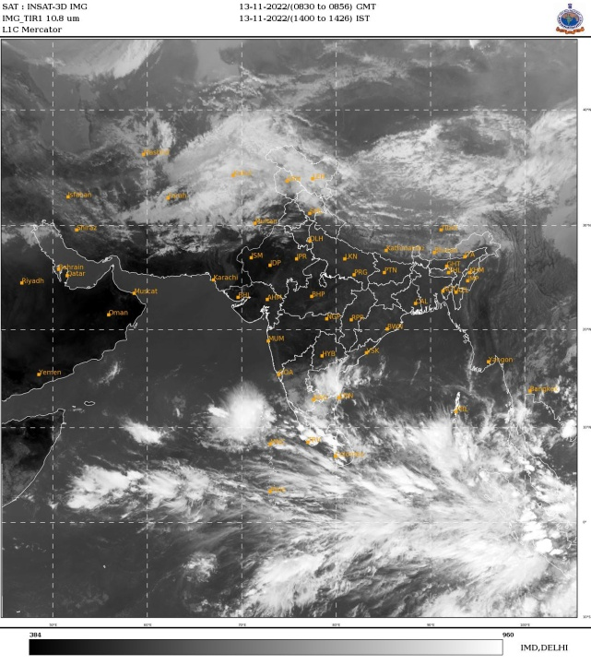
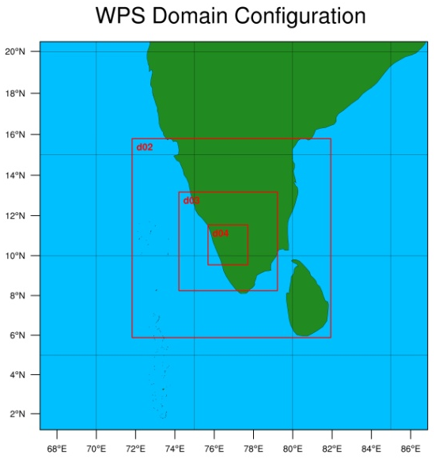
Objective
Datasets
Investigating Atmospheric Boundary Layer characteristics and thermo-dynamical changes of a severe weather event (Thunderstorm) using
205 MHz radar and ancillary datasets.
205 MHz Radar
AWS
WRF- ARW
IMDAA
ERA5
MERRA2
Methodology
ABLH estimation using Normalized Standard Deviation Method (NSDM) from VHF radar
Based on the profile of horizontal wind speed and direction which connects the turbulent intensity along with signal to noise ratio.
Angel, A. C., & Manoj, M. G., Science of The Total Environment (2024)

Slide 3
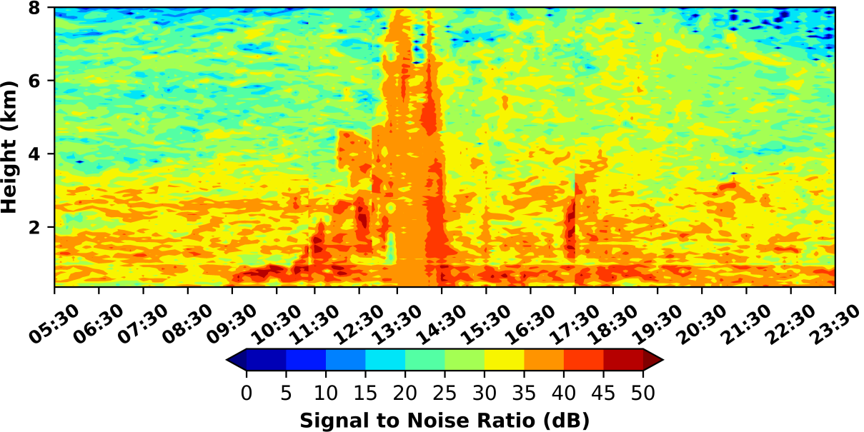
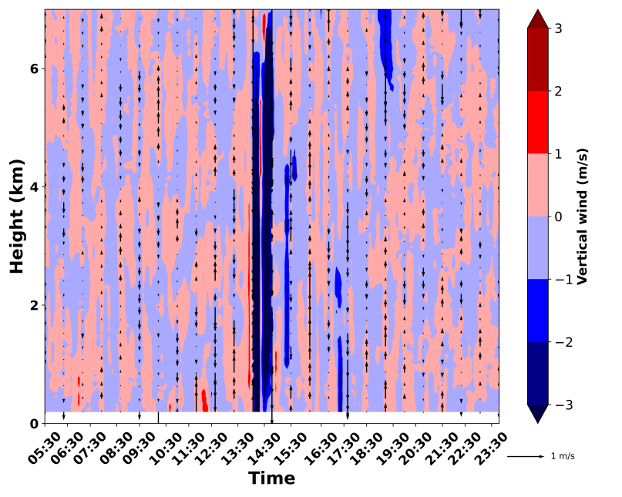
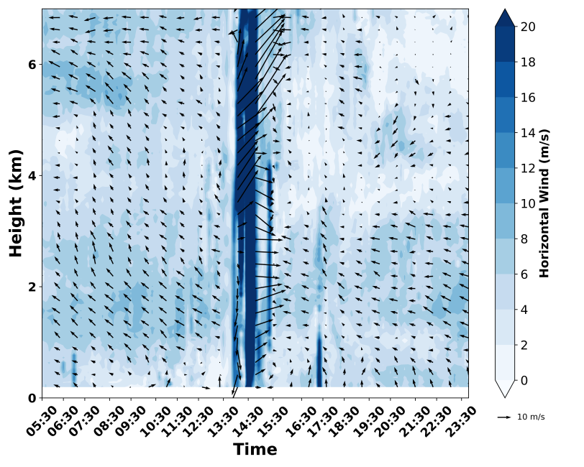
Kerala experiences highest thunderstorms frequency(80–100 days), of which 20-25 days occurs during the post-monsoon season.
.
Mesoscale forcings have a major role in triggering convection during non-monsoon seasons.
HTI of SNR observed on 13th November 2022 from Radar.
Vertical (L) & Horizontal (R) wind quiver during the day.
In the prestorm environment, layering and stability play a role in the occurrence and intensity of thunderstorms. Deep convection and thunderstorms cannot occur without instability in the atmosphere.

Slide 4
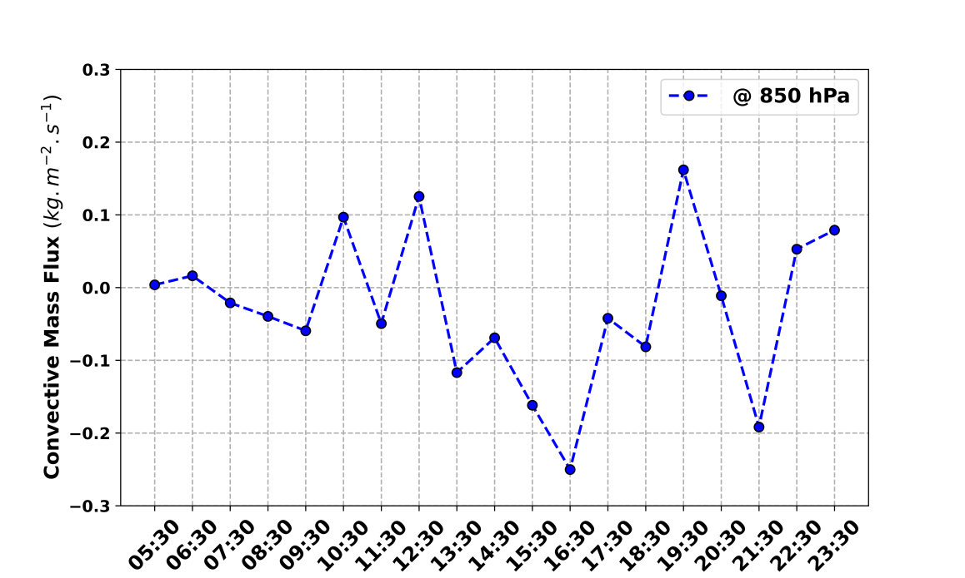
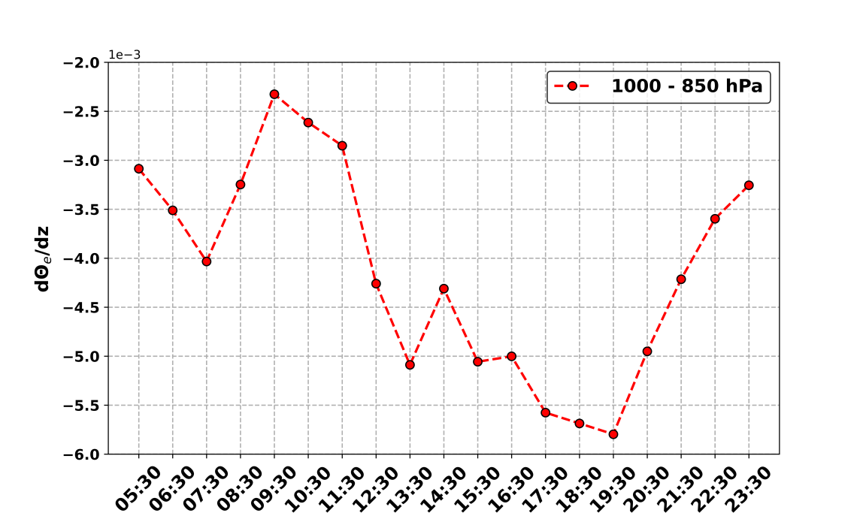
Diurnal evolution of convective mass flux. It is calculated using the following equation
Temporal variation in moist instability assessed using the Gradient of equivalent potential temperature (K m⁻¹).
Instability facilitates the ascent of air from the lower atmosphere into the upper atmospheric layers.
Time evolution of spatial distribution of moisture flux at the grid point over Cochin during the course of the thunderstorm event.

Slide 5
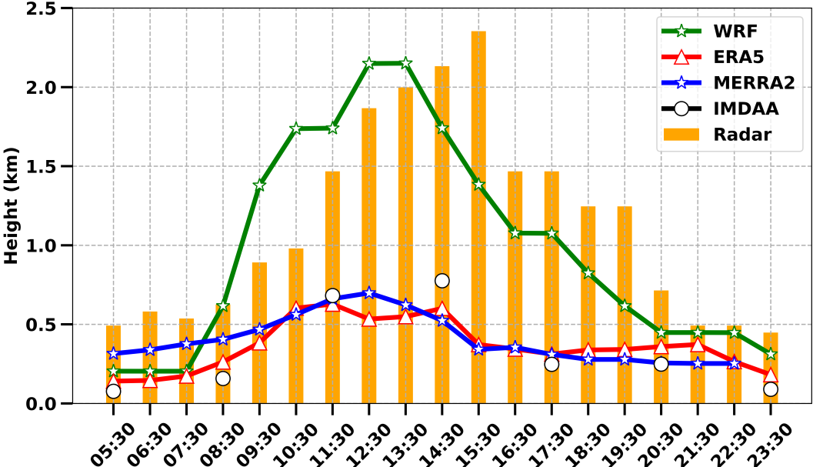
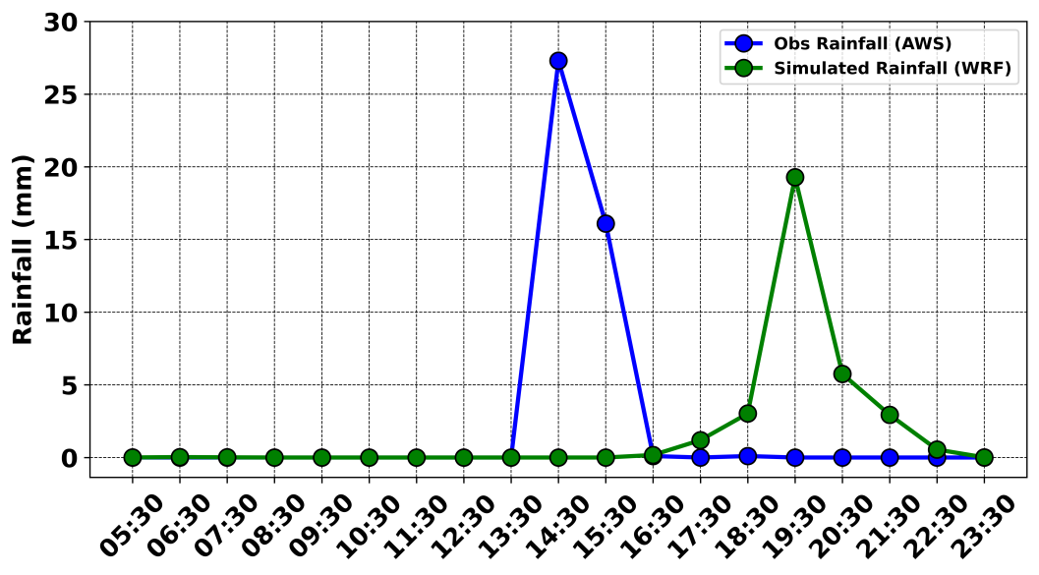
Diurnal variation of ABLH from Radar, WRF-ARW, IMDAA, ERA5 & MERRA2.
In an unstable atmospheric boundary layer, the warm, humid air packets rise as thermals. Noticeably, it has been determined that favourable conditions for the development of a thunderstorm event, is a rise in CAPE and a low value of CINE.
Time series of rainfall observed from AWS and WRF simulation on 13th Nov 2022.

Slide 6
Summary
Radar measurements during the thunderstorm are in agreement with the model-simulated diurnal evolution of ABLH with a lead time of 2 hours.
It is important to choose the appropriate combination of cumulus, PBL, and microphysics schemes to simulate a tropical thunderstorm.
From a set of 23 WRF simulations, QNSE boundary layer scheme has a significant positive impact in simulating the entire chain of events that led to deep convection and precipitation.
Further, our results suggest that even other simulations also get the sequence of events right, though showing lesser magnitude in ABL altitude.
However, reanalysis data underestimates ABLH showing the maximum difference with the Radar derived ABLH and agrees with the model data in terms of temporal variation.
Rainfall estimated from WRF simulation gives ~20 mm which is close to the observed magnitude from AWS (~28 mm) with a lag time of 4-5 hours.
This study shows that, for regional/local mesoscale weather prediction, more continuous in-situ high temporal and spatial resolution measurements are necessary.
Thank You

