Slide 1
STIPMEX-2024 (02-07 June 2024)
Title: A deep learning algorithm for classification of a widespread precipitation extremes in the Vidarbha region, India
Authors: Arvind Pagire¹², Satyaban B Ratna¹*, R. Chattopadhyay¹, O.P. Sreejith¹
Affiliations:
¹Climate Research and Services, Indian Meteorological Department, Pune, India
²Savitribai Phule Pune University, Pune, India

Slide 2
Introduction
Context:
Global increase in extreme precipitation events due to global warming.
These events are intense and can cause significant damage.
Objective:
To classify widespread precipitation extremes using a deep learning algorithm.
To assess the most significant predictors for widespread precipitation extremes.
To assess the effectiveness of deep learning algorithm for classification of widespread precipitation extremes.

Slide 3
Motivation
Importance of Study:
Extreme precipitation events can lead to floods, waterlogging, and other disasters.
Understanding and predicting these events can help mitigate their impacts.
Definition of Extreme Events:
According to the WMO, an extreme weather event is rare, occurring at or above the 90th percentile of its statistical distribution.

Slide 4
Literature Review
Previous Studies:
Relationship between large-scale circulation and extreme rainfall events (Arujo et al., 2022; Gope et al., 2016; Neto et al., 2019; Vitanza et al., 2023).
Limited use of advanced deep learning algorithms in categorizing precipitation extremes (Lima et al., 2010; Chaluvadi et al., 2021).

Slide 5
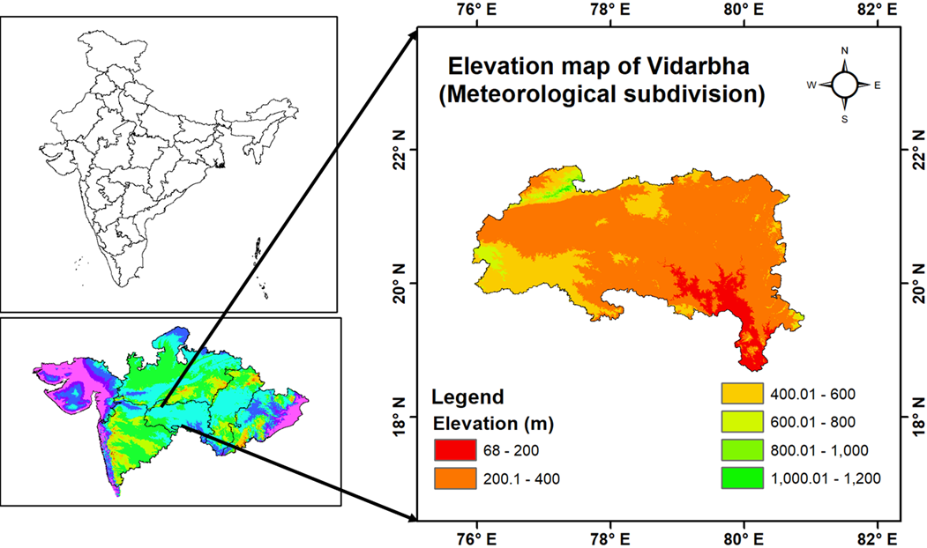
Study Area - Vidarbha Region
Location:
Situated in Maharashtra, India.
Prone to extreme rainfall events.
Significance:
High intensity rainfall impacts include floods, waterlogging, and societal issues.

Slide 6
Data Used
Meteorological Data:
Historical rainfall data from the Indian Meteorological Department (1951-2023)
Large-Scale Atmospheric Data:
Data 500-hPa geopotential height, mean sea level pressure, zonal wind, meridional wind and specific humidity dataset from National Centre for Environmental Prediction – National Centre for Atmospheric Research reanalysis dataset for the same period.
model has been trained from 1951 to 2002, validated from 2003 to 2012 and tested for 2013 to 2023.

Slide 7
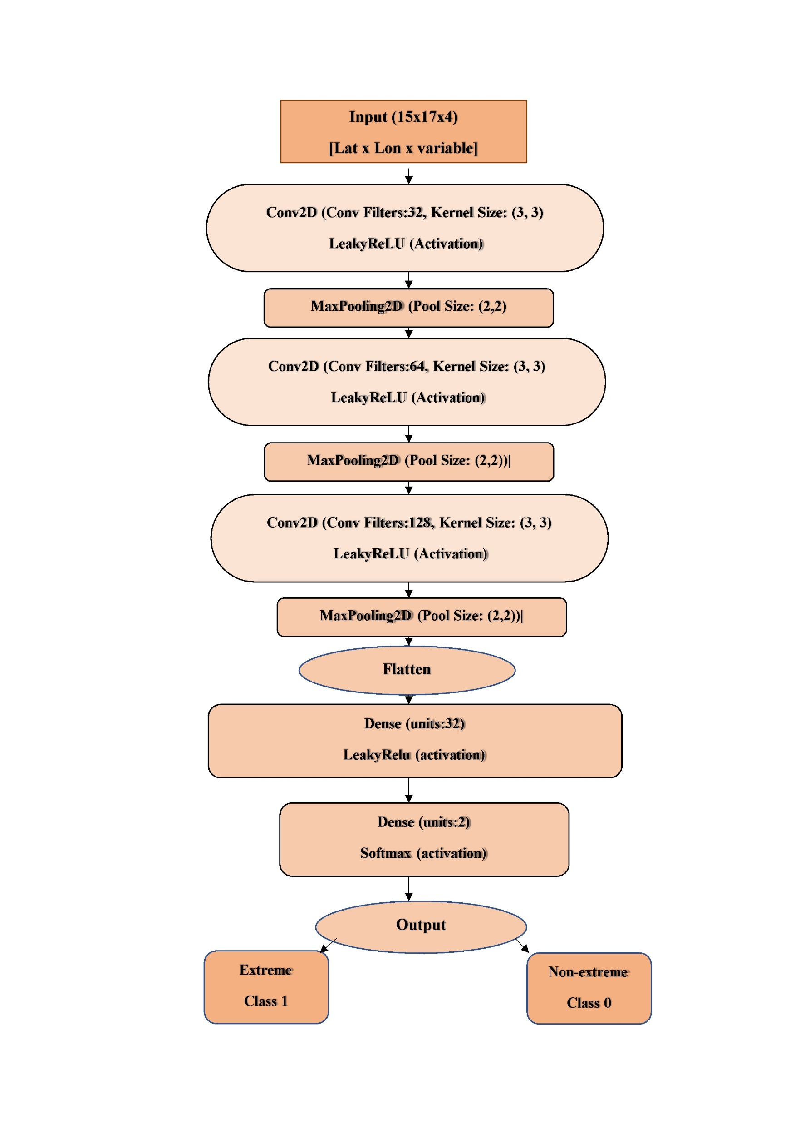
Methodology
Widespread precipitation extremes has been defined following Nikumbh et al.2020 using connected component algorithm.
The input parameter based on feature importance analysis such as wind speed at (850 & 200 hPa), vertical velocity and mean sea level pressure has been used.
The CNN model has been trained from 1951 to 2002, validated for 2003 to 2012 and tested for 2013 to 2023 during Indian summer monsoon season.

Slide 8
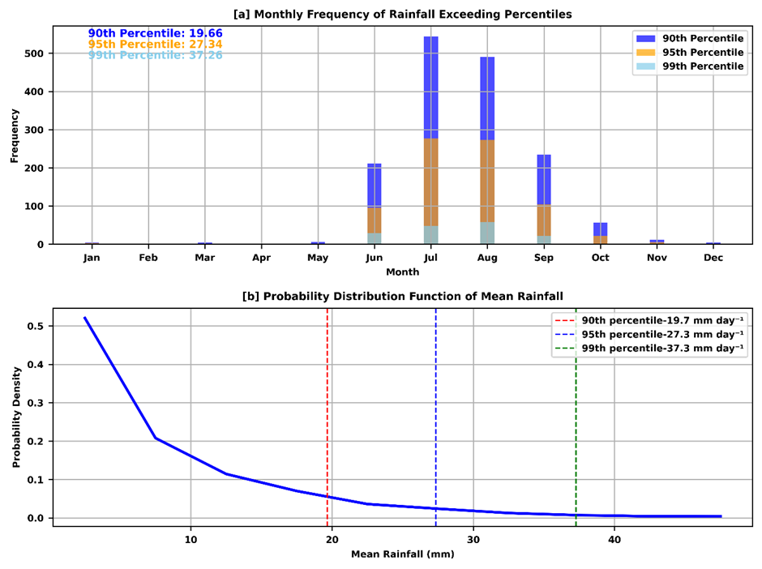
Results & Discussion
Based on feature importance analysis the wind speed at (850 & 200 hPa), vertical velocity, mean sea level pressure has been selected as a input parameter.

Slide 9
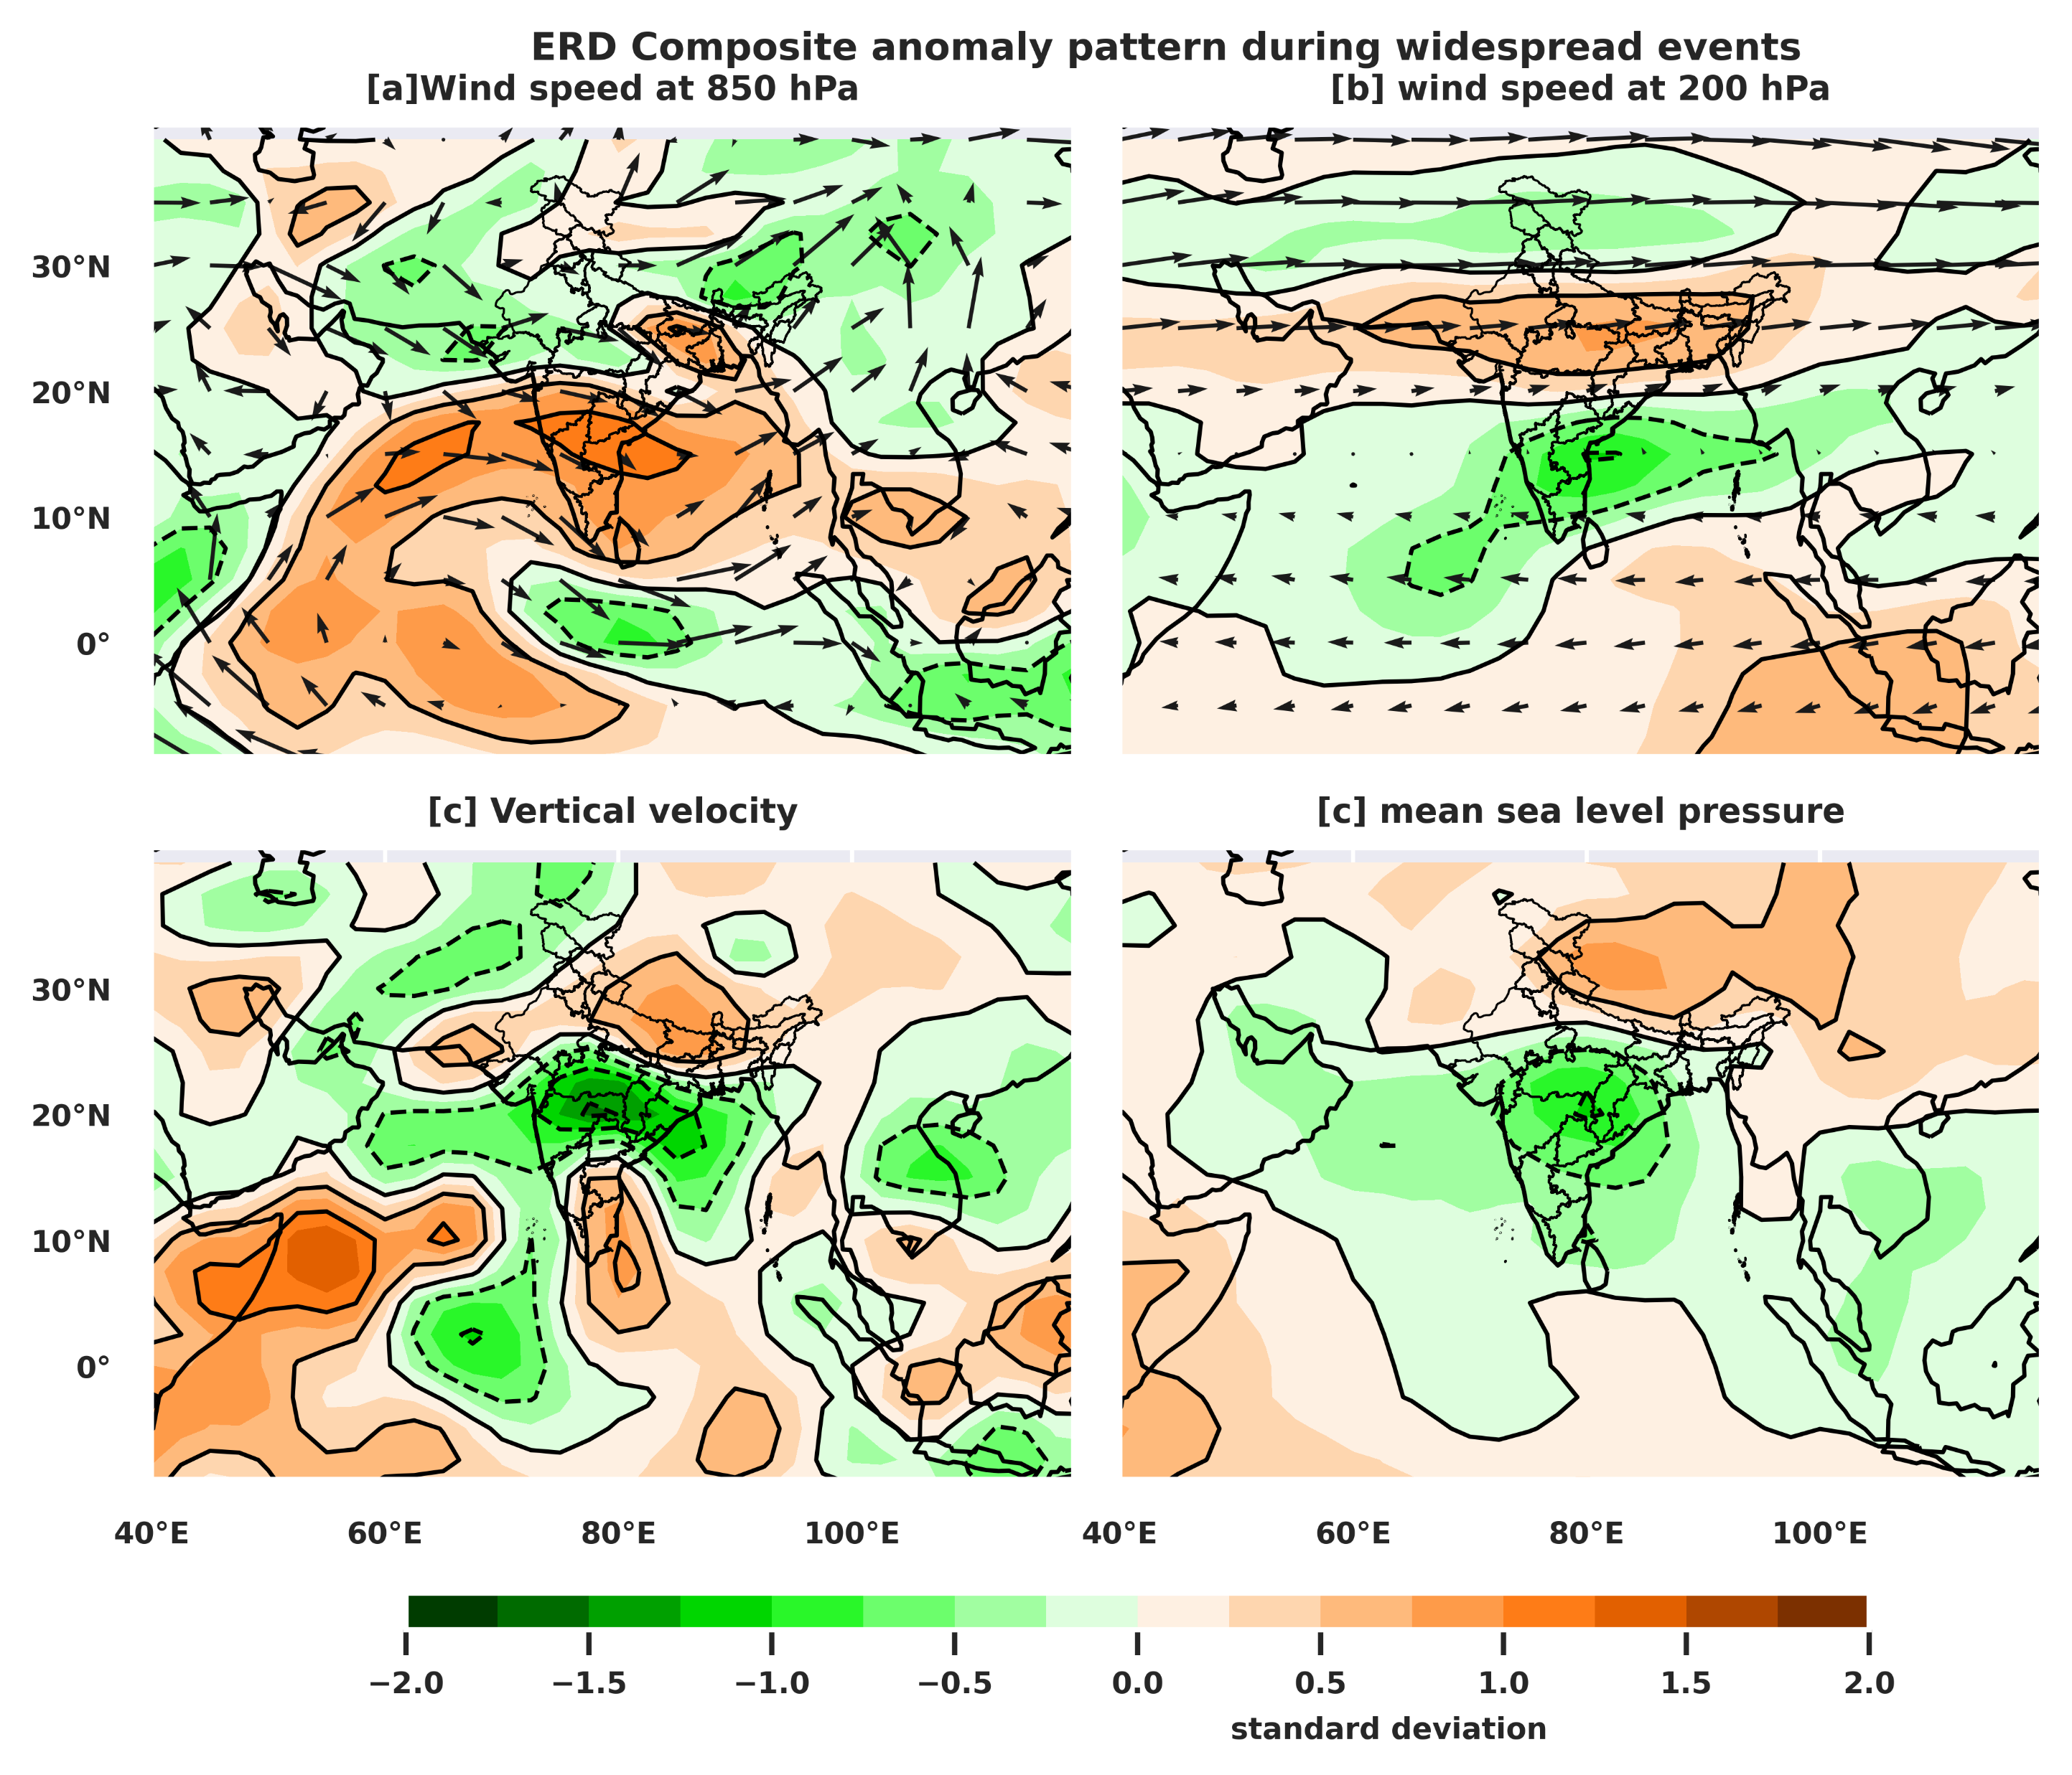
Composite analysis of predictor during classified widespread precipitation extremes:
When there is an upper level easterly (tropical easterly) flow and a low-level strong cross-equatorial (southwesterly) flow, the CNN model has been found to be sensitive for categorizing extremes.
Along with these extensive background conditions, it has been found that over Vidarbha region, substantial decrease in mean sea level pressure and vertical velocity is favorable for widespread precipitation extremes.

Slide 10
Conclusion
Measure | widespread
Sensitivity (Recall) | 0.5961
Specificity | 0.9480
Precision | 0.3163
Accuracy | 0.9344
This study found that CNN-based extreme rainfall day identification achieved an accuracy of 93.44% on the test dataset for widespread precipitation extremes.
The performance of CNN model for test dataset has been summarized in Table. 1.
When there is an upper level easterly (tropical easterly) flow and a low-level strong cross-equatorial (southwesterly) flow, the CNN model has been demonstrated to be sensitive for categorizing extremes.
Table 1

Slide 11
References
Gope, S., Sarkar, S., Mitra, P., & Ghosh, S. (2016). Early prediction of extreme rainfall events: A deep learning approach. Lecture Notes in Computer Science (Including Subseries Lecture Notes in Artificial Intelligence and Lecture Notes in Bioinformatics), 9728, 154–167. https://doi.org/10.1007/978-3-319-41561-1_12
Misra, S., Sarkar, S., & Mitra, P. (2018). Statistical downscaling of precipitation using long short-term memory recurrent neural networks. Theoretical and Applied Climatology, 134(3–4), 1179–1196. https://doi.org/10.1007/s00704-017- 2307-2
Nikumbh, A. C., Chakraborty, A., Bhat, G. S., & Frierson, D. M. W. (2020). Large-Scale Extreme Rainfall-Producing Synoptic Systems of the Indian Summer Monsoon. Geophysical Research Letters, 47(11), 1–15. https://doi.org/10.1029/2020GL088403
Vitanza, E., Dimitri, G. M., & Mocenni, C. (2023). OPEN A multi ‑ modal machine learning approach to detect extreme rainfall events in Sicily. Scientific Reports, 1–15. https://doi.org/10.1038/s41598-023-33160-9

