Slide 1
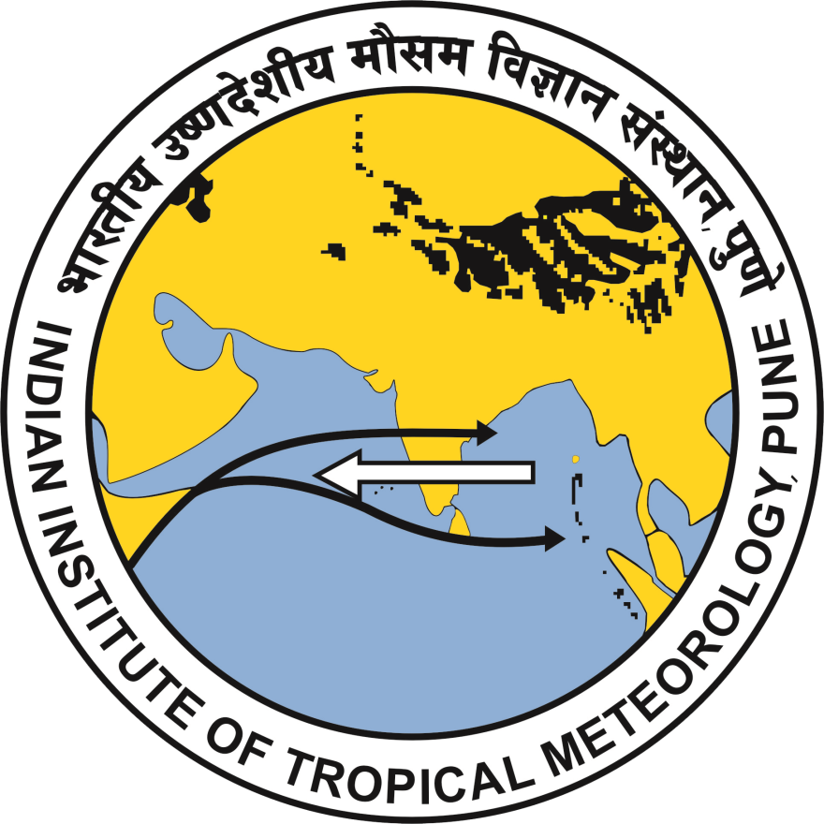
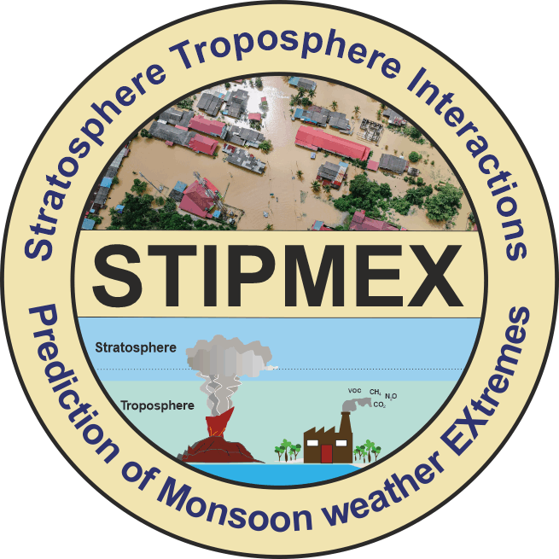
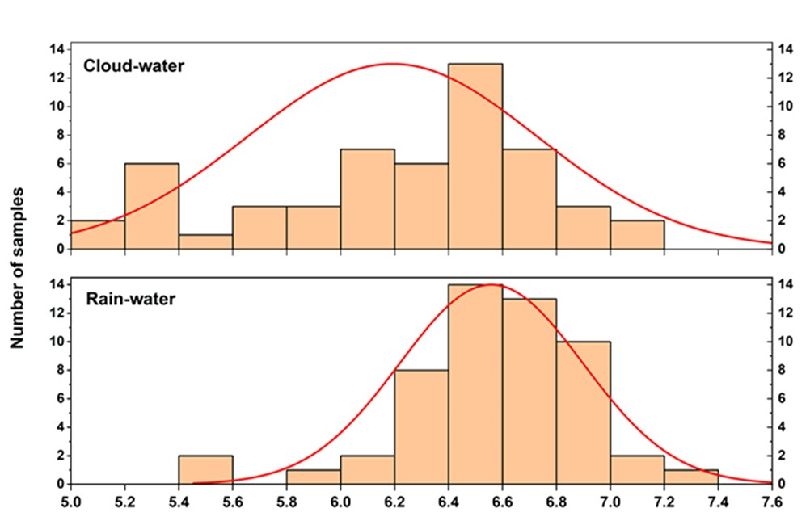
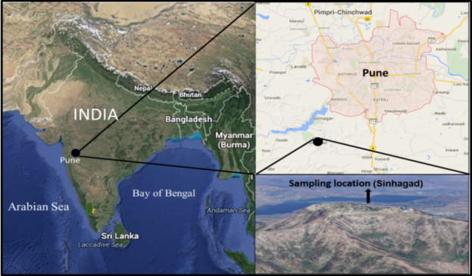
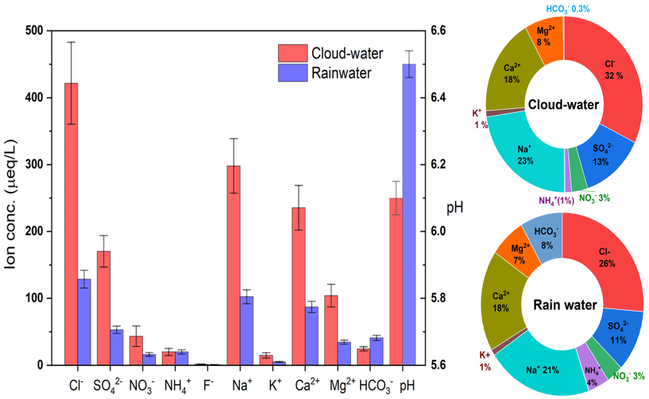
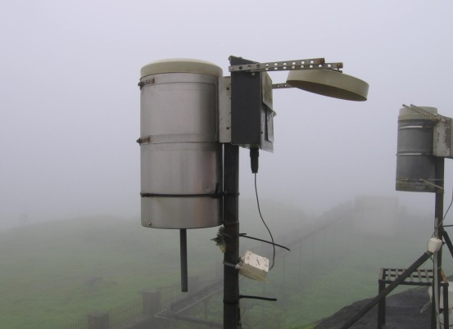
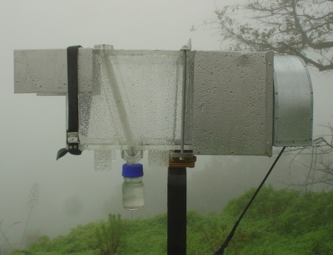
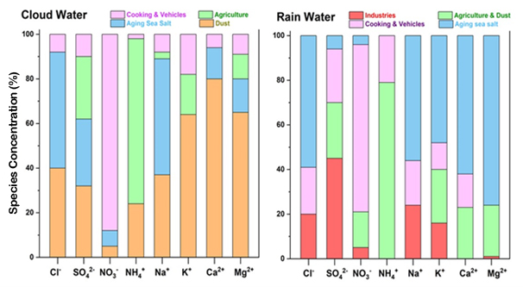
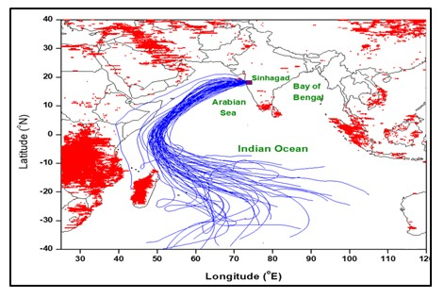
CHEMISTRY OF CLOUD WATER DURING INDIAN SUMMER MONSOON AT A HIGH-ALTITUDE LOCATION IN WEST INDIA
RANJEETA D. GAWHANE¹, K. B. BUDHAVANT^{2,3}, V. V. WAGHMARE¹, S. MUKHERJEE¹, B. PADMAKUMARI¹
¹Indian Institute of Tropical Meteorology, Ministry of Earth Sciences, Pune-411008, India
²Divecha Centre for Climate Change, Indian Institute of Science, Bangalore-560012, India
³Maldives Climate Observatory-Hanimaadhoo, Maldives Meteorological Services, Hanimaadhoo – 02020, Maldives
Presenter – Ranjeeta D. Gawhane, Indian Institute of Tropical Meteorology, Pune-411008. ranjeeta@tropmet.res.in
INTRODUCTION
The Earth's atmosphere comprises various phases, including the aqueous phase, in the form of fog droplets, cloud droplets, and wet aerosol particles. Clouds, in particular, play a crucial role in transporting constituents from the planetary boundary layer (PBL) to the free troposphere. They also play a vital role in the Earth's energy budget by reflecting and absorbing solar and terrestrial radiation. Additionally, nucleation scavenging and rainout facilitate the transfer of nutrients and contaminants from one place to another. The water in clouds is crucial in determining onset and growth rate of precipitation. This study of cloud chemical properties and air mass transport analysis identifies compositional source regimes with implications for the monsoon build-up, climate variabilities, ecosystems, agriculture, and climate change.
SAMPLING
Cloud-water (CW) and simultaneous wet-only rainwater (RW) samples were collected during southwest monsoon (June to September) 2016-2017 at a high altitude station, Sinhagad.
Figure 4. Frequency distribution of pH levels
Total ionic constituents in CW were three times more than RW, except for NH₄⁺ and HCO₃⁻.
High SO₄²⁻ and NO₃⁻ concentrations were observed in CW than in RW.
High levels of Na⁺ and Cl⁻ due to the influence of marine air mass from the Arabian Sea, which is upstream of the sampling location.
Figure 1. Sampling location, Sinhagad
CW AND RW COLLECTORS
Figure 2. Rain water and Cloud water collector
Figure 5. Comparison of ionic concentrations in CW and RW
RESULTS
CW factors extracted by PMF model - suspended dust, marine components, agricultural activities- cooking and vehicular activities.
RW factors – industries, agriculture –dust, anthropogenic fossil/ biomass burning and combination of two sources: wind-induced sea salt along with long-range transported mineral dust components.
During monsoon, south-westerly winds dominate the air mass-flow patterns, and ITCZ is at its farthest north position.
The 10-day Air mass Back Trajectory (AMBT) analysis shows that the air is primarily transported from the central Indian Ocean and the Arabian Sea to the sampling site with limited contact with anthropogenic sources.
Figure 6. Source contributions of ionic species using PMF model (4 factors)
CONCLUSIONS
Figure 3. 10-day AMBT at Sinhagad -1500 m.
In CW samples 15% values, whereas in RW only 4% values were less than pH 5.6.
High correlation observed between Ca²⁺ and sea salts and Ca²⁺ and SO₄²⁻ suggest either a marine source for Ca²⁺ or a substantial input of soil dust containing ss or the reaction between gas phase SO₂ and Ca-rich aerosol particles.
Ca²⁺ and Mg²⁺ were the primary neutralizing ions for CW & RW.
Marine, Anthropogenic and soil aerosols significantly affected CW & RW composition.
The weighted average pH of CW was 6.1 ± 0.5 (range 5.2 to 7.1) , while RW pH 6.5 ± 0.3. (range 5.5 to 7.3).
Alkaline nature (in spite of high concentrations of SO₄²⁻ and NO₃⁻) can be attributed to high concentrations of neutralizing ions, which neutralize acids and their precursors.
International workshop STIPMEX, IITM, Pune, 02-07 June, 2024

