Slide 1
Identifying Thresholds of Thunderstorm Indices for Predicting Lightning Events Across India with WRF-ARW Model and ERA5 Reanalysis Datasets
INTERNATIONAL WORKSHOP
Stratosphere-Troposphere Interactions and Prediction of Monsoon weather EXtremes (STIPMEX)
(June 01-07, 2024), IITM, Pune
Unashish Mondal¹, Subrat Kumar Panda¹, Anish Kumar^{1, 2}, Devesh Sharma¹ and Someshwar Das^{1, 3}
¹Department of Atmospheric Science, School of Earth Sciences Central University of Rajasthan ²Institute of Meteorology, Leipzig University, Leipzig, Germany ³ South Asian Meteorological Association, New Delhi

Slide 2
Introduction
The Weather Research and Forecasting (WRF) model has been integrated for 30 hours with double moment microphysics scheme NSSL-17 which accurately reproduces vertical and meteorological measures.
Thunderstorm indices are often used for convection forecasting for many decades.
The ability of a model to forecast thunderstorm events needs to be assessed and improved by employing thunderstorm indices derived from model and observational datasets (Gubenko & Rubinshtein, 2017; Mukhopadhyay et al., 2003).
The efficacy of different skill scores in the prediction of rare events, specifically tornadoes and flash floods, was examined through the analysis of contingency tables (Doswell et al. 1990).
Heidke Skill Score (HSS) and True Statistics Skill (TSS) are the effective skill scores in forecasting (Kunz, 2007; Haklander & Delden 2003).
The thunderstorm indices using optimal threshold over few station location in India has been done by (Sahu et al. 2021)

Slide 3
Model Configuration
Table 1: Summary of WRF model configuration
Parameter | Details
WRF version | 4.0.3 version
Spatial resolution | 9 and 3 Km
Model integration time | 24 Hr
Time Step | 54 Sec
Vertical Resolution | 34 Level
Dataset | NCEP – 0.25 degree
Table 3: Data description of ERA5
DATA DESCRIPTION – ECMWF [ERA5]
Data type | Gridded
Projection | Regular latitude-longitude grid
Horizontal coverage | Global
Horizontal resolution | Reanalysis: 0.25° x 0.25° (atmosphere)
Temporal coverage | 1940 to present
Temporal resolution | Hourly
File format | GRIB, NetCDF-4
Vertical coverage | 1000 hPa to 1 hPa
Vertical resolution | 37 pressure levels
Update frequency | Daily
Table 2: Physical configuration of designed experiments
Physics options | Exp.
Microphysics | NSSL-2
Longwave radiation | RRTM
Shortwave radiation | RRTMG
Land cover classification | MM5
Surface layer | NOAH
Planet boundary layer | YSU
Cumulus convection | GRELL-D

Slide 4
Thunderstorm Indices
Table Traditional approach to find out the thunderstorm probability vertical temperature, moisture and wind profiles
Table Thunderstorm probability level of severity
Index | FULL FORM
LLS | LOW LEVEL SHEAR
DLS | DEEP LEVEL SHEAR
SRH 3 KM | STORM RELATIVE HELICITY
SCP | SUPERCELL COMPOSITE PARAMETER
STP | SIGINIFICANT TORNADO PARAMETER
CAPE | CONVECTIVE AVAILABLE POTENTIAL ENERGY
K INDEX | K INDEX
CT INDEX | CROSS TOTALS INDEX
VT INDEX | VERTICAL TOTALS INDEX
TT | TOTAL TOTALS INDEX
PLCL | PRESSURE LOW LEVEL CONDENSATION
DEWPOINT | DEWPOINT TEMPERATURE
EHI | ENERGY HELICITY INDEX
POT | POTENTIAL INSTABILITY
Indices | Level 1 | Level 2 | Level 3
CAPE | 1000 J/Kg | 1500 J/Kg | 2000 J/Kg
LLS | >=10 | >=15 | >=20
DLS | >=10 | >=20 | >=25
SRH | 100 m²/s² | 150 m²/s² | 200 m²/s²
STP | >=1.2 | >=2.5 | >=5
SCP | >=3.5 | >=7.5 | >=15
Levels categories the severity of the thunderstorms

Slide 5
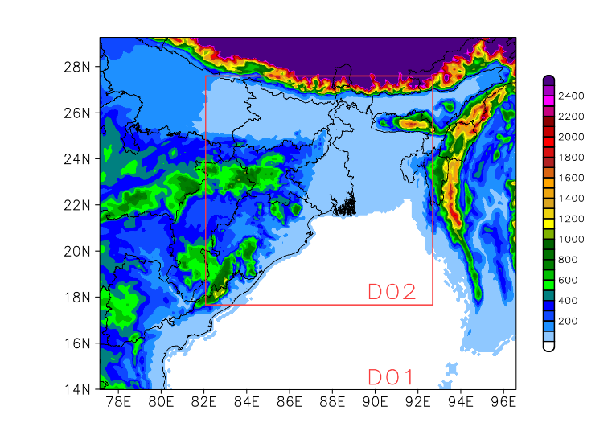
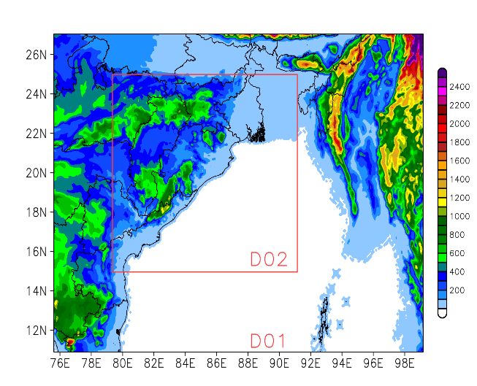
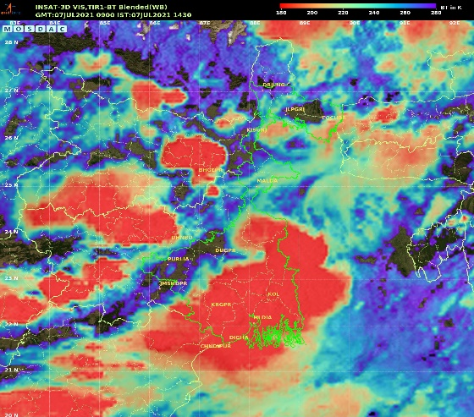
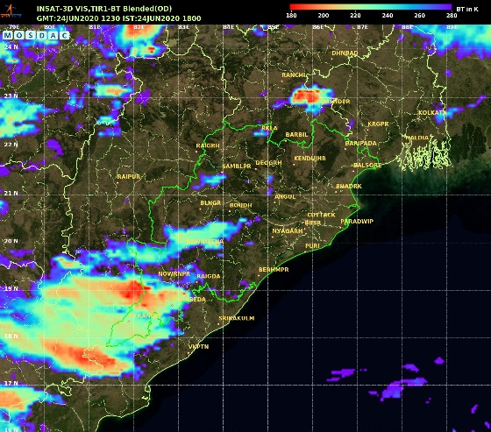
Study Domain
WRF
Model Domain
West Bengal
Odisha
INSAT – 3D
WRF model double nested domain and topography (m), horizontal resolution are D01-9 Km and D02-3 km resolution over Hooghly, West Bengal (07 June 2021) & Odisha (24 June 2020)

Slide 6
Calculation of optimal threshold
Assessment of optimal threshold using several model skill score parameters for the Cross Totals (CT index) over Surendranagar, Gujarat (example)

Slide 7
THUNDERSTORM INDICES Hooghly
Results
Time series comparison of calculated thunderstorm indices using WRF model and ERA5 datasets over domain [20.5N 22.5N 87.5E 89.5E] the vertical box in red showing the time of event occurrence, at Hooghly, West Bengal on 07 June 2021

Slide 8
Table Maximum, minimum, mean, and standard deviation computed for all thunderstorm indices over Hooghly (Max = Maximum, Min = Minimum, Mean = mean, Std = Standard Deviation)
 | WRF |  |  |  | ERA-5
Index | Max | Min | Mean | Std | Max | Min | Mean | Std
CAPE | 5624.77 | 0 | 1680.3 | 1572.65 | 6995.75 | 0 | 1359.22 | 1185.97
KI | 44.03 | 19.81 | 37.62 | 3.62 | 43.49 | -20.29 | 34.5 | 5.68
CT | 23.27 | 10.94 | 18.04 | 1.89 | 24.09 | 12.88 | 19.31 | 1.48
VT | 33.18 | 19.44 | 26.67 | 2.59 | 31.09 | 18.51 | 24.99 | 1.99
TTI | 50.78 | 36.67 | 44.71 | 2.32 | 50.32 | 14.69 | 43.86 | 3.26
DEW | 29.01 | 0.47 | 22.56 | 4.6 | 30.04 | 16.81 | 24.9 | 1.64
POT | -38.8 | -61.51 | -49.77 | 3.46 | -28.89 | -66.6 | -49.44 | 5.28
EHI | 9.38 | -0.85 | 1.41 | 1.48 | 6.69 | -0.79 | 0.83 | 0.96
SCP | 26.17 | -0.44 | 1.89 | 2.37 | 19.05 | -0.35 | 1.36 | 1.78
STP | 2.94 | -0.31 | 0.17 | 0.26 | 2.56 | -0.15 | 0.15 | 0.23
SRH 3 | 615 | -82.77 | 100.78 | 73.24 | 419.23 | -45.71 | 93.08 | 63.64
DLS | 22.578 | 0.59 | 9.77 | 4.02 | 20.01 | 0 | 8.77 | 3.49
LLS | 18.62 | 0.02 | 4.86 | 3.09 | 16.19 | 0 | 4.75 | 3.08
PLCL | 998.4 | 592.98 | 872.07 | 98.18 | 998.43 | 523.44 | 905.6 | 72.07

Slide 9
Model Skill Score – HSS (Heidke Skill Score)
Results
Statistics | Formula | Definition | Range
HSS (Heidke Skill Score) | $$HSS=\frac{YY+NN−R}{YY+YN+NY+NN−r}$$ $$R=\frac{\left(YY+YN\right)×\left(YY+NY\right)+\left(NY+NN\right)×(YN+NN)}{YY+YN+NY+NN}$$ | the fraction of correct forecast after eliminating those forecasts which would be correct due purely to random chance | -1 to 1
HSS measures the fraction of correct forecast after eliminating those forecasts which would be correct due purely to random chance. Range of HSS is -1 to 1, and 1 indicates the perfect score.
Model skill score comparison of Heidke Skill Score (HSS) for different thunderstorm indices over all the case study domains

Slide 10
Model Skill Score – TSS (True Skill Statistic)
Statistics | Formula | Definition | Range
TSS (True Skill Statistic) | $$TSS=\frac{YY ×NN−YN ×NY}{\left(YY+NY\right)×(YN+NN)}$$ | TSS explains how well the forecast separated the “yes” events from the “no” events; | -1 to 1
TSS explains how well the forecast separated the “yes” events from the “no” events; range of the TSS is -1 to 1, as 0 indicates no skill; and 1 indicates the perfect score.
Model skill score comparison of True Skill Statistic (TSS) for different thunderstorm indices over all the case study domains

Slide 11
Conclusions
Thunderstorm indices CAPE showed significant values, with CAPE reaching above >1200 J/kg and TTI around >46°C, suggesting the formation of a convective storm.
The Wind updraft potential was sufficient for thunderstorm generation, with DLS of 10m/s and LLS of 10 m/s. The EHI (>1), and SCP (>=3.5), STP (>=1.2) along with low SRH at 3 km (100 m²/s²), indicated no evidence of helicity or tornado activity during the event.
Favourable conditions for convection were indicated by CT, VT, TTI, and K index values of >18°C, >27°C, >45°C, and >30°C, respectively exhibited high predictive capacity for forecasting the onset of thunderstorms.
The simplistic indices such as VT, CT, TTI works well with the weak and non-supercell thunderstorms such as for Udaipur, Rajasthan.
The supercell thunderstorm happened at Hooghly, West Bengal was predicted well by EHI, SCP, STP and SRH (advance indicators).
The performance of a forecast model can be assessed using a contingency table using the True Skill Statistic (TSS), Probability of Detection (POD), Heidke Skill Score (HSS).
The capability of the model to track real-time events and its validity can be checked through the thunderstorm indices.
The optimal threshold of the indices obtained from both the model-simulated and reanalysis datasets demonstrated a positive correlation in almost all events and cases

