Slide 1
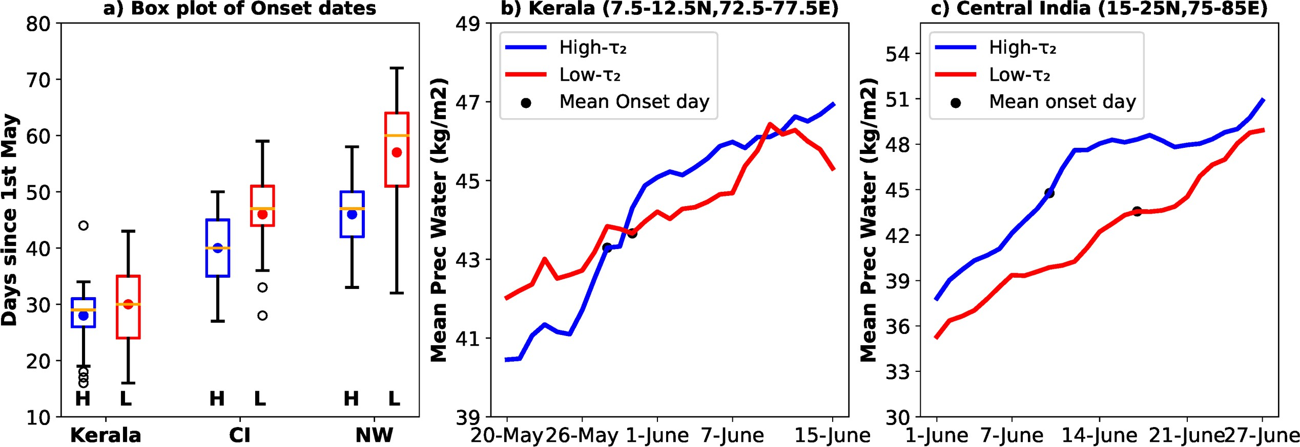
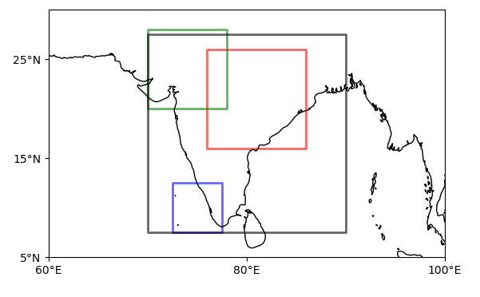
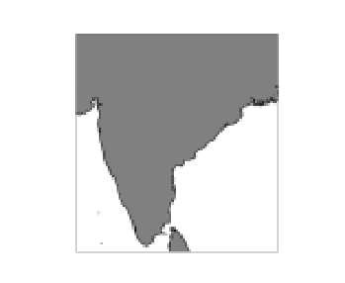
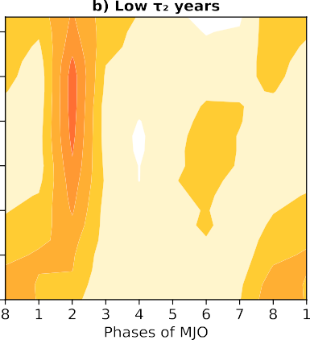
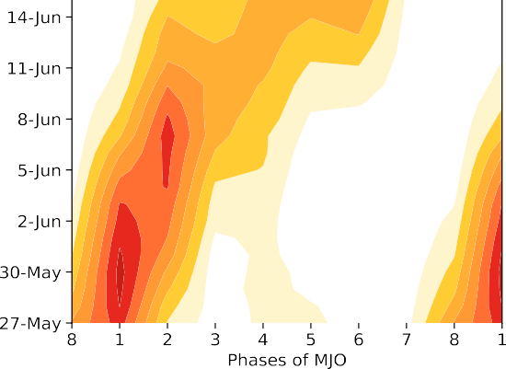
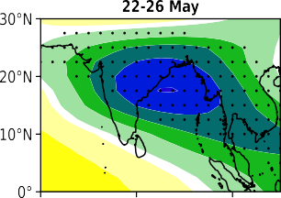
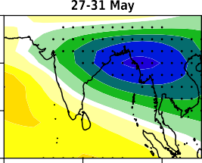
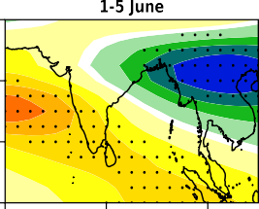
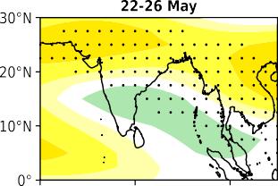
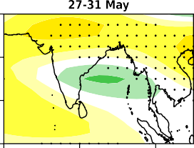
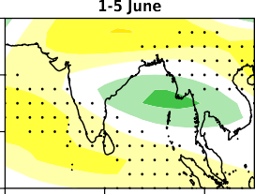
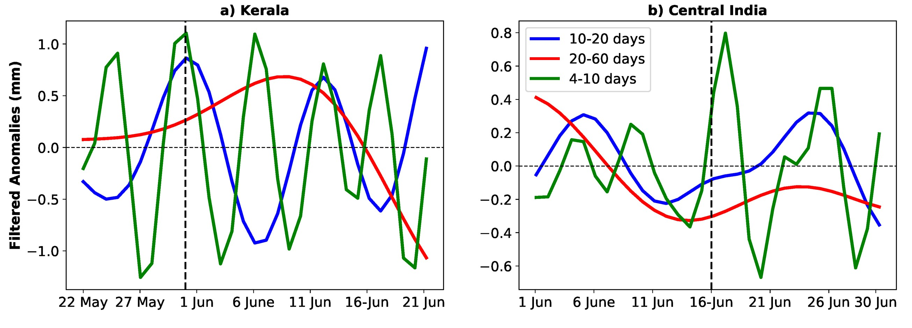
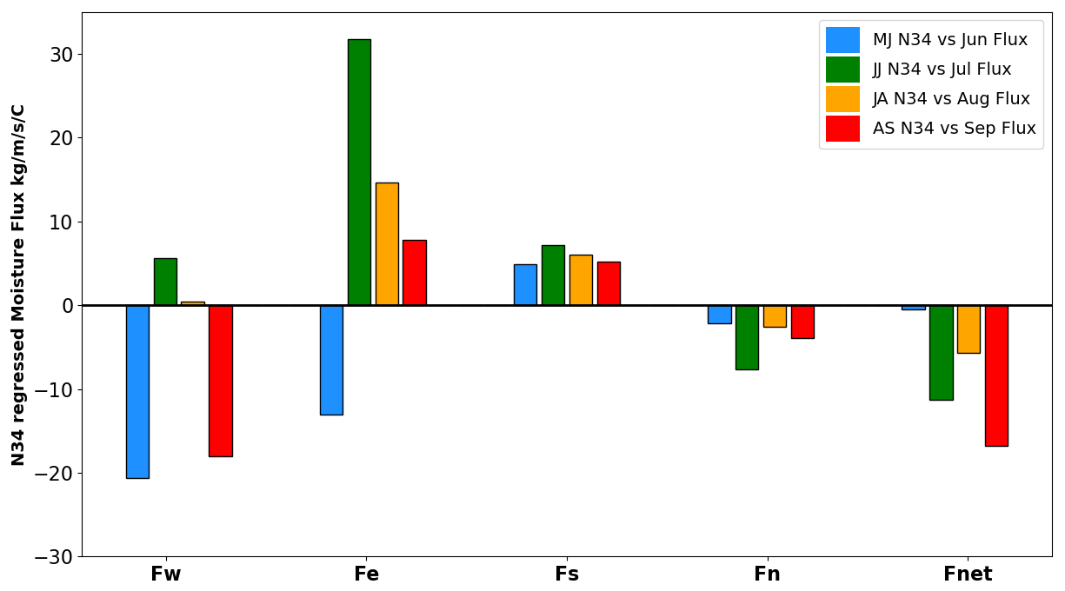
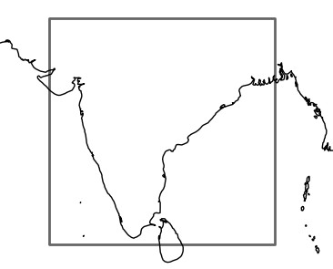
Mechanisms governing Rainfall over India during Monsoon Onset and Post Onset Phases
Sujatra Bhattacharyya¹; Arindam Chakraborty^{1,2}
¹Centre for Atmospheric and Oceanic Sciences, Indian Institute of Science, Bengaluru
²Divecha Centre for Climate Change, Indian Institute of Science, Bengaluru
Introduction
Indian Summer Monsoon variability is traditionally explained in two ways:
June Rainfall
Second Seasonal mode shows maximum variability in June. June rainfall is associated with onset of Monsoon.
Using percentile threshold approach, 𝜏₂ years are divided into high (>66.7) and low years (<33.3).
As a result of mean seasonal forcing due to seasonal migration of Inter-Tropical Convergence Zone (ITCZ) which is governed by Global energetics.
As a result of Intra-Seasonal features which occurs under the envelope of mean seasonal cycle such as Intra-seasonal Oscillations (ISOs), synoptic activities, Extremes, etc.
Very little has been studied about the seasonal cycle perspective of Indian rainfall i.e. monthly evolution of rainfall every year.
A generalized approach is devised without assuming any Intra-seasonal features. Seasonal cycle of rainfall has interannual variations. These variations on top of the mean seasonal cycle produces monthly anomalies each year.
Objective is to find the existence of physical modes that can explain the monthly evolution of rainfall every year.
Using Empirical Orthogonal Function (EOF) Analysis of monthly rainfall, first two dominant seasonal modes (EOFs--𝜙) and their corresponding interannual variabilities (PCs -- 𝜏) are constructed.
Fast advancement of monsoons is observed in High 𝜏₂ years
Slow advancement is observed in Low 𝜏₂ years
Mean background precipitable water is strong during High and
12
a) Climatology of Prec over India (1948-2021)
40
b) Variance Explained by S-EOF Modes
Interannual std
JJAS=79.3%
35
Low 𝜏 years over Kerala and Central India
10
26.0
22.7
% of variance captured
30
2
Prec (mm/day)
8
25
6
15.0
15.6
20
4
15
7.6
10
2
1.8
4.3
3.2
1.2
5
0
0.8 0.8 1.0
Apr Jun
c) Seasonal EOFs (
Aug
) of Prec
0
2
4 6 8
S-EOF mode
10
12
1
Feb
Oct
Dec
d) Cross Corr of Monthly Prec
Oct 0.05 0.04 0.68 0.62 0.83
0.34
0.5
1
0.5
2
Sep
S-EOF
0
Aug
0
Jul
High 𝝉_{𝟐} years: Phase transition of MJO is observed which might be responsible for onset and fast advancement of monsoon.
Low 𝝉_{𝟐} years: MJO is phase locked in second phase. This might be the reason for delay of onset over Central India.
High 𝝉_{𝟐} years onset mechanism
-0.5
Jun
-1
Feb Apr Jun Aug Oct Dec
May
May Jun Jul Aug Sep Oct
-0.5
Key observations:
First Seasonal Mode (𝜙₁) shows little variation in June, starts increasing from July & peaks in September.
Second Seasonal mode (𝜙₂) shows peak variation in June and than damps out for the rest of the season.
June and Post-June rainfall shows very weak correlation.
Correlation | ISMR | June | JAS
𝜏₁ | 0.90 | 0.08 | 0.96
𝜏₂ | 0.31 | 0.79 | 0.0003
High Mean Background precipitable water along with strong precipitable water anomalies due to MJO is responsible for Onset over Kerala and Central India.
Relationship of SST with 𝝉_{𝟏}& 𝝉_{𝟐}
Studies have shown that slow varying boundary conditions such as Global Sea Surface Temperature is an important predictor of ISMR. The relationships of PCs (𝜏₁ 𝑎𝑛𝑑 𝜏₂) with SST is shown.
Low 𝝉_{𝟐} years onset mechanism
Weak precipitable
water anomalies due to MJO over Kerala during its onset pentad.
Strong negative anomalies of precipitable water due to MJO over Central India during its onset pentad.
Kerala: High frequency ISO and
synoptic activity intensified by high mean background precipitable water, leads to onset.
Central India: Synoptic Activity
enhanced by high mean background precipitable water, leads to onset.
The correlation of SST over Central Pacific also referred as Nino3.4 (N34) with 𝜏₁ shows that 𝜏₁
is related to an evolving ENSO mode.
Post-June Rainfall
𝐅
Using Moisture budget analysis for understanding the global tele-connections (Chakraborty and Singhai 2021),
Regression of vertically integrated moisture fluxes at western (𝐹_{w} ), eastern (𝐹_{𝑒} ), southern (𝐹_{𝑠}), northern (𝐹_{𝑛}) and net flux (𝐹_{𝑛𝑒𝑡}) of each of the months during monsoon due to N34 averaged for that month and a month before is observed.
𝐹_{𝑛𝑒𝑡} = 𝐹_{w} − 𝐹_{𝑒} + 𝐹_{𝑠} − 𝐹_{𝑛}
𝐅_{w}
n
𝐅_{e}
Conclusions
𝐅_{s}
Post-June rainfall related to the first Seasonal mode is associated with sub-seasonal moisture flux variability due to an evolving ENSO Condition.
June rainfall of the second seasonal mode can be explained using MJO driven precipitable water or high frequency disturbances under a high mean background precipitable water state.
References
Chakraborty, A. and Singhai, P., 2021. Asymmetric response of the Indian summer monsoon to positive and negative phases of major tropical climate patterns. Scientific reports, 11(1), p.22561.
Charney, J.G. and Shukla, J., 1981. Modelling and theoretical studies.
Chakraborty, A. and Agrawal, S., 2017. Role of west Asian surface pressure in summer monsoon onset over central India. Environmental Research Letters, 12(7), p.074002.
The net regressed moisture flux shows exact same
variations as is observed in the first seasonal mode.
Mail Id: sujatrab@iisc.ac.in
RESEARCH POSTER PRESENTATION DESIGN © 2019
www.PosterPresentations.com

