Slide 1
PRECIPITATION MICROPHYSICS AND VARIABILITY DURING TROPICAL CYCLONE OVER SOUTHERN INDIA
Lekshmi Anilkumar^{a,*}, Resmi E. A^{b} , Sumesh R. K^{b,c}, Nita Sukumar^{b}, and Gadha Gopanª
a College of Climate Change and Environmental Science, b National Centre for Earth Science Studies, c Cochin University of Science and Technology
*Presenting Author:lekhp2000@gmail.com

Slide 2
INTRODUCTION
A tropical cyclone (TC) is a rotational low-pressure system in the tropics when the central pressure falls by 5 to 6 hPa from the surroundings and the maximum sustained wind speed reaches 34 knots (about 62 kmph).
Over the AS, the total SST change from 1982 to 2019 is 1.4°C and 1.2 °C in the pre-monsoon and post-monsoon season respectively. The observed difference in SST over the Bay of Bengal (BoB) is 0.5 °C in the post-monsoon and 0.8 °C in the pre-monsoon (Singh and Roxy, 2022)
A notable trend in Rapid Intensification (RI) TCs over the basin has been seen since 2000. Three or more cyclones that are intensifying, at least one of them is an RI category cyclone. The BoB basin has seen a higher number of RI cases than the AS.
To study the intensity of precipitation certain microphysical aspects has to be analyzed. The intensity of a cyclone's evolution typically relies on factors, including the intensity of the storm, the atmospheric thermodynamic profiles and the thermal structure of the upper ocean it moves through.
The raindrop size distribution (DSD) is examined to obtain information about the microphysical processes. The concentration of raindrops per unit volume is known as DSD (Rosenfeld and Ulbrich, 2003; Radhakrishna et al., 2020)
The DSD parameters showed seasonal fluctuations, with convective and stratiform precipitation features varying between the monsoon and post-monsoon seasons
OBJECTIVE
To analyze and quantify the microphysics of precipitation over the southern tip of peninsular India during the evolution of tropical cyclone
5

Slide 3
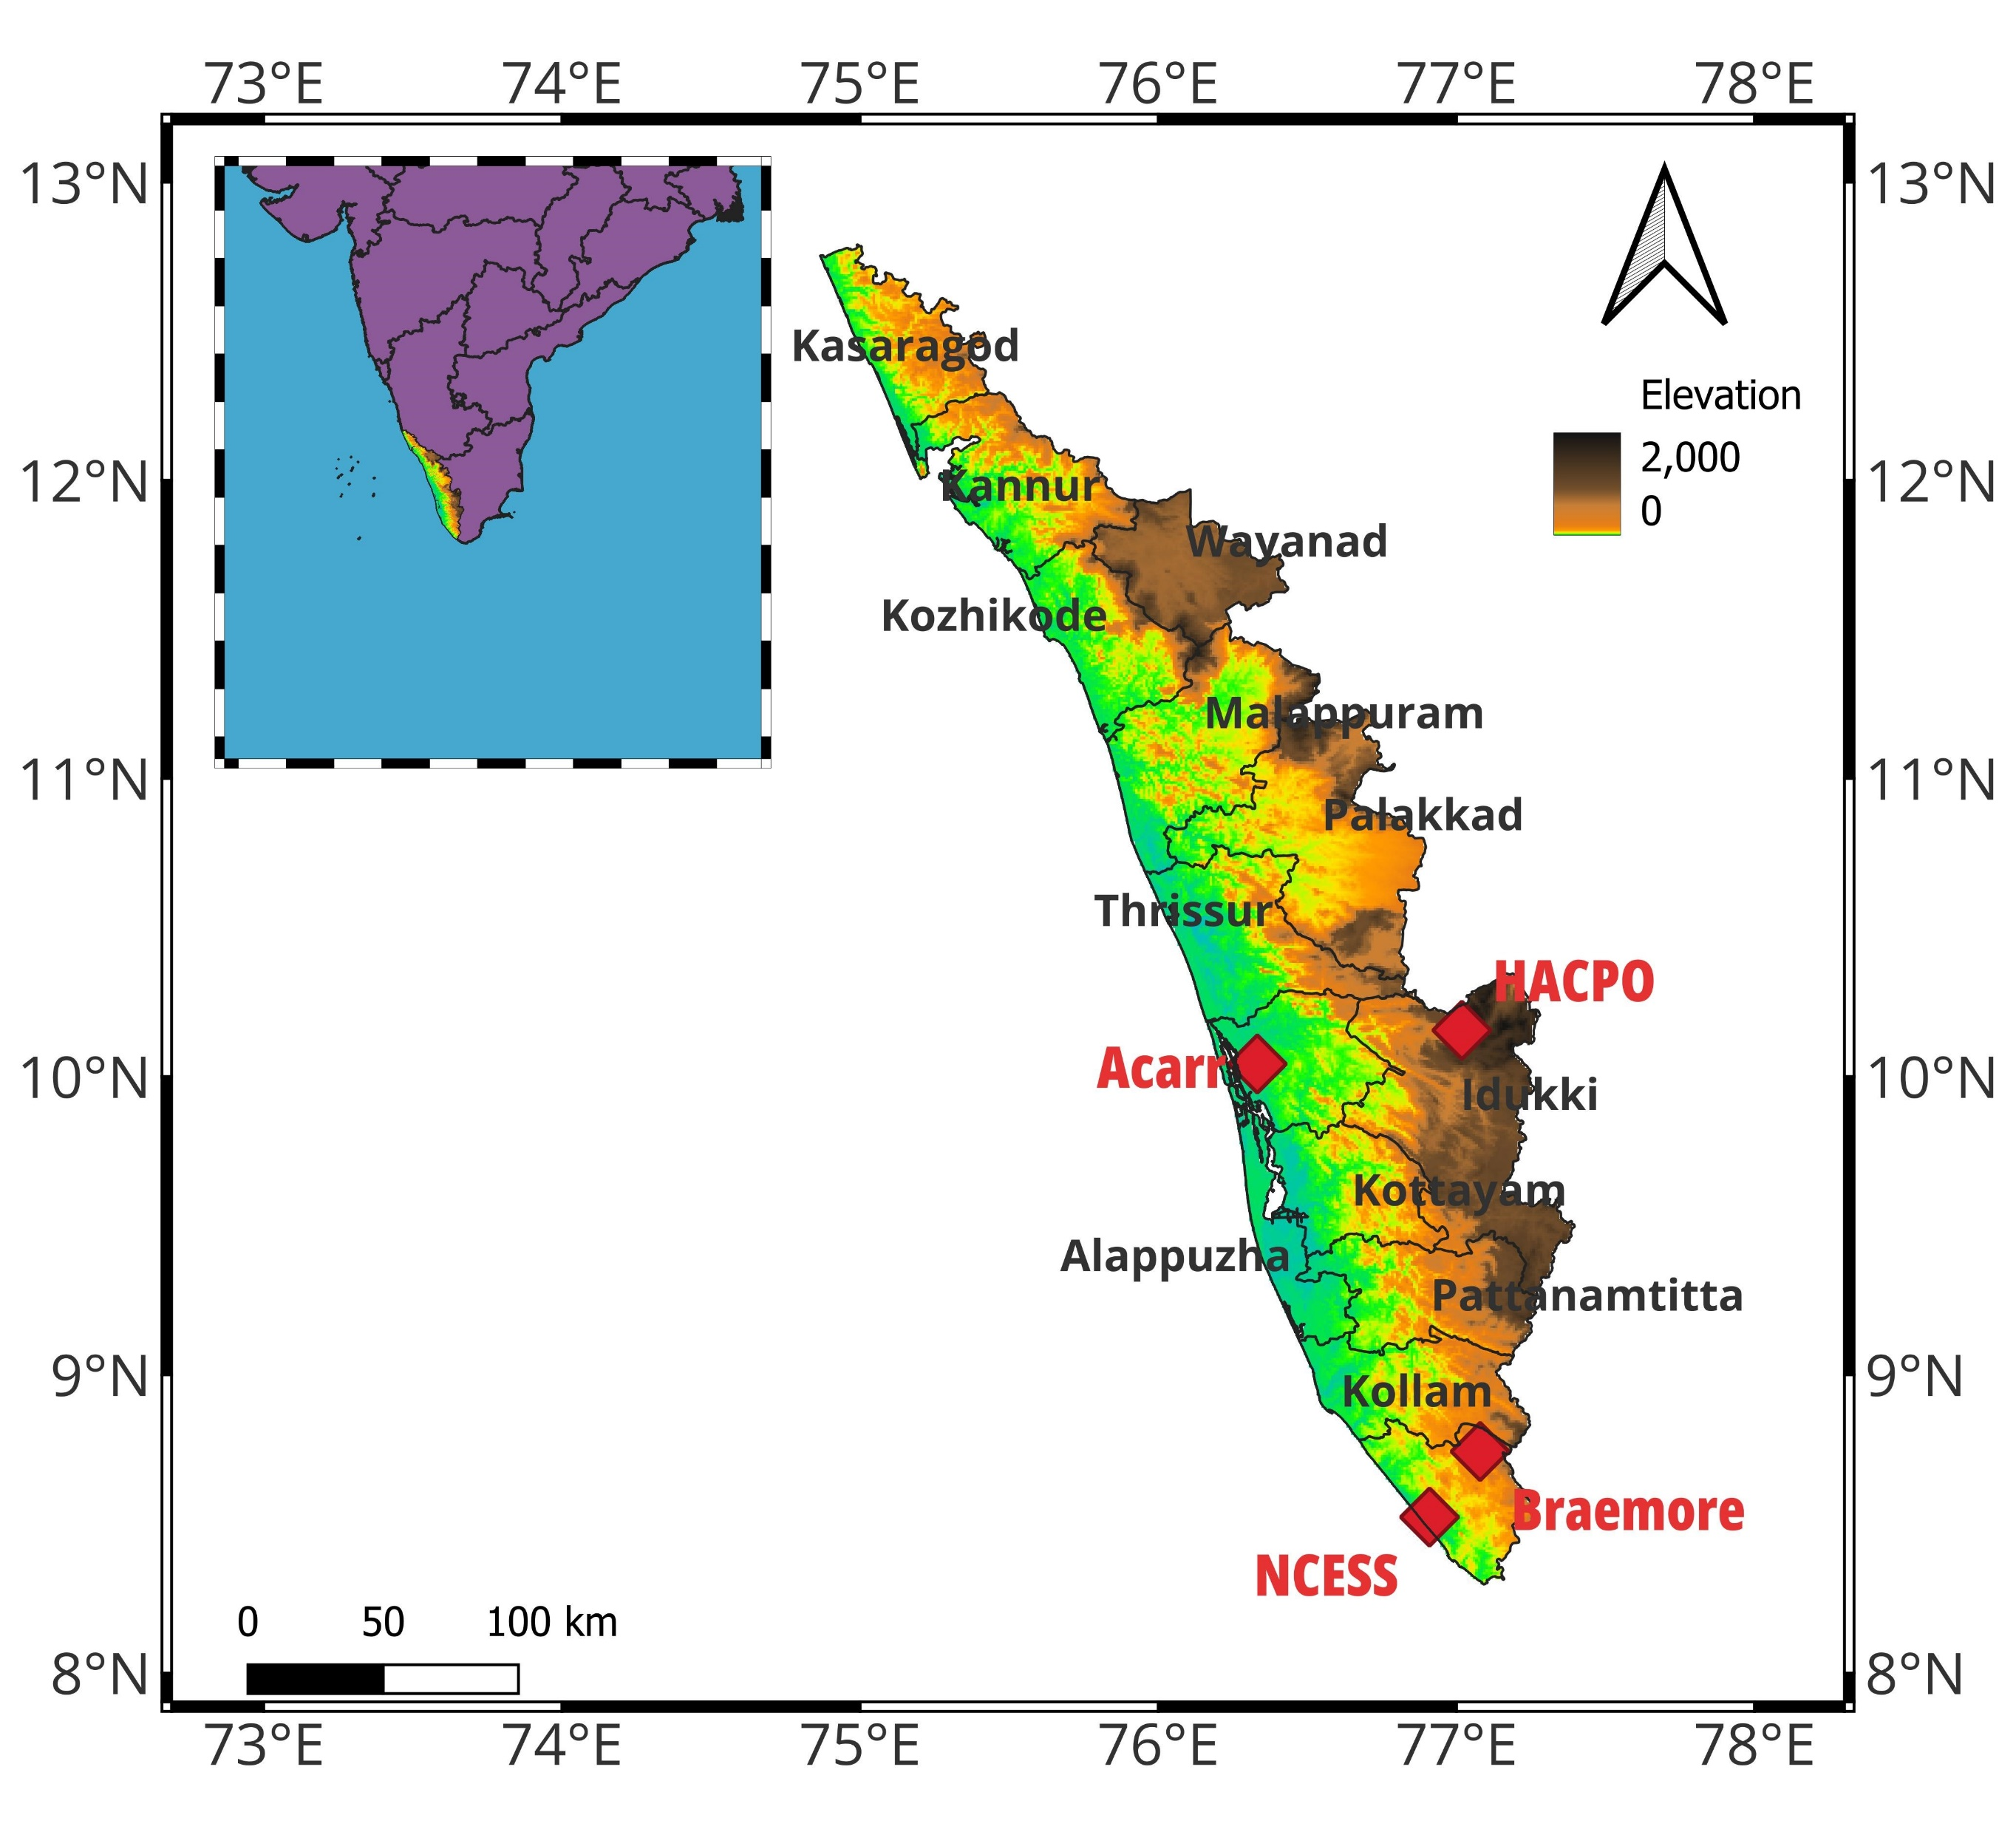
STUDY AREA
DATA & METHODS
The RSMC (Regional Specialized Meteorological Centre)-IMD (India Meteorological Department, online site utilized for obtaining detailed reports on cyclones which includes its duration, landfall, stages, and precipitation details
The INSAT-3DR data of spatial resolution 4 x 4 Km and temporal resolution of 30 mins has been obtained from MOSDAC to make use of the brightness-temperature profile during the peak cyclonic activity
IMERG- final run (spatial resolution of 10 km & temporal resolution of 24 Hr) data has been used to analyse the spatial distribution pattern of precipitation during the evolution of cyclone
The study used recorded observations of precipitation from an optical disdrometer during the period which has been coinciding with the days of the cyclonic activity from the depression stage to the dissipation stage in the 4 stations.
The vertical profile of the precipitation is studied using MRR. The normalized gamma distribution method is used to represent DSD mathematically.
For the extensive study of the type of precipitating DSDs received, i.e., a method to separate the convective and stratiform DSDs of precipitation using the variation between $N_{w}$and $D_{m}$
Coastal station: NCESS Campus Atmospheric Observatory (8.29°N, 76.59°E), Thiruvananthapuram district
Mid-altitude station : Breamore (BRM) Atmospheric Observatory (8.75°N, 77.08°E) in Thiruvananthapuram district, Kerala.
High Altitude Cloud Physics Observatory (HACPO) at Rajamallay (10.15° N, 77.02° E), near Munnar, Kerala
Urban site: Advanced Centre for Atmospheric Radar Research (ACARR)( 10.35°N, 76.35°E), CUSAT, Ernakulam
8

Slide 6
SUMMARY
The study provides insights into the spatiotemporal evolution of precipitation structures, and microphysics, through a thorough analysis of observational data, including radar, satellite, and ground-based measurements.
Single isolated rainfall peaks are the main characteristic due to the cyclone activity during the post-monsoon season
Pre-monsoon cyclones such as Fani, Asani, Tautkae, Amphan, Nisarga and Yaas are beyond 700-1000 km distance from the observation station, confirming the presence of rainfall from outer rainbands
Asani in BRM and Amphan at HACPO during the pre-monsoon season has more concentration of the first layer of clouds near the surface i.e, at an avg height of less than 2 Km these stations are in mid altitude and high altitude
Presence of multiple cloud layers are seen during the post-monsoon cyclones Burevi and Maha during the peak rf day
The near-surface DSD distribution for the precipitation shows a single peak curve. Most of the DSD spectra in pre-monsoon and post-monsoon follow the gamma distribution.
A larger distributional range of Dm (> 2.2 mm) is observed in pre-monsoon cyclones at ACCAR and NCESS
Peak concentration (> ${10}^{3}$ $m^{−3}{mm}^{−1}$) of very small drop sizes are experienced in HACPO as HACPO being a high-altitude observatory, the cloud droplets have less time and energy to coalesce and grow into larger raindrops before reaching the ground and the process of breaking of the larger sized rain drops can also lead to the presence of higher concentration of smaller drops

Slide 7
Reference
Singh, V.K. and Roxy, M.K., 2022. A review of ocean-atmosphere interactions during tropical cyclones in the north Indian Ocean. Earth-Science Reviews, 226, p.103967
Radhakrishna, B. 2022. Raindrop size distribution (DSD) during the passage of tropical cyclone Nivar: effect of measuring principle and wind on DSDs and retrieved rain integral and polarimetric parameters from impact and laser disdrometers. Atmos. Measurement Tech. 15(22): 6705-6722.
Rosenfeld, D. and Ulbrich, C.W., 2003. Cloud microphysical properties, processes, and rainfall estimation opportunities. Meteorological Monographs, 30(52), pp.237-258.

Slide 8
Thank You

