Slide 1
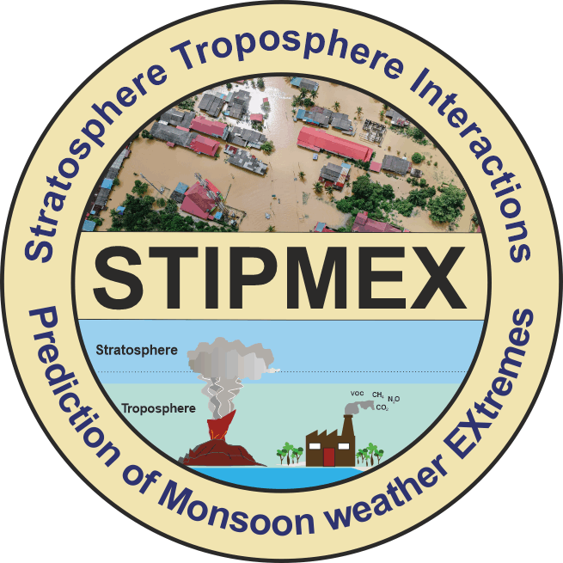
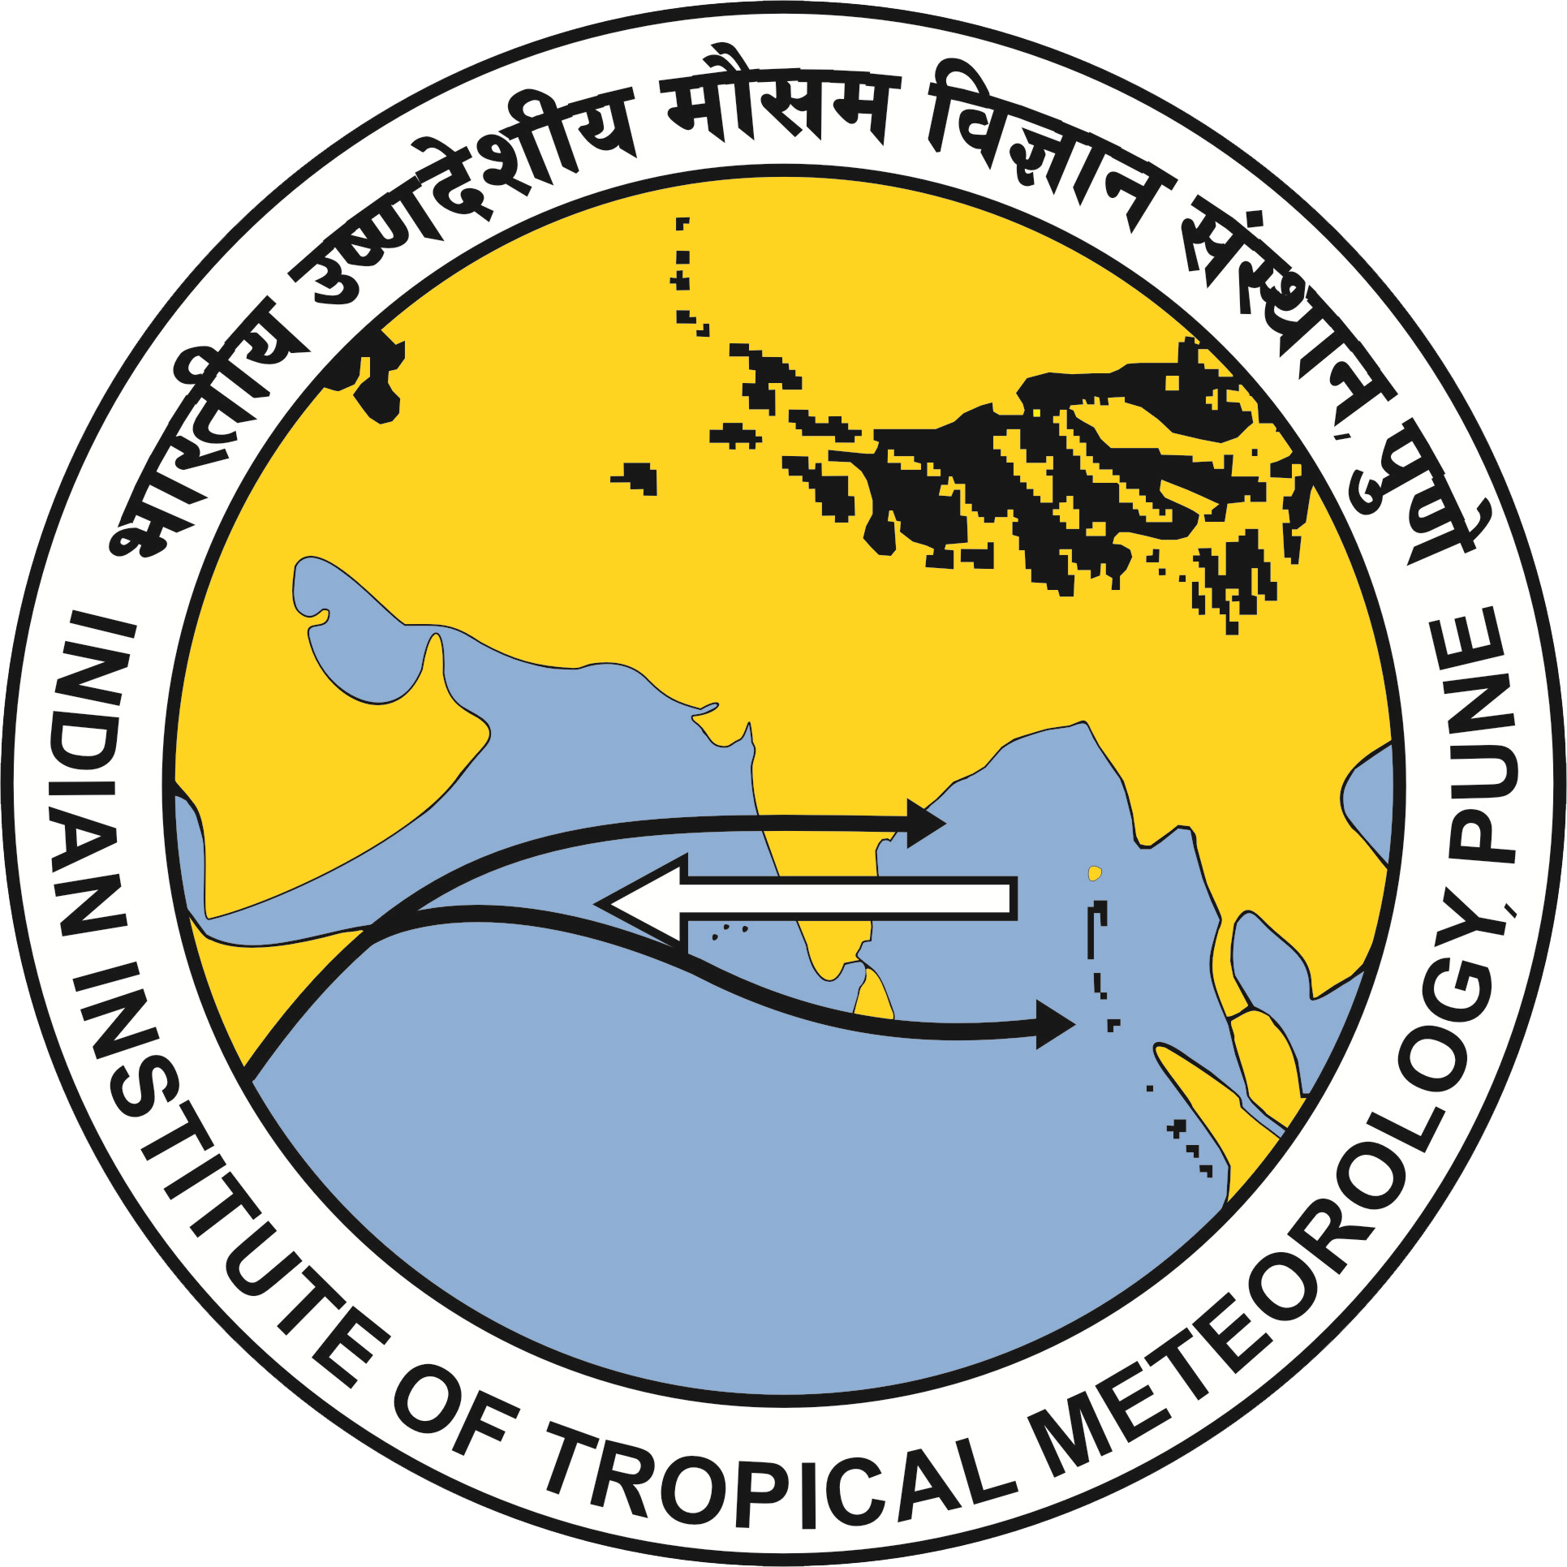
Characteristics of raindrop size distribution for precipitating systems over a coastal region
Gadha Gopan ¹ , Resmi E.A ² , Sumesh R.K ² , Nita Sukumar ² and Lekshmi Anilkumar ¹
¹ Kerala Agricultural University, Thrissur, 680656, India
² National Centre for Earth Science Studies, Thiruvananthapuram, 695011, India

Slide 2
INTRODUCTION
OBJECTIVE: To understand and analyze the Raindrop Size Distribution for precipitating systems over a coastal region
Each type of rain, such as heavy-intensity rainfall resulting from deep convective clouds, light rainfall resulting from shallow convective orographic clouds, or stratiform clouds, follows dominating microphysical processes at different altitudes (Konwar et al., 2014).
Different types of rainfall are persistent in the tropics including convective and stratiform.
Convective precipitation is shorter-lived and more intense. On the other hand, even for severe convective systems, stratiform rain contributes significantly to the volume of rainfall by covering broader areas than convective precipitation from nearby convective cells (Anagnostou., 2004).
A high cloud shield made up of active deep convective cores and cirrus anvil canopy is called a deep convective system (DCS) (Lin et al., 2007)
Raindrop size distribution (DSD) is observed for understanding the microphysical characteristics of different types of precipitation.

Slide 3
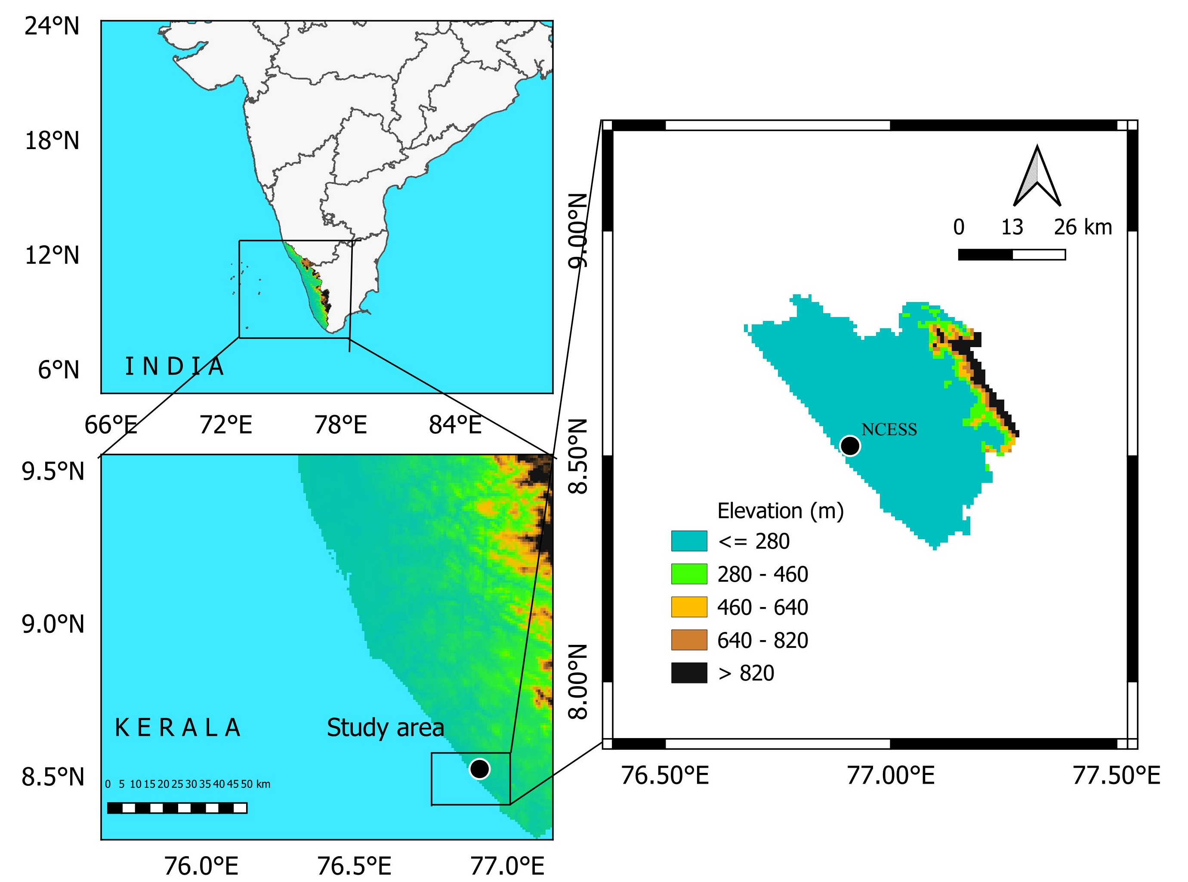
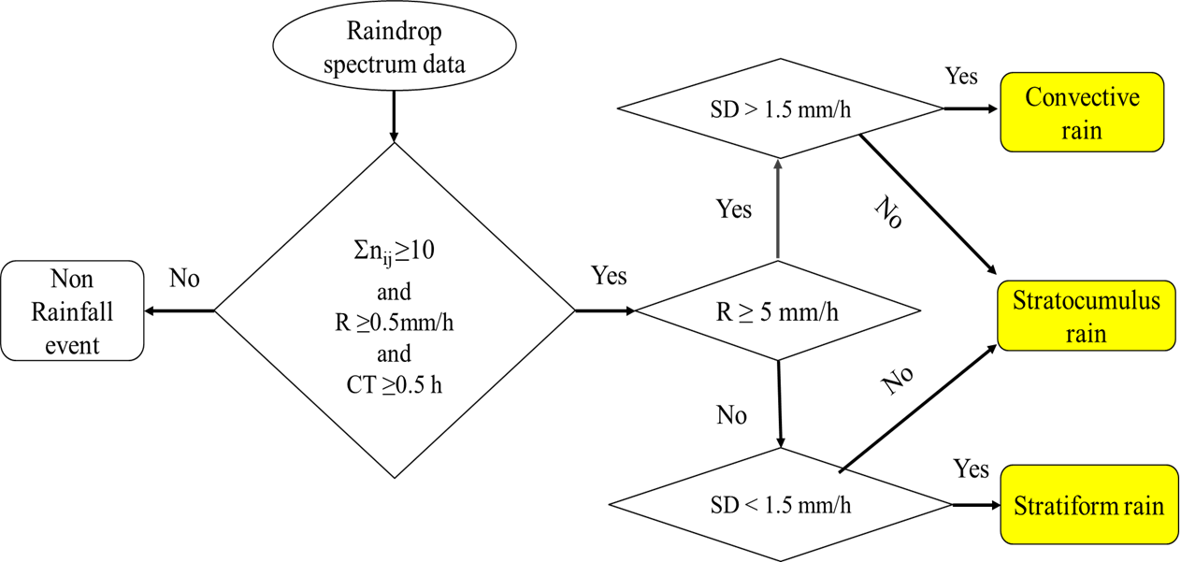
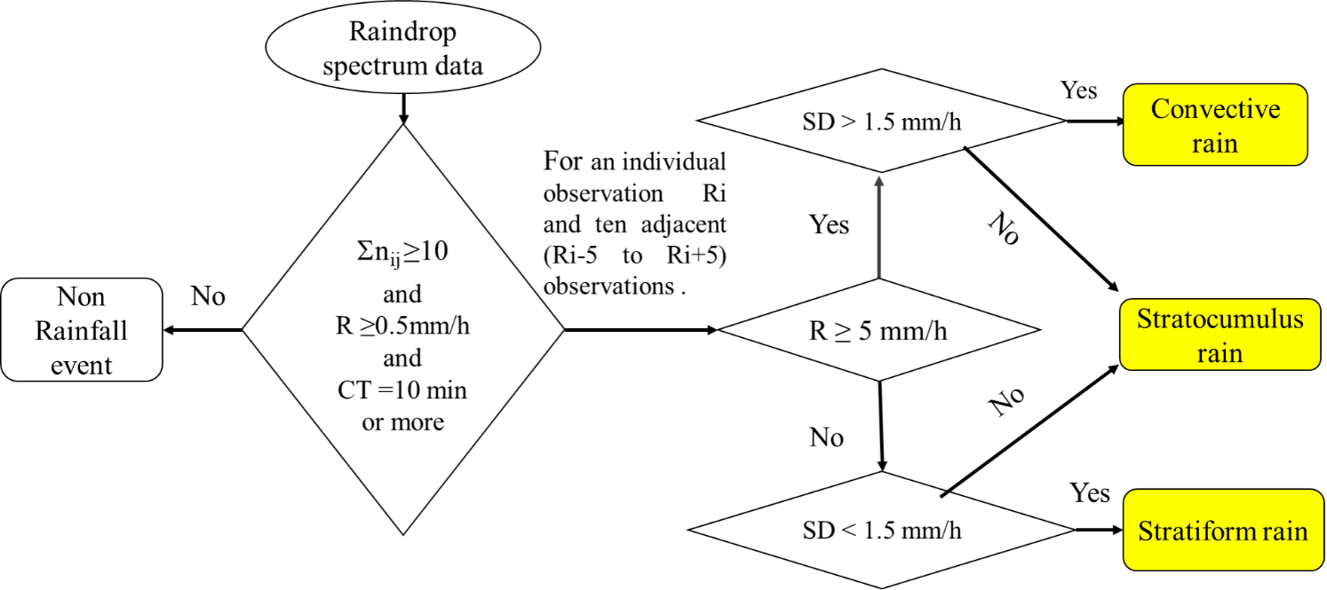
DATA AND METHODS
This study utilizes four-year (2019–2022) observations of a 1-min, optical disdrometer located at a tropical coastal station NCESS.
Four-year data are categorized into three different seasons, namely: Pre-monsoon (March to May), Monsoon (June to September), and Post-monsoon (October to December).
Data sets to be used will be observational data, reanalysis data sets and satellite data throughout pre-monsoon, monsoon and post-monsoon seasons.
Algorithm for classifying stratiform, convective, stratocumulus, and non-rainfall (Zeng et al., 2020).
Location map with elevation – NCESS station.
The observations were made at the coastal site located at the National Centre for Earth Science Studies (NCESS) campus in Thiruvananthapuram.
Modified algorithm for classifying convective, stratiform, stratocumulus rain and no rainfall with required modifications.

Slide 4
Contd.
Data Source | Parameters | Spatial resolution | Temporal resolution
PARSIVEL disdrometer | Surface rain rate (mm/hr), concentration of precipitation particles | Insitu | I min
Micro Rain Radar | Radar reflectivity (dBZ), rain rate (mm/hr) fall velocity(m/s) | Insitu | 1 min
Microwave radiometer | Relative humidity, CAPE (J/Kg), KI (K), KOI (K), TTI (K) | Remote sensing measurement | Hourly
INSAT-3DR | Brightness temperature | 4 x 4 km | 30 min
Precipitating systems |  | Date of event | Time of event (LST) | Parameters observed
Deep convective systems | Case 1 | 24 May 2022 | 4:24 h – 4:55 h | Cloud-to-ground lightning (CG) flashes, Radar reflectivity (dBZ), Relative humidity, brightness temperature (k), DSD characteristics
 | Case 2 | 26 December 2022 | 17:49 h -18:14 h

Slide 5
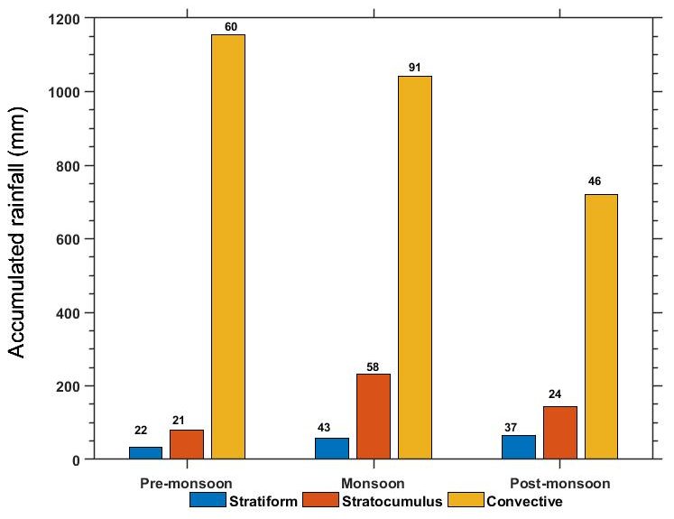
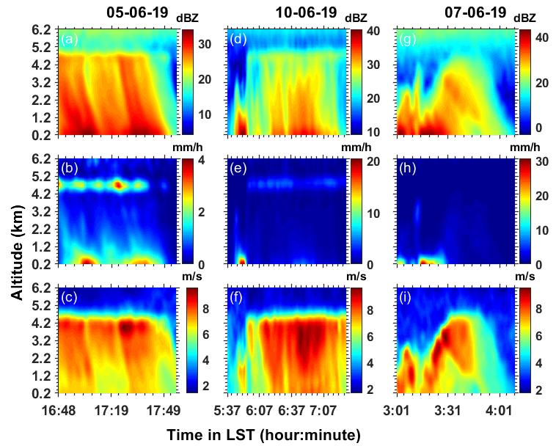
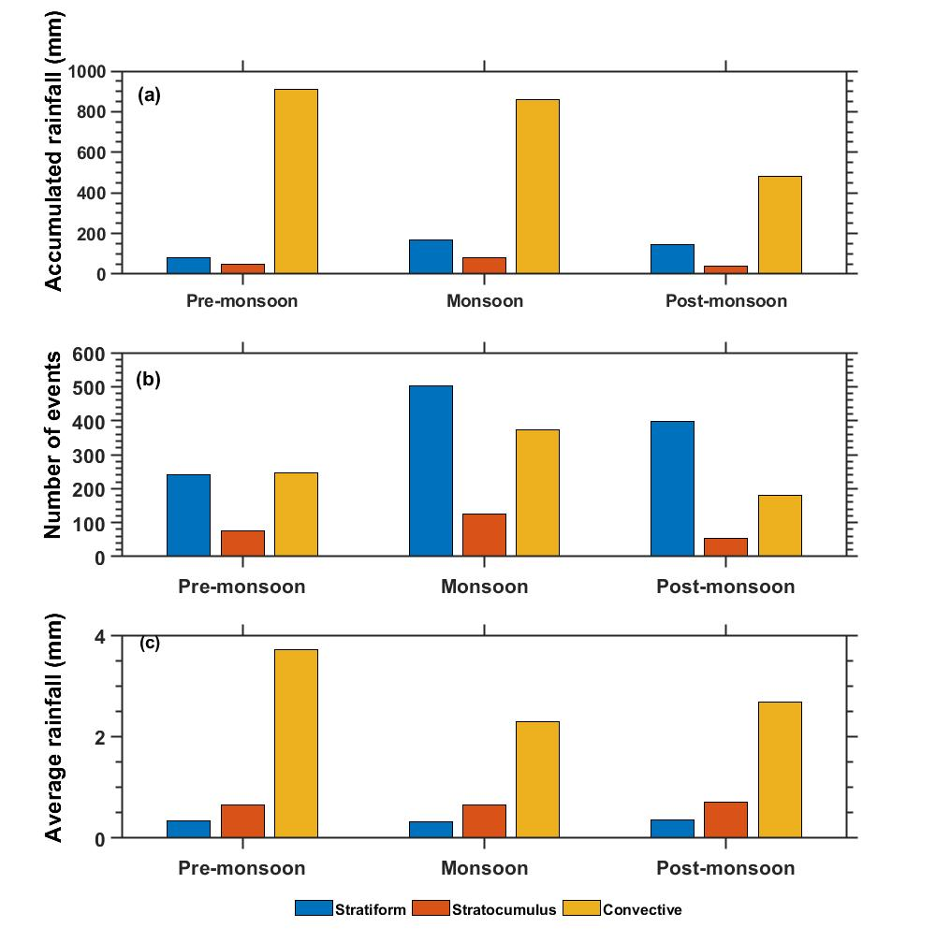
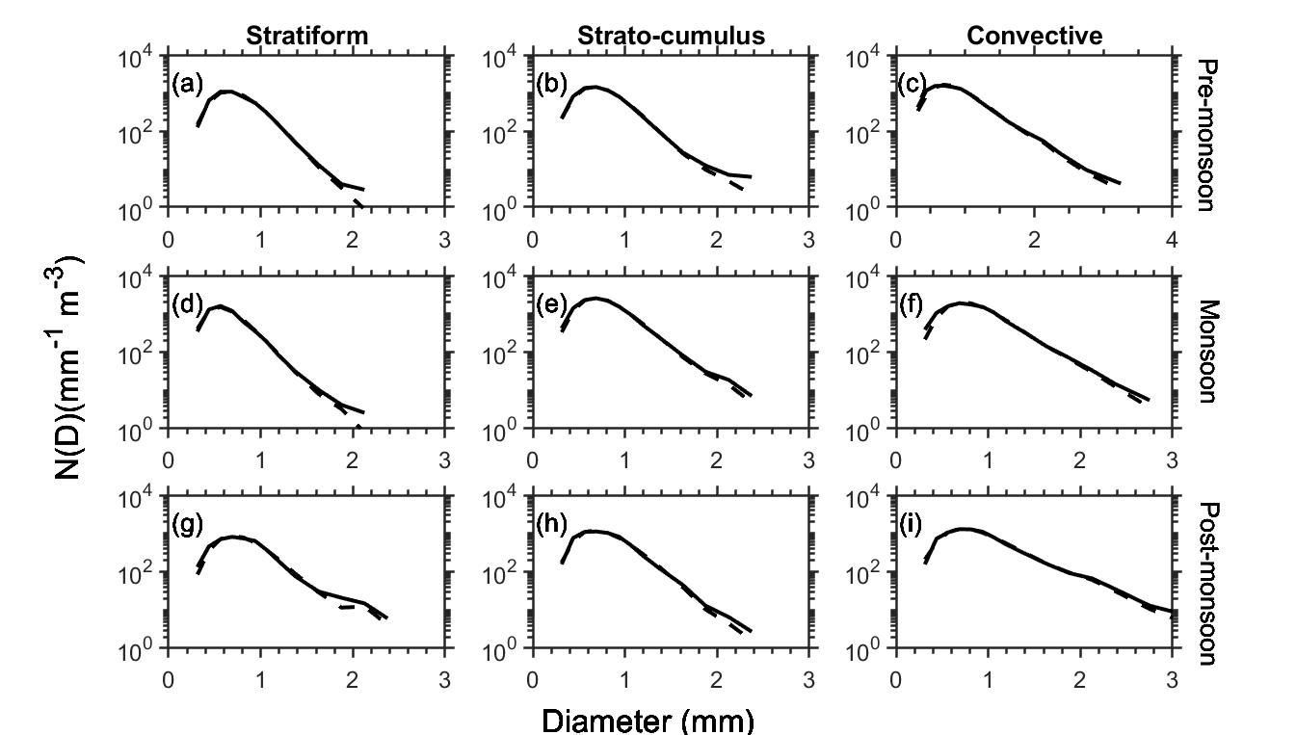
RESULTS AND DISCUSSION
(a) Total accumulated rainfall (mm), (b) The number of precipitating events, (c) Average rainfall (mm) observed in pre-monsoon ,monsoon and post monsoon over the location NCESS.
Time-height profile of radar reflectivity (dBZ), rain rate (mm/h), and fall velocity (m/s) in stratiform event (a-c), Stratocumulus (d-f), and convective event (g-e).
Total accumulated rainfall (mm) observed in pre-monsoon, monsoon, and post-monsoon
In all events, the number of concentrations of raindrop spectra is greater than 1 m⁻³ mm⁻¹ .
The maximum diameters of raindrops are approximately 3.25 mm for convective, 2.75 mm for stratocumulus, and 2.37 mm for stratiform systems. Greater drop diameter is observed for convective cases.
Raindrop size distributions (DSDs) and gamma distribution fitting curves for stratiform, stratocumulus and convective cases

Slide 6
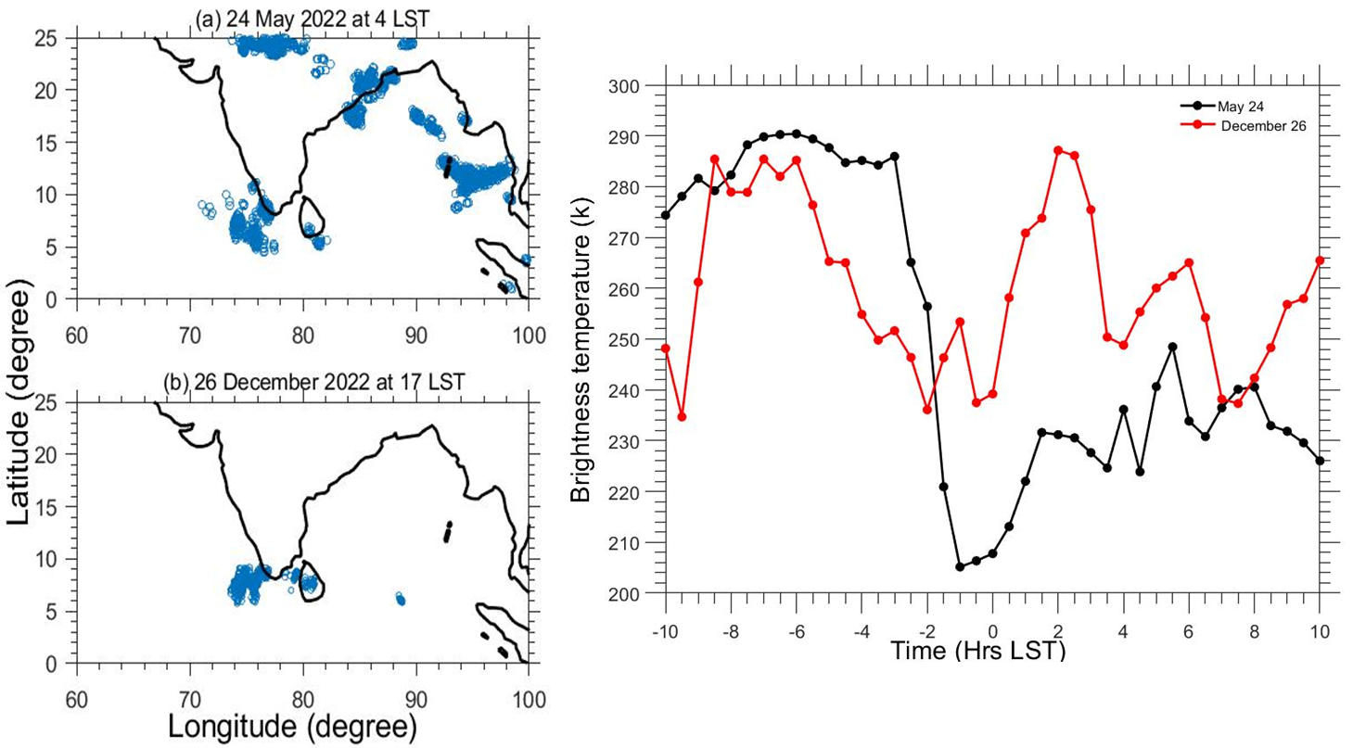
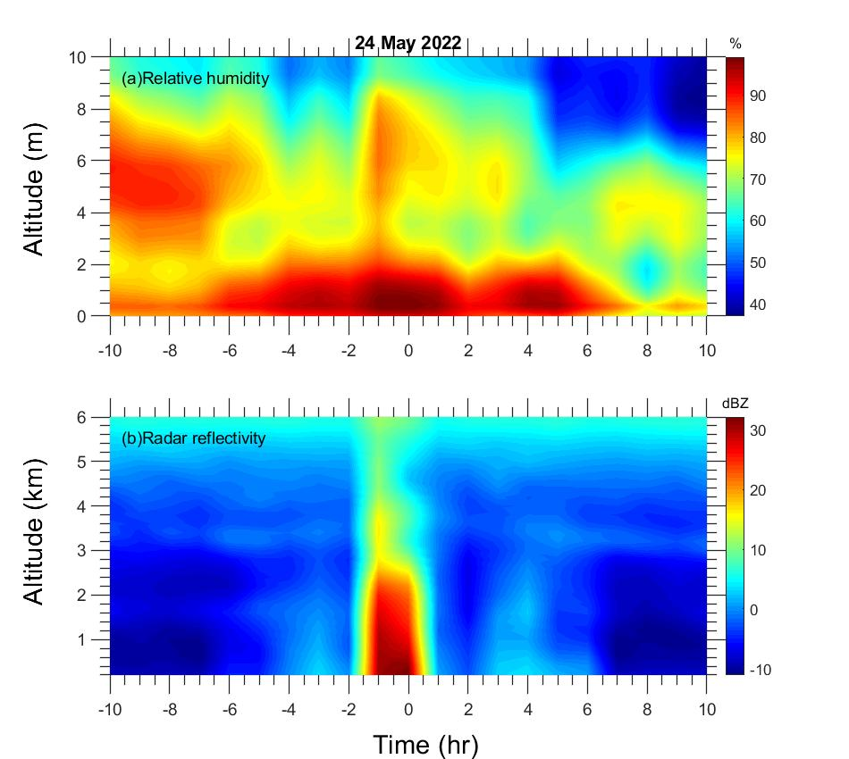
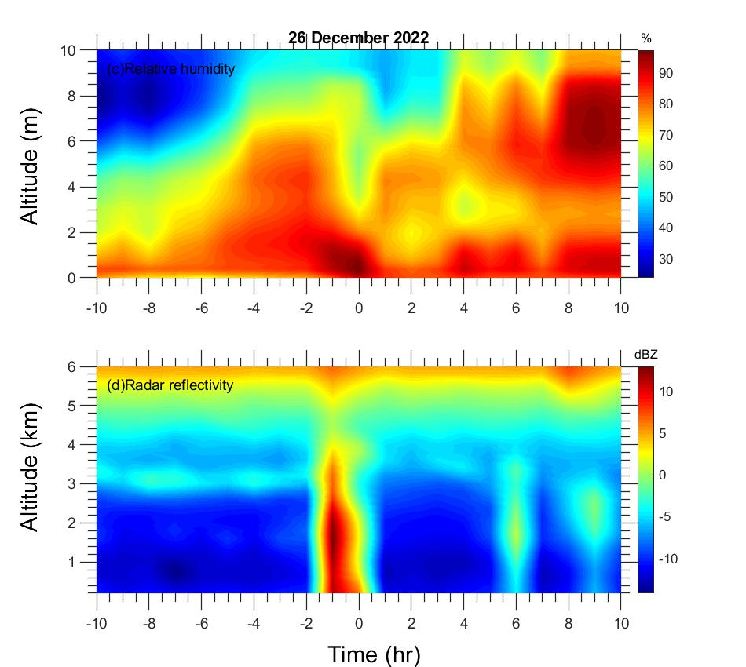
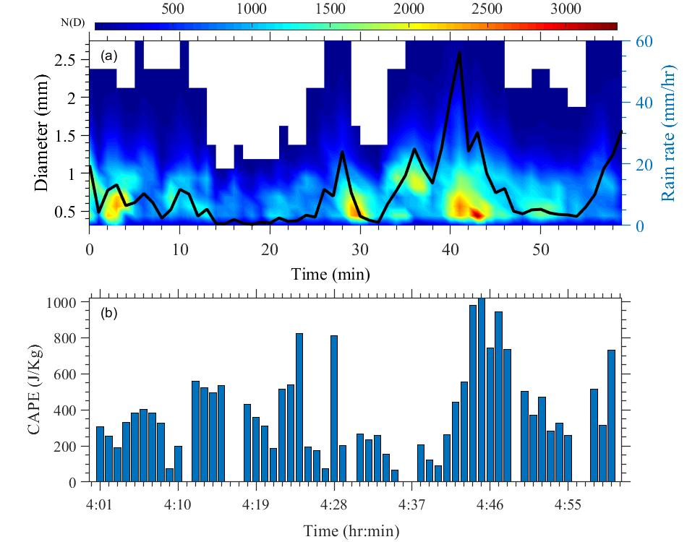
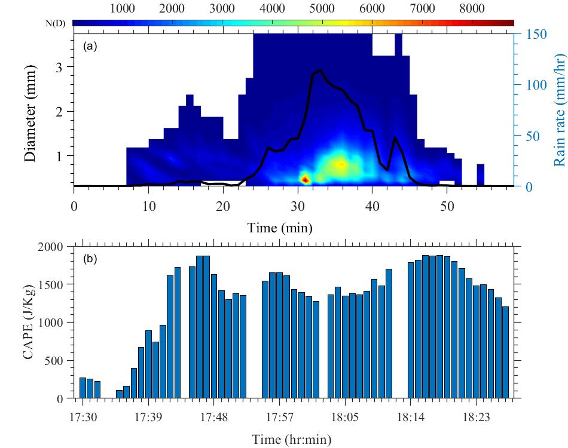
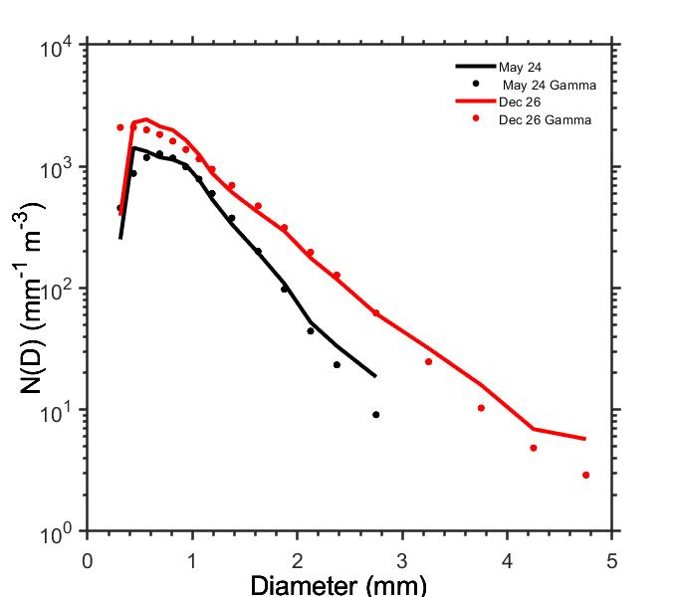
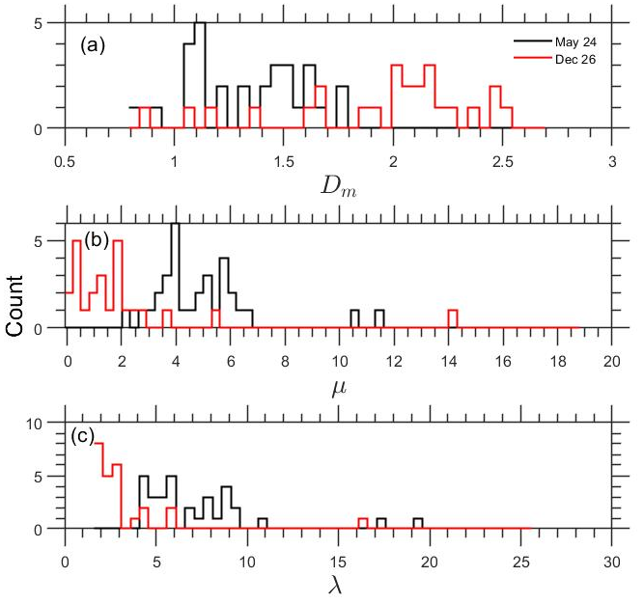
DEEP CONVECTIVE SYSTEMS-CASE STUDY
For both cases, relative humidity was greater than 90 % in the surface layer and the value of RH decreased with the vertical height during the hour of the event.
Cloud-to-ground (CG) lightning distribution and brightness temperature
Time-height profile of (a) Relative humidity using radiometer, and (b) Radar reflectivity using MRR on 24th May 2022 (left panel) and 26th December 2022 (right panel)over location NCESS
Variation of mean raindrop concentration (N(D), m⁻³ mm⁻¹) with drop diameter (D, mm) (left panel) Histograms of (a) mass-weighted mean diameter, Dm (mm), (b) shape (μ, unit less), (c) slope(Λ, mm−1),for 2 cases (May 24, Dec26) (right panel)
Time series of the drop size distribution (DSD) from the disdrometer data with their mass-weighted mean diameters (mm) given along the y-axis overlaid with rain rate (mm/hr), and (b) distribution of Convective available potential energy

Slide 7
SUMMARY AND CONCLUSION
By using the algorithm by Zeng et al., (2020), it is understood that across all seasons, convective events produced the most rainfall, whereas stratiform events produced the least amount. A higher number of precipitating events were observed in the monsoon season. It has been noted that significant bright band feature is shown by identified stratiform and stratocumulus events on representative cases (5 June 2019, 10 June 2019) in monsoon 2019.
It has been noted that the maximum diameters of raindrops are approximately 3.25 mm, 2.75 mm, and 2.37 mm for convective, stratocumulus, and stratiform events respectively. The methodology by (Zeng et al., 2020) is most suitable for identifying stratiform and stratocumulus events.
Modified algorithm suggests that throughout the study period, stratiform events occurred more frequently than convective and stratocumulus events.
Stratiform produced more rain in the monsoon season and least in pre-monsoon. This algorithm is more suitable for identifying the three types of rain observed in the study area across all three seasons.
For both deep cases, relative humidity was greater than 90 % in the surface layer and the value of RH decreased with the vertical height during the hour of the event. Similarly, the value of radar reflectivity was very high up to 4 km during the hour of the event in both cases.
Deep systems are observed with Low brightness temperature (210 K for case1 and 230 K for case2)value and high CAPE value (>1000 J/kg). A larger drop diameter is observed for the representative case of the deep system identified in 2022 post-monsoon. For the two representative cases, the λ exhibits positive values and the incidence of λ is greater below 10 mm⁻¹.

Slide 8
REFERENCES
Anagnostou, E.N., 2004. A convective/stratiform precipitation classification algorithm for volume scanning weather radar observations. Meteorological Applications, 11(4), pp.291-300.
Konwar, M., Das, S.K., Deshpande, S.M., Chakravarty, K., and Goswami, B.N. 2014. Microphysics of clouds and rain over the Western Ghat. J. Geophys. Res. Atmos. 119(10):6140-6159.
Lin, B., Xu, K.M., Minnis, P., Wielicki, B.A., Hu, Y., Chambers, L., Fan, T.F. and Sun, W., 2007. Coincident occurrences of tropical individual cirrus clouds and deep convective systems derived from TRMM observations. Geophysical research letters, 34(14).
Kurino, T., 1997. A satellite infrared technique for estimating “deep/shallow” precipitation. Advances in Space Research, 19(3), pp.511-514.
Adler, R.F. and Negri, A.J., 1988. A satellite infrared technique to estimate tropical convective and stratiform rainfall. Journal of Applied Meteorology and Climatology, 27(1), pp.30-51.
Testud, J., Oury, S. and Amayenc, P., 2000. The concept of “normalized” distribution to describe raindrop spectra: A tool for hydrometeor remote sensing. Physics and Chemistry of the Earth, Part B: Hydrology, Oceans and Atmosphere, 25(10-12), pp.897-902.
Zeng, Y., Yang, L., Zhang, Z., Tong, Z., Li, J., Liu, F., Zhang, J. and Jiang, Y., 2020. Characteristics of clouds and raindrop size distribution in Xinjiang, using cloud radar datasets and a disdrometer. Atmosphere, 11(12), p.1382.

Slide 9
Thank you

