Slide 1
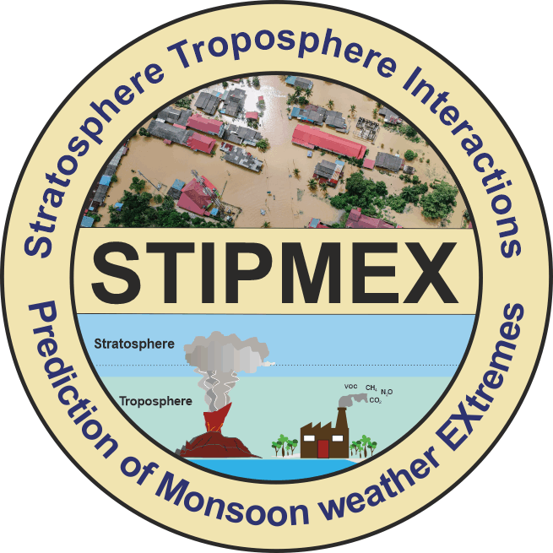
Exploring Atmospheric Gravity Waves Post-Explosive Volcanic Eruptions
Satyamesh H Tiwari^{1*} & Mala S Bagiya¹
¹Indian Institute of Geomagnetism (DST), Navi Mumbai
International Workshop on Stratosphere-Troposphere Interactions and Prediction of Monsoon weather Extremes (STIPMEX)
Indian Institute of Tropical Metrology, Pune
02-07 June 2024

Slide 2
Overview
Introduction
Motivation
Data
Observations
Result and Discussion
References

Slide 3
Introduction
Explosive volcanic eruptions erupt violently releasing gases and volcanic ash into the atmosphere
The sudden injection of a large amount of hot gas and volcanic ash during the eruption can displace the atmosphere on which gravity will act to restore the equilibrium resulting in the oscillations called gravity waves.
These gravity waves were also seen as concentric circles.
Schematic view of generation of atmospheric and ionospheric disturbances associated with a volcanic eruption.
(Image source: Atsuki Shinbori et al., 2023)

Slide 4
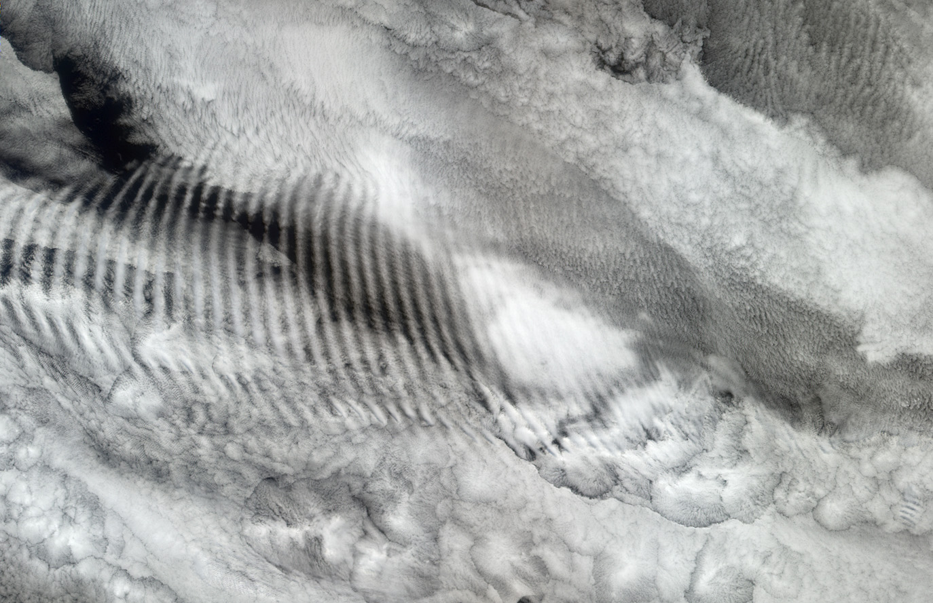
Motivation
Gravity waves are considered the principal form of energy exchange between the lower and upper atmosphere.
On breaking into the upper atmosphere, Gravity waves transfer their energy and momentum driving the mean atmospheric circulation and hence influencing tropospheric weather and climate patterns.
Despite the importance of gravity waves in upper atmospheric dynamics, very little is known about upper-level gravity wave characteristics which might be because of the lack of high-resolution observations.
This image of Gravity wave is centered over the Indian Ocean (at about 38.9° South, 80.6° East), and was acquired on October 29, 2003.
Image source: svs.gsfc.nasa.gov

Slide 5
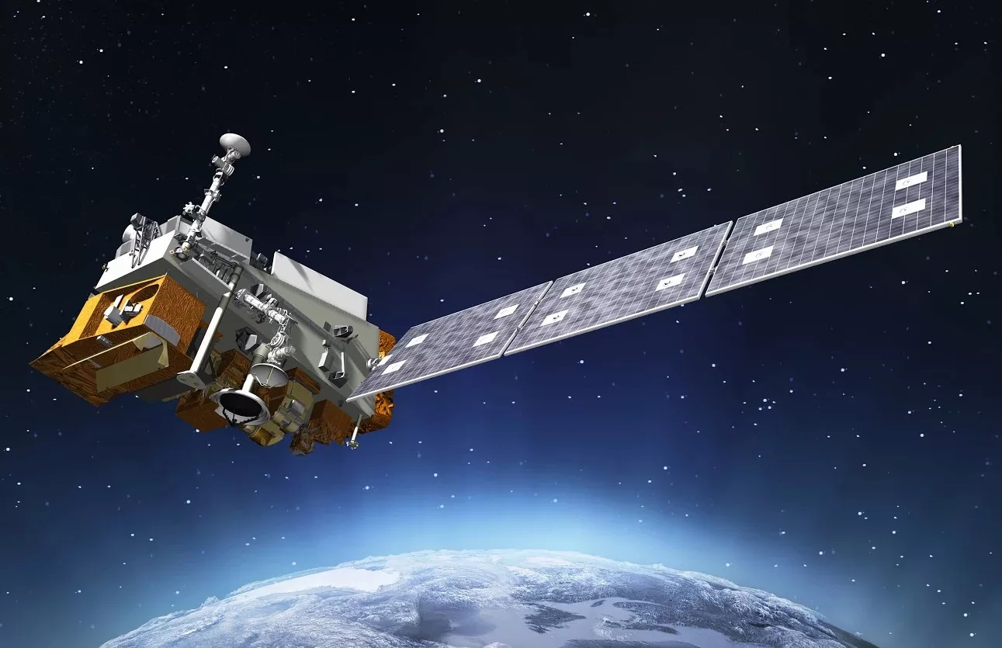
Data
Day Night Band (DNB) of Visible Infrared Imaging Radiometer Suite (VIIRS) instrument Onboard Suomi NPP satellite and NOAA-20 satellite
(Image Source: https://science.nasa.gov/mission/suomi-npp/)
Atmospheric Infrared Sounder (AIRS) Instrument Onboard NASA’s AQUA satellite. (Image Source: https://www.globe.gov/web/s-cool/home/satellite-comparison/aqua-satellite)

Slide 6
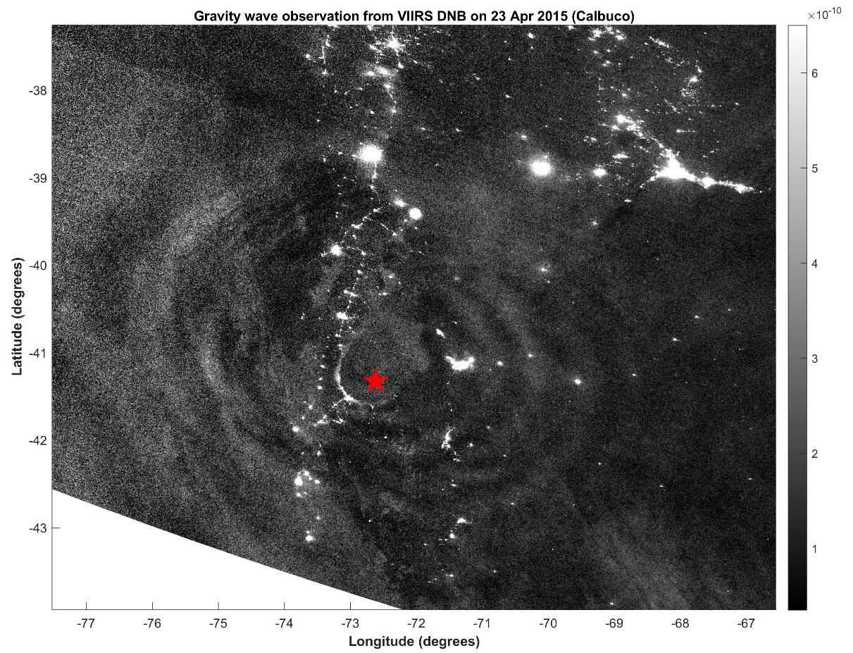
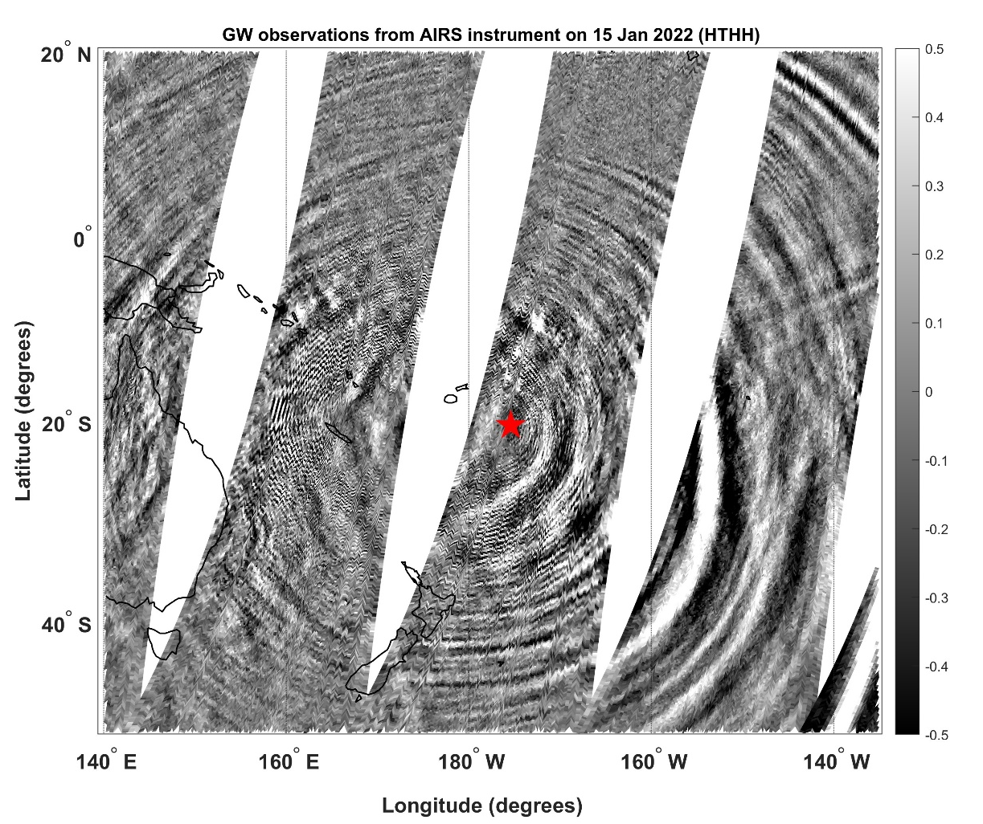
Observations
Gravity waves as observed from VIIRS DNB (0.7 micron wavelength) on 23 April 2015 after calbuco eruption
Gravity waves as observed from AIRS (in 4.3 micron wavelength) on 15 January 2022 after Hunga Tonga eruption

Slide 7
Result & Discussion
The AIRS instrument onboard the AQUA satellite has observed stratospheric Gravity waves after the 15 January 2022 Hunga Tonga volcanic eruptions.
DNB band in the VIIRS instrument onboard the Suomi NPP satellite has observed very clear Nightglow gravity waves after the 23 April 2015 Calbuco eruption during the Night-time.
Gravity wave observations from various satellite based instruments may provide newer insights into the altitudinal propagation of gravity waves in atmosphere and thus energy exchange between atmospheric layers during Plinian volcanic eruptions.

Slide 8
References
Tiwari, S.H., Bagiya, M.S., Maurya, S., Heki, K. & Dimri, A.P., 2024, On the role of volcanic plume heights in the excitation of free oscillations of the solid earth and the atmosphere: case study, Adv. Space Res., https://doi.org/10.1016/j.asr.2024.01.001
Miller SD, Straka WC III, Yue J, Smith SM, Alexander MJ, Hoffmann L, Setvak M, Partain PT (2015) Upper atmospheric gravity wave details revealed innightglow satellite imagery. Proc Natl Acad Sci USA 112(49):E6728-6735. https://doi.org/10.1073/pnas.1508084112
Baines, P.G.; Sacks, S. The Generation and Propagation of Atmospheric Internal Waves Caused by Volcanic Eruptions. Atmosphere 2017, 8, 60. https://doi.org/10.3390/atmos8030060
Yue, J., Miller, S. D., Straka III, W. C., Noh, Y.-J., Chou, M.-Y., Kahn, R., & Flower, V. (2022). La Soufriere volcanic eruptions launched gravity waves into space. Geophysical Research Letters, 49, e2022GL097952. https://doi.org/10.1029/2022GL097952
Shi, G. C., Hu, X., Yao, Z. G., Guo, W. J., Sun, M. C. and Gong, X. Y. (2021). Case study on stratospheric and mesospheric concentric gravity waves generated by deep convection. Earth Planet. Phys., 5(1), 79–89. doi: 10.26464/epp2021002
Fritts, D. C., and M. J. Alexander (2003), Gravity wave dynamics and effects in the middle atmosphere, Rev. Geophys., 41, 1003, doi:10.1029/2001RG000106, 1.

Slide 9
Thank you

