Slide 1
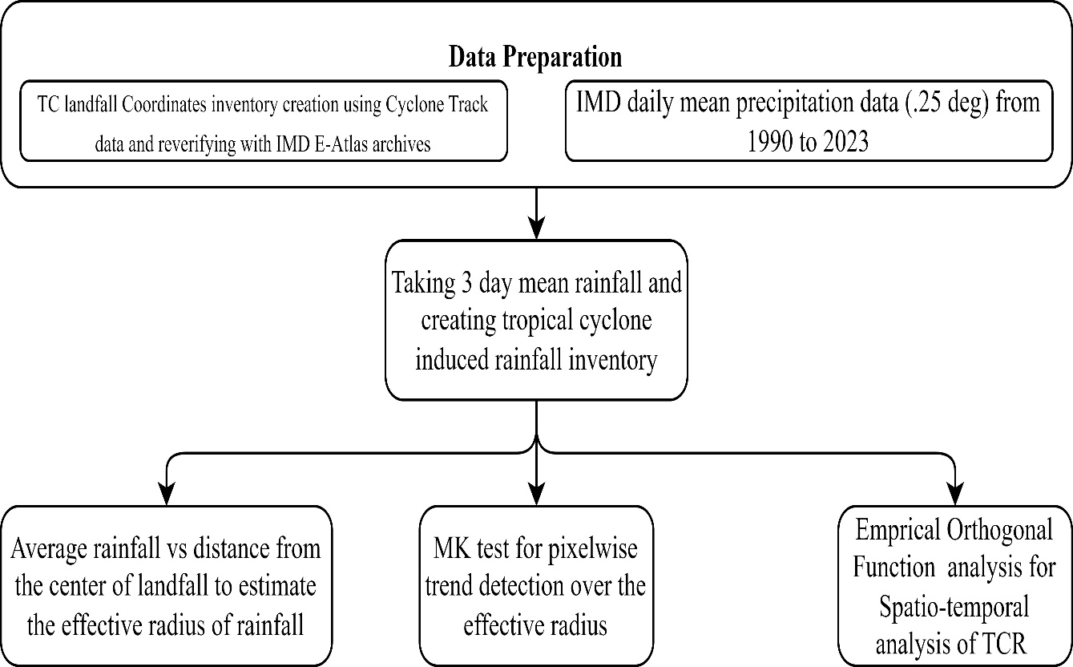
Introduction This study investigates the spatiotemporal variability of rainfall induced by tropical cyclones (TCR) and non-tropical cyclones (NTCR) across India, utilizing long-term precipitation datasets. By employing the Mann-Kendall test and the Empirical Orthogonal Function method, the research seeks to comprehend the changing rainfall patterns over time and space.
Spatiotemporal Variations of Tropical Cyclone and Non Tropical Cyclone Induced Rainfall across India.
To determine the effective radius of influence for TCR events
To Understand the Spatiotemporal variability of Tropical Cyclone induced Rainfall (TCR) events using MK test and EOF analysis.
Objectives
Making inventory of TCR and NTCR events for 1990-2023
Methodology

Slide 2
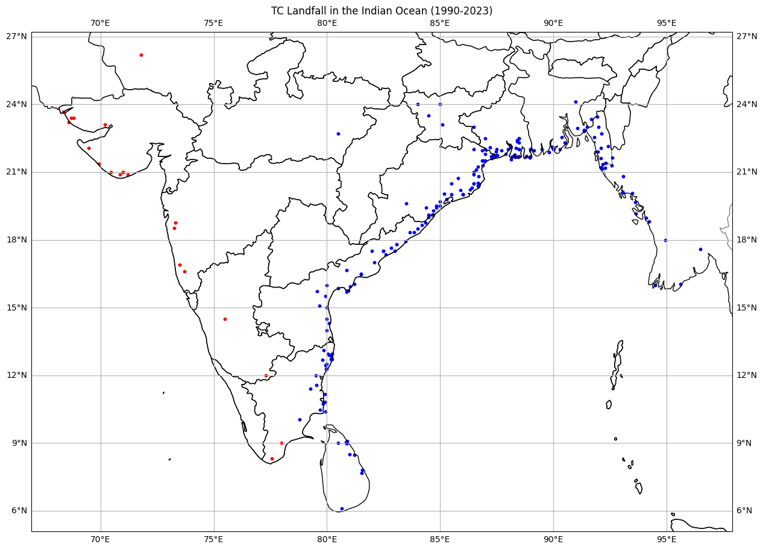
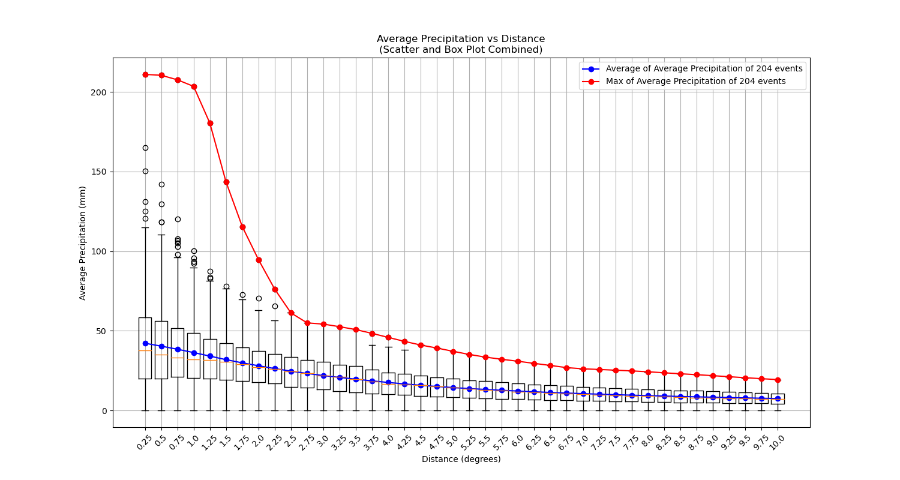
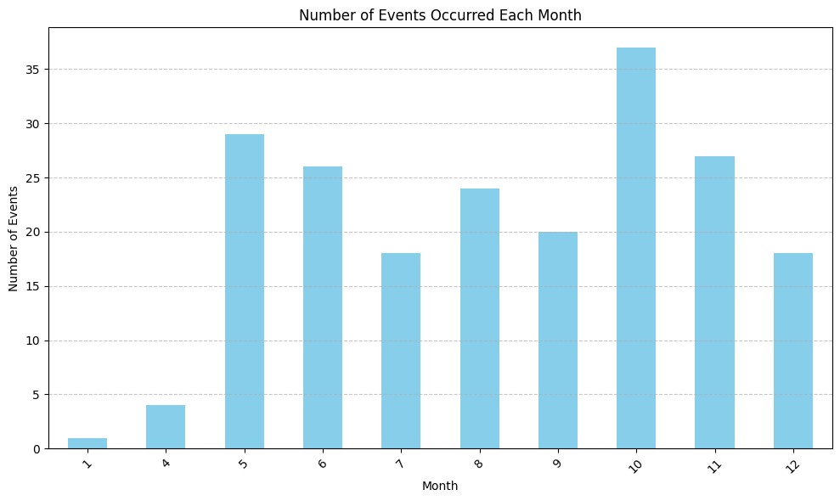
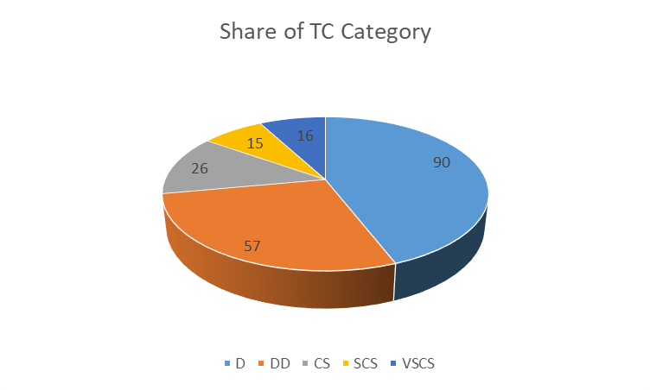
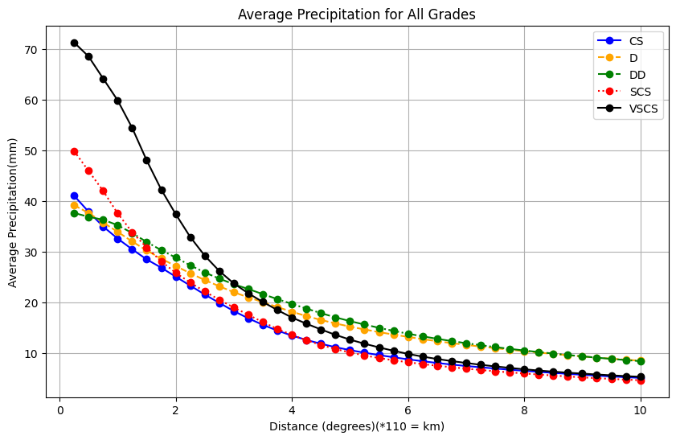
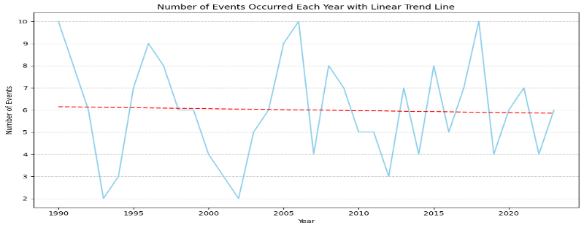
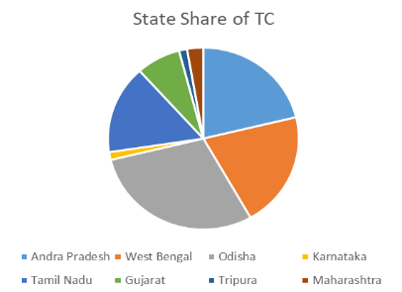
Results (Spatial Variation of Rainfall from landfall)
BoB
AS

Slide 3
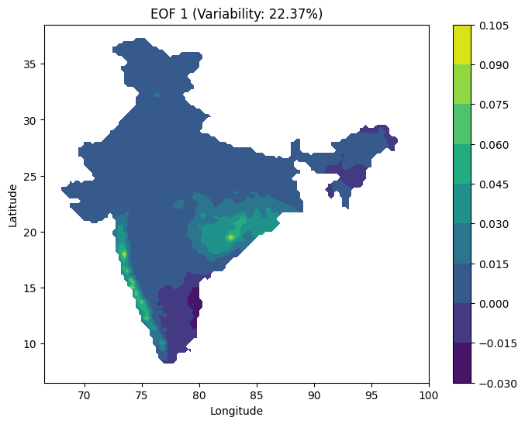
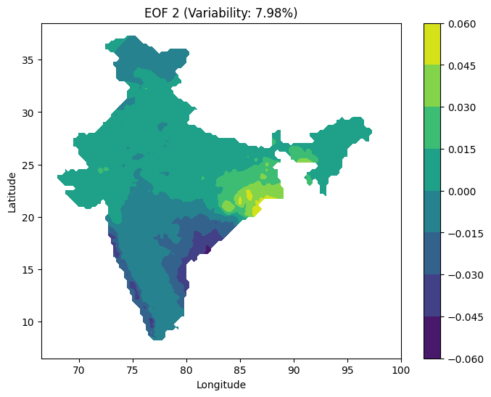
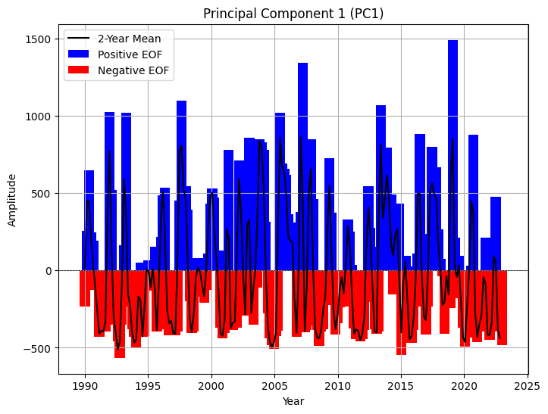
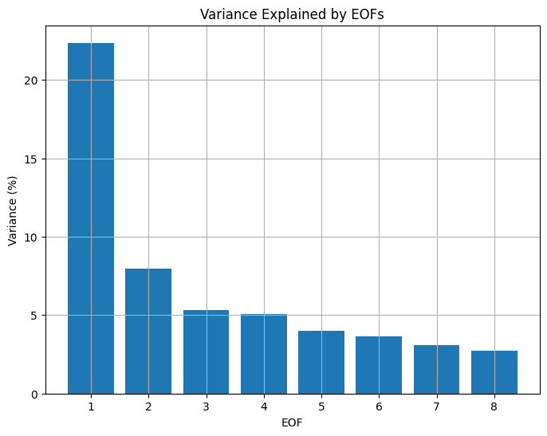
Results (Mann-Kendall Test& Empirical Orthogonal Function Analysis)
EOF Analysis
MK Test

Slide 4
Conclusion
Clarified and characterized the TC induced rainfall changes in India across.
Trend analysis for TCR.
Spatiotemporal analysis of TCR using EOF.
Quantified the contribution of NTCR over annual average.
Created a repository of 3 days mean rainfall for all types of TC events affecting India.
Created the NTCR data repository for India (1990-2023)(.25*.25)

