Slide 1
A study on the thermodynamical features of precipitating systems during southwest monsoon over coastal station
Anusha Andrews^{1,2}, Resmi E A^{1*}, Sumesh R K¹, Nita Sukumar¹, Sumit Kumar^{1,2}, Dharmadas Jash^{1,2}
¹ National Centre for Earth Science Studies (NCESS), Akkulam, Thiruvananthapuram - 695011, Kerala, India.
² Department of Atmospheric Sciences, Cochin University of Science and Technology, Kochi - 682016, India
E-Mail: anusha.andrews@gmail.com

Slide 2
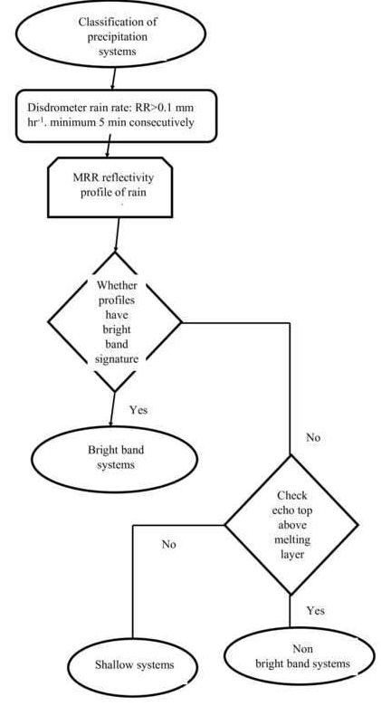
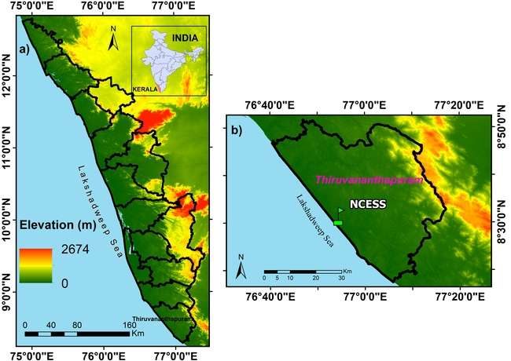
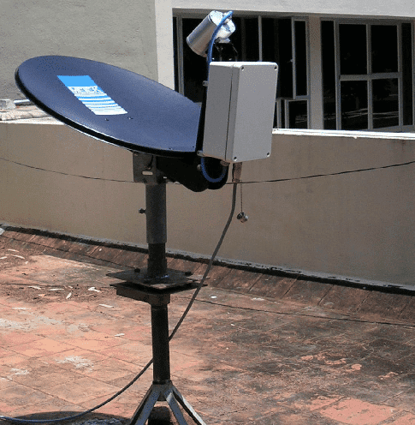
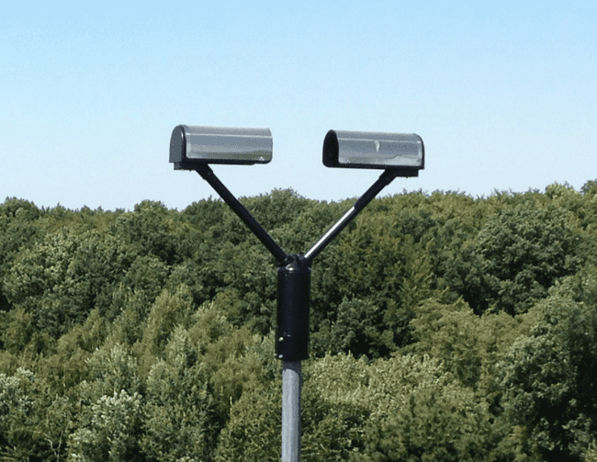
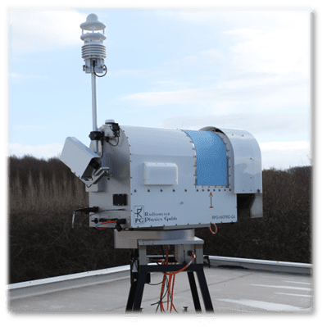
Objective of the study
Data & Methodology
Study period : June and July 2022
A deeper understanding of the thermodynamic conditions for the formation of precipitation that can be obtained by analyzing the evolution of total accumulated water vapor, cloud liquid water, and relative humidity in each layer of the atmosphere.
Instrument | Data
Microwave radiometer | Vertical profile of temperature (k), relative humidity (%), liquid water path (gm⁻²)
Micro rain radar | Rain rate (mm hr⁻¹), liquid water content (gm⁻³), fall velocity of rain drop (ms⁻¹) and rain drop size (mm)
Disdrometer | Rain drop size (mm) and rain drop fall velocity (ms⁻¹)
Study area
Micro rain radar
Disdrometer
The elevation map of Kerala (left) and the observational sites (right) NCESS (8.31° N, 76.54° E, 20m ASL)
Collocated measurements from micro rain radar (MRR) and optical disdrometer data are used to classified precipitating systems into shallow, bright band (BB) and non-bright band (NBB) precipitating system
Flow chart depicting the methodology for classification of precipitating systems using collocated in-situ observations.
Radiometer

Slide 3
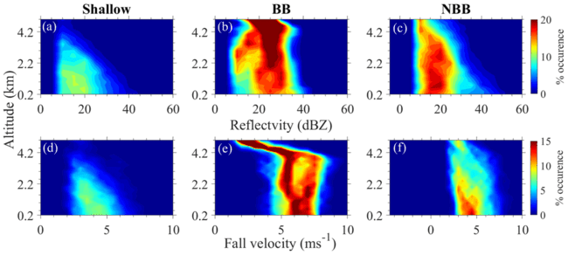
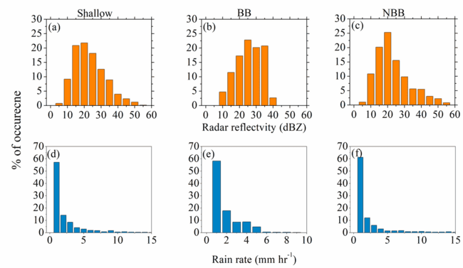
Vertical structure of Precipitating systems
a) contribution to accumulated rainfall and occurrence of shallow, BB and NBB from June to July 2022. b) Average rain rate and radar reflectivity of shallow, BB and NBB during June to July 2022.
Contoured frequency by altitude diagrams (%) of radar reflectivity (dBZ) (upper panel) and fall velocity (ms⁻¹) (lower panel) for shallow, bright band and non bright band systems occurred on 1st June to 27th July 2022 over tropical coastal region
CFAD of Radar reflectivity and fall velocity of shallow events is extended below melting layer, indicating warm rain processes are responsible for shallow precipitation.
BB events, CFAD of radar reflectivity stays nearly constant with decreasing height from below melting layer , suggesting that the raindrop evaporation and coalescence are in near balance in BB systems (Penide et al., 2013).
The frequency distribution of (a-c) radar reflectivity (dBZ), (d-i) rain rate (mm hr⁻¹) of shallow, bright band and non bright band observed during June to July 2022.

Slide 4
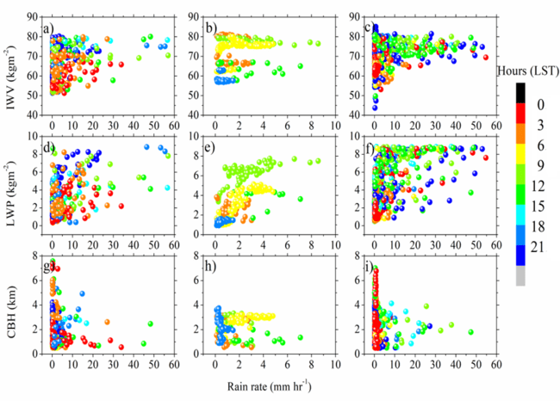
Thermodynamic conditions on formation of isolated precipitating system
Box-whisker plot for (a-c) cloud base height (km),(d-e) brightness temperature (k), (g-i) Integrated water vapour (IWV (kgm⁻²)), (j-l) liquid water path (gm-2) for shallow, BB and NBB during southwest monsoon of 2022 at tropical region.
(a-c) Time-height cross section of radar reflectivity factor (dBZ) by MRR observation overlaid with surface rain rate (mm hr⁻¹) , (d-f) Relative humidity (%) and (g-i) liquid water content by microwave radiometer observation of shallow , bright band and non bright band system observed on 10th June, 16th June and 5th July 2022 respectively
The deep and high-humidity (> 80 % ) area between of 4-8 km altitude and large value of liquid water path (LWP) and Integrated water vapor (IWV) is conducive to maintaining the precipitation process for a long time in BB systems compared to the shallow and NBB systems.
Scatter plot of surface rain rate (mm hr⁻¹; OTT) versus Integrated water vapour (IWV (kgm⁻²)) (a-c), liquid water path (gm⁻²) (d-f) and cloud base height (km) (g-i) for the shallow, BB and NBB events overlaid with the time of occurrences (LST) during southwest monsoon 2022 over tropical region
Integrated water vapor and liquid water path present in the atmosphere is less during shallow precipitating systems compared to BB and NBB systems.

Slide 5
Summary
Shallow precipitating systems are identified throughout the season. The accumulated rainfall contributed by the BB is much greater than that of other precipitating systems
Shallow systems are mostly associated with low level clouds, cloud base height varies from 0-2 km. BB and NBB systems associated with middle level clouds, cloud base height varies from 2-4 km.
The average IWV for before (during) shallow, BB and NBB is around 50 kgm⁻² (60 kgm⁻²), 80 kgm⁻² (85 kgm⁻²) and 55 kgm⁻² (80 kgm⁻²) .
The deep and high-humidity (> 80 % ) area between of 4-8 km and large value of LWP and IWV is conducive to maintaining the precipitation process for a long time in BB systems compared to the shallow and NBB systems.

Slide 6
Thank you

