Slide 1
SEASONAL CHARACTERISTICS OF CONVECTIVE PARAMETERS OVER INDIAN LATITUDES
Athira Sasikumar
PG Department of Physics and Research Centre,
MG College, University of Kerala,
Thiruvananthapuram.

Slide 2
INTRODUCTION
The weather in India is changing substantially every year .
Extraordinary and abnormal scorching temperatures are projected, as is a drop in monsoon rainfall since the 1950s, resulting in more frequent droughts and flooding in broad regions of India.
Operational forecasters, emergency managers, and risk assessors all benefit from a greater awareness of local climatology and the surrounding ecosystems.
Using several tropical stations and reanalysis data, earlier research revealed that convective accessible potential energy grew rapidly with a growth rate of ∼20% per decade during the period 1958-1997.

Slide 3
CONVECTIVE AVAILABLE POTENTIAL ENERGY(CAPE)
CAPE can be estimated by vertically integrating the parcel buoyancy between the level of free convection (LFC) and level of neutral buoyancy.
It measures the maximum kinetic energy per unit air mass achievable by the convection of moist air from the sub cloud layer, assuming undiluted ascent, and gives an upper limit to the cumulus updraft vertical velocity.
LEVEL OF FREE CONVECTION(LFC)
The equivalent potential temperature is the temperature that a moist air parcel would have if all water vapour in it were condensed out at constant pressure and adiabatically,
Equivalent potential temperature, is a quantity that is conserved during changes to an air parcel's pressure.

Slide 4
TEMPERATURE OF LIFTED CONDENSATION LEVEL
The lifted condensation level is the level to which unsaturated moist air would have to be raised under dry adiabatic expansion in order to produce saturation.
If the air parcel is lifting further beyond the LCL, water vapor in the air parcel will begin condensing, forming cloud droplets.
EQUIVALENT TEMPERATURE
The equivalent potential temperature is the temperature that a moist air parcel would have if all water vapour in it were condensed out at constant pressure and adiabatically,
Equivalent potential temperature, is a quantity that is conserved during changes to an air parcel's pressure.

Slide 5
DATA FOR THE PRESENT STUDY
Wyoming University Archive- Radiosonde Data (00UTC/12UTC)
From January 1, 2022 To December 31, 2022.
IMD Annual Report - Rainfall data
Over Indian Region - Chennai, Nagpur, New Delhi And Kolkata.

Slide 6
RESULTS
CAPE displays an increase for all stations from April to September.
For all 4 stations, LFC does not exhibit much variation month over month.

Slide 7
From February to October, the temperature of LCL reaches high values.
From April until September, the Equivalent Temperature reaches its highest values.

Slide 8
CAPE attains its highest value in the monsoons and it lowers in the winter season for all four stations irrespective of their location.
Variations in CAPE play a crucial role in influencing the intensity and likelihood of convective storms in the atmosphere.
LFC shoots to maximum value in post-monsoon in Chennai, Nagpur and becomes highest in monsoon in the New Delhi and Kolkata stations.
LFC is found to be lower in the pre-monsoons. A lower LFC generally indicates a greater potential for convective storm development.

Slide 9
Temperature of LCL is found to be highest in the pre -monsoon of Chennai region, and keeps its high scores during monsoon in the remaining stations .
It decreases in winter for all three stations except Chennai and lower values are observed for Chennai during post- monsoon.
Equivalent temperature is maximum in monsoon for all the four stations and it becomes minimum in winter.

Slide 10
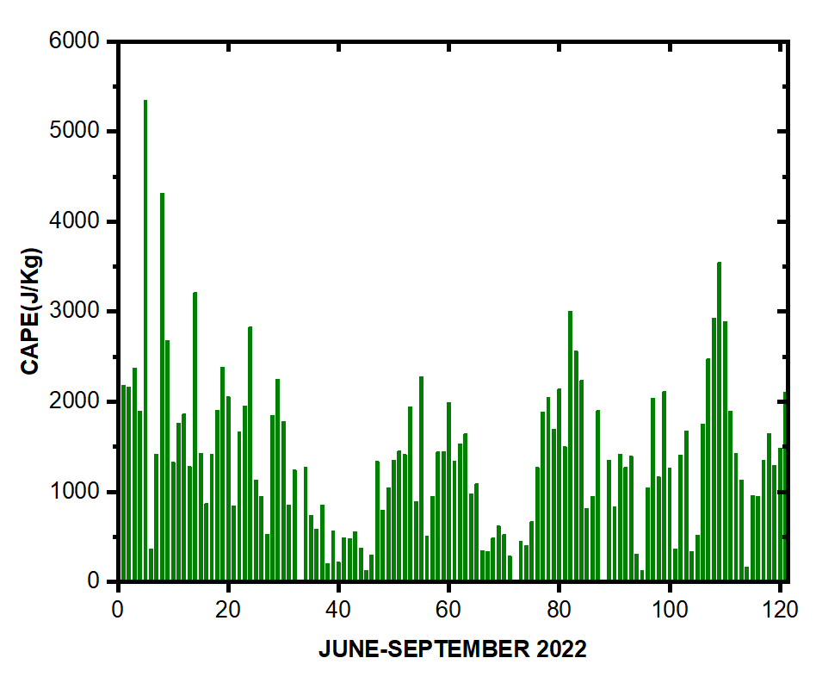
From June to September of 2022, the Chennai region's CAPE displays a positive link with precipitation.

Slide 11
CONCLUSION
The analysis shows that while CAPE is rising during a monsoon, a similar drop in LFC acts as a counterbalance.
Convection by its own nature creates an environment in which CAPE can increase to extremely high levels, perhaps leading to more frequent and severe convection.
The study's findings indicate that increased CAPE is a reason to expect convection.
The post monsoon high values of LFC in Chennai and Nagpur are bolstered by a decrease in LCL temperature.
All four sites experience high equivalent temperature in monsoon and low equivalent temperature throughout the winter.
CAPE has a favorable association with precipitation in the Chennai region from June to September of 2022.

Slide 12
REFERENCES
A. Narendra Babu, J. B. Nee, Kumar, Seasonal and diurnal variation of convective available potential energy (CAPE) using COSMIC/FORMOSAT-3 observations over the tropics, Journal of Geophys.Research, 17 February 2010.,https://doi.org/10.1029/2009JD012535.
Abhay Srivastava, Manoj Kumar, and Arun K. Dwivedi., Studies of Atmospheric Parameters during SW Monsoon Period Associated with Severe Cyclone Aila and Lightning Occurrence over Ranchi Region, International Scholarly Research Notices,2012, Volume 2012 ,Article ID 975790 ,https://doi.org/10.5402/2012/975790.
Rohit Chakraborty, Madineni Venkat Ratnam, and Shaik Ghouse Basha. . Long-term trends of instability and associated parameters over the Indian region obtained using a radiosonde network, European geosciences union, Atmospheric, Volume 19, issue 6,ACP, 19, 3687–3705, 2019.
Nabeel Ahmad ª, Samia FaizGurmani ª, Abdul Basit ^{b}, Muhammad Ali Shah ª, Talat Iqbal , Impact of local and global factors and meteorological parameters in temporal variation of atmospheric potential gradient, Research Gate, February 2021,Advances in Space Research 67(2),DOI:10.1016/j.asr.2021.01.046.
IMD Data, Annual Report 2022
Wyoming University Data Archive-2022

