Slide 1
Detection of multiple tropopause and stratospheric intrusions using VHF radar over the central Himalayan site
Aditya Jaiswal^{*1}, Subrata K. Das¹, Manish Naja²
¹ Indian Institute of Tropical Meteorology, Pune, India
² Aryabhatta Research Institute of Observational Sciences, Nainital India
International Workshop on
Stratosphere Troposphere Interaction and Prediction of Monsoon weather Extremes (STIPMEX)
2 – 7 June, 2024

Slide 2
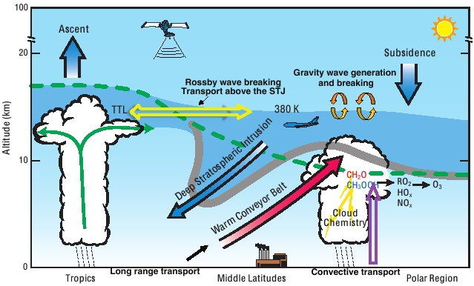
Motivation
Downward transport of ozone through stratospheric intrusions is significant for the pristine atmosphere of the Himalayan regions.
Multiple tropopauses are known to occur frequently at the edge of subtropical jet streams, which controls the excursions of stratospheric airmass into the troposphere.
Vertically propagating VHF radiowaves are strongly scattered by the stable thermal inversion around tropopause, causing sharp gradients in the refractivity structure constants. This property can be utilised to monitor the tropopause structure continuously.

Slide 3
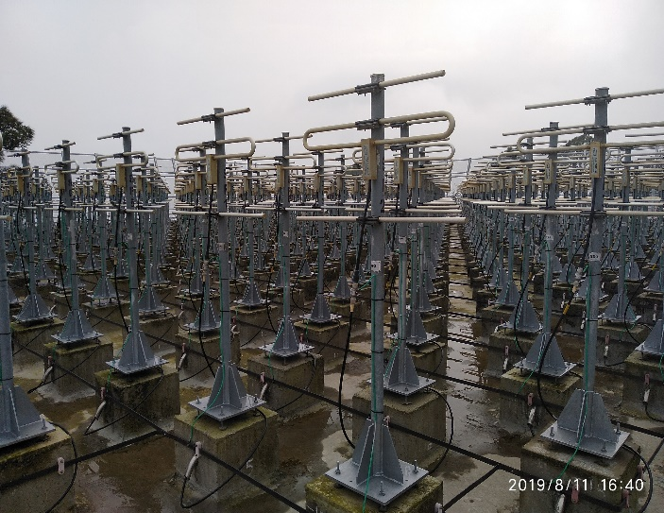
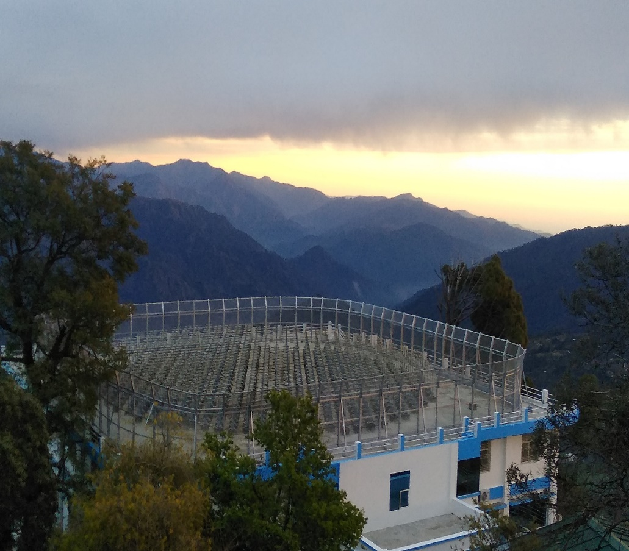
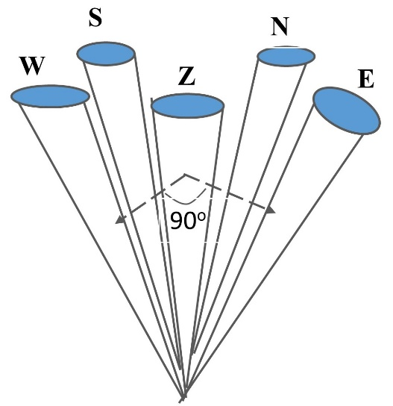
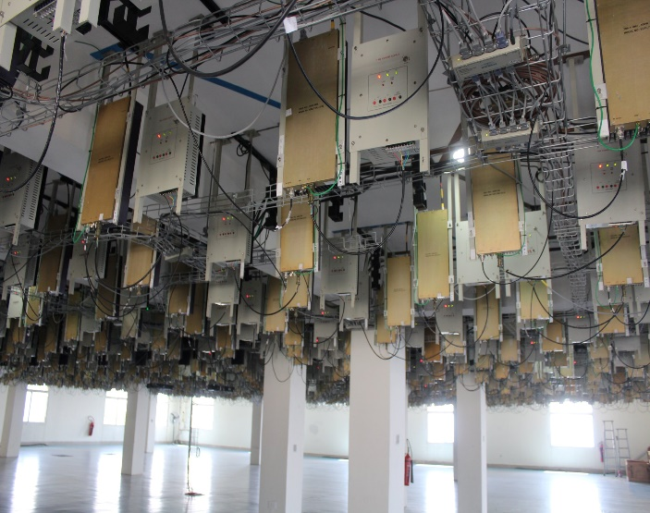
Description of experiment and dataset
ARIES Stratosphere Troposphere (ST) Radar
ARIES, Manora Peak
Location : 29.4ºN, 79.5ºE
588 Yagi elements
Operating Frequency | 206.5 MHz
Power Aperture Product | 1 x ${10}^{8} Wm^{2}$
Peak Transmitting Power | 235.2 kW
Half Power Beam Width | 3.3º
Scan Angle (Azimuth) | 0º – 360º
Scan Angle (Off-Zenith) | 0º – 30º
Vertical Resolution | 37.5 m, 75m, 150m
Height Coverage | 0.5 km – 20 km (Nominal)
Mode of Operation | DBS
ARIES ST Radar
Altitude : 1793 m (amsl)
588 Tx /Rx Modules
Active Aperture Phased Array

Slide 4
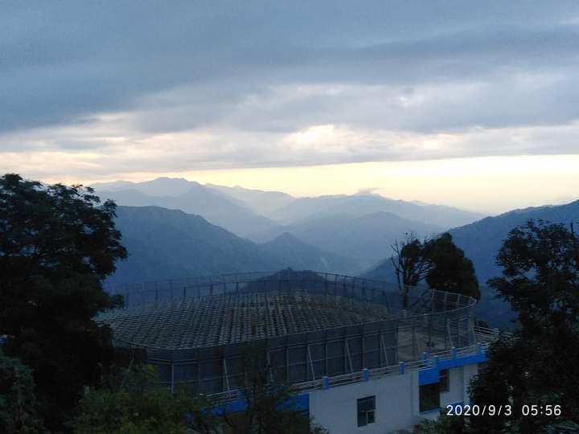
Stratosphere Troposphere Radar Over Himalayan Region
Wind profiler providing Zonal, Meridional and Vertical components of winds continuously covering up to the lower stratosphere
Operating Frequency | 206.5 MHz
Power Aperture Product | 1x10⁸ W m²
Area of Antenna Array | 491 m² (Aperture Diameter 25m)
Half Power Beam Width | 3.3º
Receiver Bandwidth | 5 MHz
Peak Power | 235 kW
Scan Angle (Azimuth) | 0 to 360⁰ (selectable)
Scan Angle(Elevation) | 0 to 30⁰ (off-Zenith) (selectable)
Range Resolution Pulse Width | 37.5m /75 m/ 150 m 0.5 – 64μs (selectable)
Height Range Temporal Resolution | 0.3 km – 20 km (Typical) ~ 1 minute
Location: 29.4 ºN, 79.5ºE (ARIES Nainital)
Altitude: 1793m amsl

Slide 5
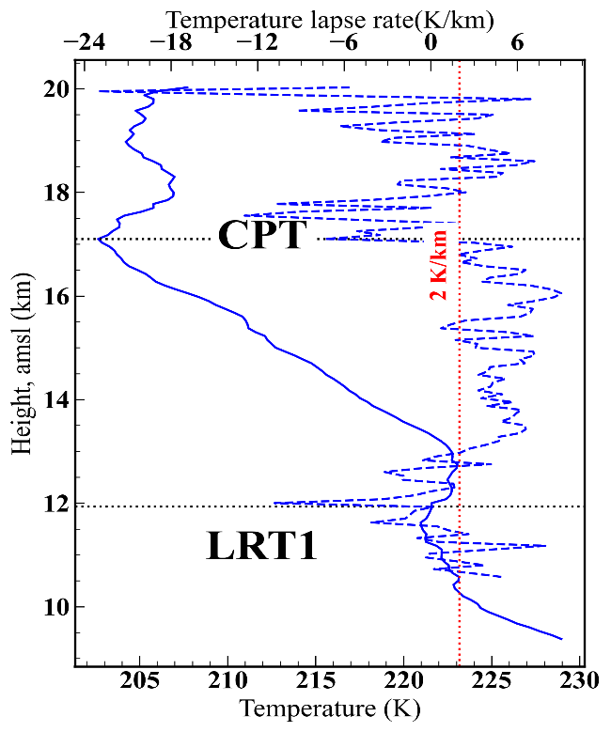
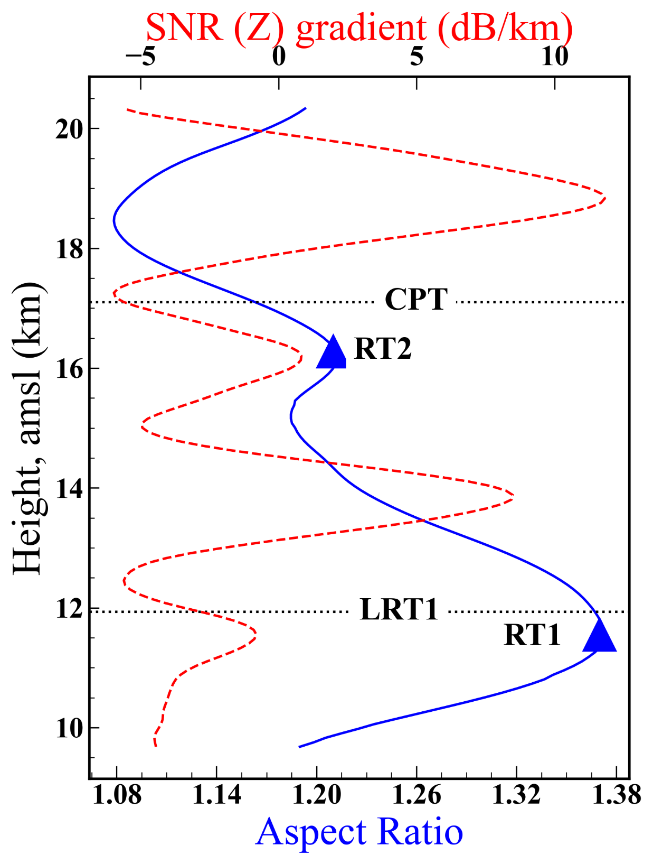
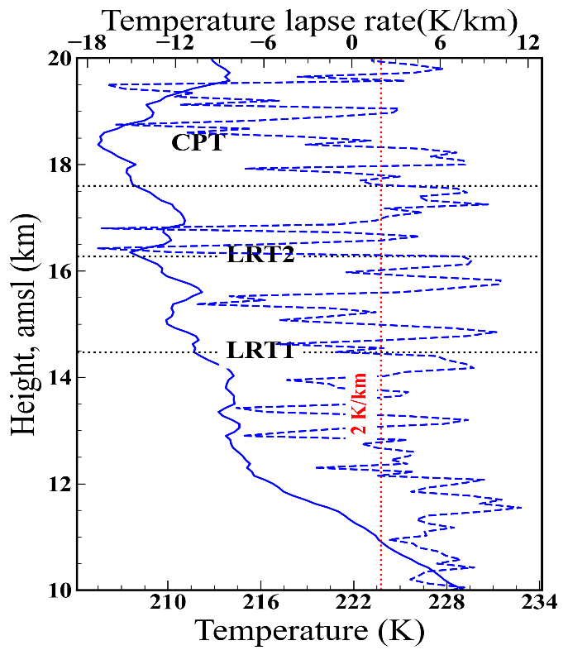
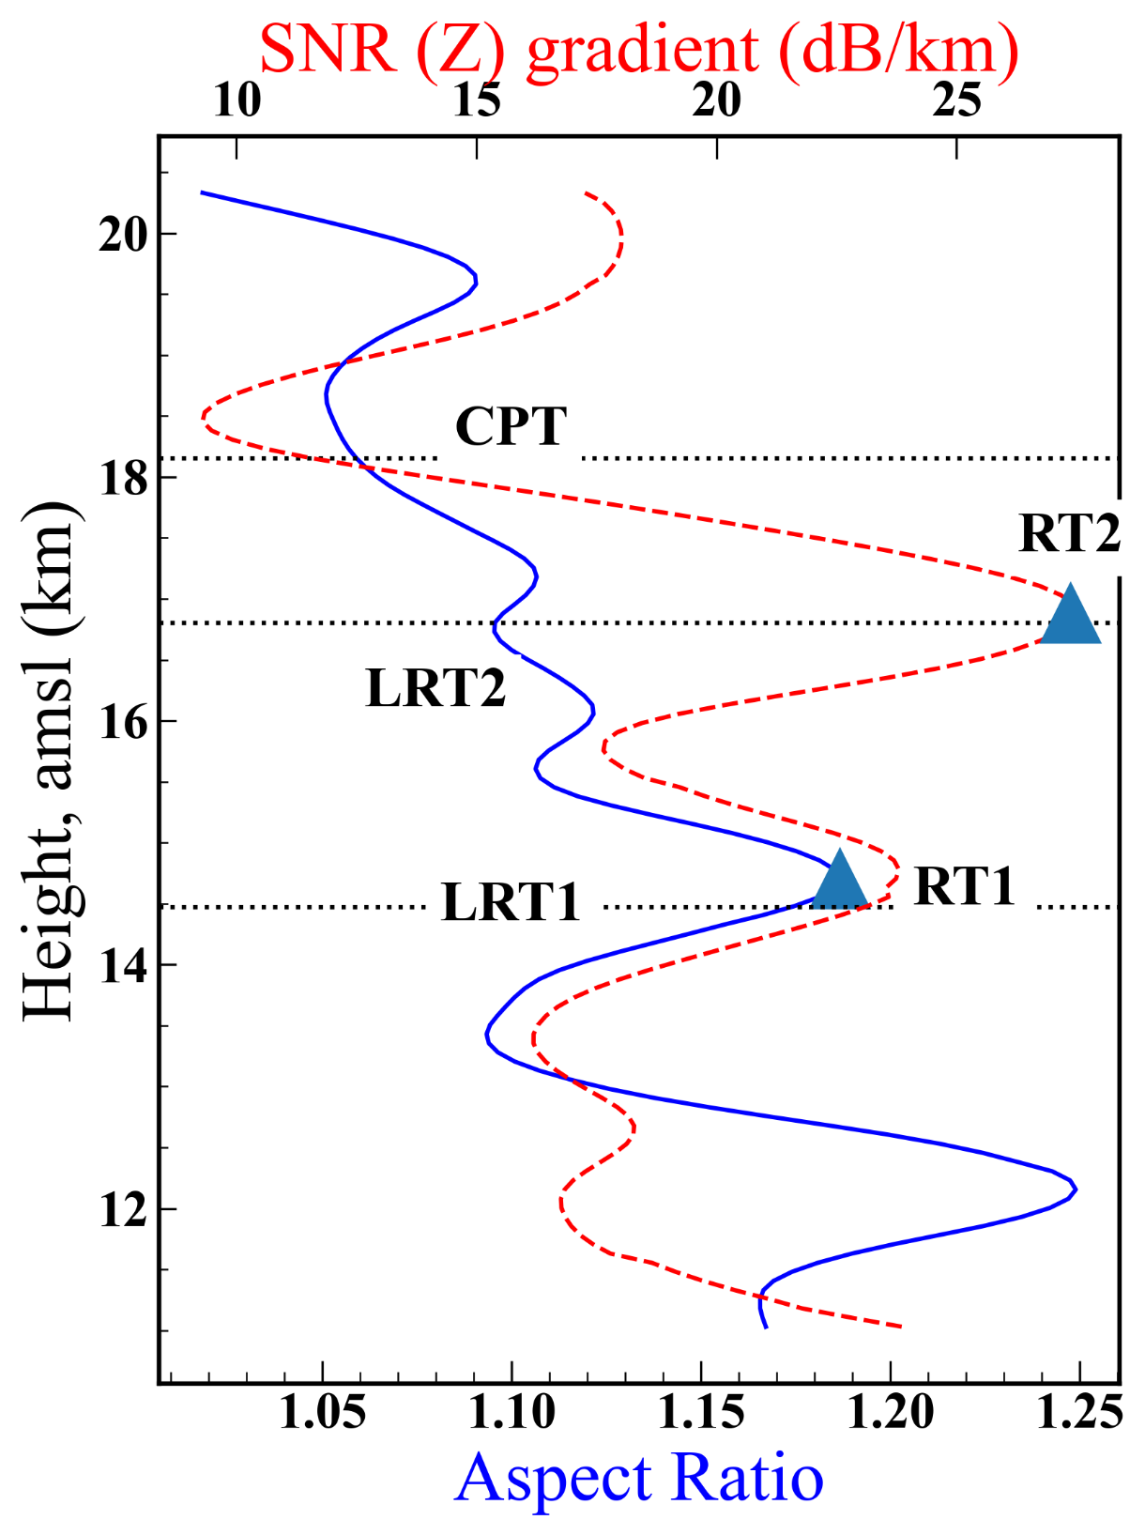
Procedure for the identification of the multiple tropopause using Radar
Take the ratio of range squared SNR of mean of the range squared SNR of the oblique beams (N,S, E, W) to estimate the aspect ratio. At the thermal inversion, vertical beam is strongly scattered as compared to oblique beams indicating the presence of cut off low or radar tropopause.
The maxima in the aspect ratio profile (obtained after smoothening using locally weighted least square regression method ) in the height region of 11 – 19 km were observed to be closely associated with Lapse Rate Tropopause. Although, not always it coincides with the gradient maxima of the range square SNR of Zenith beam.
17 February 2021
21 April 2021

Slide 6
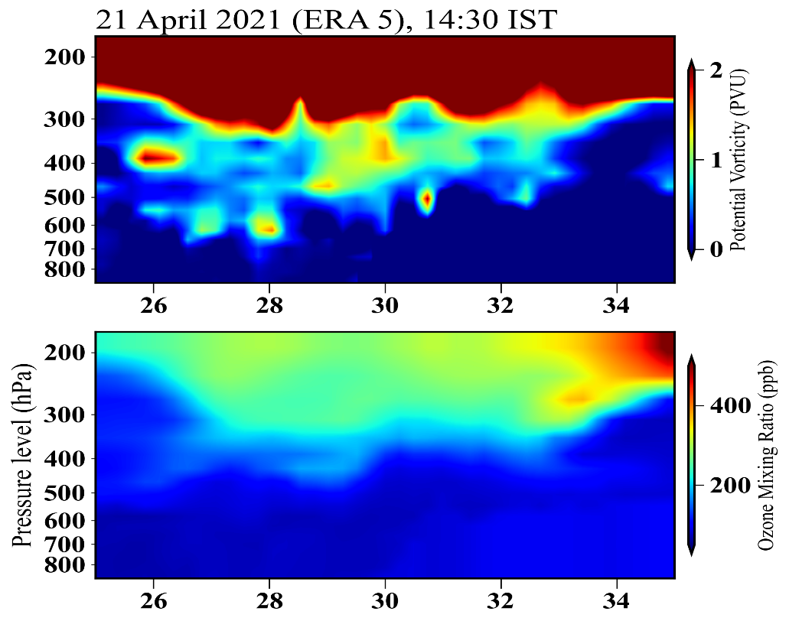
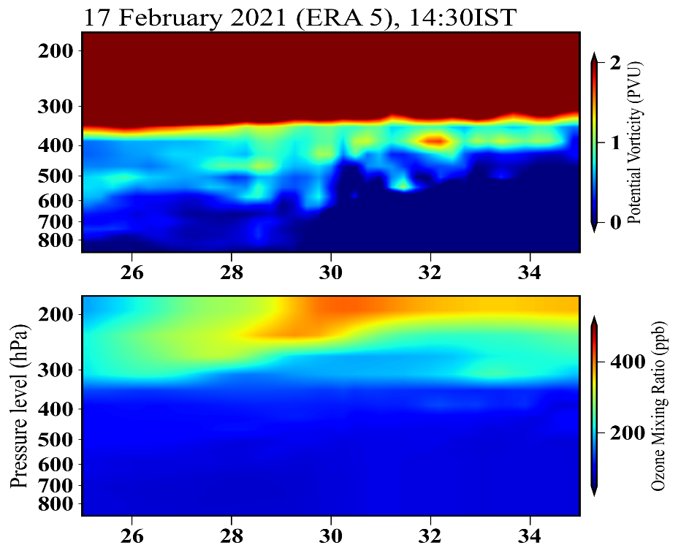
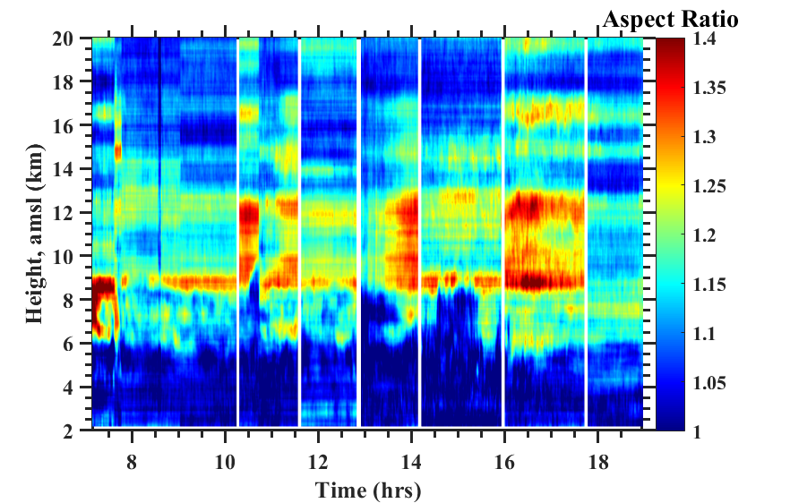
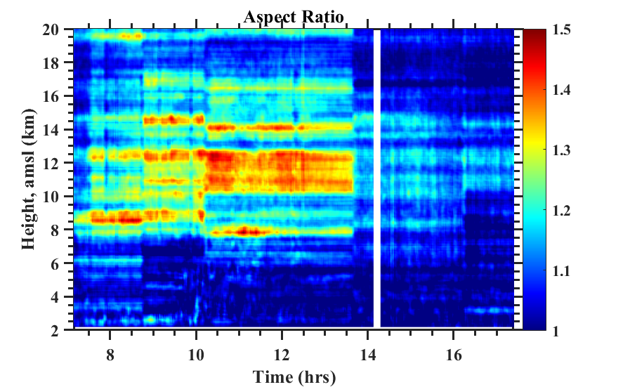
Observation of stratospheric tropospheric Exchange processes
Latitude (N)
Latitude (N)

Slide 7
Conclusions
A method has been developed for the identification of multiple tropopauses. A maxima in the aspect sensitivity profile in the height region of 11 – 19 km was found to be better match to the LRT w.r.t to the SNR gradient of the zenith beam. CPT were observed to be near the minima in the aspect ratio profile in the 11 – 19 km height region.
A weakening of the layered structure of the radar derived aspect ratio are indicative of the weakening of the tropopause structure and hence intrusion of the stratospheric airmass.
A tongue/finger shaped structures of ERA5 derived high PV (>1.6 pvu) , Ozone mixing ratio (>100 ppbv) and drier airmass (low specific humidity ) were observed around radar location up to mid and lower troposphere levels(~500 hPa).
Acknowledgments
Science and Engineering Research Board (SERB), DST, Govt. of India for funding ARIES ST Radar system.
ISRO ATCTM project for conducting the balloon borne GPS Radiosonde observations.

