Slide 1
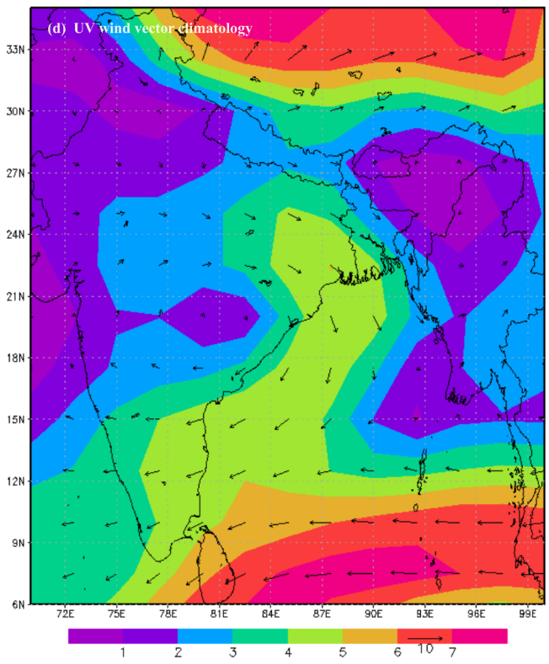
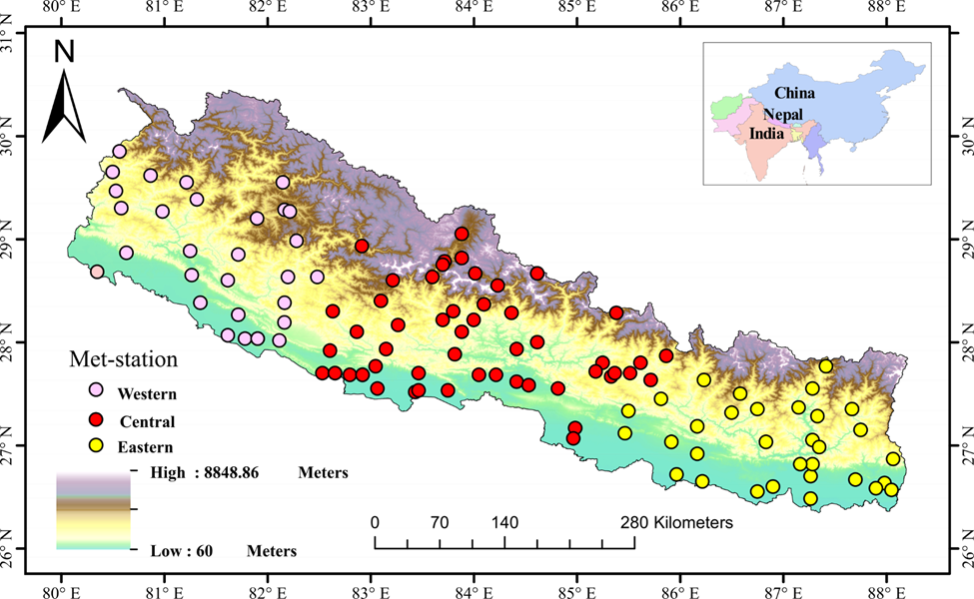
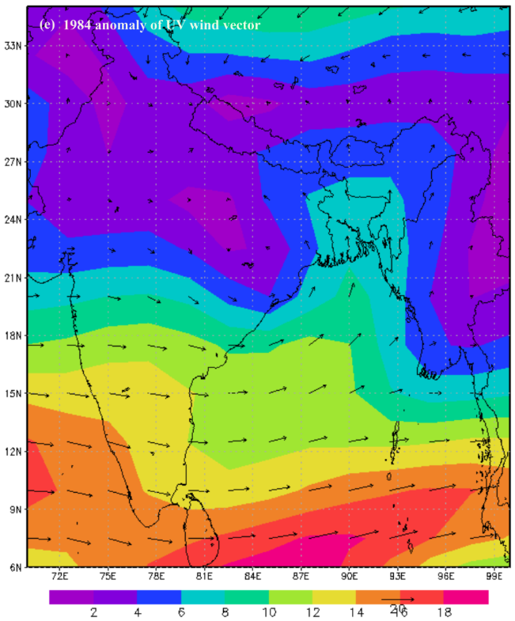
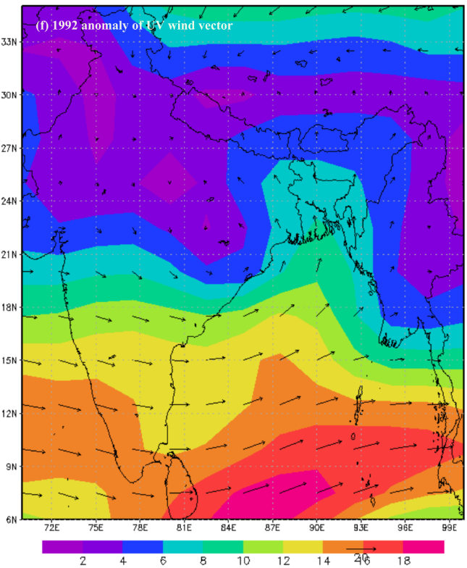
Understanding the Physical Mechanism Behind Extreme Weather Episodes in Nepal
Damodar Bagale*, Deepak Aryal and Madan Sigdel
Central Department of Hydrology and Meteorology, Tribhuvan University, Nepal
Correspondence: damu.bagale@gmail.com
1. Introduction
The significant part of the global inter-annual climate variability is related to ENSO events, which are usually linked with the major drought/flood events in many regions around the world (Trenberth and stepaniak, 2001).
Drought/flood in Nepal is caused by the weakening/strengthening of monsoon circulation in summer (Bagale et al., 2021).
The main objective of this study is to know the physical mechanism behind extreme weather episodes in Nepal.
3.2. Monsoon rainfall in Nepal associated with large scale
atmospheric circulations
2. Methodology
2.1 Study Area
2.2 Data
Meteorological Data (Precipitation) (1977 – 2018)
Southern Oscillation Index (SOI), Ocean Nino Index (ONI)
Horizontal and vertical wind vector
2.3 Methods
Standardized rainfall anomalies were used to identify the dry
and excess episodes (Bagale et al., 2021; Varikoiden et al., 2015).
3. Results
3.1Temporal variability of monsoon rainfall (1977-2018) and its
features
4.Conclusions
The study identified eight droughts and eight flood episodes from 1977 – 2018. The most intense drought was identified in 1992; while the extreme flood occured in 1984.
El Nino events result in an approximately 9% decrease in summer precipitation, while La Lina events lead to a 9% increase. The SOI and ONI anomalies indicate their impacts on summer droughts and floods.
During El Nino years, the upper air circulations are weakened due to low convection, while in La Nina years, they are strengthened due to high convection near the source regions.
(c)
5.References
Bagale, D., Sigdel, M. & Aryal, D. (2021). Drought Monitoring Over Nepal for the Last Four Decades and its Connection With Southern Oscillation Index. Water, 13: 3411. https://doi.org/10.3390/w13233411
Bagale, D., Sigdel, M.& Aryal, D. (2023). Influence of Southern Oscillation Index on Rainfall Variability in Nepal During Large Deficient Monsoon Years. Journal of Institute of Science and Technology,28 (1):11-24. https://doi.org/10.3126/jist.v28i1.43452
Varikoden, H., Revadekar, J. V, Choudhary, Y., & Preethi, B. (2015). Droughts of Indian summer monsoon associated with El Niño and Non-El Niño years, Int.J. Climatol., 1925(July 2014), 1916–1925. https://doi.org/10.1002/joc.4097
Acknowledgement: STIPMEX Workshop, Pune, India 2-7 June 2024, STIPMEX Workshop, (IITM), Pune, India
5. Conclusion
The SPHY model successfully calibrated 2004 -2008 with Nash Sutcliffe Efficiency NSE 0.79, Coefficient of Determination 0.79 and Percent of volume difference -3% at daily time series discharge of Rasnalu. Similarly, SPHY model validated 2001-2003 with Nash Sutcliffe Efficiency NSE 0.62, Coefficient of Determination 0.62 and Percent of volume difference 24% at daily time series discharge of Rasnalu.
The streamflow contribution SPHY model simulated 89% Rain-Runoff, 9% Bsseflow-Runoff, 2% Snowmelt- Runoff and 0% Glacier melt-Runoff at Rasnalu gauge station in Tamakoshi River Basin.
Water storage balance shows the negative during simulation period in Rasnalu watershed at Khmtikhola

