Slide 1
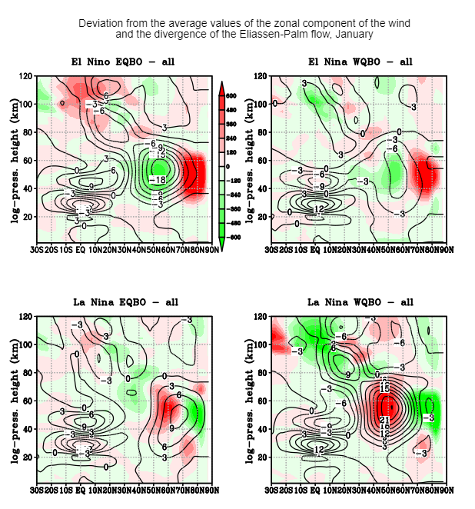
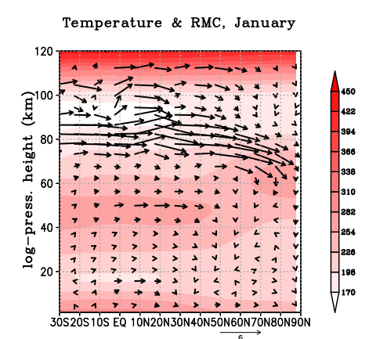
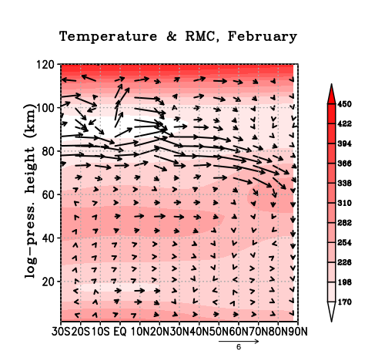
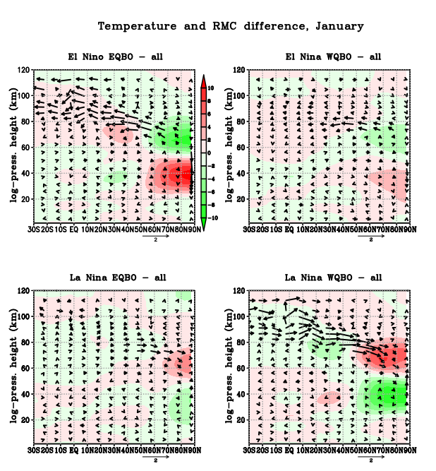
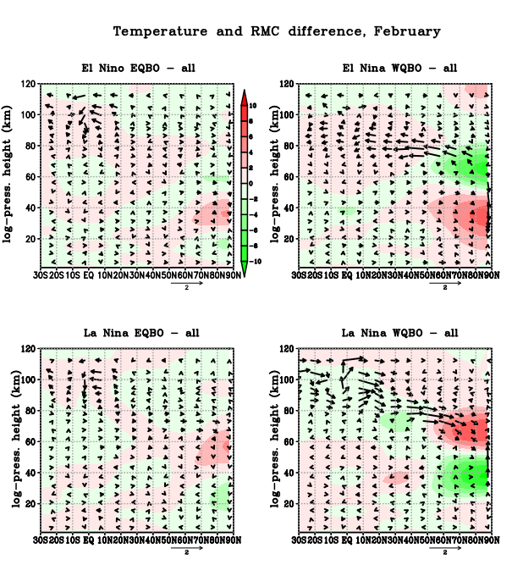
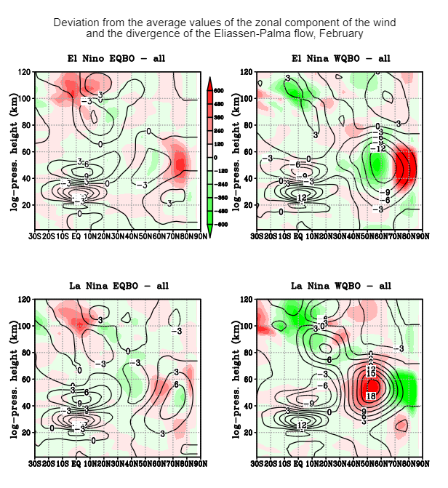
Vertical interactions of atmospheric layers under different QBO and ENSO phases Anastasiia Golovko^{1,2}, Andrey Koval², Tatyana Ermakova^{1,2} 1 Saint-Petersburg State University, Saint Petersburg, 199034, Russian Federation 2 Russian State Hydrometeorological University, , Saint Petersburg, 192007, Russian Federation golovko01@mail.ru
Abstract: In the context of global climate change, it is necessary to study not only the processes inside the troposphere, but also the interaction of the troposphere with the layers above. This interaction is important in the context of seasonal forecasts, as well as understanding possible climatic changes in individual meteorological parameters at different atmospheric altitudes. The influence of tropical oscillations on the thermodynamics of the middle and upper atmosphere of high latitudes was studied using the nonlinear model of the general circulation of the middle and upper atmosphere (MUAM). 4 ensemble calculations were carried out (10 runs in each ensemble) for January–February. It was determined that for January and February, the zonal component of the wind and divergence were especially strong under La Niña and the western phase of the QBO (wQBO) conditions. There is also an increase in convergence/divergence zones in the stratosphere of middle and high latitudes. While in January there is a strong convergence in the mid-latitudes at altitudes of 40-60 km for the combination of El Niño and the eastern phase of the QBO (eQBO), there is a strong convergence for El Niño and the wQBO in February. For January and February during La Niña and wQBO conditions the residual mean circulation (RMC) from the summer hemisphere to the winter hemisphere is maximum, which leads to the greatest positive temperature anomaly (up to 10 K) at altitudes of 60-80 km in the latitudinal zone from 55° to 90°. However, in January under El Niño and eQBO the RMC is the weakest, which leads to a negative temperature anomaly (up to -6...-8 K). The weakest transfer is observed in El Niño and wQBO conditions in February.
The influence of tropical fluctuations (quasi-biennial fluctuations of the zonal wind in the equatorial stratosphere (QBO) and the southern El Nino oscillation (ENSO)) on the dynamic state of the stratosphere, mesosphere and lower thermosphere in winter in the Northern Hemisphere was studied. Ensemble calculations were carried out using a nonlinear model of the general circulation of the middle and upper atmosphere "MUAM" for January–February, which allowed us to assess the sensitivity of the fields of zonal wind, temperature, residual meridional circulation (RMC), as well as wave activity for different combinations of phases of ENSO and QBO. The temperature anomaly and the oscillations of the wind zonal component are different under various ENSO-QBO phases, and the strengthening/weakening of the branches of the RMC shifts in height.
Fig. 3. Temperature and residual meridional circulation, January and February
Fig. 1. Deviation from the average values of the zonal component of the wind and the divergence of the Eliassen-Palma flow, January
In January and February, when analyzing the RMC averaged over all phases, the Brewer-Dobson circulation is noted at an altitude of 40 km – a deep branch of circulation in the stratosphere, which is part of the RMC. And at 80 km, the transfer from the summer hemisphere to the winter hemisphere is recorded (Fig.3).
January. The results of the study showed that the zonal component of the wind and divergence were especially strong under La Niña and the western phase of the QBO (wQBO) conditions, the difference between its wind speed with the average one obtained as the mean for all ensembles was 21 m/s. A strong divergence of the flow is observed in the region of the maximum of the stratospheric polar jet stream. The wind difference was -18 m/s for combination of El Niño and eQBO (eastern of QBO), and there was also a strong convergence at the mid latitudes at altitudes of 40-60 km. (Fig.1)
February. The components – the zonal component of the wind and the divergence – were strong for the same combination of La Niña and wQBO as in January, and the wind difference was 18 m/s. The maximum anomaly compared to average for ensembles, but with a negative sign, is noted at El Niño (as in January), but at wQBO and is -12 m/s (Fig.2). For this combination, there is also an increase in convergence/ divergence zones in the stratosphere of medium and high latitudes, as in January.
Fig. 4. Temperature and residual meridional circulation, January
Fig. 5. Temperature and residual meridional circulation, February
In January, the transfer from the summer hemisphere to the winter hemisphere is maximal under La Niña and wQBO conditions, which leads to the greatest positive temperature anomaly (up to 10 K) at altitudes of 60-80 km in the latitudinal zone from 55° to 90° NH. Below, in the stratosphere, in the same latitudes, a negative temperature anomaly is noted, which together with the zonal component of the wind demonstrates that the probability of sudden stratospheric warming (SSW) is minimal. During the conditions of El Nino and eQBO, the transfer from the summer hemisphere to the winter is the weakest, which leads to a negative temperature anomaly (up to -6...-8 K) at altitudes of 60-80 km in the same latitudinal zone from 55° to 90° NH. In the stratosphere from 23 to 55 km, at the same latitudes it is fixed maximum positive temperature anomaly (up to 10 K). Under these conditions of tropical oscillation, the development of a SSW can be expected (Fig.4).
In Fig.5 it can be seen that the maximum transfer from the summer hemisphere to the winter is also noted here, and the largest positive temperature anomaly (up to 10 K) is recorded at altitudes of 60-80 km in the latitudinal zone from 55 to 90 NH under the conditions of La Niña and the wQBO in February. And in the stratosphere at altitudes from 23-55 km from 55° to 90° NH there is a negative temperature anomaly. It can also be assumed that the probability of SSW is less relative to other phases. However, in February, the weakest transfer from the summer hemisphere to the winter hemisphere is already registered under the conditions of El Nino and wQBO. This also leads to a negative temperature anomaly (up to -6...-8 K) at altitudes of 60-80 km at the same latitudes from 55° to 90° NH. And at altitudes from 23 to 55 km at the same latitudes, a positive temperature anomaly is observed (up to 6...8 K). In such conditions, it is possible to assume the occurrence of SSW (Fig.5).
Fig. 2. Deviation from the average values of the zonal component of the wind and the divergence of the Eliassen-Palma flow, February
Depending on the combination of phases, the temperature anomaly and the oscillations of the mean zonal wind are different, and the strengthening/weakening of the branches of the RMC shifts with height. The investigation shows that the greatest temperature increase in the stratosphere and cooling in the mesosphere, as well as the weakening of the stratospheric night jet stream in January, are simulated under the conditions of El Nino and the eastern phase of the QBO, while the maximum weakening of the meridional transfer from the summer pole to the winter pole at an altitude of 80-90 km is noted. The reverse situation is observed under La Niña and the western phase of the QBO: the zonal component of the wind is maximum in the stratosphere of mid latitudes, with a minimum temperature above the pole in both January and February. As a result of such different manifestations of tropical oscillations through teleconnections in mid and high latitudes, their impact on the frequency and intensity of sudden stratospheric warming, as well as events that lead to extreme cold waves near the surface over Eurasia, is obvious.
This study is supported by the Russian Science Foundation (grant #20-77-10006-P)

