Slide 1
Assimilation of Weather and Ecological Responses to explore the Extreme Weather events
Sanjeev Kimothi^{1*}, Sameer Rawat¹, and Asha Thapliyal²
¹Department of Physics, Graphic Era deemed to be University, Dehradun, 248002, India
²Uttarakhand Space Application Centre (USAC), Dehradun, 248001, India
drskimothi@gmail.com,
Sameerrawat.2020@gmail.com

Slide 2
Introduction
Extreme weather derived natural disasters pose hazardous to infrastructure reliability, public safety, the preservation of natural resources, and economic growth.
The frequency and impact of these disasters have increased noticeably in recent years. The world's largest and densest populated aquifer systems are found in the high-mountainous regions of the Himalayas, which sustain substantial eco-hydrological processes on Earth, but are heavily influenced by human activity and climate change.
Extreme weather occurrences are used extensively around the world to comprehend future climate scenarios and to pique curiosity about how extreme events may evolve in the future.
A comprehensive statistical analysis of management strategies at all sizes, from micro to macro, may eventually provides an crucial input for evaluating the sustainable ecological environment strategies.
The climate change derived extreme weather events has an adverse effect and pose a major threat to earth ecosystems.
Extreme weather occurrences are used extensively around the world to comprehend future climate scenarios and to pique curiosity about how extreme events may evolve in the future.

Slide 3
Objective
Assimilation of weather and Vegetation response Analysis in the context of climate change in the foothill region of Himalaya.
To analyze the Temperature extremes using statistical and predictive models.

Slide 4
Dataset and study region Used

Slide 5
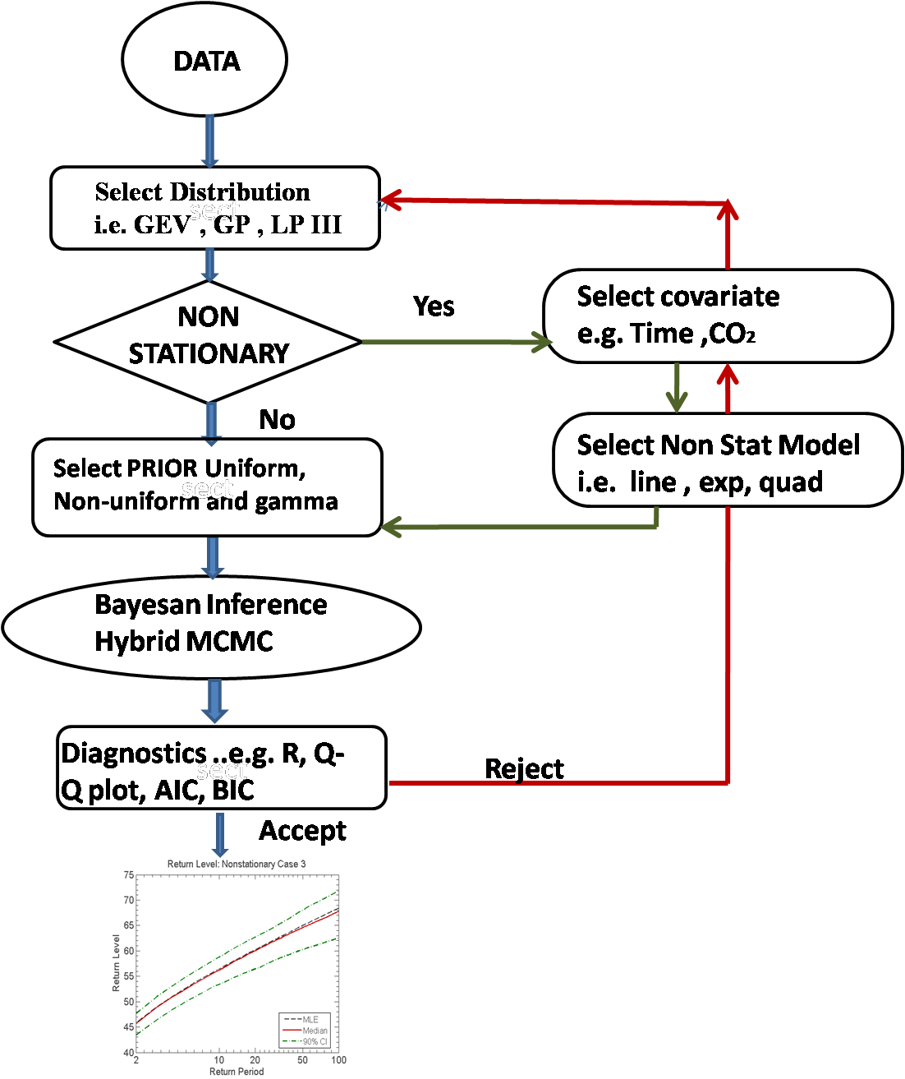
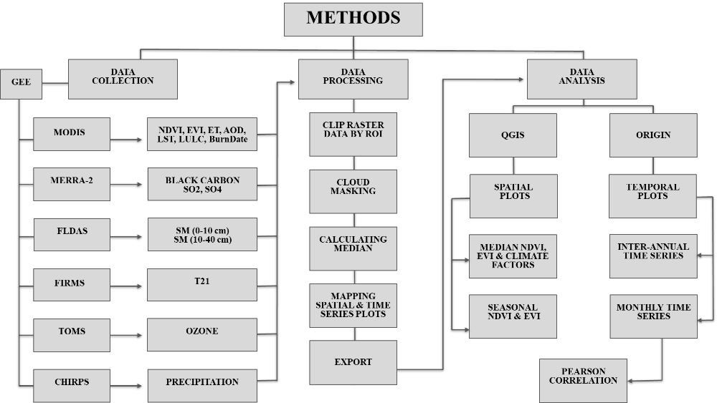
METHODOLOGY
Flow Chart of Raw data processing
Flow chart of Extreme Value predictions

Slide 6
Results and Discussion
Climate parameters are obtained from Google earth engine (GEE) platform for the period 1980 to 2022. Key weather variables such as air temperature (T), precipitation (Pr), wind velocity (W), and relative humidity (Rh) are essential for forecasting extreme weather events.
Weather indices, including the Hurst coefficient (H), predictability (PI), and fractal dimension (FD), are estimated using a multifractal approach. The study observes ambiguities between H, PI, FD, and NDVI, EVI, and UHI responses. Findings indicate an increasing heat index, a warming trend, and decreasing NDVI and EVI, suggesting potential heat waves and long-term weather pattern impacts. The spatial-temporal climate changes over the past 40 years in the Central Himalayan region are analyzed using MFDFA. Multifractal exponent correlation analysis shows a positive association between LST and NDBI and a negative correlation between NDVI, EVI, and NDBI.
Over the past three decades, vegetation profiles have declined, as shown by NDVI patterns. Climatic and topographical changes influence the spread of UHIs, affecting local weather conditions.
Irregular precipitation patterns provide further evidence of changes in forest and landscape patterns. The study successfully identifies extreme weather events through self-symmetric patterns and long-term behaviours, with multifractality in vegetation loss and increase of UHI patterns and land surface air temperature showing a positive association during these events.
Multiple research efforts indicate that accurately predicting record exceptionally extreme air temperatures is nearly difficult. As our research has shown, it is only feasible to examine the likelihood and frequency of such occurrences.

Slide 7
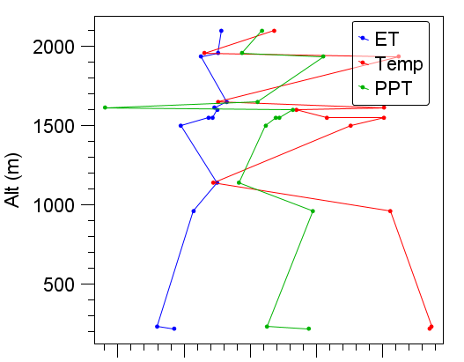
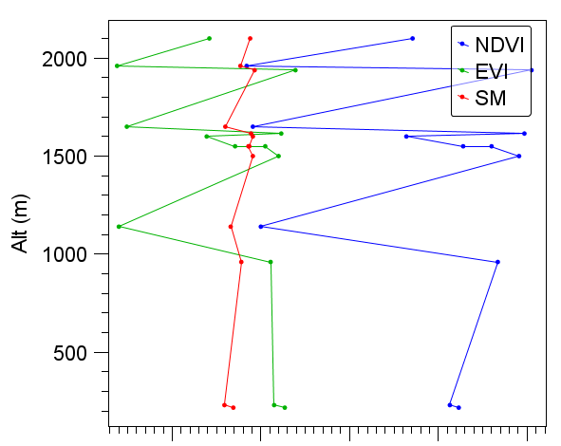
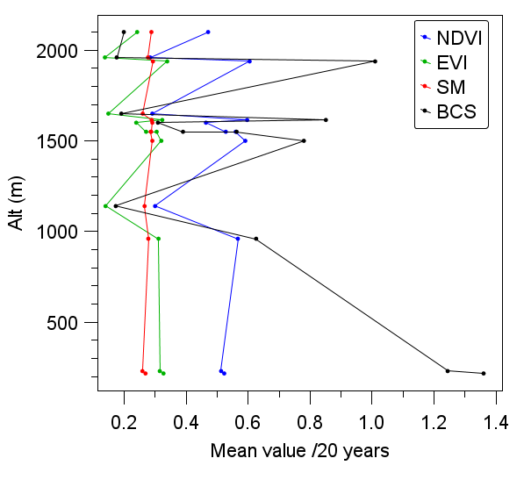
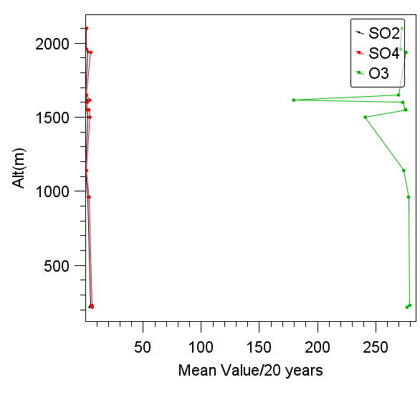
Senstivity Analysis of Vegetation and Physical Parameters

Slide 8
Fractal Analysis of the Physical Parameters time series datasets
Fractal methods evaluate meteorological predictability and climatic characteristics at various elevations in vulnerable areas such as the Himalayas. The Himalayan foothills' climate change scenarios are revealed by the spatiotemporal patterns of UHIs and LST multifractal features, which help guide mitigation and adaptation plans.

Slide 9
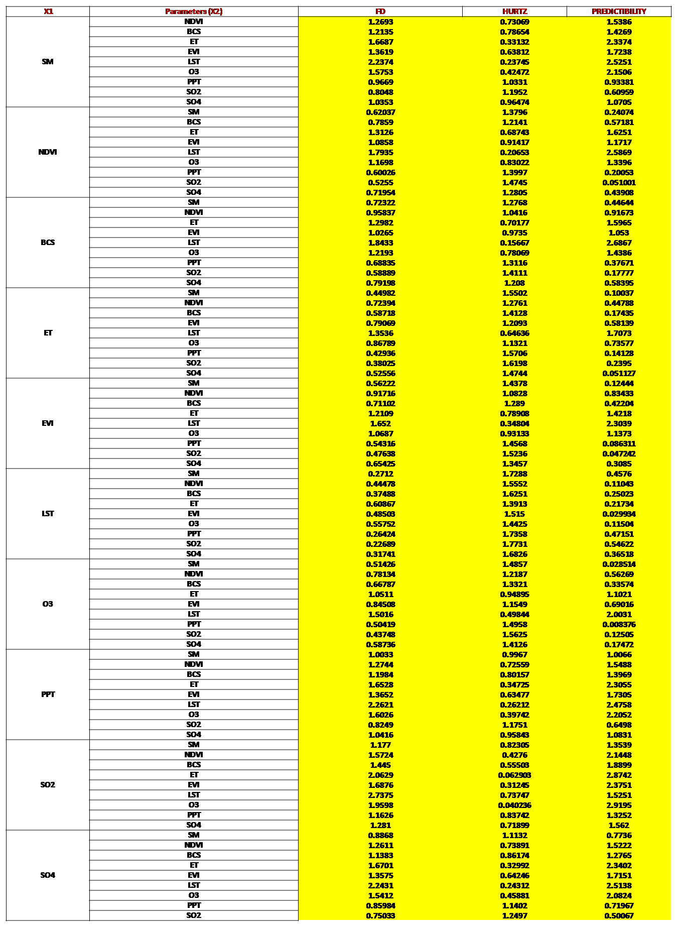

Slide 10
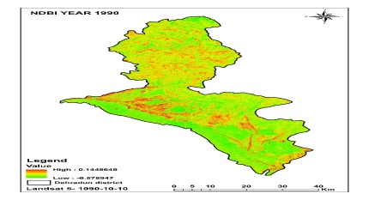
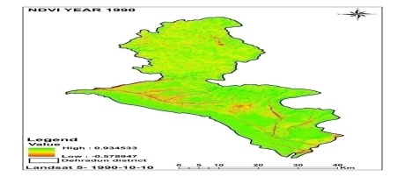
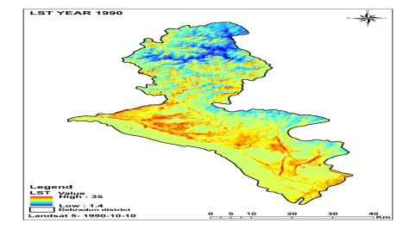
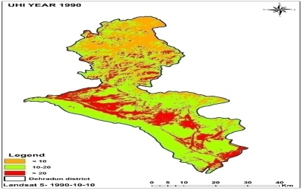
Vegetation Response Analysis: NDBI, NDVI, LST, UHI Variation over Himalayan foothill region (Dehradun)
NDBI
NDVI
LST
UHI

Slide 11
UHI and LST Analysis
In the Himalayan foothills, the interplay of urbanisation, changing land use, and climatic alterations results in heat exchange anomalies and complicated weather extremes.
These variables affect local hydrological cycles and microclimates by changing the distribution of heat. Urban growth upsets the natural equilibrium, impacting biodiversity, biodiversity management, and weather extremes.
Due to long-term interactions between climate parameters, forest loss, changes in land use, and climate change all further contribute to ecological imbalances and changes in energy flux. Urban Heat Islands (UHIs) are a manifestation of these changes, which modify surface temperatures and cause disturbances to local climates.
Climate research benefits greatly from the mapping of land cover and surface temperatures made possible by remote sensing techniques like NDVI and NDBI. MFDFA and other statistical analysis aid in the understanding of UHI growth and the prediction of long-term climatic patterns.

Slide 12
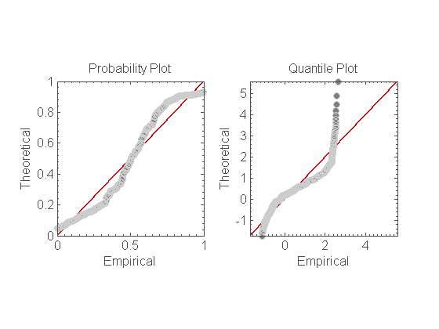
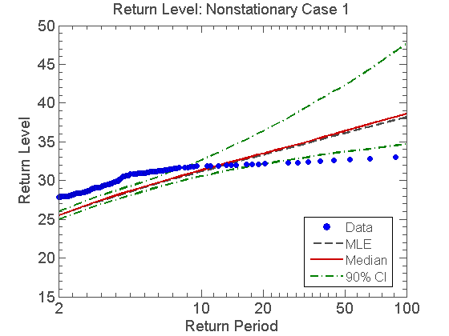
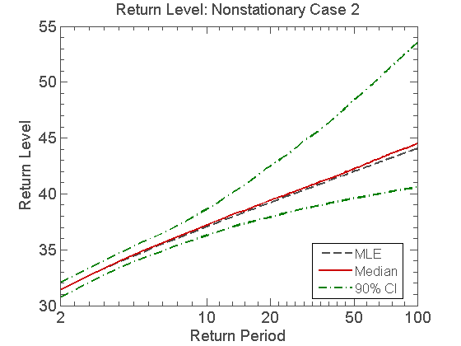
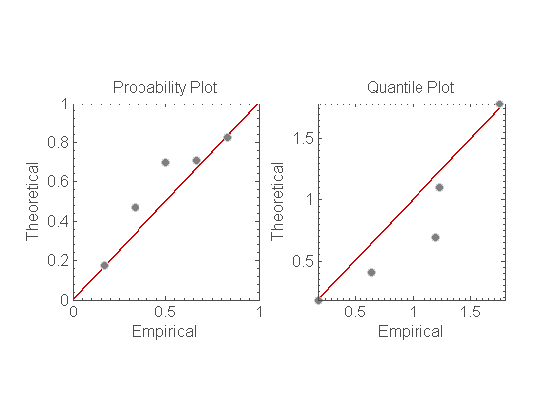
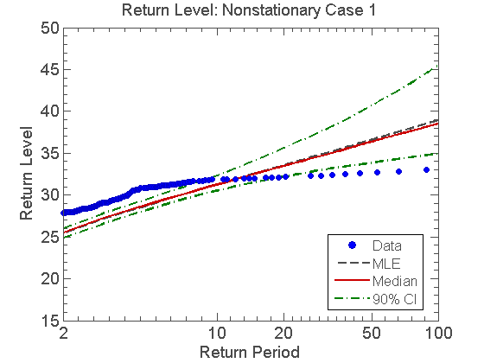
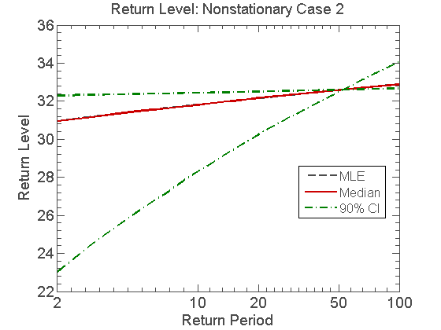
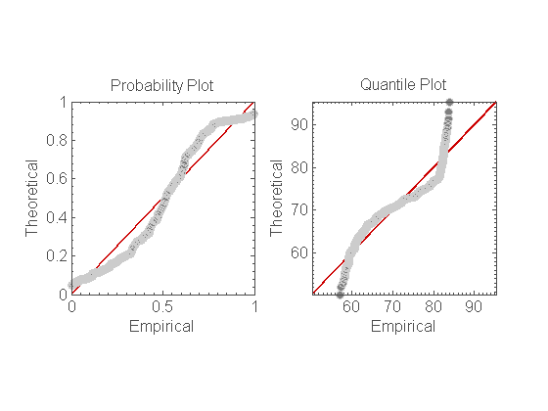
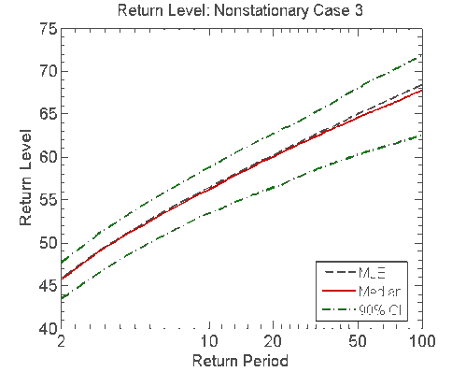
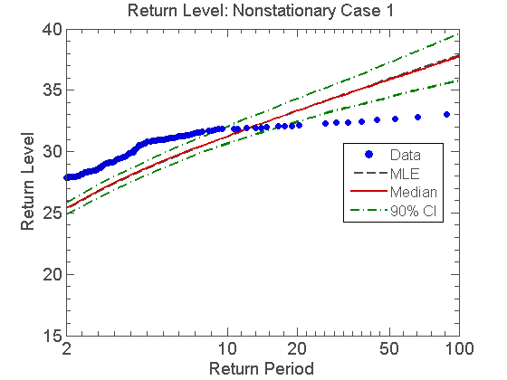
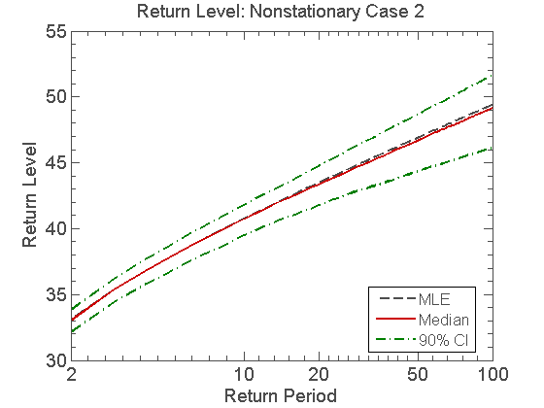
Extreme Temperature Values for Foothill region of Himalaya
GEV
GP
LP-III

Slide 13
Results and Discussion…..
It is observed that the huge Urbanization and anthropogenic activities induced CO2 impacts on the temperature increase in future.
LP3 Algorithm suggest good-fit results comparing GEV and GP algorithms.
Though may have few lacuna in the length of data series, but model predicts the significant range of increased temperature.

Slide 14
Thank You

