Slide 1
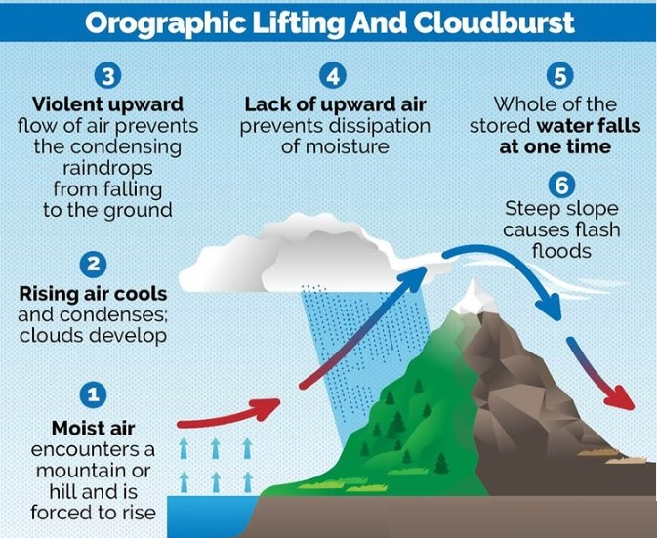
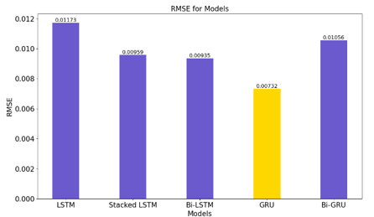
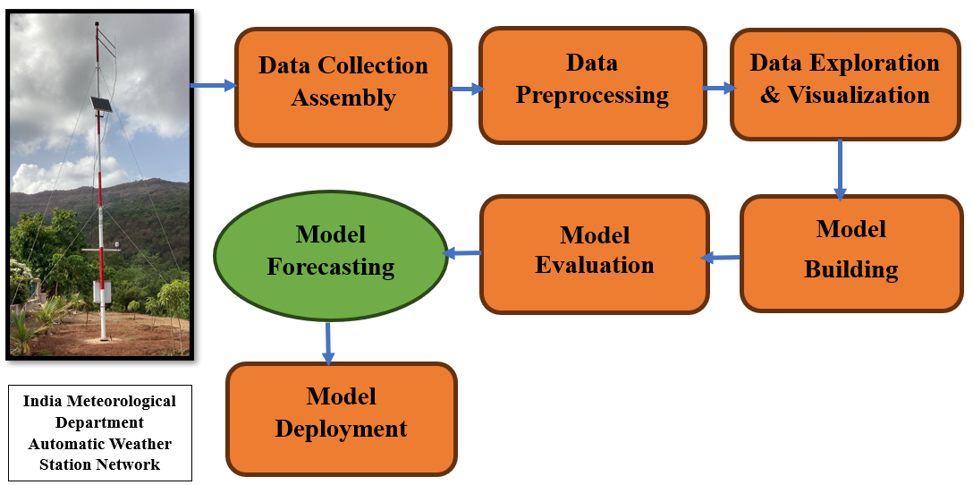
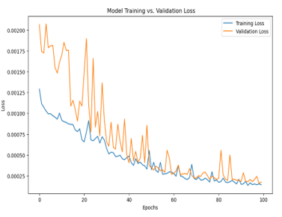
Abstract ID-
CLOUDBURST PREDICTION IN THE INDIAN HIMALAYAS
B Sudarsan Patro¹, Prashant P. Bartakke²
COEP Technological University,Pune^{1,2} , India Meteorological Department¹
sbp21.extc@coeptech.ac.in , sudarsan.patro@imd.gov.in
COEP Tech
Introduction
Literature, Experimental Setup & Discussion
The dataset utilized in this study is from the IMD AWS in Almora, Uttarakhand, India, situated at Lat 29.6002° N, Long 79.6651° E, elevation 1620 m. Data at 15-minute intervals from January 2020 to September 2023.
Forecasting Cloudbursts in the Indian Himalayas key Challenges:
1. Geographical Complexity:
Rugged Terrain: Steep slopes and high altitudes complicate weather prediction.
Influence of Topography: Interplay of geographical features affects rainfall patterns.
2. Meteorological Factors:
Sudden Rainfall Events: Intense rainfall events are hard to predict due to rapid development.
Isolated Occurrences: Cloudbursts often occur in isolated pockets, making system-wide forecasting difficult.
3. Data Scarcity:
Lack of Real-Time Data: Remote and inaccessible regions lack sufficient meteorological stations.
Model Development: Insufficient data hinders the creation and calibration of accurate forecasting models.
4. Indian Meteorological Department(IMD) & Indian Institute of Tropical Meteorology (IITM)Definitions
Cloudbursts(CBs): Extremely heavy rainfall, defined as 100 mm or more within an hour.
Mini‐cloud burst : A new and second category of short‐term heavy rainfall event has been defined as “mini‐cloud burst” (MCB). It is an event in which rainfall in two consecutive rain‐hours is 5 cm or more (Nayana Deshpande et. al. 2018).
The Indian Himalayas exhibit distinct atmospheric dynamics, where moist air masses interact with complex topography, introducing additional complexities. Convectional processes triggered by orographic features play a pivotal role in cloudburst initiation and intensification.
What are the causes of cloud burst?
Monsoon: It often occurs during monsoon season when the South West Monsoon winds bring in large amount of moisture which fuels the cloudburst.
Orographic lift: It is affected by factors like local topology, wind systems, and temperature gradients between the lower and upper atmosphere.
Thunderstorm: It is caused due to excessive amount of condensation in the cloud during thunderstorm.
Climate change: Global warming is leading to more evaporation of water and because of this dense cumulonimbus clouds are forming, resulting in intense rainfall. Even 1 degree Celsius rise in global temperature can cause change in monsoon extremes and frequent cloudburst.
What are the areas prone to cloudburst?
Regions more prone: The Himalayas , Western Ghats, Northeastern hill States of India, Coastal regions
Metrics | LSTM | Stacked LSTM | Bi-LSTM | GRU | Bi-GRU
RMSE MSE MAE R² | 0.01173 0.00013 0.00329 0.88529 | 0.00959 0.00009 0.00303 0.92324 | 0.00935 0.00008 0.00292 0.92708 | 0.00732 0.00005 0.00284 0.95524 | 0.01056 0.00011 0.00299 0.90693
Conclusion
Objectives
Geographical challenges: Steep slopes and high altitudes complicate predictions.
Data scarcity: Lack of real-time data from remote areas impedes model development.
Forecasting urgency: 6 to 12 hours in advance prediction and warnings of heavy rainfall , which cloud results in cloudburst kind of situations are crucial for downstream communities vulnerable to flash floods.
Mitigation strategies: Advanced modeling and enhanced observational infrastructure are essential for accurate forecasting. It requires a very dense network of weather instruments, and computing capabilities that seems unfeasible with current technologies
Enhancing Forecasting Accuracy: Develop advanced modeling techniques to accurately simulate the complex atmospheric processes specific to the Indian Himalayas, considering the region's unique geographical and meteorological features.
Improving Observational Infrastructure: Deploy weather stations in remote and inaccessible Himalayan areas to collect real-time data, addressing the scarcity of observational data crucial for model development and calibration.
Providing Timely Warnings: Establish a comprehensive forecasting system capable of issuing timely warnings to downstream vulnerable communities, emphasizing the urgency of improving forecasting accuracy to mitigate the devastating consequences of flash floods resulting from cloudbursts.
Acknowledgements & References
Cloudburst in the Indian Himalayas
Acknowledgements
References
It is an extremely high amount of precipitation in a short span of time.
It is a highly localized but intense rainfall activity that can cause widespread destruction, especially in hilly regions.
Region- It usually occurs over a small geographical region (20-30 sq.km).
Criteria- Rainfall of 10 cm or more in an hour over a roughly 10 km x 10-km area is classified as a cloudburst event. A new and second category of short‐term heavy rainfall event has been defined as “mini‐cloud burst” (MCB) , It is an event in which rainfall in two consecutive rain‐hours is 5 cm or more would be categorized as a mini-cloudburst.
Mechanism- It happens when saturated clouds are unable to produce rain because of the upward movement of very warm current of air.
Cloud formation- This updraft movement of warm wind along with clouds forms the Cumulonimbus clouds. It can grow up to 12-15 km in height through the entire troposphere (occasionally up to 21 km) and can hold huge amounts of water Instead of dropping down, raindrops get bigger in size and get pushed up due to the air current. Eventually they become too heavy to hold and drop down, leading to more rain than usual.
Authors would like to thanks Centre of Excellence ( COE ) in Signal and Image Processing , COEP Technological University, Pune (COEP Tech) for providing the computational resources for Research & India Meteorological Department (IMD) for providing the weather data , resources for Research.
Proposed method to predict Cloudburst or mini cloudburst , Extreme rainfall events
this study used models, LSTM, Stacked LSTM, Bi-LSTM, GRU, and Bi-GRU, Specific configurations such as 50 hidden layers, Relu activation at the input layer and linear activation at output layer, batch size of 32, Epochs of 100, Adam Optimizer, Learning rate at 0.000001. Data ratio of 80:20 for the training and testing sets split.
INTERNATIONAL WORKSHOP ON
STRATOSPHERE-TROPOSPHERE INTERACTIONS AND PREDICTION OF MONSOON WEATHER EXTREMES (STIPMEX)
02-07 JUNE 2024, IITM PUNE, MAHARASHTRA

